Slide 1
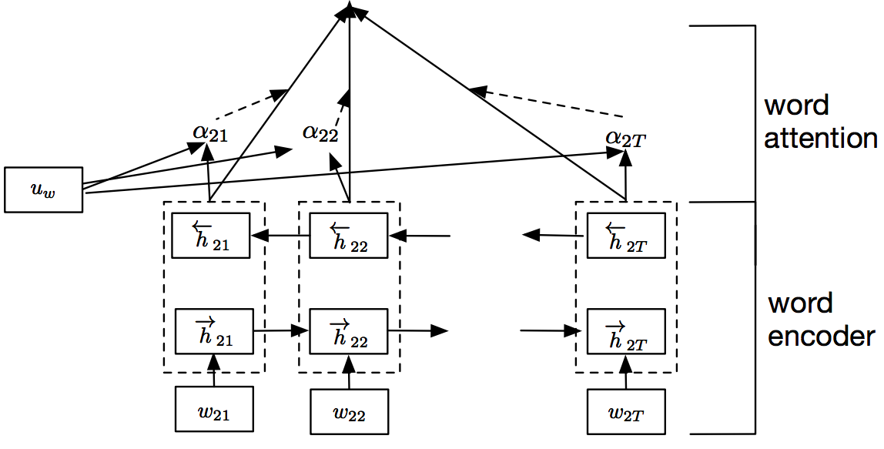
Sigmoid
Dense + Dropout

