Slide 1
SG
SAVE ARLINGTON
GYMNASTICS
An Advocacy Toolkit for Aerials, Tigers & All Arlington Gymnastics Families
FY 2027 Budget Response | February 2026 | savearlingtongymnastics.com
PUBLIC BUDGET HEARING: MARCH 24, 2026

Slide 2
BREAKING: FEB 20, 2026
Aerials gymnasts learned their program is being cut — at the State Meet
On Feb. 11, Yorktown High School's girls gymnastics team — packed with Arlington Aerials athletes — won the 6D North Region Championship, their first region title since 2016. Days later, while competing at the VHSL Class 6 State Meet, these Aerials gymnasts received word that Arlington County plans to eliminate the very club program that built their success.
1st
50%
Aerials
Region title
since 2016
Of the team
are Aerials
Club program
at the core
Source: ARLnow, Feb. 18, 2026
savearlingtongymnastics.com | @SaveArlingtonGym | Change.org petition: c.org/Fq86V645dB

Slide 3
WHAT IS BEING PROPOSED
Proposed elimination of ALL gymnastics — competitive, recreational, and adaptive
The FY 2027 Proposed Budget eliminates ALL competitive, recreational, and adaptive gymnastics programs — including the Arlington Aerials, Arlington Tigers, youth rec classes, parent-tot gymnastics, and adaptive programming for children with disabilities — and closes Barcroft Sports & Fitness Center.
Aerials and Tigers competitive programs discontinued effective May 16, 2026
ALL recreational gymnastics — youth rec, parent-tot — eliminated entirely
Adaptive gymnastics for children with disabilities — gone
Barcroft facility (28,000 sq ft purpose-built center) closed for at least one year
No community consultation — the budget survey never asked about this cut
DPR cites declining post-pandemic participation & cost recovery challenges
savearlingtongymnastics.com | @SaveArlingtonGym | Change.org petition: c.org/Fq86V645dB

Slide 4
47 YEARS OF ARLINGTON GYMNASTICS
The legacy of Tim Mengering, Steve Garman & the Arlington Aerials
In 1979, Coach Tim Mengering and Steve Garman co-founded the Arlington Aerials with just 20 girls in a middle school gym. 47 years later, tens of thousands of Arlington kids have been shaped by their vision. Tim was inducted into the Arlington County Sports Hall of Fame in 2012, and the County Board itself formally commended his life's work through a proclamation by Chair Libby Garvey.
1979
47
10,000s
2012
Program founded
Years of Arlington
gymnastics
Youth served
Hall of Fame
induction
"Tim Mengering has dedicated his life to coaching young athletes in the sport of gymnastics... his unwavering commitment to Arlington's youth has left an indelible mark on the community."
— Libby Garvey, Arlington County Board Chair
savearlingtongymnastics.com | @SaveArlingtonGym | Change.org petition: c.org/Fq86V645dB

Slide 5
ARLINGTON TIGERS: BOYS GYMNASTICS
Featured by NPR | Producing college athletes | Now on the chopping block
In 2009, six boys asked their instructor: why don't we have a team? Coach Sonja Hird Clark made it happen. NPR profiled the Tigers during the 2024 Paris Olympics as a model of what public boys gymnastics can be. Now the county wants to eliminate them.
2009
1st Place
Level 10
2
Founded by
6 boys
Eastern Nationals
2024
Athletes
competing
College gymnasts
produced
Will Terzaken — Committed to Army West Point Gymnastics (NCAA D1), announced February 2026
Boys programs are vanishing nationwide
Only 15 NCAA men's programs remain. Only 12,000 boys compete nationally vs 138,000 girls. The Tigers are a lifeline — taking in boys from programs that closed across Northern Virginia.
Xion Snowden — Freshman on Arizona State Sun Devil Gymnastics (GymACT), studying Computer Science
Source: NPR, "Boys gymnastics programs are hard to find," July 29, 2024
savearlingtongymnastics.com | @SaveArlingtonGym | Change.org petition: c.org/Fq86V645dB

Slide 6
WHY THIS MATTERS
The impact on families, athletes, and the community
For Families & Youth
For the Community
Only affordable, publicly accessible competitive gymnastics in Arlington
Barcroft is a purpose-built 28,000 sq ft facility — repurposing wastes taxpayer investment
Adaptive programs for children with disabilities — no replacement exists
70% of survey respondents can afford or adjust to fee increases
Rec classes serve hundreds of non-competitive kids who benefit from the sport
High school gymnastics depends on these feeder programs (Yorktown = 2026 Region Champs)
Private alternatives are significantly more expensive — equity is at stake
Budget engagement survey never asked about cutting gymnastics or closing Barcroft
Tigers are one of the few public boys programs in the region
2 Tigers athletes headed to college gymnastics — the pipeline is proven
savearlingtongymnastics.com | @SaveArlingtonGym | Change.org petition: c.org/Fq86V645dB

Slide 7
WHAT ARLINGTON RESIDENTS SAID
FY 2027 Budget Engagement | 2,455 respondents | Jan. 14–30, 2026
37%
70%
41%
Are parents/caregivers
of children or teens
Can afford or adjust to
fee increases
Disagree with cutting
community programs
49% of those who can't afford a tax increase are parents — they need affordable programs, not elimination
Energy & technology projects ranked most acceptable to delay — NOT community facilities
The engagement survey never asked residents about eliminating gymnastics or closing Barcroft
Several public comments specifically support fee increases and sliding-scale fee structures for DPR programs
savearlingtongymnastics.com | @SaveArlingtonGym | Change.org petition: c.org/Fq86V645dB

Slide 8
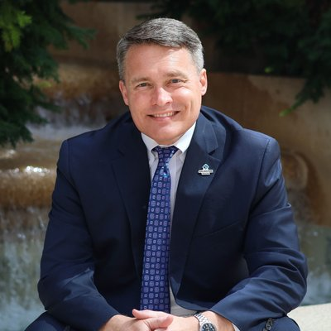

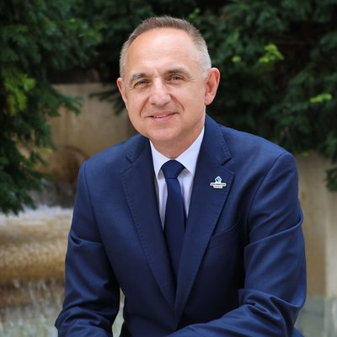

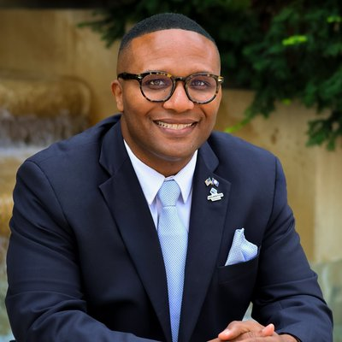
YOUR COUNTY BOARD
In their own words — January 5, 2026 Organizational Meeting Remarks
Matt de Ferranti
Maureen Coffey
Takis Karantonis
Susan Cunningham
J.D. Spain Sr.
Board Chair
Vice Chair
Board Member
Board Member ★ KEY
Board Member
"Protecting the investments that make Arlington great — our environment, our schools, and our children."
"Caring and courageous leadership requires we parse out what is necessary from what is nice."
"Can we do the same with less? Can we apply our equity lens?"
"We kept our People first, focusing care and resources on our youth."
"Strategic investments in people, prevention, and stability reduce long-term costs."
Father of 3-month-old son. Helped pass $400K for after-school programs in 2025.
Youngest-ever vice chair. Champions community engagement and transparency.
Economist. Named Parks and Sports as services needing creative rethinking.
KEY — Liaison to Parks & Rec Commission AND Sports Commission.
Champions youth programming, affordability, and inclusive governance.
mdeferranti@arlingtonva.us
mcoffey@arlingtonva.us
tkarantonis@arlingtonva.us
scunningham@arlingtonva.us
jdspainsr@arlingtonva.us
Contact all: countyboard@arlingtonva.us | Budget comments: dmf@arlingtonva.us | Phone: 703-228-3130
savearlingtongymnastics.com | @SaveArlingtonGym | Change.org petition: c.org/Fq86V645dB

Slide 9
ALTERNATIVES TO ELIMINATION
Constructive proposals to present to the Board
Increase Program Fees
Public-Private Partnership
70% of survey respondents can afford or adjust to fee increases. Raise competitive gymnastics fees to improve cost recovery before eliminating.
Partner with a private gymnastics operator to run programs at Barcroft, reducing county staffing costs while maintaining community access.
Shared-Use Model
Sliding-Scale Fee Structure
Keep gymnastics in its purpose-built space while adding other programming to increase utilization and revenue.
Ensure economic accessibility for families who need it through flexible pricing tiers, scholarships, or fee waivers — while improving cost recovery across competitive, rec, and adaptive programs.
Community Fundraising
Transparent Cost Analysis
Allow families to fundraise supplemental support. Explore state/federal recreation grants. Many communities have saved programs this way.
Release the full cost-benefit analysis. What does it actually cost vs. repurposing? The public deserves these numbers.
savearlingtongymnastics.com | @SaveArlingtonGym | Change.org petition: c.org/Fq86V645dB

Slide 10
KEY DATES & ACTION STEPS
Mark your calendar. Every one of these matters.
FEB 21
FY 2027 Proposed Budget Released
Read the details. Share this deck.
EVERY MON
Open Door Mondays
Meet Board members one-on-one, 6-8 PM
MAR 5
Board Work Session with DPR (1:00 PM)
Watch online. No public comment.
MAR 24
Public Budget Hearing (6:30 PM)
SIGN UP TO SPEAK. Bozman Govt Center, 3rd Floor.
MAR 26
Tax Rate & Fees Hearing (6:30 PM)
Speak about fee alternatives to cuts.
APRIL
Board Adopts Final Budget
Final push: emails, calls, public comments.
MAY 4
Town Hall Meeting (6:30 PM)
New format — additional opportunity for community voice.
savearlingtongymnastics.com | @SaveArlingtonGym | Change.org petition: c.org/Fq86V645dB

Slide 11
TALKING POINTS
For emails, testimony & public comment — personalize with your family's story
Your Story
Fee Alternative
"My child has been in the Aerials/Tigers program for [X years]. This program has taught [discipline, confidence, teamwork]."
"Arlington's own survey shows 70% of residents can afford or adjust to fee increases. Why wasn't that explored before elimination?"
Facility Investment
Lack of Input
"Barcroft carries debt on a $150M county credit line. The county allocated $5M to pay it down last year, then deferred. Closing it doesn't eliminate the debt — taxpayers keep paying for an empty building."
"The budget engagement never asked residents about closing Barcroft or cutting gymnastics. This decision lacks community input."
Board's Own Words
Equity & Access
"Chair de Ferranti pledged to protect 'investments in our children.' Board Member Cunningham launched the Youth Strategic Plan. This cut contradicts both."
"Private programs are significantly more expensive. County programs provide equitable access. Families of children with disabilities will lose adaptive gymnastics."
Selective Notification
No Real Alternatives
"The county emailed competitive families on a Friday afternoon — less than 24 hours before the budget. Rec and adaptive families received nothing. Staff got severance offers the same day."
"The county says families can find 'non-County alternatives.' Private programs cost 2–3x more. For adaptive gymnastics, there IS no alternative in Arlington."
The Math
No Plan for Barcroft
"Closing Barcroft saves $969,542 — that's 0.057% of a $1.69B budget. About $4.50 per household per year. That's the price of every gymnastics program in the county."
"The county's own budget says Barcroft will be 'closed for a year while staff determine the condition.' They're closing it, laying off staff, and ending programs before they have a plan."
savearlingtongymnastics.com | @SaveArlingtonGym | Change.org petition: c.org/Fq86V645dB

Slide 12
TAKE ACTION NOW
1
SIGN the Change.org petition: c.org/Fq86V645dB
2
EMAIL all five Board members AND dmf@arlingtonva.us with your personal story
3
ATTEND Open Door Mondays — meet Board members one-on-one every Monday
4
SHOW UP to speak at the March 24 Public Budget Hearing (6:30 PM)
5
ATTEND the March 26 Tax Rate & Fees Hearing — advocate for fee alternatives
6
VOLUNTEER to help: forms.gle/6W4scgk1N4z3MYwA9
7
SHARE savearlingtongymnastics.com and follow @SaveArlingtonGym
AERIALS: Megan Powers (President) meg.hess@gmail.com | TIGERS: Kari Garcia (ATPA President) atpa.president@gmail.com
savearlingtongymnastics.com | @SaveArlingtonGym | #SaveArlingtonGymnastics

