Slide 1
Engineering
Module 1

Slide 2
Contents
Terminologies & Patterns
1
Database
2
Cache
3
Basics understanding of many concepts and theories
Differentiate between SQL & NoSQL
Abstraction, Advantages, Drawbacks and Types

Slide 3
Terminologies
&
Patterns

Slide 4
Performance
Scalability
The amount of useful work accomplished by a system within a given time interval.
If you have a performance problem, your system is slow for a single user.
The ability of a system to handle a growing amount of work.
If you have a scalability problem, your system is fast for a single user but slow under heavy load.

Slide 5
Vertical Scaling
Horizontal Scaling
Scaling up a single server on more expensive hardware.
Scaling out using commodity machines

Slide 6
Is achieving scalability possible?
Possible when
We take scalability into account when architecting systems.
We carefully
Inspect which axis system grows
Handle heterogeneity
Be aware of knowing and using suitable tools

Slide 7
Latency
Throughput
Time to perform actions / product results
Measured in units of time (hours/minutes/seconds…)
Number of actions per unit of time
Measured in whatever is being produced per unit of time.

Slide 8
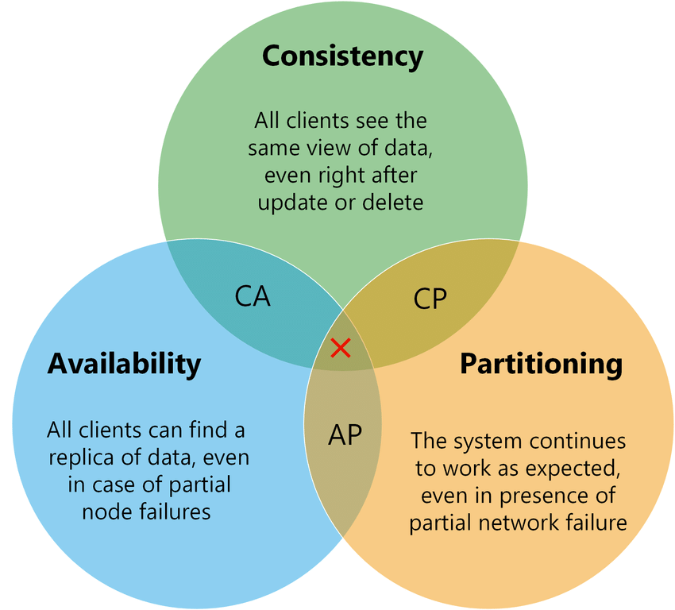
CAP Theorem
Consistency: Reads are always up-to-date.
Availability: Reads always receive a response (when valid).
Partition Tolerance: Network fault doesn’t prevent message transferring between nodes

Slide 9
CAP Theorem
In reality, networks aren’t reliable, so you’ll need to support Partition Tolerance.
Then, you must trade-off between:
Consistency
Availability

Slide 10
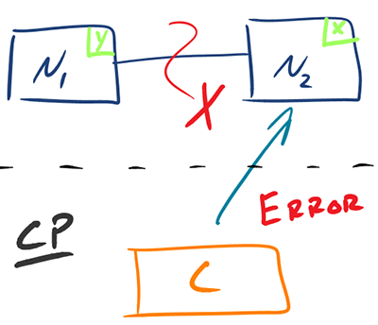
CAP Theorem
CP - consistency and partition tolerance
Used for reading up-to-date data or timeout (when data is stale)
Good for strict reads and writes

Slide 11
CAP Theorem
AP - availability and partition tolerance
Return the most recent data (could be stale)
Process writes later when partition is resolved
Good for system needs to continue working despite external errors

Slide 12
Consistency Patterns
Weak Consistency
After a write, reads may not see it
Works well in real time use cases
Eventual Consistency
After a write, reads will eventually see it.
Works well in highly available systems.
Strong Consistency
After a write, reads will see it.
Works well in systems that need transactions.

Slide 13
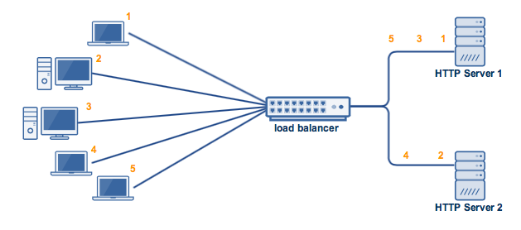
Availability Patterns
Fail-Over / Active-Active
Two servers concurrently working and processing data.
Ensure availability and data safety.
Reduce server load (load balancer)

Slide 14
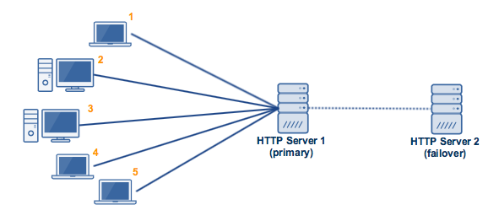
Availability Patterns
Fail-Over / Active-Passive
Two servers: one active, one passive.
When the active server is down, the passive one will replace main server.
Although cannot improve performance, it ensures availability.

Slide 15
Availability Patterns
Fail-Over / Disadvantages
Adding more hardware and complexity
Potential loss of data if writes take place when the active system fails during replicating data to the passive.

Slide 16
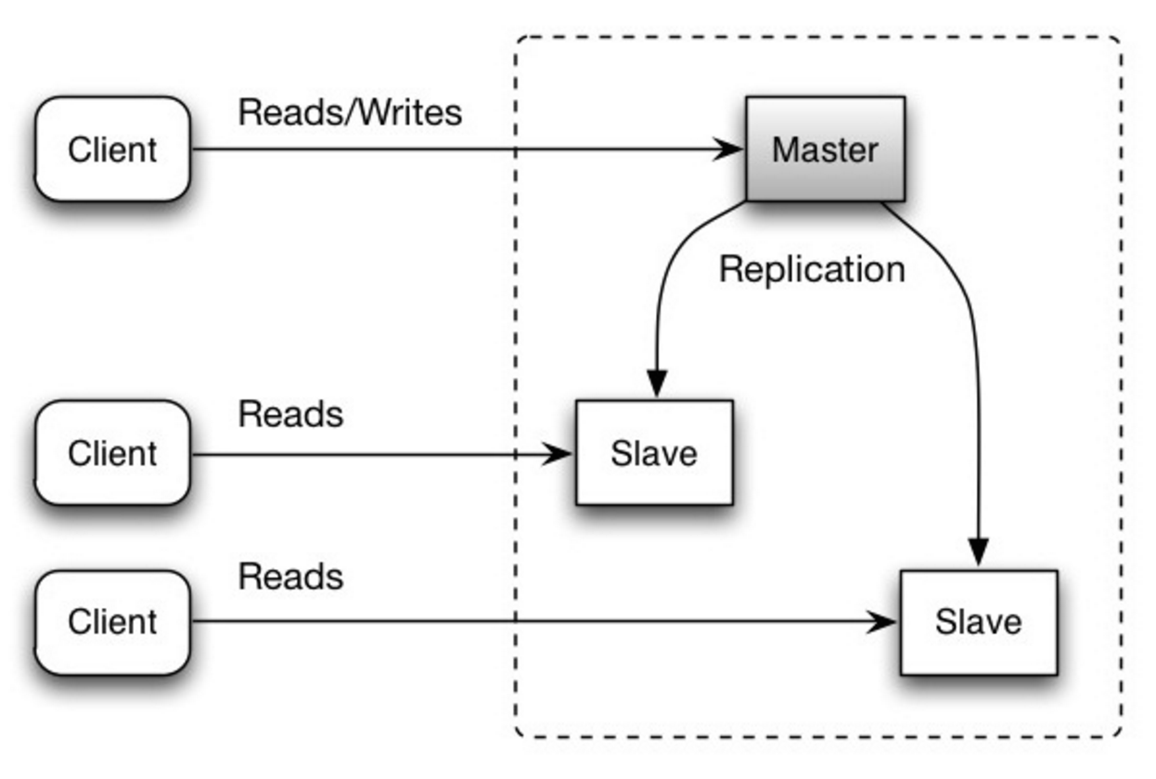
Availability Patterns
Replication/ Master-Slave
Master server reads and writes, replicating writes to slaves, which serves only reads.
Slaves can replicate to new slaves in a tree-like fashion.
If master goes offline, system can continue in read-only mode.

Slide 17
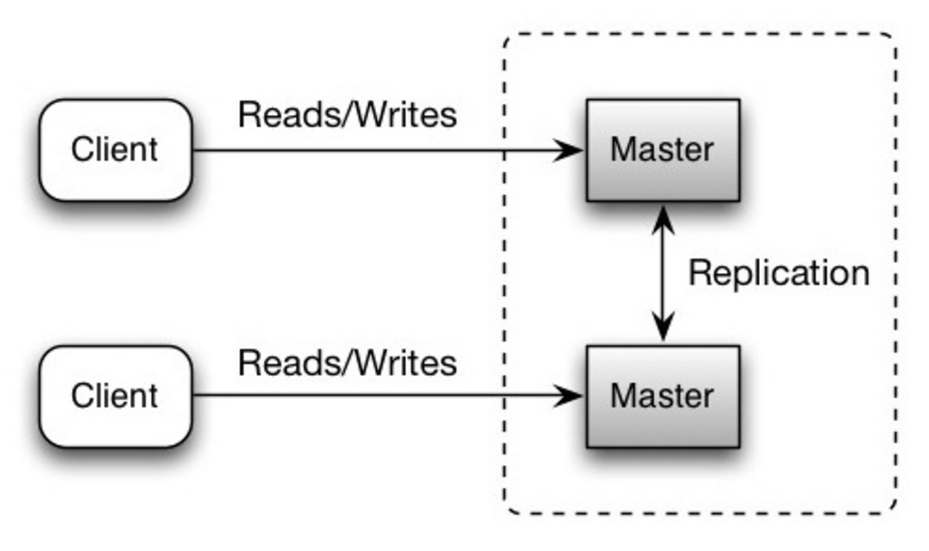
Availability Patterns
Replication/ Master-Master
Both servers serve reads and writes and synchronize with each other on writes.
If either master goes offline, system can continue in with both reads and writes.

Slide 18
Availability Patterns
Replication/ Master-Master
Both servers serve reads and writes and synchronize with each other on writes.
If either master goes offline, system can continue in with both reads and writes.
Loosely consistent due to synchronization latency.

Slide 19
Availability Patterns
Replication / Disadvantages
Too many writes will needs replicating to slaves which will block reads.
The more slaves, the more replication which increases replication lag.
On some systems, multiple threads are supported to write in parallel, whereas read replicas only support writing sequentially with single thread.

Slide 20
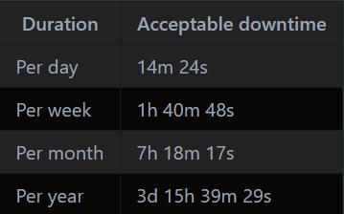
Availability Patterns
In numbers

Slide 21
Availability Patterns
In Sequence
In Parallel

Slide 22
Stability Patterns
Timeout patterns
Pooling pattern
Asynchronous pattern

Slide 23
Availability Patterns
In Sequence
In Parallel

Slide 24
DNS
Used for translating domain name to an IP address.
DNS results can also be cached by your browser or OS for a certain period of time, determined by the time to live (TTL).

Slide 25
DNS
Methods
Weighted round-robin
Latency-based
Geolocation-based
Disadvantages
Slight delay, although caching
Complex, managed by government
Vulnerable to DDoS attack

Slide 26
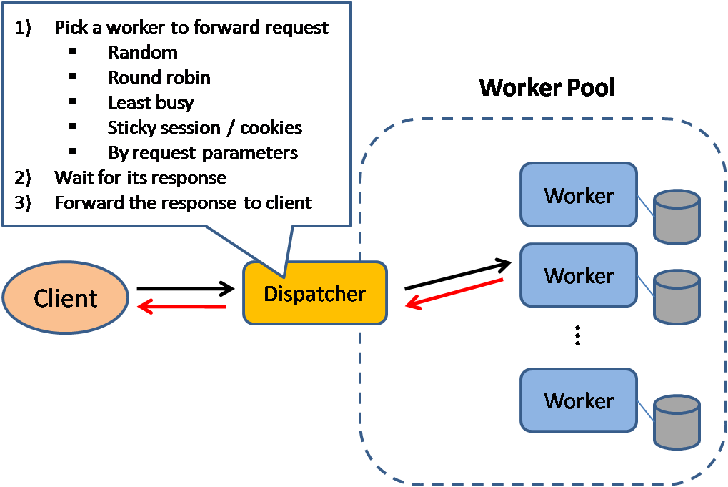
Load balancer
Distribute incoming requests to computing resources (servers/databases)
To prevent failures, it's common to set up multiple load balancers, either in active-passive or active-active mode.

Slide 27
Load balancer
Prevent
Requests going to unhealthy servers
Overloading resources
Avoid single point of failure
Offer
SSL Termination
Session Persistence
Disadvantages
Can be bottleneck if it doesn’t have enough resources/not configured properly

Slide 28
Load balancer
Methods
Random
Least loaded
Sessions/Cookies
(Weighted) Round robin
Layer 4 - Involves src, dest IP address and ports, not the contents
Layer 7 - Involves header, messages and cookies

Slide 29
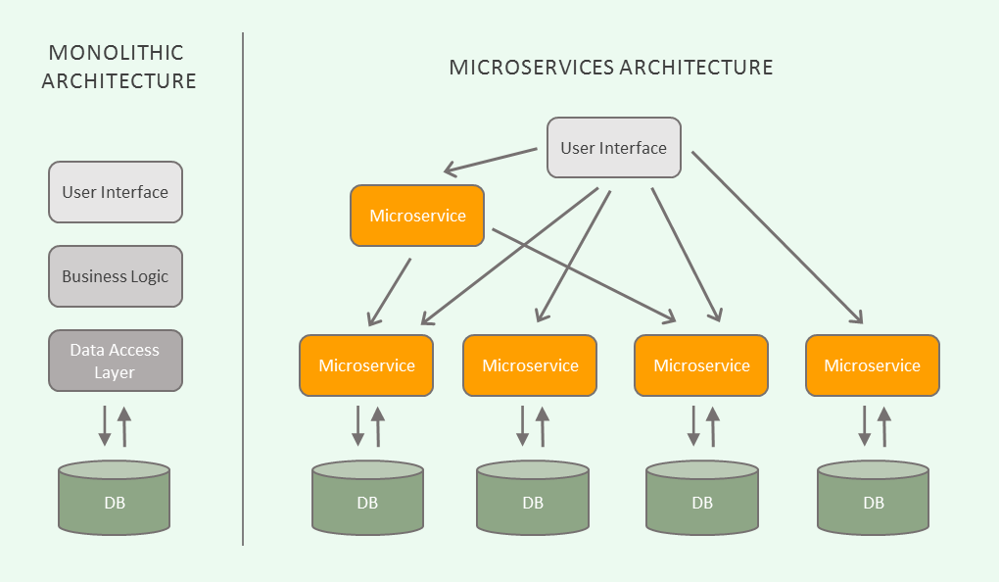
Microservices

Slide 30
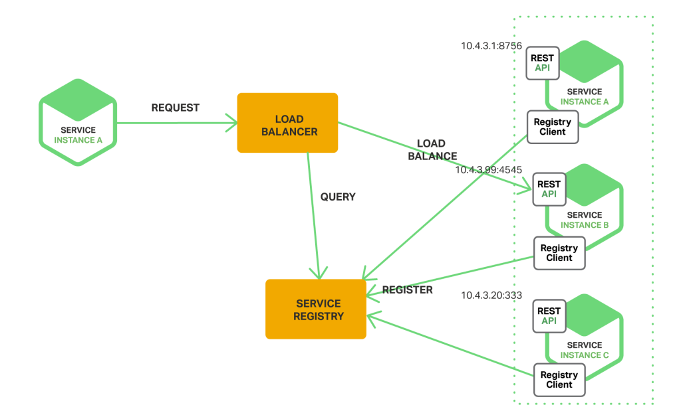
Microservices

Slide 31
Databases

Slide 32
Relational database management system (RDBMS)
A collection of data items organized in tables.
ACID
Atomicity: Guarantees that all operations in a transaction are treated as a single “unit”, which either succeeds completely or fails completely.
Consistency: Ensures that any changes to a database must be consistent across the whole.
Isolation: Determines whether or not a change is immediately visible to the rest of the database and related code or queries.
Durability: Ensure when a change is made to the database, it will survive.

Slide 33
Relational database management system (RDBMS)
Techniques for scaling
Federation
Sharding
Denormalization
SQL Tuning

Slide 34
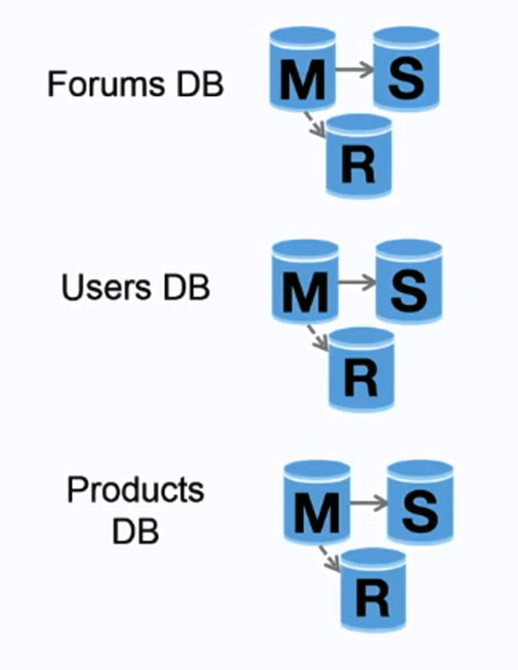
Relational database management system (RDBMS)
Federation
Instead of a single, monolithic database, we split up databases by function.

Slide 35
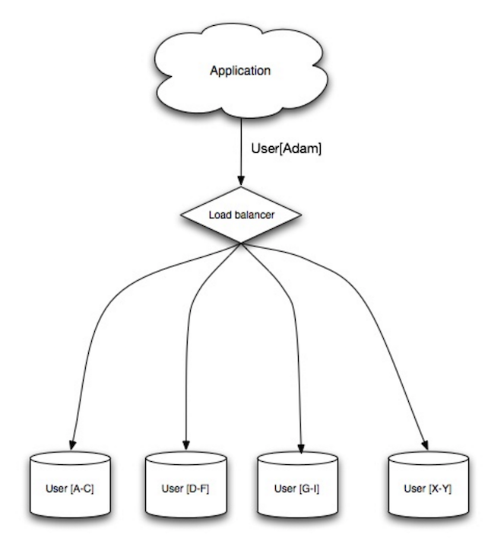
Relational database management system (RDBMS)
Sharding
Distributes data across different databases such that each database can only manage a subset of the data.

Slide 36
NoSQL
A collection of data items represented in a key-value store, document store, wide column store, or a graph database.
BASE
Basically available: Guarantees the availability of the data. There will be a response to any request (can be a failure too).
Soft state: The state of the system could change over time.
Eventual consistency: The system will eventually become consistent once it stops receiving input.

Slide 37
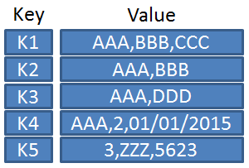
NoSQL
Key-Value store / Hash Table
Provides high performance and often used for simple data models or rapidly-changing data (in-memory cache).
Allow
O(1) reads and writes
storing metadata with value.

Slide 38
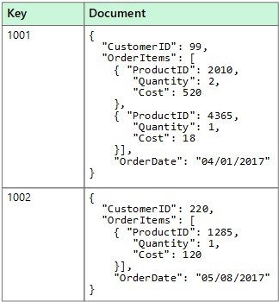
NoSQL
Document store
Key-value store with documents stored as values
Used for occasionally changing data
High flexibility
Platforms: CouchDB, MongoDB, DynamoDB

Slide 39
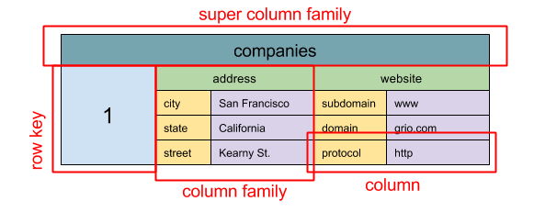
NoSQL
Wide column store
Stores basic unit of data is a column (name/value pair).
A column can be grouped into column families.
We can access each column independently with a row key, and columns with the same row key form a row.
High availability
High scalability
Platforms: Bigtable, Cassandra

Slide 40
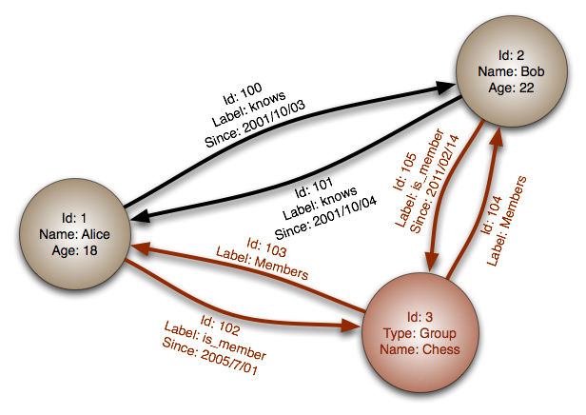
NoSQL
Graph database
Each node is a record
Each arc is a relationship between two nodes
Used to represent complex relationships with many foreign keys or many-to-many relationships.
High performance for data models with complex relationships (social network).
Platforms: Bigtable, Cassandra

Slide 41
Caches

Slide 42
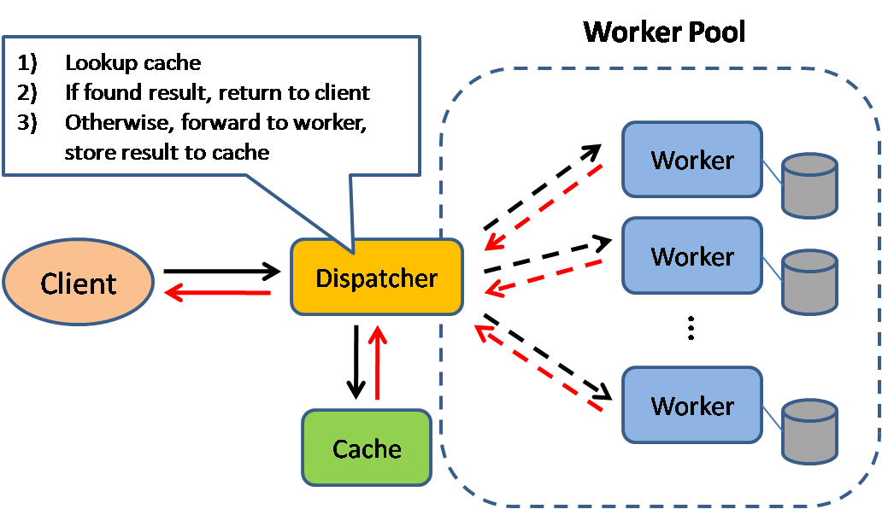
Caches
The dispatcher will lookup if the request has been made before and try to return the previous result (if yes), in order to save the actual execution.
Advantages
Improve page load time, reduce load on server
Disadvantages
Need to maintain consistency between caches and databases (caches invalidation)

Slide 43
Caches
Types
Client Caching
CDN caching
Web-server caching
Database caching
Application caching
Caching database query
Caching object

Slide 44
Caches
Methods
Cache-aside
Write-through
Write-behind (write-back)
Refresh-ahead

Slide 45
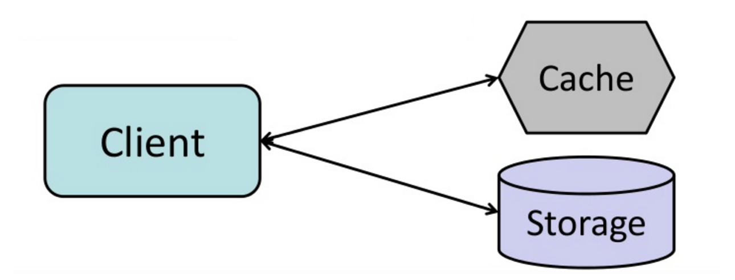
Caches
Cache-aside
Steps
Look for entry in cache, resulting in a cache miss
Load entry from database
Add entry to cache
Return entry
Advantages
Fast
Lazy loading
Disadvantages
Delay
Data can be stale

Slide 46
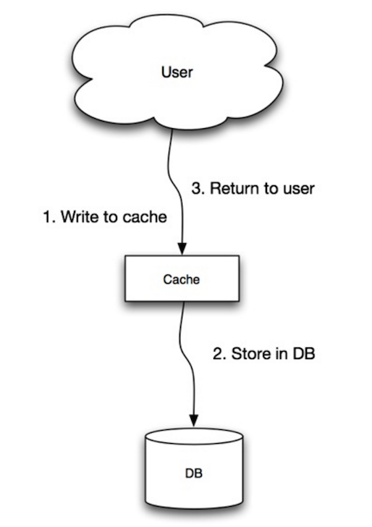
Caches
Write-through
Application uses cache as main data store, reading/writing data to it.
Cache is responsible for reading/writing to database.
Advantages
Reads of just written data are fast.
Data in cache is not stale
Disadvantages
Slow operation
Most data written might not be read

Slide 47
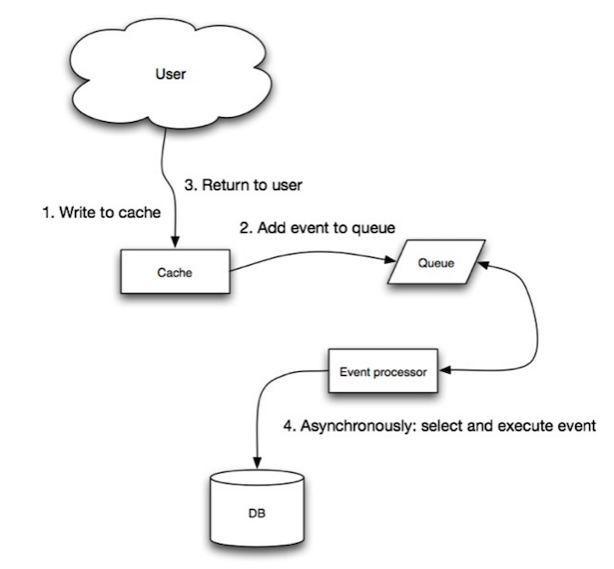
Caches
Write-behind (write-back)
Add/update entry in cache
Asynchronously write entry to data store, improving write performance.
Advantages
Low latency
High throughput for write-intensive applications.
Disadvantages
Data loss when cache cannot write to data store.
More complex to implement than previous methods.

Slide 48
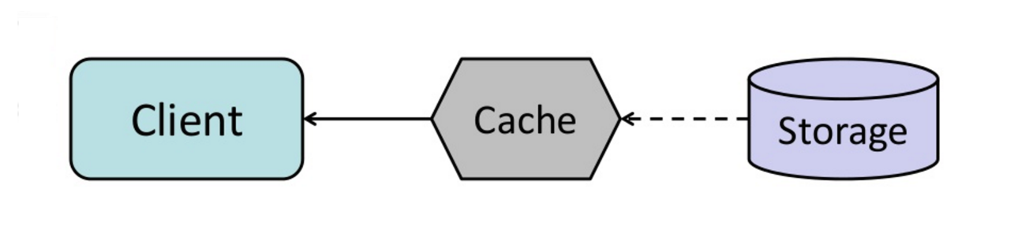
Caches
Write-behind (write-back)
Configure the cache to automatically refresh any recently accessed cache entry before expiration.
Advantages
Reduce in latency vs read-through if cache accurately predict which items will be needed in future..
Disadvantages
Reduce in performance when predicting incorrectly.

Slide 49
Thanks!
Does anyone have any questions?
hungnp5@vng.com.vn

Slide 50
Credits
Donnemartin, donnermartin. “Donnemartin/System-Design-Primer.” Github.com, 2020, github.com/donnemartin/system-design-primer.
Vogels, Werner. “All Things Distributed.” A Word on Scalability - All Things Distributed, 2006, www.allthingsdistributed.com/2006/03/a_word_on_scalability.html.
Greiner, Robert. “CAP Theorem: Revisited.” Robert Greiner, 23 Sept. 2019, robertgreiner.com/cap-theorem-revisited/.
Wodehouse, Carey. “SQL vs. NoSQL Databases: What's the Difference?: Upwork.” RSS, 2019, www.upwork.com/resources/sql-vs-nosql-databases-whats-the-difference.

