Slide 1
Chloris
Anthony Jarjour

Slide 2
Problem
Chloris addresses the challenge of
Bird identification for casual hikers and beginner bird watchers/ornithologists, allowing the classification of 525 different species.
Bird sighting prediction which utilizes 20 years of historical data.

Slide 3
Approach
I use a Resnet 50 (Residual Neural Network of 50 layers) fitted to the 525-Bird-Species dataset.
I also us a One Class Support Vector Machine (OC-SVM) to fit FeederWatch sightings, and calculates probability and possibility of a new sighting with the use of distance equations

Slide 4
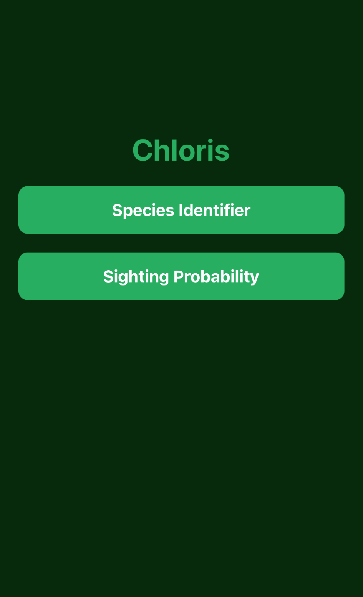
Tech
● Front end
○ Expo Go and NodeJS
○ Written in HTML, CSS, and Javascript
● API
○ Fast Api
○ Written in Python
● Backend Scripts and Models
○ Tensorflow, scikit-learn, and pandas
○ Written in Python, mainly jupyter notebook on google colab

Slide 5
525 Species Dataset
https://www.kaggle.com/datasets/gpiosenka/100-bird-species
This dataset consists of 85,000+ images of birds with labels 0-524
Data processing was straightforward, loaded the samples into a test, validation, and training set
Throughout training the training set was augmented
During the last steps of training I normalized the images

Slide 6
Resnet50
A residual neural network is much like a CNN, however it solves the issue of a vanishing gradient problem with deeper networks. It solves this issue by introducing skip connections during back propagation, allowing the gradient to smoothly travel the layers of the network

Slide 7
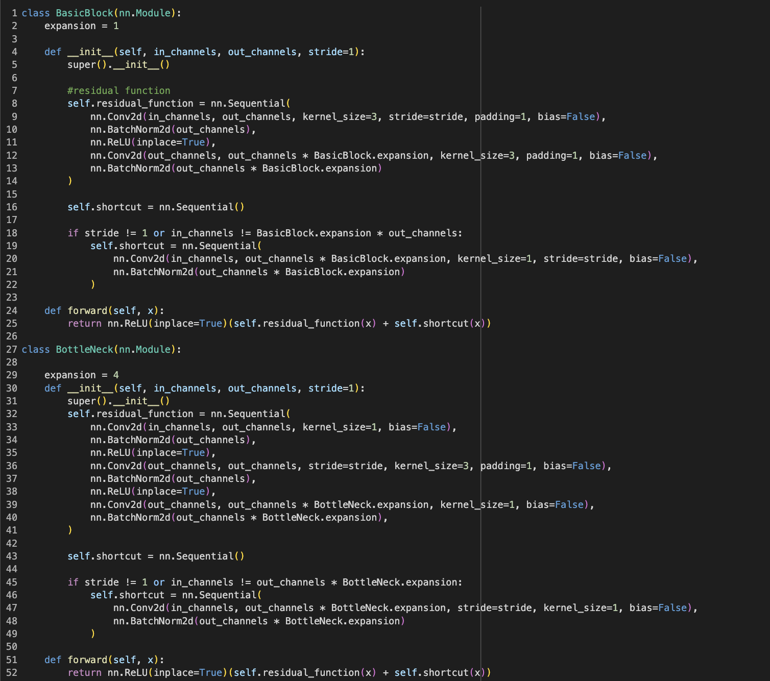
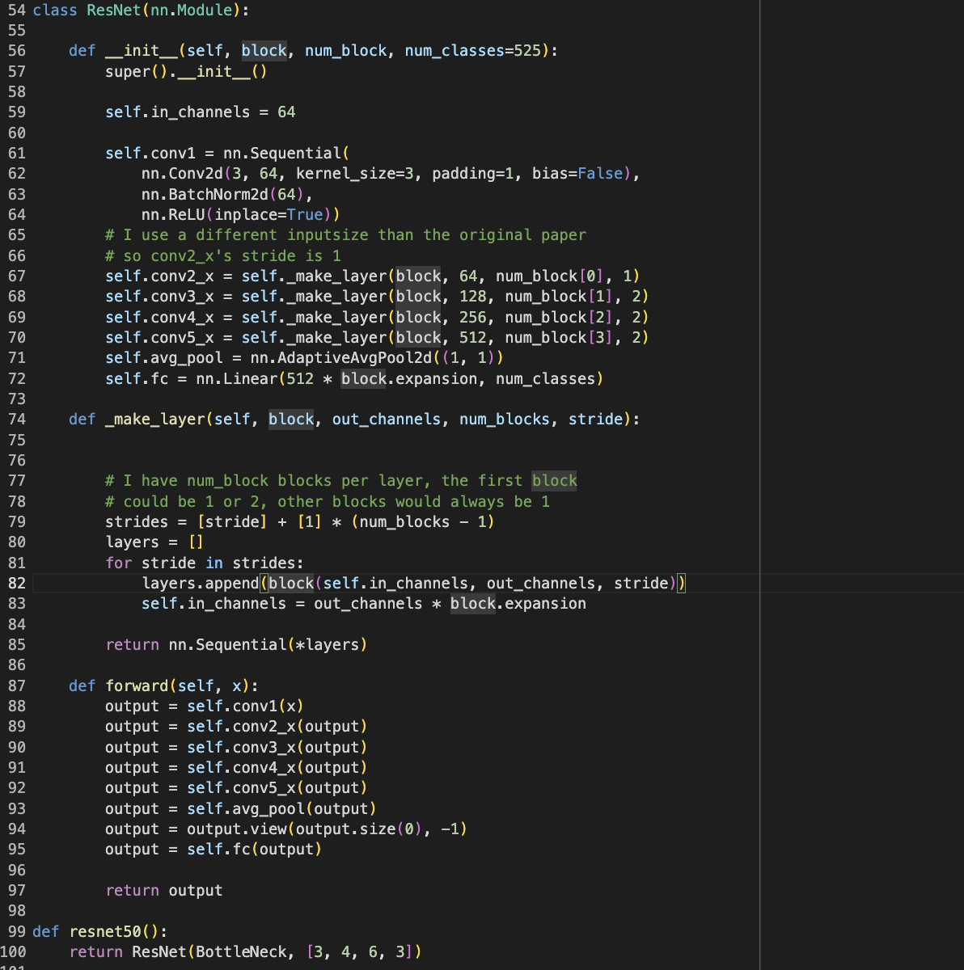
Model

Slide 8
Training
While training the resnet I utilized the following hyperparameters
Cross entropy for loss
Adam for optimization
StepLR and ReduceOnAPlatuea for scheduling

Slide 9
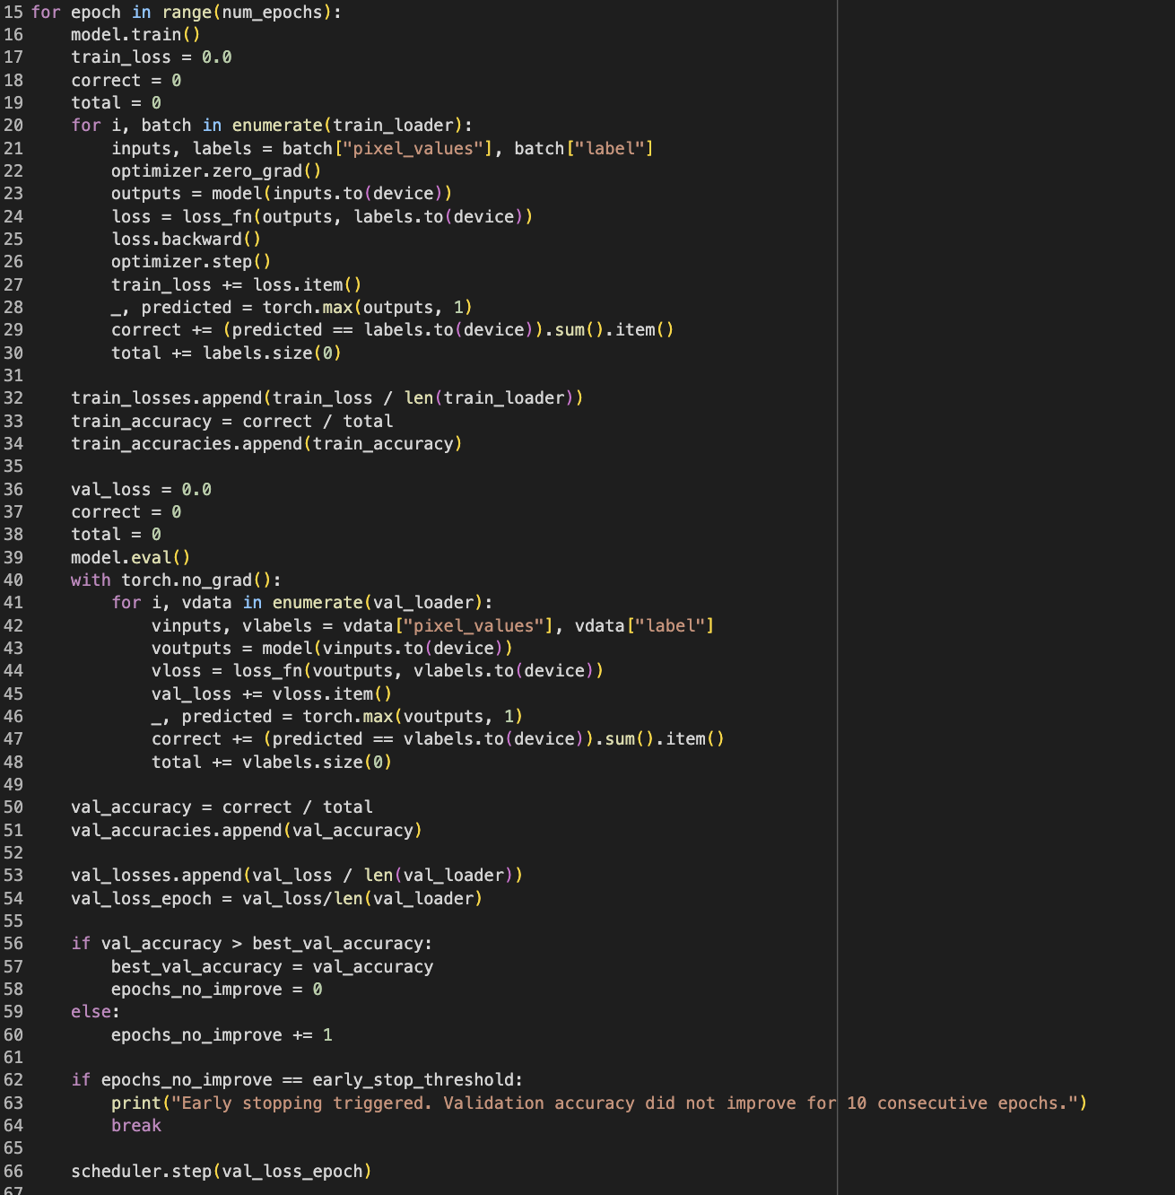
Training Cont

Slide 10
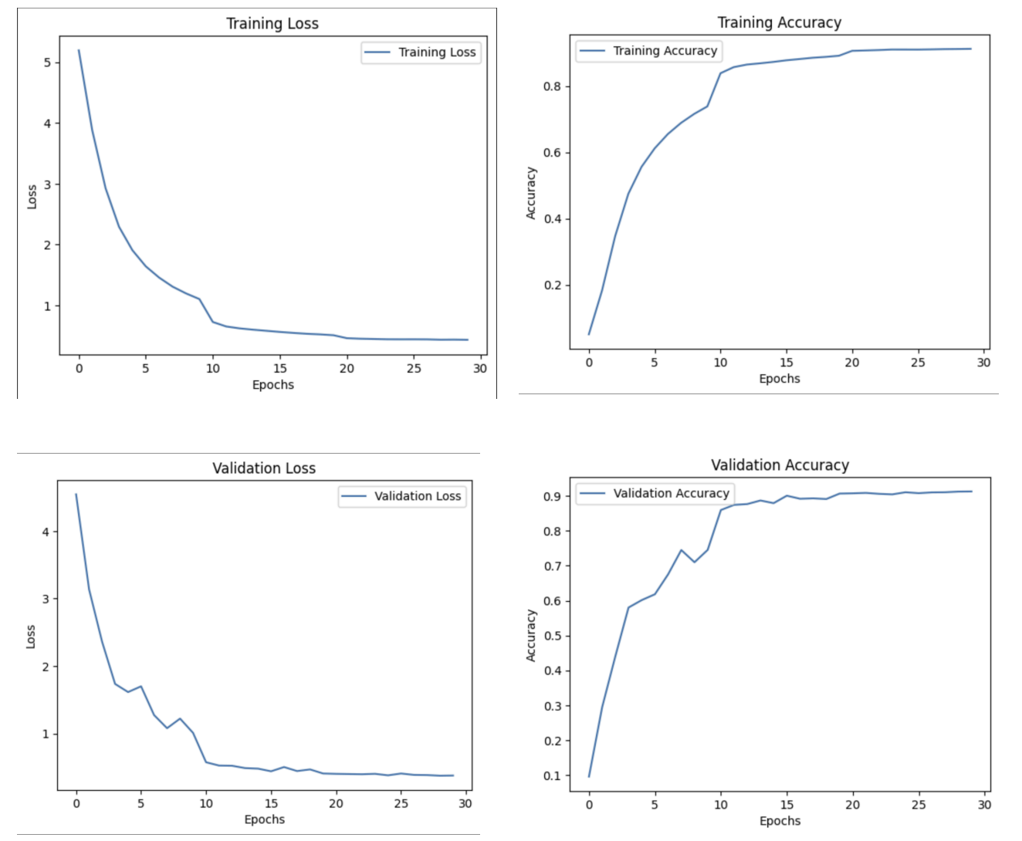
Results
First 30 Epochs with StepLR

Slide 11
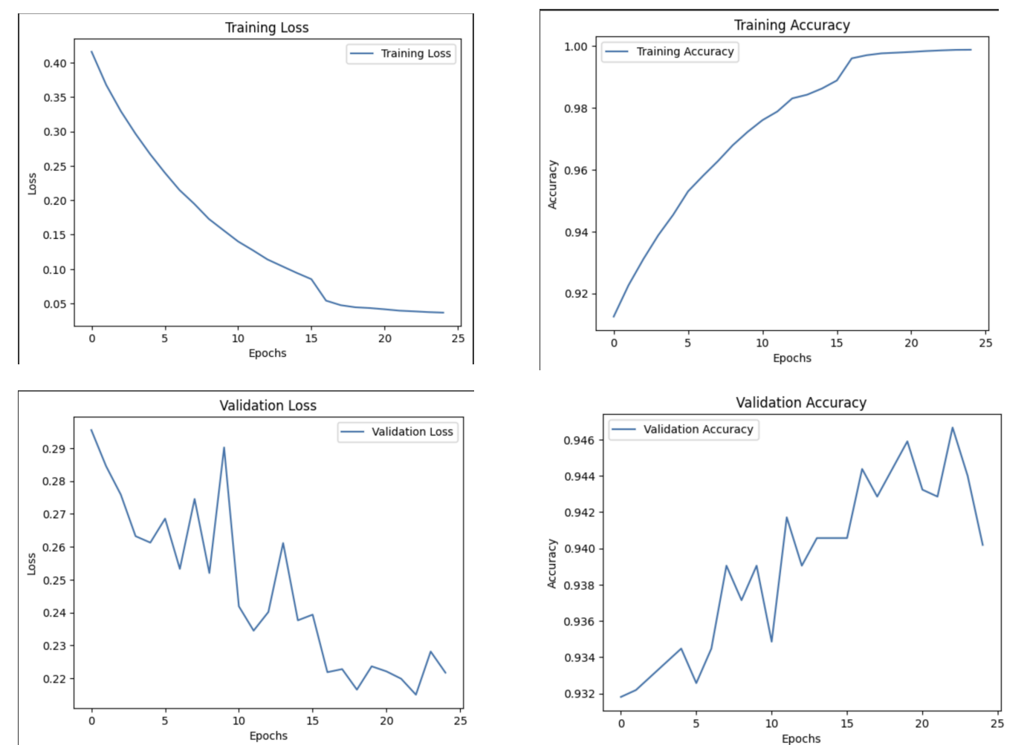
Results Cont
25 Epochs with
ReduceOnAPlatuea

Slide 12
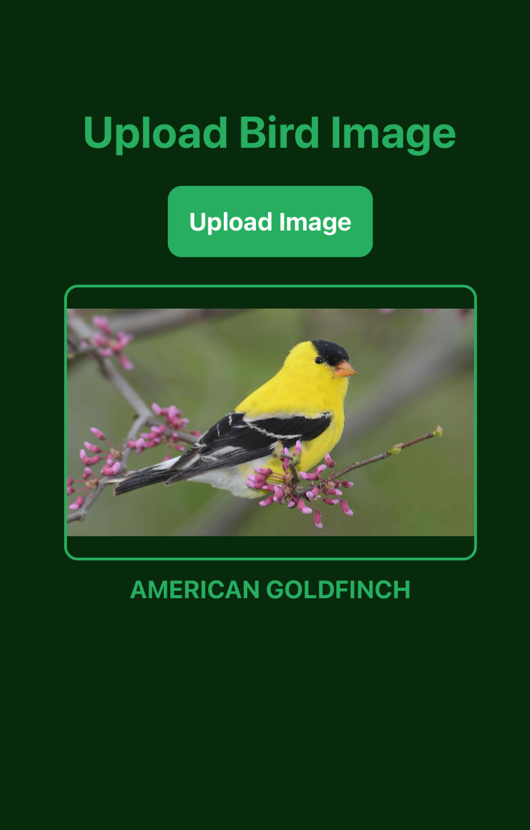
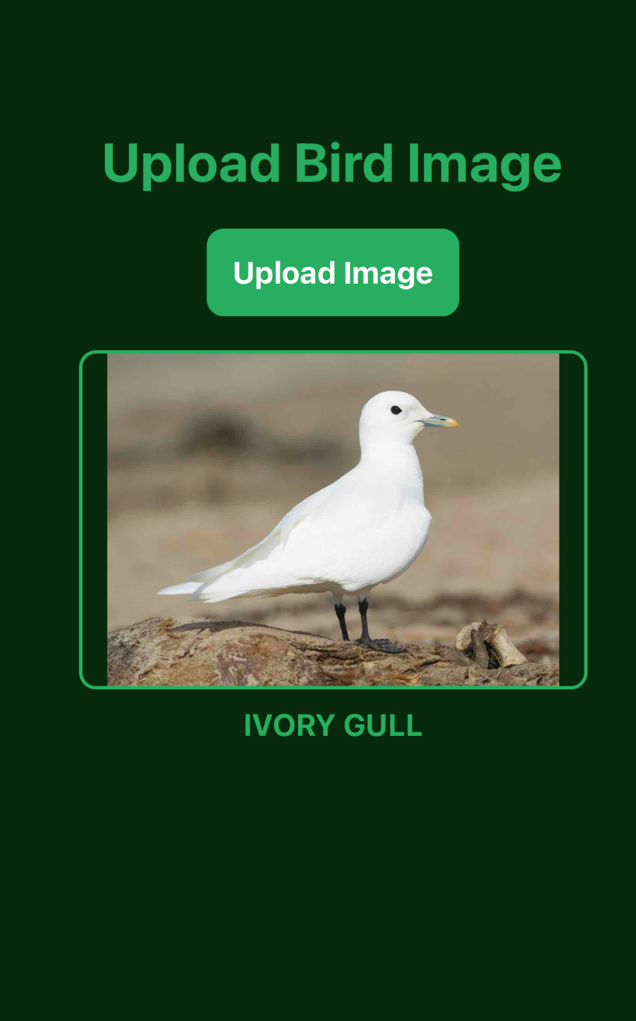
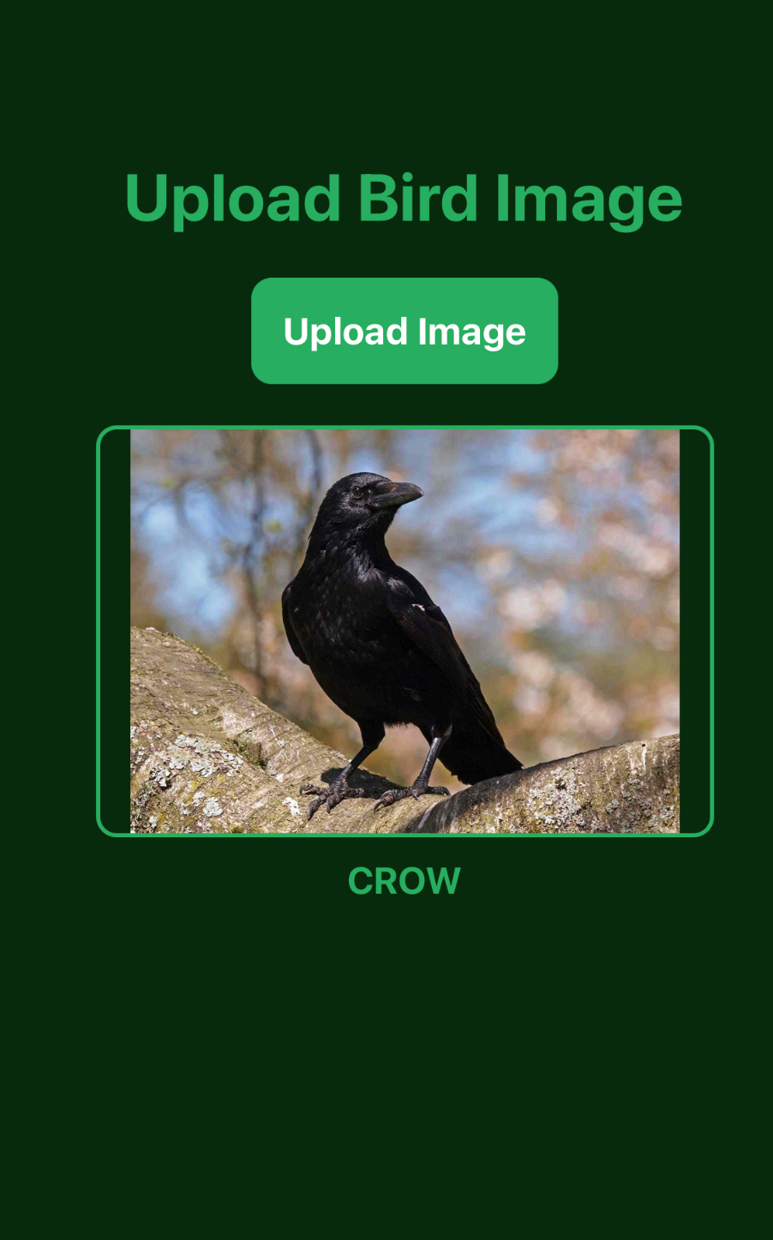
Results Visualized

Slide 13
FeederWatch Dataset
https://feederwatch.org/explore/raw-dataset-requests/
FeederWatch dataset is an open source database with user submitted sighting of birds, open from Nov to April of every year
Data is organized into CSV with columns Latitude, Longitude, Date, and Species

Slide 14
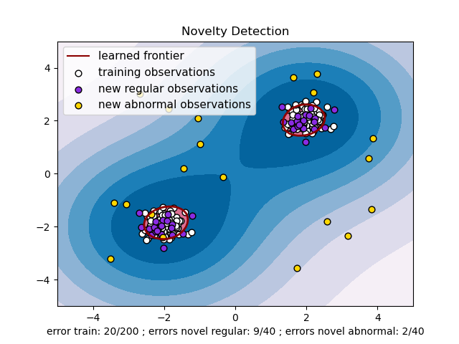
OC-SVM
In order to calculate probability of new sightings I use a OC-SVM from the Scikit learn library

Slide 15
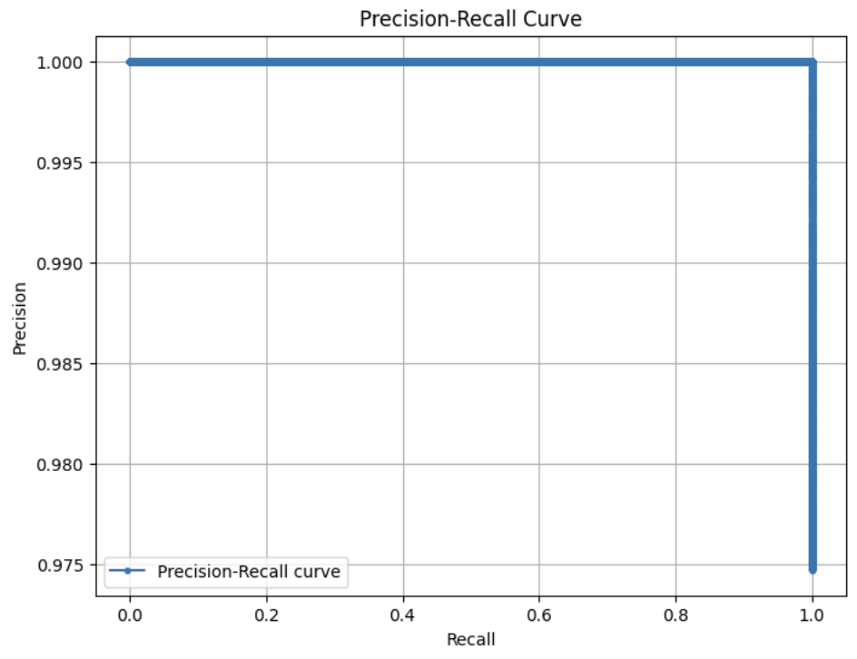
Results
Precision accuracy score of 0.99

Slide 16
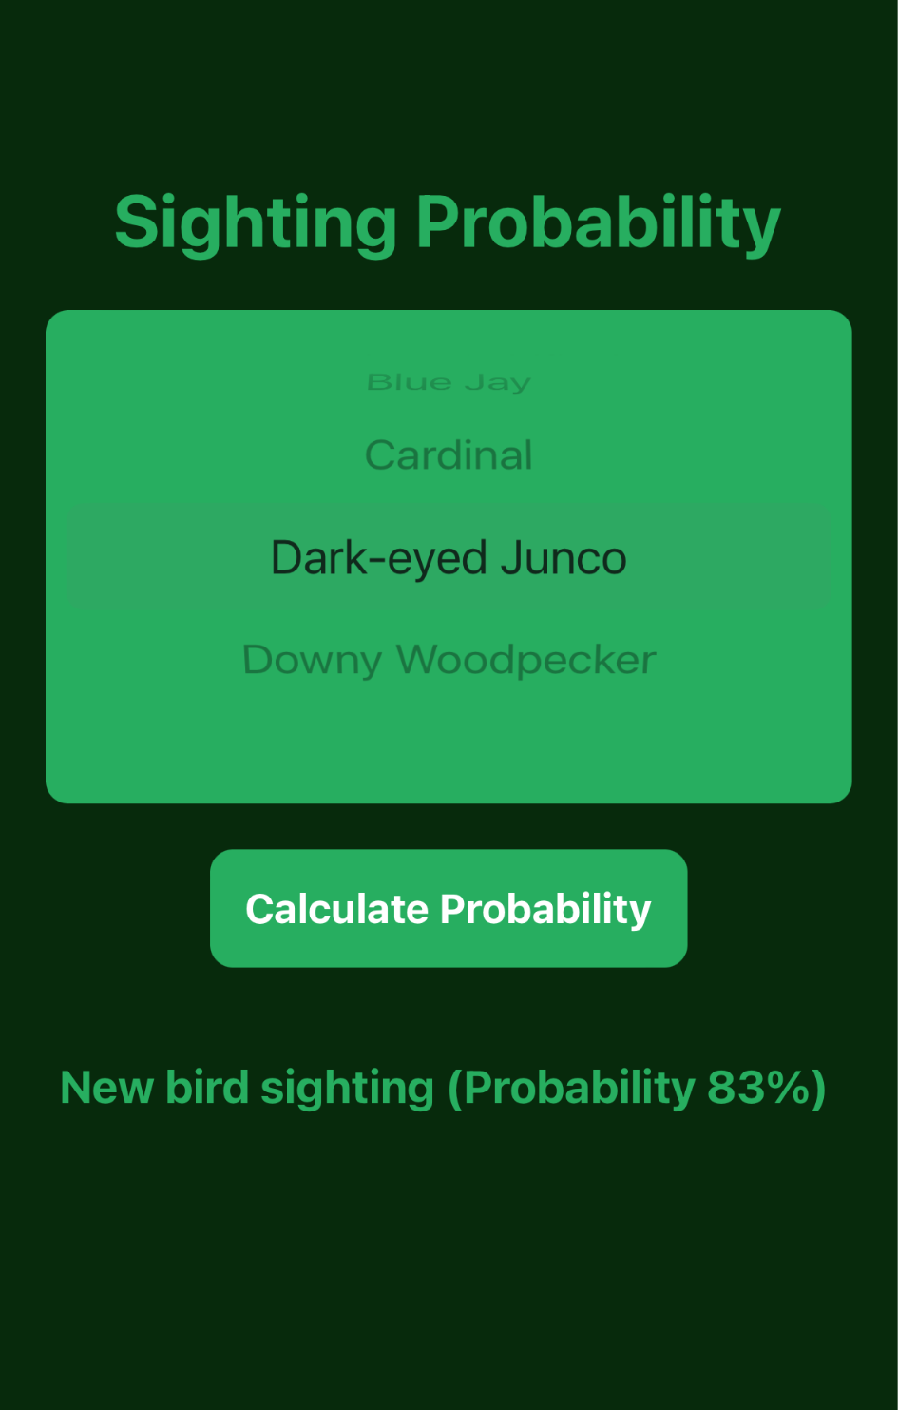
Results Visualized

Slide 17
Problems and Ideas
Resnet had unstable training towards the later epochs
Normalize images from the start
Overconfident, overfitted OC-SVM, with a Precision accuracy score of 0.99 and a Precision Recall graph that look perfect
Implement more columns such as weather, or use a bigger dataset

Slide 18
Questions
Thanks for listening!

