Slide 1
Foodie Finder
Ahmad Aldasouqi Anthony Jarjour

Slide 2
Our Code
https://github.com/anthonyjarjar/FoodieFinder

Slide 3
Our Goal
"FoodieFinder" is a project that utilizes machine learning, classifiers, and neural networks to identify a wide array of food items through images. We wanted to utilize the architectures we learned in class, specifically CNNs, and apply them to a real life application.

Slide 4
Approach
By utilizing a convolutional neural network, optimization techniques, and a diverse food image dataset, Foodie Finder will be able to identify food names, ingredient lists, and nutritional information, such as allergen info, through a users’ uploaded image.

Slide 5
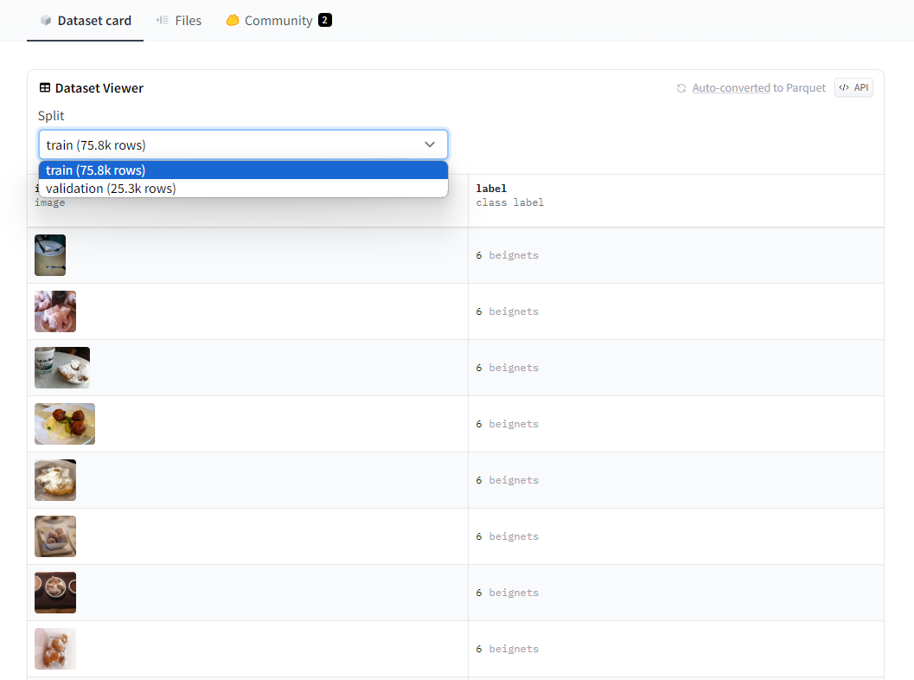
Food 101 Dataset
After choosing the ResNet18 architecture, it was time to choose a Data set
Food101
Food101 is a data set comprised of 101,000 images of food, all labeled and classified, we preprocessed the images by resizing them to 128x128, and converting them to tensors
We then split the dataset into a train, validation, and test set
Once fully loaded and completed, we were ready for the next step

Slide 6
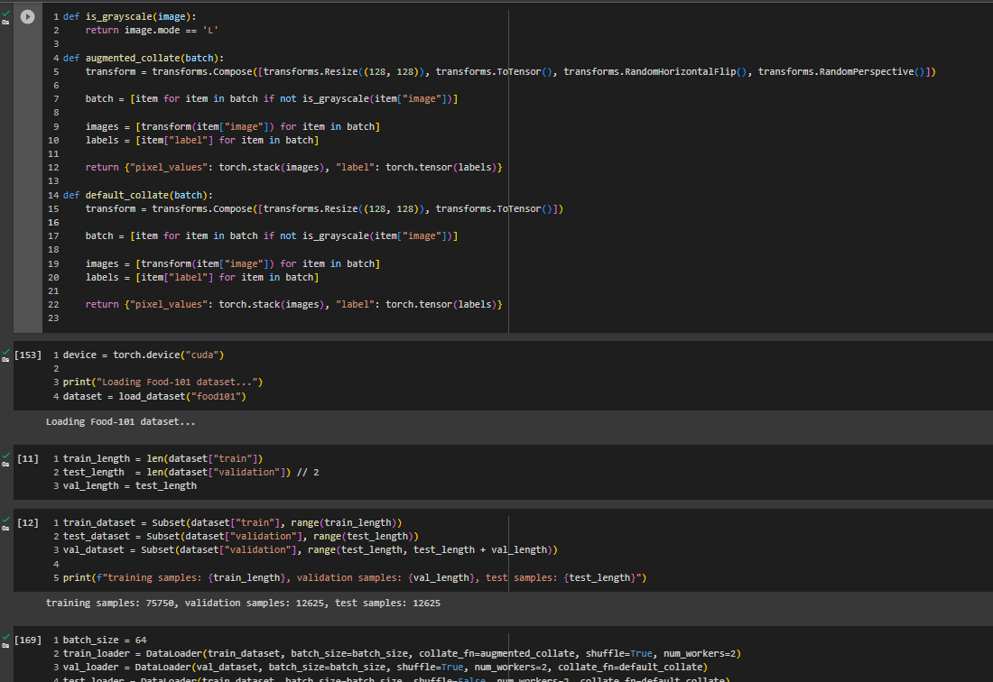

Slide 7
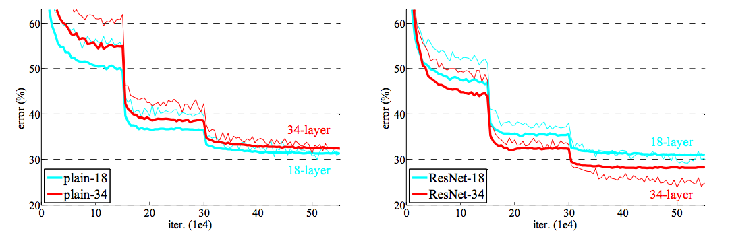
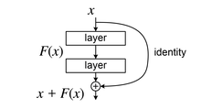
ResNet18
We utilized the ResNet architecture for our classifier. The ResNet architecture innovated over previous CNN’s by adding residual connections, which allow the network to benefit from more layers.
Previously, making networks deeper and deeper was actually making the networks perform slightly worse.

Slide 8
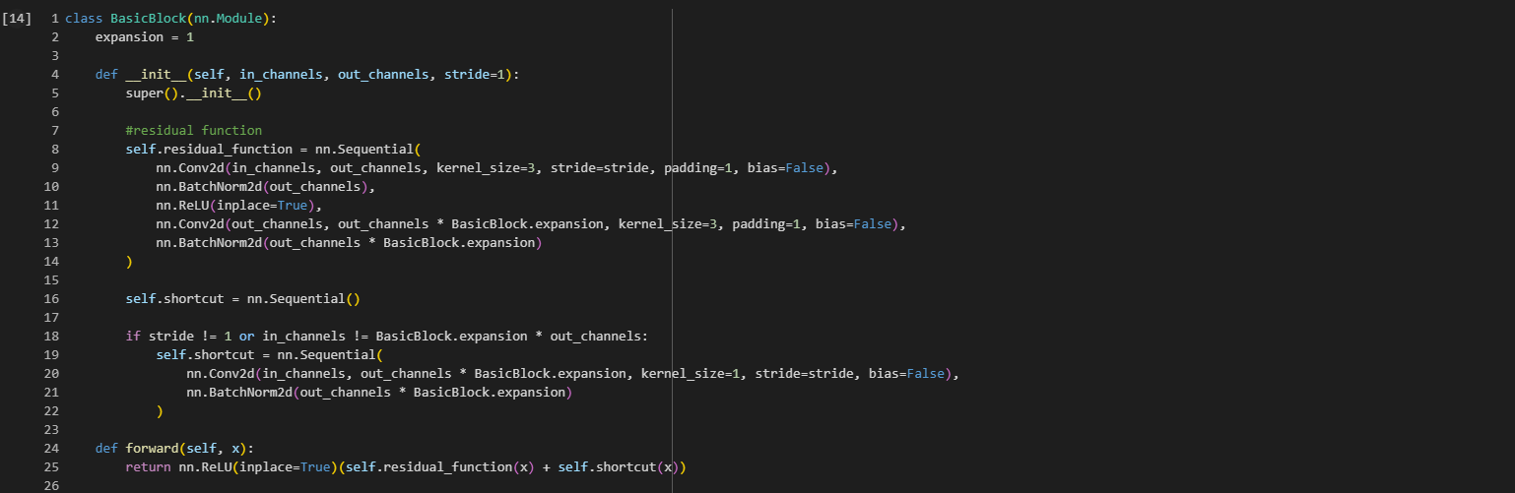

Slide 9
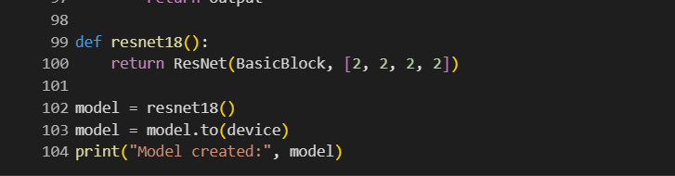

Slide 10
Epoch and Training
Loss Function and Optimizer:
The loss function is defined as cross-entropy loss (nn.CrossEntropyLoss()), which is commonly used for classification problems, and the industry standard.
The optimizer is Adam, it's used to update the model parameters during training.
Fewer parameters needed, better for gradient noise, good for large data sets
The learning rate is set to 1e-n, and weight decay is set to 1e-n. (tweaked for each epoch)
Training Loop:
The script then enters a training loop that iterates over the specified number of epochs (num_epochs).
Inside the loop, the model is set to training mode (model.train()), and the training data is processed in batches using the train_loader.
For each batch, the model parameters are zeroed (optimizer.zero_grad()), the forward pass is performed (outputs = model(inputs)), the loss is computed (loss = loss_fn(outputs, labels)), and the backward pass is executed (loss.backward()).
The optimizer then updates the model parameters based on the computed gradients (optimizer.step()).
After processing all batches in the training set, the model is set to evaluation mode (model.eval()), and the loss for the epoch is printed.

Slide 11
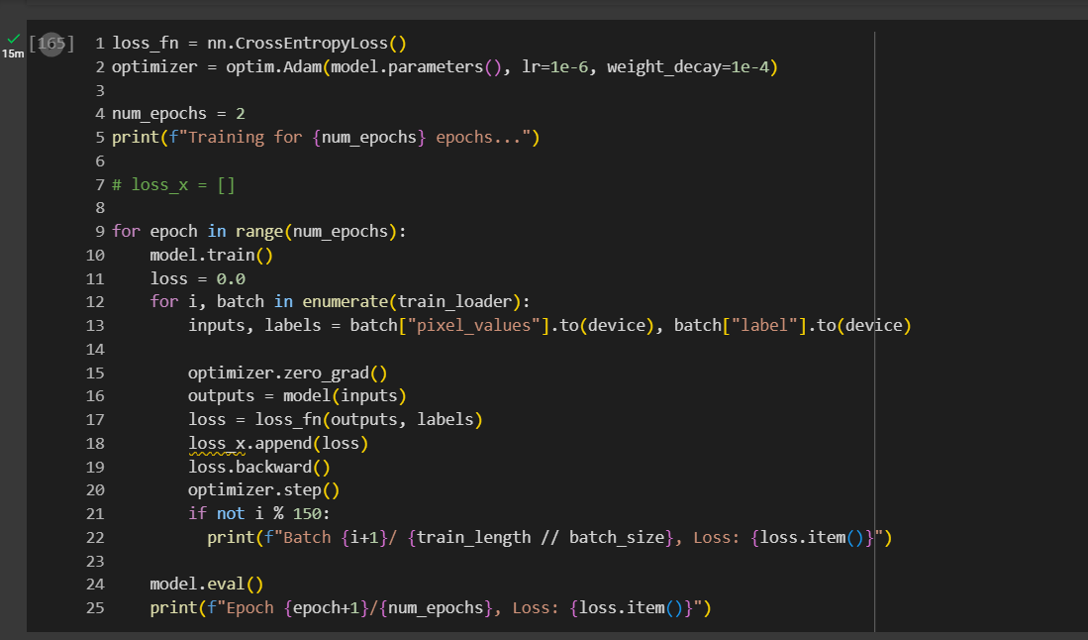

Slide 12
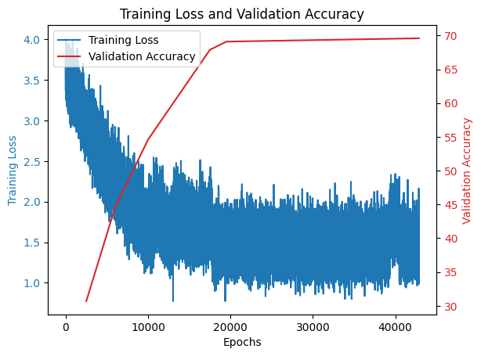
Loss
While training, we kept track of our loss overtime
We were able to paint a story through graphing our loss per batch

Slide 13
Mistakes
Not using regularization
Model started overfitting
Not augmenting our training set
Not cleaning dataset
Found different formats
Not using correct hyperparameters

Slide 14
Our Final Accuracy
After several rounds of training and data augmentation we finally arrived at an expected 75% accuracy, which allowed us to move to the app building process

Slide 15
Foodie App
Using react native and flask we were able to develop an app that calls for a user to upload an image, sends it through a custom built api, and returns a predicted label, allowing the user to confidently assess what they uploaded

Slide 16

Video Demo

Slide 17
Sources
https://github.com/pytorch/vision/blob/main/torchvision/models/resnet.py
https://huggingface.co/datasets/food101
https://github.com/weiaicunzai/pytorch-cifar100/tree/master
https://arxiv.org/abs/1512.03385

Slide 18
Questions?

