Slide 1
Objectives
To learn how to use the standard sorting methods in the Java API
To learn how to implement the following sorting algorithms:
selection sort
bubble sort
insertion sort
Shell sort
merge sort
heapsort
quicksort
To understand the differences in performance of these algorithms, and which to use for small, medium, and large arrays

Slide 2
Introduction
Sorting entails arranging data in order
Familiarity with sorting algorithms is an important programming skill
The study of sorting algorithms provides insight into
problem solving techniques such as divide and conquer
the analysis and comparison of algorithms which perform the same task

Slide 3
Using Java Sorting Methods
The Java API provides a class Arrays with several overloaded sort methods for different array types
The Collections class provides similar sorting methods for Lists
Sorting methods for arrays of primitive types are based on the quicksort algorithm
Sorting methods for arrays of objects and Lists are based on the merge sort algorithm
Both algorithms are O(n log n)

Slide 4
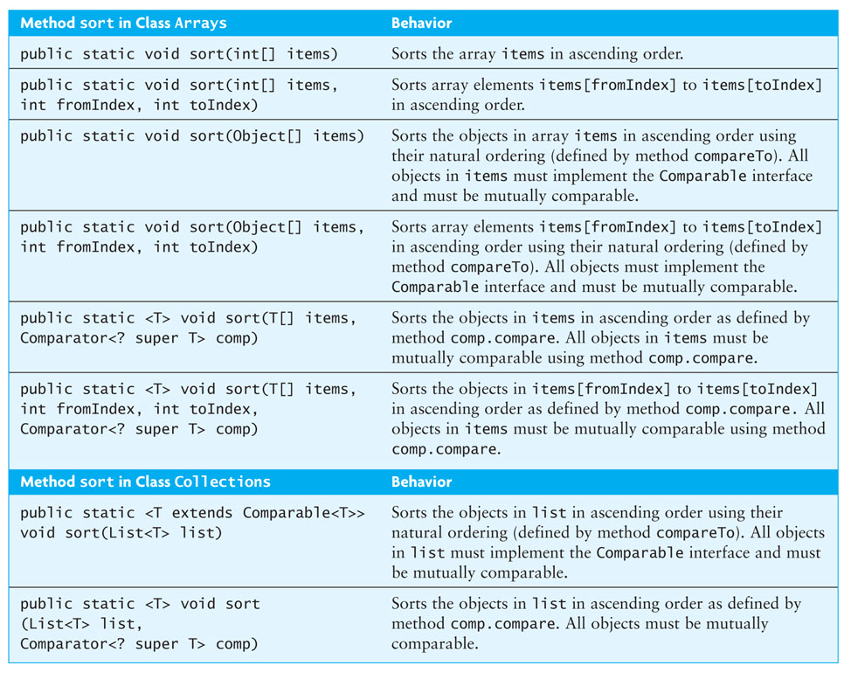
Using Java Sorting Methods (cont.)

Slide 5
Selection Sort
Selection sort is relatively easy to understand
It sorts an array by making several passes through the array, selecting a next smallest item in the array each time and placing it where it belongs in the array
While the sort algorithms are not limited to arrays, throughout this chapter we will sort arrays for simplicity
All items to be sorted must be Comparable objects, so, for example, any int values must be wrapped in Integer objects

Slide 6
Trace of Selection Sort
n = number of elements in the array
for fill = 0 to n – 2 do
Set posMin to the subscript of a smallest item in the subarray starting at subscript fill
Exchange the item at posMin with the one at fill
0
1
2
3
4
35
65
30
60
20
n | 5
fill
posMin

Slide 7
Trace of Selection Sort (cont.)
n = number of elements in the array
for fill = 0 to n – 2 do
Set posMin to the subscript of a smallest item in the subarray starting at subscript fill
Exchange the item at posMin with the one at fill
0
1
2
3
4
35
65
30
60
20
n | 5
fill | 0
posMin
fill

Slide 8
Trace of Selection Sort (cont.)
n = number of elements in the array
for fill = 0 to n – 2 do
Set posMin to the subscript of a smallest item in the subarray starting at subscript fill
Exchange the item at posMin with the one at fill
0
1
2
3
4
35
65
30
60
20
n | 5
fill | 0
posMin | 4
fill
posMin

Slide 9
Trace of Selection Sort (cont.)
n = number of elements in the array
for fill = 0 to n – 2 do
Set posMin to the subscript of a smallest item in the subarray starting at subscript fill
Exchange the item at posMin with the one at fill
0
1
2
3
4
20
65
30
60
35
n | 5
fill | 0
posMin | 4
fill
posMin

Slide 10
Trace of Selection Sort (cont.)
n = number of elements in the array
for fill = 0 to n – 2 do
Set posMin to the subscript of a smallest item in the subarray starting at subscript fill
Exchange the item at posMin with the one at fill
0
1
2
3
4
20
65
30
60
35
n | 5
fill | 1
posMin | 4
fill
posMin

Slide 11
Trace of Selection Sort (cont.)
n = number of elements in the array
for fill = 0 to n – 2 do
Set posMin to the subscript of a smallest item in the subarray starting at subscript fill
Exchange the item at posMin with the one at fill
0
1
2
3
4
20
65
30
60
35
n | 5
fill | 1
posMin | 2
fill
posMin

Slide 12
Trace of Selection Sort (cont.)
n = number of elements in the array
for fill = 0 to n – 2 do
Set posMin to the subscript of a smallest item in the subarray starting at subscript fill
Exchange the item at posMin with the one at fill
0
1
2
3
4
20
30
65
60
35
n | 5
fill | 1
posMin | 2
fill
posMin

Slide 13
Trace of Selection Sort (cont.)
n = number of elements in the array
for fill = 0 to n – 2 do
Set posMin to the subscript of a smallest item in the subarray starting at subscript fill
Exchange the item at posMin with the one at fill
0
1
2
3
4
20
30
65
60
35
n | 5
fill | 2
posMin | 2
fill
posMin

Slide 14
Trace of Selection Sort (cont.)
n = number of elements in the array
for fill = 0 to n – 2 do
Set posMin to the subscript of a smallest item in the subarray starting at subscript fill
Exchange the item at posMin with the one at fill
0
1
2
3
4
20
30
65
60
35
n | 5
fill | 2
posMin | 4
fill
posMin

Slide 15
Trace of Selection Sort (cont.)
n = number of elements in the array
for fill = 0 to n – 2 do
Set posMin to the subscript of a smallest item in the subarray starting at subscript fill
Exchange the item at posMin with the one at fill
0
1
2
3
4
20
30
35
60
65
n | 5
fill | 2
posMin | 4
fill
posMin

Slide 16
Trace of Selection Sort (cont.)
n = number of elements in the array
for fill = 0 to n – 2 do
Set posMin to the subscript of a smallest item in the subarray starting at subscript fill
Exchange the item at posMin with the one at fill
0
1
2
3
4
20
30
35
60
65
n | 5
fill | 3
posMin | 4
fill
posMin

Slide 17
Trace of Selection Sort (cont.)
n = number of elements in the array
for fill = 0 to n – 2 do
Set posMin to the subscript of a smallest item in the subarray starting at subscript fill
Exchange the item at posMin with the one at fill
0
1
2
3
4
20
30
35
60
65
n | 5
fill | 3
posMin | 3
fill
posMin

Slide 18
Trace of Selection Sort (cont.)
n = number of elements in the array
for fill = 0 to n – 2 do
Set posMin to the subscript of a smallest item in the subarray starting at subscript fill
Exchange the item at posMin with the one at fill
0
1
2
3
4
20
30
35
60
65
n | 5
fill | 3
posMin | 3
fill
posMin

Slide 19
Trace of Selection Sort (cont.)
n = number of elements in the array
for fill = 0 to n – 2 do
Set posMin to the subscript of a smallest item in the subarray starting at subscript fill
Exchange the item at posMin with the one at fill
0
1
2
3
4
20
30
35
60
65
n | 5
fill | 3
posMin | 3

Slide 20
Trace of Selection Sort Refinement
n | 5
fill
posMin
next
for fill = 0 to n – 2 do
Initialize posMin to fill
for next = fill + 1 to n – 1 do
if the item at next is less than the item at posMin
Reset posMin to next
Exchange the item at posMin with the one at fill
0
1
2
3
4
35
65
30
60
20

Slide 21
Trace of Selection Sort Refinement (cont.)
n | 5
fill | 0
posMin
next
for fill = 0 to n – 2 do
Initialize posMin to fill
for next = fill + 1 to n – 1 do
if the item at next is less than the item at posMin
Reset posMin to next
Exchange the item at posMin with the one at fill
0
1
2
3
4
35
65
30
60
20
fill

Slide 22
Trace of Selection Sort Refinement (cont.)
n | 5
fill | 0
posMin | 0
next
for fill = 0 to n – 2 do
Initialize posMin to fill
for next = fill + 1 to n – 1 do
if the item at next is less than the item at posMin
Reset posMin to next
Exchange the item at posMin with the one at fill
0
1
2
3
4
35
65
30
60
20
fill
posMin

Slide 23
Trace of Selection Sort Refinement (cont.)
n | 5
fill | 0
posMin | 0
next | 1
for fill = 0 to n – 2 do
Initialize posMin to fill
for next = fill + 1 to n – 1 do
if the item at next is less than the item at posMin
Reset posMin to next
Exchange the item at posMin with the one at fill
0
1
2
3
4
35
65
30
60
20
fill
next
posMin

Slide 24
Trace of Selection Sort Refinement (cont.)
n | 5
fill | 0
posMin | 0
next | 1
for fill = 0 to n – 2 do
Initialize posMin to fill
for next = fill + 1 to n – 1 do
if the item at next is less than the item at posMin
Reset posMin to next
Exchange the item at posMin with the one at fill
0
1
2
3
4
35
65
30
60
20
fill
next
posMin

Slide 25
Trace of Selection Sort Refinement (cont.)
n | 5
fill | 0
posMin | 0
next | 2
for fill = 0 to n – 2 do
Initialize posMin to fill
for next = fill + 1 to n – 1 do
if the item at next is less than the item at posMin
Reset posMin to next
Exchange the item at posMin with the one at fill
0
1
2
3
4
35
65
30
60
20
fill
next
posMin

Slide 26
Trace of Selection Sort Refinement (cont.)
n | 5
fill | 0
posMin | 0
next | 2
for fill = 0 to n – 2 do
Initialize posMin to fill
for next = fill + 1 to n – 1 do
if the item at next is less than the item at posMin
Reset posMin to next
Exchange the item at posMin with the one at fill
0
1
2
3
4
35
65
30
60
20
fill
next
posMin

Slide 27
Trace of Selection Sort Refinement (cont.)
n | 5
fill | 0
posMin | 2
next | 2
for fill = 0 to n – 2 do
Initialize posMin to fill
for next = fill + 1 to n – 1 do
if the item at next is less than the item at posMin
Reset posMin to next
Exchange the item at posMin with the one at fill
0
1
2
3
4
35
65
30
60
20
fill
next
posMin

Slide 28
Trace of Selection Sort Refinement (cont.)
n | 5
fill | 0
posMin | 2
next | 3
for fill = 0 to n – 2 do
Initialize posMin to fill
for next = fill + 1 to n – 1 do
if the item at next is less than the item at posMin
Reset posMin to next
Exchange the item at posMin with the one at fill
0
1
2
3
4
35
65
30
60
20
fill
next
posMin

Slide 29
Trace of Selection Sort Refinement (cont.)
n | 5
fill | 0
posMin | 2
next | 3
for fill = 0 to n – 2 do
Initialize posMin to fill
for next = fill + 1 to n – 1 do
if the item at next is less than the item at posMin
Reset posMin to next
Exchange the item at posMin with the one at fill
0
1
2
3
4
35
65
30
60
20
fill
next
posMin

Slide 30
Trace of Selection Sort Refinement (cont.)
n | 5
fill | 0
posMin | 2
next | 4
for fill = 0 to n – 2 do
Initialize posMin to fill
for next = fill + 1 to n – 1 do
if the item at next is less than the item at posMin
Reset posMin to next
Exchange the item at posMin with the one at fill
0
1
2
3
4
35
65
30
60
20
fill
next
posMin

Slide 31
Trace of Selection Sort Refinement (cont.)
n | 5
fill | 0
posMin | 2
next | 4
for fill = 0 to n – 2 do
Initialize posMin to fill
for next = fill + 1 to n – 1 do
if the item at next is less than the item at posMin
Reset posMin to next
Exchange the item at posMin with the one at fill
0
1
2
3
4
35
65
30
60
20
fill
next
posMin

Slide 32
Trace of Selection Sort Refinement (cont.)
n | 5
fill | 0
posMin | 4
next | 4
for fill = 0 to n – 2 do
Initialize posMin to fill
for next = fill + 1 to n – 1 do
if the item at next is less than the item at posMin
Reset posMin to next
Exchange the item at posMin with the one at fill
0
1
2
3
4
35
65
30
60
20
fill
next
posMin

Slide 33
Trace of Selection Sort Refinement (cont.)
n | 5
fill | 0
posMin | 4
next | 4
for fill = 0 to n – 2 do
Initialize posMin to fill
for next = fill + 1 to n – 1 do
if the item at next is less than the item at posMin
Reset posMin to next
Exchange the item at posMin with the one at fill
0
1
2
3
4
20
65
30
60
35
fill
next
posMin

Slide 34
Trace of Selection Sort Refinement (cont.)
n | 5
fill | 1
posMin | 4
next | 4
for fill = 0 to n – 2 do
Initialize posMin to fill
for next = fill + 1 to n – 1 do
if the item at next is less than the item at posMin
Reset posMin to next
Exchange the item at posMin with the one at fill
0
1
2
3
4
20
65
30
60
35
fill
next
posMin

Slide 35
Trace of Selection Sort Refinement (cont.)
n | 5
fill | 1
posMin | 1
next | 4
for fill = 0 to n – 2 do
Initialize posMin to fill
for next = fill + 1 to n – 1 do
if the item at next is less than the item at posMin
Reset posMin to next
Exchange the item at posMin with the one at fill
0
1
2
3
4
20
65
30
60
35
fill
next
posMin

Slide 36
Trace of Selection Sort Refinement (cont.)
n | 5
fill | 1
posMin | 1
next | 2
for fill = 0 to n – 2 do
Initialize posMin to fill
for next = fill + 1 to n – 1 do
if the item at next is less than the item at posMin
Reset posMin to next
Exchange the item at posMin with the one at fill
0
1
2
3
4
20
65
30
60
35
fill
next
posMin

Slide 37
Trace of Selection Sort Refinement (cont.)
n | 5
fill | 1
posMin | 1
next | 2
for fill = 0 to n – 2 do
Initialize posMin to fill
for next = fill + 1 to n – 1 do
if the item at next is less than the item at posMin
Reset posMin to next
Exchange the item at posMin with the one at fill
0
1
2
3
4
20
65
30
60
35
fill
next
posMin

Slide 38
Trace of Selection Sort Refinement (cont.)
n | 5
fill | 1
posMin | 2
next | 2
for fill = 0 to n – 2 do
Initialize posMin to fill
for next = fill + 1 to n – 1 do
if the item at next is less than the item at posMin
Reset posMin to next
Exchange the item at posMin with the one at fill
0
1
2
3
4
20
65
30
60
35
fill
next
posMin

Slide 39
Trace of Selection Sort Refinement (cont.)
n | 5
fill | 1
posMin | 2
next | 3
for fill = 0 to n – 2 do
Initialize posMin to fill
for next = fill + 1 to n – 1 do
if the item at next is less than the item at posMin
Reset posMin to next
Exchange the item at posMin with the one at fill
0
1
2
3
4
20
65
30
60
35
fill
next
posMin

Slide 40
Trace of Selection Sort Refinement (cont.)
n | 5
fill | 1
posMin | 2
next | 3
for fill = 0 to n – 2 do
Initialize posMin to fill
for next = fill + 1 to n – 1 do
if the item at next is less than the item at posMin
Reset posMin to next
Exchange the item at posMin with the one at fill
0
1
2
3
4
20
65
30
60
35
fill
next
posMin

Slide 41
Trace of Selection Sort Refinement (cont.)
n | 5
fill | 1
posMin | 2
next | 4
for fill = 0 to n – 2 do
Initialize posMin to fill
for next = fill + 1 to n – 1 do
if the item at next is less than the item at posMin
Reset posMin to next
Exchange the item at posMin with the one at fill
0
1
2
3
4
20
65
30
60
35
fill
next
posMin

Slide 42
Trace of Selection Sort Refinement (cont.)
n | 5
fill | 1
posMin | 2
next | 4
for fill = 0 to n – 2 do
Initialize posMin to fill
for next = fill + 1 to n – 1 do
if the item at next is less than the item at posMin
Reset posMin to next
Exchange the item at posMin with the one at fill
0
1
2
3
4
20
65
30
60
35
fill
next
posMin

Slide 43
Trace of Selection Sort Refinement (cont.)
n | 5
fill | 1
posMin | 2
next | 4
for fill = 0 to n – 2 do
Initialize posMin to fill
for next = fill + 1 to n – 1 do
if the item at next is less than the item at posMin
Reset posMin to next
Exchange the item at posMin with the one at fill
0
1
2
3
4
20
30
65
60
35
fill
next
posMin

Slide 44
Trace of Selection Sort Refinement (cont.)
n | 5
fill | 2
posMin | 2
next | 4
for fill = 0 to n – 2 do
Initialize posMin to fill
for next = fill + 1 to n – 1 do
if the item at next is less than the item at posMin
Reset posMin to next
Exchange the item at posMin with the one at fill
0
1
2
3
4
20
30
65
60
35
fill
next
posMin

Slide 45
Trace of Selection Sort Refinement (cont.)
n | 5
fill | 2
posMin | 2
next | 4
for fill = 0 to n – 2 do
Initialize posMin to fill
for next = fill + 1 to n – 1 do
if the item at next is less than the item at posMin
Reset posMin to next
Exchange the item at posMin with the one at fill
0
1
2
3
4
20
30
65
60
35
fill
next
posMin

Slide 46
Trace of Selection Sort Refinement (cont.)
n | 5
fill | 2
posMin | 2
next | 3
for fill = 0 to n – 2 do
Initialize posMin to fill
for next = fill + 1 to n – 1 do
if the item at next is less than the item at posMin
Reset posMin to next
Exchange the item at posMin with the one at fill
0
1
2
3
4
20
30
65
60
35
fill
next
posMin

Slide 47
Trace of Selection Sort Refinement (cont.)
n | 5
fill | 2
posMin | 2
next | 3
for fill = 0 to n – 2 do
Initialize posMin to fill
for next = fill + 1 to n – 1 do
if the item at next is less than the item at posMin
Reset posMin to next
Exchange the item at posMin with the one at fill
0
1
2
3
4
20
30
65
60
35
fill
next
posMin

Slide 48
Trace of Selection Sort Refinement (cont.)
n | 5
fill | 2
posMin | 3
next | 3
for fill = 0 to n – 2 do
Initialize posMin to fill
for next = fill + 1 to n – 1 do
if the item at next is less than the item at posMin
Reset posMin to next
Exchange the item at posMin with the one at fill
0
1
2
3
4
20
30
65
60
35
fill
next
posMin

Slide 49
Trace of Selection Sort Refinement (cont.)
n | 5
fill | 2
posMin | 3
next | 4
for fill = 0 to n – 2 do
Initialize posMin to fill
for next = fill + 1 to n – 1 do
if the item at next is less than the item at posMin
Reset posMin to next
Exchange the item at posMin with the one at fill
0
1
2
3
4
20
30
65
60
35
fill
next
posMin

Slide 50
Trace of Selection Sort Refinement (cont.)
n | 5
fill | 2
posMin | 3
next | 4
for fill = 0 to n – 2 do
Initialize posMin to fill
for next = fill + 1 to n – 1 do
if the item at next is less than the item at posMin
Reset posMin to next
Exchange the item at posMin with the one at fill
0
1
2
3
4
20
30
65
60
35
fill
next
posMin

Slide 51
Trace of Selection Sort Refinement (cont.)
n | 5
fill | 2
posMin | 4
next | 4
for fill = 0 to n – 2 do
Initialize posMin to fill
for next = fill + 1 to n – 1 do
if the item at next is less than the item at posMin
Reset posMin to next
Exchange the item at posMin with the one at fill
0
1
2
3
4
20
30
65
60
35
fill
next
posMin

Slide 52
Trace of Selection Sort Refinement (cont.)
n | 5
fill | 2
posMin | 4
next | 4
for fill = 0 to n – 2 do
Initialize posMin to fill
for next = fill + 1 to n – 1 do
if the item at next is less than the item at posMin
Reset posMin to next
Exchange the item at posMin with the one at fill
0
1
2
3
4
20
30
35
60
65
fill
next
posMin

Slide 53
Trace of Selection Sort Refinement (cont.)
n | 5
fill | 3
posMin | 4
next | 4
for fill = 0 to n – 2 do
Initialize posMin to fill
for next = fill + 1 to n – 1 do
if the item at next is less than the item at posMin
Reset posMin to next
Exchange the item at posMin with the one at fill
0
1
2
3
4
20
30
35
60
65
fill
next
posMin

Slide 54
Trace of Selection Sort Refinement (cont.)
n | 5
fill | 3
posMin | 3
next | 4
for fill = 0 to n – 2 do
Initialize posMin to fill
for next = fill + 1 to n – 1 do
if the item at next is less than the item at posMin
Reset posMin to next
Exchange the item at posMin with the one at fill
0
1
2
3
4
20
30
35
60
65
fill
next
posMin

Slide 55
Trace of Selection Sort Refinement (cont.)
n | 5
fill | 3
posMin | 3
next | 4
for fill = 0 to n – 2 do
Initialize posMin to fill
for next = fill + 1 to n – 1 do
if the item at next is less than the item at posMin
Reset posMin to next
Exchange the item at posMin with the one at fill
0
1
2
3
4
20
30
35
60
65
fill
next
posMin

Slide 56
Trace of Selection Sort Refinement (cont.)
n | 5
fill | 3
posMin | 3
next | 4
for fill = 0 to n – 2 do
Initialize posMin to fill
for next = fill + 1 to n – 1 do
if the item at next is less than the item at posMin
Reset posMin to next
Exchange the item at posMin with the one at fill
0
1
2
3
4
20
30
35
60
65
fill
next
posMin

Slide 57
Trace of Selection Sort Refinement (cont.)
n | 5
fill | 3
posMin | 3
next | 4
for fill = 0 to n – 2 do
Initialize posMin to fill
for next = fill + 1 to n – 1 do
if the item at next is less than the item at posMin
Reset posMin to next
Exchange the item at posMin with the one at fill
0
1
2
3
4
20
30
35
60
65
fill
next
posMin

Slide 58
Trace of Selection Sort Refinement (cont.)
n | 5
fill | 3
posMin | 3
next | 4
for fill = 0 to n – 2 do
Initialize posMin to fill
for next = fill + 1 to n – 1 do
if the item at next is less than the item at posMin
Reset posMin to next
Exchange the item at posMin with the one at fill
0
1
2
3
4
20
30
35
60
65

Slide 59
Analysis of Selection Sort
for fill = 0 to n – 2 do
Initialize posMin to fill
for next = fill + 1 to n – 1 do
if the item at next is less than the item at posMin
Reset posMin to next
Exchange the item at posMin with the one at fill
This loop is performed n-1 times

Slide 60
Analysis of Selection Sort (cont.)
for fill = 0 to n – 2 do
Initialize posMin to fill
for next = fill + 1 to n – 1 do
if the item at next is less than the item at posMin
Reset posMin to next
Exchange the item at posMin with the one at fill
There are n-1 exchanges

Slide 61
Analysis of Selection Sort (cont.)
for fill = 0 to n – 2 do
Initialize posMin to fill
for next = fill + 1 to n – 1 do
if the item at next is less than the item at posMin
Reset posMin to next
Exchange the item at posMin with the one at fill
This comparison is performed (n – 1 - fill)
times for each value of fill and can be represented by the following series: (n-1) + (n-2) + ... + 3 + 2 + 1

Slide 62
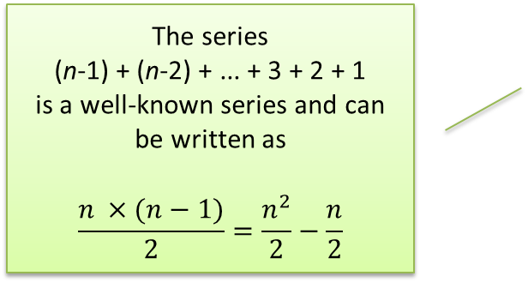
Analysis of Selection Sort (cont.)
for fill = 0 to n – 2 do
Initialize posMin to fill
for next = fill + 1 to n – 1 do
if the item at next is less than the item at posMin
Reset posMin to next
Exchange the item at posMin with the one at fill

Slide 63
Analysis of Selection Sort (cont.)
for fill = 0 to n – 2 do
Initialize posMin to fill
for next = fill + 1 to n – 1 do
if the item at next is less than the item at posMin
Reset posMin to next
Exchange the item at posMin with the one at fill
For very large n we can ignore all but the significant term in the expression, so the number of
comparisons is O(n²)
exchanges is O(n)
An O(n²) sort is called a quadratic sort

Slide 64
Making Sort Methods Generic
To avoid a warning message about an unchecked call to compareTo, change the method heading to
public static <T extends Comparable<T>> void sort(T[] table {
and change the variable temp from Comparable to type T
T temp = table[fill];

Slide 65
Bubble Sort
Also a quadratic sort
Compares adjacent array elements and exchanges their values if they are out of order
Smaller values bubble up to the top of the array and larger values sink to the bottom; hence the name

Slide 66
Trace of Bubble Sort
do
for each pair of adjacent array elements
if the values in a pair are out of order
Exchange the values
while the array is not sorted
[0]
60
[1]
42
[2]
75
[3]
83
[4]
27

Slide 67
Trace of Bubble Sort (cont.)
pass | 1
exchanges made | 0
do
for each pair of adjacent array elements
if the values in a pair are out of order
Exchange the values
while the array is not sorted
[0]
60
[1]
42
[2]
75
[3]
83
[4]
27

Slide 68
Trace of Bubble Sort (cont.)
pass | 1
exchanges made | 1
do
for each pair of adjacent array elements
if the values in a pair are out of order
Exchange the values
while the array is not sorted
[0]
42
[1]
60
[2]
75
[3]
83
[4]
27

Slide 69
Trace of Bubble Sort (cont.)
pass | 1
exchanges made | 1
do
for each pair of adjacent array elements
if the values in a pair are out of order
Exchange the values
while the array is not sorted
[0]
42
[1]
60
[2]
75
[3]
83
[4]
27

Slide 70
Trace of Bubble Sort (cont.)
pass | 1
exchanges made | 1
do
for each pair of adjacent array elements
if the values in a pair are out of order
Exchange the values
while the array is not sorted
[0]
42
[1]
60
[2]
75
[3]
83
[4]
27

Slide 71
Trace of Bubble Sort (cont.)
pass | 1
exchanges made | 1
do
for each pair of adjacent array elements
if the values in a pair are out of order
Exchange the values
while the array is not sorted
[0]
42
[1]
60
[2]
75
[3]
83
[4]
27

Slide 72
Trace of Bubble Sort (cont.)
pass | 1
exchanges made | 1
do
for each pair of adjacent array elements
if the values in a pair are out of order
Exchange the values
while the array is not sorted
[0]
42
[1]
60
[2]
75
[3]
27
[4]
83

Slide 73
Trace of Bubble Sort (cont.)
pass | 1
exchanges made | 2
do
for each pair of adjacent array elements
if the values in a pair are out of order
Exchange the values
while the array is not sorted
[0]
42
[1]
60
[2]
75
At the end of pass 1, the last item (index [4]) is guaranteed to be in its correct position. There is no need to test it again in the next pass
[3]
27
[4]
83

Slide 74
Trace of Bubble Sort (cont.)
pass | 2
exchanges made | 0
do
for each pair of adjacent array elements
if the values in a pair are out of order
Exchange the values
while the array is not sorted
[0]
42
[1]
60
[2]
75
[3]
27
[4]
83

Slide 75
Trace of Bubble Sort (cont.)
pass | 2
exchanges made | 0
do
for each pair of adjacent array elements
if the values in a pair are out of order
Exchange the values
while the array is not sorted
[0]
42
[1]
60
[2]
75
[3]
27
[4]
83

Slide 76
Trace of Bubble Sort (cont.)
pass | 2
exchanges made | 0
do
for each pair of adjacent array elements
if the values in a pair are out of order
Exchange the values
while the array is not sorted
[0]
42
[1]
60
[2]
75
[3]
27
[4]
83

Slide 77
Trace of Bubble Sort (cont.)
pass | 2
exchanges made | 1
do
for each pair of adjacent array elements
if the values in a pair are out of order
Exchange the values
while the array is not sorted
[0]
42
[1]
60
[2]
27
[3]
75
[4]
83

Slide 78
Trace of Bubble Sort (cont.)
pass | 2
exchanges made | 1
do
for each pair of adjacent array elements
if the values in a pair are out of order
Exchange the values
while the array is not sorted
[0]
42
[1]
60
[2]
27
[3]
75
[4]
83

Slide 79
Trace of Bubble Sort (cont.)
pass | 3
exchanges made | 0
do
for each pair of adjacent array elements
if the values in a pair are out of order
Exchange the values
while the array is not sorted
[0]
42
[1]
60
[2]
27
[3]
75
[4]
83

Slide 80
Trace of Bubble Sort (cont.)
pass | 3
exchanges made | 0
do
for each pair of adjacent array elements
if the values in a pair are out of order
Exchange the values
while the array is not sorted
[0]
42
[1]
60
[2]
27
[3]
75
[4]
83

Slide 81
Trace of Bubble Sort (cont.)
pass | 3
exchanges made | 1
do
for each pair of adjacent array elements
if the values in a pair are out of order
Exchange the values
while the array is not sorted
[0]
42
[1]
27
[2]
60
[3]
75
[4]
83

Slide 82
Trace of Bubble Sort (cont.)
pass | 3
exchanges made | 1
do
for each pair of adjacent array elements
if the values in a pair are out of order
Exchange the values
while the array is not sorted
[0]
42
[1]
27
[2]
60
[3]
75
[4]
83

Slide 83
Trace of Bubble Sort (cont.)
pass | 4
exchanges made | 0
do
for each pair of adjacent array elements
if the values in a pair are out of order
Exchange the values
while the array is not sorted
[0]
42
[1]
27
[2]
60
[3]
75
[4]
83

Slide 84
Trace of Bubble Sort (cont.)
pass | 4
exchanges made | 1
do
for each pair of adjacent array elements
if the values in a pair are out of order
Exchange the values
while the array is not sorted
[0]
27
[1]
42
[2]
60
[3]
75
[4]
83

Slide 85
Trace of Bubble Sort (cont.)
pass | 4
exchanges made | 1
do
for each pair of adjacent array elements
if the values in a pair are out of order
Exchange the values
while the array is not sorted
[0]
27
[1]
42
[2]
60
[3]
75
[4]
83

Slide 86
Trace of Bubble Sort (cont.)
pass | 4
exchanges made | 1
do
for each pair of adjacent array elements
if the values in a pair are out of order
Exchange the values
while the array is not sorted
[0]
27
[1]
42
[2]
60
Where n is the length of the array, after the completion of n – 1 passes (4, in this example) the array is sorted
[3]
75
[4]
83

Slide 87
Trace of Bubble Sort (cont.)
pass | 4
exchanges made | 1
do
for each pair of adjacent array elements
if the values in a pair are out of order
Exchange the values
while the array is not sorted
[0]
27
[1]
42
[2]
60
Sometimes an array will be sorted before n – 1 passes. This can be detected if there are no exchanges made during a pass through the array
[3]
75
[4]
83

Slide 88
Trace of Bubble Sort (cont.)
pass | 4
exchanges made | 1
do
for each pair of adjacent array elements
if the values in a pair are out of order
Exchange the values
while the array is not sorted
[0]
27
[1]
42
[2]
60
The algorithm can be modified to detect exchanges (next)
[3]
75
[4]
83

Slide 89
Trace of Bubble Sort (cont.)
pass | 4
exchanges made | 1
Initialize exchanges to false
for each pair of adjacent array elements
if the values in a pair are out of order
Exchange the values
Set exchanges to true
[0]
27
[1]
42
[2]
60
The algorithm can be modified to detect exchanges
[3]
75
[4]
83

Slide 90
Analysis of Bubble Sort
The number of comparisons and exchanges is represented by
(n – 1) + (n – 2) + ... + 3 + 2 + 1
Worst case:
number of comparisons is O(n²)
number of exchanges is O(n²)
Compared to selection sort with its O(n²) comparisons and O(n) exchanges, bubble sort usually performs worse
If the array is sorted early, the later comparisons and exchanges are not performed and performance is improved

Slide 91
Analysis of Bubble Sort (cont.)
The best case occurs when the array is sorted already
one pass is required (O(n) comparisons)
no exchanges are required (O(1) exchanges)
Bubble sort works best on arrays nearly sorted and worst on inverted arrays (elements are in reverse sorted order)

Slide 92
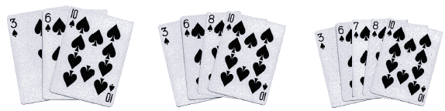
Insertion Sort
Another quadratic sort, insertion sort, is based on the technique used by card players to arrange a hand of cards
The player keeps the cards that have been picked up so far in sorted order
When the player picks up a new card, the player makes room for the new card and then inserts it in its proper place

Slide 93
Trace of Insertion Sort
for each array element from the second (nextPos = 1) to the last
Insert the element at nextPos where it belongs in the array, increasing the length of the sorted subarray by 1 element
[0]
30
[1]
25
[2]
15
To adapt the insertion algorithm to an array that is filled with data, we start with a sorted subarray consisting of only the first element
[3]
20
[4]
28

Slide 94
Trace of Insertion Sort (cont.)
nextPos | 1
for each array element from the second (nextPos = 1) to the last
Insert the element at nextPos where it belongs in the array, increasing the length of the sorted subarray by 1 element
[0]
30
[1]
25
nextPos
[2]
15
[3]
20
[4]
28

Slide 95
Trace of Insertion Sort (cont.)
nextPos | 1
for each array element from the second (nextPos = 1) to the last
Insert the element at nextPos where it belongs in the array, increasing the length of the sorted subarray by 1 element
[0]
25
[1]
30
nextPos
[2]
15
[3]
20
[4]
28

Slide 96
Trace of Insertion Sort (cont.)
nextPos | 2
for each array element from the second (nextPos = 1) to the last
Insert the element at nextPos where it belongs in the array, increasing the length of the sorted subarray by 1 element
[0]
25
[1]
30
[2]
15
nextPos
[3]
20
[4]
28

Slide 97
Trace of Insertion Sort (cont.)
nextPos | 2
for each array element from the second (nextPos = 1) to the last
Insert the element at nextPos where it belongs in the array, increasing the length of the sorted subarray by 1 element
[0]
15
[1]
25
[2]
30
nextPos
[3]
20
[4]
28

Slide 98
Trace of Insertion Sort (cont.)
nextPos | 3
for each array element from the second (nextPos = 1) to the last
Insert the element at nextPos where it belongs in the array, increasing the length of the sorted subarray by 1 element
[0]
15
[1]
25
[2]
30
[3]
20
nextPos
[4]
28

Slide 99
Trace of Insertion Sort (cont.)
nextPos | 3
for each array element from the second (nextPos = 1) to the last
Insert the element at nextPos where it belongs in the array, increasing the length of the sorted subarray by 1 element
[0]
15
[1]
20
[2]
25
[3]
30
nextPos
[4]
28

Slide 100
Trace of Insertion Sort (cont.)
nextPos | 4
for each array element from the second (nextPos = 1) to the last
Insert the element at nextPos where it belongs in the array, increasing the length of the sorted subarray by 1 element
[0]
15
[1]
20
[2]
25
[3]
30
[4]
28
nextPos

Slide 101
Trace of Insertion Sort (cont.)
nextPos | 4
for each array element from the second (nextPos = 1) to the last
Insert the element at nextPos where it belongs in the array, increasing the length of the sorted subarray by 1 element
[0]
15
[1]
20
[2]
25
[3]
28
[4]
30
nextPos

Slide 102
Trace of Insertion Sort (cont.)
nextPos | -
for each array element from the second (nextPos = 1) to the last
Insert the element at nextPos where it belongs in the array, increasing the length of the sorted subarray by 1 element
[0]
15
[1]
20
[2]
25
[3]
28
[4]
30

Slide 103
Trace of Insertion Sort Refinement
for each array element from the second (nextPos = 1) to the last
nextPos is the position of the element to insert
Save the value of the element to insert in nextVal
while nextPos > 0 and the element at nextPos – 1 > nextVal
Shift the element at nextPos – 1 to position nextPos
Decrement nextPos by 1
Insert nextVal at nextPos
[0]
30
[1]
25
[2]
15
[3]
20
[4]
28

Slide 104
Trace of Insertion Sort Refinement (cont.)
nextPos | 1
nextVal
for each array element from the second (nextPos = 1) to the last
nextPos is the position of the element to insert
Save the value of the element to insert in nextVal
while nextPos > 0 and the element at nextPos – 1 > nextVal
Shift the element at nextPos – 1 to position nextPos
Decrement nextPos by 1
Insert nextVal at nextPos
[0]
30
loop position
[1]
25
[2]
15
[3]
20
[4]
28

Slide 105
Trace of Insertion Sort Refinement (cont.)
nextPos | 1
nextVal
for each array element from the second (nextPos = 1) to the last
nextPos is the position of the element to insert
Save the value of the element to insert in nextVal
while nextPos > 0 and the element at nextPos – 1 > nextVal
Shift the element at nextPos – 1 to position nextPos
Decrement nextPos by 1
Insert nextVal at nextPos
[0]
30
loop position
[1]
25
nextPos
[2]
15
[3]
20
[4]
28

Slide 106
Trace of Insertion Sort Refinement (cont.)
nextPos | 1
nextVal | 25
for each array element from the second (nextPos = 1) to the last
nextPos is the position of the element to insert
Save the value of the element to insert in nextVal
while nextPos > 0 and the element at nextPos – 1 > nextVal
Shift the element at nextPos – 1 to position nextPos
Decrement nextPos by 1
Insert nextVal at nextPos
[0]
30
loop position
[1]
25
nextPos
[2]
15
[3]
20
[4]
28

Slide 107
Trace of Insertion Sort Refinement (cont.)
nextPos | 1
nextVal | 25
for each array element from the second (nextPos = 1) to the last
nextPos is the position of the element to insert
Save the value of the element to insert in nextVal
while nextPos > 0 and the element at nextPos – 1 > nextVal
Shift the element at nextPos – 1 to position nextPos
Decrement nextPos by 1
Insert nextVal at nextPos
[0]
30
loop position
[1]
25
nextPos
[2]
15
[3]
20
[4]
28

Slide 108
Trace of Insertion Sort Refinement (cont.)
nextPos | 1
nextVal | 25
for each array element from the second (nextPos = 1) to the last
nextPos is the position of the element to insert
Save the value of the element to insert in nextVal
while nextPos > 0 and the element at nextPos – 1 > nextVal
Shift the element at nextPos – 1 to position nextPos
Decrement nextPos by 1
Insert nextVal at nextPos
[0]
30
loop position
[1]
30
nextPos
[2]
15
[3]
20
[4]
28

Slide 109
Trace of Insertion Sort Refinement (cont.)
nextPos | 0
nextVal | 25
for each array element from the second (nextPos = 1) to the last
nextPos is the position of the element to insert
Save the value of the element to insert in nextVal
while nextPos > 0 and the element at nextPos – 1 > nextVal
Shift the element at nextPos – 1 to position nextPos
Decrement nextPos by 1
Insert nextVal at nextPos
[0]
30
nextPos
loop position
[1]
30
[2]
15
[3]
20
[4]
28

Slide 110
Trace of Insertion Sort Refinement (cont.)
nextPos | 0
nextVal | 25
for each array element from the second (nextPos = 1) to the last
nextPos is the position of the element to insert
Save the value of the element to insert in nextVal
while nextPos > 0 and the element at nextPos – 1 > nextVal
Shift the element at nextPos – 1 to position nextPos
Decrement nextPos by 1
Insert nextVal at nextPos
[0]
30
nextPos
loop position
[1]
30
[2]
15
[3]
20
[4]
28

Slide 111
Trace of Insertion Sort Refinement (cont.)
nextPos | 0
nextVal | 25
for each array element from the second (nextPos = 1) to the last
nextPos is the position of the element to insert
Save the value of the element to insert in nextVal
while nextPos > 0 and the element at nextPos – 1 > nextVal
Shift the element at nextPos – 1 to position nextPos
Decrement nextPos by 1
Insert nextVal at nextPos
[0]
25
nextPos
loop position
[1]
30
[2]
15
[3]
20
[4]
28

Slide 112
Trace of Insertion Sort Refinement (cont.)
nextPos | 0
nextVal | 25
for each array element from the second (nextPos = 1) to the last
nextPos is the position of the element to insert
Save the value of the element to insert in nextVal
while nextPos > 0 and the element at nextPos – 1 > nextVal
Shift the element at nextPos – 1 to position nextPos
Decrement nextPos by 1
Insert nextVal at nextPos
[0]
25
[1]
30
loop position
[2]
15
[3]
20
[4]
28

Slide 113
Trace of Insertion Sort Refinement (cont.)
nextPos | 2
nextVal | 25
for each array element from the second (nextPos = 1) to the last
nextPos is the position of the element to insert
Save the value of the element to insert in nextVal
while nextPos > 0 and the element at nextPos – 1 > nextVal
Shift the element at nextPos – 1 to position nextPos
Decrement nextPos by 1
Insert nextVal at nextPos
[0]
25
[1]
30
loop position
[2]
15
nextPos
[3]
20
[4]
28

Slide 114
Trace of Insertion Sort Refinement (cont.)
nextPos | 2
nextVal | 15
for each array element from the second (nextPos = 1) to the last
nextPos is the position of the element to insert
Save the value of the element to insert in nextVal
while nextPos > 0 and the element at nextPos – 1 > nextVal
Shift the element at nextPos – 1 to position nextPos
Decrement nextPos by 1
Insert nextVal at nextPos
[0]
25
[1]
30
loop position
[2]
15
nextPos
[3]
20
[4]
28

Slide 115
Trace of Insertion Sort Refinement (cont.)
nextPos | 2
nextVal | 15
for each array element from the second (nextPos = 1) to the last
nextPos is the position of the element to insert
Save the value of the element to insert in nextVal
while nextPos > 0 and the element at nextPos – 1 > nextVal
Shift the element at nextPos – 1 to position nextPos
Decrement nextPos by 1
Insert nextVal at nextPos
[0]
25
[1]
30
loop position
[2]
15
nextPos
[3]
20
[4]
28

Slide 116
Trace of Insertion Sort Refinement (cont.)
nextPos | 2
nextVal | 15
for each array element from the second (nextPos = 1) to the last
nextPos is the position of the element to insert
Save the value of the element to insert in nextVal
while nextPos > 0 and the element at nextPos – 1 > nextVal
Shift the element at nextPos – 1 to position nextPos
Decrement nextPos by 1
Insert nextVal at nextPos
[0]
25
[1]
30
loop position
[2]
30
nextPos
[3]
20
[4]
28

Slide 117
Trace of Insertion Sort Refinement (cont.)
nextPos | 1
nextVal | 15
for each array element from the second (nextPos = 1) to the last
nextPos is the position of the element to insert
Save the value of the element to insert in nextVal
while nextPos > 0 and the element at nextPos – 1 > nextVal
Shift the element at nextPos – 1 to position nextPos
Decrement nextPos by 1
Insert nextVal at nextPos
[0]
25
[1]
30
nextPos
loop position
[2]
30
[3]
20
[4]
28

Slide 118
Trace of Insertion Sort Refinement (cont.)
nextPos | 1
nextVal | 15
for each array element from the second (nextPos = 1) to the last
nextPos is the position of the element to insert
Save the value of the element to insert in nextVal
while nextPos > 0 and the element at nextPos – 1 > nextVal
Shift the element at nextPos – 1 to position nextPos
Decrement nextPos by 1
Insert nextVal at nextPos
[0]
25
[1]
30
nextPos
loop position
[2]
30
[3]
20
[4]
28

Slide 119
Trace of Insertion Sort Refinement (cont.)
nextPos | 1
nextVal | 15
for each array element from the second (nextPos = 1) to the last
nextPos is the position of the element to insert
Save the value of the element to insert in nextVal
while nextPos > 0 and the element at nextPos – 1 > nextVal
Shift the element at nextPos – 1 to position nextPos
Decrement nextPos by 1
Insert nextVal at nextPos
[0]
25
[1]
25
nextPos
loop position
[2]
30
[3]
20
[4]
28

Slide 120
Trace of Insertion Sort Refinement (cont.)
nextPos | 0
nextVal | 15
for each array element from the second (nextPos = 1) to the last
nextPos is the position of the element to insert
Save the value of the element to insert in nextVal
while nextPos > 0 and the element at nextPos – 1 > nextVal
Shift the element at nextPos – 1 to position nextPos
Decrement nextPos by 1
Insert nextVal at nextPos
[0]
25
nextPos
[1]
25
loop position
[2]
30
[3]
20
[4]
28

Slide 121
Trace of Insertion Sort Refinement (cont.)
nextPos | 0
nextVal | 15
for each array element from the second (nextPos = 1) to the last
nextPos is the position of the element to insert
Save the value of the element to insert in nextVal
while nextPos > 0 and the element at nextPos – 1 > nextVal
Shift the element at nextPos – 1 to position nextPos
Decrement nextPos by 1
Insert nextVal at nextPos
[0]
25
nextPos
[1]
25
loop position
[2]
30
[3]
20
[4]
28

Slide 122
Trace of Insertion Sort Refinement (cont.)
nextPos | 0
nextVal | 15
for each array element from the second (nextPos = 1) to the last
nextPos is the position of the element to insert
Save the value of the element to insert in nextVal
while nextPos > 0 and the element at nextPos – 1 > nextVal
Shift the element at nextPos – 1 to position nextPos
Decrement nextPos by 1
Insert nextVal at nextPos
[0]
15
nextPos
[1]
25
loop position
[2]
30
[3]
20
[4]
28

Slide 123
Trace of Insertion Sort Refinement (cont.)
nextPos | 0
nextVal | 15
for each array element from the second (nextPos = 1) to the last
nextPos is the position of the element to insert
Save the value of the element to insert in nextVal
while nextPos > 0 and the element at nextPos – 1 > nextVal
Shift the element at nextPos – 1 to position nextPos
Decrement nextPos by 1
Insert nextVal at nextPos
[0]
15
nextPos
[1]
25
[2]
30
loop position
[3]
20
[4]
28

Slide 124
Trace of Insertion Sort Refinement (cont.)
nextPos | 3
nextVal | 15
for each array element from the second (nextPos = 1) to the last
nextPos is the position of the element to insert
Save the value of the element to insert in nextVal
while nextPos > 0 and the element at nextPos – 1 > nextVal
Shift the element at nextPos – 1 to position nextPos
Decrement nextPos by 1
Insert nextVal at nextPos
[0]
15
[1]
25
[2]
30
loop position
[3]
20
nextPos
[4]
28

Slide 125
Trace of Insertion Sort Refinement (cont.)
nextPos | 3
nextVal | 20
for each array element from the second (nextPos = 1) to the last
nextPos is the position of the element to insert
Save the value of the element to insert in nextVal
while nextPos > 0 and the element at nextPos – 1 > nextVal
Shift the element at nextPos – 1 to position nextPos
Decrement nextPos by 1
Insert nextVal at nextPos
[0]
15
[1]
25
[2]
30
loop position
[3]
20
nextPos
[4]
28

Slide 126
Trace of Insertion Sort Refinement (cont.)
nextPos | 3
nextVal | 20
for each array element from the second (nextPos = 1) to the last
nextPos is the position of the element to insert
Save the value of the element to insert in nextVal
while nextPos > 0 and the element at nextPos – 1 > nextVal
Shift the element at nextPos – 1 to position nextPos
Decrement nextPos by 1
Insert nextVal at nextPos
[0]
15
[1]
25
[2]
30
loop position
[3]
20
nextPos
[4]
28

Slide 127
Trace of Insertion Sort Refinement (cont.)
nextPos | 3
nextVal | 20
for each array element from the second (nextPos = 1) to the last
nextPos is the position of the element to insert
Save the value of the element to insert in nextVal
while nextPos > 0 and the element at nextPos – 1 > nextVal
Shift the element at nextPos – 1 to position nextPos
Decrement nextPos by 1
Insert nextVal at nextPos
[0]
15
[1]
25
[2]
30
loop position
[3]
30
nextPos
[4]
28

Slide 128
Trace of Insertion Sort Refinement (cont.)
nextPos | 2
nextVal | 20
for each array element from the second (nextPos = 1) to the last
nextPos is the position of the element to insert
Save the value of the element to insert in nextVal
while nextPos > 0 and the element at nextPos – 1 > nextVal
Shift the element at nextPos – 1 to position nextPos
Decrement nextPos by 1
Insert nextVal at nextPos
[0]
15
[1]
25
[2]
30
nextPos
loop position
[3]
30
[4]
28

Slide 129
Trace of Insertion Sort Refinement (cont.)
nextPos | 2
nextVal | 20
for each array element from the second (nextPos = 1) to the last
nextPos is the position of the element to insert
Save the value of the element to insert in nextVal
while nextPos > 0 and the element at nextPos – 1 > nextVal
Shift the element at nextPos – 1 to position nextPos
Decrement nextPos by 1
Insert nextVal at nextPos
[0]
15
[1]
25
[2]
30
nextPos
loop position
[3]
30
[4]
28

Slide 130
Trace of Insertion Sort Refinement (cont.)
nextPos | 2
nextVal | 20
for each array element from the second (nextPos = 1) to the last
nextPos is the position of the element to insert
Save the value of the element to insert in nextVal
while nextPos > 0 and the element at nextPos – 1 > nextVal
Shift the element at nextPos – 1 to position nextPos
Decrement nextPos by 1
Insert nextVal at nextPos
[0]
15
[1]
25
[2]
25
nextPos
loop position
[3]
30
[4]
28

Slide 131
Trace of Insertion Sort Refinement (cont.)
nextPos | 1
nextVal | 20
for each array element from the second (nextPos = 1) to the last
nextPos is the position of the element to insert
Save the value of the element to insert in nextVal
while nextPos > 0 and the element at nextPos – 1 > nextVal
Shift the element at nextPos – 1 to position nextPos
Decrement nextPos by 1
Insert nextVal at nextPos
[0]
15
[1]
25
nextPos
[2]
25
loop position
[3]
30
[4]
28

Slide 132
Trace of Insertion Sort Refinement (cont.)
nextPos | 1
nextVal | 20
for each array element from the second (nextPos = 1) to the last
nextPos is the position of the element to insert
Save the value of the element to insert in nextVal
while nextPos > 0 and the element at nextPos – 1 > nextVal
Shift the element at nextPos – 1 to position nextPos
Decrement nextPos by 1
Insert nextVal at nextPos
[0]
15
[1]
25
nextPos
[2]
25
loop position
[3]
30
[4]
28

Slide 133
Trace of Insertion Sort Refinement (cont.)
nextPos | 1
nextVal | 20
for each array element from the second (nextPos = 1) to the last
nextPos is the position of the element to insert
Save the value of the element to insert in nextVal
while nextPos > 0 and the element at nextPos – 1 > nextVal
Shift the element at nextPos – 1 to position nextPos
Decrement nextPos by 1
Insert nextVal at nextPos
[0]
15
[1]
20
nextPos
[2]
25
loop position
[3]
30
[4]
28

Slide 134
Trace of Insertion Sort Refinement (cont.)
nextPos | 1
nextVal | 20
for each array element from the second (nextPos = 1) to the last
nextPos is the position of the element to insert
Save the value of the element to insert in nextVal
while nextPos > 0 and the element at nextPos – 1 > nextVal
Shift the element at nextPos – 1 to position nextPos
Decrement nextPos by 1
Insert nextVal at nextPos
[0]
15
[1]
20
[2]
25
[3]
30
loop position
[4]
28

Slide 135
Trace of Insertion Sort Refinement (cont.)
nextPos | 4
nextVal | 20
for each array element from the second (nextPos = 1) to the last
nextPos is the position of the element to insert
Save the value of the element to insert in nextVal
while nextPos > 0 and the element at nextPos – 1 > nextVal
Shift the element at nextPos – 1 to position nextPos
Decrement nextPos by 1
Insert nextVal at nextPos
[0]
15
[1]
20
[2]
25
[3]
30
loop position
[4]
28
nextPos

Slide 136
Trace of Insertion Sort Refinement (cont.)
nextPos | 4
nextVal | 28
for each array element from the second (nextPos = 1) to the last
nextPos is the position of the element to insert
Save the value of the element to insert in nextVal
while nextPos > 0 and the element at nextPos – 1 > nextVal
Shift the element at nextPos – 1 to position nextPos
Decrement nextPos by 1
Insert nextVal at nextPos
[0]
15
[1]
20
[2]
25
[3]
30
loop position
[4]
28
nextPos

Slide 137
Trace of Insertion Sort Refinement (cont.)
nextPos | 4
nextVal | 28
for each array element from the second (nextPos = 1) to the last
nextPos is the position of the element to insert
Save the value of the element to insert in nextVal
while nextPos > 0 and the element at nextPos – 1 > nextVal
Shift the element at nextPos – 1 to position nextPos
Decrement nextPos by 1
Insert nextVal at nextPos
[0]
15
[1]
20
[2]
25
[3]
30
loop position
[4]
28
nextPos

Slide 138
Trace of Insertion Sort Refinement (cont.)
nextPos | 4
nextVal | 28
for each array element from the second (nextPos = 1) to the last
nextPos is the position of the element to insert
Save the value of the element to insert in nextVal
while nextPos > 0 and the element at nextPos – 1 > nextVal
Shift the element at nextPos – 1 to position nextPos
Decrement nextPos by 1
Insert nextVal at nextPos
[0]
15
[1]
20
[2]
25
[3]
30
loop position
[4]
30
nextPos

Slide 139
Trace of Insertion Sort Refinement (cont.)
nextPos | 3
nextVal | 28
for each array element from the second (nextPos = 1) to the last
nextPos is the position of the element to insert
Save the value of the element to insert in nextVal
while nextPos > 0 and the element at nextPos – 1 > nextVal
Shift the element at nextPos – 1 to position nextPos
Decrement nextPos by 1
Insert nextVal at nextPos
[0]
15
[1]
20
[2]
25
[3]
30
nextPos
loop position
[4]
30

Slide 140
Trace of Insertion Sort Refinement (cont.)
nextPos | 3
nextVal | 28
for each array element from the second (nextPos = 1) to the last
nextPos is the position of the element to insert
Save the value of the element to insert in nextVal
while nextPos > 0 and the element at nextPos – 1 > nextVal
Shift the element at nextPos – 1 to position nextPos
Decrement nextPos by 1
Insert nextVal at nextPos
[0]
15
[1]
20
[2]
25
[3]
30
nextPos
loop position
[4]
30

Slide 141
Trace of Insertion Sort Refinement (cont.)
nextPos | 3
nextVal | 28
for each array element from the second (nextPos = 1) to the last
nextPos is the position of the element to insert
Save the value of the element to insert in nextVal
while nextPos > 0 and the element at nextPos – 1 > nextVal
Shift the element at nextPos – 1 to position nextPos
Decrement nextPos by 1
Insert nextVal at nextPos
[0]
15
[1]
20
[2]
25
[3]
28
nextPos
loop position
[4]
30

Slide 142
Trace of Insertion Sort Refinement (cont.)
nextPos | 3
nextVal | 28
for each array element from the second (nextPos = 1) to the last
nextPos is the position of the element to insert
Save the value of the element to insert in nextVal
while nextPos > 0 and the element at nextPos – 1 > nextVal
Shift the element at nextPos – 1 to position nextPos
Decrement nextPos by 1
Insert nextVal at nextPos
[0]
15
[1]
20
[2]
25
[3]
28
[4]
30

Slide 143
Analysis of Insertion Sort
The insertion step is performed n – 1 times
In the worst case, all elements in the sorted subarray are compared to nextVal for each insertion
The maximum number of comparisons then will be:
1 + 2 + 3 + ... + (n – 2) + (n – 1)
which is O(n²)

Slide 144
Analysis of Insertion Sort (cont.)
In the best case (when the array is sorted already), only one comparison is required for each insertion
In the best case, the number of comparisons is O(n)
The number of shifts performed during an insertion is one less than the number of comparisons
Or, when the new value is the smallest so far, it is the same as the number of comparisons
A shift in an insertion sort requires movement of only 1 item, while an exchange in a bubble or selection sort involves a temporary item and the movement of three items
The item moved may be a primitive or an object reference
The objects themselves do not change their locations

Slide 145
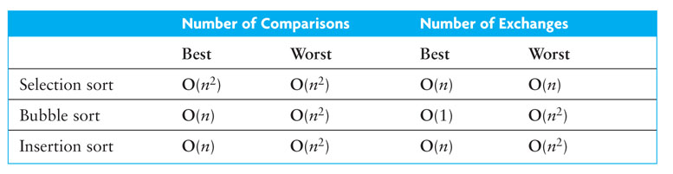
Comparison of Quadratic Sorts

Slide 146
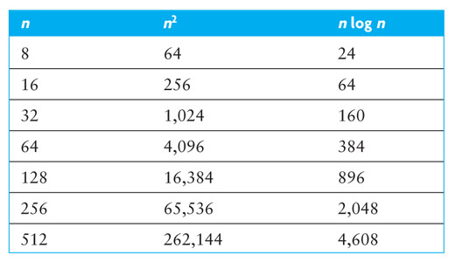
Comparison of Quadratic Sorts (cont.)
Comparison of growth rates

Slide 147
Comparison of Quadratic Sorts (cont.)
Insertion sort
gives the best performance for most arrays
takes advantage of any partial sorting in the array and uses less costly shifts
Bubble sort generally gives the worst performance—unless the array is nearly sorted
Big-O analysis ignores constants and overhead
None of the quadratic search algorithms are particularly good for large arrays (n > 1000)
The best sorting algorithms provide n log n average case performance

Slide 148
Comparison of Quadratic Sorts (cont.)
All quadratic sorts require storage for the array being sorted
However, the array is sorted in place
While there are also storage requirements for variables, for large n, the size of the array dominates and extra space usage is O(1)

Slide 149
Comparisons versus Exchanges
In Java, an exchange requires a switch of two object references using a third object reference as an intermediary
A comparison requires an execution of a compareTo method
The cost of a comparison depends on its complexity, but is generally more costly than an exchange
For some other languages, an exchange may involve physically moving information rather than swapping object references. In these cases, an exchange may be more costly than a comparison

Slide 150
Shell Sort: A Better Insertion Sort
A Shell sort is a type of insertion sort, but with O(n^{3/2}) or better performance than the O(n²) sorts
It is named after its discoverer, Donald Shell
A Shell sort can be thought of as a divide-and-conquer approach to insertion sort
Instead of sorting the entire array, Shell sort sorts many smaller subarrays using insertion sort before sorting the entire array

Slide 151
Trace of Shell Sort
gap value | 7
[0]
[1]
[2]
[3]
[4]
[5]
[6]
[7]
[8]
[9]
[10]
[11]
[12]
[13]
[14]
[15]
40
35
85
75
60
90
70
75
55
90
80
34
45
62
57
65

Slide 152
Trace of Shell Sort (cont.)
gap value | 7
[0]
[1]
[2]
[3]
[4]
[5]
[6]
[7]
[8]
[9]
[10]
[11]
[12]
[13]
[14]
[15]
40
35
85
75
60
90
70
75
55
90
80
34
45
62
57
65
subarray 1

Slide 153
Trace of Shell Sort (cont.)
gap value | 7
[0]
[1]
[2]
[3]
[4]
[5]
[6]
[7]
[8]
[9]
[10]
[11]
[12]
[13]
[14]
[15]
40
35
85
75
60
90
70
75
55
90
80
34
45
62
57
65
subarray 2

Slide 154
Trace of Shell Sort (cont.)
gap value | 7
[0]
[1]
[2]
[3]
[4]
[5]
[6]
[7]
[8]
[9]
[10]
[11]
[12]
[13]
[14]
[15]
40
35
85
75
60
90
70
75
55
90
80
34
45
62
57
65
subarray 3

Slide 155
Trace of Shell Sort (cont.)
gap value | 7
[0]
[1]
[2]
[3]
[4]
[5]
[6]
[7]
[8]
[9]
[10]
[11]
[12]
[13]
[14]
[15]
40
35
85
75
60
90
70
75
55
90
80
34
45
62
57
65
subarray 4

Slide 156
Trace of Shell Sort (cont.)
gap value | 7
[0]
[1]
[2]
[3]
[4]
[5]
[6]
[7]
[8]
[9]
[10]
[11]
[12]
[13]
[14]
[15]
40
35
85
75
60
90
70
75
55
90
80
34
45
62
57
65
subarray 5

Slide 157
Trace of Shell Sort (cont.)
gap value | 7
[0]
[1]
[2]
[3]
[4]
[5]
[6]
[7]
[8]
[9]
[10]
[11]
[12]
[13]
[14]
[15]
40
35
85
75
60
90
70
75
55
90
80
34
45
62
57
65
subarray 6

Slide 158
Trace of Shell Sort (cont.)
gap value | 7
[0]
[1]
[2]
[3]
[4]
[5]
[6]
[7]
[8]
[9]
[10]
[11]
[12]
[13]
[14]
[15]
40
35
85
75
60
90
70
75
55
90
80
34
45
62
57
65
subarray 7

Slide 159
Trace of Shell Sort (cont.)
gap value | 7
Sort subarray 1
[0]
[1]
[2]
[3]
[4]
[5]
[6]
[7]
[8]
[9]
[10]
[11]
[12]
[13]
[14]
[15]
40
35
85
75
60
90
70
75
55
90
80
34
45
62
57
65
subarray 1

Slide 160
Trace of Shell Sort (cont.)
gap value | 7
Sort subarray 2
[0]
[1]
[2]
[3]
[4]
[5]
[6]
[7]
[8]
[9]
[10]
[11]
[12]
[13]
[14]
[15]
40
35
85
75
60
90
70
57
55
90
80
34
45
62
75
65
subarray 2

Slide 161
Trace of Shell Sort (cont.)
gap value | 7
Sort subarray 3
[0]
[1]
[2]
[3]
[4]
[5]
[6]
[7]
[8]
[9]
[10]
[11]
[12]
[13]
[14]
[15]
40
35
85
75
60
90
70
57
55
90
80
34
45
62
75
65
subarray 3

Slide 162
Trace of Shell Sort (cont.)
gap value | 7
Sort subarray 4
[0]
[1]
[2]
[3]
[4]
[5]
[6]
[7]
[8]
[9]
[10]
[11]
[12]
[13]
[14]
[15]
40
35
85
75
60
90
70
57
55
90
80
34
45
62
75
65
subarray 4

Slide 163
Trace of Shell Sort (cont.)
gap value | 7
Sort subarray 5
[0]
[1]
[2]
[3]
[4]
[5]
[6]
[7]
[8]
[9]
[10]
[11]
[12]
[13]
[14]
[15]
40
35
85
75
60
90
70
57
55
90
80
34
45
62
75
65
subarray 5

Slide 164
Trace of Shell Sort (cont.)
gap value | 7
Sort subarray 5
[0]
[1]
[2]
[3]
[4]
[5]
[6]
[7]
[8]
[9]
[10]
[11]
[12]
[13]
[14]
[15]
40
35
85
75
34
90
70
57
55
90
80
60
45
62
75
65
subarray 5

Slide 165
Trace of Shell Sort (cont.)
gap value | 7
Sort subarray 6
[0]
[1]
[2]
[3]
[4]
[5]
[6]
[7]
[8]
[9]
[10]
[11]
[12]
[13]
[14]
[15]
40
35
85
75
34
90
70
57
55
90
80
60
45
62
75
65
subarray 6

Slide 166
Trace of Shell Sort (cont.)
gap value | 7
Sort subarray 6
[0]
[1]
[2]
[3]
[4]
[5]
[6]
[7]
[8]
[9]
[10]
[11]
[12]
[13]
[14]
[15]
40
35
85
75
34
45
70
57
55
90
80
60
90
62
75
65
subarray 6

Slide 167
Trace of Shell Sort (cont.)
gap value | 7
Sort subarray 7
[0]
[1]
[2]
[3]
[4]
[5]
[6]
[7]
[8]
[9]
[10]
[11]
[12]
[13]
[14]
[15]
40
35
85
75
34
45
70
57
55
90
80
60
90
62
75
65
subarray 7

Slide 168
Trace of Shell Sort (cont.)
gap value | 7
Sort subarray 7
[0]
[1]
[2]
[3]
[4]
[5]
[6]
[7]
[8]
[9]
[10]
[11]
[12]
[13]
[14]
[15]
40
35
85
75
34
45
62
57
55
90
80
60
90
70
75
65
subarray 7

Slide 169
Trace of Shell Sort (cont.)
gap value | 7
Sort subarray 1
[0]
[1]
[2]
[3]
[4]
[5]
[6]
[7]
[8]
[9]
[10]
[11]
[12]
[13]
[14]
[15]
40
35
85
75
34
45
62
57
55
90
80
60
90
70
75
65
subarray 1

Slide 170
Trace of Shell Sort (cont.)
gap value | 7
Sort subarray 2
[0]
[1]
[2]
[3]
[4]
[5]
[6]
[7]
[8]
[9]
[10]
[11]
[12]
[13]
[14]
[15]
40
35
85
75
34
45
62
57
55
90
80
60
90
70
75
65
subarray 2

Slide 171
Trace of Shell Sort (cont.)
gap value | 7
Sort on smaller gap value next
[0]
[1]
[2]
[3]
[4]
[5]
[6]
[7]
[8]
[9]
[10]
[11]
[12]
[13]
[14]
[15]
40
35
85
75
34
45
62
57
55
90
80
60
90
70
75
65

Slide 172
Trace of Shell Sort (cont.)
gap value | 3
Sort on smaller gap value
[0]
[1]
[2]
[3]
[4]
[5]
[6]
[7]
[8]
[9]
[10]
[11]
[12]
[13]
[14]
[15]
40
35
85
75
34
45
62
57
55
90
80
60
90
70
75
65

Slide 173
Trace of Shell Sort (cont.)
gap value | 3
Sort subarray 1
[0]
[1]
[2]
[3]
[4]
[5]
[6]
[7]
[8]
[9]
[10]
[11]
[12]
[13]
[14]
[15]
40
35
85
75
34
45
62
57
55
90
80
60
90
70
75
65
subarray 1

Slide 174
Trace of Shell Sort (cont.)
gap value | 3
Sort subarray 2
[0]
[1]
[2]
[3]
[4]
[5]
[6]
[7]
[8]
[9]
[10]
[11]
[12]
[13]
[14]
[15]
40
35
85
75
34
45
62
57
55
90
80
60
90
70
75
65
subarray 2

Slide 175
Trace of Shell Sort (cont.)
gap value | 3
Sort subarray 2
[0]
[1]
[2]
[3]
[4]
[5]
[6]
[7]
[8]
[9]
[10]
[11]
[12]
[13]
[14]
[15]
40
34
85
75
35
45
62
57
55
90
80
60
90
70
75
65
subarray 2

Slide 176
Trace of Shell Sort (cont.)
gap value | 3
Sort subarray 3
[0]
[1]
[2]
[3]
[4]
[5]
[6]
[7]
[8]
[9]
[10]
[11]
[12]
[13]
[14]
[15]
40
34
85
75
35
45
62
57
55
90
80
60
90
70
75
65
subarray 3

Slide 177
Trace of Shell Sort (cont.)
gap value | 3
Sort subarray 3
[0]
[1]
[2]
[3]
[4]
[5]
[6]
[7]
[8]
[9]
[10]
[11]
[12]
[13]
[14]
[15]
40
34
45
75
35
85
62
57
55
90
80
60
90
70
75
65
subarray 3

Slide 178
Trace of Shell Sort (cont.)
gap value | 3
Sort subarray 1
[0]
[1]
[2]
[3]
[4]
[5]
[6]
[7]
[8]
[9]
[10]
[11]
[12]
[13]
[14]
[15]
40
34
45
75
35
85
62
57
55
90
80
60
90
70
75
65
subarray 1

Slide 179
Trace of Shell Sort (cont.)
gap value | 3
Sort subarray 1
[0]
[1]
[2]
[3]
[4]
[5]
[6]
[7]
[8]
[9]
[10]
[11]
[12]
[13]
[14]
[15]
40
34
45
62
35
85
75
57
55
90
80
60
90
70
75
65
subarray 1

Slide 180
Trace of Shell Sort (cont.)
gap value | 3
Sort subarray 2
[0]
[1]
[2]
[3]
[4]
[5]
[6]
[7]
[8]
[9]
[10]
[11]
[12]
[13]
[14]
[15]
40
34
45
62
35
85
75
57
55
90
80
60
90
70
75
65
subarray 2

Slide 181
Trace of Shell Sort (cont.)
gap value | 3
Sort subarray 3
[0]
[1]
[2]
[3]
[4]
[5]
[6]
[7]
[8]
[9]
[10]
[11]
[12]
[13]
[14]
[15]
40
34
45
62
35
85
75
57
55
90
80
60
90
70
75
65
subarray 3

Slide 182
Trace of Shell Sort (cont.)
gap value | 3
Sort subarray 3
[0]
[1]
[2]
[3]
[4]
[5]
[6]
[7]
[8]
[9]
[10]
[11]
[12]
[13]
[14]
[15]
40
34
45
62
35
55
75
57
85
90
80
60
90
70
75
65
subarray 3

Slide 183
Trace of Shell Sort (cont.)
gap value | 3
Sort subarray 1
[0]
[1]
[2]
[3]
[4]
[5]
[6]
[7]
[8]
[9]
[10]
[11]
[12]
[13]
[14]
[15]
40
34
45
62
35
55
75
57
85
90
80
60
90
70
75
65
subarray 1

Slide 184
Trace of Shell Sort (cont.)
gap value | 3
Sort subarray 2
[0]
[1]
[2]
[3]
[4]
[5]
[6]
[7]
[8]
[9]
[10]
[11]
[12]
[13]
[14]
[15]
40
34
45
62
35
55
75
57
85
90
80
60
90
70
75
65
subarray 2

Slide 185
Trace of Shell Sort (cont.)
gap value | 3
Sort subarray 3
[0]
[1]
[2]
[3]
[4]
[5]
[6]
[7]
[8]
[9]
[10]
[11]
[12]
[13]
[14]
[15]
40
34
45
62
35
55
75
57
85
90
80
60
90
70
75
65
subarray 3

Slide 186
Trace of Shell Sort (cont.)
gap value | 3
Sort subarray 3
[0]
[1]
[2]
[3]
[4]
[5]
[6]
[7]
[8]
[9]
[10]
[11]
[12]
[13]
[14]
[15]
40
34
45
62
35
55
75
57
60
90
80
85
90
70
75
65
subarray 3

Slide 187
Trace of Shell Sort (cont.)
gap value | 3
Sort subarray 1
[0]
[1]
[2]
[3]
[4]
[5]
[6]
[7]
[8]
[9]
[10]
[11]
[12]
[13]
[14]
[15]
40
34
45
62
35
55
75
57
60
90
80
85
90
70
75
65
subarray 1

Slide 188
Trace of Shell Sort (cont.)
gap value | 3
Sort subarray 2
[0]
[1]
[2]
[3]
[4]
[5]
[6]
[7]
[8]
[9]
[10]
[11]
[12]
[13]
[14]
[15]
40
34
45
62
35
55
75
57
60
90
80
85
90
70
75
65
subarray 2

Slide 189
Trace of Shell Sort (cont.)
gap value | 3
Sort subarray 2
[0]
[1]
[2]
[3]
[4]
[5]
[6]
[7]
[8]
[9]
[10]
[11]
[12]
[13]
[14]
[15]
40
34
45
62
35
55
75
57
60
90
70
85
90
80
75
65
subarray 2

Slide 190
Trace of Shell Sort (cont.)
gap value | 3
Sort subarray 3
[0]
[1]
[2]
[3]
[4]
[5]
[6]
[7]
[8]
[9]
[10]
[11]
[12]
[13]
[14]
[15]
40
34
45
62
35
55
75
57
60
90
70
85
90
80
75
65
subarray 3

Slide 191
Trace of Shell Sort (cont.)
gap value | 3
Sort subarray 3
[0]
[1]
[2]
[3]
[4]
[5]
[6]
[7]
[8]
[9]
[10]
[11]
[12]
[13]
[14]
[15]
40
34
45
62
35
55
75
57
60
90
70
75
90
80
85
65
subarray 3

Slide 192
Trace of Shell Sort (cont.)
gap value | 3
Sort subarray 1
[0]
[1]
[2]
[3]
[4]
[5]
[6]
[7]
[8]
[9]
[10]
[11]
[12]
[13]
[14]
[15]
40
34
45
62
35
55
75
57
60
90
70
75
90
80
85
65
subarray 1

Slide 193
Trace of Shell Sort (cont.)
gap value | 3
Sort subarray 1
[0]
[1]
[2]
[3]
[4]
[5]
[6]
[7]
[8]
[9]
[10]
[11]
[12]
[13]
[14]
[15]
40
34
45
62
35
55
75
57
60
65
70
75
90
80
85
90
subarray 1

Slide 194
Trace of Shell Sort (cont.)
gap value | 3
Sort subarray 1
[0]
[1]
[2]
[3]
[4]
[5]
[6]
[7]
[8]
[9]
[10]
[11]
[12]
[13]
[14]
[15]
40
34
45
62
35
55
65
57
60
75
70
75
90
80
85
90
subarray 1

Slide 195
Trace of Shell Sort (cont.)
gap value | 3
Sort on gap value of 1 (a regular insertion sort)
[0]
[1]
[2]
[3]
[4]
[5]
[6]
[7]
[8]
[9]
[10]
[11]
[12]
[13]
[14]
[15]
40
34
45
62
35
55
65
57
60
75
70
75
90
80
85
90

Slide 196
Trace of Shell Sort (cont.)
gap value | 1
Sort on gap value of 1 (a regular insertion sort)

Slide 197
Trace of Shell Sort (cont.)
gap value | 1
Sort on gap value of 1 (a regular insertion sort)
[0]
[1]
[2]
[3]
[4]
[5]
[6]
[7]
[8]
[9]
[10]
[11]
[12]
[13]
[14]
[15]
40
34
45
62
35
55
65
57
60
75
70
75
90
80
85
90

Slide 198
Trace of Shell Sort (cont.)
gap value | 1
Sort on gap value of 1 (a regular insertion sort)
[0]
[1]
[2]
[3]
[4]
[5]
[6]
[7]
[8]
[9]
[10]
[11]
[12]
[13]
[14]
[15]
34
40
45
62
35
55
65
57
60
75
70
75
90
80
85
90

Slide 199
Trace of Shell Sort (cont.)
gap value | 1
Sort on gap value of 1 (a regular insertion sort)
[0]
[1]
[2]
[3]
[4]
[5]
[6]
[7]
[8]
[9]
[10]
[11]
[12]
[13]
[14]
[15]
34
40
45
62
35
55
65
57
60
75
70
75
90
80
85
90

Slide 200
Trace of Shell Sort (cont.)
gap value | 1
Sort on gap value of 1 (a regular insertion sort)
[0]
[1]
[2]
[3]
[4]
[5]
[6]
[7]
[8]
[9]
[10]
[11]
[12]
[13]
[14]
[15]
34
40
45
62
35
55
65
57
60
75
70
75
90
80
85
90

Slide 201
Trace of Shell Sort (cont.)
gap value | 1
Sort on gap value of 1 (a regular insertion sort)
[0]
[1]
[2]
[3]
[4]
[5]
[6]
[7]
[8]
[9]
[10]
[11]
[12]
[13]
[14]
[15]
34
40
45
62
35
55
65
57
60
75
70
75
90
80
85
90

Slide 202
Trace of Shell Sort (cont.)
gap value | 1
Sort on gap value of 1 (a regular insertion sort)
[0]
[1]
[2]
[3]
[4]
[5]
[6]
[7]
[8]
[9]
[10]
[11]
[12]
[13]
[14]
[15]
34
40
45
62
35
55
65
57
60
75
70
75
90
80
85
90

Slide 203
Trace of Shell Sort (cont.)
gap value | 1
Sort on gap value of 1 (a regular insertion sort)
[0]
[1]
[2]
[3]
[4]
[5]
[6]
[7]
[8]
[9]
[10]
[11]
[12]
[13]
[14]
[15]
34
40
45
62
35
55
65
57
60
75
70
75
90
80
85
90

Slide 204
Trace of Shell Sort (cont.)
gap value | 1
Sort on gap value of 1 (a regular insertion sort)
[0]
[1]
[2]
[3]
[4]
[5]
[6]
[7]
[8]
[9]
[10]
[11]
[12]
[13]
[14]
[15]
34
35
40
45
62
55
65
57
60
75
70
75
90
80
85
90

Slide 205
Trace of Shell Sort (cont.)
gap value | 1
Sort on gap value of 1 (a regular insertion sort)
[0]
[1]
[2]
[3]
[4]
[5]
[6]
[7]
[8]
[9]
[10]
[11]
[12]
[13]
[14]
[15]
34
35
40
45
62
55
65
57
60
75
70
75
90
80
85
90

Slide 206
Trace of Shell Sort (cont.)
gap value | 1
Sort on gap value of 1 (a regular insertion sort)
[0]
[1]
[2]
[3]
[4]
[5]
[6]
[7]
[8]
[9]
[10]
[11]
[12]
[13]
[14]
[15]
34
35
40
45
55
62
65
57
60
75
70
75
90
80
85
90

Slide 207
Trace of Shell Sort (cont.)
gap value | 1
Sort on gap value of 1 (a regular insertion sort)
[0]
[1]
[2]
[3]
[4]
[5]
[6]
[7]
[8]
[9]
[10]
[11]
[12]
[13]
[14]
[15]
34
35
40
45
55
62
65
57
60
75
70
75
90
80
85
90

Slide 208
Trace of Shell Sort (cont.)
gap value | 1
Sort on gap value of 1 (a regular insertion sort)
[0]
[1]
[2]
[3]
[4]
[5]
[6]
[7]
[8]
[9]
[10]
[11]
[12]
[13]
[14]
[15]
34
35
40
45
55
62
65
57
60
75
70
75
90
80
85
90

Slide 209
Trace of Shell Sort (cont.)
gap value | 1
Sort on gap value of 1 (a regular insertion sort)
[0]
[1]
[2]
[3]
[4]
[5]
[6]
[7]
[8]
[9]
[10]
[11]
[12]
[13]
[14]
[15]
34
35
40
45
55
62
65
57
60
75
70
75
90
80
85
90

Slide 210
Trace of Shell Sort (cont.)
gap value | 1
Sort on gap value of 1 (a regular insertion sort)
[0]
[1]
[2]
[3]
[4]
[5]
[6]
[7]
[8]
[9]
[10]
[11]
[12]
[13]
[14]
[15]
34
35
40
45
55
57
62
65
60
75
70
75
90
80
85
90

Slide 211
Trace of Shell Sort (cont.)
gap value | 1
Sort on gap value of 1 (a regular insertion sort)
[0]
[1]
[2]
[3]
[4]
[5]
[6]
[7]
[8]
[9]
[10]
[11]
[12]
[13]
[14]
[15]
34
35
40
45
55
57
62
65
60
75
70
75
90
80
85
90

Slide 212
Trace of Shell Sort (cont.)
gap value | 1
Sort on gap value of 1 (a regular insertion sort)
[0]
[1]
[2]
[3]
[4]
[5]
[6]
[7]
[8]
[9]
[10]
[11]
[12]
[13]
[14]
[15]
34
35
40
45
55
57
60
62
65
75
70
75
90
80
85
90

Slide 213
Trace of Shell Sort (cont.)
gap value | 1
Sort on gap value of 1 (a regular insertion sort)
[0]
[1]
[2]
[3]
[4]
[5]
[6]
[7]
[8]
[9]
[10]
[11]
[12]
[13]
[14]
[15]
34
35
40
45
55
57
60
62
65
75
70
75
90
80
85
90

Slide 214
Trace of Shell Sort (cont.)
gap value | 1
Sort on gap value of 1 (a regular insertion sort)
[0]
[1]
[2]
[3]
[4]
[5]
[6]
[7]
[8]
[9]
[10]
[11]
[12]
[13]
[14]
[15]
34
35
40
45
55
57
60
62
65
75
70
75
90
80
85
90

Slide 215
Trace of Shell Sort (cont.)
gap value | 1
Sort on gap value of 1 (a regular insertion sort)
[0]
[1]
[2]
[3]
[4]
[5]
[6]
[7]
[8]
[9]
[10]
[11]
[12]
[13]
[14]
[15]
34
35
40
45
55
57
60
62
65
75
70
75
90
80
85
90

Slide 216
Trace of Shell Sort (cont.)
gap value | 1
Sort on gap value of 1 (a regular insertion sort)
[0]
[1]
[2]
[3]
[4]
[5]
[6]
[7]
[8]
[9]
[10]
[11]
[12]
[13]
[14]
[15]
34
35
40
45
55
57
60
62
65
70
75
75
90
80
85
90

Slide 217
Trace of Shell Sort (cont.)
gap value | 1
Sort on gap value of 1 (a regular insertion sort)
[0]
[1]
[2]
[3]
[4]
[5]
[6]
[7]
[8]
[9]
[10]
[11]
[12]
[13]
[14]
[15]
34
35
40
45
55
57
60
62
65
70
75
75
90
80
85
90

Slide 218
Trace of Shell Sort (cont.)
gap value | 1
Sort on gap value of 1 (a regular insertion sort)
[0]
[1]
[2]
[3]
[4]
[5]
[6]
[7]
[8]
[9]
[10]
[11]
[12]
[13]
[14]
[15]
34
35
40
45
55
57
60
62
65
70
75
75
90
80
85
90

Slide 219
Trace of Shell Sort (cont.)
gap value | 1
Sort on gap value of 1 (a regular insertion sort)
[0]
[1]
[2]
[3]
[4]
[5]
[6]
[7]
[8]
[9]
[10]
[11]
[12]
[13]
[14]
[15]
34
35
40
45
55
57
60
62
65
70
75
75
90
80
85
90

Slide 220
Trace of Shell Sort (cont.)
gap value | 1
Sort on gap value of 1 (a regular insertion sort)
[0]
[1]
[2]
[3]
[4]
[5]
[6]
[7]
[8]
[9]
[10]
[11]
[12]
[13]
[14]
[15]
34
35
40
45
55
57
60
62
65
70
75
75
90
80
85
90

Slide 221
Trace of Shell Sort (cont.)
gap value | 1
Sort on gap value of 1 (a regular insertion sort)
[0]
[1]
[2]
[3]
[4]
[5]
[6]
[7]
[8]
[9]
[10]
[11]
[12]
[13]
[14]
[15]
34
35
40
45
55
57
60
62
65
70
75
75
90
80
85
90

Slide 222
Trace of Shell Sort (cont.)
gap value | 1
Sort on gap value of 1 (a regular insertion sort)
[0]
[1]
[2]
[3]
[4]
[5]
[6]
[7]
[8]
[9]
[10]
[11]
[12]
[13]
[14]
[15]
34
35
40
45
55
57
60
62
65
70
75
75
80
90
85
90

Slide 223
Trace of Shell Sort (cont.)
gap value | 1
Sort on gap value of 1 (a regular insertion sort)
[0]
[1]
[2]
[3]
[4]
[5]
[6]
[7]
[8]
[9]
[10]
[11]
[12]
[13]
[14]
[15]
34
35
40
45
55
57
60
62
65
70
75
75
80
90
85
90

Slide 224
Trace of Shell Sort (cont.)
gap value | 1
Sort on gap value of 1 (a regular insertion sort)
[0]
[1]
[2]
[3]
[4]
[5]
[6]
[7]
[8]
[9]
[10]
[11]
[12]
[13]
[14]
[15]
34
35
40
45
55
57
60
62
65
70
75
75
80
85
90
90

Slide 225
Trace of Shell Sort (cont.)
gap value | 1
Sort on gap value of 1 (a regular insertion sort)
[0]
[1]
[2]
[3]
[4]
[5]
[6]
[7]
[8]
[9]
[10]
[11]
[12]
[13]
[14]
[15]
34
35
40
45
55
57
60
62
65
70
75
75
80
85
90
90

Slide 226
Trace of Shell Sort (cont.)
gap value | 1
Sort on gap value of 1 (a regular insertion sort)
[0]
[1]
[2]
[3]
[4]
[5]
[6]
[7]
[8]
[9]
[10]
[11]
[12]
[13]
[14]
[15]
34
35
40
45
55
57
60
62
65
70
75
75
80
85
90
90

Slide 227
Shell Sort Algorithm
Shell Sort Algorithm
1. Set the initial value of gap to n / 2
2. while gap > 0
3. for each array element from position gap to the last element
4. Insert this element where it belongs in its subarray.
5. if gap is 2, set it to 1
6. else gap = gap / 2.2. // chosen by experimentation

Slide 228
Shell Sort Algorithm (cont.)
Refinement of Step 4, the Insertion Step
4.1 nextPos is the position of the element to insert
4.2 Save the value of the element to insert in nextVal
4.3 while nextPos > gap and the element at nextPos – gap > nextVal
4.4 Shift the element at nextPos – gap to position nextPos
4.5 Decrement nextPos by gap
4.6 Insert nextVal at nextPos

Slide 229
Analysis of Shell Sort
Because the behavior of insertion sort is closer to O(n) than O(n²) when an array is nearly sorted, presorting speeds up later sorting
This is critical when sorting large arrays where the O(n²) performance becomes significant

Slide 230
Analysis of Shell Sort (cont.)
A general analysis of Shell sort is an open research problem in computer science
Performance depends on how the decreasing sequence of values for gap is chosen
If successive powers of 2 are used for gap, performance is O(n²)
If successive values for gap are based on Hibbard's sequence,
2^{k} – 1 (i.e. 31, 15, 7, 3, 1)
it can be proven that the performance is O(n^{3/2})
Other sequences give similar or better performance

Slide 231
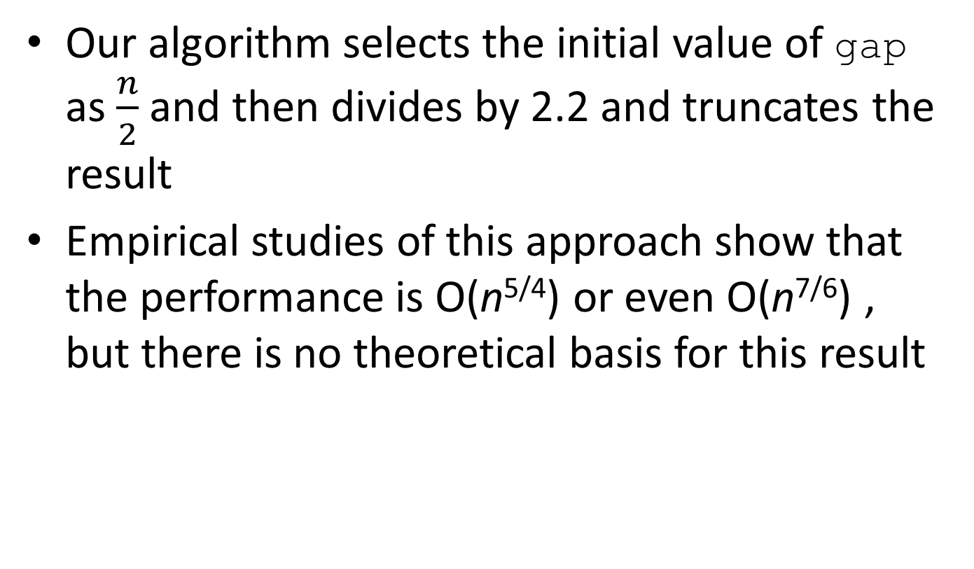
Analysis of Shell Sort (cont.)

Slide 232
Merge
A merge is a common data processing operation performed on two sequences of data with the following characteristics
Both sequences contain items with a common compareTo method
The objects in both sequences are ordered in accordance with this compareTo method
The result is a third sequence containing all the data from the first two sequences

Slide 233
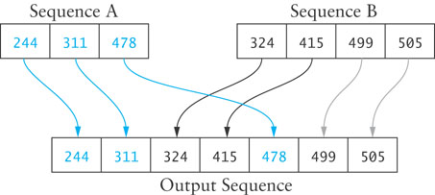
Merge Algorithm
Merge Algorithm
1. Access the first item from both sequences.
2. while not finished with either sequence
3. Compare the current items from the two sequences, copy the smaller
current item to the output sequence, and access the next item from the
input sequence whose item was copied.
4. Copy any remaining items from the first sequence to the output sequence.
5. Copy any remaining items from the second sequence to the output sequence.

Slide 234
Analysis of Merge
For two input sequences each containing n elements, each element needs to move from its input sequence to the output sequence
Merge time is O(n)
Space requirements
The array cannot be merged in place
Additional space usage is O(n)

Slide 235
Merge Sort
We can modify merging to sort a single, unsorted array
Split the array into two halves
Sort the left half
Sort the right half
Merge the two
This algorithm can be written with a recursive step

Slide 236
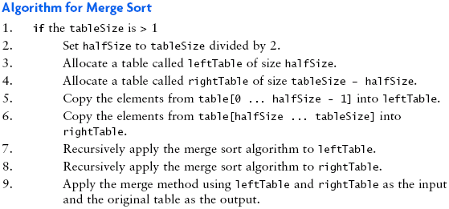
(recursive) Algorithm for Merge Sort

Slide 237
Trace of Merge Sort
50
60
45
30
90
20
80
15
50
60
45
30
90
20
80
15
50
60
45
30
90
20
80
15

Slide 238
Trace of Merge Sort (cont.)
50
60
45
30
90
20
80
15
50
60
45
30
90
20
80
15
50
60
45
30
50
60
45
30

Slide 239
Trace of Merge Sort (cont.)
50
60
45
30
90
20
80
15
50
60
45
30
90
20
80
15
50
60
45
30
50
60
50
60

Slide 240
Trace of Merge Sort (cont.)
50
60
45
30
90
20
80
15
50
60
45
30
90
20
80
15
50
60
45
30
50
60
60

Slide 241
Trace of Merge Sort (cont.)
50
60
45
30
90
20
80
15
50
60
45
30
90
20
80
15
50
60
45
30
45
30
45
30

Slide 242
Trace of Merge Sort (cont.)
50
60
45
30
90
20
80
15
50
60
45
30
90
20
80
15
50
60
30
45
30
45
45
30
45

Slide 243
Trace of Merge Sort (cont.)
50
60
45
30
90
20
80
15
30
50
45
60
50
45
60
30
90
20
80
15
50
60
30
45
30
45
45
30

Slide 244
Trace of Merge Sort (cont.)
50
60
45
30
90
20
80
15
30
50
45
60
50
45
60
30
90
20
80
15
90
20
80
15

Slide 245
Trace of Merge Sort (cont.)
50
60
45
30
90
20
80
15
30
50
45
60
50
45
60
30
90
20
80
15
90
20
80
15
90
20

Slide 246
Trace of Merge Sort (cont.)
50
60
45
30
90
20
80
15
30
50
45
60
50
45
60
30
90
20
80
15
90
20
20
90
80
15
90
20

Slide 247
Trace of Merge Sort (cont.)
50
60
45
30
90
20
80
15
30
50
45
60
50
45
60
30
90
20
80
15
20
90
80
15
80
15

Slide 248
Trace of Merge Sort (cont.)
50
60
45
30
90
20
80
15
30
50
45
60
50
45
60
30
90
20
80
15
20
90
80
15
80
15
80
15

Slide 249
Trace of Merge Sort (cont.)
50
60
45
30
90
20
80
15
30
50
45
60
50
45
60
30
90
15
20
20
80
80
15
90
20
90
15
80

Slide 250
Trace of Merge Sort (cont.)
50
15
60
20
45
30
30
45
90
50
20
60
80
80
15
90
30
50
45
60
50
45
60
30
90
15
20
20
85
80
15
90

Slide 251
Analysis of Merge Sort
Each backward step requires a movement of n elements from smaller-size arrays to larger arrays; the effort is O(n)
The number of steps which require merging is log n because each recursive call splits the array in half
The total effort to reconstruct the sorted array through merging is O(n log n)

Slide 252
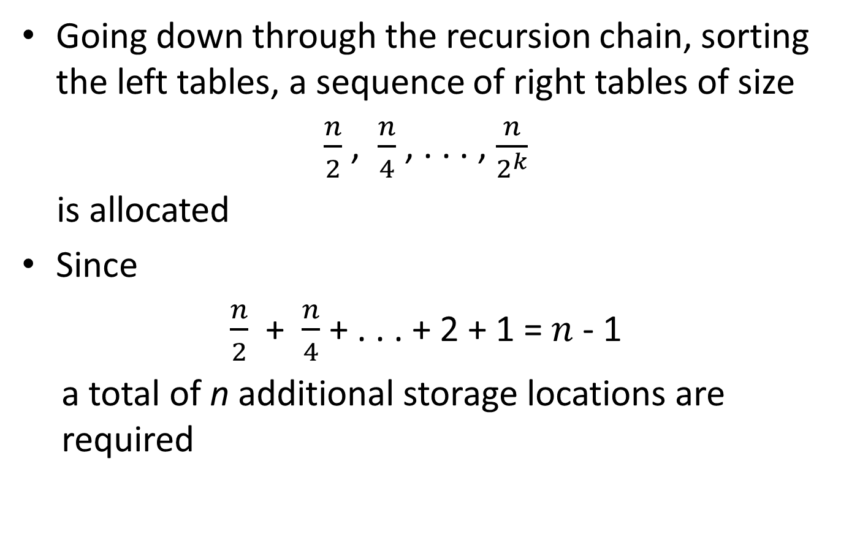
Analysis of Merge Sort (cont.)

Slide 253
Heapsort
Merge sort time is O(n log n) but still requires, temporarily, n extra storage locations
Heapsort does not require any additional storage
As its name implies, heapsort uses a heap to store the array

Slide 254
First Version of a Heapsort Algorithm
When used as a priority queue, a heap maintains a smallest value at the top
The following algorithm
places an array's data into a heap,
then removes each heap item (O(n log n)) and moves it back into the array
This version of the algorithm requires n extra storage locations
Heapsort Algorithm: First Version
1. Insert each value from the array to be sorted into a priority queue (heap).
2. Set i to 0
3. while the priority queue is not empty
4. Remove an item from the queue and insert it back into the array at position i
5. Increment i

Slide 255
Revising the Heapsort Algorithm
In heaps we've used so far, each parent node value was not greater than the values of its children
We can build a heap so that each parent node value is not less than its children
Then,
move the top item to the bottom of the heap
reheap, ignoring the item moved to the bottom

Slide 256
Trace of Heapsort
89
76
74
37
32
39
66
20
26
18
28
29
6

Slide 257
Trace of Heapsort (cont.)
89
76
74
37
32
39
66
20
26
18
28
29
6

Slide 258
Trace of Heapsort (cont.)
89
76
74
37
32
39
66
20
26
18
28
29
6

Slide 259
Trace of Heapsort (cont.)
6
76
74
37
32
39
66
20
26
18
28
29
89

Slide 260
Trace of Heapsort (cont.)
76
6
74
37
32
39
66
20
26
18
28
29
89

Slide 261
Trace of Heapsort (cont.)
76
37
74
6
32
39
66
20
26
18
28
29
89

Slide 262
Trace of Heapsort (cont.)
76
37
74
26
32
39
66
20
6
18
28
29
89

Slide 263
Trace of Heapsort (cont.)
76
37
74
26
32
39
66
20
6
18
28
29
89

Slide 264
Trace of Heapsort (cont.)
76
37
74
26
32
39
66
20
6
18
28
29
89

Slide 265
Trace of Heapsort (cont.)
76
37
74
26
32
39
66
20
6
18
28
29
89

Slide 266
Trace of Heapsort (cont.)
29
37
74
26
32
39
66
20
6
18
28
76
89

Slide 267
Trace of Heapsort (cont.)
74
37
29
26
32
39
66
20
6
18
28
76
89

Slide 268
Trace of Heapsort (cont.)
74
37
66
26
32
39
29
20
6
18
28
76
89

Slide 269
Trace of Heapsort (cont.)
74
37
66
26
32
39
29
20
6
18
28
76
89

Slide 270
Trace of Heapsort (cont.)
74
37
66
26
32
39
29
20
6
18
28
76
89

Slide 271
Trace of Heapsort (cont.)
74
37
66
26
32
39
29
20
6
18
28
76
89

Slide 272
Trace of Heapsort (cont.)
28
37
66
26
32
39
29
20
6
18
74
76
89

Slide 273
Trace of Heapsort (cont.)
66
37
28
26
32
39
29
20
6
18
74
76
89

Slide 274
Trace of Heapsort (cont.)
66
37
39
26
32
28
29
20
6
18
74
76
89

Slide 275
Trace of Heapsort (cont.)
66
37
39
26
32
28
29
20
6
18
74
76
89

Slide 276
Trace of Heapsort (cont.)
66
37
39
26
32
28
29
20
6
18
74
76
89

Slide 277
Trace of Heapsort (cont.)
66
37
39
26
32
28
29
20
6
18
74
76
89

Slide 278
Trace of Heapsort (cont.)
18
37
39
26
32
28
29
20
6
66
74
76
89

Slide 279
Trace of Heapsort (cont.)
39
37
18
26
32
28
29
20
6
66
74
76
89

Slide 280
Trace of Heapsort (cont.)
39
37
29
26
32
28
18
20
6
66
74
76
89

Slide 281
Trace of Heapsort (cont.)
39
37
29
26
32
28
18
20
6
66
74
76
89

Slide 282
Trace of Heapsort (cont.)
39
37
29
26
32
28
18
20
6
66
74
76
89

Slide 283
Trace of Heapsort (cont.)
39
37
29
26
32
28
18
20
6
66
74
76
89

Slide 284
Trace of Heapsort (cont.)
6
37
29
26
32
28
18
20
39
66
74
76
89

Slide 285
Trace of Heapsort (cont.)
37
6
29
26
32
28
18
20
39
66
74
76
89

Slide 286
Trace of Heapsort (cont.)
37
32
29
26
6
28
18
20
39
66
74
76
89

Slide 287
Trace of Heapsort (cont.)
37
32
29
26
6
28
18
20
39
66
74
76
89

Slide 288
Trace of Heapsort (cont.)
37
32
29
26
6
28
18
20
39
66
74
76
89

Slide 289
Trace of Heapsort (cont.)
37
32
29
26
6
28
18
20
39
66
74
76
89

Slide 290
Trace of Heapsort (cont.)
20
32
29
26
6
28
18
37
39
66
74
76
89

Slide 291
Trace of Heapsort (cont.)
32
20
29
26
6
28
18
37
39
66
74
76
89

Slide 292
Trace of Heapsort (cont.)
32
26
29
20
6
28
18
37
39
66
74
76
89

Slide 293
Trace of Heapsort (cont.)
32
26
29
20
6
28
18
37
39
66
74
76
89

Slide 294
Trace of Heapsort (cont.)
32
26
29
20
6
28
18
37
39
66
74
76
89

Slide 295
Trace of Heapsort (cont.)
32
26
29
20
6
28
18
37
39
66
74
76
89

Slide 296
Trace of Heapsort (cont.)
18
26
29
20
6
28
32
37
39
66
74
76
89

Slide 297
Trace of Heapsort (cont.)
29
26
18
20
6
28
32
37
39
66
74
76
89

Slide 298
Trace of Heapsort (cont.)
29
26
28
20
6
18
32
37
39
66
74
76
89

Slide 299
Trace of Heapsort (cont.)
29
26
28
20
6
18
32
37
39
66
74
76
89

Slide 300
Trace of Heapsort (cont.)
29
26
28
20
6
18
32
37
39
66
74
76
89

Slide 301
Trace of Heapsort (cont.)
29
26
28
20
6
18
32
37
39
66
74
76
89

Slide 302
Trace of Heapsort (cont.)
18
26
28
20
6
29
32
37
39
66
74
76
89

Slide 303
Trace of Heapsort (cont.)
28
26
18
20
6
29
32
37
39
66
74
76
89

Slide 304
Trace of Heapsort (cont.)
28
26
18
20
6
29
32
37
39
66
74
76
89

Slide 305
Trace of Heapsort (cont.)
28
26
18
20
6
29
32
37
39
66
74
76
89

Slide 306
Trace of Heapsort (cont.)
28
26
18
20
6
29
32
37
39
66
74
76
89

Slide 307
Trace of Heapsort (cont.)
6
26
18
20
28
29
32
37
39
66
74
76
89

Slide 308
Trace of Heapsort (cont.)
26
6
18
20
28
29
32
37
39
66
74
76
89

Slide 309
Trace of Heapsort (cont.)
26
20
18
6
28
29
32
37
39
66
74
76
89

Slide 310
Trace of Heapsort (cont.)
26
20
18
6
28
29
32
37
39
66
74
76
89

Slide 311
Trace of Heapsort (cont.)
26
20
18
6
28
29
32
37
39
66
74
76
89

Slide 312
Trace of Heapsort (cont.)
26
20
18
6
28
29
32
37
39
66
74
76
89

Slide 313
Trace of Heapsort (cont.)
6
20
18
26
28
29
32
37
39
66
74
76
89

Slide 314
Trace of Heapsort (cont.)
20
6
18
26
28
29
32
37
39
66
74
76
89

Slide 315
Trace of Heapsort (cont.)
20
6
18
26
28
29
32
37
39
66
74
76
89

Slide 316
Trace of Heapsort (cont.)
20
6
18
26
28
29
32
37
39
66
74
76
89

Slide 317
Trace of Heapsort (cont.)
20
6
18
26
28
29
32
37
39
66
74
76
89

Slide 318
Trace of Heapsort (cont.)
18
6
20
26
28
29
32
37
39
66
74
76
89

Slide 319
Trace of Heapsort (cont.)
18
6
20
26
28
29
32
37
39
66
74
76
89

Slide 320
Trace of Heapsort (cont.)
18
6
20
26
28
29
32
37
39
66
74
76
89

Slide 321
Trace of Heapsort (cont.)
18
6
20
26
28
29
32
37
39
66
74
76
89

Slide 322
Trace of Heapsort (cont.)
6
18
20
26
28
29
32
37
39
66
74
76
89

Slide 323
Trace of Heapsort (cont.)
6
18
20
26
28
29
32
37
39
66
74
76
89

Slide 324
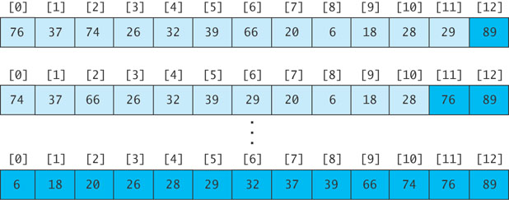
Revising the Heapsort Algorithm
If we implement the heap as an array
each element removed will be placed at the end of the array, and
the heap part of the array decreases by one element

Slide 325
Algorithm for In-Place Heapsort
Algorithm for In-Place Heapsort
1. Build a heap by rearranging the elements in an unsorted array
2. while the heap is not empty
3. Remove the first item from the heap by swapping it with the last item in the heap and restoring the heap property

Slide 326
Algorithm to Build a Heap
Start with an array table of length table.length
Consider the first item to be a heap of one item
Next, consider the general case where the items in array table from 0 through n-1 form a heap and the items from n through table.length – 1 are not in the heap

Slide 327
Algorithm to Build a Heap (cont.)
Refinement of Step 1 for In-Place Heapsort
1.1 while n is less than table.length
1.2 Increment n by 1. This inserts a new item into the heap
1.3 Restore the heap property

Slide 328
Analysis of Heapsort
Because a heap is a complete binary tree, it has log n levels
Building a heap of size n requires finding the correct location for an item in a heap with log n levels
Each insert (or remove) is O(log n)
With n items, building a heap is O(n log n)
No extra storage is needed

Slide 329
Quicksort
Developed in 1962
Quicksort selects a specific value called a pivot and rearranges the array into two parts (called partioning)
all the elements in the left subarray are less than or equal to the pivot
all the elements in the right subarray are larger than the pivot
The pivot is placed between the two subarrays
The process is repeated until the array is sorted

Slide 330
Trace of Quicksort
44
75
23
43
55
12
64
77
33

Slide 331
Trace of Quicksort (cont.)
44
75
23
43
55
12
64
77
33
Arbitrarily select the first element as the pivot

Slide 332
Trace of Quicksort (cont.)
55
75
23
43
44
12
64
77
33
Swap the pivot with the element in the middle

Slide 333
Trace of Quicksort (cont.)
55
75
23
43
44
12
64
77
33
Partition the elements so that all values less than or equal to the pivot are to the left, and all values greater than the pivot are to the right

Slide 334
Trace of Quicksort (cont.)
12
33
23
43
44
55
64
77
75
Partition the elements so that all values less than or equal to the pivot are to the left, and all values greater than the pivot are to the right

Slide 335
Quicksort Example(cont.)
44 is now in its correct position
12
33
23
43
44
55
64
77
75

Slide 336
Trace of Quicksort (cont.)
12
33
23
43
44
55
64
77
75
Now apply quicksort recursively to the two subarrays

Slide 337
Trace of Quicksort (cont.)
Pivot value = 12
12
33
23
43
44
55
64
77
75

Slide 338
Trace of Quicksort (cont.)
Pivot value = 12
12
33
23
43
44
55
64
77
75

Slide 339
Trace of Quicksort (cont.)
Pivot value = 33
12
33
23
43
44
55
64
77
75

Slide 340
Trace of Quicksort (cont.)
Pivot value = 33
12
23
33
43
44
55
64
77
75

Slide 341
Trace of Quicksort (cont.)
Pivot value = 33
12
23
33
43
44
55
64
77
75

Slide 342
Trace of Quicksort (cont.)
Pivot value = 33
12
23
33
43
44
55
64
77
75
Left and right subarrays have single values; they are sorted

Slide 343
Trace of Quicksort (cont.)
Pivot value = 33
12
23
33
43
44
55
64
77
75
Left and right subarrays have single values; they are sorted

Slide 344
Trace of Quicksort (cont.)
Pivot value = 55
12
23
33
43
44
55
64
77
75

Slide 345
Trace of Quicksort (cont.)
Pivot value = 64
12
23
33
43
44
55
64
77
75

Slide 346
Trace of Quicksort (cont.)
Pivot value = 77
12
23
33
43
44
55
64
77
75

Slide 347
Trace of Quicksort (cont.)
Pivot value = 77
12
23
33
43
44
55
64
75
77

Slide 348
Trace of Quicksort (cont.)
Pivot value = 77
12
23
33
43
44
55
64
75
77

Slide 349
Trace of Quicksort (cont.)
12
23
33
43
44
55
64
75
77
Left subarray has single value; it is sorted

Slide 350
Trace of Quicksort (cont.)
12
23
33
43
44
55
64
75
77

Slide 351
Algorithm for Quicksort
We describe how to do the partitioning later
The indexes first and last are the end points of the array being sorted
The index of the pivot after partitioning is pivIndex
Algorithm for Quicksort
1. if first < last then
2. Partition the elements in the subarray first . . . last so that the pivot value is in its correct place (subscript pivIndex)
3. Recursively apply quicksort to the subarray first . . . pivIndex - 1
4. Recursively apply quicksort to the subarray pivIndex + 1 . . . last

Slide 352
Analysis of Quicksort
If the pivot value is a random value selected from the current subarray,
then statistically half of the items in the subarray will be less than the pivot and half will be greater
If both subarrays have the same number of elements (best case), there will be log n levels of recursion
At each recursion level, the partitioning process involves moving every element to its correct position—n moves
Quicksort is O(n log n), just like merge sort

Slide 353
Analysis of Quicksort (cont.)
The array split may not be the best case, i.e. 50-50
An exact analysis is difficult (and beyond the scope of this class), but, the running time will be bounded by a constant x n log n

Slide 354
Analysis of Quicksort (cont.)
A quicksort will give very poor behavior if, each time the array is partitioned, a subarray is empty.
In that case, the sort will be O(n²)
Under these circumstances, the overhead of recursive calls and the extra run-time stack storage required by these calls makes this version of quicksort a poor performer relative to the quadratic sorts
We’ll discuss a solution later

Slide 355
Algorithm for Partitioning
44
75
23
43
55
12
64
77
33
If the array is randomly ordered, it does not matter which element is the pivot.
For simplicity we pick the element with subscript first

Slide 356
Trace of Partitioning (cont.)
44
75
23
43
55
12
64
77
33
If the array is randomly ordered, it does not matter which element is the pivot.
For simplicity we pick the element with subscript first

Slide 357
Trace of Partitioning (cont.)
44
75
23
43
55
12
64
77
33
For visualization purposes, items less than or equal to the pivot will be colored blue; items greater than the pivot will be colored light purple

Slide 358
Trace of Partitioning (cont.)
44
75
23
43
55
12
64
77
33
For visualization purposes, items less than or equal to the pivot will be colored blue; items greater than the pivot will be colored light purple

Slide 359
Trace of Partitioning (cont.)
44
75
23
43
55
12
64
77
33
Search for the first value at the left end of the array that is greater than the pivot value

Slide 360
Trace of Partitioning (cont.)
up
44
75
23
43
55
12
64
77
33
Search for the first value at the left end of the array that is greater than the pivot value

Slide 361
Trace of Partitioning (cont.)
up
44
75
23
43
55
12
64
77
33
Then search for the first value at the right end of the array that is less than or equal to the pivot value

Slide 362
Trace of Partitioning (cont.)
up
down
44
75
23
43
55
12
64
77
33
Then search for the first value at the right end of the array that is less than or equal to the pivot value

Slide 363
Trace of Partitioning (cont.)
up
down
44
75
23
43
55
12
64
77
33
Exchange these values

Slide 364
Trace of Partitioning (cont.)
44
33
23
43
55
12
64
77
75
Exchange these values

Slide 365
Trace of Partitioning (cont.)
44
33
23
43
55
12
64
77
75
Repeat

Slide 366
Trace of Partitioning (cont.)
up
44
33
23
43
55
12
64
77
75
Find first value at left end greater than pivot

Slide 367
Trace of Partitioning (cont.)
up
down
44
33
23
43
55
12
64
77
75
Find first value at right end less than or equal to pivot

Slide 368
Trace of Partitioning (cont.)
44
33
23
43
12
55
64
77
75
Exchange

Slide 369
Trace of Partitioning (cont.)
44
33
23
43
12
55
64
77
75
Repeat

Slide 370
Trace of Partitioning (cont.)
up
44
33
23
43
12
55
64
77
75
Find first element at left end greater than pivot

Slide 371
Trace of Partitioning (cont.)
down
up
44
33
23
43
12
55
64
77
75
Find first element at right end less than or equal to pivot

Slide 372
Trace of Partitioning (cont.)
down
up
44
33
23
43
12
55
64
77
75
Since down has "passed" up, do not exchange

Slide 373
Trace of Partitioning (cont.)
down
up
44
33
23
43
12
55
64
77
75
Exchange the pivot value with the value at down

Slide 374
Trace of Partitioning (cont.)
down
12
33
23
43
44
55
64
77
75
Exchange the pivot value with the value at down

Slide 375
Trace of Partitioning (cont.)
down
12
33
23
43
44
55
64
77
75
The pivot value is in the correct position; return the value of down and assign it to the pivot index pivIndex

Slide 376
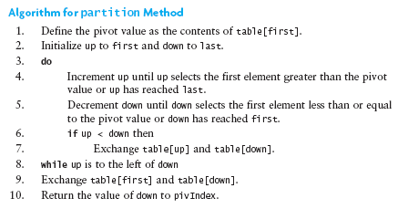
Algorithm for Partitioning

Slide 377
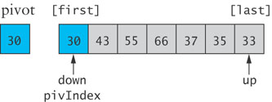
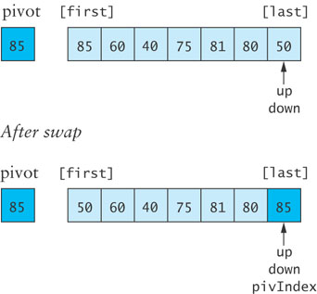
Code for partition when Pivot is the largest or smallest value

Slide 378
Revised Partition Algorithm
Quicksort is O(n²) when each split yields one empty subarray, which is the case when the array is presorted
A better solution is to pick the pivot value in a way that is less likely to lead to a bad split
Use three references: first, middle, last
Select the median of the these items as the pivot

Slide 379
Trace of Revised Partitioning
44
75
23
43
55
12
64
77
33

Slide 380
Trace of Revised Partitioning (cont.)
first
middle
last
44
75
23
43
55
12
64
77
33

Slide 381
Trace of Revised Partitioning (cont.)
first
middle
last
44
75
23
43
55
12
64
77
33
Sort these values

Slide 382
Trace of Revised Partitioning (cont.)
first
middle
last
33
75
23
43
44
12
64
77
55
Sort these values

Slide 383
Trace of Revised Partitioning (cont.)
first
middle
last
33
75
23
43
44
12
64
77
55
Exchange middle with first

Slide 384
Trace of Revised Partitioning (cont.)
first
middle
last
44
75
23
43
33
12
64
77
55
Exchange middle with first

Slide 385
Trace of Revised Partitioning (cont.)
44
75
23
43
33
12
64
77
55
Run the partition algorithm using the first element as the pivot

Slide 386
Algorithm for Revised partition Method
Algorithm for Revised partition Method
1. Sort table[first], table[middle], and table[last]
2. Move the median value to table[first] (the pivot value) by exchanging table[first] and table[middle].
3. Initialize up to first and down to last
4. do
5. Increment up until up selects the first element greater than the pivot value or up has reached last
6. Decrement down until down selects the first element less than or equal to the pivot value or down has reached first
7. if up < down then
8. Exchange table[up] and table[down]
9. while up is to the left of down
10. Exchange table[first] and table[down]
11. Return the value of down to pivIndex

Slide 387
Testing the Sort Algorithms
Use a variety of test cases
small and large arrays
arrays in random order
arrays that are already sorted
arrays with duplicate values
Compare performance on each type of array

Slide 388
The Dutch National Flag Problem
A variety of partitioning algorithms for quicksort have been published
A popular variation uses a single left-to-right scan of the array
Edsger W. Dijkstra developed a partitioning algorithm using both techniques to partition an array into three segments

Slide 389
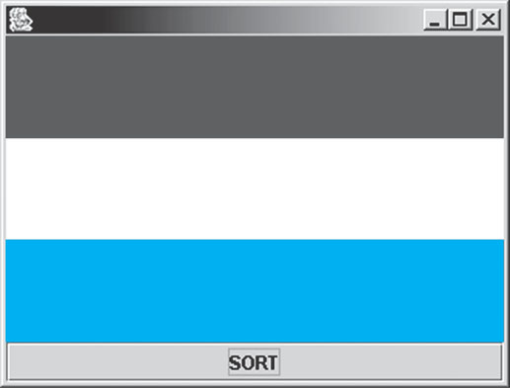
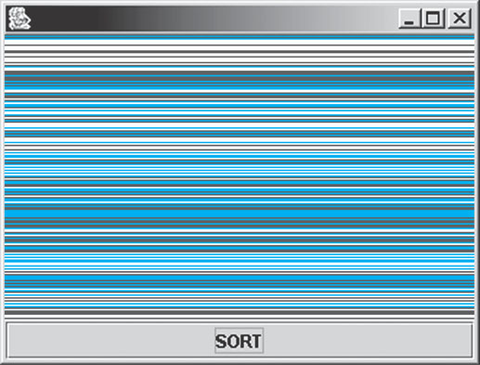
Problem
Partition a disordered three-color flag into the appropriate three segments by writing software for an unscrambling machine

Slide 390
Analysis
The unscrambling machine can
look at one thread in the flag and determine its color
swap the position of two threads in the flag
execute while loops and if statements

Slide 391
Design – Loop Invariant
As with quicksort, values between first and up are less than or equal to the pivot
Values between down and last are greater than the pivot
Values between up and down are unknown
Initially,
The unknown region is the entire array (first == up and down == last)

Slide 392
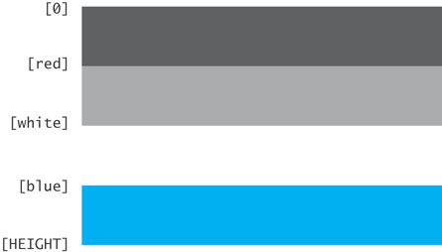
Design
Have four regions:
Red (light gray)
white
blue
unknown (dark gray)
Flag is complete:
if 0 <= i < red then threads[i] is red
if white < i <= blue then threads[i] is white
if blue < i < HEIGHT then threads[i] is blue
If red <= i <= white then the flag is not complete and the color is unknown

Slide 393
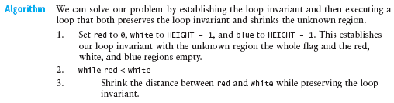
Algorithm

Slide 394
Preserving the Loop Invariant
Assume we know the value of threads[white]
either leave it where it is (in the white region if it is white) or
place it in the region where it belongs

Slide 395
Preserving the Loop Invariant
Three cases
The color of threads[white] is white
Decrement the value of white, increasing the size of the white region by one thread
The color of threads[white] is red
The color of threads[red] is unknown
Swap the thread at threads[red] with the thread at threads[white], adding the thread to the end of the red region and reducing the size of the unknown region by one thread
The color of threads[white] is blue
The color of threads[blue] is white
Swap the thread at threads[white] with the thread at threads[blue]
Decrement both blue and white, inserting the thread at the beginning of the blue region and reducing the size of the unknown region by one thread

Slide 396
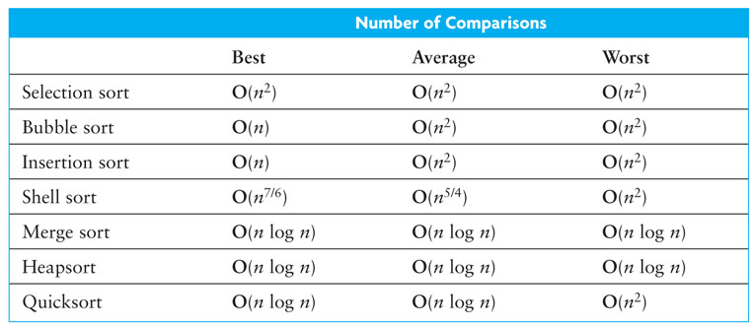
Sort Review

