Slide 1
Methods for Generating Hash Codes
In most applications, a key will consist of strings of letters or digits (such as a social security number, an email address, or a partial ID) rather than a single character
The number of possible key values is much larger than the table size
Generating good hash codes typically is an experimental process
The goal is a random distribution of values
Simple algorithms sometimes generate lots of collisions

Slide 2
Java HashCode Method
For strings, simply summing the int values of all characters returns the same hash code for "sign" and "sing"
The Java API algorithm accounts for position of the characters as well
String.hashCode() returns the integer calculated by the formula:
s₀ x 31^{(n-1)} + s₁ x 31^{(n-2)} + … + s_{n-1}
where s_{i} is the ith character of the string, and n is the length of the string
“Cat” has a hash code of:
‘C’ x 31² + ‘a’ x 31 + ‘t’ = 67,510
31 is a prime number, and prime numbers generate relatively few collisions

Slide 3
Java HashCode Method (cont.)
Because there are too many possible strings, the integer value returned by String.hashCode can't be unique
However, because the String.hashCode method distributes the hash code values fairly evenly throughout the range, the probability of two strings having the same hash code is low
The probability of a collision with
s.hashCode() % table.length
is proportional to how full the table is

Slide 4
Methods for Generating Hash Codes (cont.)
A good hash function should be relatively simple and efficient to compute
It doesn't make sense to use an O(n) hash function to avoid doing an O(n) search

Slide 5
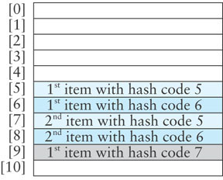
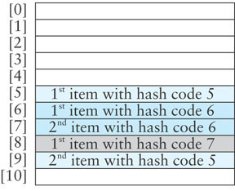
Reducing Collisions Using Quadratic Probing
Linear probing tends to form clusters of keys in the hash table, causing longer search chains
Quadratic probing can reduce the effect of clustering
  Increments form a quadratic series (1 + 2² + 3² + ...)
  probeNum++;
  index = (startIndex + probeNum * probeNum) % table.length
If an item has a hash code of 5, successive values of index will be 6 (5+1), 9 (5+4), 14 (5+9), . . .

Slide 6
Problems with Quadratic Probing
The disadvantage of quadratic probing is that the next index calculation is time-consuming, involving multiplication, addition, and modulo division
A more efficient way to calculate the next index is:
      k += 2;
      index = (index + k) % table.length;

Slide 7
Problems with Quadratic Probing (cont.)
Examples:
  If the initial value of k is -1, successive values of k will be 1, 3, 5, …
  If the initial value of index is 5, successive value of index will be 6 (= 5 + 1), 9 (= 5 + 1 + 3), 14 (= 5 + 1 + 3 + 5), …
The proof of the equality of these two calculation methods is based on the mathematical series:
n² = 1 + 3 + 5 + ... + 2n - 1

Slide 8
Problems with Quadratic Probing (cont.)
A more serious problem is that not all table elements are examined when looking for an insertion index; this may mean that
  an item can't be inserted even when the table is not full
  the program will get stuck in an infinite loop searching for an empty slot
If the table size is a prime number and it is never more than half full, this won't happen
However, requiring a half empty table wastes a lot of memory

Slide 9
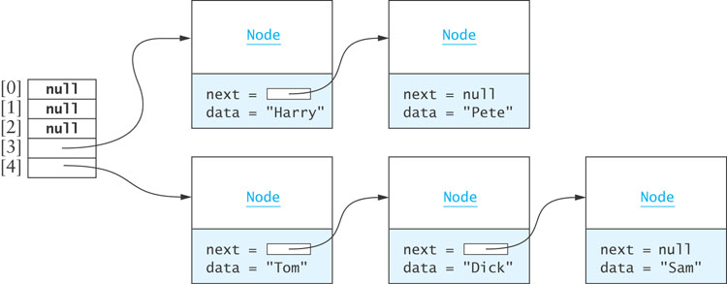
Chaining
Chaining is an alternative to open addressing
Each table element references a linked list that contains all of the items that hash to the same table index
  The linked list often is called a bucket
  The approach sometimes is called bucket hashing

Slide 10
Chaining (cont.)
Advantages relative to open addressing:
  Only items that have the same value for their hash codes are examined when looking for an object
  You can store more elements in the table than the number of table slots (indices)
  Once you determine an item is not present, you can insert it at the beginning or end of the list
  To remove an item, you simply delete it; you do not need to replace it with a dummy item or mark it as deleted

Slide 11
Performance of Hash Tables
Load factor is the number of filled cells divided by the table size
Load factor has the greatest effect on hash table performance
The lower the load factor, the better the performance as there is a smaller chance of collision when a table is sparsely populated
If there are no collisions, performance for search and retrieval is O(1) regardless of table size

Slide 12
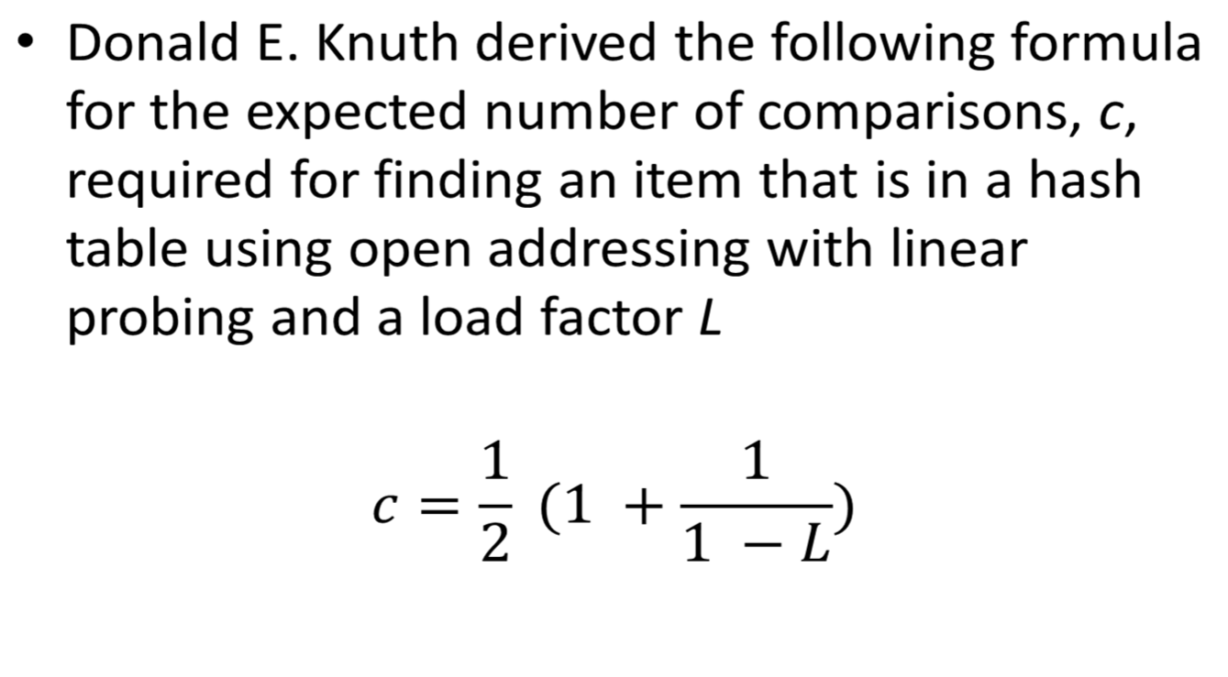
Performance of Open Addressing versus Chaining

Slide 13

Performance of Open Addressing versus Chaining (cont.)
Using chaining, if an item is in the table, on average we must examine the table element corresponding to the item’s hash code and then half of the items in each list
c = 1 +
where L is the average number of items in a list (the number of items divided by the table size)

Slide 14
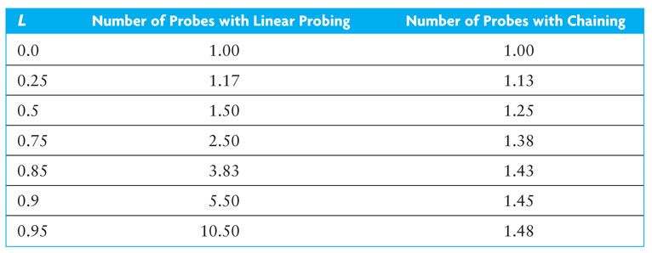
Performance of Open Addressing versus Chaining (cont.)

Slide 15
Performance of Hash Tables versus Sorted Array and Binary Search Tree
The number of comparisons required for a binary search of a sorted array is O(log n)
  A sorted array of size 128 requires up to 7 probes (2⁷ is 128) which is more than for a hash table of any size that is 90% full
  A binary search tree performs similarly
Insertion or removal
hash table | O(1) expected; worst case O(n)
unsorted array | O(n)
binary search tree | O(log n); worst case O(n)

Slide 16
Storage Requirements for Hash Tables, Sorted Arrays, and Trees
The performance of hashing is superior to that of binary search of an array or a binary search tree, particularly if the load factor is less than 0.75
However, the lower the load factor, the more empty storage cells
  there are no empty cells in a sorted array
A binary search tree requires three references per node (item, left subtree, right subtree), so more storage is required for a binary search tree than for a hash table with load factor 0.75

Slide 17
Storage Requirements for Open Addressing and Chaining
For open addressing, the number of references to items (key-value pairs) is n (the size of the table)
For chaining , the average number of nodes in a list is L (the load factor) and n is the number of table elements
  Using the Java API LinkedList, there will be three references in each node (item, next, previous)
  Using our own single linked list, we can reduce the references to two by eliminating the previous-element reference
  Therefore, storage for n + 2L references is needed

Slide 18
Storage Requirements for Open Addressing and Chaining (cont.)
Example:
  Assume open addressing, 60,000 items in the hash table, and a load factor of 0.75
  This requires a table of size 80,000 and results in an expected number of comparisons of 2.5
  Calculating the table size n to get similar performance using chaining
  2.5 = 1 + L/2
  5.0 = 2 + L
  3.0 = 60,000/n
  n = 20,000

Slide 19
Storage Requirements for Open Addressing and Chaining (cont.)
  A hash table of size 20,000 provides storage space for 20,000 references to lists
  There are 60,000 nodes in the table (one for each item)
  This requires storage for 140,000 references (2 x 60,000 + 20,000), which is 175% of the storage needed for open addressing

Slide 20
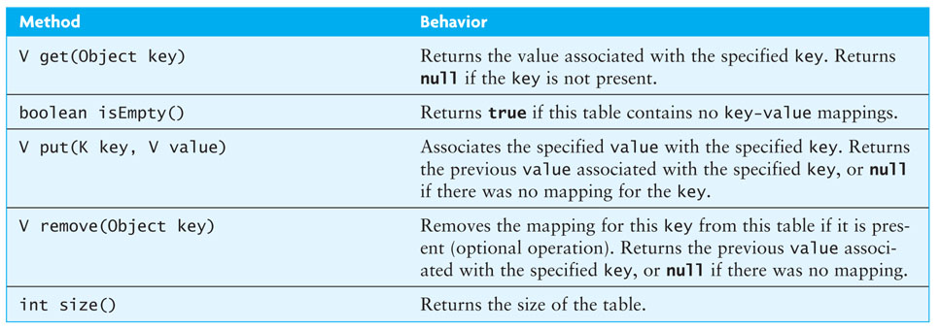
Interface KWHashMap

Slide 21
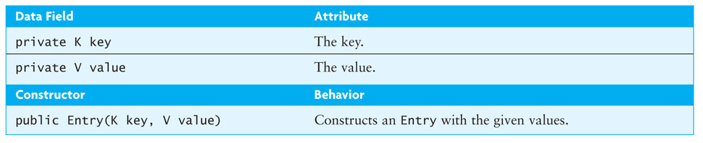
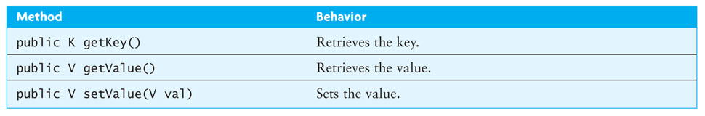
Class Entry

Slide 22
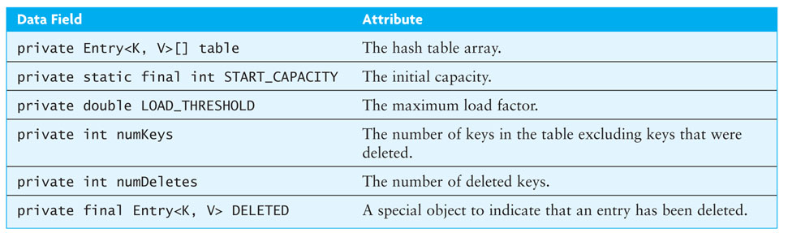
Class HashTableOpen
/** Hash table implementation using open addressing. */
public class HashtableOpen<K, V> implements KWHashMap<K, V> {
// Data Fields
private Entry<K, V>[] table;
private static final int START_CAPACITY = 101;
private double LOAD_THRESHOLD = 0.75;
private int numKeys;
private int numDeletes;
private final Entry<K, V> DELETED =
new Entry<K, V>(null, null);
// Constructor
public HashTableOpen() {
table = new Entry[START_CAPACITY];
}
// Insert inner class Entry<K, V> here.
. . .

Slide 23
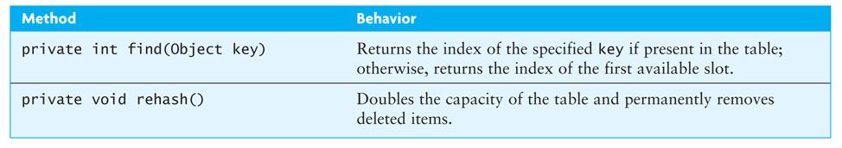
Class HashTableOpen (cont.)
Algorithm for HashtableOpen.find(Object key)
1. Set index to key.hashCode() % table.length.
2. if index is negative, add table.length.
3. while table[index] is not empty and the key is not at table[index]
4. increment index.
5. if index is greater than or equal to table.length
6. Set index to 0.
7. Return the index.

Slide 24
Class HashTableOpen (cont.)
Algorithm for get(Object key)
1. Find the first table element that is empty or the table element that contains the key.
2. if the table element found contains the key
return the value at this table element.
3. else
4. return null.

Slide 25
Class HashTableOpen (cont.)
Algorithm for HashtableOpen.put(K key, V value)
1. Find the first table element that is empty or the table element that contains
the key.
2. if an empty element was found
3. insert the new item and increment numKeys.
4. check for need to rehash.
5. return null.
6. The key was found. Replace the value associated with this table element and
return the old value.

Slide 26
Class HashTableOpen (cont.)
Algorithm for remove(Object key)
1. Find the first table element that is empty or the table element that contains
the key.
2. if an empty element was found
3. return null.
4. Key was found. Remove this table element by setting it to reference DELETED,
increment numDeletes, and decrement numKeys.
5. Return the value associated with this key.

Slide 27
Class HashTableOpen (cont.)
Algorithm for HashtableOpen.rehash
1. Allocate a new hash table that is at least double the size and has an odd length.
2. Reset the number of keys and number of deletions to 0.
3. Reinsert each table entry that has not been deleted in the new hash table.

Slide 28
Class HashTableChain (cont.)
Algorithm for HashtableChain.get(Object key)
1. Set index to key.hashCode() % table.length.
2. if index is negative
3. add table.length.
4. if table[index] is null
5. key is not in the table; return null.
6. For each element in the list at table[index]
7. if that element’s key matches the search key
8. return that element’s value.
9. key is not in the table; return null.

Slide 29
Class HashTableChain (cont.)
Algorithm for HashtableChain.put(K key, V value)
1. Set index to key.hashCode() % table.length.
2. if index is negative, add table.length.
3. if table[index] is null
4. create a new linked list at table[index].
5. Search the list at table[index] to find the key.
6. if the search is successful
7. replace the value associated with this key.
8. return the old value.
9. else
10. insert the new key-value pair in the linked list located at table[index].
11. increment numKeys.
12. if the load factor exceeds the LOAD_THRESHOLD
13. Rehash.
14. return null.

Slide 30
Class HashTableChain (cont.)
Algorithm for HashtableChain.remove(Object key)
1. Set index to key.hashCode() % table.length.
2. if index is negative, add table.length.
3. if table[index] is null
4. key is not in the table; return null.
5. Search the list at table[index] to find the key.
6. if the search is successful
7. remove the entry with this key and decrement numKeys.
8. if the list at table[index] is empty
9. Set table[index] to null.
10. return the value associated with this key.
11. The key is not in the table; return null.

Slide 31
Testing the Hash Table Implementation
Write a method to
  create a file of key-value pairs
  read each key-value pair and insert it in the hash table
  observe how the hash table is filled
Implementation
  Write a toString method that captures the index of each non-null table element and the contents of the table element
  For open addressing, the contents consists of the string representation of the key-value pair
  For chaining, a list iterator can traverse at the table element and append each key-value pair to the resulting string

Slide 32
Testing the Hash Table Implementation (cont.)
Cases to examine:
  Does the array index wrap around as it should?
  Are collisions resolved correctly?
  Are duplicate keys handled appropriately? Is the new value retrieved instead of the original value?
  Are deleted keys retained in the table but no longer accessible via a get?
  Does rehashing occur when the load factor reaches 0.75 (3.0 for chaining)?
Step through the get and put methods to
  observe how the table is probed
  examine the search chain followed to access or retrieve a key

Slide 33
Testing the Hash Table Implementation (cont.)
Alternatively, insert randomly generated integers in the hash table to create a large table with O(n) effort
for (int i = 0; i < SIZE; i++) {
Integer nextInt = (int) (32000 * Math.random());
hashTable.put(nextInt, nextInt):
}

Slide 34
Testing the Hash Table Implementation (cont.)
Insertion of randomly generated integers into a table allows testing of tables of very large sizes, but is less helpful for testing for collisions
You can add code to count the number of items probed each time an insertion is made—these can be totaled and divided by the number of insertions to determine the average search chain length
After all items are inserted, you can calculate the average length of each linked list and compare that with the number predicted by the formula discussed in section 7.3

Slide 35
Methods hashCode and equals
Class Object implements methods hashCode and equals, so every class can access these methods unless it overrides them
Object.equals compares two objects based on their addresses, not their contents
Most predefined classes override method equals and compare objects based on content
If you want to compare two objects (whose classes you've written) for equality of content, you need to override the equals method

Slide 36
Methods hashCode and equals (cont.)
Object.hashCode calculates an object’s hash code based on its address, not its contents
Most predefined classes also override method hashcode
Java recommends that if you override the equals method, then you should also override the hashCode method
Otherwise, you violate the following rule:
If obj1.equals(obj2) is true,
then obj1.hashCode() == obj2.hashCode()

Slide 37
Methods hashCode and equals (cont.)
Make sure your hashCode method uses the same data field(s) as your equals method

Slide 38
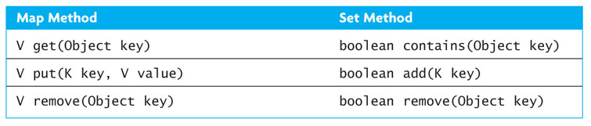
Implementing HashSetOpen

