Slide 1
Double-Linked Lists
Limitations of a singly-linked list include:
  Insertion at the front is O(1); insertion at other positions is O(n)
  Insertion is convenient only after a referenced node
  Removing a node requires a reference to the previous node
  We can traverse the list only in the forward direction
We can overcome these limitations:
  Add a reference in each node to the previous node, creating a double-linked list

Slide 2
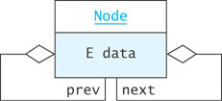
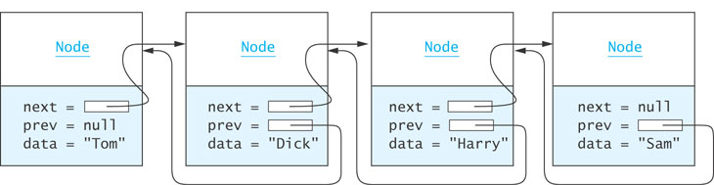
Double-Linked Lists (cont.)

Slide 3
Node Class
private static class Node<E> {
private E data;
private Node<E> next = null;
private Node<E> prev = null;
private Node(E dataItem) {
data = dataItem;
}
}

Slide 4
Inserting into a Double-Linked List
from predecessor
sam
Node
Node
next =
= prev
data = "Harry"
next = null
= prev
data = "Sam"
to predecessor
Node<E> sharon = new Node<E>("Sharon");
sharon.next = sam;
sharon.prev = sam.prev;
sam.prev.next = sharon;
sam.prev = sharon
sharon
Node
next =
= prev
data = "Sharon"

Slide 5
Removing from a Double-Linked List
harry
Node
Node
next =
= prev
data = "Dick"
next =
= prev
data = "Sharon"
Node
harry.prev.next = harry.next
harry.next.prev = harry.prev
next =
= prev
data = "Harry"

Slide 6

A Double-Linked List Class
So far we have worked only
with internal nodes
As with the single-linked class,
it is best to access the internal
nodes with a double-linked list
object
A double-linked list object has data fields:
  head (a reference to the first list Node)
  tail (a reference to the last list Node)
  size
Insertion at either end is O(1); insertion elsewhere is still O(n)

Slide 7
Circular Lists
Circular double-linked list:
  Link last node to the first node, and
  Link first node to the last node
We can also build singly-linked circular lists:
  Traverse in forward direction only
Advantages:
  Continue to traverse even after passing the first or last node
  Visit all elements from any starting point
  Never fall off the end of a list
Disadvantage: Code must avoid an infinite loop!

Slide 8
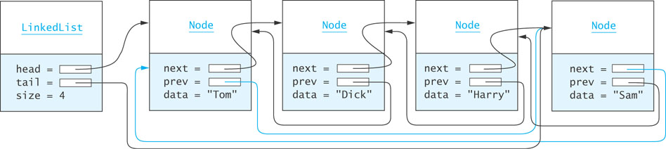
Circular Lists (cont.)

