Slide 1
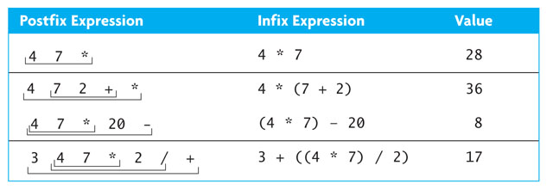
Additional Stack Applications
Postfix and infix notation
  Expressions normally are written in infix form, but
  it easier to evaluate an expression in postfix form since there is no need to group sub-expressions in parentheses or worry about operator precedence

Slide 2
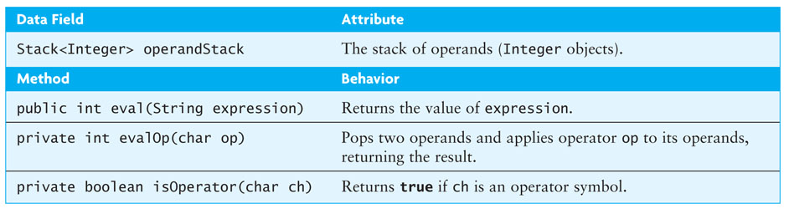
Evaluating Postfix Expressions
Write a class that evaluates a postfix expression
Use the space character as a delimiter between tokens

Slide 3
Evaluating Postfix Expressions (cont.)
4
4
7
*
20
-
4
1. create an empty stack of integers
2. while there are more tokens
3. get the next token
4. if the first character of the token is a digit
5. push the token on the stack
6. else if the token is an operator
7. pop the right operand off the stack
8. pop the left operand off the stack
9. evaluate the operation
10. push the result onto the stack
11. pop the stack and return the result

Slide 4
Evaluating Postfix Expressions (cont.)
4
4
7
7
*
20
-
4
7
4
1. create an empty stack of integers
2. while there are more tokens
3. get the next token
4. if the first character of the token is a digit
5. push the token on the stack
6. else if the token is an operator
7. pop the right operand off the stack
8. pop the left operand off the stack
9. evaluate the operation
10. push the result onto the stack
11. pop the stack and return the result

Slide 5
Evaluating Postfix Expressions (cont.)
4 * 7
4
4
7
7
*
20
-
7
4
1. create an empty stack of integers
2. while there are more tokens
3. get the next token
4. if the first character of the token is a digit
5. push the token on the stack
6. else if the token is an operator
7. pop the right operand off the stack
8. pop the left operand off the stack
9. evaluate the operation
10. push the result onto the stack
11. pop the stack and return the result

Slide 6
Evaluating Postfix Expressions (cont.)
28
4
4
7
7
*
20
-
28
1. create an empty stack of integers
2. while there are more tokens
3. get the next token
4. if the first character of the token is a digit
5. push the token on the stack
6. else if the token is an operator
7. pop the right operand off the stack
8. pop the left operand off the stack
9. evaluate the operation
10. push the result onto the stack
11. pop the stack and return the result

Slide 7
Evaluating Postfix Expressions (cont.)
4
4
7
7
*
20
20
-
28
20
28
1. create an empty stack of integers
2. while there are more tokens
3. get the next token
4. if the first character of the token is a digit
5. push the token on the stack
6. else if the token is an operator
7. pop the right operand off the stack
8. pop the left operand off the stack
9. evaluate the operation
10. push the result onto the stack
11. pop the stack and return the result

Slide 8
Evaluating Postfix Expressions (cont.)
28 - 20
4
4
7
7
*
20
-
20
28
1. create an empty stack of integers
2. while there are more tokens
3. get the next token
4. if the first character of the token is a digit
5. push the token on the stack
6. else if the token is an operator
7. pop the right operand off the stack
8. pop the left operand off the stack
9. evaluate the operation
10. push the result onto the stack
11. pop the stack and return the result

Slide 9
Evaluating Postfix Expressions (cont.)
8
4
4
7
7
*
20
-
8
1. create an empty stack of integers
2. while there are more tokens
3. get the next token
4. if the first character of the token is a digit
5. push the token on the stack
6. else if the token is an operator
7. pop the right operand off the stack
8. pop the left operand off the stack
9. evaluate the operation
10. push the result onto the stack
11. pop the stack and return the result

Slide 10
Evaluating Postfix Expressions (cont.)
4
4
7
7
*
20
-
8
1. create an empty stack of integers
2. while there are more tokens
3. get the next token
4. if the first character of the token is a digit
5. push the token on the stack
6. else if the token is an operator
7. pop the right operand off the stack
8. pop the left operand off the stack
9. evaluate the operation
10. push the result onto the stack
11. pop the stack and return the result

Slide 11
Evaluating Postfix Expressions (cont.)
Listing 3.6 (PostfixEvaluator.java, pages 173 - 175)

Slide 12
Evaluating Postfix Expressions (cont.)
Testing: write a driver which
  creates a PostfixEvaluator object
  reads one or more expressions and report the result
  catches PostfixEvaluator.SyntaxErrorException
  exercises each path by using each operator
  exercises each path through the method by trying different orderings and multiple occurrences of operators
  tests for syntax errors:
    an operator without any operands
    a single operand
    an extra operand
    an extra operator
    a variable name
    the empty string

Slide 13
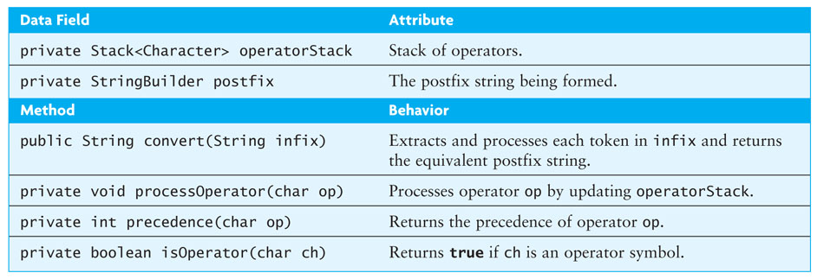
Converting from Infix to Postfix
Convert infix expressions to postfix expressions
Assume:
  expressions consists of only spaces, operands, and operators
  space is a delimiter character
  all operands that are identifiers begin with a letter or underscore
  all operands that are numbers begin with a digit

Slide 14
Converting from Infix to Postfix (cont.)
Example: convert
w – 5.1 / sum * 2
to its postfix form
w 5.1 sum / 2 * -

Slide 15
Converting from Infix to Postfix
Convert infix expressions to postfix expressions
Assume:
  expressions consists of only spaces, operands, and operators
  space is a delimiter character
  all operands that are identifiers begin with a letter or underscore
  all operands that are numbers begin with a digit

Slide 16
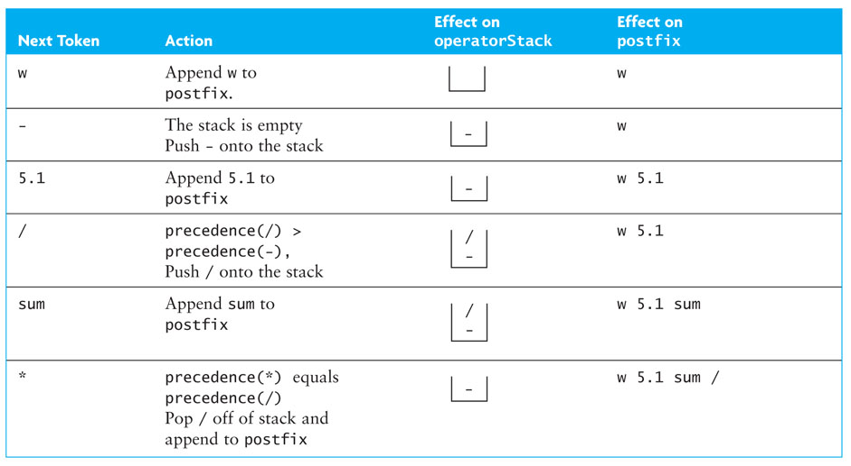
Converting from Infix to Postfix (cont.)

Slide 17
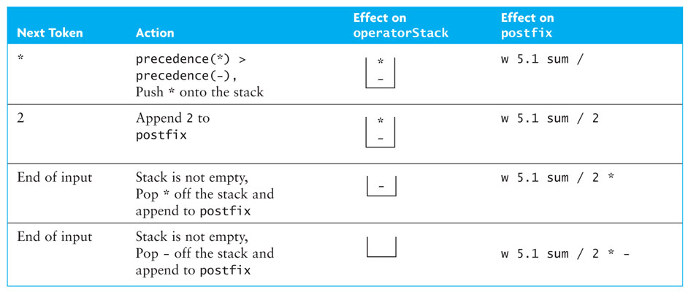
Converting from Infix to Postfix (cont.)

Slide 18
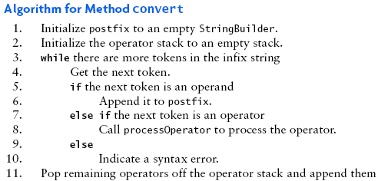
Converting from Infix to Postfix (cont.)

Slide 19
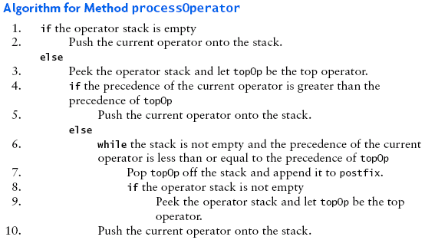
Converting from Infix to Postfix (cont.)

Slide 20
Converting from Infix to Postfix (cont.)
Listing 3.7 (InfixToPostfix.java, pages 181 - 183)

Slide 21
Converting from Infix to Postfix (cont.)
Testing
  Use enough test expressions to satisfy yourself that the conversions are correct for properly formed input expressions
  Use a driver to catch InfixToPostfix.SyntaxErrorException
Listing 3.8 (TestInfixToPostfix.java, page 184)

Slide 22
Converting Expressions with Parentheses
The ability to convert expressions with parentheses is an important (and necessary) addition
Modify processOperator to push each opening parenthesis onto the stack as soon as it is scanned
When a closing parenthesis is encountered, pop off operators until the opening parenthesis is encountered
Listing 3.9 (InfixToPostfixParens.java, pages 186 - 188)

