Slide 1



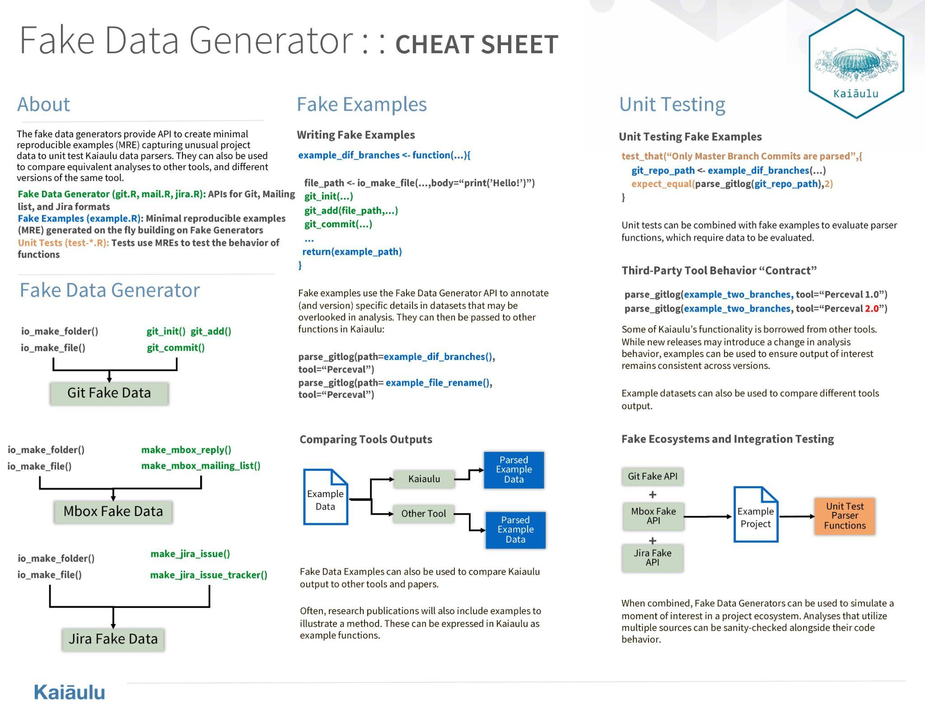

Fake Data Generators
ICS 496
Fall 2023
Ruben Jacobo, Waylon Ho
Project Sponsors: Carlos Paradis and Rick Kazman
https://github/sauluh/kaiaulu
Introduction
What is Kaiaulu?
Open Source Package designed to provide a means for analyzing a variety of software development stacks (git log, mailing list, issue trackers, source code, etc.) Kaiaulu API returns tables, which allows for simple data exploration and integration from various sources.
Methodology
Leveraged Agile methodologies to:
Streamline our software development process
Emphasize close collaboration
Adaptively plan out new implementation
Iterative delivery on deliverables
Technology Used
RStudio IDE and R Language
Testthat
Unit Testing Capabilities
Perceval
Third party data retrieval tool used in conjunction with parser functions
Solution
Tasks Accomplished
Challenges
Learnings
Developed and implemented specialized functions for generating fake data in three critical domains: Git, Mailbox, and Jira files.
Created realistic yet artificial datasets that mimic real-world scenarios for testing and validation purposes.
Enhanced the robustness of existing parser functions by subjecting them to a wide array of simulated real-world scenarios.
Implemented an architecture of Fake Data creation that allows for a.) On-the-fly data generation b.) Examples that capture edge situations in real world dataset and c.) their associated unit tests.
Crafted a succinct and visually intuitive one-page cheat sheet encapsulating key concepts and usage scenarios of the fake data generators.
Adapting to RStudio and the intricacies of the R language.
Delved into Kaiaulu's existing codebase, ensuring a comprehensive understanding before making impactful contributions.
Effectively communicating progress and challenges of weekly deliverables.
Mastered effective communication with our sponsor, translating requests seamlessly into code that aligns with their needs.
Recognized the critical role of communication with team members and the sponsor/client, pivotal for project success within the specified timeline.

