Slide 1



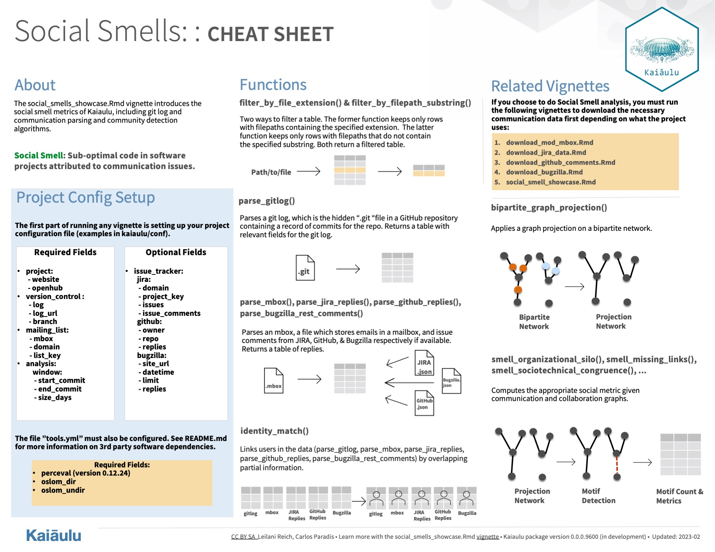
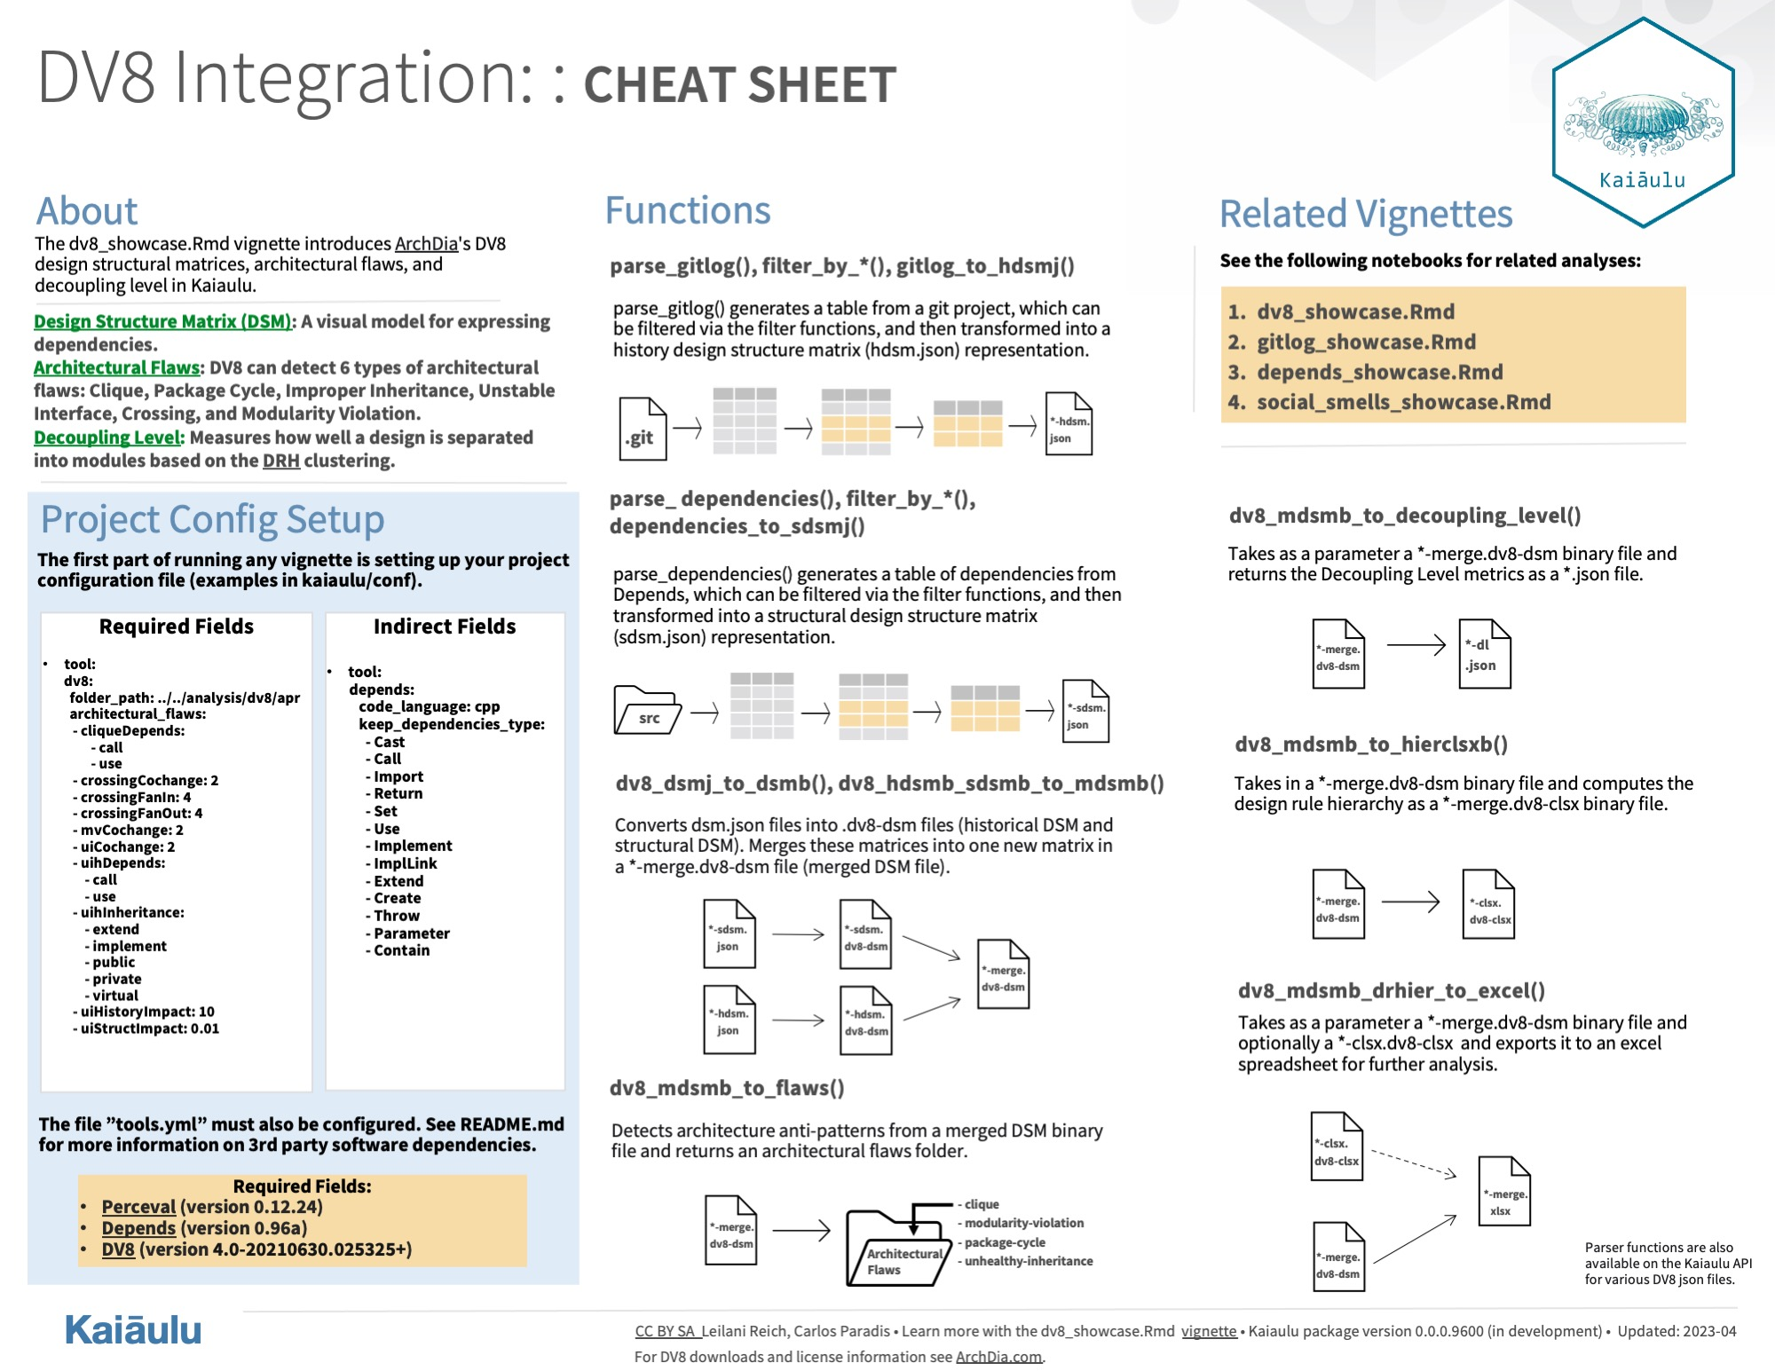

Socio-Architectural Analysis in Kaiaulu
Leilani Reich, Nicholas Lee, Malia Liu
Sponsor: Rick Kazman, Shidler College of Business
Stakeholder/Mentor: Carlos Paradis, Ph.D. in Computer Science
ICS 496 Capstone Project – Spring 2023
https://github.com/sailuh/kaiaulu
What is Kaiaulu?
Kaiaulu is an R package that helps with understanding evolving software development communities, and the artifacts (gitlog, mailing list, files, etc.) which developers collaborate and communicate with.
Tasks Accomplished
Documentation/Unit Testing
Improvements to the Kaiaulu documentation (social smells notebook, function documentation, and wiki)
Created Kaiaulu cheatsheet
Added unit tests (integrated into GitHub actions) to various Kaiaulu modules
Bugzilla Wrapper/Crawler
Bugzilla Wrapper (Perceval traditional & REST API backends)
Created downloader functions to call Perceval commands
Created parser functions to parse Bugzilla data
Bugzilla Crawler (REST API)
Created downloader functions to extract Bugzilla data directly from the REST API
Created parser functions to parse Bugzilla issues and comments data
DV8 Integration
Created wrapper functions to call DV8 commands
Created parser functions and new data representations not available in DV8 for new analysis
Defined functionality to export any type of Kaiaulu graph to JSON for interoperability with tools like DV8
Problem
Create reproducible mining software repositories pipeline
Expose assumptions to mitigate threats to validity in experimental design
Minimal path to data
Objectives
Improve Kaiaulu usability via cheatsheets
Better represent project communication network in mailing lists with inclusion of issue trackers like Bugzilla
Define an API for DV8 to enable reproducible pipelines, notebooks, and visualizations
Methodology
Project Management
Agile process
Github issues/pull requests/project board
Roles
Malia - Technical/Documentation
Nico - Technical/Testing
Leilani - Technical/Communications/Meeting Scribe/
Requirements
Challenges
Getting familiar with the project’s functions and documentation
All team members relatively unfamiliar with the R language
Moving away from Windows to Linux/OSX
Learnings
Becoming adaptable between different OS
How to be productive with the RStudio IDE
Professional version control management with Git
Software design analysis and flaws
Technologies Utilized
R Packages
jsonlite, data.table, httr
Retrieve, load, and read project data
testthat
Unit testing
Third Party Tools
Perceval
Retrieve project data from Bugzilla sites
DV8
Convert project data to design structure matrices
Conclusion
Performing project analysis on repositories and issue trackers like Bugzilla can aid in tracking project dynamics, while analysis through DV8 can reveal architectural flaws and potential code relation problems. By analyzing data and identifying patterns, project managers can make informed decisions, mitigate risks, and ultimately improve project performance. Therefore, these newly integrated analysis capabilities are a valuable addition to Kaiaulu.

