Slide 1
Kaiaulu Final Presentation
By: Ruben Jacobo, Waylon Ho

Slide 2
Table of contents
01
02
03
04
05
06
Introduction
Problem Statement
Major Accomplishments
Project Management and Delivery
Reflecting
Next Steps

Slide 3
01
Introduction

Slide 4


Kaiaulu Refresher
Open Source Package designed to provide a means for analyzing a variety of software development stacks (git log, mailing list, issue trackers, source code, etc.)
Kaiaulu API returns tables, which allows for simple data exploration and integration from various sources.
Project configuration files are used to store project-specific information for reproducibility.
Configuration files are decoupled from R Notebooks, allowing users to alter parameters and inspect output.

Slide 5
Problem Statement & Solution
Kaiaulu’s codebase has many different parts and functions
Not very “user-friendly”, requires familiarity with Kaiaulu to use efficiently
Old code is dependent on outdated software that could change
Technical Solution
Augment Kaiaulu to have more functionality, easier to understand code interface, improve overall usability of tool for future users
Refactor older code into more flexible functions for more customization and testing

Slide 6
Major Accomplishments
Experience Report + Git Fake Data
Implement git functions that allow us to customize fake git data
Jira and Mbox Fake Data generators
Jira and Mbox fake data generator functions and testing.
R Cheat Sheet
Created a one page documentation visual of all functions

Slide 7
Mbox Fake Data Generator
Objective: Develop fake data generation functions for mailbox analysis.
make_mbox:
Purpose: Compiles multiple replies into one mailbox.
Input: Accepts any number of replies generated by make_mbox_reply.
Output: A compiled mbox ready for analysis.
make_mbox_reply:
Purpose: Generates a single entry in the mailbox.
Input: Recipient information, Sender information, email body, time, etc
Output: A single reply entry for the mailbox in proper mbox format

Slide 8
Mbox Fake Data Continued
Example Data Creation:
Utilized the functions to create example data
Demonstrated the flexibility of the functions by customizing content and structure.
Unit Testing:
Implemented unit tests for the existing parse_mbox() function.
Ensured that parse_mbox() accurately processes the fake data generated by make_mbox.

Slide 9

Git Fake Data Generator
Finalized the fake data generator for Git infrastructure. This includes functions like git_init(), git_commit(), git_add() and more to fully encapsulate the functionality of a real git repository
Allows for full customization of git data that can be used for testing in the next steps
Used those functions to create example git repos and then tested their expected output using third party tools like perceval

Slide 10
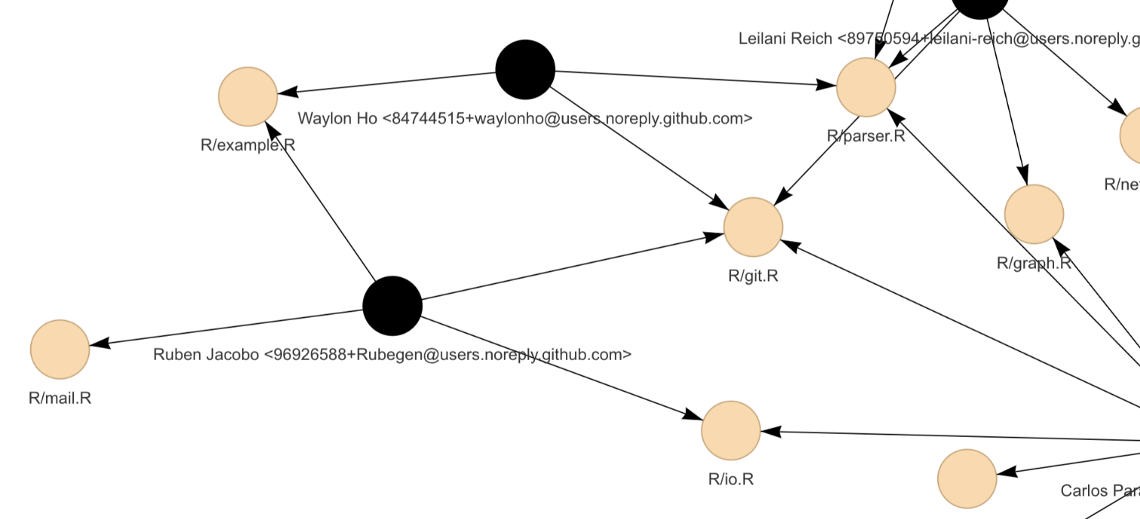
Files Changed
Example.R
TestParser.R
- Use git log functions we parameterized to create example data “scenarios” that would help us create our unit tests
Write our unit tests in TestParser.R
Create Unit tests that can test the output of an existing function- parse_gitlog() using our example fake data

Slide 11

Jira Fake Data Generator
Similar to Mbox functions, adapted to create JIRA issues and issue comments
Able to mimic realistic JIRA data from user customized fields
very useful for testing parse functions
tests indicate if changes to code lead to unexpected results
Modular function design includes create_base_info, create_ext_info, create_comments -> make_jira_issue, make_jira_issue_comments
Consolidates previous multi function generation into one single neat interface with clear parameters the user can understand
Contributes to larger goal of making Kaiaulu more flexible, user friendly, and continuable in the future (more parameters)

Slide 12
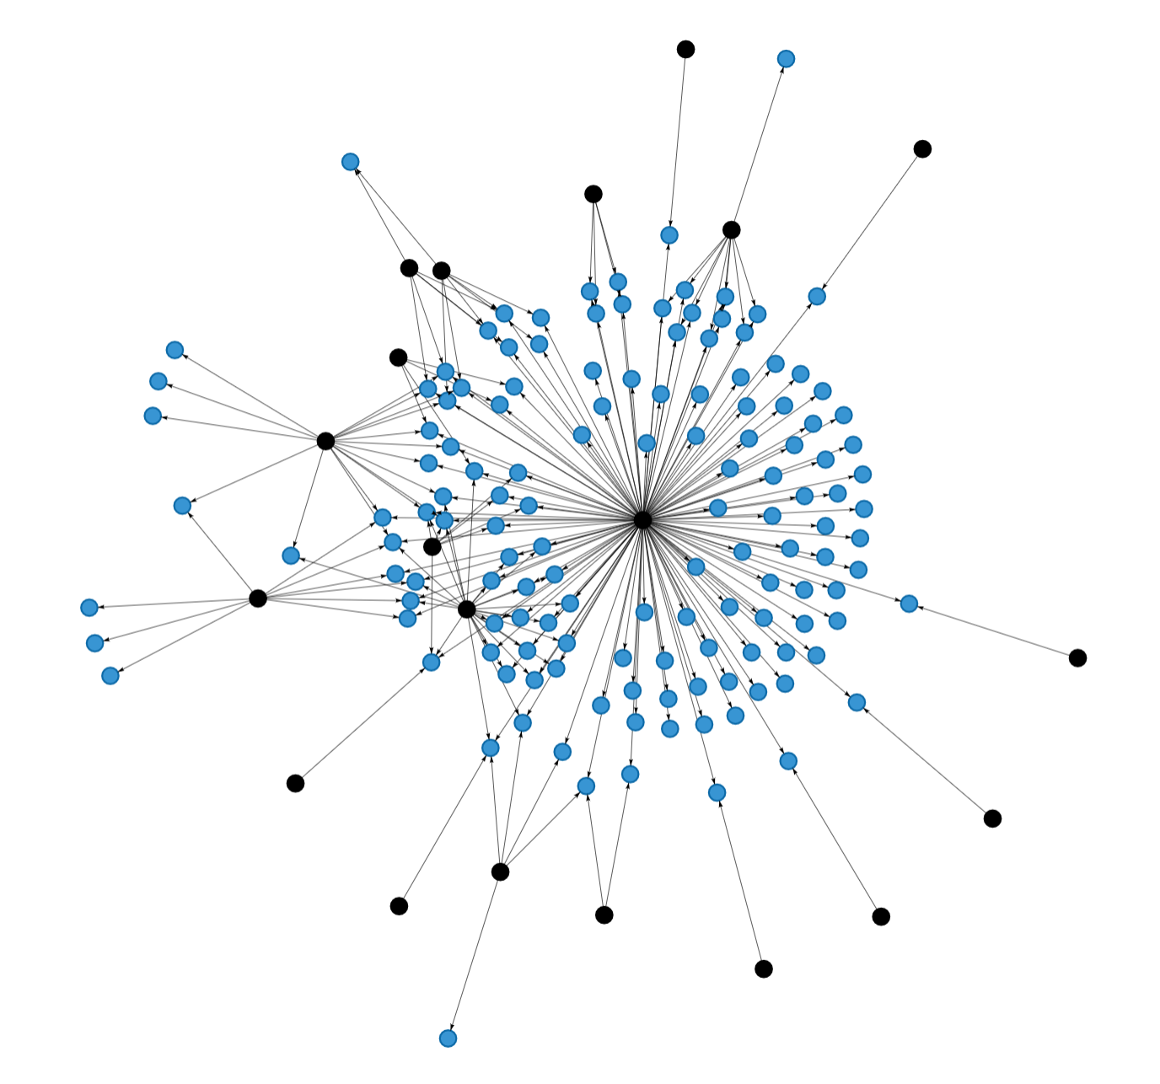
Project Management and Delivery
Sponsor created issues through github with an extensive explanation of the problem and we were given creative freedom to solve the problem.
We first laid out the groundwork of the code we planned to add, then received approval from Carlos to proceed with the coding process.
Found that committing code and getting regular feedback from our sponsor was the key to our success in Milestone 2.

Slide 13

Reflections
Milestone 2 went smoothly when we adapted to the codebase more and to RStudio and its capabilities.
Technical problems with installing third party software
Communication could have been improved
more concrete deadlines and frequent updates with our sponsor
constant updates and iterating back and forth achieved much more progress towards the end
Able to clarify effectively with our sponsor about the exact solution he wants of us.

Slide 14
06
Next Steps

Slide 15

Next Steps
Create more example data with our functions
Add more Unit testing to our Jira and Mbox fake data generator functions as well as the associated parser functions
Add more Fake data generators from different sources (ex: bugzilla issues)
Finalize cheat sheet and other documentation for future developers to continue improving Kaiaulu

Slide 16


Acknowledgements
We’d like to thank our sponsors:
Carlos Paradis and Rick Kazman
for the opportunity to contribute to Kaiaulu and for their guidance and patience throughout the semester.

Slide 17
Thank you!

Slide 18
Presentation Deliverables Here:
https://docs.google.com/document/d/1X6rIt4Wj-04mqMSyvDpYm49KelEMN4jVZky5_5q9oZE/edit
At a minimum, the presentation should contain the following.
Problem Statement
Technical Solution Overview
Major Accomplishments
Also, include requirements that were not implemented or partially implemented and the rationale behind missing/partial implementation
If the sponsor approves, include screenshots.
Include brief details about the technical implementation
Client feedback on delivered/implemented features/modules
Quality Assurance Metrics (Overall)
Defects reported, fixed, open, etc.
Project Management and Delivery
An overview of the software process the team followed
Reflections
What went right?
What went wrong?
What could have been done differently?
Includes technical and soft skills individuals in the team acquired or improved upon
Next Steps
What are the next steps for the client?
Acknowledgments

