Slide 1
Kaiaulu
Leilani, Nicholas, Malia

Slide 2

Problem Statement
What is Kaiaulu? Open source tool to mine software repositories to analyze their characteristics Composed of functions, notebooks, config files for notebooks Fun fact: Kaiaulu was created and currently maintained by PhD alumni in UH ICS dept Our Goal Extending capabilities of Kaiaulu to include design flaw detection Why? Software design analysis is hard Few tools available; they are standalone Help developers find social smell and architecture flaws and improve project efficiency

Slide 3

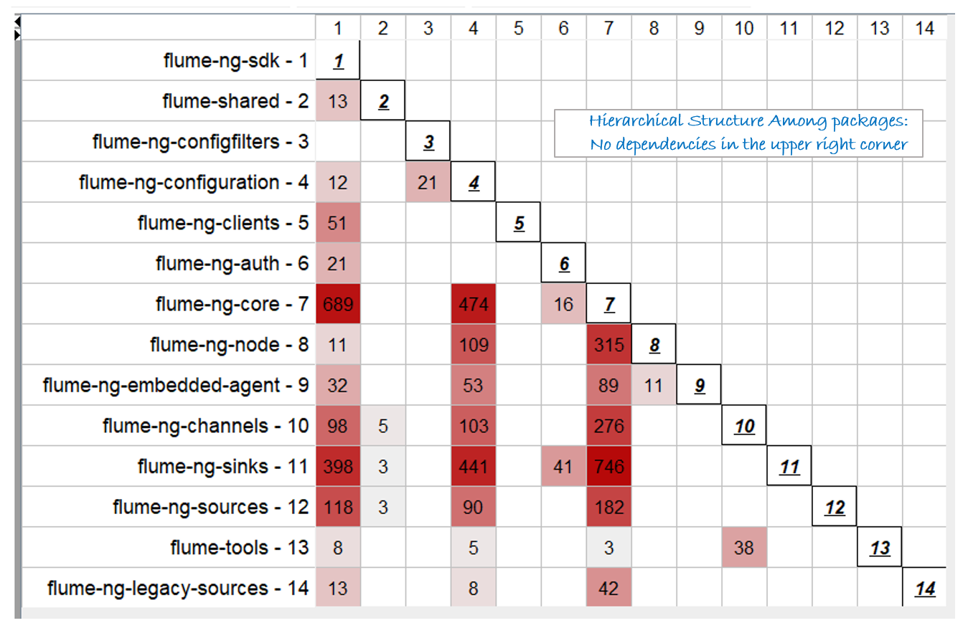
What is DV8?
Tool by ArchDia for detecting design flaws
Measures codebase quality/design
Facilitates project improvement
Types of flaws:
Clique
Modularity Violation
Package Cycle
Unhealthy Inheritance
Crossing
Unstable Interface
Notes:
Clique: a group of related files, forming a strongly connected "component".
Package Cycle: a group of packages that depend on each other in a cyclic relation.
Improper Inheritance: an inheritance hierarchy that violates the Liskov Substitution Principle. Another design flaw is unhealthy inheritance. File b is inheriting from a, but a depends on b. Parent depending on its child.
The following three anti-patterns can only be detected using both structural relation and co-change information:
Unstable Interface: file(s) that have many dependents and frequently change with these dependents.
Crossing: a file with both high fan-in and high fan-out and frequently changes with all of its relationships—the set of files that it depends on and the set of files that depend on it.
Modularity Violation: a group of files that do not have structural relationships but frequently change together.

Slide 4
Technical Solution Overview
Milestone 1:
Documentation/Unit Testing
Surrounds Social Smells notebook
Milestone 3:
DV8 Integration
Adding DV8 capabilities as Kaiaulu functions
Milestone 2:
Bugzilla Wrapper/Crawler
To download & parse bugzilla data
Notes:
So, at the end of this semester, we're basically wrapping up the tasks that we've broken down into these three milestones. For milestone 1, we've improved the documentation and added unit testing to Kaiaulu. In milestone 2, we were working on tasks such as adding a Bugzilla wrapper and a crawler function to download and parse project data. And finally, for milestone 3, we've integrated DV8 which was mentioned in the last slide, into Kaiaulu.

Slide 5
Technical Implementation
Bugzilla
Bugzilla wrapper (Perceval traditional & REST API backends)
Created wrapper functions to call Perceval commands with system2() function
Created parser functions to parse bugzilla data
Bugzilla crawler (REST API)
Created downloader function to download bugzilla data
Use httr package to create get request
Use jsonlite package to write the bugs to a file
Created two parser functions to parse bugzilla issue data and comment data
Loop over the given folder and use jsonlite package to get bugzilla data
Look for desired data and create data table
DV8
Created wrapper functions to call dv8 command with system2() function
Created parser functions and new data representations not available in DV8 for new analysis
Defined functionality to export any type of Kaiaulu graph to JSON for interoperability with tools like DV8
Notes:
We break the bugzilla into two section, one is bugzilla wrapper, another is bugzilla crawler. In bugzilla wrapper we created wrapper function to call perceval command to get project data from two backend; traditional and REST API backends. And created a parser function to shown these project data as data table. In bugzilla crawler, we created function to send GET request (which use httr package) to bugzilla site to get project data, and parse the project data to data table
For DV8, we also created wrapper function to call DV8 command and parser function and new data representation that are not available in DV8 for new analysis. Most importantly, defined functionality to export any type of Kaiaulu graph to JSON for [inter-oper-ability] with tools like DV8

Slide 6
Major Accomplishments
Milestone 3: Fine-grained DV8 Integration with Kaiaulu
Wrapper functions around DV8 commands
Functions providing interoperability with Kaiaulu
Revisiting Milestone 1 & 2:
Unit test revisions for parser, git, interval modules
Bugzilla wrapper & crawler revisions
Bugzilla showcase notebook
Partially/Not Implemented (for now):
DV8 milestone 3.4 functions
Bugzilla wrapper & crawler unit tests

Slide 7
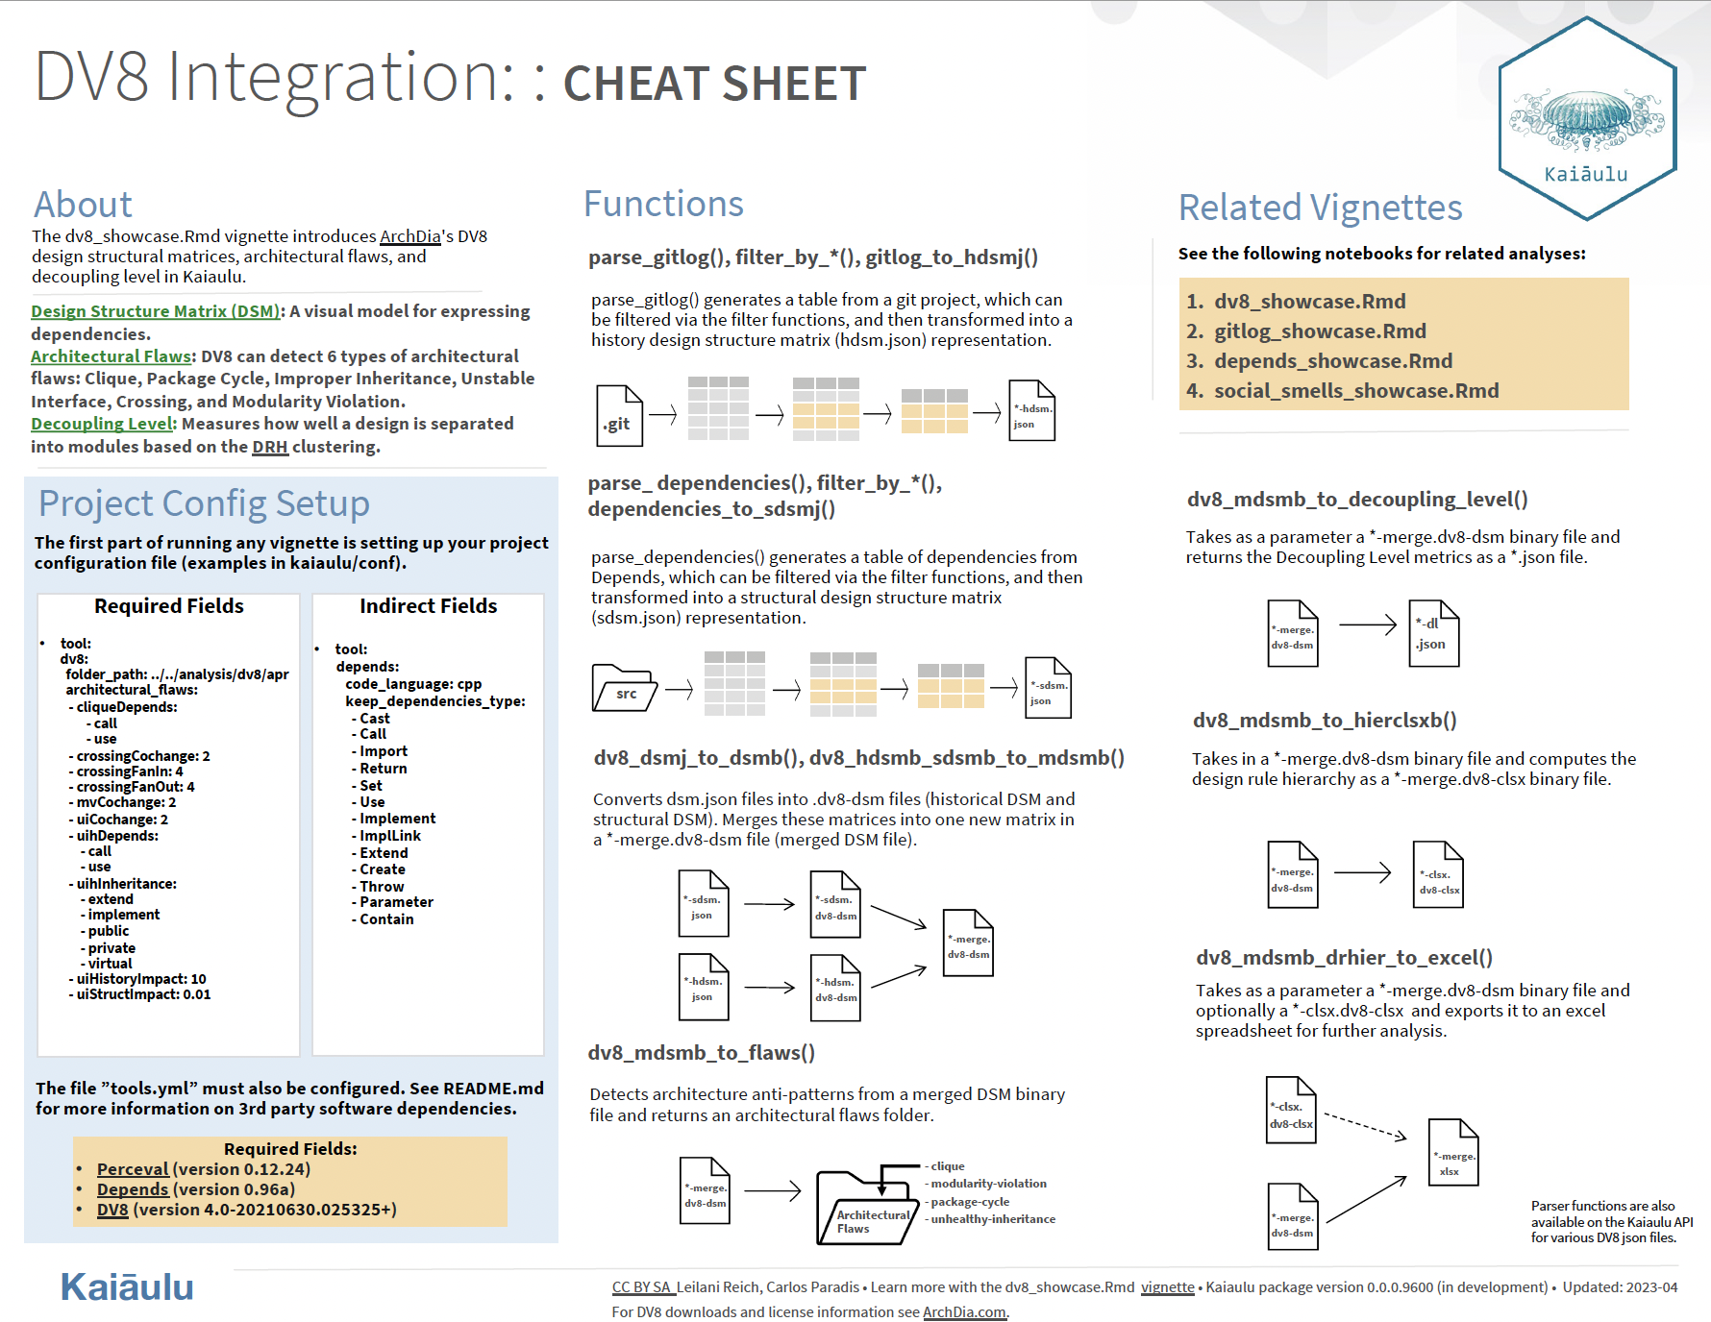

Slide 8
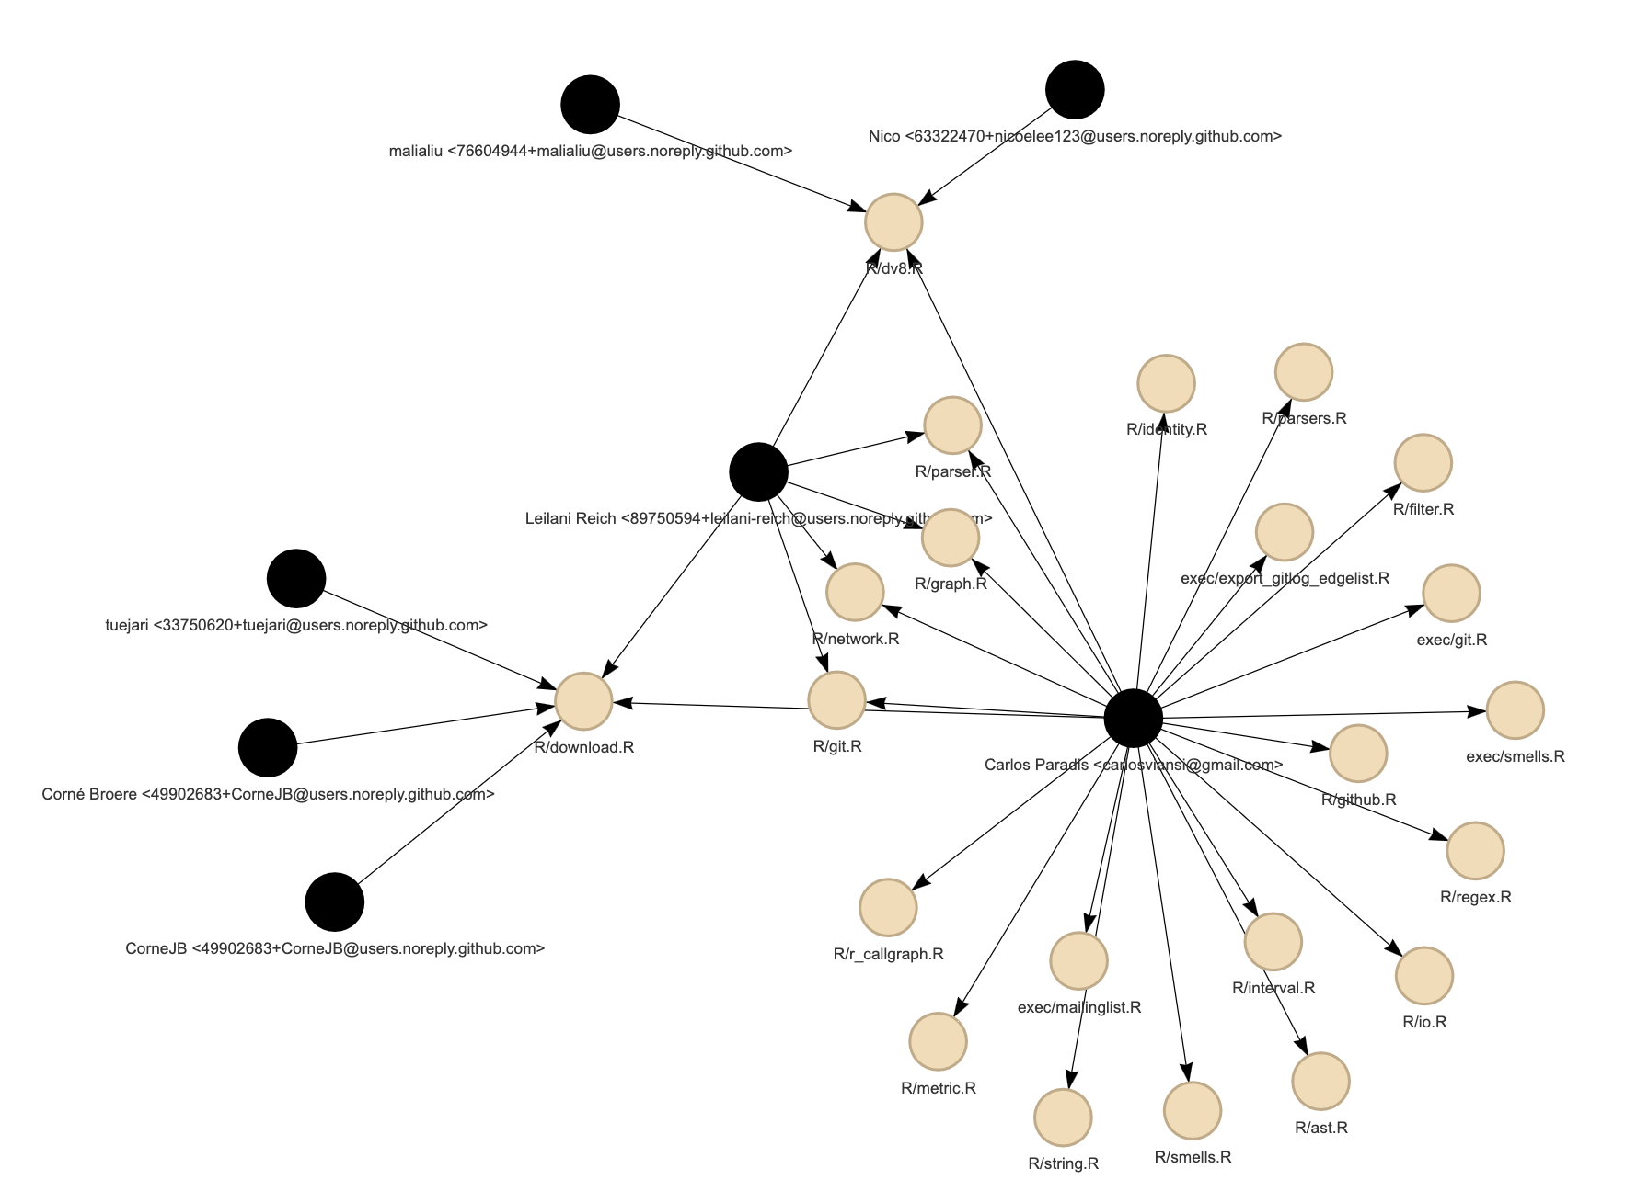
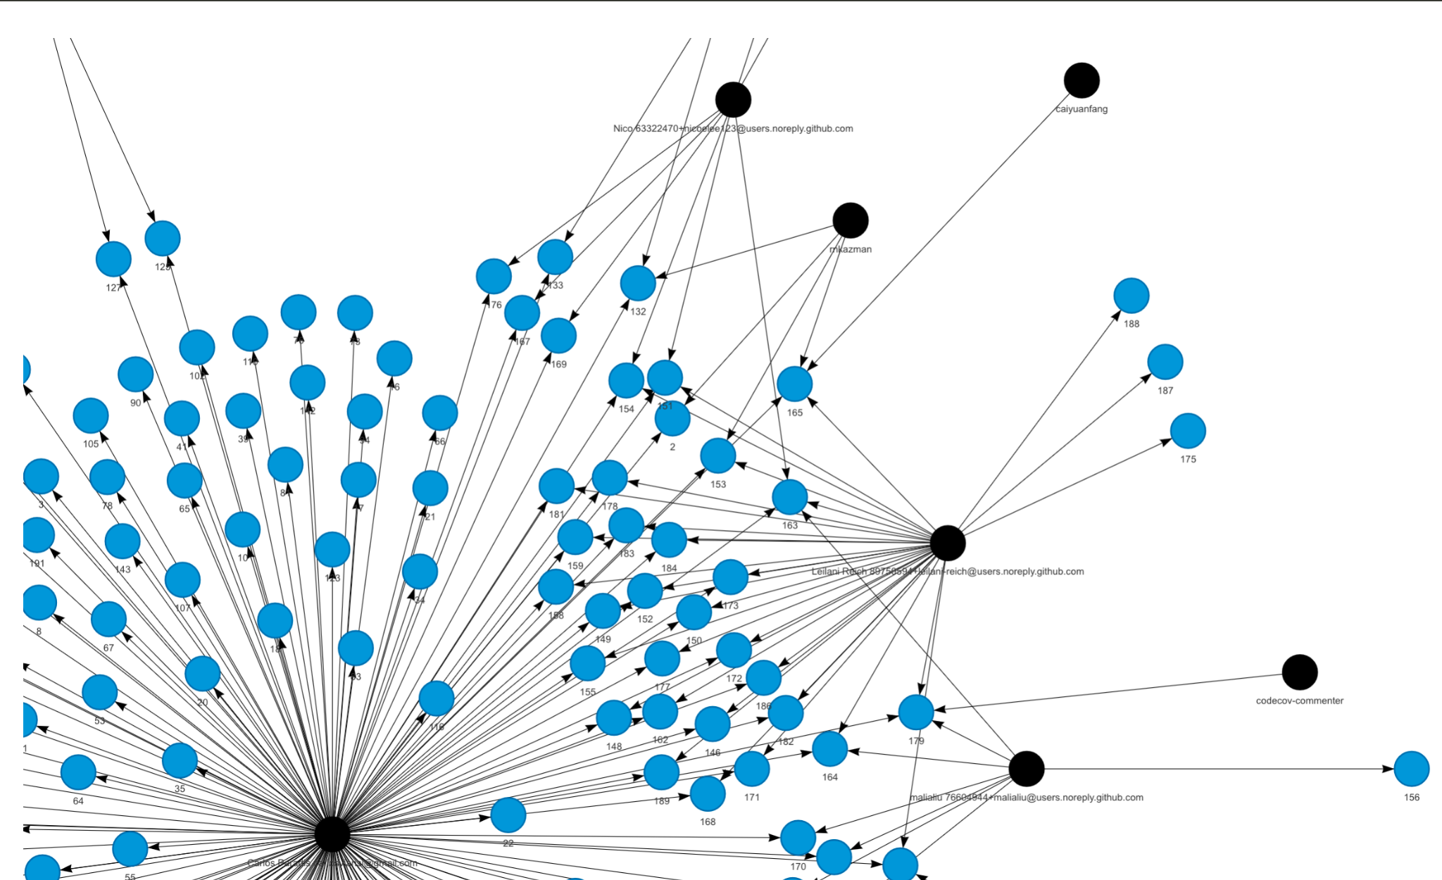
Client Feedback
Notes:
The graphs, created with the help of the DV8 tool we integrated into Kaiaulu, are showing our contributions over milestone 3 on the left and overall on the right. The black dots are contributors and the other colored nodes are files we were involved in.
Feedback:
The group succeeded, as the image shows, through the 3 milestones, to go in such a short time frame from users to effective contributors of Kaiaulu. The group's success extends beyond deliverables: The team was able to parallelize three milestones across, at times, tight schedules and multi-task effectively, leading to high-quality deliverables and strong communication. I am happy to see the UH ICS program's soon-to-be alumni hold high standards for their development practices

Slide 9

Quality Assurance
Unit testing
Testthat R package
Test inputs & outputs of functions
Enables users to figure out issues in their setup beforehand
Incorrect config file parameters
Wrong or missing package version
Enables contributors to not break code that already exists
End-To-End testing
Bugzilla Showcase Notebook
DV8 Showcase Notebook
Testing chained use of functions

Slide 10

Project Management and Delivery
Contributions:
Made publicly via GitHub Pull Request/Issue Tracker system
Unit tested on every commit/pull request
Task Management:
Github project board
Member task list under each issue
Milestone timeline
Communication:
Github Issues
Github pull requests
Weekly meetings
Tuesdays: 9:30-10:30am
Thursdays: 10:30-11:45am
Notes:
So, as you've seen, we contribute to our project via GitHub Pull Request and use it as an issue tracker system to manage our tasks and timeline. We've created milestones and checkboxes on our issues, and our stakeholders provide guidance by putting comments on our pull requests and GitHub issues. Plus, we have meetings every Tuesday from 9:30 to 10:30 am with sponsor and stakeholder and every Thursday from 10:30 to 11:45 am as our team meeting

Slide 11
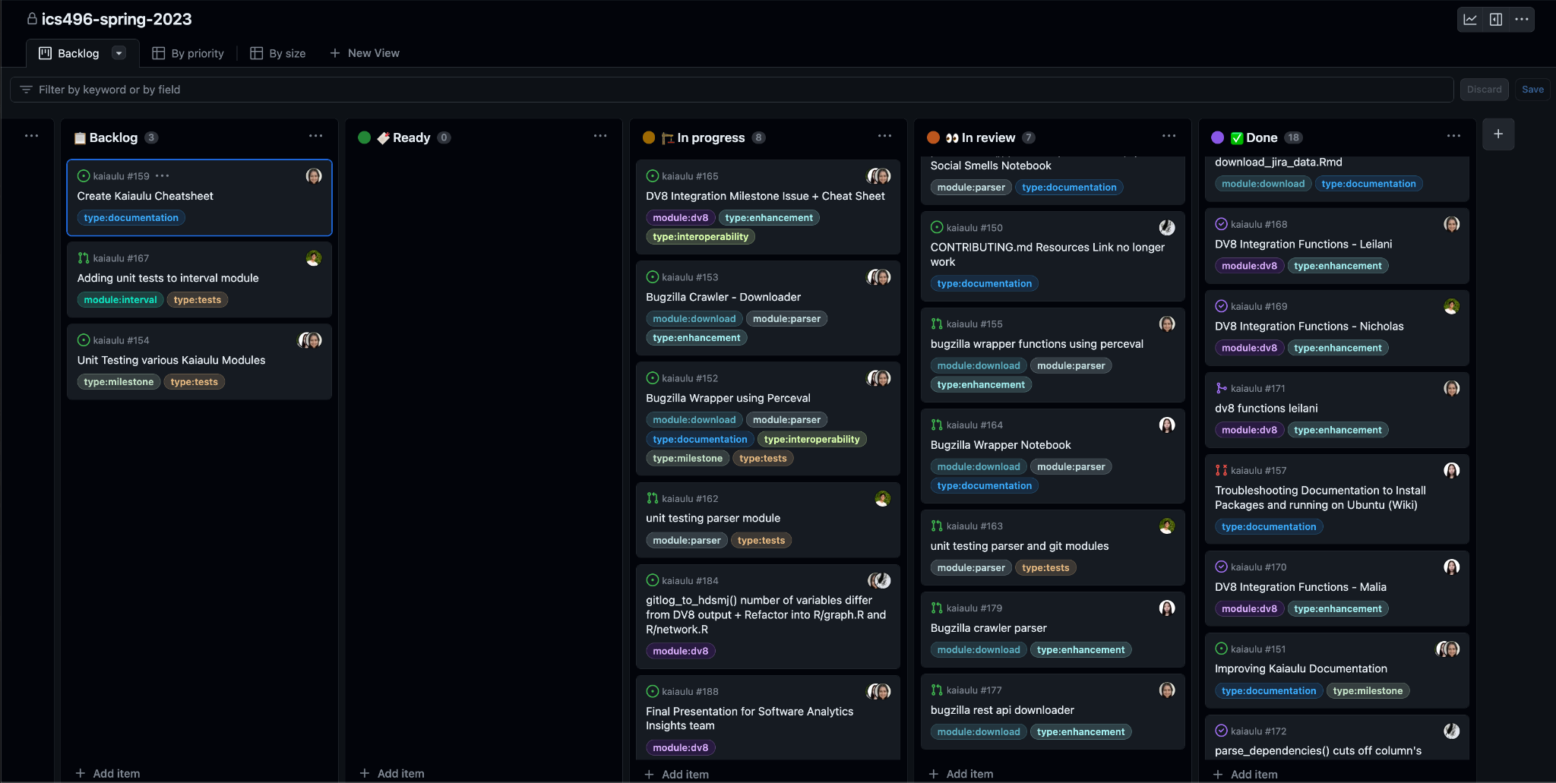

Slide 12
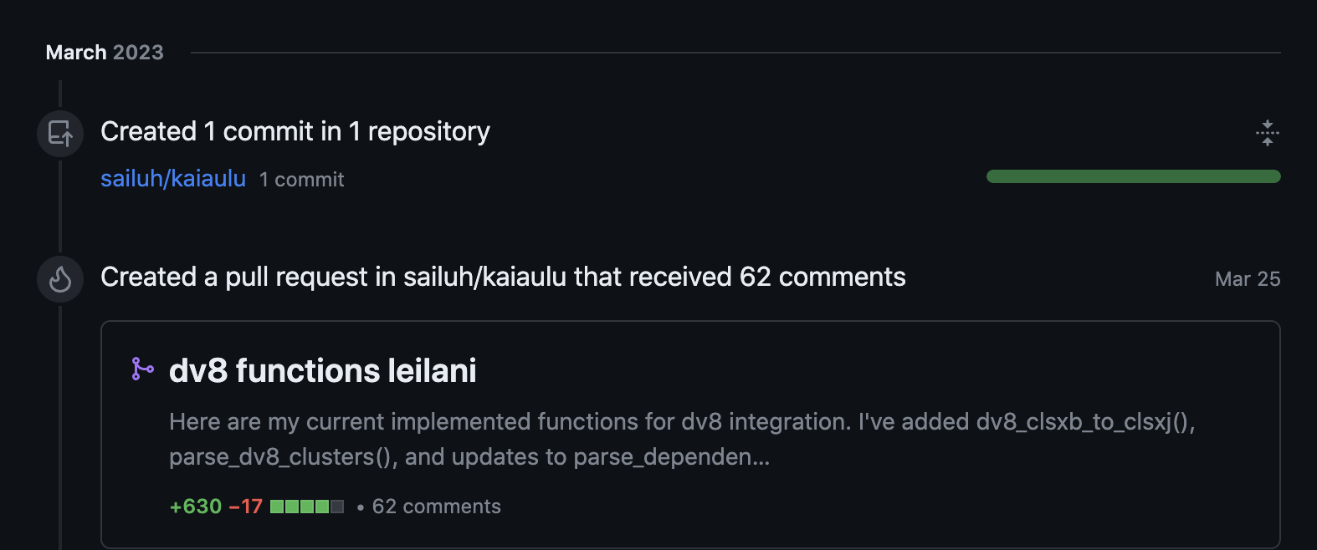
Reflections
What went right?
Successfully created deliverables for each milestone
What went wrong?
Missing messages on GitHub issues/pull requests
What could have been done differently?
Should switch from Windows to Linux earlier
Falling behind on task/milestone due dates
More planning on task distribution
Technical/soft skills
Learning Git (instead of GitHub Desktop)
Learning R & RStudio
Using GitHub pull requests
Communication with clients

Slide 13
Next Steps
Our Next Steps
Finishing up DV8 functions
Finishing up Bugzilla functions, notebook, and unit testing
Client Next Steps
Adding new functionality
e.g. NLP to extract concepts

Slide 14
Acknowledgements
Rick Kazman: Sponsor, Shidler College of Business
Carlos Paradis: Stakeholder/Mentor, Ph.D. in Computer Science

