Slide 1

BlackJack Game in JavaFX
By: Anthony Khemmoro

Slide 2
How BlackJack works
BlackJack is a game where you vs a dealer and try to beat them, try to get closest to 21 to win, anything over 21 is an automatic loss.
Face cards are 10, Ace is 1/11, dealer has to hit if its under 17, anything after 17 it has to automatically stop
If you get blackjack on the first go ( Ace + 10/Face card) you automatically win.

Slide 3
Features of the Game
BlackJack.java uses a full 52 deck of cards when playing
The card images work flawlessly
The play again feature restarts the game without needing to close and rerun the project
Can auto detect a Blackjack
The

Slide 4
Inner Class: Card
Each card has its own value ("A", "2", "3",… "K")
Each card has its own type (("H", "S", "C", "D"(Hearts, Spades, Clubs, Diamonds))

Slide 5
GUI
private HBox dealerCards = new HBox(5);
private HBox playerCards = new HBox(5);
private Text resultText = new Text();
private Text playerTotalText = new Text();
private Text dealerTotalText = new Text();
These show each hand, players score, and the result message at the end
Has the "Hit", "Stay", and "Play Again" buttons.

Slide 6
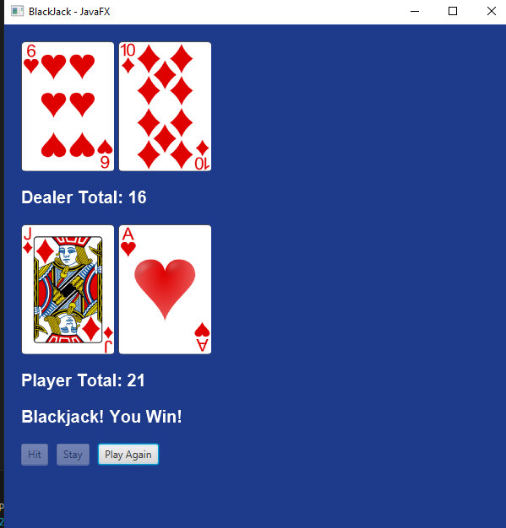
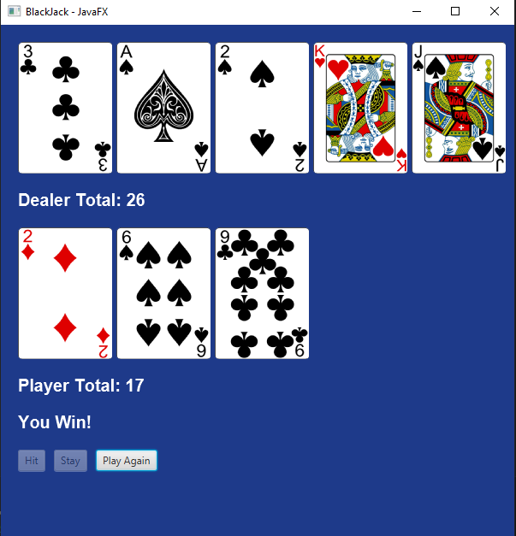
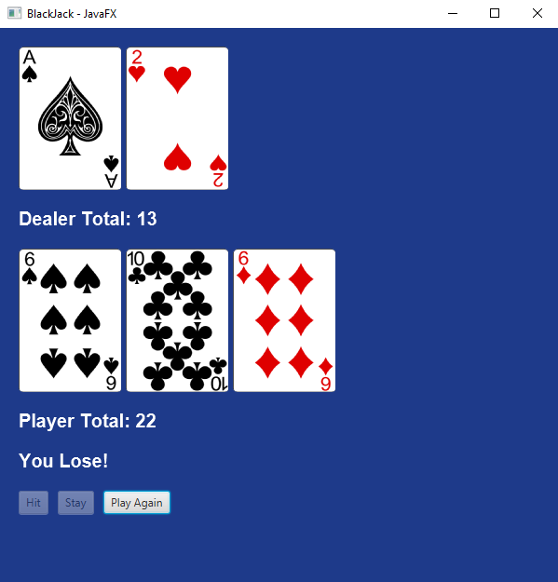
Demo/ Examples

Slide 7
Challenges when Creating Blackjack.java
Figuring out the JavaFX
Finding the Card images was slightly hard
Having to make the Ace card either 1/11
Having the GUI constantly update

