Slide 1
Programming for Data Science CA1 (Analysis on Motor Vehicles)
Anthony Koh Hong Ji

Slide 2
URLs
Monthly Motor Vehicle Population by Vehicle Type
data.gov.sg/dataset/monthly-motor-vehicle-population-by-type
Annual Revalidation of Certificates of Entitlement of Existing Vehicles
data.gov.sg/dataset/annual-revalidation-of-coe-of-existing-vehicles
Annual Motor Vehicle Inspection – Passing Rate of Motor Vehicles on First Inspection
data.gov.sg/dataset/annual-motor-vehicle-inspection-passing-rate-of-motor-vehicles-on-first-inspection
Notes:
data.gov.sg/dataset/monthly-motor-vehicle-population-by-type
https://data.gov.sg/dataset/annual-motor-vehicle-inspection-passing-rate-of-motor-vehicles-on-first-inspection
data.gov.sg/dataset/annual-revalidation-of-coe-of-existing-vehicles

Slide 3
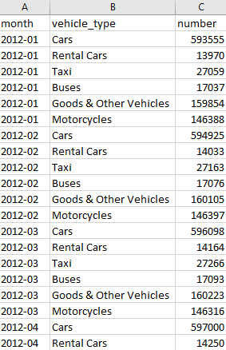
Monthly Motor Vehicle Population by Vehicle Type
Number of motor vehicles categorised by vehicle types (cars, taxi, buses, etc.)
Figures include vehicles exempted from Vehicle Quota System and tax
3 columns
month [Datetime (Month) “YYYY-MM”]
vehicle_type [Text (General)]
number (Numeric (General)]

Slide 4
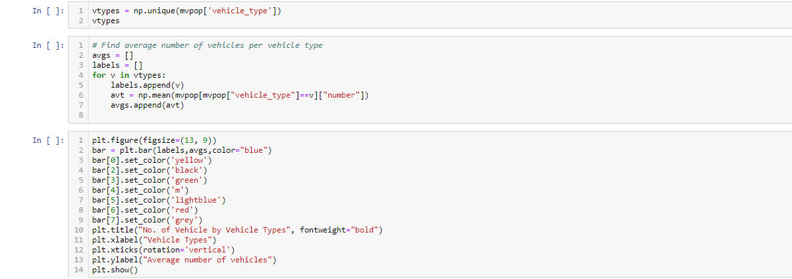
Monthly Motor Vehicle Population by Vehicle Type
To find out which vehicle type had the highest population
Used numpy.mean to find the average population of each vehicle type
Used plt.bar to transform the data into a bar chart

Slide 5
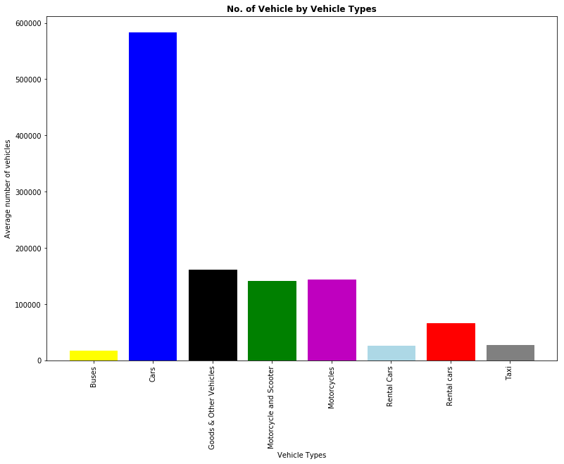

Slide 6
Monthly Motor Vehicle Population by Vehicle Type
3 vehicle types with highest population:
Cars
Goods & Other Vehicles
Motorcycles
3 vehicle types with the lowest population:
Buses
Rental Cars
Taxi

Slide 7
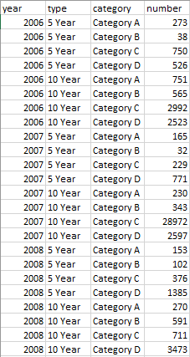
Annual Revalidation of COE of Existing Vehicles
Revalidation of COES in different categories for 5-year & 10-year
5-year COEs (except for Category C 5-year COEs that are expiring on or after 25 Feb 2013) cannot be further renewed
4 columns
year [Datetime (Year) “YYYY”]
type [Text (General)]
category [Text (General)]
number (Numeric (General)] - revalidations

Slide 8
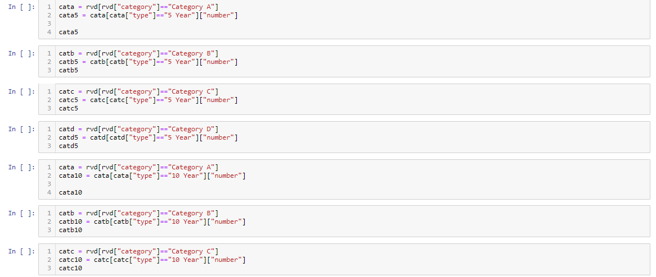
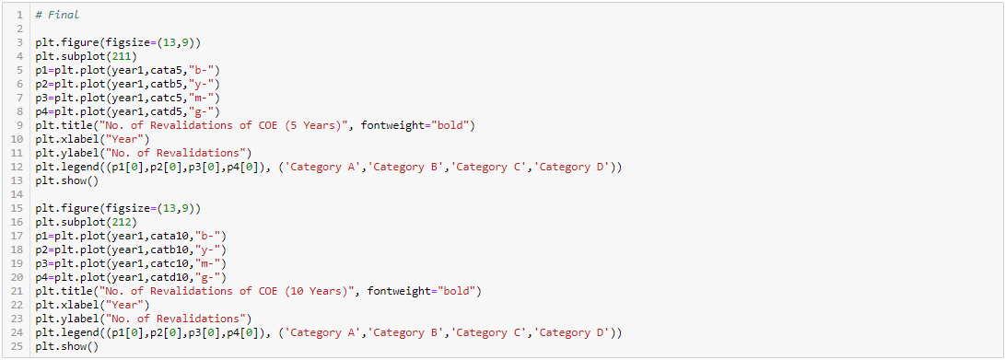
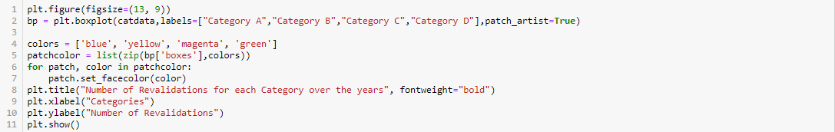
Annual Revalidation of COE of Existing Vehicles
Used Boolean indexing to attain data
Used plt.subplot to visualise 5-year COE chart and 10-year COE chart at the same time
Used plt.plot to get a line chart
Used plt.legend
Used plt.boxplot

Slide 9
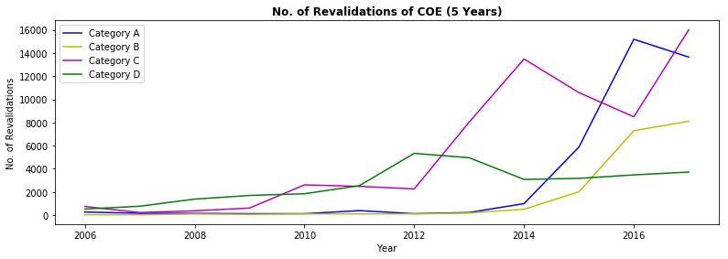
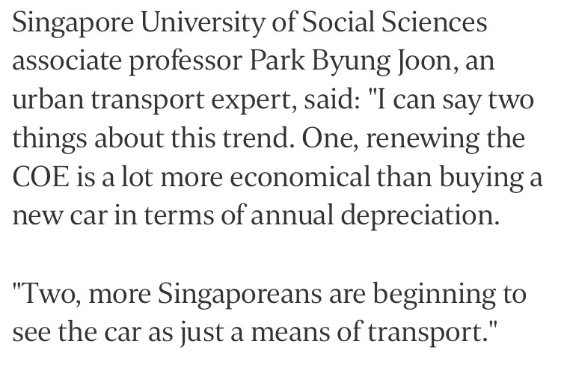

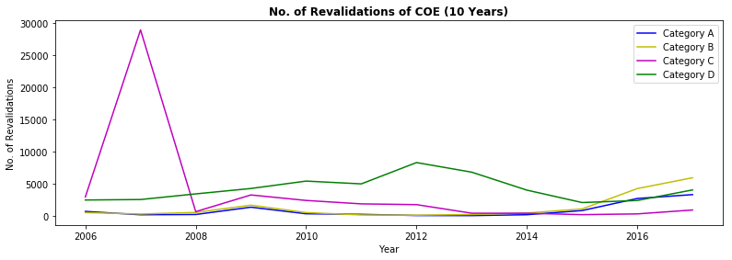
Category A | Car up to 1,600cc & 97kW (130bhp)
Category B | Car above 1,600cc or 97kW (130bhp)
Category C | Goods vehicle and bus
Category D | Motorcycle
Notes:
https://www.straitstimes.com/singapore/transport/coes-extended-for-record-number-of-vehicles

Slide 10
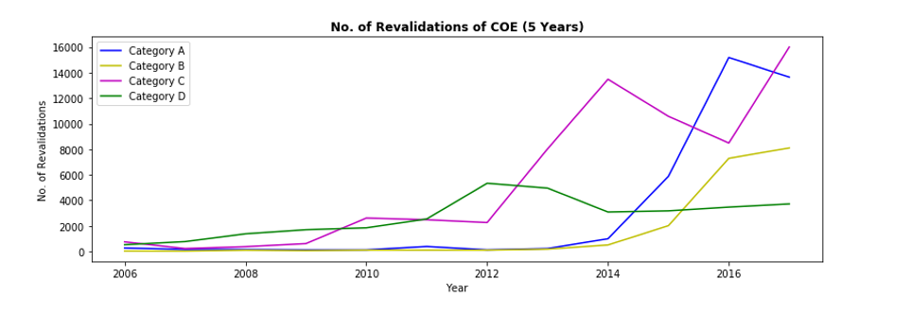
Annual Revalidation of COE of Existing Vehicles
5-Year COEs
General upwards trend across all categories
Sharp increase in Category C COEs in 2012 before dipping and increasing again in 2017
Sharp increase in Category A COEs in 2014

Slide 11
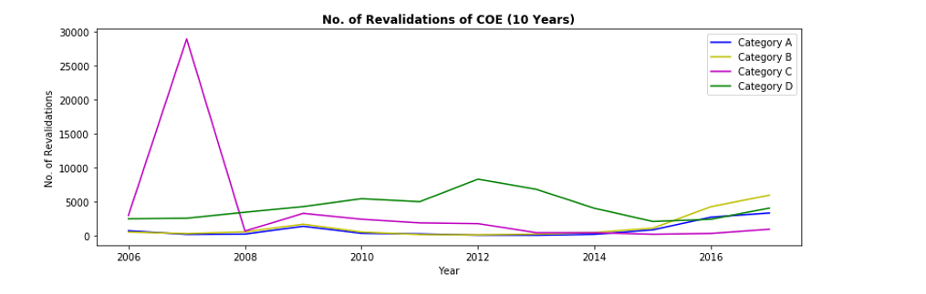
Annual Revalidation of COE of Existing Vehicles
10-Year COEs
Sharp increase in 2006 before a steep dip in 2007 for Category C COEs
Category D vehicles have the highest revalidations of COE on average across the years
Generally a low trend

Slide 12
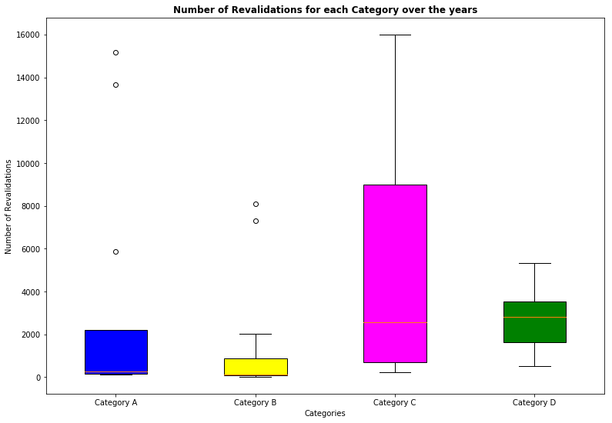
Category A | Car up to 1,600cc & 97kW (130bhp)
Category B | Car above 1,600cc or 97kW (130bhp)
Category C | Goods vehicle and bus
Category D | Motorcycle

Slide 13
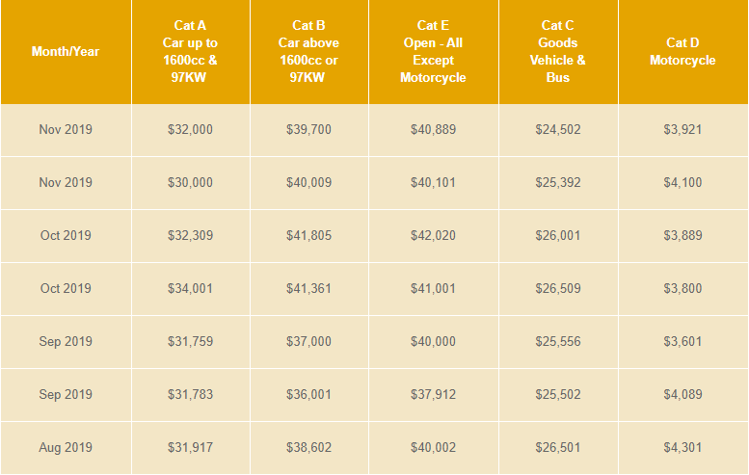
Annual Revalidation of COE of Existing Vehicles
Category D has the best median across all categories
Category B has the lowest IQR while Category C has the highest IQR
Category B COEs has the least revalidations

Slide 14
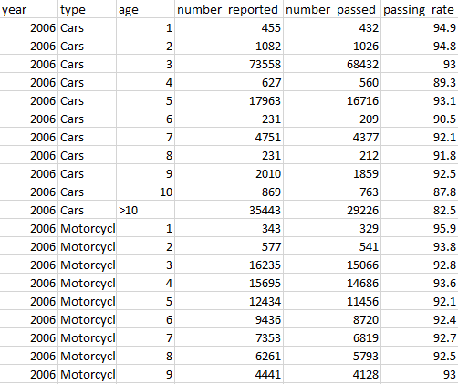
Annual Motor Vehicle Inspection – Passing Rate of Motor Vehicles on First Inspection
Passing rates of motor vehicles on first inspection
6 columns
year [Datetime (Year) “YYYY”]
type [Text (General)] – vehicle type
age [Text (General)] - age
number_reported (Numeric (General)] – reported
number_passed (Numeric (General)] – passed
passing_rate (Numeric (Percentage)]

Slide 15
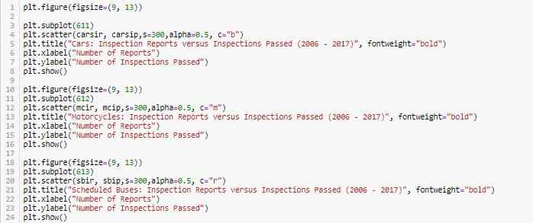



Annual Motor Vehicle Inspection – Passing Rate of Motor Vehicles on First Inspection
To find out the relationship between inspection reports versus inspections passed
Used Boolean indexing to attain data
Used plt.scatter

Slide 16
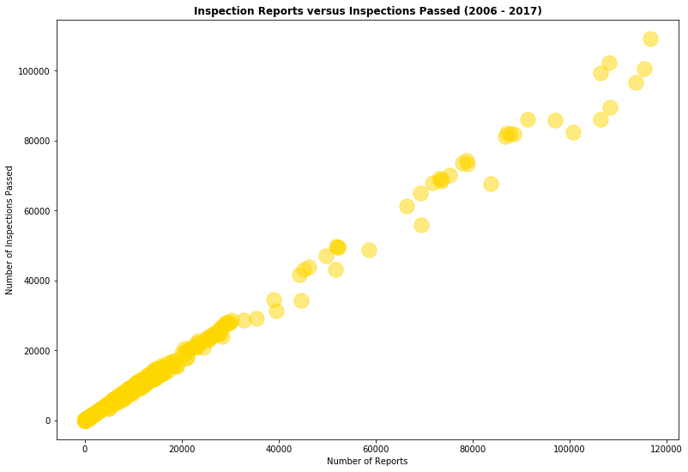
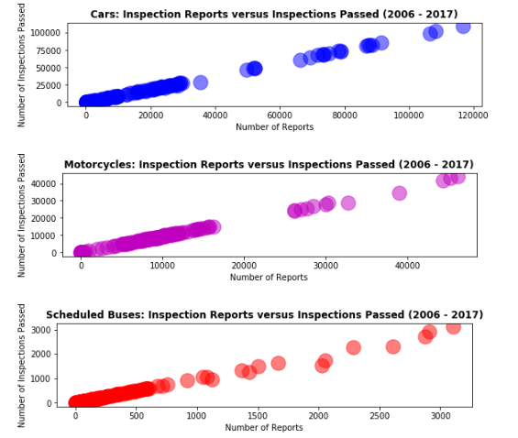
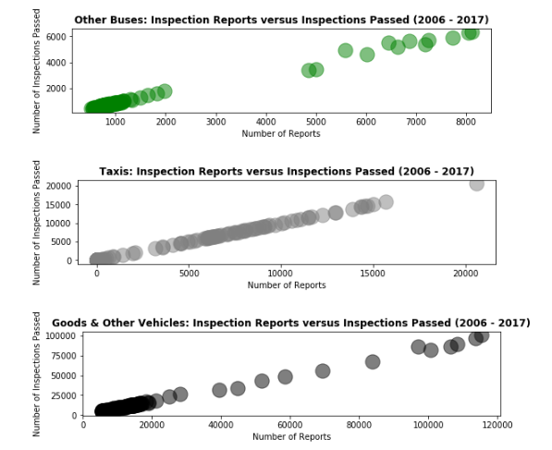

Slide 17
Annual Motor Vehicle Inspection – Passing Rate of Motor Vehicles on First Inspection
Positive linear correlation between the two axis
As the number of reports increase, the number of passes also increases – high passing rate

Slide 18
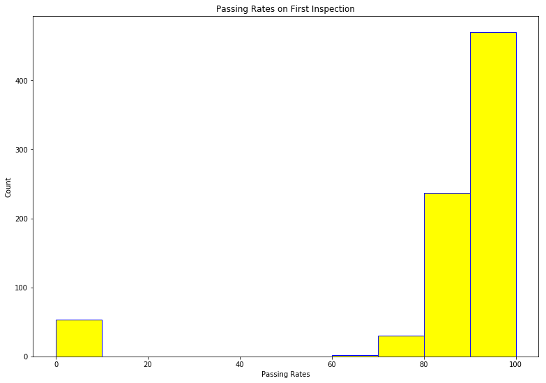

Slide 19
Annual Motor Vehicle Inspection – Passing Rate of Motor Vehicles on First Inspection
Most of the passing rates are in the 90% - 100% range
Generally motor vehicle owners in Singapore follow the rules as inferred from the passing rates

Slide 20
END

