Slide 1
RENT VS RESALE FLATS IN SINGAPORE
ST0248: Programming For Data Science CA2 Anthony Koh Hong Ji

Slide 2
Datasets
Number of Applications Registered for Resale and Rental Flats https://data.gov.sg/dataset/number-of-applications-registered-for-resale-flats
Median Rent by Town and Flat Type https://data.gov.sg/dataset/median-rent-by-town-and-flat-type
Median Resale Prices for Registered Applications by Town and Flat Type https://data.gov.sg/dataset/median-resale-prices-for-registered-applications-by-town-and-flat-type

Slide 3
STORY
Notes:
A family of four is looking to shift houses and would like to look for HDB flats that is in the West of Singapore because of the proximity of the parents’ workplaces and the children’ schools.

Slide 4
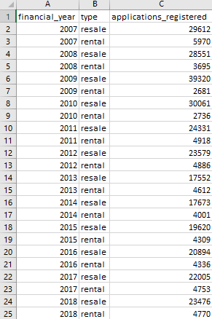
Number of Applications Registered for Resale and Rental Flats
2007 - 2018
25 rows of records
3 columns:
financial_year [Datetime “YYYY”]
type [Text (General)]
applications_registered [Numeric (General)]

Slide 5
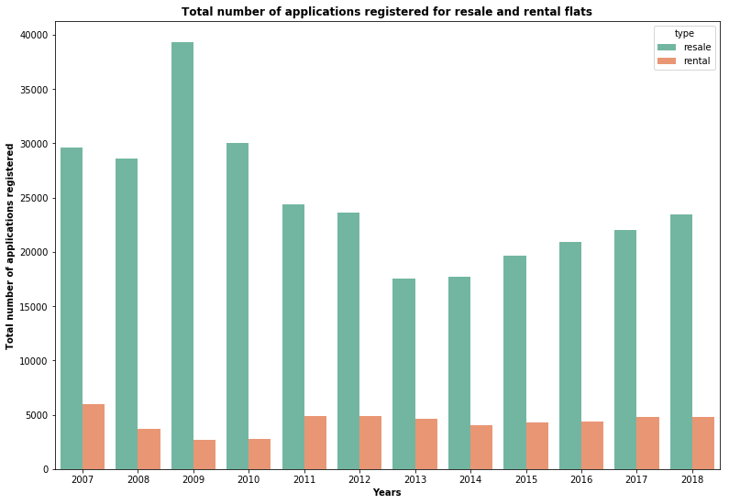
sns.barplot(x="financial_year", y="applications_registered", hue="type", palette="Set2",data=df)

Slide 6
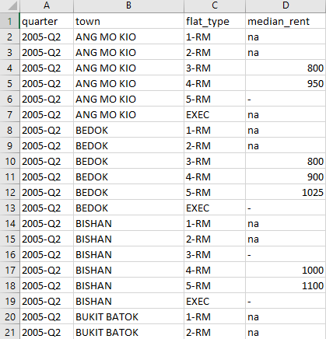
Median Rent by Town and Flat Type
2005 - 2019
9,094 rows of records
4 columns:
quarter [Datetime (Quarter) “YYYY-[Q]Q”]
town [Text (General)]
flat_type [Text (General)]
median_rent [Text (General)]
“na”: Data not available or not applicable
“-”: Data is negligible or not significant

Slide 7
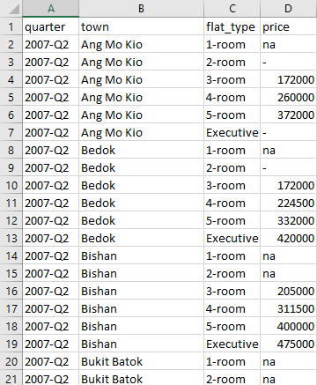
Median Resale Prices for Registered Applications by Town and Flat Type
2007 - 2019
7,801 rows of records
4 columns:
quarter [Datetime (Quarter) “YYYY-[Q]Q”]
town [Text (General)]
flat_type [Text (General)]
price [Text (General)]
“na”: Data not available or not applicable
“-”: Data is negligible or not significant

Slide 8
Data Manipulation - West
west = ("BUKIT BATOK", "BUKIT PANJANG", "BUKIT TIMAH", "CHOA CHU KANG", "CLEMENTI", "JURONG EAST", "JURONG WEST")
RENT
westrent = rentdf[rentdf.town.isin(west)]
RESALE
resaledf['town'] = resaledf['town'].str.upper()
westresale = resaledf[resaledf.town.isin(west)]

Slide 9
Data Manipulation – 2007 to 2018
years = "2007|2008|2009|2010|2011|2012|2013|2014|2015|2016|2017|2018“
RENT
yearswestrent = westrent[westrent['quarter'].str.contains(years)]
RESALE
yearswestresale = westresale[westresale['quarter'].str.contains(years)]

Slide 10
Data Manipulation – 4-RM, 5-RM, & EXEC
flats = ("4-RM", "5-RM", "EXEC")
RENT
yearswestflatsrent = yearswestrent[yearswestrent.flat_type.isin(flats)]
RESALE
yearswestresale1 = yearswestresale.replace({'4-room': '4-RM', '5-room': '5-RM', 'Executive': 'EXEC’})
yearswestflatsresale = yearswestresale1[yearswestresale1.flat_type.isin(flats)]

Slide 11
Data Manipulation – Combining 2 dataframes
rent = yearswestflatsrent.set_index(['quarter', 'town', 'flat_type'])
resale = yearswestflatsresale.set_index(['quarter', 'town', 'flat_type’])
result = pd.concat([rent, resale], axis = 1)

Slide 12
Data Manipulation – Dropping N.A
result = result.replace(['na', '-'], np.NaN)
result = result.dropna()

Slide 13
Data Manipulation – Changing dtypes
result2['median_rent'] = result2['median_rent'].astype(int)
result2['price'] = result2['price'].astype(int)

Slide 14
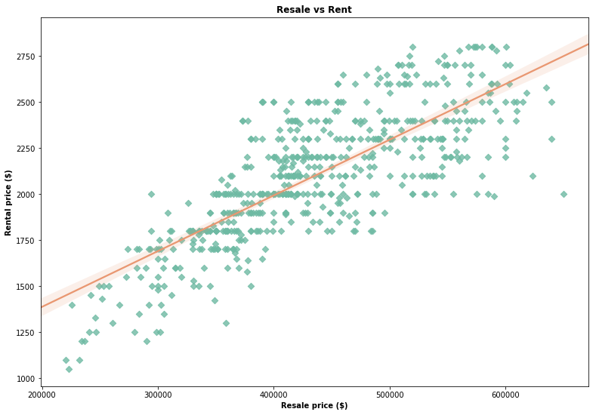
Objective
To find out the relationship between the rental prices and resale prices of flats in Singapore
Insights
Positive linear correlation between rental prices and resale prices of flats
The higher the resale price of flats, the higher the rent for flats in Singapore
sns.regplot(x="median_rent", y="price", marker="D", scatter_kws={"color":"#6EBAA3"}, line_kws={"color":"#E99771"}, data=result2)

Slide 15
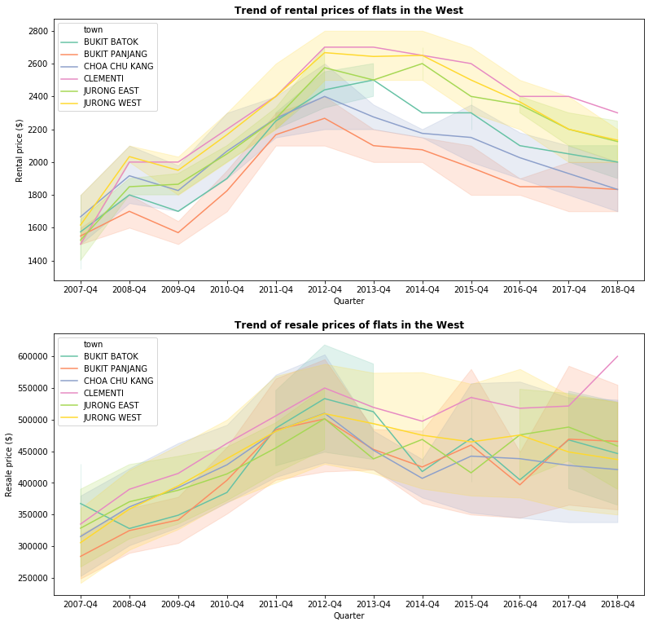
b = result[result['quarter'].str.contains('Q4’)]
sns.lineplot(x=b.quarter, y="median_rent", hue="town", palette="Set2", data=result)
sns.lineplot(x=b.quarter, y="price", hue="town", palette="Set2", data=result).set(xlabel="Quarter", ylabel="Resale price ($)")

Slide 16
Objective
To find out the most affordable town to either rent/buy a resale flat from in the West area and to understand the price trend of the flats
Insights
Rent (most exp. to least exp.)*
No. | Towns
1 | Clementi
2 | Jurong West
3 | Jurong East
4 | Bukit Batok
5 | Choa Chu Kang
6 | Bukit Panjang
Resale (most exp. to least exp.)*
No. | Towns
1 | Clementi
2 | Bukit Panjang
3 | Jurong East
4 | Bukit Batok
5 | Jurong West
6 | Choa Chu Kang
*at the end of 2018 Q4

Slide 17
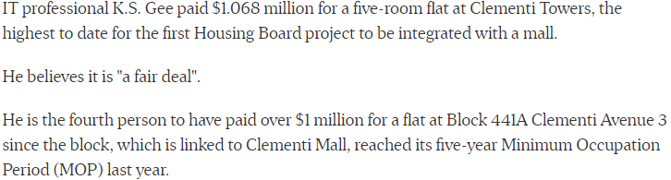
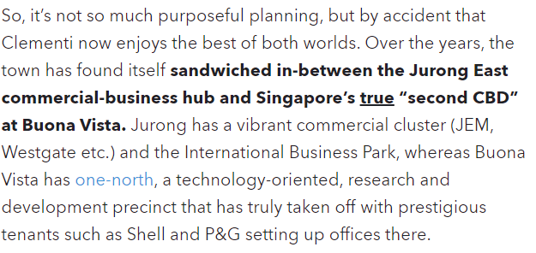
Analysis
What makes Clementi so expensive?
Schools near Clementi:
National University of Singapore (NUS)
Singapore University of Social Sciences (SUSS)
Singapore Polytechnic (SP)
Ngee Ann Polytechnic (NP)
NUS High School of Math and Science
Nan Hua High School
Nan Hua Primary School

Slide 18
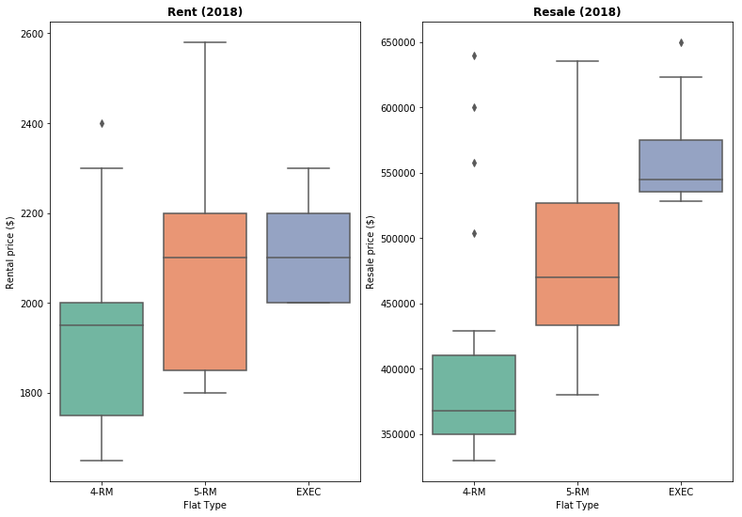
Objective
To find out the difference in price for a 4-room flat vs a 5-room flat vs an executive flat for both rented and resale flats
Insights
Rent (2018)
Flat Type | Median price ($)
4-RM | 1950
5-RM | 2100
EXEC | 2100
Resale (2018)
Flat Type | Median price ($)
4-RM | 370,000
5-RM | 470,000
EXEC | 540,000
a = result[result['quarter'].str.contains('2018’)]
sns.boxplot(x=a.flat_type, y="median_rent", palette="Set2", data=a).set(xlabel="Flat Type", ylabel="Rental price ($)")
sns.boxplot(x=a.flat_type, y="price", palette="Set2", data=a).set(xlabel="Flat Type", ylabel="Resale price ($)")

Slide 19
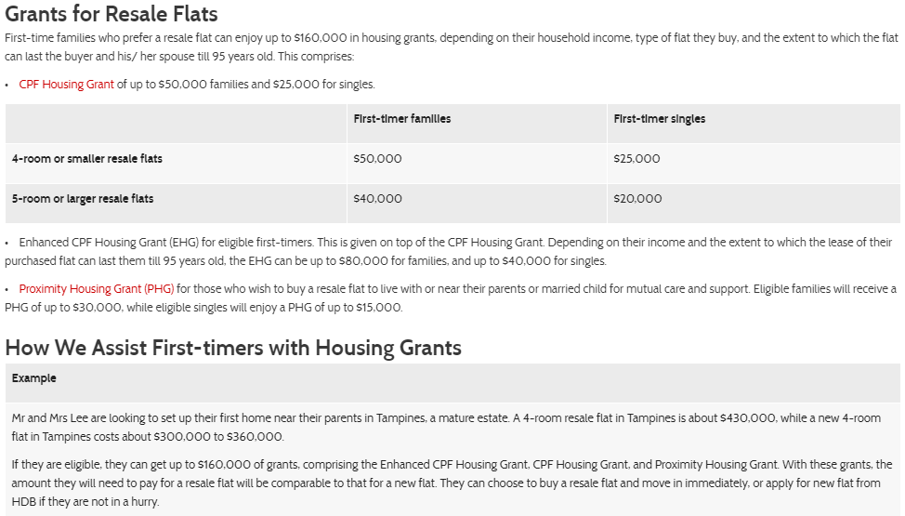

Slide 20
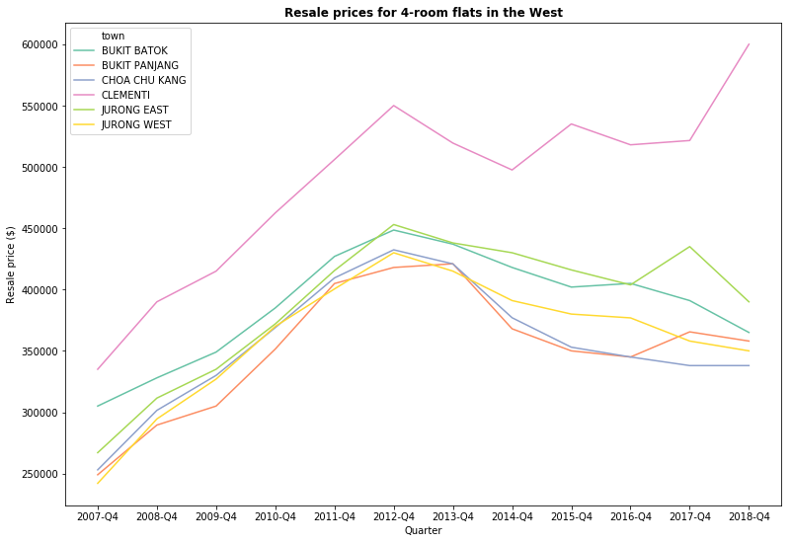
Objective
To find out the difference in price for a 4-room for resale flats in the West
Insights
Resale (most exp. to least exp.)*
No. | Towns
1 | Clementi
2 | Jurong East
3 | Bukit Batok
4 | Bukit Panjang
5 | Jurong West
6 | Choa Chu Kang
*at the end of 2018 Q4
four = result[result["flat_type"] == "4-RM"]
sns.lineplot(x=b.quarter, y="price", hue="town", palette="Set2", data=four).set(xlabel="Quarter", ylabel="Resale price ($)")

Slide 21
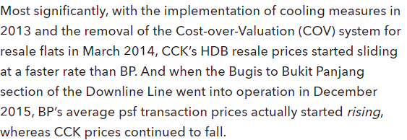
Analysis
What happened to CCK’s resale value? Why is BP on the rise and not CCK?
Cash Over Valuation (COV) happens when you buy a resale flat above its actual HDB valuation.
For example, if a resale flat is valued at $600,000 by HDB, but you agree on a purchase price of $620,000, then the COV is $20,000.
four = result[result["flat_type"] == "4-RM"]
sns.lineplot(x=b.quarter, y="price", hue="town", palette="Set2", data=four).set(xlabel="Quarter", ylabel="Resale price ($)")

Slide 22
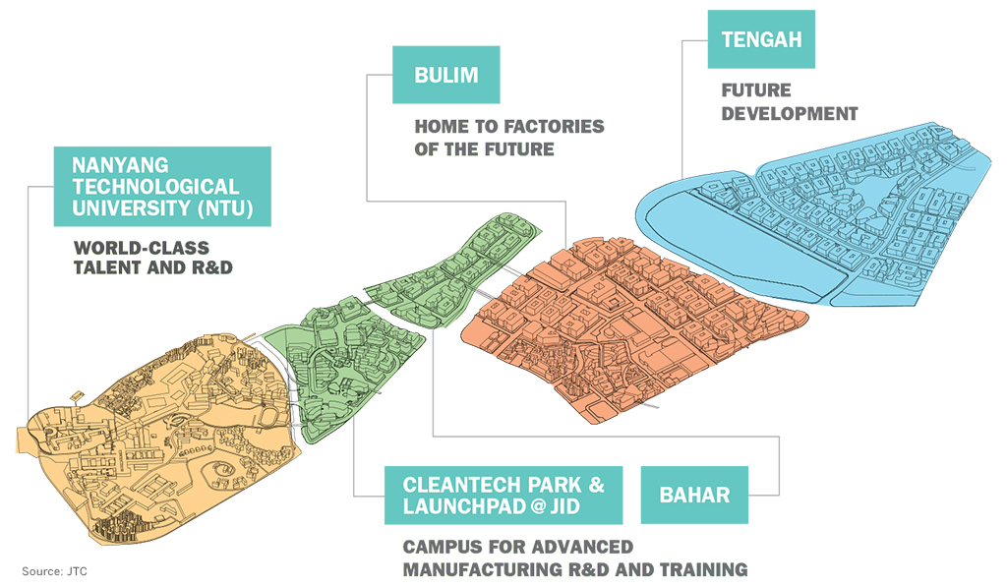
Jurong Innovation District (JID)

Slide 23
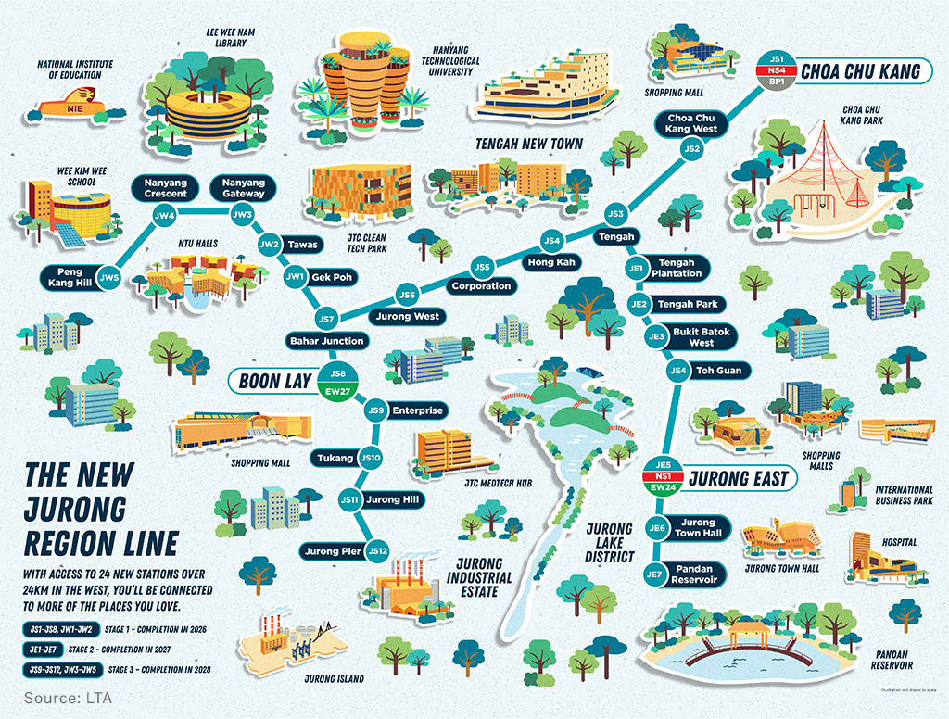
Jurong Region Line (JRL)

Slide 24
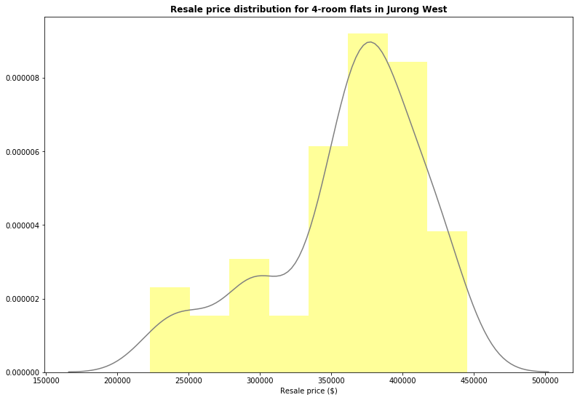
Objective
To find out the distribution of the resale price of 4-room flats in Jurong West to get an idea of how much to pay
Insights
Slightly skewed to the left
Most of the 4-room flats in Jurong West cost from the $350,000 to $420,000 range
jw = four[four.town == "JURONG WEST"]
sns.distplot(jw.price, color="yellow", kde_kws={"color": "gray"}).set(xlabel="Resale price ($)")

Slide 25
Recommendations
Jurong West has the second lowest median resale price at the end of 2018
The price range of 4-room flats in Jurong West hovers around the median resale price of 4-room flats in the West
JID and JRL coming up – potential increase in resale/rental prices in that area

Slide 26
END

