Slide 1
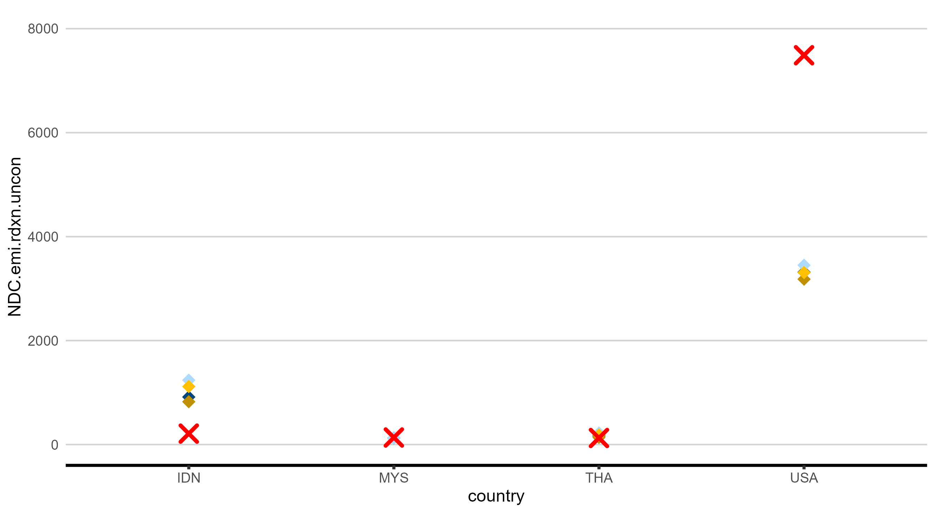

Slide 2
8000
6000
NDC.emi.rdxn.uncon
4000
2000
0
IDN
MYS
country
THA
USA

