Slide 1
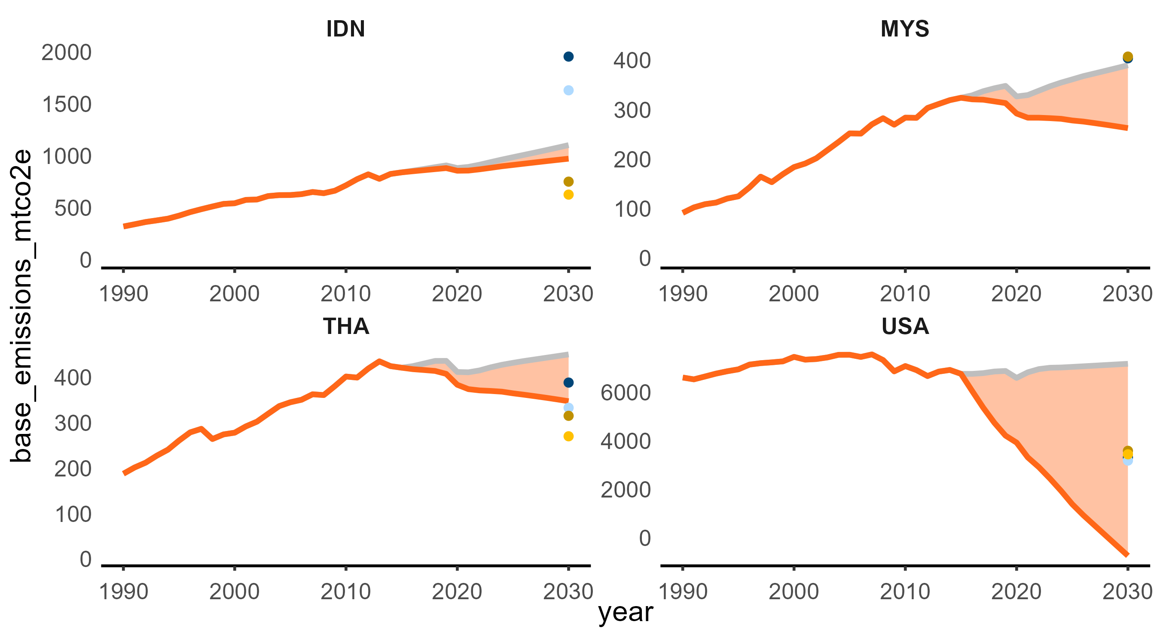

Slide 2
MtCO2e
IDN
MYS
2000
NDC conditional
400
NDC uncon.
1500
300
1000
200
Rebased NDC con.
Rebased NDC uncon.
500
100
0
0
1990
2000
2010
2020
2030
1990
2000
2010
2020
2030
THA
USA
400
6000
300
4000
200
2000
100
0
0
1990
2000
2010
2020
2030
1990
2000
2010
2020
2030

Slide 3
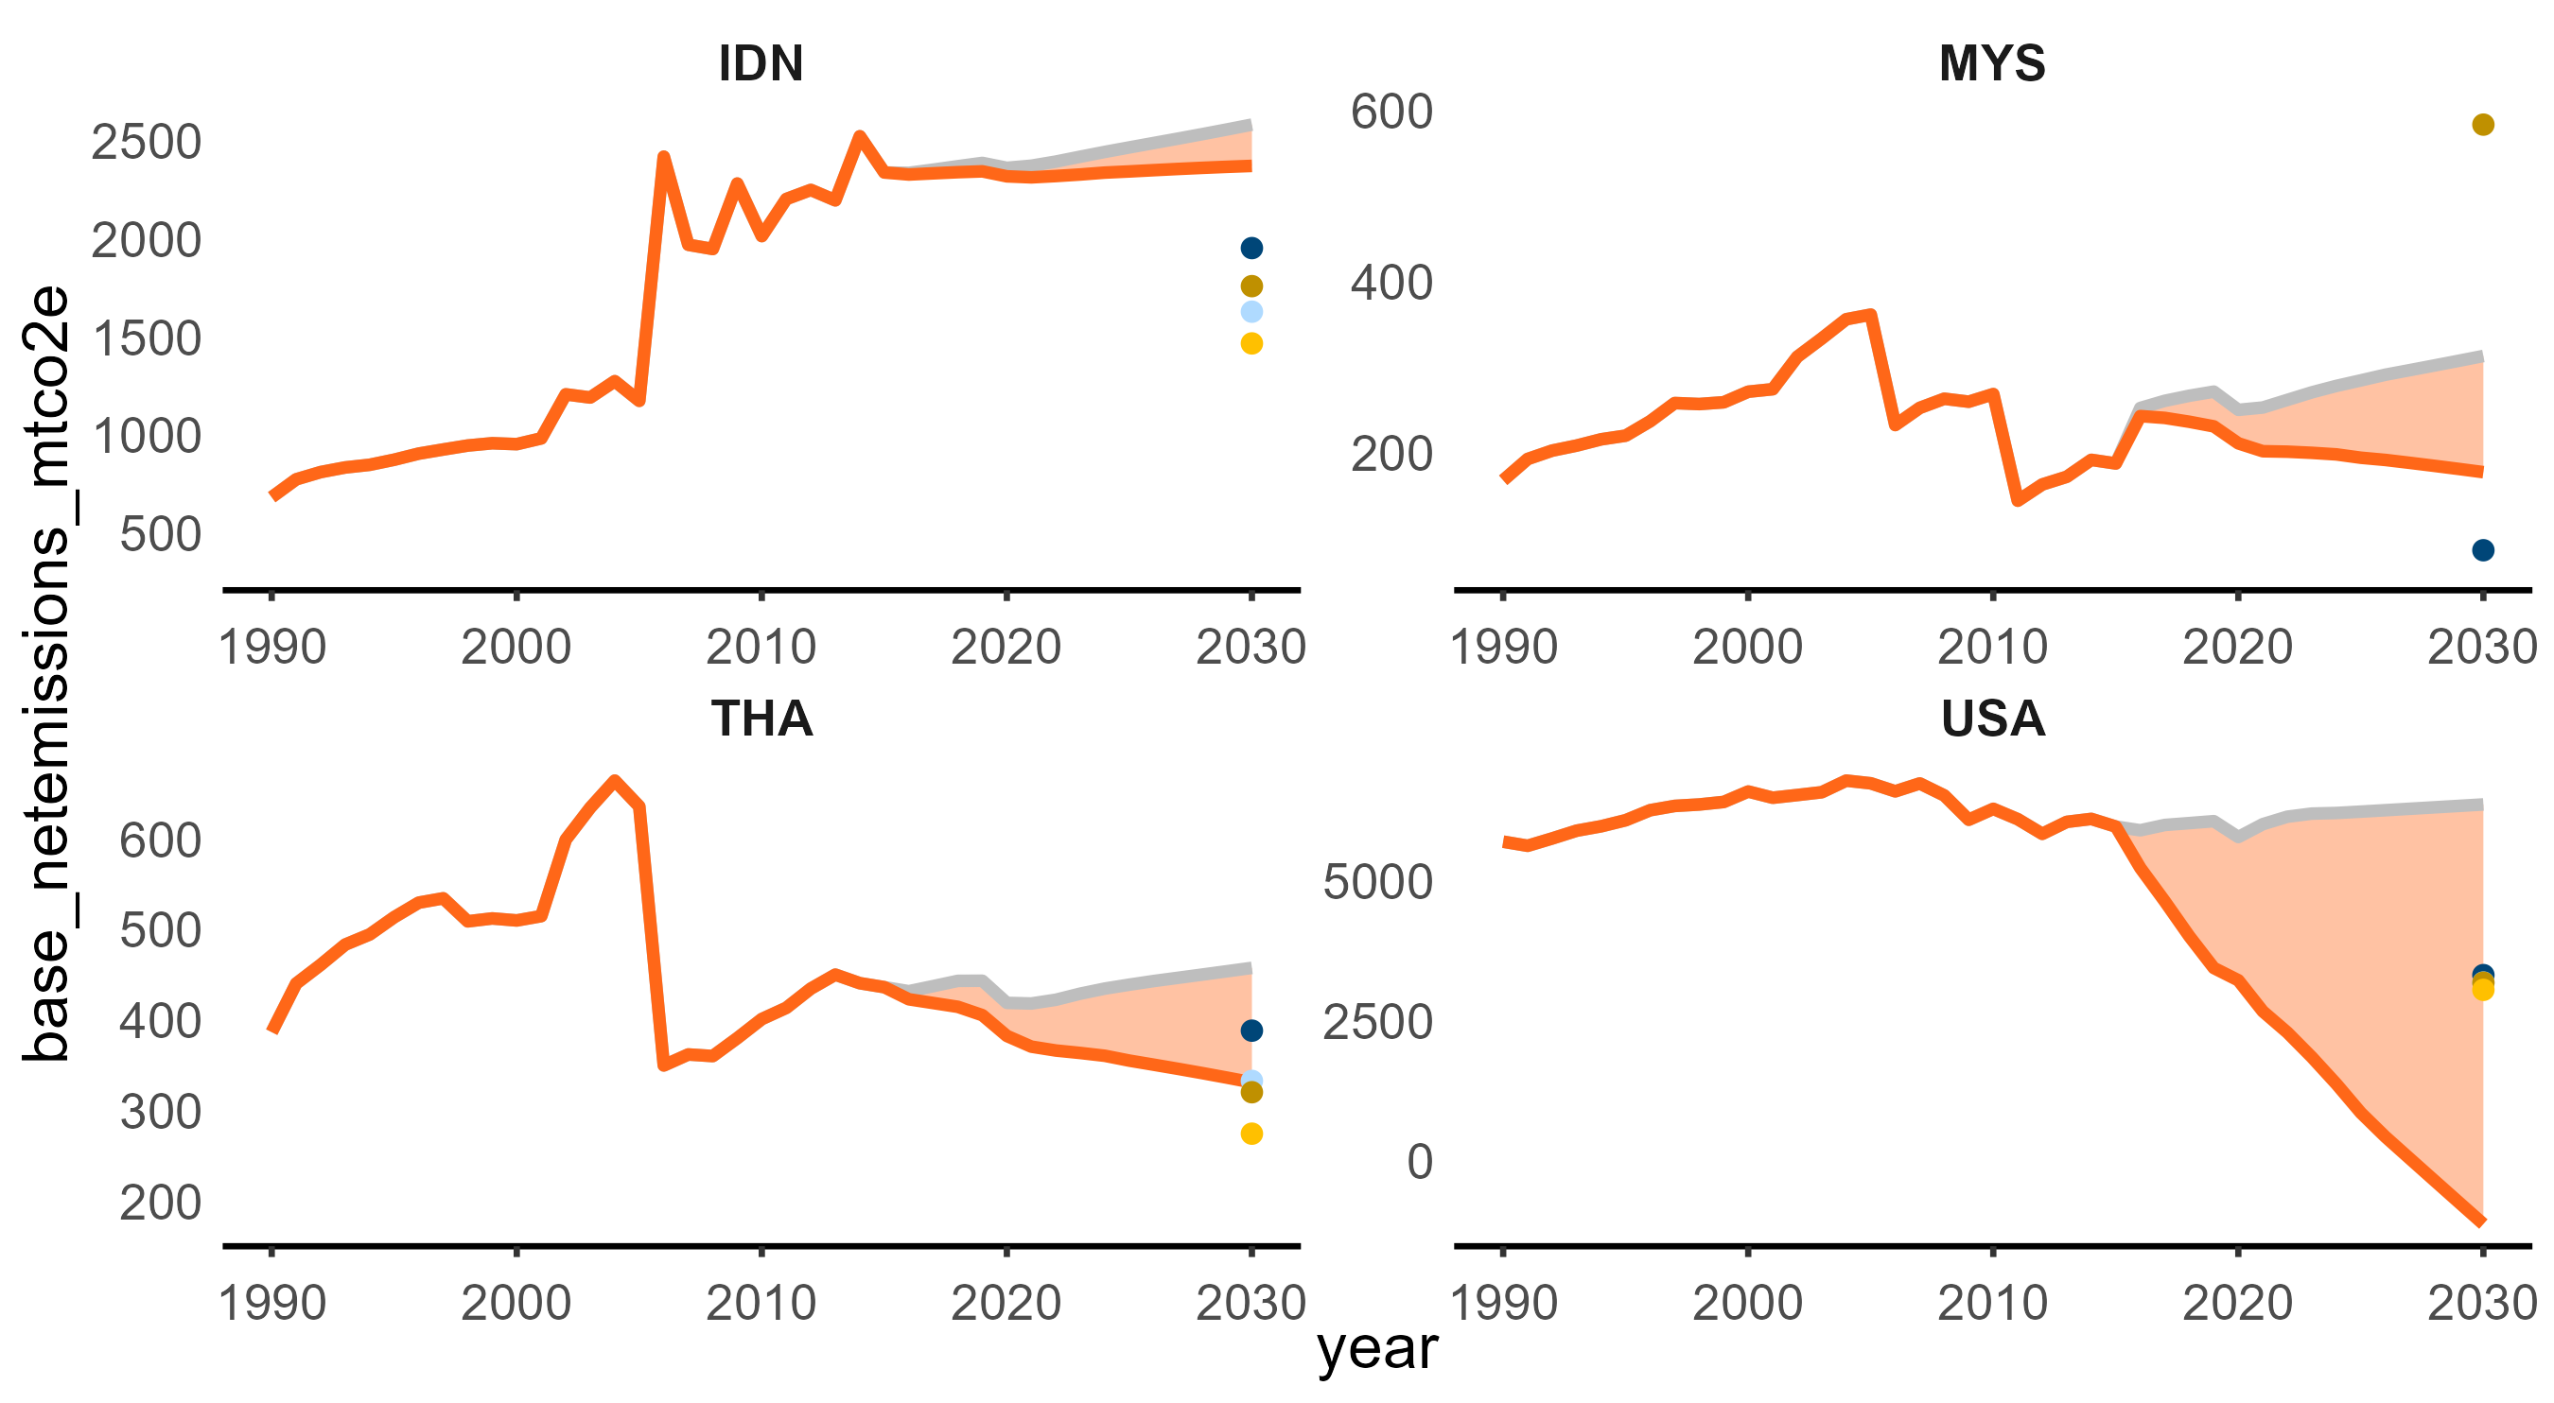

Slide 4
MtCO2e
IDN
MYS
2500
600
2000
400
1500
1000
200
500
1990
2000
2010
2020
2030
1990
2000
2010
2020
2030
THA
USA
600
5000
500
400
2500
300
0
200
1990
2000
2010
2020
2030
1990
2000
2010
2020
2030

Slide 5
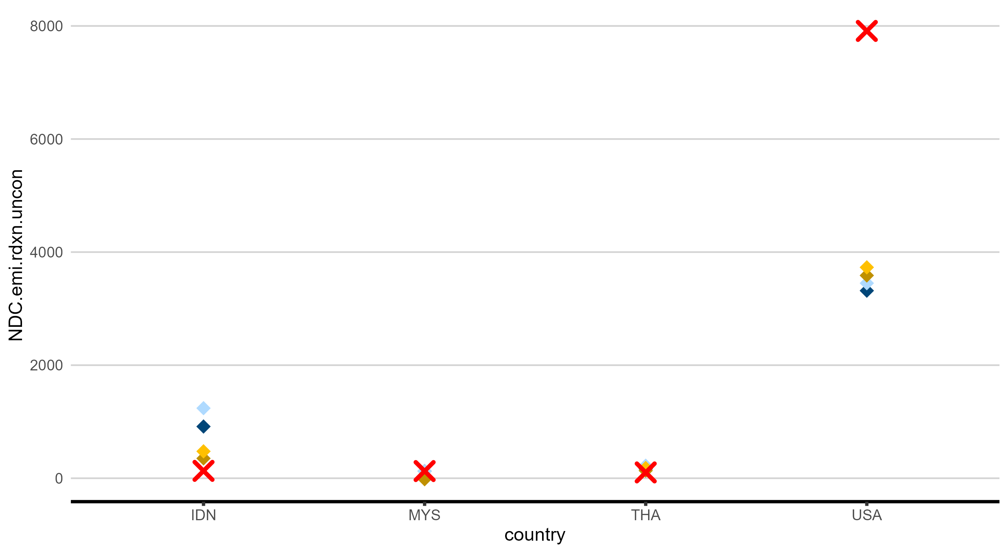

Slide 6
MtCO2e
8000
6000
4000
2000
0
IDN
MYS
THA
USA

Slide 7
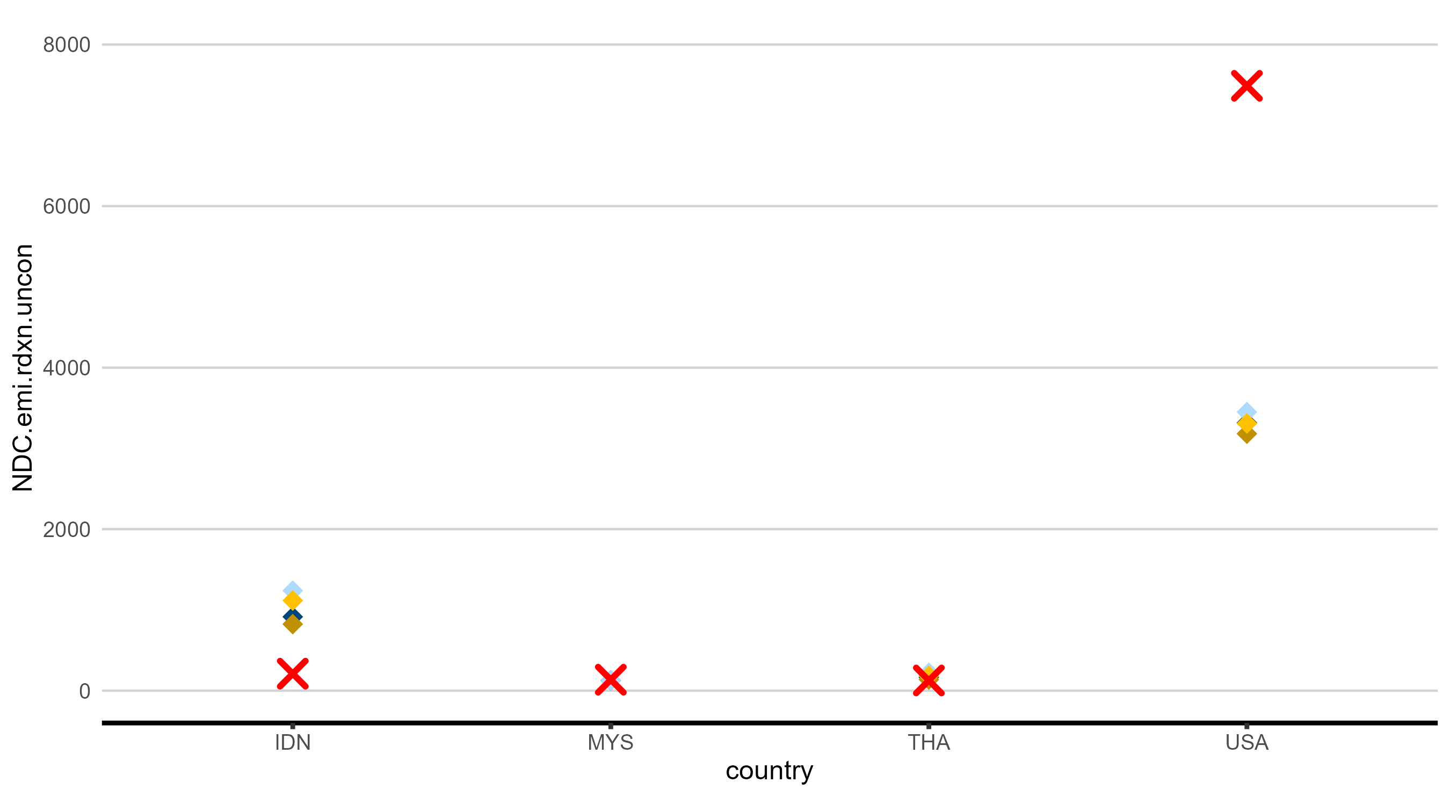

Slide 8
MtCO2e
8000
6000
4000
2000
0
IDN
MYS
THA
USA

Slide 9
W/o rebase

Slide 10
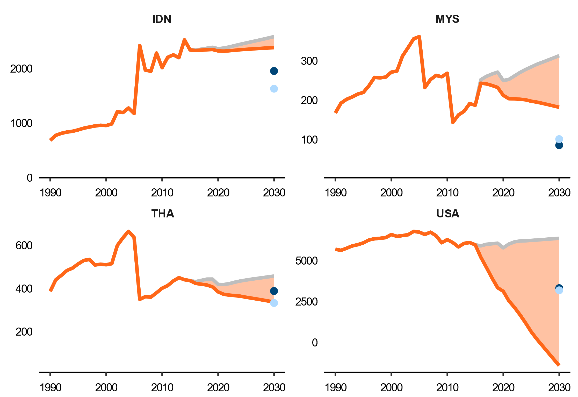
Projected emission
MtCO₂e
NDC uncon.
NDC conditional
Emission allowance

Slide 11
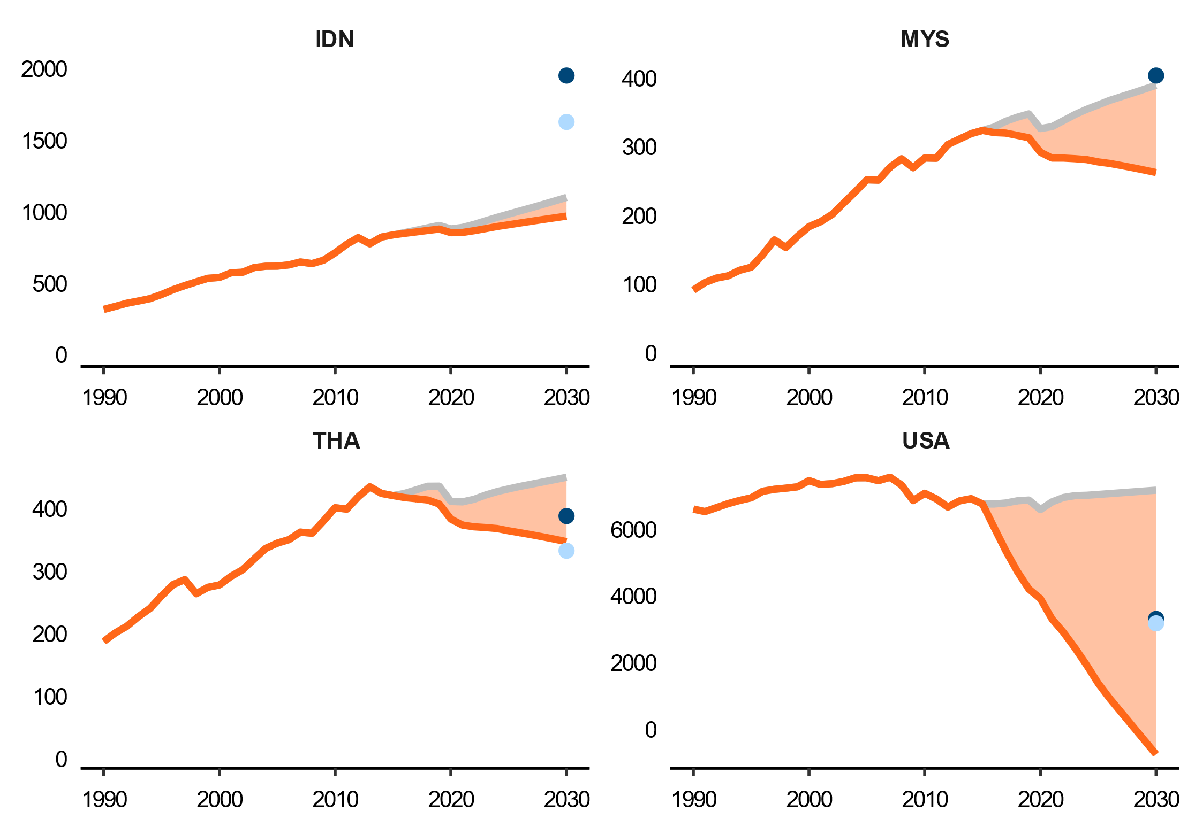
MtCO₂e
NDC uncon.
NDC conditional
Projected emission
Emission allowance

