Slide 1


COMPANY & PRODUCT PRESENTATION
Heliospace Corporation
Flight proven deployable antennas, booms, and mechanisms for the expanding space economy
NEW SPACE VISION × REAL SPACE EXPERIENCE
August 2026 | Berkeley, California | Proprietary and Confidential

Slide 2

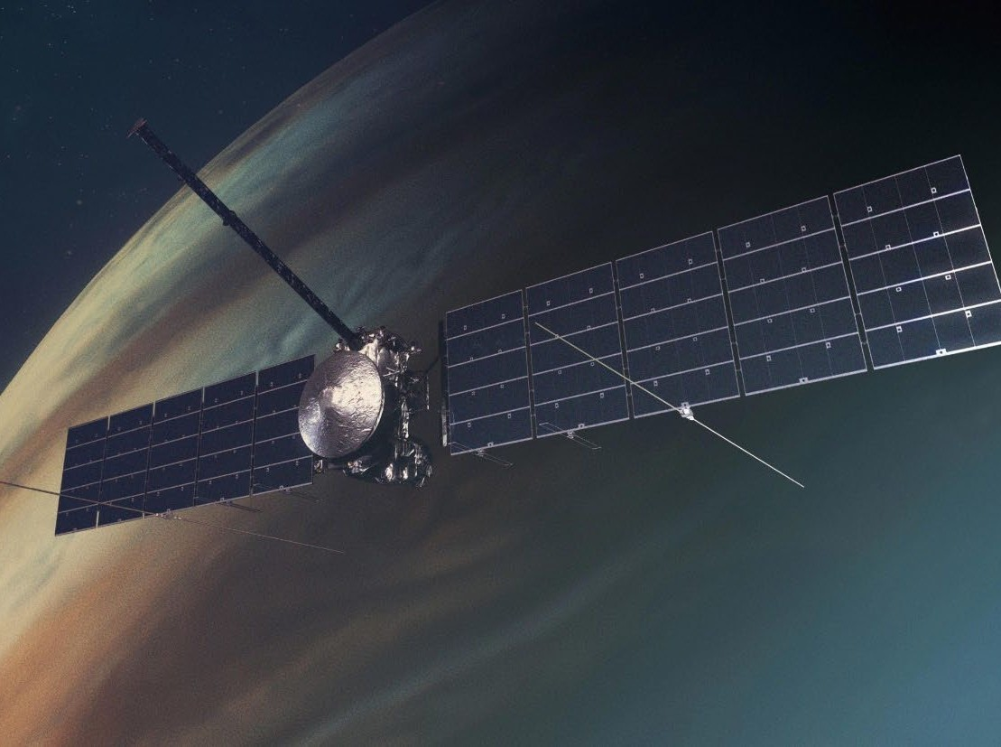
COMPANY OVERVIEW
Heliospace at a Glance
Helio is pioneering a new class of energy infrastructure: space based power systems, known as power plants in space, that capture solar energy beyond Earth's atmosphere and beam it safely and efficiently to the surface. Our vision is to establish orbital energy platforms as a foundational layer of the global power grid, delivering uninterrupted, carbon free electricity at scale and reshaping how nations power cities, industries, and critical systems.
Since being founded in 2018, Helio has specialized in delivering cutting edge aerospace hardware, systems engineering, and mission services. From small scale projects to flagship space missions, we support NASA, private companies, universities, and global space agencies to achieve success in space.
Europa Clipper with Heliospace built REASON radar antennas deployed. Image credit: NASA.
We are proud to be a trusted partner to over a dozen space agencies, organizations, and companies across the globe. Our products can be found operating from the Sun to Jupiter. From NASA and the European Space Agency to emerging private aerospace firms and academic institutions, we collaborate with some of the most innovative and forward thinking players in the space industry.
40+
125+
space flight missions supported
instruments and systems built
30+
$45M
engineers on the team
delivered in contracts
Heliospace Corporation | Proprietary and Confidential
2

Slide 3
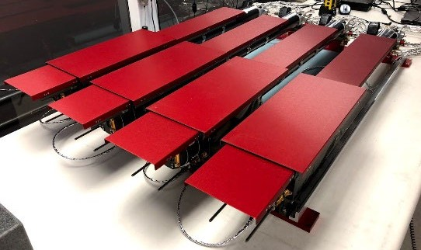
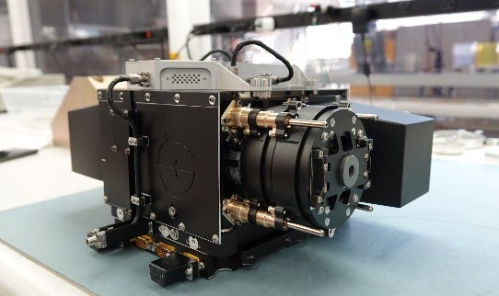
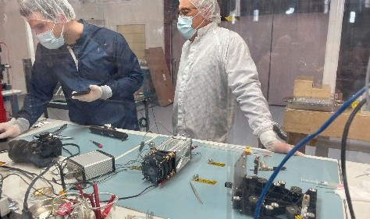
CAPABILITIES
What We Do
Five product and revenue areas supported by a single Berkeley facility and quality system, from initial design through on orbit operations.
Space Qualified Hardware
Mission Systems and Engineering Services
Deployable Space Systems
Deployable antennas
Sensors and scientific instruments
Mechanical systems and structures for spacecraft
Spacecraft system design
Integration and testing
Engineering support for government and commercial space missions
Large deployable antennas
Solar arrays and other expandable structures
Components for satellites, lunar missions, and deep space missions
Space Based Solar Power Technology
Future Manufacturing and Licensing
Orbital solar power platforms, power plants in space
Wireless energy transmission systems intended to beam solar energy from orbit to Earth
Mass production of space qualified hardware
Licensing of proprietary space technologies
Heritage examples: hardware for missions such as NASA's Europa Clipper, James Webb Space Telescope program support, solar science missions, and lunar related systems.
Heliospace Corporation | Proprietary and Confidential
3

Slide 4
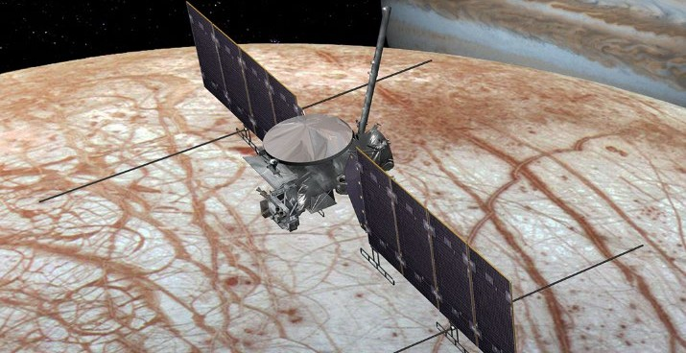
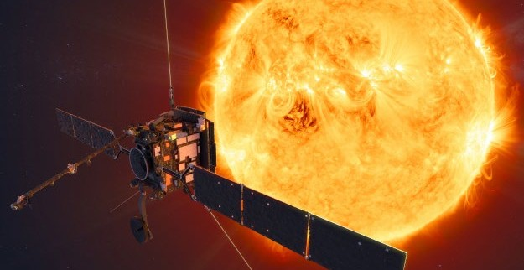
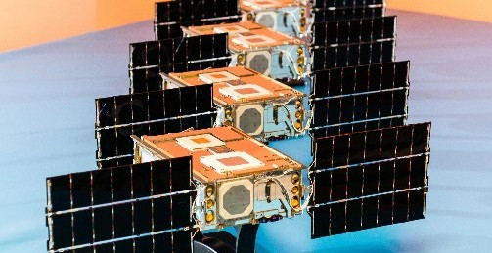
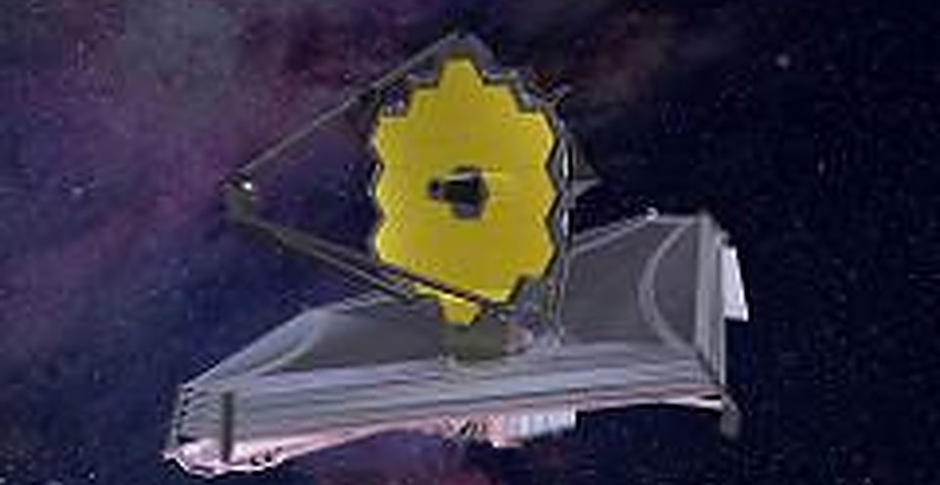
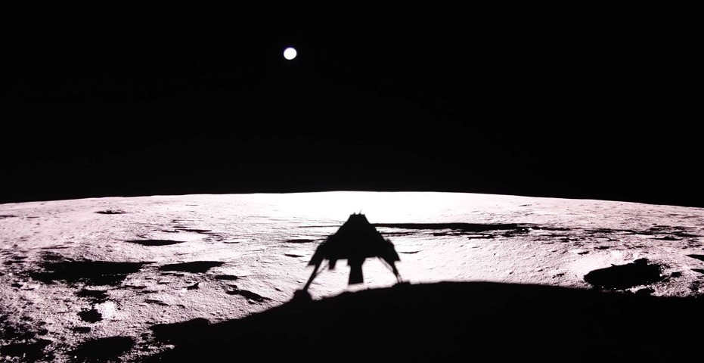
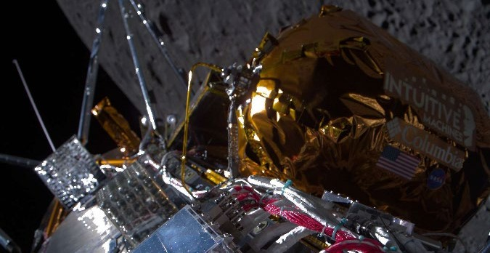
FLIGHT HERITAGE
At Jupiter, the Sun, and the Moon
Europa Clipper, REASON (NASA/JPL)
Solar Orbiter, RPW (ESA)
SunRISE (NASA/JPL)
Two 17.6 m radar dipoles, deployed and operating en route to Europa.
Three 6.5 m antennas performing nominally near the Sun.
28 CubeSat compatible monopoles delivered at production volume.
James Webb Space Telescope
Blue Ghost Mission 1 (Firefly / SwRI)
IM-1 (Intuitive Machines / NASA)
Systems engineering, integration, and test support through commissioning.
LMS lunar science payload delivered under the NASA CLPS program.
ROLSES antennas flown on the first commercial US lunar landing.
Heliospace Corporation | Proprietary and Confidential
4

Slide 5
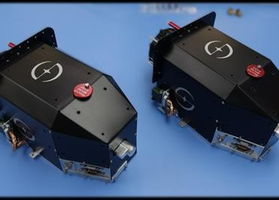
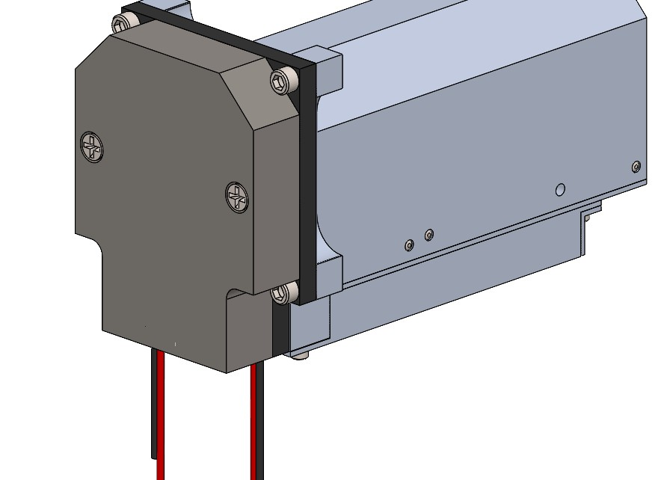
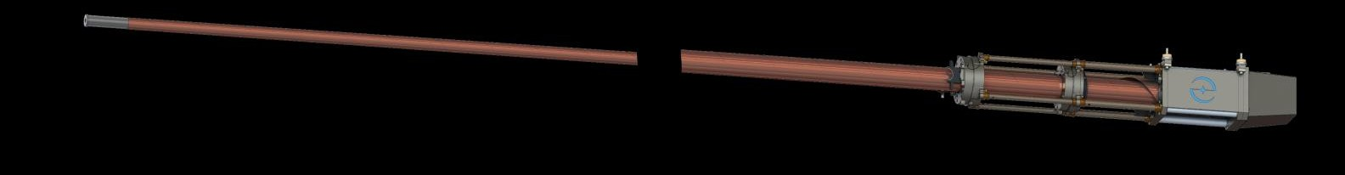
PRODUCTS
The SABER Deployable Boom Product Line
Mission unique heritage, productized: standardized mechanisms with published interfaces, short lead times, and configurations from monopole to dipole to custom geometries.
Model SB1
Model SB2
Deploys 1.0 m to 10.0 m
Up to 30:1 stow ratio
3.5 to 5.0 kg class mass
MAVEN, Solar Orbiter, and Europa Clipper heritage
Deploys 1.0 m to 6.0 m
Up to 50:1 stow ratio
200 g class mass
Rated -200 C to +200 C
SB1 class flight mechanisms
SB2 mechanism render
Europa Clipper REASON high frequency antenna configuration: 58 ft (17.6 m) tip to tip deployed length.
Heliospace Corporation | Proprietary and Confidential
5

Slide 6
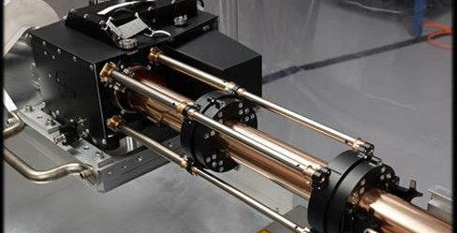
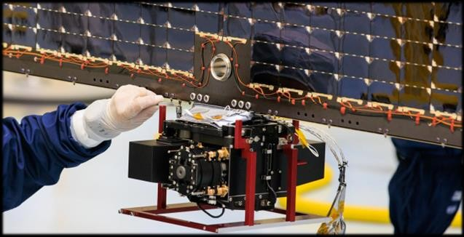
PRODUCT DETAIL
Model SB1: The Flight Proven Workhorse
A low mass, compact, high reliability boom for antennas, sensors, and deployed hardware, with well controlled deployment to precise lengths of up to 10.0 m.
Deployed length | 3.3 to 32.8 ft (1.0 to 10.0 m), selectable
Mass | 7.7 lb (3.5 kg) at 4.0 m; 11.0 lb (5.0 kg) at 10.0 m
Stowed envelope | 4.2 x 5.3 x 13.6 in (11 x 13 x 35 cm)
Deploy power | 25 W (+28 V at 0.9 A) for 30 s, typical
Deployment control | About 0.5 m/s; length precision of +/- 0.25 in
Thermal, post deploy | -135 C to +120 C
Structure | Stowed first mode above 200 Hz
Random vibration | GSFC-STD-7000B protoflight levels
Controlled deployment testing at the Berkeley facility.
SB1 class mechanism integrated on a flight solar array.
Heliospace Corporation | Proprietary and Confidential
6

Slide 7
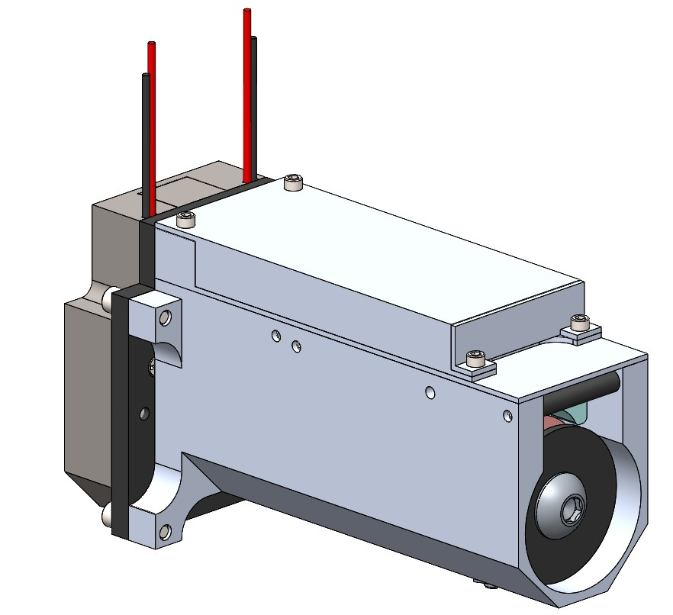
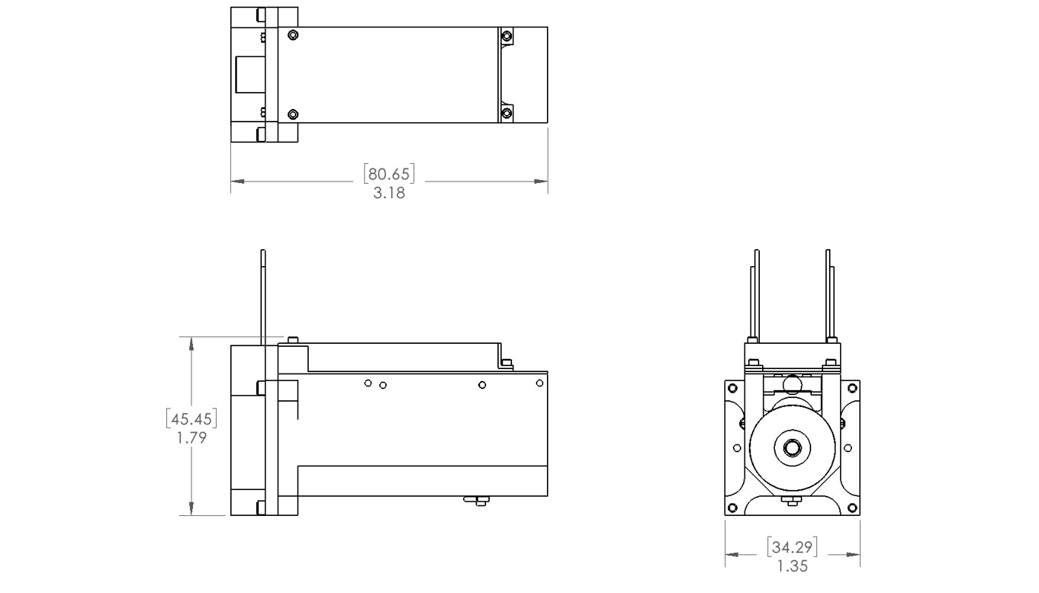
PRODUCT DETAIL
Model SB2: SABER for Small Platforms
A 200 gram class deployable boom that brings full SABER capability to CubeSats, lunar payloads, and mass constrained platforms.
Deployed length
Mass
Up to 19.7 ft (6.0 m)
0.44 lb (200 g)
Stowed envelope
Stow ratio
1.4 x 1.8 x 3.2 in
Up to 50:1
Thermal capability
Deploy power
-200 C to +200 C
134 W pulse, under 10 ms
Proprietary release mechanism
Deployable element shown in red.
Melt wire design with redundant actuation mechanisms and circuits
Re usable, non explosive release; no ordnance handling
Operates above 150 C, beyond the 90 to 120 C limit of SMA actuators
Roughly one third the stowed length of comparable devices, at lower cost and shorter lead times
Heliospace Corporation | Proprietary and Confidential
7

Slide 8
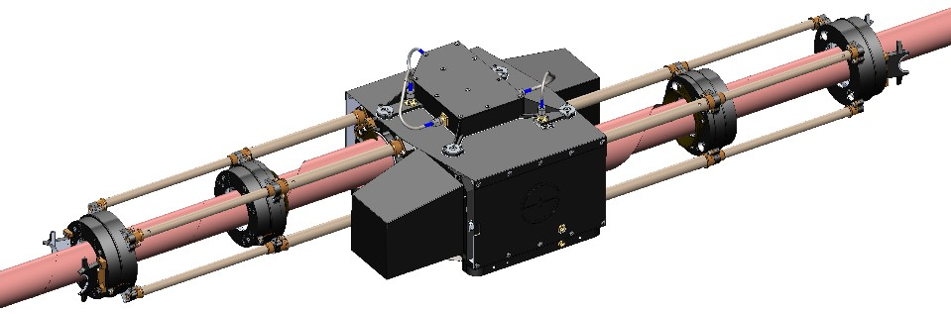
PRODUCTS
Deployable Antenna Systems
Stacer based flight antennas for sensitive receivers, transmitters, and radars, configurable as monopoles, dipoles, folded dipoles, and custom arrays with tip mounted instruments.
Configurations and options
Element lengths of 1 m to 10 m in BeCu or Elgiloy
Monopole, dipole, folded dipole, and custom geometries
Grounded, isolated, or driven antenna elements
Sensors and instruments integrated at the boom tip
Delivered fully qualified to mission requirements
18 m class dipole with central mechanism, shown deployed.
Flight heritage
Example: 18 m tip to tip dipole (REASON HF class)
Solar Orbiter RPW (ESA) | Three 6.5 m antennas, DC to 20 MHz
Europa Clipper REASON | Two 18 m dipoles; four 2.5 m folded dipoles
SunRISE (NASA/JPL) | 28 monopoles for a CubeSat constellation
Dipole mass under 11.3 kg; 20 x 30 x 10 cm stowed per side
Self powered deployment with non explosive actuation
Hundreds of successful operational Stacer deployments
Heliospace Corporation | Proprietary and Confidential
8

Slide 9
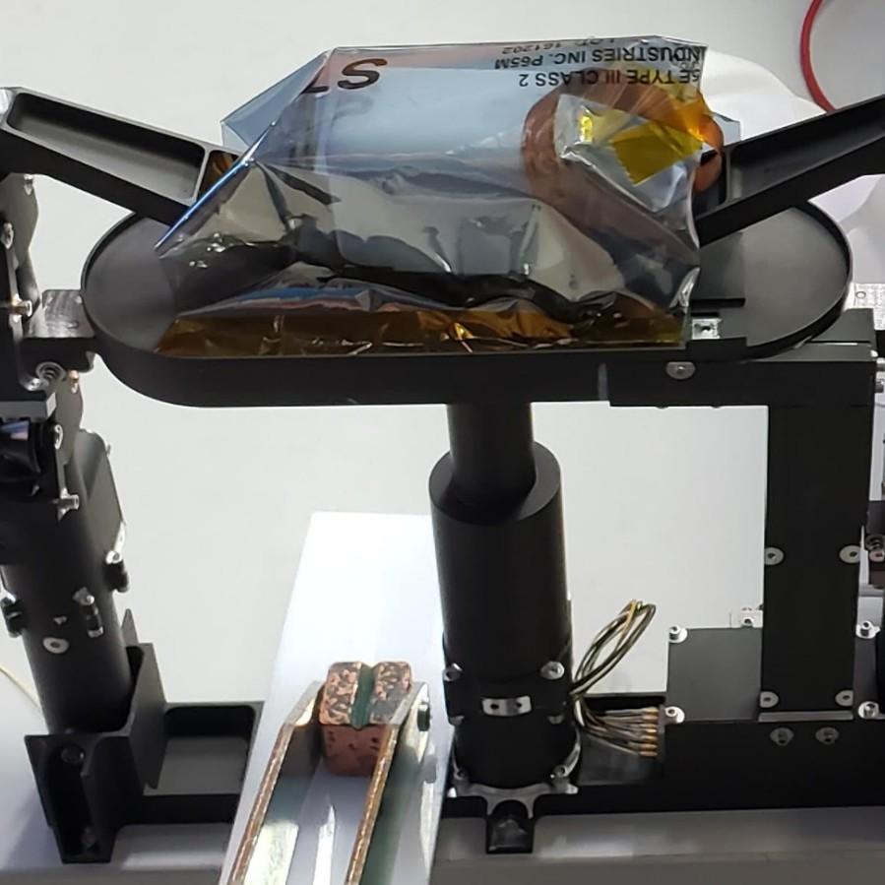
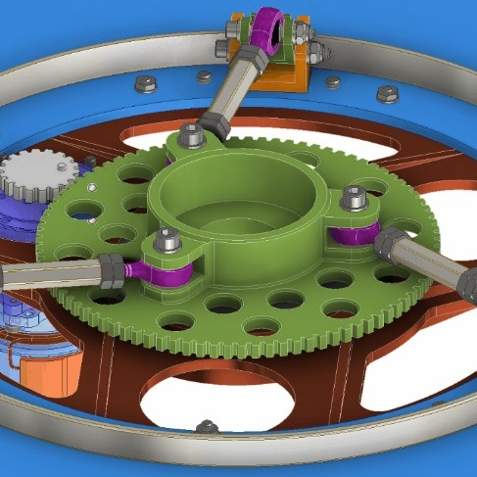
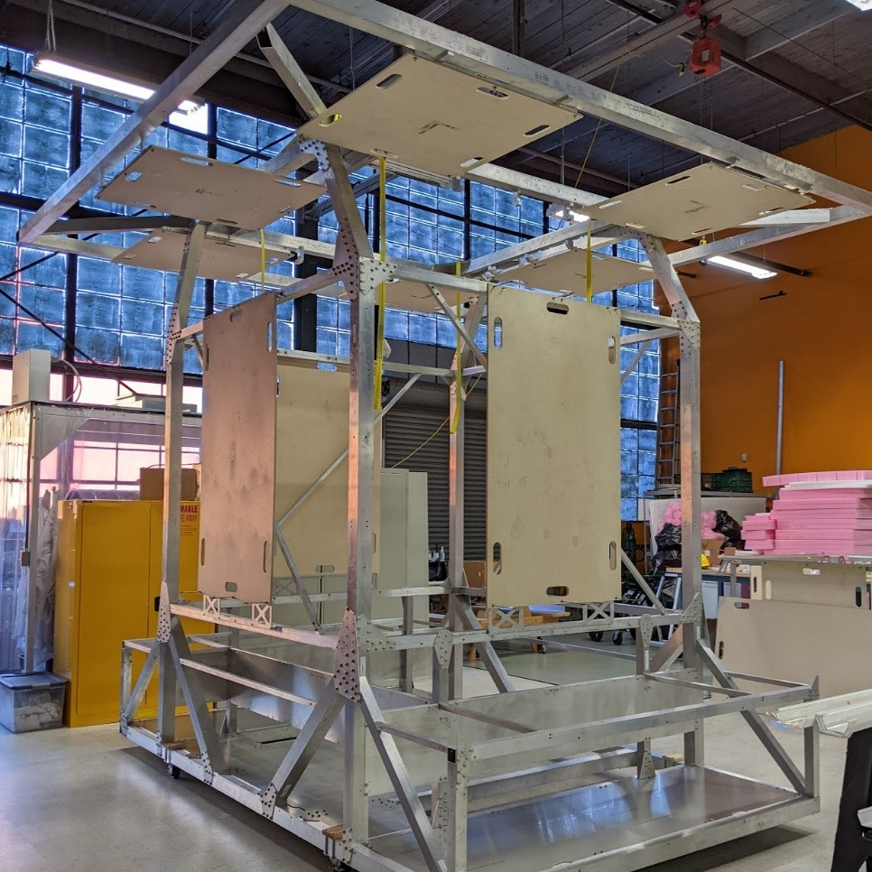
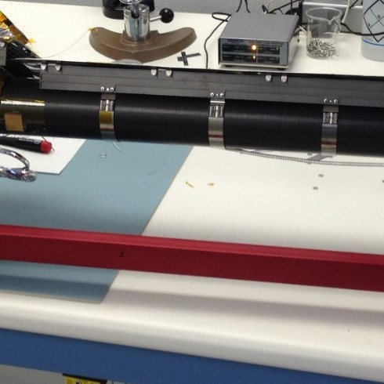
PRODUCTS
Sensors, Mechanisms, and Instruments
Beyond booms and antennas, Heliospace delivers the surrounding flight hardware: payload sensors, release and retention mechanisms, instrument structures, and extreme environment thermal protection.
Lunar and suborbital payloads
Release mechanisms
Electric field sensor packages and launch mortars for the LMS instrument, ROLSES lunar antennas, and 7 m quad boom packages for the SEED sounding rocket program.
Precision retention, release, and handling mechanisms developed for Mars Sample Return concepts, alongside the proprietary SABER melt wire release.
Instruments and structures
Extreme environments
COSI gamma ray instrument cryostat and shield, the GAPS antimatter detector gondola, and UVEX ultraviolet telescope structure concepts.
All niobium multilayer insulation and thermal design protecting Solar Orbiter antennas that reach nearly 500 C in a 15 sun environment.
Heliospace Corporation | Proprietary and Confidential
9

Slide 10
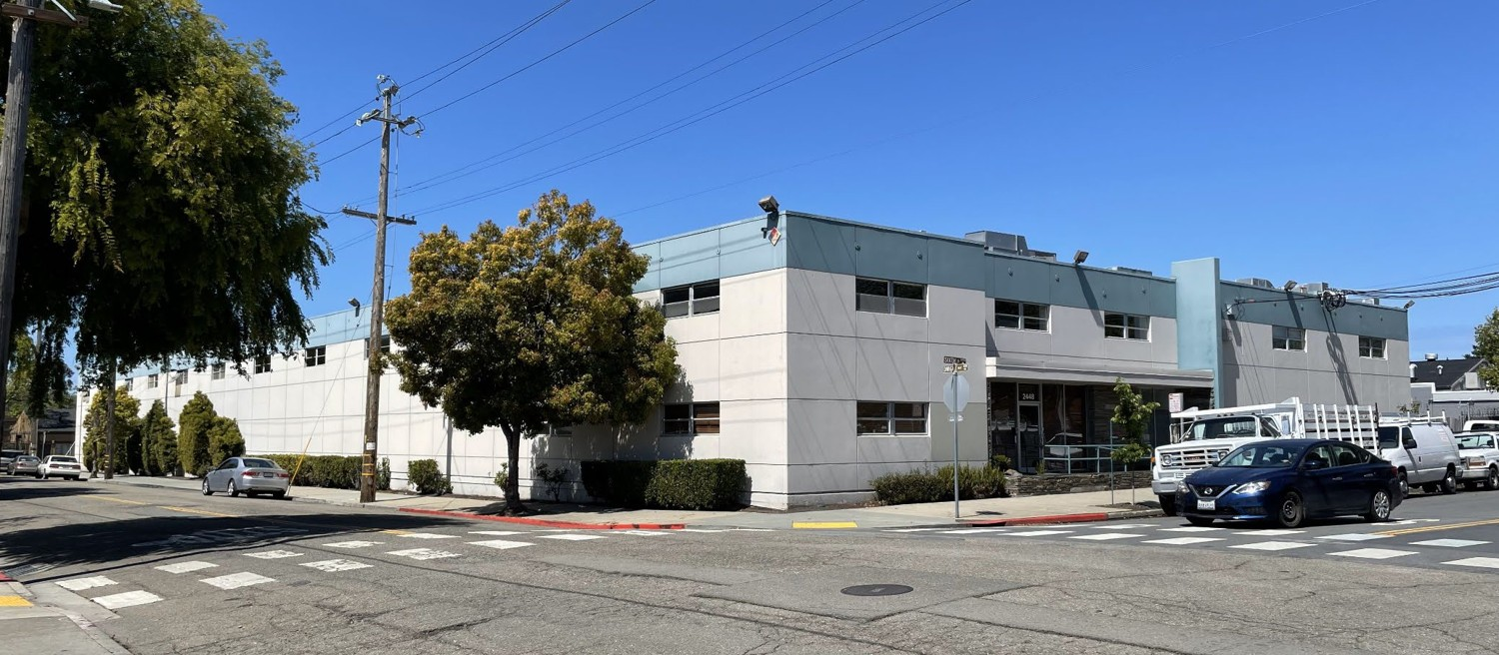
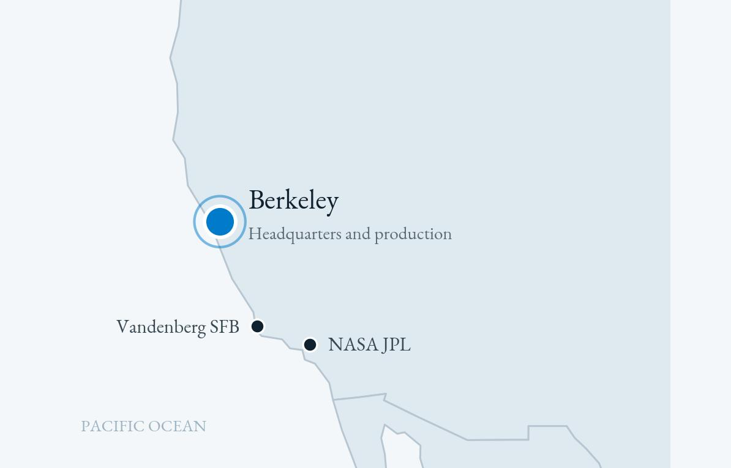
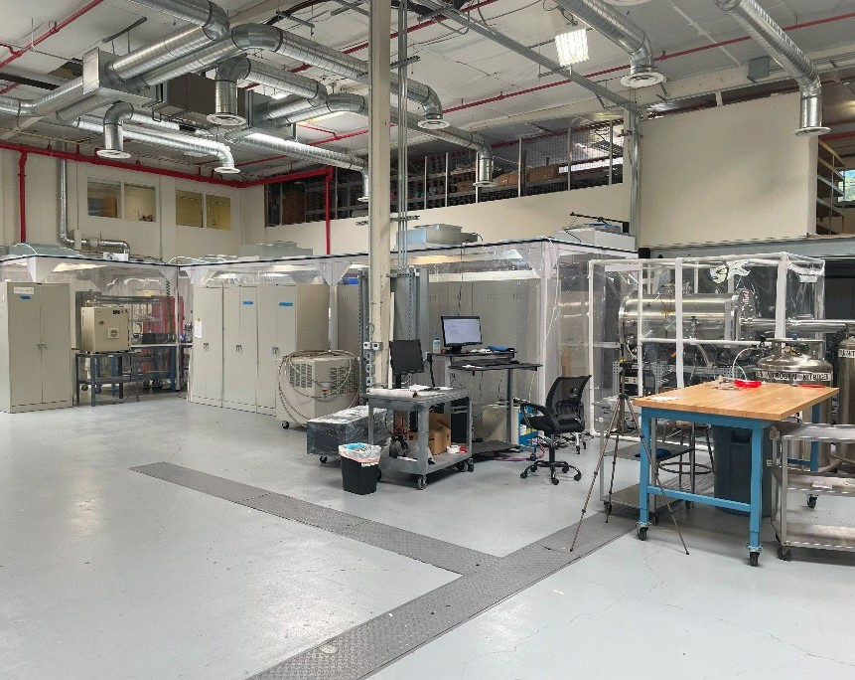
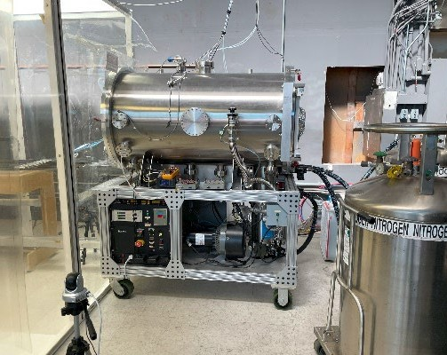
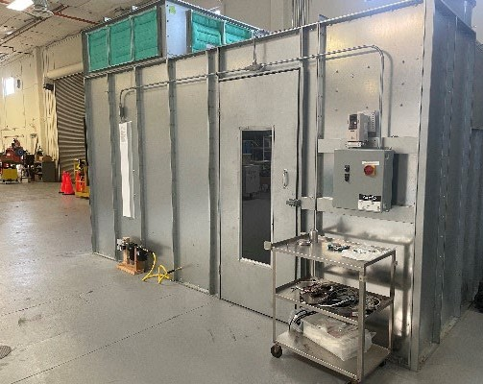
FACILITIES AND LOCATION
Purpose Built Production in Berkeley
20,000 square feet
of production capacity: high bay assembly and test, cleanroom, thermal vacuum chamber, and machine shop.
Heliospace Corporation
2448 Sixth Street, Berkeley, CA 94710
San Francisco Bay Area: near NASA Ames, UC Berkeley, and the West Coast supply base.
High bay assembly
Thermal vacuum
Cleanroom
Heliospace Corporation | Proprietary and Confidential
10

Slide 11
MARKET OPPORTUNITY
A Structurally Expanding Market
Global space economy, USD billions
Addressable market, top down
TAM: TOTAL SPACE ECONOMY
$1.8 trillion by 2035E
Global space economy forecast (World Economic Forum and McKinsey, 2024)
SAM: SATELLITE MANUFACTURING
$20.4 billion in 2025
Global commercial satellite manufacturing revenue (SIA and BryceTech, 2026)
SOM: DEPLOYABLE BOOMS, ANTENNAS, AND MECHANISMS
16,900 small satellites, 2026 to 2035E
Forecast for launch (Novaspace). No independent estimate is published for this niche; it is presented qualitatively.
Source: World Economic Forum and McKinsey, Space: The $1.8 Trillion Opportunity, 2024.
Sources: World Economic Forum and McKinsey, 2024; SIA and BryceTech, State of the Satellite Industry Report, 2026; Novaspace, Satellites to be Built and Launched, 2025.
Heliospace Corporation | Proprietary and Confidential
11

Slide 12
COMPETITIVE POSITION
Why Customers Choose Heliospace
1
Proven space heritage
4
Innovation and future technology
Helio has supported more than 40 space flight missions and built and deployed more than 125 instruments and systems, giving customers confidence that its hardware can survive demanding space environments. Its technology has been used on major missions, including NASA's Europa Clipper and support activities related to the James Webb Space Telescope.
Beyond current space hardware, Helio is developing space based solar power systems designed to collect solar energy in orbit and transmit power to Earth. Customers and partners interested in future space infrastructure value Helio's combination of existing engineering capability and long term energy technology goals.
2
Specialized engineering expertise
5
Flexible partner for government and commercial customers
Space missions often require custom solutions rather than off the shelf products. Helio focuses on deployable antennas, sensors, large deployable structures, spacecraft mechanisms, and systems engineering and design. Customers choose Helio because these components must work reliably in extreme conditions where repair is impossible.
Helio works with government agencies, private aerospace companies, universities, and research organizations, providing customized systems rather than only standardized products.
3
Lower mission risk
In summary
Space agencies and aerospace companies value suppliers with previous successful missions because failures in space are extremely expensive. Helio positions itself as a problem solver for difficult space hardware challenges, helping customers reduce technical risk.
Customers choose Helio because it offers proven space qualified hardware, specialized engineering skills, mission reliability, and a pathway toward next generation space infrastructure.
Heliospace Corporation | Proprietary and Confidential
12

Slide 13


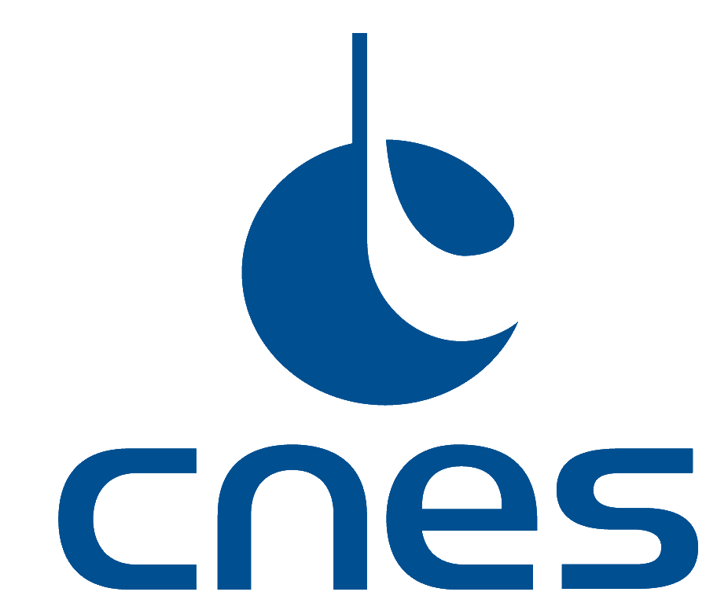






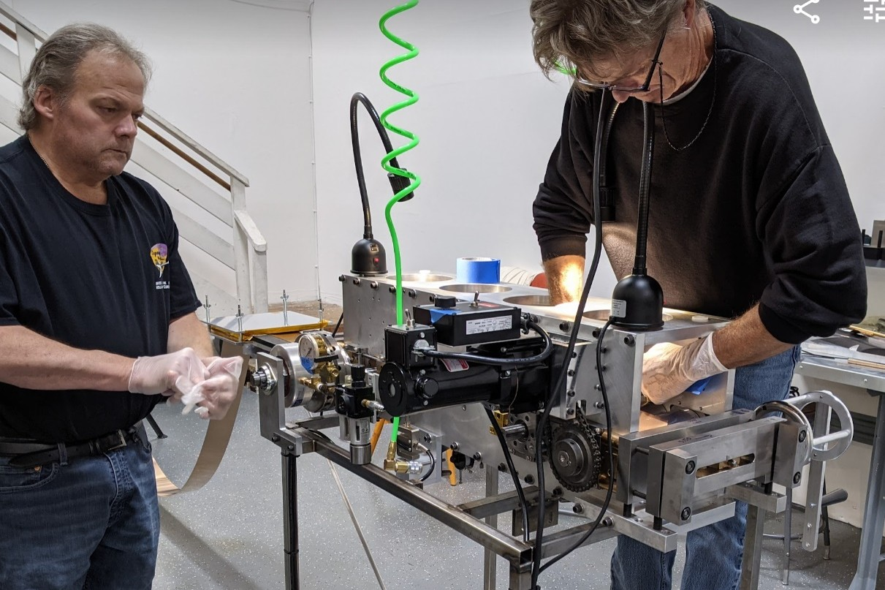
CLIENT BASE
Customers Who Validate the Technology
Space agencies and programs
NASA, NASA JPL, NASA Goddard Space Flight Center, CNES, and the NASA SBIR and STTR America's Seed Fund
Commercial aerospace
Firefly Aerospace, Intuitive Machines, Honeybee Robotics, Blue Origin, Aerodyne, and ASES
Research institutions and universities
Southwest Research Institute, UC Berkeley, Columbia University, and Embry-Riddle Aeronautical University
Science and philanthropic initiatives
Selected clients and partners.
Breakthrough Listen and Earth Guard
10+
Why they stay
missions supported across NASA, ESA, and commercial programs
Supplier of record on marquee missions
On schedule delivery for launch critical payloads
Repeat awards across programs and platforms
Flight hardware assembly at the Berkeley facility.
Heliospace Corporation | Proprietary and Confidential
13

Slide 14
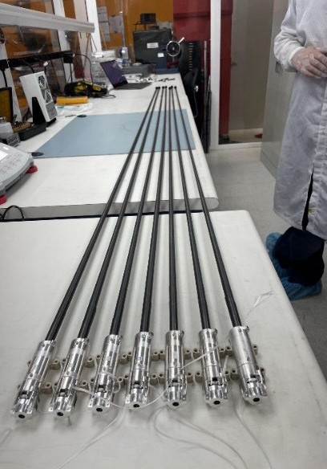
GROWTH STRATEGY
From Heritage Programs to Product Scale
1
2
3
Productize
Scale production
Expand markets
Convert mission unique heritage into the standard SABER catalog with published interfaces, catalog pricing, and lead times measured in weeks.
Expand Berkeley capacity and the in house boom forming line to serve constellation class order volumes without sole source risk.
Grow beyond civil science into US defense and commercial constellation primes, and serve allied international customers in Europe, Japan, Canada, and Australia under US export licenses.
Export compliance
Heliospace hardware and technical data are subject to US export controls under ITAR and the EAR. All international business is pursued only under required US Government authorizations, supported by an internal export compliance program.
Heliospace Corporation | Proprietary and Confidential
14

Slide 15
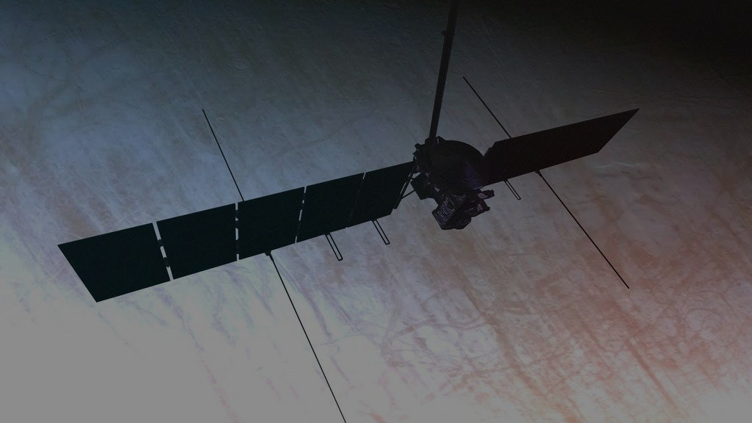
THANK YOU
Questions and Discussion
Rocky Chen
Exclusive Sales Distributor in China
rocky@helio.space | 19921169641
Proprietary and Confidential

