Slide 1
The Landscape of Immune Dysregulation in Crohn's Disease Revealed Through Single-Cell Transcriptomic Profiling in the Ileum and Colon by Kong et al.
Notes:
Introduction of selves
For our project, we decided to pick a study of interest, reproduce their results, find potential pitfalls in their results and analysis and extend their original analyses.

Slide 2
Introduction
Kong investigated alterations in gene expression across diverse cell types within the GI tract affected by Crohn’s disease
Crohn’s disease is multifactorial. There have been discoveries of risk genes related to:
Epithelial barrier function
Microbe sensing and restriction
Adaptive immunity
Notes:
Investigating the gene expression across diverse cell types, Kong hoped to paint a better picture of the underlying mechanisms related to the disease. In a larger context, this research is important because the treatment burden is billions of dollars.
Understanding such a complex disease requires a full system-level understanding of what is going on – hence the use of single-cell transcriptomics across different cell types

Slide 3
Investigating Differential Cell Expression
Kong used Model-Based Analysis of Single-Cell Transcriptomics (MAST) to find the expression of different cells
Kong compared the expression of different cells amongst healthy, non-inflamed and inflamed tissues
All genes with no disease-related difference were filtered out

Slide 4
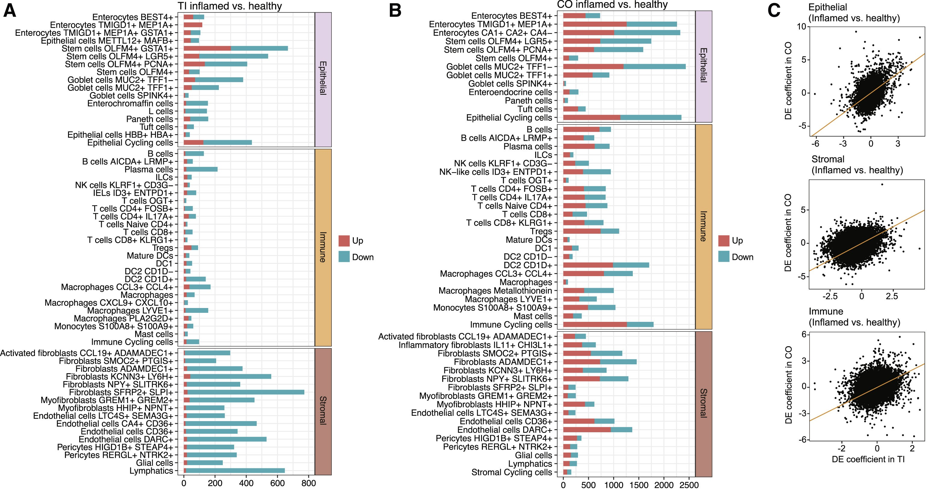
Notes:
Figure 3. Location- and cell-type-specific differential expression in active CD
(A) Number of differentially expressed genes between inflamed CD and healthy samples in TI, broken down by cell type (discrete component of a MAST model; FDR < 0.05).
(B) Same as (A) but for CO.
(C) Relationship between differential expression in TI and CO for each cell compartment.

Slide 5
Overall Conclusion
Kong found organ and compartment specific responses to acute and chronic inflammation
Most immune changes were in cell composition and transcriptional changes dominated among epithelial and stromal cells
disease-associated markers of myofibroblast activation were identified
Notes:
Altogether, these results contribute to the wholistic understanding of cell-type and organ specific differences in Crohn’s disease and therefore elude to potential directions for therapeutic development.
Myofibroblasts are specialized cells that are involved in wound healing, tissue repair, and tissue remodeling
These genes may therefore be involved in CD-related fibrotic strictures and suggest novel therapeutic hypotheses for the management of this complication

