Slide 1
The Landscape of Immune Dysregulation in Crohn's Disease Revealed Through Single-Cell Transcriptomic Profiling in the Ileum and Colon by Kong et al.
Presented by: Anthony Lopes, Haikun Zhao, James Chung
Notes:
Introduction of selves
For our project, we decided to pick a study of interest, reproduce their results, find potential pitfalls in their results and analysis and extend their original analyses.

Slide 2
Introduction
Kong investigated alterations in gene expression across diverse cell types within the GI tract affected by Crohn’s disease
Crohn’s disease is multifactorial. There have been discoveries of risk genes related to:
Epithelial barrier function
Microbe sensing and restriction
Adaptive immunity
Notes:
Investigating the gene expression across diverse cell types, Kong hoped to paint a better picture of the underlying mechanisms related to the disease. In a larger context, this research is important because the treatment burden is billions of dollars.
Understanding such a complex disease requires a full system-level understanding of what is going on – hence the use of single-cell transcriptomics across different cell types

Slide 3
Investigating Differential Cell Expression
Kong used Model-Based Analysis of Single-Cell Transcriptomics (MAST) to find the expression of different cells
Kong compared the expression of different cells amongst healthy, non-inflamed and inflamed tissues
All genes with no disease-related difference were filtered out

Slide 4
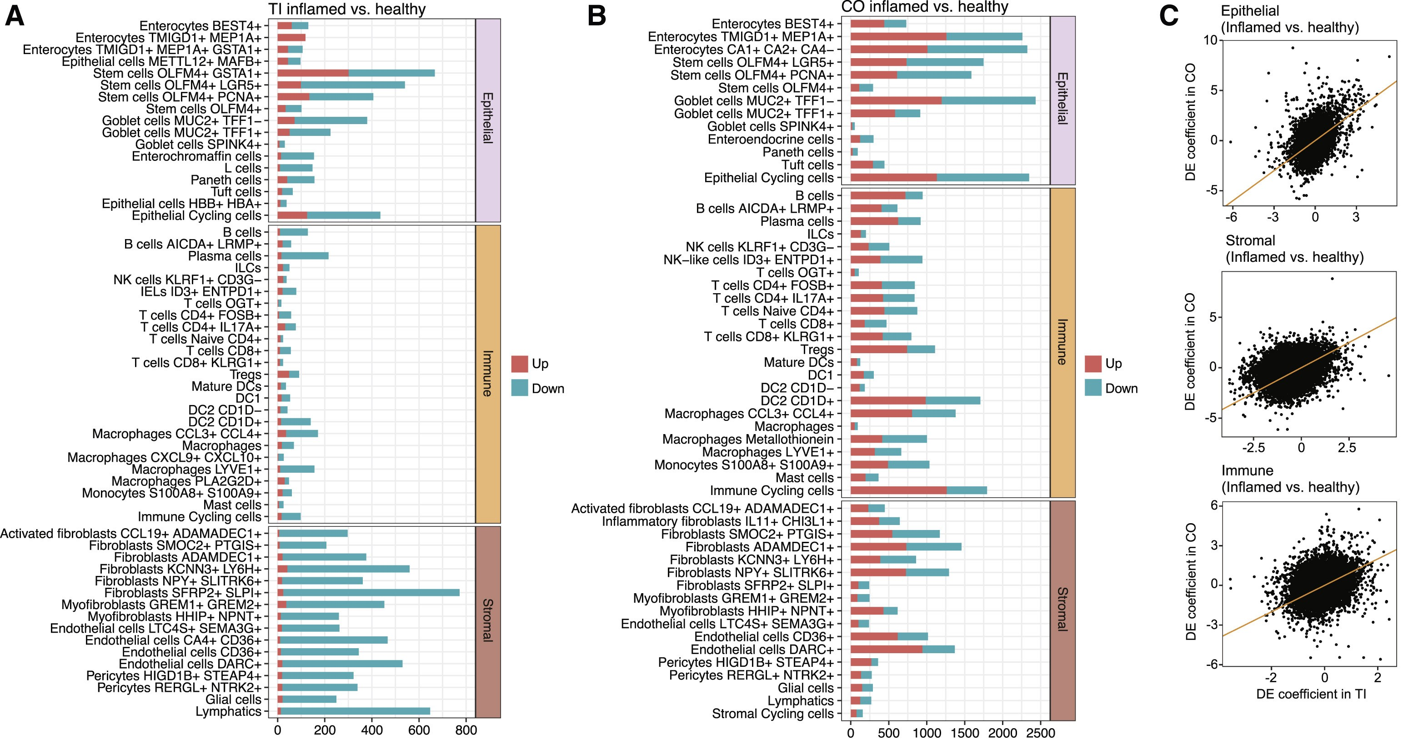
Notes:
Figure 3. Location- and cell-type-specific differential expression in active CD
(A) Number of differentially expressed genes between inflamed CD and healthy samples in TI, broken down by cell type (discrete component of a MAST model; FDR < 0.05).
(B) Same as (A) but for CO.
(C) Relationship between differential expression in TI and CO for each cell compartment.

Slide 5
Kong’s Conclusion
Kong found organ and compartment specific responses to acute and chronic inflammation
Most immune changes were in cell composition and transcriptional changes dominated among epithelial and stromal cells
disease-associated markers of myofibroblast activation were identified
Notes:
Altogether, these results contribute to the wholistic understanding of cell-type and organ specific differences in Crohn’s disease and therefore elude to potential directions for therapeutic development.
Myofibroblasts are specialized cells that are involved in wound healing, tissue repair, and tissue remodeling
These genes may therefore be involved in CD-related fibrotic strictures and suggest novel therapeutic hypotheses for the management of this complication

Slide 6
Differential Expression with MAST
MAST – Finak et al. (2015)
Analysis has two parts (hurdle model):
(1) discrete component of gene expression (binary – a gene is expressed or not)
(2) continuous component (expression level given that a gene is expressed)
Standard prep with Seurat (log-transform, normalize)
Model allows for flexible covariates
E.g., multiple treatment groups, technical factors (batch/time info)
Notes:
MAST: Model-based Analysis of Single-cell Transcriptomics
Allows for flexible covariates due to linear nature of the model (can easily add variables)

Slide 7
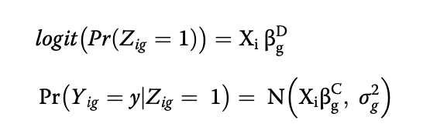
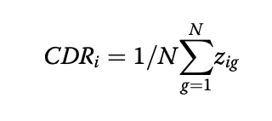
MAST – Hurdle Model
(1) Logistic regression for discrete component (Z)
(2) Expression level (conditional on Z) is modeled by linear Gaussian (Y | Z)
Use MLE to fit this model
For each gene, determine regression coefficients below
Hypothesis testing to determine significance of covariates’ effects on gene expression
Genes with p-values below threshold are considered differentially expressed
Notes:
X: covariates
Z: probability of a gene being expressed in a cell (binary – 0 or 1)
Y|Z: predicts the expression level of a gene given that it is expressed in the cell (i.e., Z=1)
CDR (Cellular detection rate): proportion of genes detected in each cell
Account for CDR variability by linearly adding this variable as a covariate in the discrete and continuous models (Basically add a column to matrix X)
Hypothesis testing w.r.t.

Slide 8
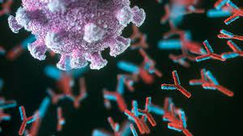

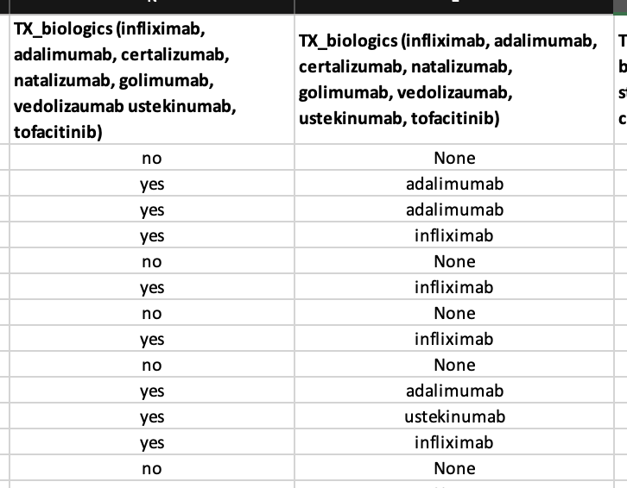
Further Exploration with MAST
Limitation of study: authors aware that patients were on various biologics but did not consider for model
Original MAST model used for study:
“Expression ~ NGenes + Layer + DiseaseGroup”
Presence or absence of immunotherapies may affect differential expression esp. w.r.t. immune cells.
Patients’ treatments are detailed in supplementary data. Could add as covariate.

Slide 9
DESeq2
Michael Love, Wolfgang Huber, and Simon Anders (2014)
Identify differentially expressed genes (DEGs)
Generalized linear model (GLM) based on the negative binomial distribution
Notes:
GLMs: Generalize ordinary linear regression by relating the linear model to the response variables via a link function
Extend the linear model to accommodate non-normal response variables

Slide 10
Key features of DESeq2
Normalization
Dispersion estimation & fold change
Differential expression analysis
Result visualization
Notes:
Normalization: DESeq2 uses a normalization method based on the assumption that the majority of genes are not differentially expressed. It calculates size factors to adjust for library size differences between samples, ensuring accurate comparisons of gene expression levels.
Dispersion estimation: DESeq2 estimates the dispersion of count data, which represents the biological variability among replicates. This is essential for identifying DEGs while minimizing false positives.
Dispersion: parameter that Love et al. developed – biological variability between samples - The dispersion parameter links the variance and mean of the count for the negative binomial distribution.
Differential expression analysis: DESeq2 fits a negative binomial generalized linear model to the count data and tests for differential expression using the Wald test or the likelihood ratio test. It provides log2 fold changes, p-values, and adjusted p-values (using the Benjamini-Hochberg procedure) to control for false discovery rates.
Fold change: is a measure describing how much a quantity changes between an original and a subsequent measurement.
Result visualization: DESeq2 offers various visualization options, including MA plots, volcano plots, and heatmaps, to facilitate the interpretation and presentation of differential expression results.

Slide 11
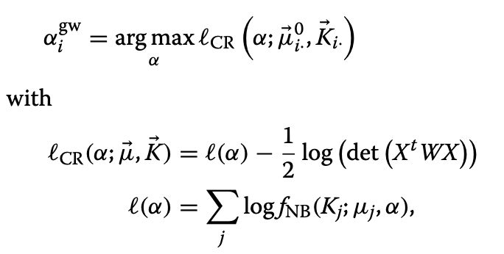
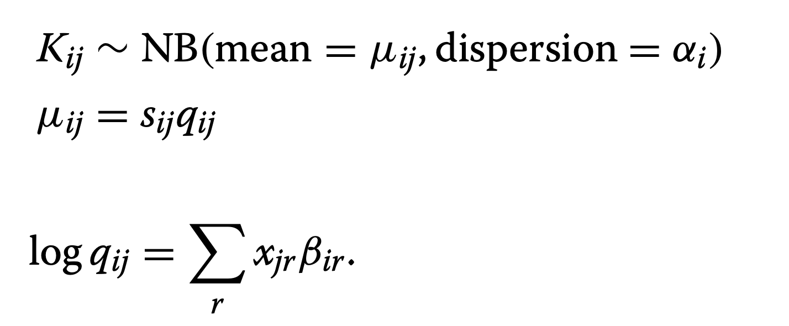
Running DESeq2
In DESeq2, read counts (K_{ij} for gene i in sample j) are distributed by a GLM of negative binomial family with logarithmic link function
Dispersion estimates for each gene
Notes:
X: covariates (i.e., the elements in design matrix)
ESTIMATING DISPERSION: First, fit negative binomial GLM with the count data > obtain fitted values for mu, and then maximize the “Cox-Reid adjusted likelihood of dispersion” to obtain alpha
GLMs: Generalize ordinary linear regression by relating the linear model to the response variables via a link function

Slide 12
Main findings (Preliminary)
Differential expression profiles showed some consistency between the CO and TI, particularly in epithelial and stromal cells. However, weak correlations indicate that the two sites behave very differently.
Differential expression was more pronounced in the CO compared to the TI, with the transcriptional response to inflammation being more marked in the CO. This difference was particularly strong among epithelial cell types.
Immune cells showed the least differential expression in inflammation. This suggests that compositional changes, such as infiltration of activated immune cells, are the main drivers of immune differences.

Slide 13
MAST vs. DESeq2
MAST: Particularly good at handling "dropouts" and high variability in scRNA-seq data
DESeq2: Originally designed for bulk RNA-seq, not optimal for handling dropouts and high variability in scRNA-seq data
Both MAST and DESeq2 allow for easy expansion of covariates
Notes:
One important characteristic of scRNA-seq data that feeds into all these challenges is a phenomenon called “dropout”, where a gene is observed at a low or moderate expression level in one cell but is not detected in another cell of the same cell type
SENSITIVITY: TP/TP+FN, probability that an actual positive will test positive
PRECISION: TP/TP+FP, proportion of cases giving positive test results amongst those labeled as positive

Slide 14
Comparative Analysis of DE Tools (Wang et al., 2019)
Trade-off between sensitivity and precision
MAST: High precision but low sensitivity
DESeq2: More balanced performance between sensitivity and precision

Slide 15
Expected Outcomes in Healthy vs. Inflamed Analysis
DESeq2 may not identify as many up-regulated or down-regulated genes as MAST in the comparison between healthy and inflamed tissues.
This could be due to DESeq2's bulk RNA-seq design and less effective handling of dropout events and high variability in scRNA-seq data.
Researchers should consider the trade-offs between sensitivity and precision when choosing a differential expression analysis tool for scRNA-seq data.

