Slide 1
Predicting solar installation rates in different locations using demographic data

Slide 2
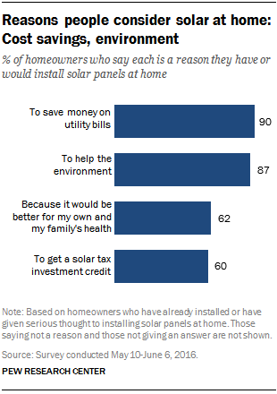
Solar installations are integral in our transition to renewable energy sources
As the effects of global climate change are becoming better understood, the move towards renewable energy sources has become an important focus
Solar energy is emerging as one of the most popular forms of renewable energy for reasons such as decreasing costs, environmental ethics, health, government incentives and accessibility

Slide 3
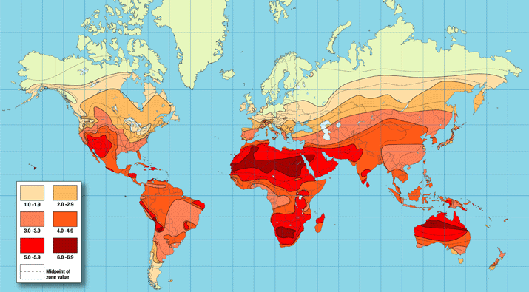
Australia has some of the world’s best solar exposure

Slide 4
Prediction has value to policy makers, investors and researchers
Reliable predictions on installation rates may guide projections and highlight both the level and content of policy intervention justified in affecting solar uptake
Investors in the solar industry hold an advantage if they have reliable guidance on which local government areas in the future (accounting for demographic shifts) are likely to install solar
Results from attempting to answer this question may lead to new lines of inquiry among researchers (e.g. if we can indeed predict installation rates then that provides justification to then do further research on which exact demographic factors have an effect)

Slide 5
Scope of analysis
To answer: “Can we predict solar installation rates in the different local government areas of Australia using demographic data?”
To build a machine learning algorithm to make predictions on solar installation rates in different local government areas (LGAs) given certain demographic factors
(Not included in analysis): which specific demographic factors are related to different solar installation rates

Slide 6
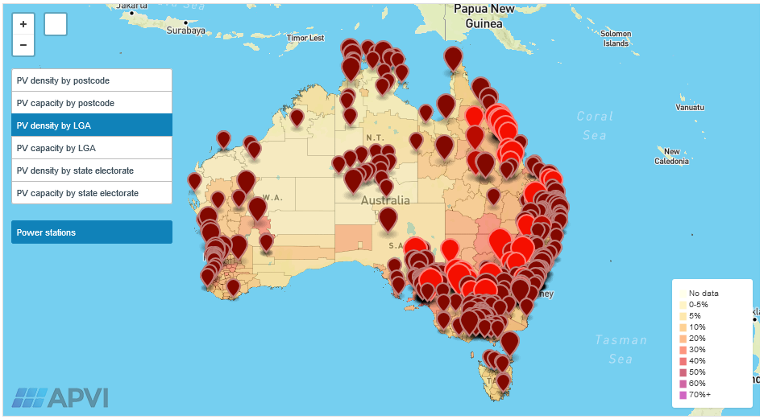
Solar installation rate data from Australian Photovoltaic Institute

Slide 7
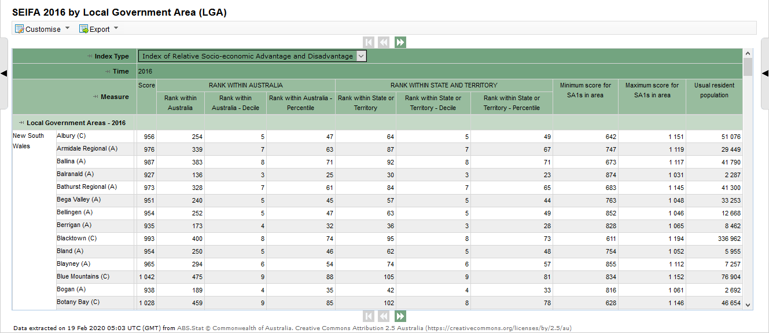
Demographic information datasets from Australian Bureau of Statistics

Slide 8
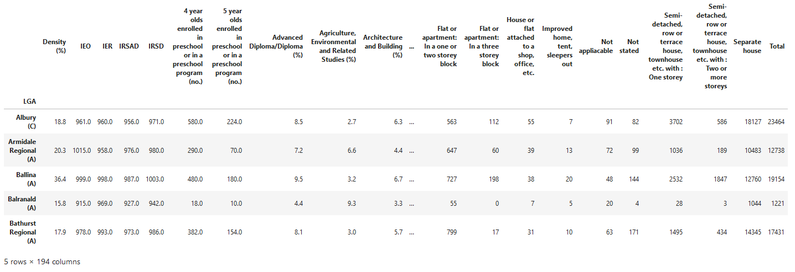
Data converted to form where demographic predictors are columns

Slide 9
Data processing
Combined dataset size was 481 rows by 194 columns
Predictors with missing values were imputed or dropped, resulting in dataset size of 481 rows by 125 columns
Train-test split of 70-30 was performed
Scaling and principal components transformation of predictors was performed
The first 20 principal components captured 99.999% of variability in predictors
These first 20 principal components were used as predictors and the density (solar installation rate) as the response for our machine learning models

Slide 10

Four machine learning models were built
Multiple Linear Regression Model
Boosting Regression Model
Random Forest Model
Random Forest Model with Hyperparameter Tuning
Random Forest Model (without tuning) was selected as final model

Slide 11
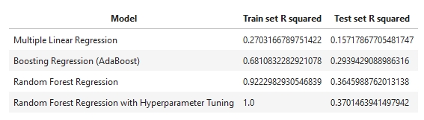
We can indeed predict solar installation rates by LGA using demographics
Within our final model (using Random Forest Regression), around 36% of the variability in solar installation rates can be predicted by demographic factors

Slide 12
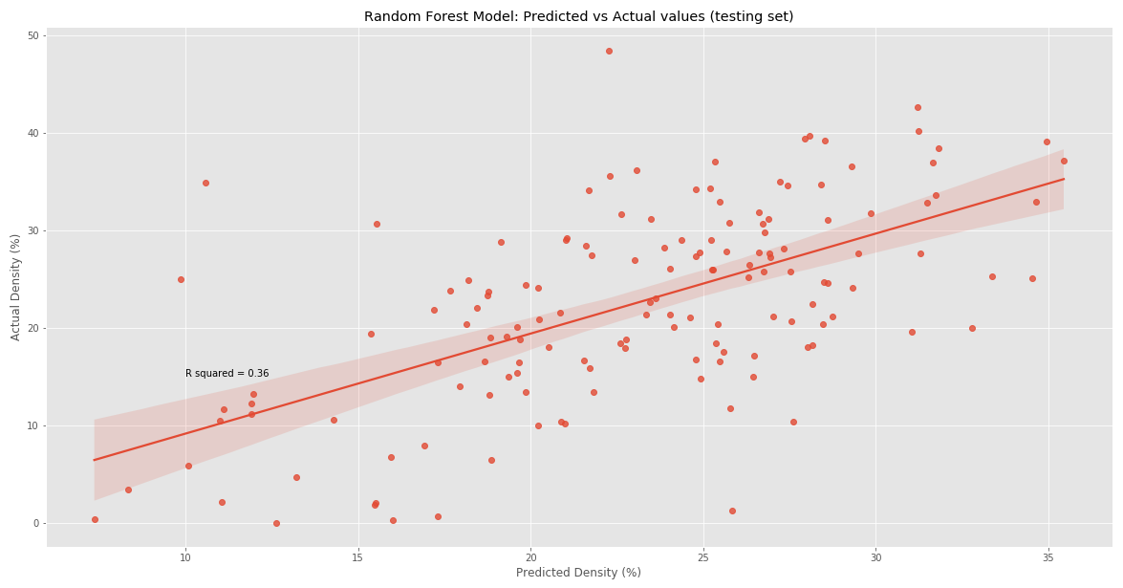
Demographic factors clearly affect solar installation rates

Slide 13
Conclusion and recommendations
A Random Forest model which was able to explain around 36% of variability in solar installation rates was built
There is a clear link between solar installation rates in different LGAs and demographics
Qualitative research should be conducted to elicit what are the most relevant demographic or even individual factors affecting solar installation
Perform further data collection on a finer scale to create larger datasets for computational analysis, preferably after conducting the qualitative research so data of greater relevance is collected
Improve upon current algorithm to build a model with higher accuracy

Slide 14
References
Liu, A. (2020). Predicting solar installation rates in different locations using demographic data.
https://www.pewresearch.org/fact-tank/2016/10/05/americans-strongly-favor-expanding-solar-power-to-help-address-costs-and-environmental-concerns/
https://www.altestore.com/howto/images/article/world_solar_insolation_data.gif
Australian PV Institute (APVI) Solar Map, funded by the Australian Renewable Energy Agency, accessed from pv-map.apvi.org.au on 19 February 2020.
Australian Bureau of Statistics 2020, viewed 26 February 2020, http://stat.data.abs.gov.au.
https://medium.com/@williamkoehrsen/random-forest-simple-explanation-377895a60d2d

