Slide 1
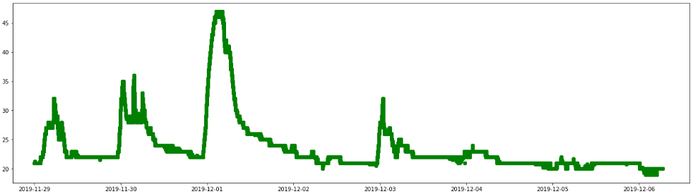
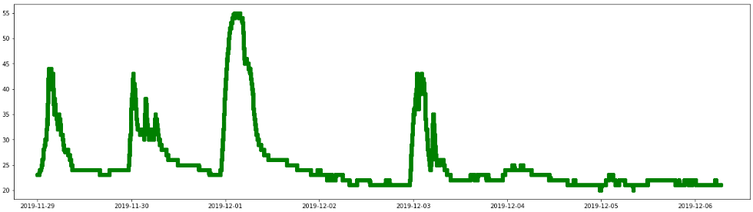
Raspberry Pi Zero Data
(2019-11-28 18:00:00 ~ 2019-12-06 14:00:00)
關窗時間 :
11/28 14:30 ~ 11/29 13:00
12/02 10:00 ~ 12/03 16: 00
Indoor Temperature
RTD Temperature (Glass)

Slide 2
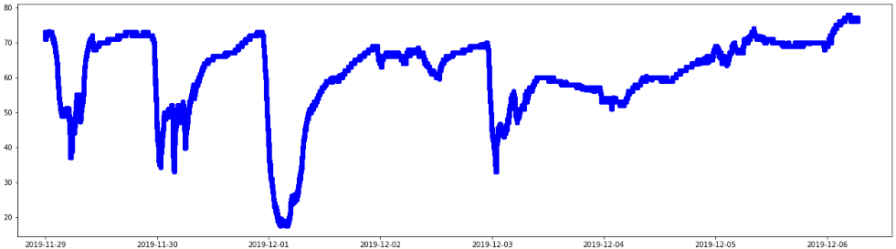
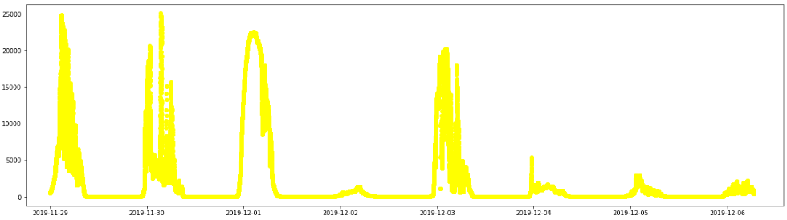
Raspberry Pi Zero Data
(2019-11-28 18:00:00 ~ 2019-12-06 14:00:00)
關窗時間 :
11/28 14:30 ~ 11/29 13:00
12/02 10:00 ~ 12/03 16: 00
Indoor Humidity
Lux Meter

Slide 3
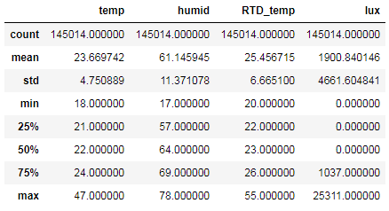
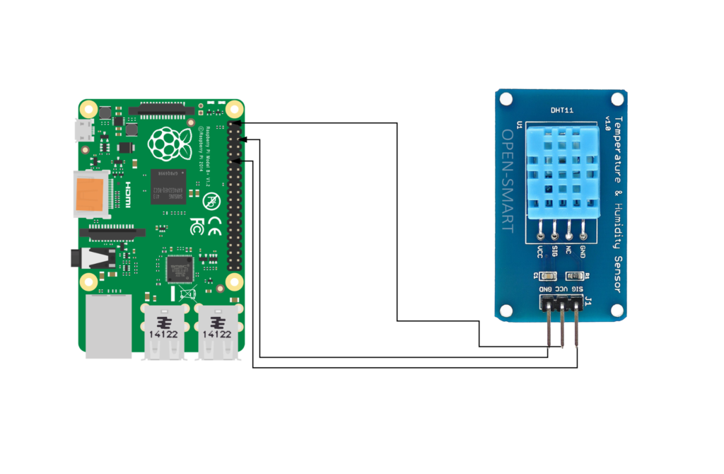
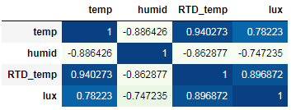
Raspberry Pi Zero Data
(2019-11-28 18:00:00 ~ 2019-12-06 14:00:00)
Brief Description
關窗時間 :
11/28 14:30 ~ 11/29 13:00
12/02 10:00 ~ 12/03 16: 00
Correlation Matrix

Slide 4
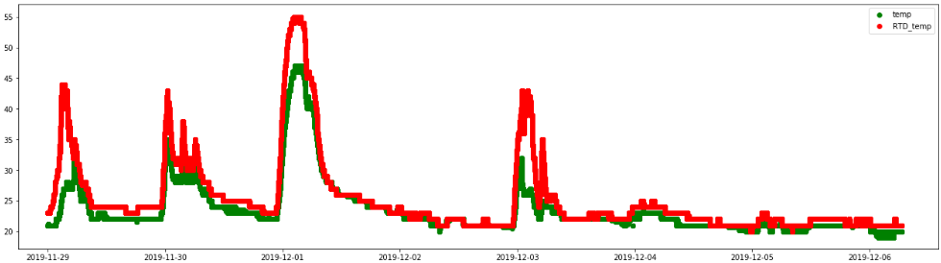
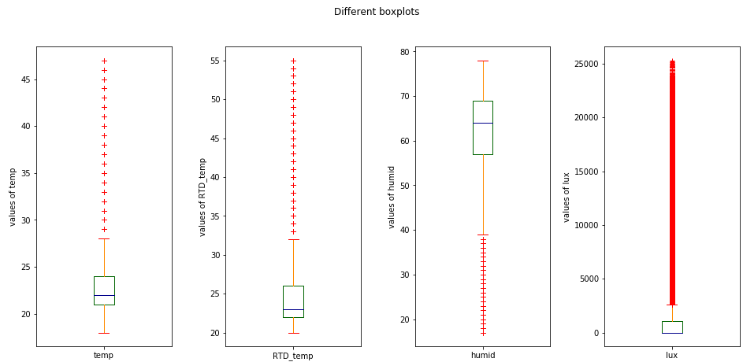
Raspberry Pi Zero Data
(2019-11-28 18:00:00 ~ 2019-12-06 14:00:00)
關窗時間 :
11/28 14:30 ~ 11/29 13:00
12/02 10:00 ~ 12/03 16: 00
Temperature Comparison
Box plot

Slide 5
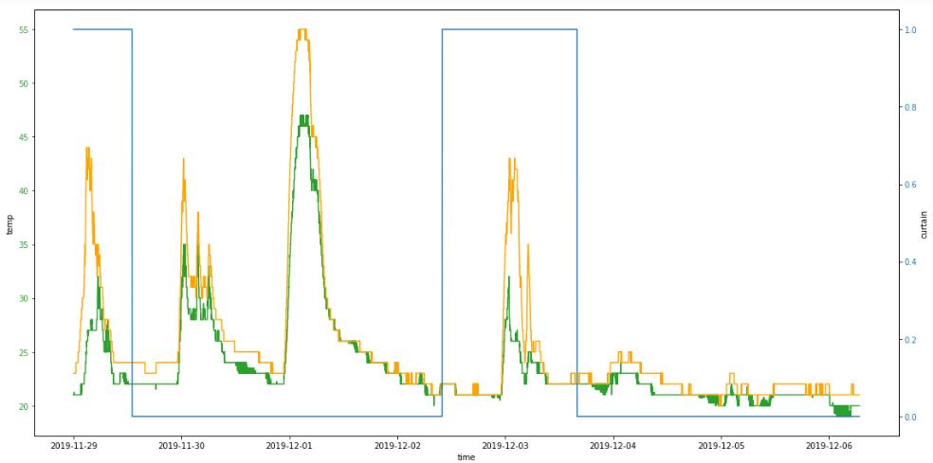
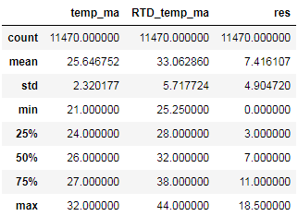
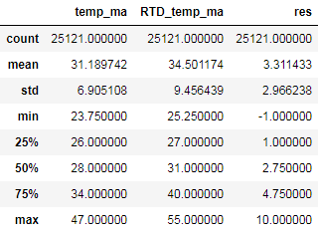


Raspberry Pi Zero Data
(2019-11-28 18:00:00 ~ 2019-12-06 14:00:00)
關窗時間 :
11/28 14:30 ~ 11/29 13:00
12/02 10:00 ~ 12/03 16: 00
Temperature Comparison
Temperature Describe (down)
Temperature Correlation (up)

