Slide 1


Career Services Overview
Lily Holzner, M.S.
She/Her/Hers
CSM Career Counselor

Slide 2
We've Got You Covered
Resume/Cover Letter Review
Mock Interviewing
Career Exploration
Job Search
Online Assessments (Values, Interests, Personality, & Strengths)
LinkedIn/Cal Poly Career Connections
Career Fair Prep
Elevator Pitch
Salary Negotiation
Job Offer Evaluation
Grad School Prep
Network Opportunities
Change of Major/Major Indecision

Slide 3
Events Workshops & Programs
Virtual Career Fairs
Workshops & Events
Emerging Markets, Professional Panels, & Industry Insiders
Career Counseling Groups
Professional Development Certificate

Slide 4
24/7 Resources: careerservices.calpoly.edu
MustangJOBS, powered by Handshake
Big Interview
Sample Resumes & Templates
Career Self-Assessments
Graduate Status Report
Cal Poly Career Connections
Portfolium
Virtual Career Resource Library

Slide 5

So I'm a math major...
What can I do with that?

Slide 6
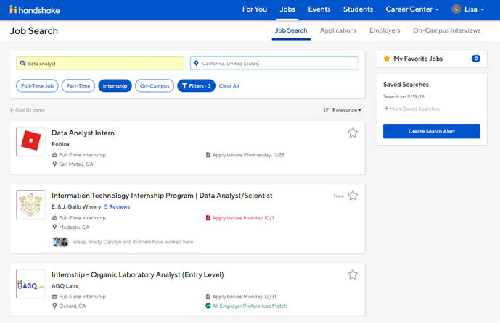
MustangJOBS: Powered by Handshake
Access through your
Cal Poly Portal:
Online job listing service
Update your profile**
Connect with employers
Notes:
Pull out of presentation and show them how to navigate Handshake
Jobs, Events, Q & A, Students, Career Center
Jobs: Job search, save applications/favorite positions, on-campus interviews
Students: Peer to peer networking

Slide 7
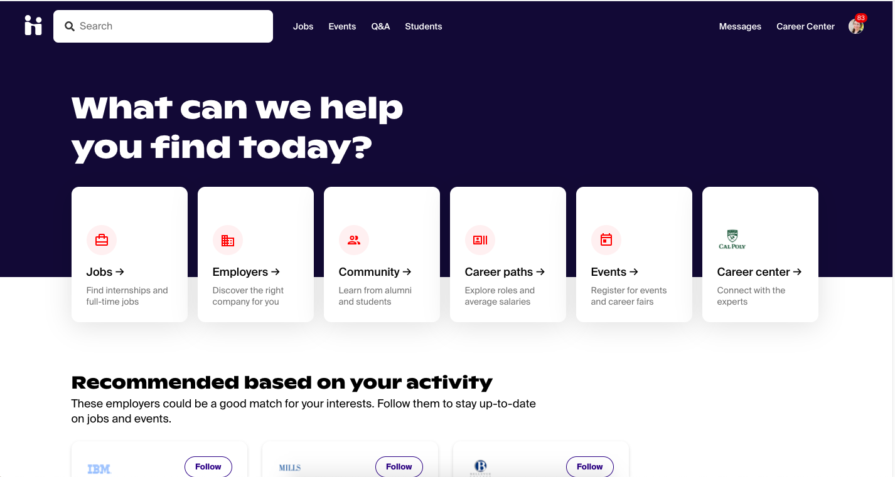
MustangJOBS: Professional Development & Job Search Guide for Mathematics Majors
Notes:
Pull out of presentation and show students how to find list under resources!
Click on the resources tab within the Career Center, search for your CP acronym (MATH): Top Employers & Career Resources for Your Major
What you'll find:
Employers with most job openings
Companies hiring CP students
Job titles to search for
Grad schools CP students have pursued
Jobs board
Additional career resources

Slide 8
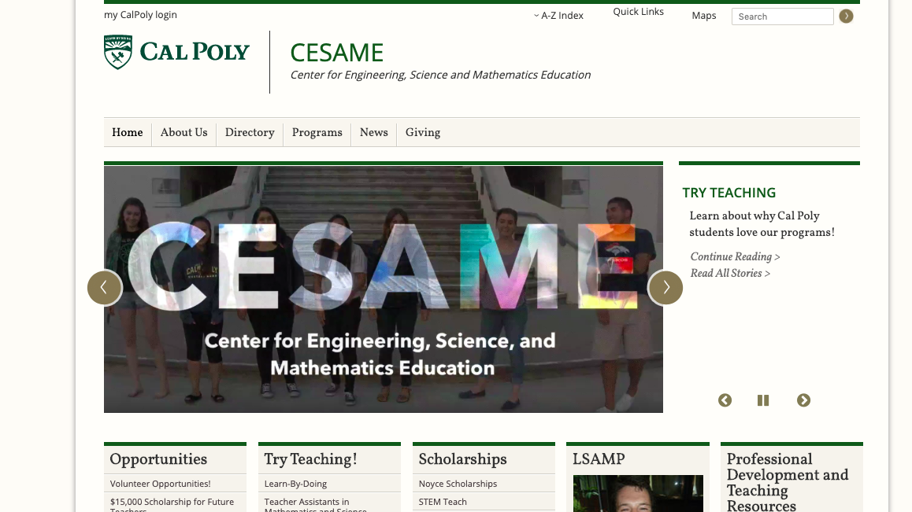
Interested in Teaching? Check out CESAME

Slide 9
Look @ Research Opportunities
Check out the Cal Poly Math Department website
Browse faculty research interests
Keep an eye out for Summer Research opportunities
Look at Professional Societies, and check out research experiences for undergraduates (REUs)

Slide 10
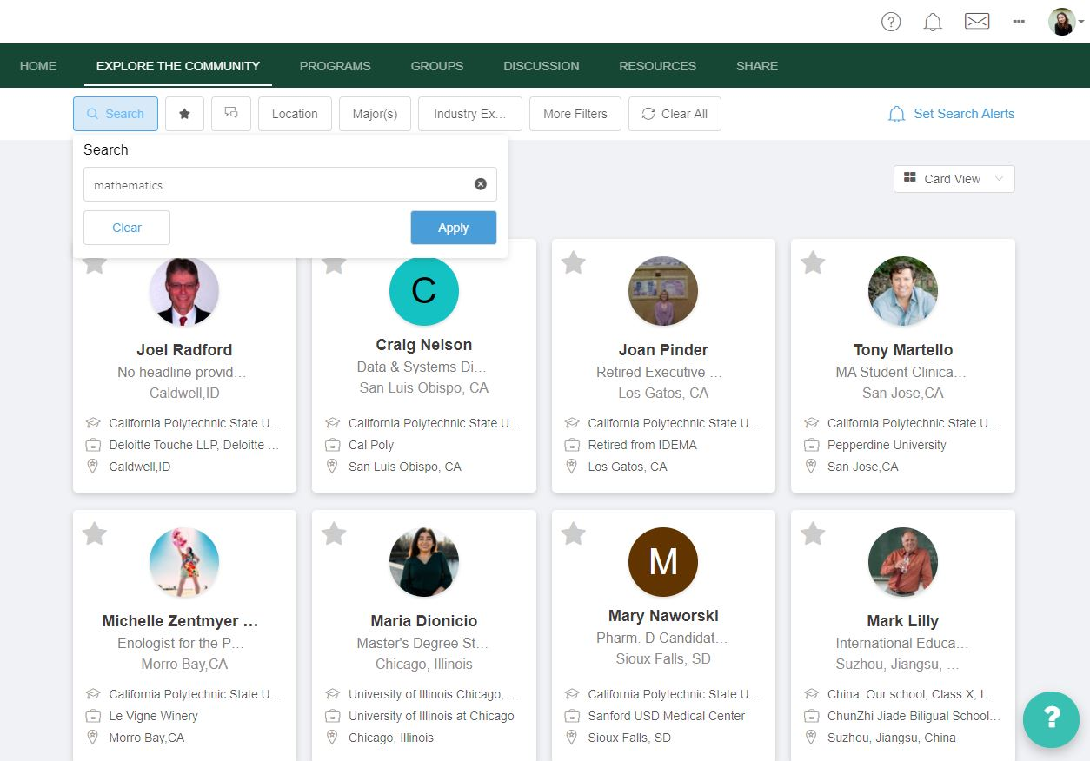
Create a Cal Poly Career Connections Profile and Connect with Alumni
An exclusive networking and mentoring platform for Cal Poly students and alumni!
Notes:
Pull out of presentation and show CPCC

Slide 11
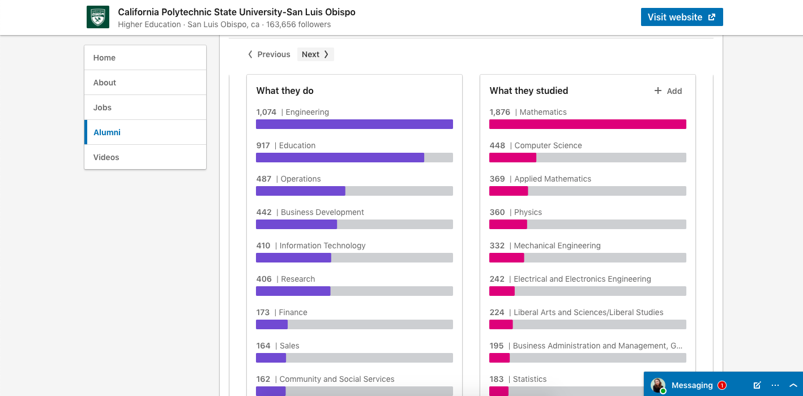
LinkedIn Alumni Function
Use the "Alumni" function on LinkedIn to explore careers and network with people in your area(s) of interest

Slide 12
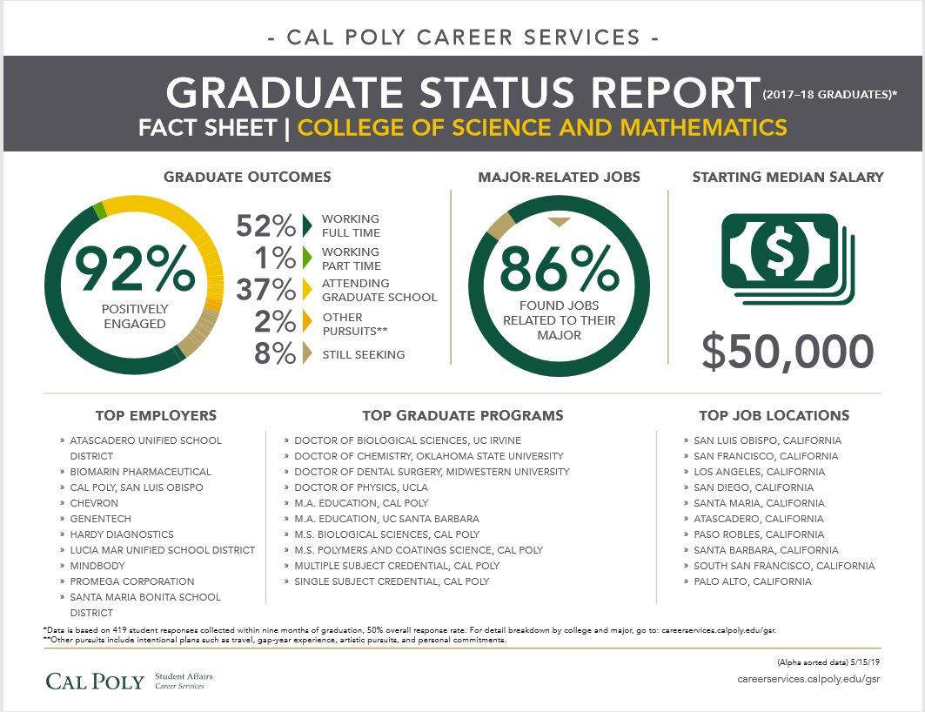
Reference the Graduate Status Report
Annual survey of the activities of Cal Poly's most recent graduates

Slide 13

Explore the Fall 2021 Career Fairs
Computing Career Fair
In-Person: Tuesday, Oct. 5 (MAC)
Virtual: Tuesday, Oct. 12 (via Handshake)
4-7 pm for both
Fall Career Fair
In-Person: Wed. – Fri., Oct. 6-8
Virtual: Wed./Thurs, Oct. 13-14 (via Handshake)
10 am – 3 pm for all 5 days
Notes:
Highlight major differences for the VCF compared to in-person CF.

Slide 14
Preparing for the Career Fair
Build
Build a resume:
Check out our online resume guide and resume templates
Research
Research companies that will be attending the fair:
Complete the Career Fair Prep worksheet
Practice
Attend the Preparing for the Career Fair Workshop
Dress For Success
Dress professionally
Decide who you want to talk to
Visit us for feedback & support
Attend a resume clinic or workshop, make an appt with your career counselor, or come to Drop-In!
Practice your Elevator Pitch

Slide 15

In-Person Career Fairs Logistics
Fall Career Fairs: 3 sessions:
10:00 – 11:30 am, 11:45 am – 1:15 pm and 1:30 – 3:00 pm
Computing Career Fairs: 2 sessions:
4:00 to 5:30 pm and 5:45 – 7:00 pm
Register for sessions on Handshake (300 students max per session)
If not registered, you can still attend and be let in when not at capacity (300 student capacity max)
15-minute breaks between each session – students need to clear out the MAC even if you’re in the next session
Notes:
At the MAC, two lines set up 1. Pre-registration and 2. Wait Line
A staff member will ask students if they’ve pre-registered for that time block and direct students the appropriate line, either Pre-Registered Line or Wait Line
Students that pre-registered will be checked in first
Once all the pre-registration students have checked in, and 15 minutes into the time block, students in the Wait Line will be admitted until the student capacity is reached – 300 students in the building
If the 300 student capacity is reached, students outside will need to wait until a student inside leaves.
As students leave the building, additional students can enter.
If a pre-registered student shows up after the first 15 minutes of that time block, they will need to go to the wait line.

Slide 16
Overall Preparation Tips
Update your Handshake Profile: If you have signed up for Individual or Groups Sessions with Employers for virtual fairs, they can review your profile before a session, so be sure to update your Handshake profile with role and location preferences, skills, organizations, work experience, and make sure your graduation date is correct.
Update Your Resume and have it reviewed before the career fair(s)
Upload General Resume under Documents in Handshake and make it visible
Opt-in to Resume Book(s)
Instructions can be found under Career Fair Details tab for each Career Fair
Notes:
Change Document Visibility You can see which document is currently public by clicking your account icon in the upper-right corner of Handshake, then click Documents. Look to the column "On Profile" - if the circle is filled in green with a white check, that indicates it is visible. Click the circle to quickly change visibility.

Slide 17




Craft Your Pitch!
WHO ARE YOU AND WHAT DO YOU WANT?
WHAT MAKES YOU UNIQUE?
Practice your pitch out loud before the Career Fair!
For your next steps, thank the employer and restate your interest by sending a follow-up via email or LinkedIn
Your class level and major; what position you are interested in (include statement about applying online if you did)
Targeted summary of relevant experience and skills
FIND A SEAMLESS WAY TO TRANSITION…
Ask a question

Slide 18
Get in touch!
1:1 Career Counseling Appointments
Virtual Drop-In Hours
M-TH 1:00-4:00pm PDT, via in-person and Zoom
M-F 9am-4pm PDT, via in-person or Zoom
Schedule via MustangJOBS/Handshake
MustangJOBS > Career Center > Appointments
OR call (805)756-2501
careerservices.calpoly.edu

Slide 19

Questions?

