Slide 1
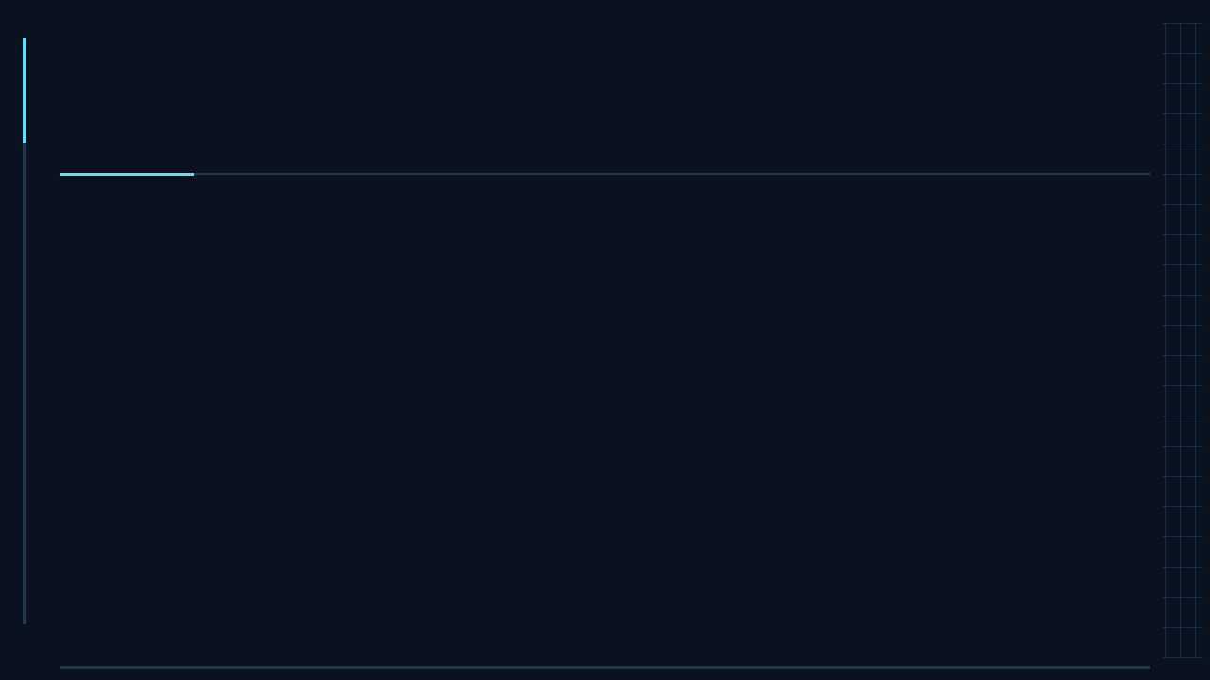
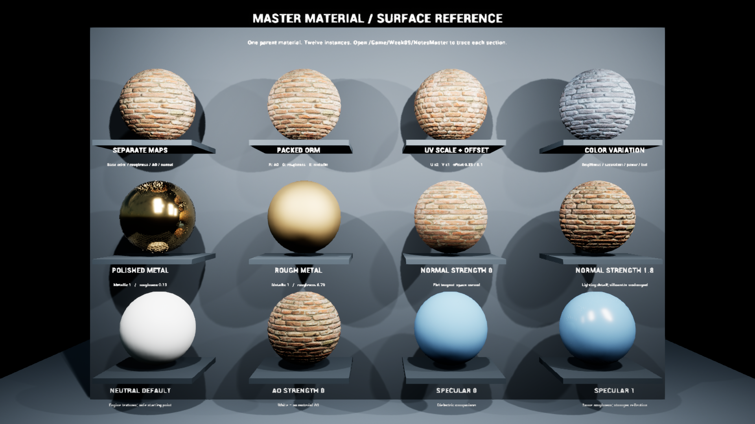
WEEK 9
Shaders and
material systems
Read the surface. Change one control. Explain the result.
Guest speakers • Finish your shader • Final-project planning

Slide 2
WELCOME • 4:30–4:45
Today’s agenda
Time | Activity
4:30–4:45 | Welcome, agenda, tech setup
4:45–6:00 | Guest speakers and questions
6:00–6:15 | Break
6:15–6:25 | Material systems: quick walkthrough
6:25–6:50 | Workshop: finish your original shader
6:50–7:00 | Final assignment overview
02

Slide 3
TECH SETUP
Get ready to finish your shader
Open your shader project
Keep your Week 8 work ready; Week 9 stations are optional references.
Use a reference if helpful
In the Outliner, expand ReferenceWing and choose a numbered camera.
Keep a place for your cheat sheet
Record the control, its meaning, the visible result, and how to reset it.
03

Slide 4
4:45–6:00
Guest speakers
As you watch, choose one example to unpack.
What changed?
Look for the input, the control, and the visible consequence.
Keep one question for discussion.
04

Slide 5
6:00–6:15
Break
Back at 6:15
Next: a quick Unreal walkthrough, then your shader lab.
05

Slide 6
MATERIAL SYSTEMS
Material, instance and input data
Parent material
Defines the surface calculation.
Material instance
Stores overrides of exposed controls.
Texture + mesh data
Check channels, UVs and color space.
One parent • twelve surface variants
06

Slide 7
SURFACE CONTROLS · MASTER → FUNCTION → INSTANCE
Roughness: graph and artist controls
MF_W09_Roughness · active signal path
Sample
Lerp
Saturate
Roughness
→
→
→
R or ORM G
Min / Max
Clamp 0–1
Surface input
Find the active controls
Keep the interface readable
04 Roughness: MinRoughness / MaxRoughness
07 Packed ORM: the ORM endpoint pair
Group by property; order related controls.
Give each a clear name and reset value.
Which branch is active before you change an endpoint?
6A

Slide 8


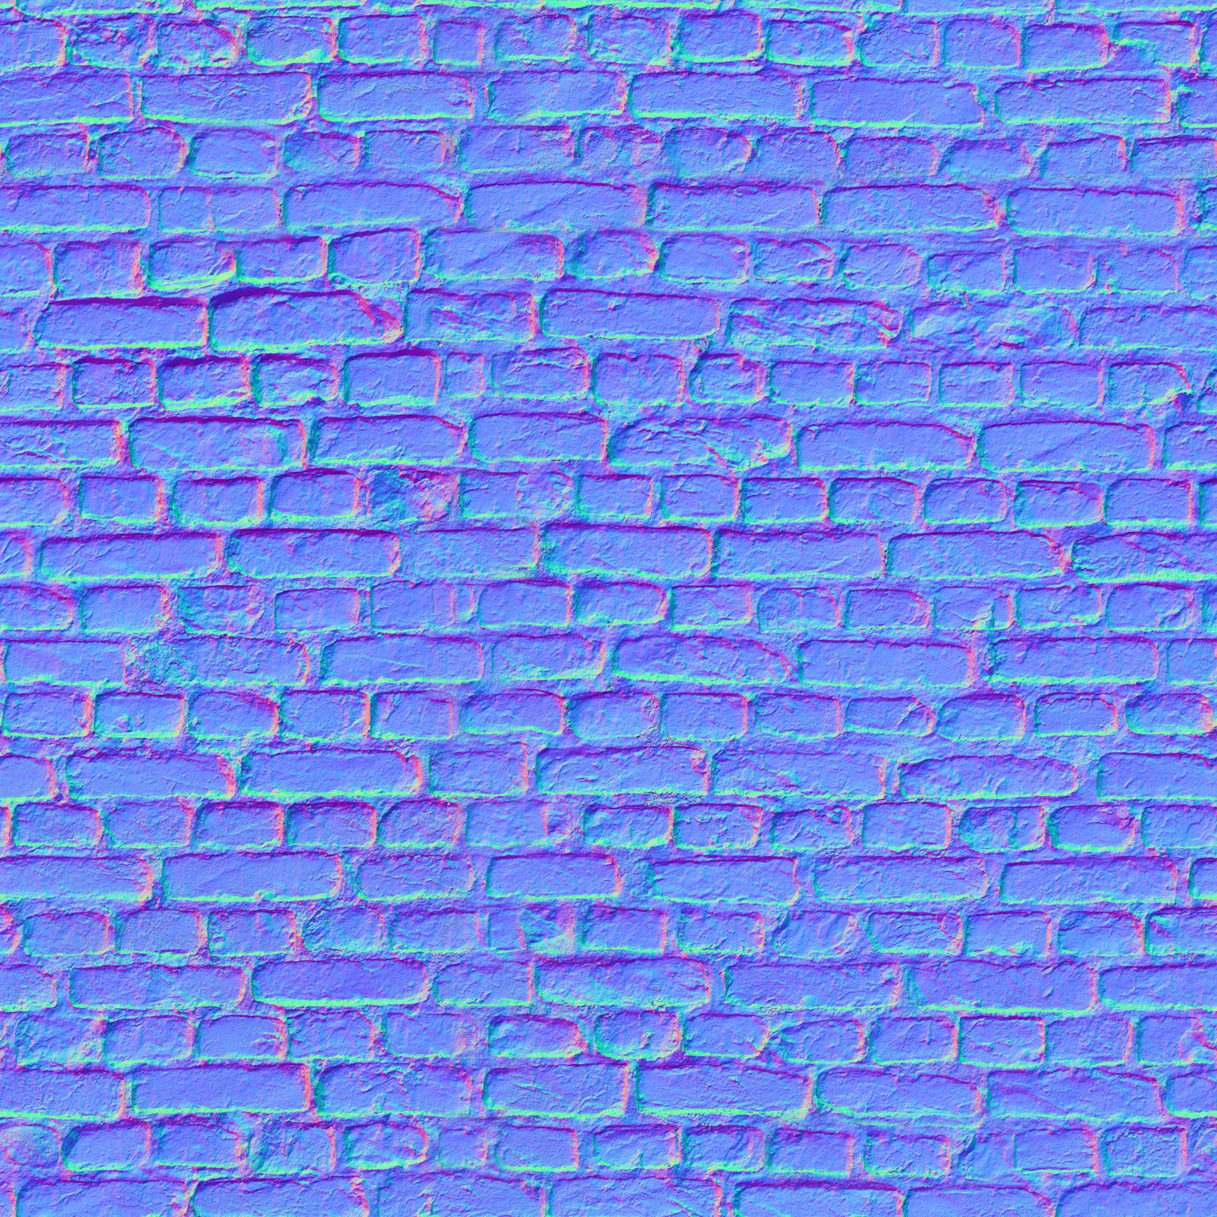
TEXTURE INPUTS
Texture data roles
Base Color · sRGB
Roughness · linear
Normal · direction data
Same brick set. Check import settings AND the material sampler.
What goes wrong when a roughness map is interpreted as color?
6B

Slide 9
TEXTURE INPUTS
Separate maps and packed maps
UsePackedORM | Signal | Active controls
Off | RoughnessTexture R | MinRoughness / MaxRoughness
On | ORMTexture G | ORM_MinRoughness / ORM_MaxRoughness
On | ORM R / ORM B | AO / metallic data
ORM here: R = AO, G = roughness, B = metallic. Station 07 uses MRAH.
Why can MinRoughness change numerically but leave the surface unchanged?
6C

Slide 10
LAB ROUTE A
Controlled roughness comparison
State | MinRoughness | MaxRoughness
Original supplied instance | 0.12 | 0.12
A: controlled baseline | 0.20 | 0.20
B: changed response | 0.80 | 0.80
UsePackedORM off · same mesh, tint, normal, lighting, exposure and camera
If both endpoints equal 0.2, can the texture vary the output?
6D

Slide 11
UV CONTROLS
UV tiling and offset
UV transform
uv × scale + offset
Numeric vector
UVScaleOffset: RG = U/V tiling, BA = U/V offset
Aligned texture features
Use matching UVs for color, roughness and normal features that should line up.
Does doubling UV tiling make each brick appear larger or smaller?
6E

Slide 12
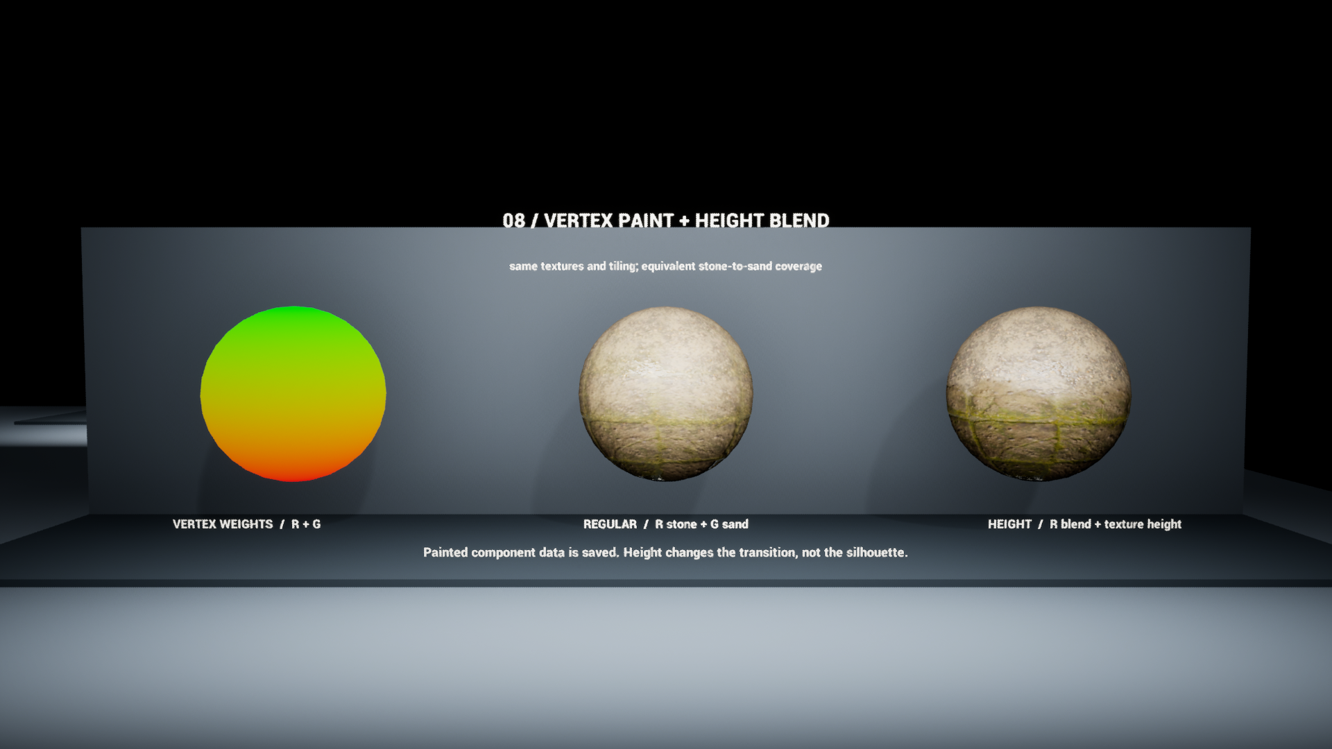
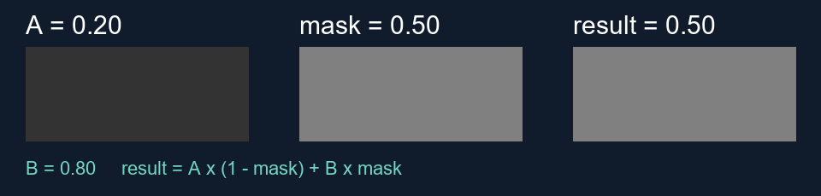
MASKS AND BLENDING
Masks and material blending
0 selects A · 1 selects B
Height reshapes the transition.
The mesh silhouette stays fixed.
07

Slide 13
PAINTED BLENDING
Vertex colors and painted weights
Station 08 example | Stored data | Interpretation
Weight diagnostic | Vertex R and G | Displays saved component paint
Regular blend | R = stone; G = sand | Two painted contributions
Height blend | R = blend control | Weight plus height shapes coverage
Vertex density limits paint detail; values interpolate between vertices.
Before painting red, which material connection must you inspect?
7A

Slide 14
LAB ROUTE B
Height-based blending
Hold fixed
Saved vertex paint, textures and tiling
Change
MI_08_HeightBlend → Blend Contrast: 1 versus 4
Observe
Boundary shape and sharpness; unchanged outer geometry
What evidence would distinguish height blending from displacement?
7B

Slide 15
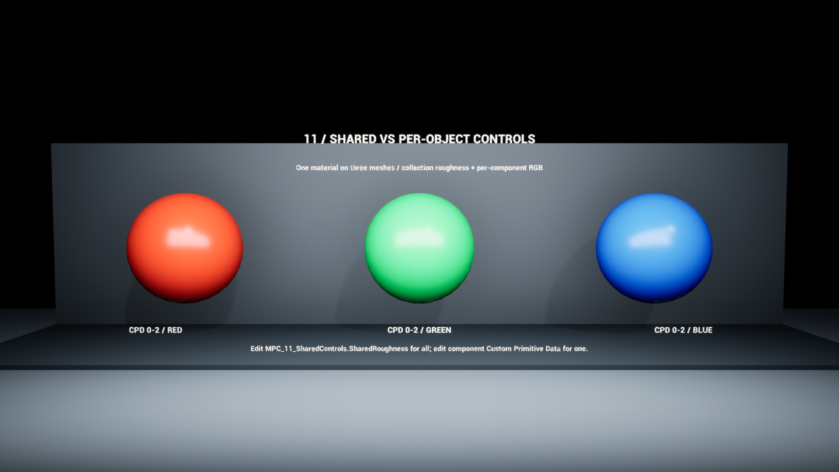
PARAMETER SCOPE
Parameter scope
Instance
Parameter collection
Primitive data
Reusable variant
Shared values (MPC)
Per component (CPD)
Runtime edits: dynamic instance, collection or primitive data
Static switches select compiled variants
08

Slide 16
LAB ROUTE C
Shared and per-component controls
Test 1 · collection
SharedRoughness: 0.2 → 0.8; observe all three spheres.
Reset before Test 2
Restore the recorded collection value (staged: 0.28).
Test 2 · component
Change one mesh component’s RGB data at indices 0–2.
Would duplicating an instance isolate a collection value?
8A

Slide 17
PARAMETER BEHAVIOR
Runtime values and static switches
Need | Mechanism | Important condition
Reusable surface variant | Material instance | Objects using it share its overrides
Change a value during play | Dynamic material instance | Create, assign, then update that same MID
Set runtime data | MPC / primitive data | Choose shared or component scope
Choose a graph branch | Static switch | Compile-time variant; not runtime interpolation
UsePackedORM / UseAdvancedUV: static. Sequencer can animate collection values.
Why is setting a scalar on an unused dynamic instance invisible?
8B

Slide 18
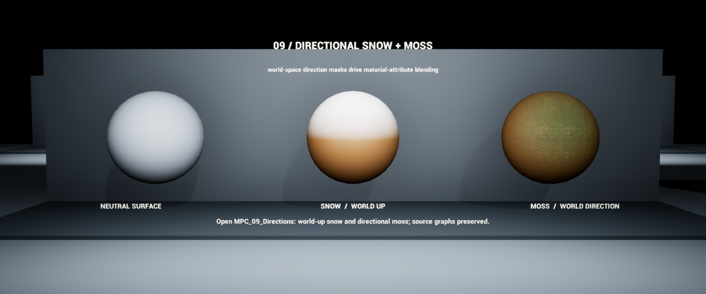
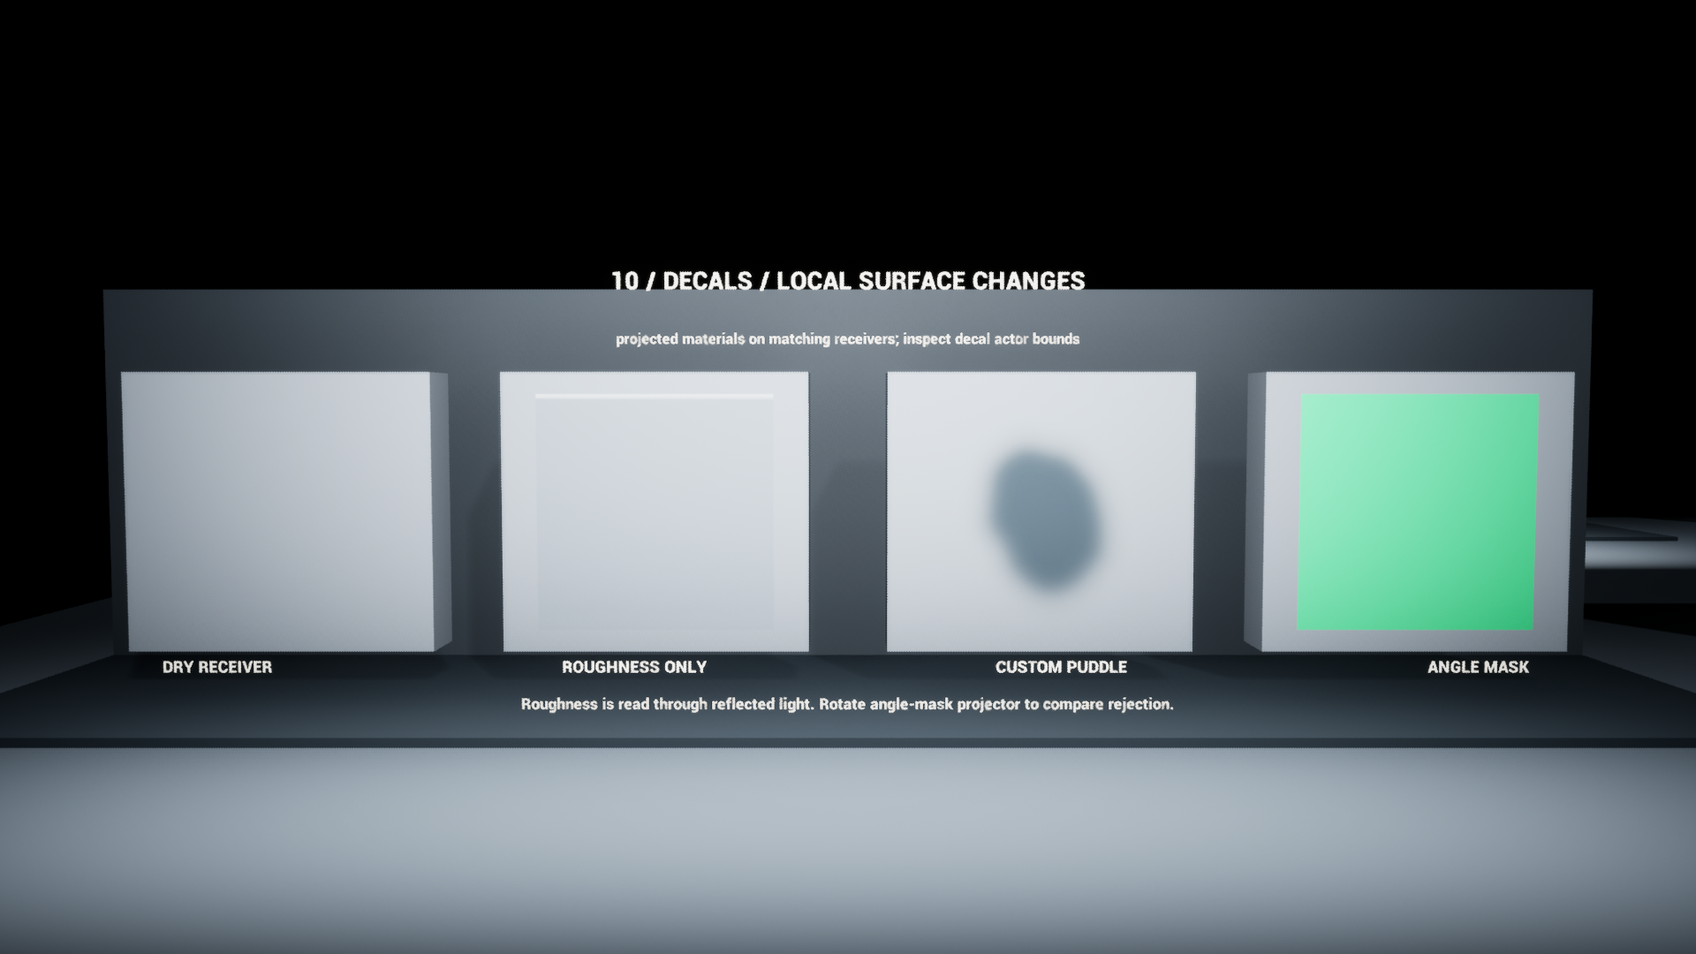
REFERENCE STATIONS
Directional coverage and decals
09 / Directional coverage
10 / Decal projection
Compare normal and direction
in the same coordinate space.
Check projector bounds and
receiver response.
Predict → change one control → compare → reset
09

Slide 19
DIRECTIONAL SNOW AND MOSS
Directional coverage
Compare directions
coverage = saturate(dot(Nworld, Dunit))
Shape the response
coverageᵖ with p > 0; a larger p narrows intermediate coverage.
Read this implementation
Moss normalizes D internally. Snow expects a unit direction.
What does dot = 0 mean? Is it the same as a height threshold?
9A

Slide 20
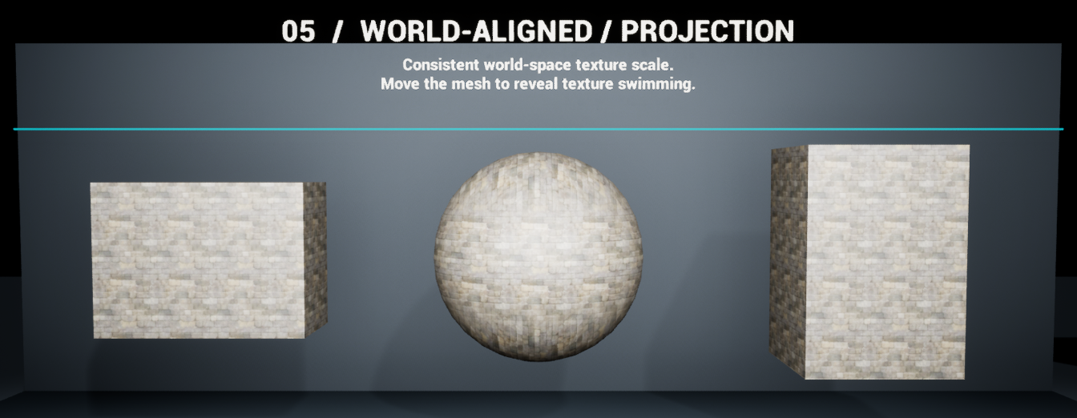
COORDINATES AND MOTION
UV space and world projection
UV coordinates
The pattern follows the mesh’s UV mapping.
World projection
The sampling field stays in world space.
Movement test
Translate the object, then inspect whether the pattern follows.
Should this surface pattern move with the object or remain in the world?
9B

Slide 21
LAB ROUTE D
Decal projection and receivers
Projector
Material assignment, direction and volume bounds
Receiver
Receives Decals + the material’s Decal Response
Controlled test
MI_10_RoughnessDecal: Roughness 0.03 versus 0.8
Why might a roughness-only decal show no obvious color patch?
9C

Slide 22
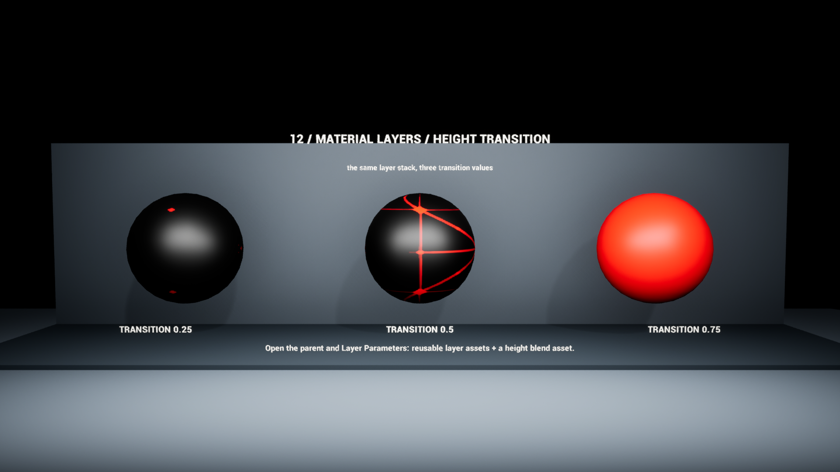
REUSABLE LAYERS
Material layers and blends
Surface layer
Defines the surface attributes.
Layer blend
Defines how the next surface contributes.
Instance controls
MI_12_Layers_0/1/2 → Layer Parameters → Transition
If a parameter name repeats, what else identifies the correct control?
9D

Slide 23
NORMALS AND AMBIENT OCCLUSION
Neutral normal and AO inputs
Control | Neutral state here | Interpretation
NormalStrength = 0 | Flat tangent-space normal | Removes mapped shading detail
AOStrength = 0 | AO output becomes 1 | Removes material AO contribution
UsePackedORM = on | ORM_AOStrength is active | Separate AOStrength is inactive
AO = lerp(1, sampled AO, strength). Neutral is white, not black.
Why does multiplying an AO texture by zero give the wrong disable state?
9E

Slide 24
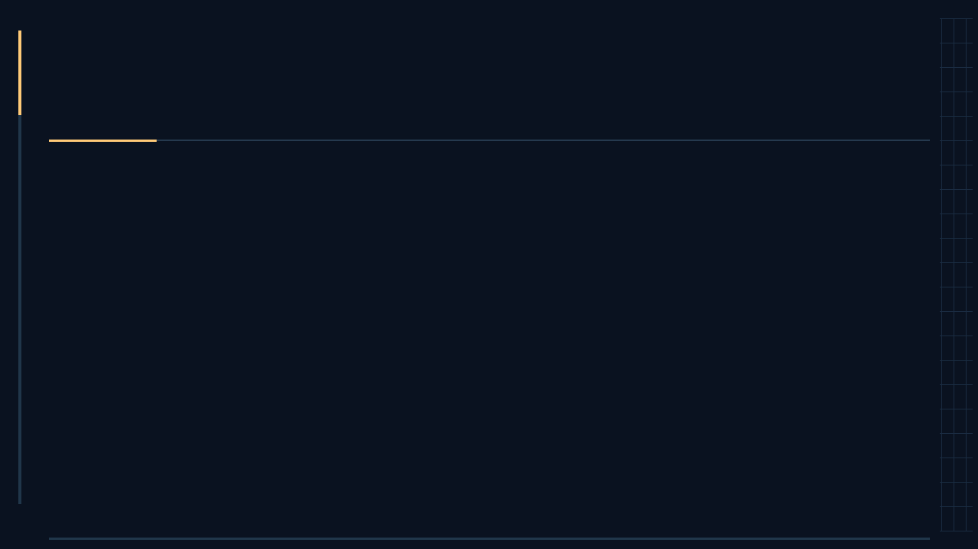
LAB HANDOFF
LAB: finish your original shader
Choose and predict
Choose one unfinished feature or problem in your existing shader.
Change and compare
Make a focused improvement; use a reference route if it helps.
Explain and save
Capture the result and explain your graph. Keep your finished work.
10

Slide 25
LAB HANDOFF
Optional: document a debugging test
Record | Example for Route A
Asset + route | Assigned duplicate of MI_W09_05_PolishedMetal; packed mode off
Fixed conditions | Same mesh, tint, normal, light, exposure and camera
Changed variable | Both roughness endpoints: .2/.2 → .8/.8
Evidence + explanation | Your A/B views and observed reflection difference
Reset | Original .12/.12 or original assignment; verify it
Prediction is not evidence. Record what you actually tested.
What would another student still need to repeat your comparison?
10A

Slide 26
LAB • 6:25–6:50
Your shader: result and explanation
Finish your shader | Use the existing assignment brief
Choose a finish or fix | One missing feature, unclear control or visual issue
Test the result | Check the intended view and one useful edge case
Make the graph readable | Group logic and label artist-facing controls
Capture and explain | Show your result and how the shader produces it
Save your work | Keep useful edits; reset temporary reference tests
Use your actual parameter name, values, and observed result.
11

Slide 27
FINAL ASSIGNMENT · ROUGH OUTLINE · 6:50–6:55
Final project: exploratory technical art
Explore and build
Work solo or in a group
Choose a technical-art question.
Make a tool, shader, procedural (PCG) system, effect or other exploration. A tool is optional.
Scope a small, functional result, as with the midterm.
For teams, define each person’s contribution.
Final presentation
Develop a portfolio piece
Teach the class and demonstrate your work.
Explain the concept, experiments, results and limitations.
Plan a clear breakdown with visuals, your process and evidence.
Show what you contributed and learned.
Start with: question → minimum useful result → test → teaching goal
12

Slide 28
PROJECT DISCUSSION · 6:55–7:00
Your project starting point
Question + smallest useful result
What will you investigate, and what can you build first?
Evidence + teaching goal
How will you test it? What should classmates understand after your demo?
Roles + portfolio evidence
Solo or group? Identify contributions and the visuals you need to capture.
What part of your idea needs help with scope or technical direction?
13

Slide 29
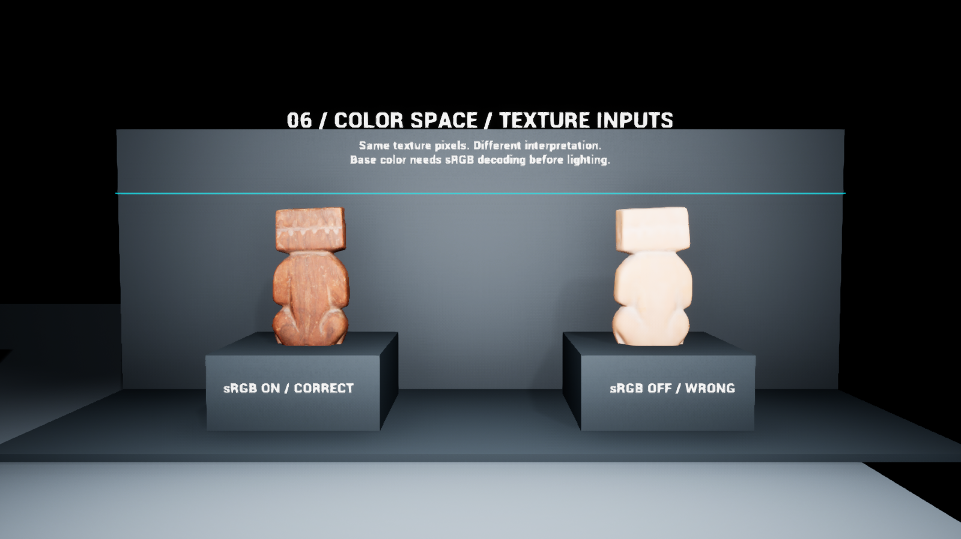
REFERENCE • EXPLORE AFTER THE LIVE WALKTHROUGH
Texture-channel reference
Color
Base Color: supplied sRGB texture
with Color sampling.
Numerical data
Roughness, AO and masks: linear.
Check channel and sampler.
Normal data
Use the matching convention
and Normal compression.
This master: ORM = R: AO G: roughness B: metallic
14

Slide 30
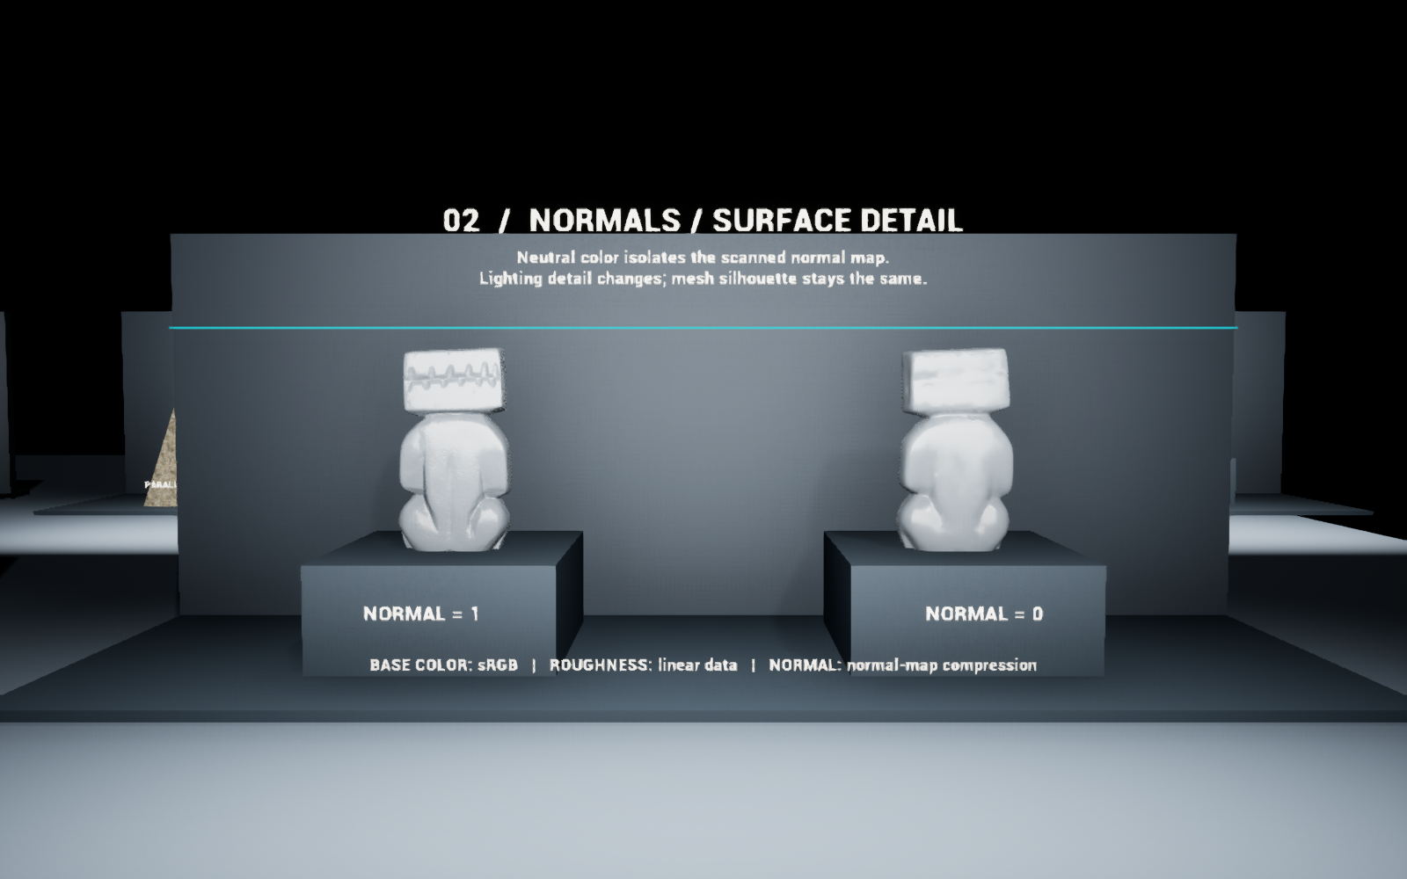
REFERENCE • EXPLORE AFTER THE LIVE WALKTHROUGH
Normal, POM and vertex movement
Same geometry • different shading normals
Normal map: lighting detail POM: apparent depth WPO: vertex movement
15

Slide 31
REFERENCE • EXPLORE AFTER THE LIVE WALKTHROUGH
Parameter troubleshooting
1 / Assignment and override
Is the duplicate assigned? Is its parameter checkbox enabled?
2 / Active branch and scope
Packed mode uses ORM controls. Collection values affect every reader.
3 / Data and comparison
Check channels, color space, sampler, camera, light and exposure.
Explore further: Shader cheat sheet + Lab outline in the Week 9 packet
16

Slide 32
OPTIONAL STATION 07 EXTENSION
Parallax: height changes the texture lookup
HEIGHT SOURCE
Texture Object → height channel A
VIEW-DEPENDENT LOOKUP
POM samples the heightfield along the view ray
CONSISTENT SURFACE
Parallax UVs → base color, normal and packed maps
Move sideways: does the apparent relief change while the silhouette stays fixed?
15A

Slide 33
OPTIONAL STATION 07 EXTENSION
Parallax: test depth, then test quality
ONE CONTROL AT A TIME
Near Height: 0.00 → 0.04; keep the camera close
QUALITY HAS A COST
More steps can reduce artifacts; inspect shallow angles
CHECK IN THE SCENE
Test distance, intersections, lighting and the silhouette
Record the visible benefit, one failure case, and your reset values.
15B

Slide 34
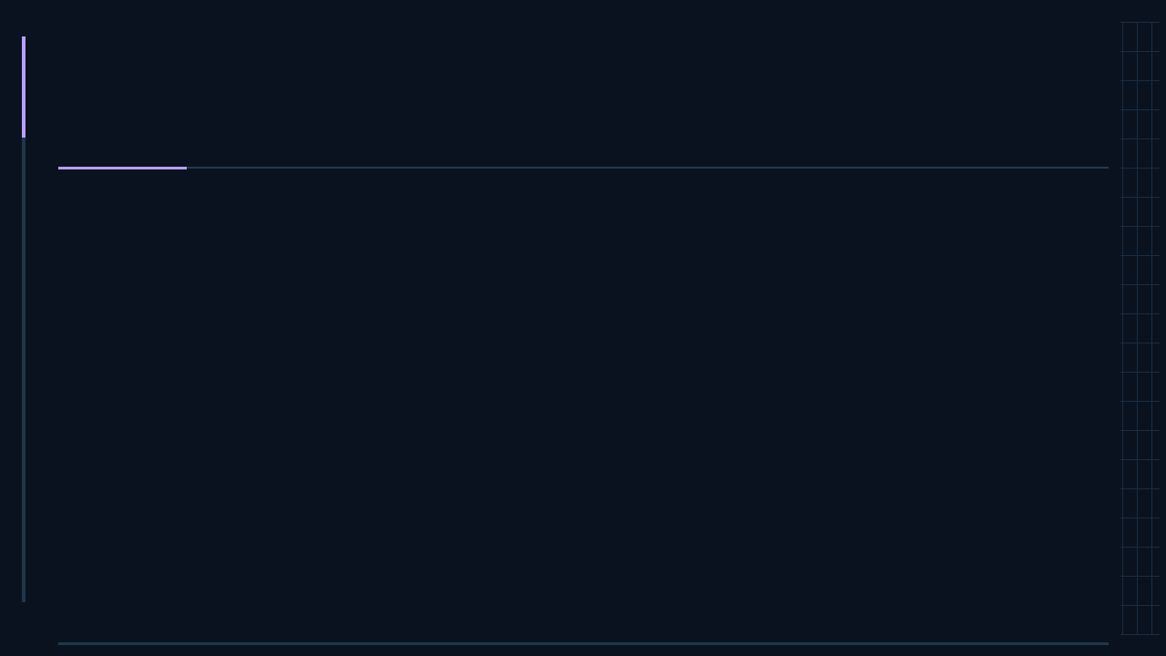
OPTIONAL LAB COMPANION
Lab review: finish your shader
6:25–6:30 · PREPARE
Open your shader. Choose one finish or fix.
6:30–6:45 · TEST
Build, test and capture your improvement.
6:45–6:50 · EXPLAIN
Explain your result; save your work and evidence.
What is the smallest improvement that makes your shader ready?
L0

Slide 35
OPTIONAL LAB COMPANION
A · Surface response
SET UP
Assign a copy of MI_W09_05_PolishedMetal.
COMPARE
MinRoughness = MaxRoughness: 0.2 → 0.8
LOOK FOR
Broader reflections; keep metallic, tint and normals fixed.
Why set both endpoints to the same value?
LA

Slide 36
OPTIONAL LAB COMPANION
B · Painted height transition
SET UP
Station 08 · copy MI_08_HeightBlend
COMPARE
Blend Contrast: 1 → 4
LOOK FOR
Transition shape; unchanged silhouette
Is this changing blend coverage or moving vertices?
LB

Slide 37
OPTIONAL LAB COMPANION
C · Shared and per-object controls
TEST 1 · SHARED
SharedRoughness: 0.2 → 0.8
RESET, THEN TEST 2
Change one component’s RGB data: entries 0–2
LOOK FOR
Three surfaces change; then only one changes
Which object owns each value?
LC

Slide 38
OPTIONAL LAB COMPANION
D · Decal surface response
SET UP
Assign a copy of MI_10_RoughnessDecal.
COMPARE
Roughness: 0.03 → 0.8
LOOK FOR
Changed reflections inside the projection
Can a decal change a surface without adding a color patch?
LD

Slide 39
OPTIONAL LAB COMPANION
Optional · Parallax depth
SET UP
Station 07 · duplicate and assign the POM instance.
COMPARE CLOSE TO THE SURFACE
POM | Near Height: 0.00 → 0.04
LOOK FOR
View-dependent relief; unchanged mesh silhouette
What changes when you move sideways—and what does not?
LE

Slide 40
OPTIONAL LAB COMPANION
Lab review: explain your result
SHOW
Your shader result + the graph that produces it
EXPLAIN
Prediction → observation → reason or limitation
MAKE IT REPRODUCIBLE
Readable graph, result capture and a brief explanation
Can a classmate explain how your shader achieves its effect?
LF

Slide 41
OPTIONAL · TEXTURE ORGANIZATION
Channel packing, atlases and arrays
Channel packing
Texture atlas
Texture array
Different data in R / G / B
Different images in one 2D sheet
Different images in indexed slices
One UV lookup; select a channel.
Remap UVs into a tile.
Sample with UV + slice index.
Example: AO / roughness / metallic
Manage borders and mip bleeding.
Keep matching map slices aligned.
Week 10: compare the same result, then measure memory and rendering cost.
17

Slide 42
OPTIONAL · WATER SHADER REFERENCE
Flow mask and flow direction
Mask · where / how much
Flowmap · which direction
A scalar weight from 0 to 1.
Use it to limit flow near a bank
or blend still and flowing detail.
RG stores a 2D direction field.
For a 0–1 encoded map:
direction = RG × 2 − 1
Flow influence = direction × mask × speed
Compare mask 0 → 1 while keeping direction, speed and view fixed.
Texture motion does not move the mesh. Keep this an optional extension.
18

Slide 43
OPTIONAL · DECAL RECEIVERS
Custom decal response
PROJECTED INPUT
The decal supplies color, normal or roughness data.
RECEIVER LOGIC
A surface mask can confine the response to crevices.
APPLY ONCE
For manual DBuffer blending: receiver Decal Response = None.
Actor Receives Decals and material Decal Response are different controls.
9F

Slide 44
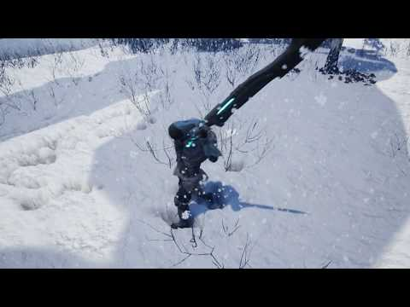
OPTIONAL · OUTSIDE EXAMPLE
Snow that remembers contact
MECHANISM
A render target stores an interaction mask.
START SMALL
One small patch; stamp a footprint mask.
FINAL-PROJECT STRETCH
Persistent trails with convincing depth.
Open the online example ↗
Borrow a focused idea for the shader you are already making.
19A

Slide 45
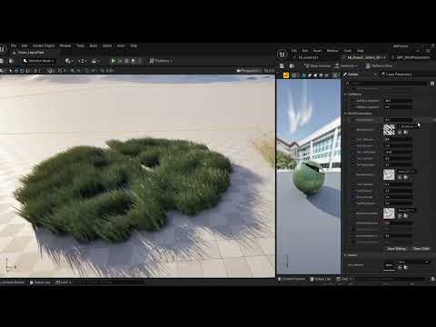
OPTIONAL · OUTSIDE EXAMPLE
Grass that bends with the world
MECHANISM
Pivot data guides material-driven bending.
START SMALL
Mask the roots; animate one grass clump.
FINAL-PROJECT STRETCH
Add player interaction and varied motion.
Open the online example ↗
Borrow a focused idea for the shader you are already making.
19B

Slide 46
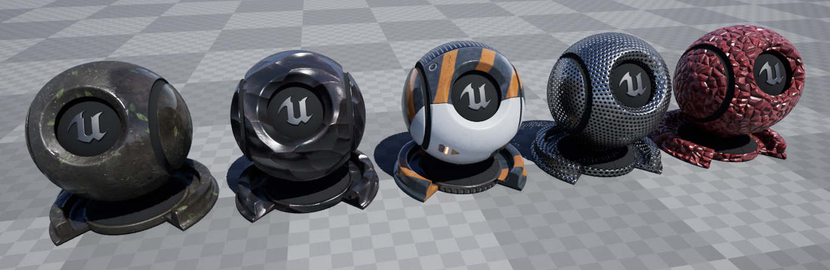
OPTIONAL · OUTSIDE EXAMPLE
One material family, useful variations
MECHANISM
A shared parent exposes purposeful controls.
START SMALL
Make three readable instances of your shader.
FINAL-PROJECT STRETCH
Build a focused, documented surface library.
Open the online example ↗
Borrow a focused idea for the shader you are already making.
19C

