Slide 1

WEEK 10
Profiling, Performance, and Optimization
Technical Art
01
Notes:
Today we will measure an Unreal scene, decide where it spends its frame time, and test a change without losing the intended look.

Slide 2
AGENDA
Class plan
00–35 Workload, frame budget and profiler choice
35–60 Geometry, materials, lights and texture memory
60–85 Guided showroom A/B and evidence review
85–95 Break
95–125 Team performance assessment
125–150 Debrief, packaged bot and Unreal Insights
02
Notes:
After the demonstration you will use the same evidence process on your own case.
One consolidated Week 10 deck. Slides 1-60 form the lecture and discussion route. Slides 61-81 are technique walkthroughs in this same file. Preserve the 10-minute break and 30-minute assessment; select reference depth to suit questions. See Course/Slides/Week10/Looman-Integration/Instructor-Compilation.html for the old-to-new slide map.
Expanded current deck: 100 total slides. Technique walkthrough appendix starts at slide 80. The requested view modes, profiler breakdown, Nanite GPU implications, Simplygon and custom tools are integrated into this file. Preserve the scheduled break and assessment; adjust explanation depth in class.
Current lighting update: 105 total slides; lighting mobility sequence 37–41; walkthrough appendix 85–105.
Current shader-logic update: 116 slides. Shader logic sequence 54-64; furnished lounge lab 82; walkthrough appendix 96-116. Use the shader exercise as a separate follow-up or select its demonstrations within the scheduled block.
Current article/04 integration: 126 slides. Main lounge activity is 89; walkthrough appendix is 106-126. Ten new slides are integrated beside their relevant topics; the appendix assessment now uses the furnished lounge. Source-version advice is qualified for the pinned UE 5.7 project.

Slide 3
TECHNICAL JUDGMENT
A budget needs a workload
60 FPS on the target machine gives us 16.67 ms per frame.
Choose a representative view or route. Record resolution, quality settings and scene state.
Agree on the visual or interaction requirements before changing the scene.
03
Notes:
Ask which view would make a busy gallery representative. A view of the floor can be repeatable and still fail to answer the production question.

Slide 4
TECHNICAL JUDGMENT
The optimization loop
Measure the baseline and identify the limiting work.
Predict what one change should affect.
Repeat the capture. Compare the timings and the view.
Record whether you would keep, revise or reject the change.
04
Notes:
Changing one variable gives us a better chance of connecting a timing difference to a cause.

Slide 5
FRAME TIME AND BUDGETS
Frame time in milliseconds
Frame budget = 1,000 ÷ target FPS
30 FPS ≈ 33.33 ms 60 FPS ≈ 16.67 ms 120 FPS ≈ 8.33 ms
At 60 FPS, a 21.0 ms frame needs to recover how much time?
05
Notes:
Allow a minute for arithmetic. The answer is about 4.33 ms. Compare improvements in milliseconds because FPS differences have different meanings at different starting points.

Slide 6
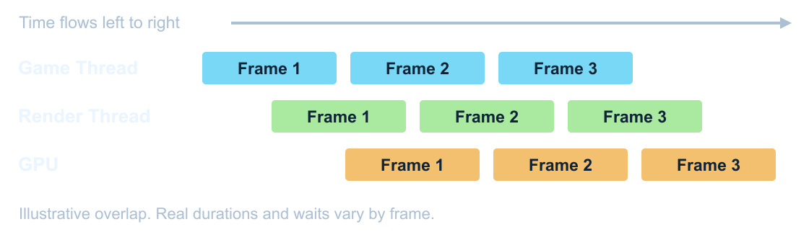
FRAME TIME AND BUDGETS
CPU and GPU overlap
Use stat unit to compare timing leads. CPU and GPU work can overlap.
06
Notes:
Imagine the CPU preparing a later frame while the GPU draws the current one. Show stat unit before opening a more detailed capture. Source: https://dev.epicgames.com/documentation/en-us/unreal-engine/stat-commands-in-unreal-engine?application_version=5.7

Slide 7
PROFILING TOOLS
Choosing a profiler
stat unit gives you a quick read on the limiting work. Use stat gpu to inspect rendering passes.
Use Unreal Insights to follow CPU and GPU work across frames, including hitches.
Use RenderDoc to inspect the draws, textures and pipeline state inside one frame.
07
Notes:
Start with the question. Did the whole frame slow down, did one pass get heavier, or did a particular draw use the wrong resource? Those questions lead to different tools.

Slide 8
PROFILER BREAKDOWN
Start with the performance question
Frame time: does the target workload meet its budget?
CPU timeline: which work or dependency delayed the frame?
GPU timeline: which passes and queues occupied the device?
Memory and loading: what stayed resident, streamed or hitched?
08
Notes:
Choose evidence for the symptom. A large asset does not prove a slow frame. A bright complexity view does not identify a millisecond saving. We will read live stats, a timeline, a pass breakdown, a capture distribution and a memory investigation as different instruments. Their outputs support different claims. Source: Epic performance profiling guidance and the supplied course captures.

Slide 9
PROFILER BREAKDOWN
Read stat unit
Counter
Meaning / first follow-up
Frame
Overall frame interval in ms; compare with the target budget
Game
Game-thread update; inspect gameplay, ticks, animation or physics
Draw
Render-thread CPU preparation; inspect visibility and submission
RHIT
RHI-thread translation/submission where enabled; inspect waits
GPU
Device execution estimate; open rendering pass / queue evidence
These estimates overlap across threads and frames. Do not add them.
A timing close to Frame is a lead; caps and waits can hide the limiter.
09
Notes:
Game and Draw are CPU work. GPU is device timing. RHIT describes the CPU-side rendering interface thread where present. Frame is the observed frame interval rather than the arithmetic sum of those values. If the GPU is busy while the CPU waits, optimizing a small CPU scope may not change Frame. If everything clusters near 16.67 ms, first check synchronization and the cap. Use stat unitgraph to find sustained cost or spikes. Source: Epic stat command guidance; AMD GPUOpen Unreal performance guide.

Slide 10
PROFILER BREAKDOWN
Read a CPU timeline
Select the problem frame; align Game, Render, RHI and worker tracks.
Expand the expensive scope. Inclusive time contains its children.
Exclusive time excludes nested child scopes on that track.
A wait names a pause. Follow the dependency that releases it.
10
Notes:
Zoom to a frame before interpreting an aggregate. A large parent and its children describe nested time, so adding them counts work twice. Thread occupancy is not the same as the critical path: independent tasks can overlap. Use event timing, call stacks where available, task dependencies and context bookmarks to form the next test. In our existing traced repeat, the aligned waits are evidence of a dependency to inspect; they do not prove what caused a separate earlier launch. Source: Epic Timing Insights documentation.

Slide 11
PROFILER BREAKDOWN
Read a GPU timeline in UE 5.7
Inspect graphics and compute queues, event nesting and fence waits.
Use the busiest relevant interval and the whole-frame result together.
Async compute can overlap graphics. Summed queue times overstate elapsed time.
ProfileGPU may report to the log; use Insights for the newer timeline.
11
Notes:
The GPU profiler changed in UE 5.6 and later. Older tutorials show a ProfileGPU popup that is not a reliable UI expectation in this UE 5.7 installation. The newer event stream exposes graphics, compute, idle bubbles and cross-queue dependencies. An idle interval can mean the GPU is waiting for submitted work rather than doing an expensive shader. Read the log output and corresponding Insights tracks for the actual build. Primary source: Epic Unreal Fest New GPU Profiler and RHI Submission Pipeline, https://www.youtube.com/watch?v=vnbARZHccpQ. Also consult the installed engine implementation and target RHI.

Slide 12
GPU PASS BREAKDOWN
Geometry, surfaces and shadows
Pass family
Work / content to inspect
PrePass / depth
Depth visibility; geometry, masking and coverage
Nanite VisBuffer
Nanite cluster visibility / raster work; instances and coverage
BasePass / shading
Surface material evaluation and outputs; coverage / materials
ShadowDepths / VSM
Shadow rendering and page updates; casters and invalidation
Lights / projection
Apply light influence; overlap, radius and shadow lookup
Names and grouping vary with renderer, feature set and engine version.
Use inclusive / exclusive context; do not sum nested entries.
12
Notes:
A pass name tells us a rendering responsibility, not which single asset to delete. Follow it to the relevant visualization and actual scene data. Nanite visibility and conventional depth rendering have different paths. Base-pass cost can involve coverage, material work and GBuffer output. Shadow depths generate shadow data; projecting lighting is additional work. Select a specific hypothesis and time a duplicate treatment in Lit. Sources: Epic rendering documentation and the supplied Looman traces.

Slide 13
GPU PASS BREAKDOWN
Lighting, effects and the final image
Pass family
Work / evidence to inspect
Lumen / reflections
Scene lighting, traces and reconstruction; quality / route
Translucency
Layered surfaces and effects; screen coverage / sorting
Niagara GPU simulation
Particle state computation; active systems / target / policy
Post processing / TSR
Exposure, upscaling and screen effects; internal resolution
Decal composition
Projected material work; receiver coverage and channels
A feature can create work in several passes.
Return to Lit and repeat the same view after each isolated treatment.
13
Notes:
Lumen, translucency and post processing depend on settings and resolution. Some components participate in more than one rendering responsibility. A decal may appear in separate composition work; a translucent effect can incur simulation and rendering. A high pass can be an intentional part of the look, so state which requirement survives before changing it. A debug view changes the renderer and is not an A/B timing result. Sources: Epic rendering guidance and Looman Far Far West companion.

Slide 14
PROFILER BREAKDOWN
Capture a repeatable trace
Use the supplied Capture-Insights.ps1 on the chosen case.
Record build, machine, API, camera, resolution, quality and warm-up.
Capture cpu, gpu, frame and bookmark channels for the timing question.
Add loading or memory channels when those are the symptom.
14
Notes:
Open the target project and choose the workload before starting. The existing script launches a packaged scenario and stores a trace; inspect its project/build assumptions before reusing it. In a Development executable, a minimal timing launch can include -trace=cpu,gpu,frame,bookmark and -tracefile=<absolute-output.utrace>. Open the completed trace in UnrealInsights.exe. Broader channel sets add overhead and file size. Use a screenshot pass for visual comparisons separately from the timing pass. Sources: Epic Unreal Insights and Developer Guide to Tracing.

Slide 15
PROFILER BREAKDOWN
Memory, residency and loading
Instrument
Question it can help answer
stat streaming
Texture pool pressure, wanted mips and residency behavior
stat RHI
Rendering counters and resource estimates for this RHI
memreport -full
Which object/resource categories occupy a runtime snapshot?
Size Map / Statistics
Which references and assets deserve closer inspection?
Insights load / memory
When did loading, registration or allocation coincide with a hitch?
A snapshot finds resident resources. A timeline explains when they arrived.
A smaller package is a separate result from a smaller runtime footprint.
15
Notes:
Use the instrument that can see the kind of memory you care about. Size Map shows reference relationships and resource estimates; it is not a direct measurement of total VRAM. Memory Insights allocation tracing and graphics residency are separate evidence. A larger streaming pool can spend more GPU memory without changing the quality budget of the assets. A traversal is required to investigate a loading hitch. Source: Epic Memory Insights and stat command documentation.

Slide 16
PROFILER BREAKDOWN
Compare distributions and individual frames
Median describes the middle sample; p95 describes the slow tail.
State the capture window and number of frames.
Repeat launches to estimate variation. Report inconclusive differences.
Open a slow frame in a trace; averages cannot explain its cause.
16
Notes:
Our audit dashboard can attach selected CSVs using an explicit data-row window. The historical slow run has a 7.80 ms median and 25.46 ms p95 over rows 190 through 394 inclusive. That is 205 frames. A repeat trace is another launch; it cannot retroactively identify the original cause. Keep raw CSVs and build conditions. The budget is 16.67 ms at 60 FPS. Do not estimate p95 from three spot readings. Sources: existing Original-Slow-Run.csv and Traced-Repeat.csv; values recomputed by the project report generator.

Slide 17
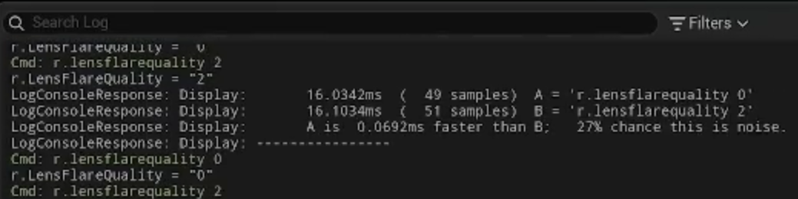
PERFORMANCE INVESTIGATION
A/B output can report noise
The source tool flags uncertainty despite a small apparent improvement.
Repeat independent launches; a smaller number alone does not establish a saving.
17
Notes:
This is the lens-flare example in your latest 04 notes. The first displayed comparison reports A about 16.0342 ms and B about 16.1034 ms, with 27 percent chance this is noise in that tool. A later comparison is only about 0.0323 ms apart and also flags uncertainty. We cannot turn that into a proven classroom saving or assign its frame delta to a single pass. Keep image quality and recorded conditions in the decision. Source screenshot Pasted image 20261105090422.png; video https://www.youtube.com/watch?v=c2MH20OPSw0 around 38–41 minutes. The on-screen percentages belong to the source tool, not a confidence model applied to our lab.

Slide 18
PROFILER BREAKDOWN
From a pass to the exact draw
Insights explains time across frames, threads and queues.
RenderDoc inspects one captured frame: events, resources and pipeline state.
PIX or a vendor profiler can inspect device-level execution details.
Keep capture overhead and supported API/device paths in the report.
18
Notes:
A pass trace and a frame debugger answer different questions. If a material samples the wrong texture, inspect the draw and bound resource. If the GPU stalls, inspect queues and hardware evidence on the target platform. Capture tools can alter timing, so treat a detailed inspection and an unbiased performance run as related but different experiments. Source: AMD GPUOpen Unreal Engine Performance Guide, https://gpuopen.com/learn/unreal-engine-performance-guide/; Epic profiling documentation.

Slide 19

PROFILING CONDITIONS
Reproducible captures
Lock output size, screen percentage, quality and camera. Record the rendering API and build.
Finish compilation. Remove caps for an uncapped cost test; record VSync and frame smoothing.
Warm the workload. Add a trace bookmark at the action you want to inspect.
19
Notes:
We need to know which workload these numbers describe. Resizing the editor can change pixel count and GPU cost. An uncapped cost test and a capped player-experience test answer different questions. Capture Lit timing separately from debug views and screenshots. Recheck the intended cap for delivery. Historical talk: JetBrains, Preparing for Profiling at 4:00. https://tomlooman.com/unreal-engine-optimization-talk/ Read the actual renderer and baked-lighting configuration; do not require a light bake in a fully dynamic Lumen scene.
Private integration ID: prepare. Original source captures:

Slide 20
PERFORMANCE INVESTIGATION
Internal resolution and output quality
Record output size, internal screen percentage and the upscaler separately.
50% of each dimension at 3840 × 2160 gives 1920 × 1080 internally.
Resizing or maximizing an editor viewport can change the workload.
Check motion, thin geometry and sharpening; keep timing comparisons matched.
20
Notes:
The source video changes viewport size and sees a different GPU cost. That is a different pixel workload, not evidence of an asset change. Half the width and half the height mean a quarter as many internal pixels in this simple example; total frame cost does not necessarily quarter because other work remains. An internal 1080p target is an option for a particular device and reconstruction path, not a universal recommendation. Sharpening changes appearance and can expose ringing; it is not a replacement for missing geometry detail. Source: 04 notes and https://www.youtube.com/watch?v=c2MH20OPSw0 around 3–4 and 53–56 minutes. UE 5.7 lab captures must keep output, internal resolution and quality fixed for an isolated A/B.

Slide 21
FRAME TIME AND BUDGETS
Steady cost and hitches
A slow interval across many frames suggests a sustained cost.
A single spike needs a capture around the event. Look for streaming, compilation or a system that runs in bursts.
Record a typical value and the spread. Keep a trace when a spike matters.
21
Notes:
An average can hide a hitch at the moment a player enters a room. In Timing Insights, select the problem frame and inspect the longest relevant scopes on the corresponding thread. Source: https://dev.epicgames.com/documentation/en-us/unreal-engine/timing-insights-in-unreal-engine-5?application_version=5.7

Slide 22
PERFORMANCE INVESTIGATION
Cold first use and warm steady state
Shader bytecode, pipeline-state creation and steady drawing are different work.
A warm driver cache can hide a first-use hitch.
Compare a documented first encounter with a repeated route and the same quality.
Use an Insights trace to separate PSO work from loading, streaming or gameplay.
22
Notes:
A lower median in a warmed fixed camera does not prove a hitch-free first experience. A new process is not necessarily a cold driver cache. Record how cache state was prepared and test the same route, spawned effects and material/quality variants. Do not clear global caches as part of the ordinary student steady-state benchmark. This extends our existing shader warm-up guard without claiming that every black frame or hitch was a PSO. Source: https://tomlooman.com/unreal-engine-psocaching/ . The newer Advanced Shader Delivery section of that article concerns later engines and is not a UE 5.7 lab dependency.

Slide 23
PROFILING TOOLS
Steady cost, hitches and memory
A slow pass across many frames calls for a steady capture.
A hitch as you enter a room calls for a trace around the transition. Check asset loading and compilation.
A blurry texture can point to streaming pressure even when frame time meets budget.
23
Notes:
Give the class three symptoms and ask which evidence they would collect first. The fixed Audit Camera lets us repeat the glass test, but it cannot reproduce a room-entry hitch.

Slide 24
WHERE THE FRAME GOES
Meshes and submission
Many separate components and material sections can increase submission work.
Look at Draw and RHI evidence, then check visible components, material slots and repeated meshes.
Instancing can help repeated meshes. LODs and culling change what gets drawn. Check the silhouette and distance transitions.
24
Notes:
Relate a material slot on the asset to the rendered sections it may create. Rerun the same camera after changing instance organization.

Slide 25
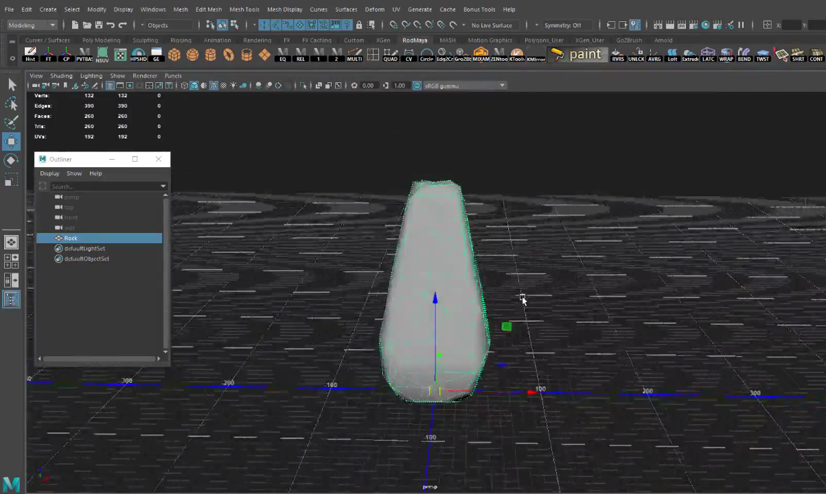
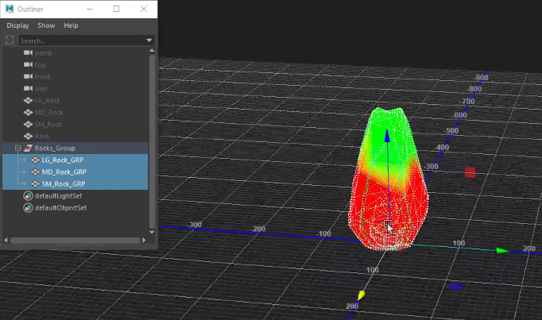
ASSET PIPELINE
Maya to Unreal: verify the contract
Maya pivot
Unreal vertex-color check
Choose a pivot for placement and snapping. Export a named static mesh with only the data it needs.
Verify scale, normals, vertex colors and collision after import and reimport.
For a baked normal map, keep triangulation consistent with the bake.
25
Notes:
A correct-looking object in Maya can arrive with the wrong pivot or missing vertex colors. Compare the same rock before and after export. Use the vertex-color view, then reimport a deliberate color change. Replace imports source colors; Ignore preserves existing painted data in the legacy FBX workflow. Do not blindly replace painted colors. The Gnomon recording uses an older FBX preset. UE 5.7 FBX documentation names FBX 2020.2; record whether your project uses FBX or Interchange. Source: Rodrigo Brea, Gnomon Workshop, supplied 01 Export & Import Settings.md. https://dev.epicgames.com/documentation/en-us/unreal-engine/fbx-static-mesh-pipeline-in-unreal-engine?application_version=5.7
Private integration ID: import. Original source captures: 20261103225636, 20261104003436

Slide 26
DEMO EXTENSIONS
Conventional LODs and Simplygon
On a mesh with Nanite disabled, force each level and inspect the silhouette.
The demo mesh goes from 54,700 to 27,349 to 13,675 triangles using Unreal reduction.
A Simplygon LOD Recipe can build the chain when the plugin is available. Restore Auto to check screen-size transitions.
26
Notes:
Open SM_LOD_Demo. The built-in Unreal reduction produced 54,700, 27,349 and 13,675 triangles. Use it for the live conventional LOD check. Show the Simplygon recipe only when the licensed plugin has been rehearsed.

Slide 27
SIMPLYGON
Reduction, remeshing and material baking
Operation
Result / quality check
Reduction
Simpler mesh; inspect silhouette, normals, UV seams and attributes
Remeshing
Replacement surface; inspect thin features and projected error
Aggregation
Combine source geometry; inspect visibility granularity
Material baking
Bake appearance into fewer materials; inspect shading / UVs
LOD Recipe / HLOD
Repeatable build policy; inspect transitions and dependencies
Choose the representation for the platform, object and viewing distance.
27
Notes:
Simplygon is an asset-processing toolchain. Its UE plugin provides reusable recipes and HLOD-related processing. Reducing triangles, creating a replacement surface and combining materials are distinct operations. Material baking can change world-position or vertex-color dependent appearance, so test those materials carefully. These are workflow explanations from the vendor, not evidence that this machine ran Simplygon. https://documentation.simplygon.com/SimplygonSDK_10.4.169.0/ue5/

Slide 28
SIMPLYGON
Build and validate an LOD recipe
Verify the plugin, license and exact Unreal-version support first.
Duplicate the test asset. Create a recipe and set a reduction target.
Build, force each LOD, then restore Auto and walk the camera route.
Compare visual quality and matched GPU/submission evidence.
28
Notes:
The installed UE 5.7 engine does not contain the Simplygon plugin. The existing 54,700 → 27,349 → 13,675 triangle demonstration uses Unreal built-in reduction; it is not a Simplygon result. Vendor 10.4.169 documentation names UE 5.4 and 5.5 support, so do not infer compatibility with 5.7 from that page. Use a vendor build or documented integration path matching the engine and license before a live recipe demonstration. The recipe should name its screen-size thresholds and preserve the original mesh. https://documentation.simplygon.com/SimplygonSDK_10.4.169.0/ue5/

Slide 29
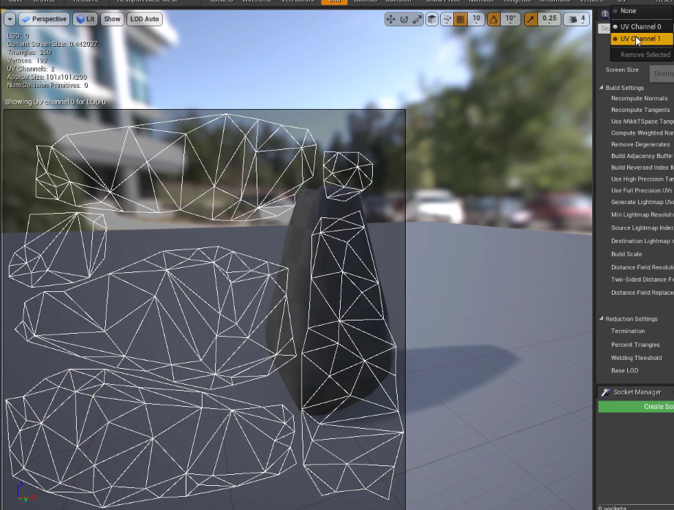
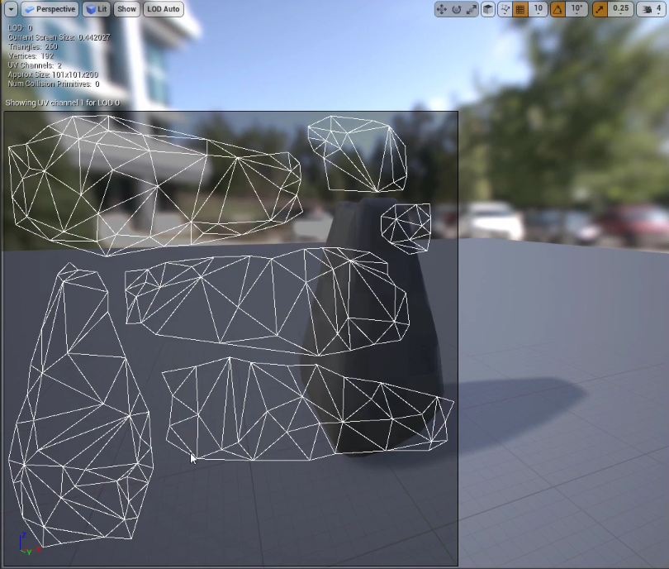
ASSET REPRESENTATION
Lightmap UVs and geometry LODs
Texture UV channel
Separate lightmap layout
Geometry LOD changes the mesh. A lightmap UV channel stores the layout for baked lighting.
For baked lighting, inspect non-overlapping UVs and Light Map Coordinate Index.
Compare Lit shading and silhouette after changing LOD or lightmap resolution.
29
Notes:
Do not confuse a texture mip, a geometry LOD and a lightmap. These are different representations with different controls. Source and destination lightmap indices describe generation, while Light Map Coordinate Index selects the runtime lightmap UV channel. If the project uses fully dynamic lighting, establish whether baked lightmaps are needed before generating data. Force each conventional mesh LOD, then restore Auto and test transitions. Gnomon 02 Asset Settings & Features.md. Historical screenshots are teaching references, not captures of the current assessment project.
Private integration ID: lightmap. Original source captures: 20261104012630, 20261104012644

Slide 30
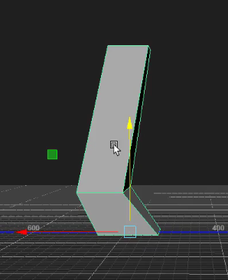
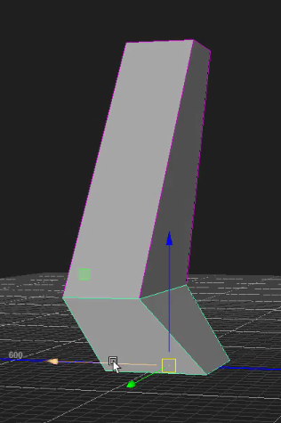
ASSET REPRESENTATION
Collision follows the interaction
One hull fills the opening
Several hulls preserve the opening
Use simple shapes or several convex hulls for a concave opening.
Match Collision Enabled and channel responses to required queries and simulation.
Test player passage, a line trace and any required physical contact.
30
Notes:
A single convex hull fills a concavity. Several convex shapes can approximate a doorway or curved asset without sealing the gap. Query Only can serve traces and overlaps; physics simulation needs a suitable collision configuration. Inspect actual collision complexity before claiming a saving. Nanite render geometry does not remove collision cost. Gnomon 02 Asset Settings & Features.md and Looman JetBrains Collision & Physics. https://tomlooman.com/unreal-engine-optimization-talk/
Private integration ID: collision. Original source captures: 20261104015852, 20261104015951

Slide 31
WHERE THE FRAME GOES
Materials and screen coverage
A material that covers more pixels has more opportunities to cost time. Layered translucent surfaces can shade the same pixel repeatedly.
Shader Complexity shows an estimate. Return to Lit and time the matching GPU pass.
For glass, check what remains visible through the surface and how its edges and reflections read.
31
Notes:
Reuse the Week 9 glass example. A graph with fewer visible nodes can still execute expensive work. Source: https://dev.epicgames.com/documentation/en-us/unreal-engine/viewport-modes-in-unreal-engine?application_version=5.7

Slide 32
VIEW MODES
Lit, Unlit and neutral lighting
View
What to inspect / limit
Lit · Alt+4
Final material and lighting appearance; acceptance view
Unlit · Alt+3
Surface color without scene lighting; not a timing shortcut
Lighting Only · Alt+6
Neutral surface lighting without original normal maps
Detail Lighting · Alt+5
Neutral surface lighting retaining normal-map detail
Wireframe · Alt+2
Geometry edges; conventional wireframe is not Nanite workload
Choose the mode for the question; compare the same region before drawing a conclusion.
32
Notes:
Lit remains our appearance acceptance view. Unlit is useful for surface color inspection but is not a guarantee of displaying raw imported texels for every shading model and emissive material. Lighting Only removes original normal-map detail; Detail Lighting retains that normal contribution on a neutral surface. Compare the same object to separate color, normal and lighting problems. Source: https://dev.epicgames.com/documentation/en-us/unreal-engine/viewport-modes-in-unreal-engine?application_version=5.7

Slide 33
VIEW MODES
Complexity views suggest a test
Light Complexity counts overlapping non-static lights affecting geometry.
Shader Complexity estimates instruction work; texture access and loops complicate it.
Quad Overdraw inspects inefficient pixel-quad coverage where supported.
A green view can still be slow. Confirm with the matching Lit pass.
33
Notes:
These colors describe a diagnostic model, not universal timing. A few expensive texture reads and a similar number of arithmetic operations can take different time on hardware. Tiny or layered triangles can leave work for lanes that do not contribute useful visible pixels. Different renderer paths may not be represented the same way by a traditional view. We already have a glass example whose shader view looks green despite substantial Lit cost. What other evidence would distinguish a shader issue from a coverage issue? Pause for student questions. Source: https://dev.epicgames.com/documentation/en-us/unreal-engine/viewport-modes-in-unreal-engine?application_version=5.7

Slide 34
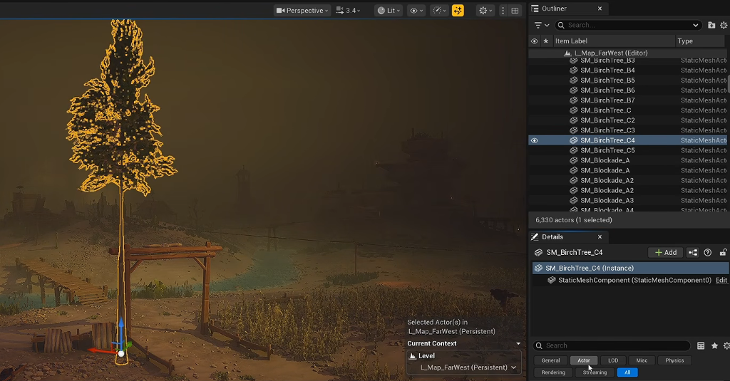
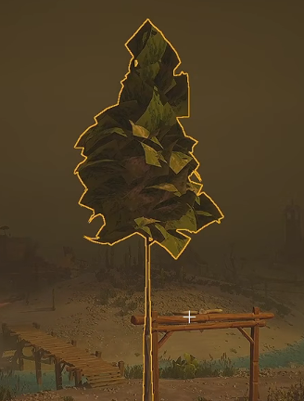
NANITE MATERIALS
Foliage coverage and motion
Cutout silhouette
Opaque-distance experiment
Masked leaves preserve cutouts. Opaque cards can expose the full card silhouette.
Inspect WPO and Pixel Programmable work separately.
Test near, far and moving views before changing distance or density rules.
34
Notes:
The paired tree views show a shape change that can make an apparently cheaper path unacceptable. Nanite itself is not the experimental feature warning in the UE 5.7 Far Far West companion; the warning concerns the new Nanite Foliage workflow. WPO, masking and PDO have different costs and quality requirements. Reducing visible WPO amplitude to zero is not proof that WPO evaluation has stopped. The component or foliage disable distance must agree with a material fade. The recorded density values describe one scene. https://tomlooman.com/unreal-engine-optimization-farfarwest/
Private integration ID: foliage. Original source captures: 20261104190638, 20261104190827

Slide 35
NANITE GPU
Nanite work on the GPU
Stream and select detail from hierarchical geometry clusters.
Cull and rasterize visible geometry into visibility information.
Evaluate the visible material work and write the shaded result.
Inspect VisBuffer, shading and shadows as separate responsibilities.
35
Notes:
Nanite virtualizes geometry detail; it does not make every triangle, material or shadow free. The exact software/hardware raster choices and pass grouping are implementation dependent. Conventional object draw-call counts are insufficient to explain Nanite work. Cluster and triangle visualizations expose representation, while the GPU trace establishes time. Shading bins group material work, and empty bins are not the same thing as expensive visible shading. Source: Epic Nanite technical documentation, https://dev.epicgames.com/documentation/en-us/unreal-engine/nanite-technical-details?application_version=5.7

Slide 36
NANITE GPU
Coverage, masking and deformation
Dense overlapping leaves can spend work on hidden or partly covered surfaces.
Masked coverage and Pixel Depth Offset can require programmable raster work.
WPO changes geometry and may invalidate shadow pages.
More aggressive detail can change silhouettes and transitions.
36
Notes:
Nanite excels at representing detailed surfaces, but aggregate geometry such as leaves has different visibility and coverage characteristics. Tiny geometry and overdraw can remain expensive. Do not equate a large source polycount with a known GPU time. Inspect Evaluate WPO, Pixel Programmable, overdraw-related Nanite views and the trace. A material fade and an evaluation-disable distance solve different parts of the problem. Source: Epic Nanite docs and supplied Far Far West source frames. https://dev.epicgames.com/documentation/en-us/unreal-engine/nanite-technical-details?application_version=5.7

Slide 37
NANITE GPU
Test a Nanite hypothesis
Fix camera, renderer, resolution, material and lighting.
Change one treatment: evaluation distance, coverage or detail threshold.
Check near/far Lit motion, VisBuffer, shading and shadow timing.
Record residency and fallback users when geometry settings change.
37
Notes:
Run the representative shot and a transition route. If reducing VisBuffer does not change the frame, inspect what now limits the frame and compare the whole workload. A frozen deformation shadow or exposed opaque leaf card can reject an otherwise cheaper treatment. Fallback geometry may serve collision, ray tracing or unsupported paths, depending on the configuration; inspect those users separately. This is an experiment recipe, not a newly measured Nanite speedup. Source: https://dev.epicgames.com/documentation/en-us/unreal-engine/nanite-technical-details?application_version=5.7

Slide 38
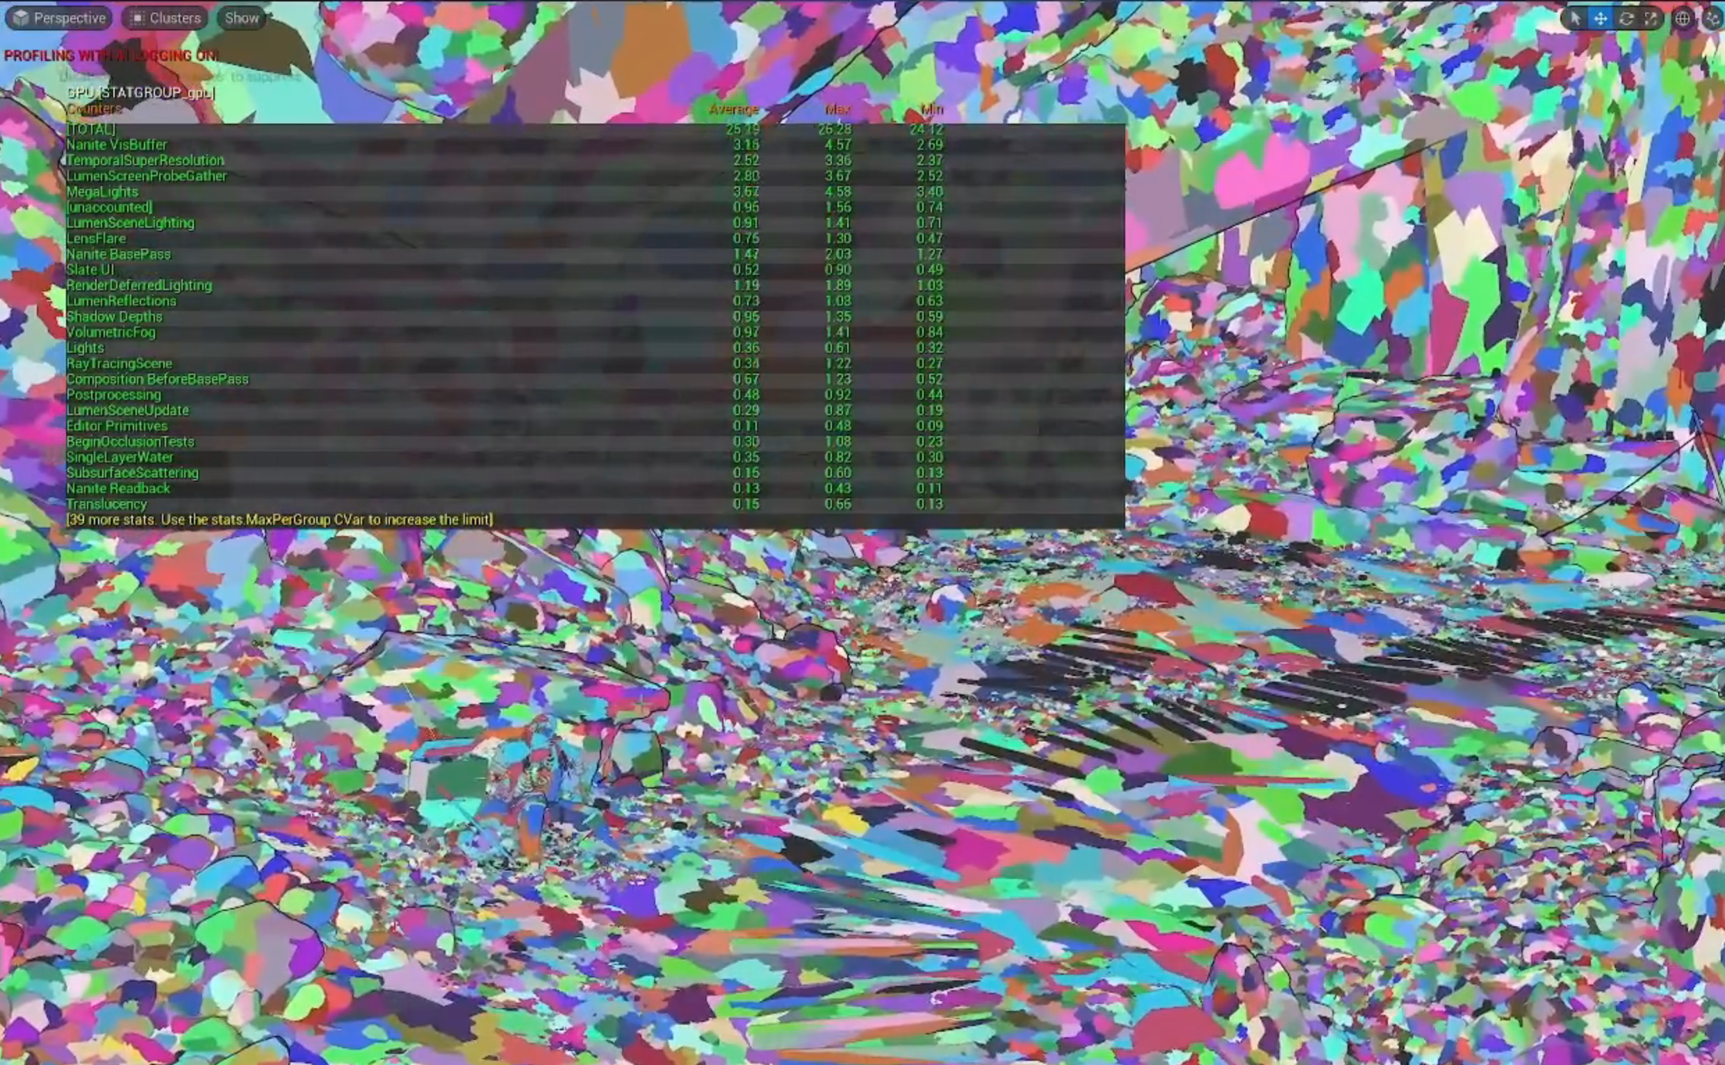
PERFORMANCE INVESTIGATION
Nanite pixel error as a quality budget
Larger MaxPixelsPerEdge permits coarser geometry; it is not a quality upgrade.
Inspect clusters and VisBuffer cost, then check silhouettes and transitions in Lit.
38
Notes:
In 04, the speaker increases r.Nanite.MaxPixelsPerEdge from its captured default of one to extreme values such as ten, then discusses more moderate values. This relaxes screen-space detail selection and can reduce geometry work, with visible quality changes. The note phrase about smoother LODs should not imply that a larger value automatically improves transitions. We do not adopt ten as a class default or transfer the source GPU timings to the lounge. Source: https://www.youtube.com/watch?v=c2MH20OPSw0 around 56–60 minutes; supplied images Pasted image 20261105095008.png and 20261105095645.png. Validate support and actual value in UE 5.7 before a local test.

Slide 39
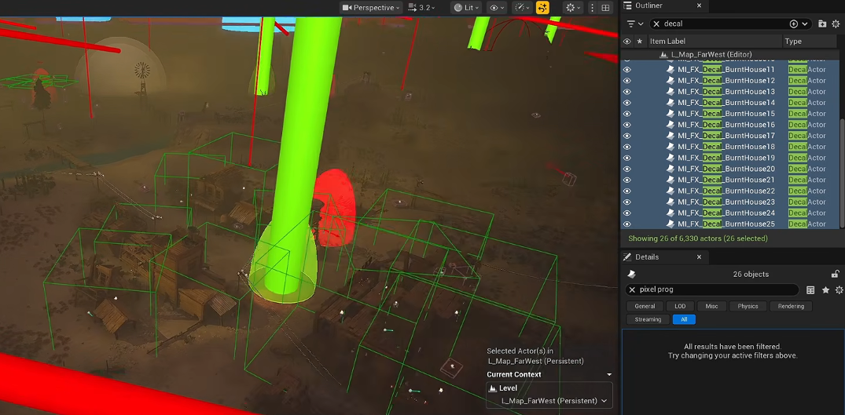
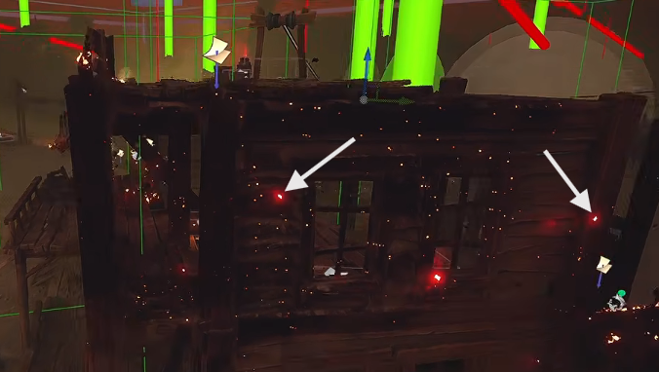
SCREEN COVERAGE
Decal cost spans several passes
Projection volumes
Small visible emissive details
A decal projects a material onto receiving surfaces. Large projection volumes can cover many pixels.
Inspect the decal material and related pass timings together.
Cull decoration before story or gameplay cues; check fade boundaries in Lit.
39
Notes:
These images show projected decal volumes and emissive details in the source scene. The companion identifies decal work in CompositionBeforeBasePass and LightCompositionTasks_PreLighting. Match the actual pass names in your renderer; nested and overlapping scope times must not simply be added. The author later found world-sized decals beyond the town. Inspect the whole level before blaming the visible small decals. Material channels can create additional rendering work; count is not necessarily doubled cost. https://tomlooman.com/unreal-engine-optimization-farfarwest/
Private integration ID: decals. Original source captures: 20261104194430, 20261104194742

Slide 40
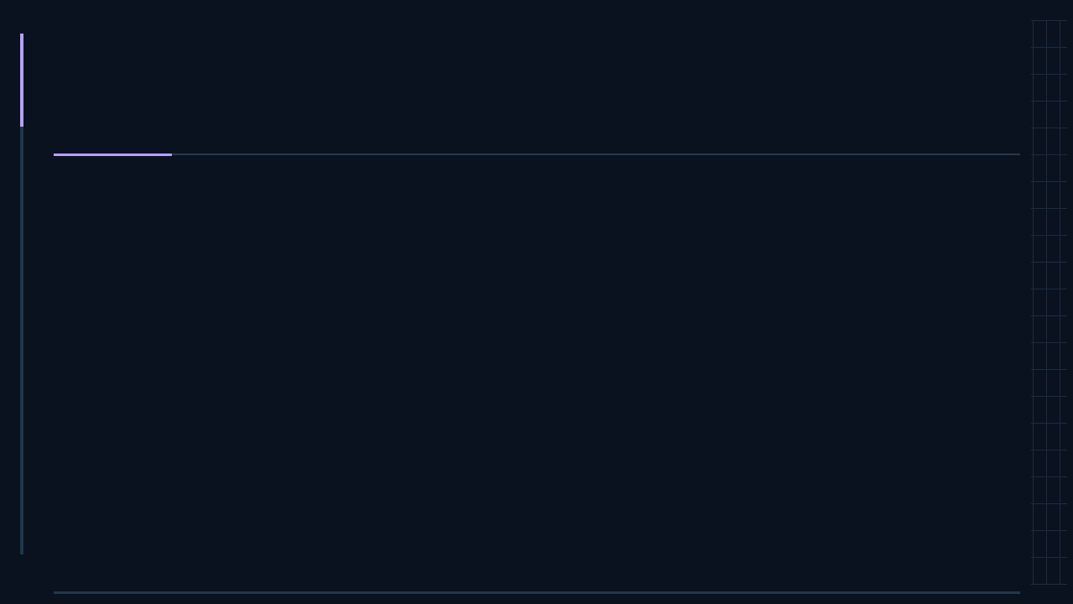
WHERE THE FRAME GOES
Lights and shadows
Overlapping local lights can affect the same surfaces. Shadow-casting lights also need shadow data.
Inspect GPU pass timings, then check mobility, attenuation radius and Cast Shadows on relevant lights.
Judge contact, contrast and readability when changing fill lights.
40
Notes:
Open the Light Complexity view as a lead and return to Lit before recording numbers. Source: https://dev.epicgames.com/documentation/en-us/unreal-engine/viewport-modes-in-unreal-engine?application_version=5.7

Slide 41
LIGHTS AND SHADOWS
Static, Stationary and Movable lights
Mobility
Lighting work and runtime flexibility
Static
Bake fixed illumination; cannot change in play.
Stationary
Bake indirect light; direct light remains dynamic.
Movable
Evaluate at runtime; can move and change.
Mobility controls change. Point, Spot, Rect and Directional describe light shape.
Baked behavior below requires a compatible precomputed lighting setup.
41
Notes:
A Point light can have different mobility settings. Static suits a fixed environment. Stationary permits brightness and color changes while keeping its transform fixed. Movable permits transform changes too. The hybrid option still has dynamic work. This comparison describes a precomputed workflow; the next slides explain the renderer conditions. Sources: https://dev.epicgames.com/documentation/en-us/unreal-engine/static-light-mobility-in-unreal-engine?application_version=5.7 ; https://dev.epicgames.com/documentation/en-us/unreal-engine/stationary-light-mobility-in-unreal-engine?application_version=5.7 ; https://dev.epicgames.com/documentation/en-us/unreal-engine/virtual-shadow-maps-in-unreal-engine?application_version=5.7

Slide 42
LIGHTS AND SHADOWS
Baked lighting: costs and constraints
Lightmass computes fixed lighting before play and stores lightmaps.
Spend UV space, texture memory, storage and build time to reduce runtime light work.
Lightmap resolution trades shadow detail for memory and bake time.
Changed fixed geometry or lighting needs a new bake.
42
Notes:
Lightmaps need a suitable non-overlapping UV layout and adequate padding. Inspect Lightmap Density and the resulting shadows in Lit. Volumetric Lightmaps supply precomputed lighting samples for moving objects, but do not turn a fixed light into a fully dynamic one. Doubling both texture dimensions gives four times as many texels, before compression or mip differences. A baked scene still pays for drawing surfaces and reading data. Source: https://dev.epicgames.com/documentation/en-us/unreal-engine/static-light-mobility-in-unreal-engine?application_version=5.7

Slide 43
LIGHTS AND SHADOWS
Stationary lighting: hybrid implications
Color and intensity may change; the light stays in one place.
Baked bounce does not automatically follow a runtime color change.
Conventional baked shadow channels allow at most four overlaps; layout can lower this.
Check Stationary Light Overlap and the active shadow method.
43
Notes:
In the conventional precomputed path, exceeding available stationary shadow channels can cause costly whole-scene dynamic shadow fallback. A directional light also consumes a channel. Runtime light changes do not rebuild the stored indirect result. With Virtual Shadow Maps, direct lighting and shadows are dynamic as for Movable; baked indirect can still contribute when the GI path permits it. Do not present the conventional four-channel limit as a universal limit on dynamic lights. Sources: https://dev.epicgames.com/documentation/en-us/unreal-engine/stationary-light-mobility-in-unreal-engine?application_version=5.7 ; https://dev.epicgames.com/documentation/en-us/unreal-engine/virtual-shadow-maps-in-unreal-engine?application_version=5.7

Slide 44
LIGHTS AND SHADOWS
Dynamic lighting, Lumen and shadows
Movable permits changing lights, but radius, overlap and shadow casters still matter.
Lumen handles dynamic indirect lighting; shadow mapping is a separate choice.
With Lumen GI active, baked lightmaps are hidden and Static lights do not contribute.
VSM caches pages; moving lights or casters can invalidate cached work.
44
Notes:
Lumen GI and the reflection method are separate project choices with possible Post Process overrides. Check the effective settings rather than assuming every UE5 project uses Lumen. VSM is a shadow technique, not a synonym for Lumen or baked lighting. Hardware ray-traced shadows are another possible path. A Stationary label alone does not guarantee cheap shadows under VSM. Sources: https://dev.epicgames.com/documentation/en-us/unreal-engine/lumen-global-illumination-and-reflections-in-unreal-engine ; https://dev.epicgames.com/documentation/en-us/unreal-engine/virtual-shadow-maps-in-unreal-engine?application_version=5.7

Slide 45
LIGHTS AND SHADOWS
Choose and test a lighting strategy
Check GI, Shadow Map Method, Allow Static Lighting and Force No Precomputed Lighting.
In the lounge, test one light radius or shadow change before changing the renderer.
For a bake comparison, use a separate compatible map and complete the lighting build.
Compare GPU passes, memory and the image; move an object to test the quality limit.
45
Notes:
Use Project Settings > Rendering and World Settings to identify the lighting path. Allow Static Lighting is a project capability; Force No Precomputed Lighting is a world constraint. A valid baked comparison also needs compatible GI, static receivers, suitable UVs and a completed build. Restart if a setting requires it. Switching to Static and losing illumination is a failed quality test, not a speedup. The current workshop ships without a completed baked counterpart. Keep its original baseline, fixed camera and quality requirements. Do not change the entire project renderer during a single light A/B test. Sources: https://dev.epicgames.com/documentation/en-us/unreal-engine/static-light-mobility-in-unreal-engine?application_version=5.7 ; https://dev.epicgames.com/documentation/en-us/unreal-engine/lumen-global-illumination-and-reflections-in-unreal-engine ; https://dev.epicgames.com/documentation/en-us/unreal-engine/virtual-shadow-maps-in-unreal-engine?application_version=5.7

Slide 46
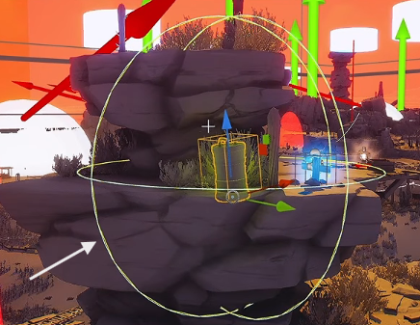
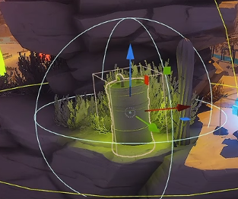
LIGHTING COST
Light influence and attenuation
Large influence volume
Smaller influence volume
Use Light Mixer to inspect placed lights and Blueprint light components.
Reduce Attenuation Radius only while preserving the required lighting.
An artistic falloff change needs intensity retuning and a new visual comparison.
46
Notes:
The yellow boundary is the influence volume of the selected light. Light projection can spend time on a much larger region than the visible contribution suggests. Isolate the light to understand its contribution; judge the full Lit composition before accepting it. Disabling Use Inverse Squared Falloff exposes Light Falloff Exponent and changes intensity behavior. This is a stylized alternative, not an automatic optimization. First test radius alone. Source: Lighting & Shadows 1:49–7:35. https://www.youtube.com/watch?v=1uFR9lXrpyQ
Private integration ID: lights. Original source captures: 20261104215749, 20261104220148

Slide 47
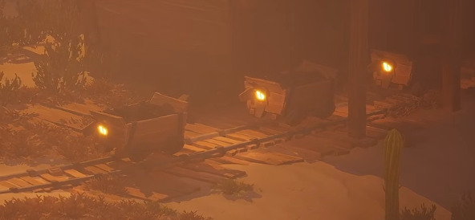
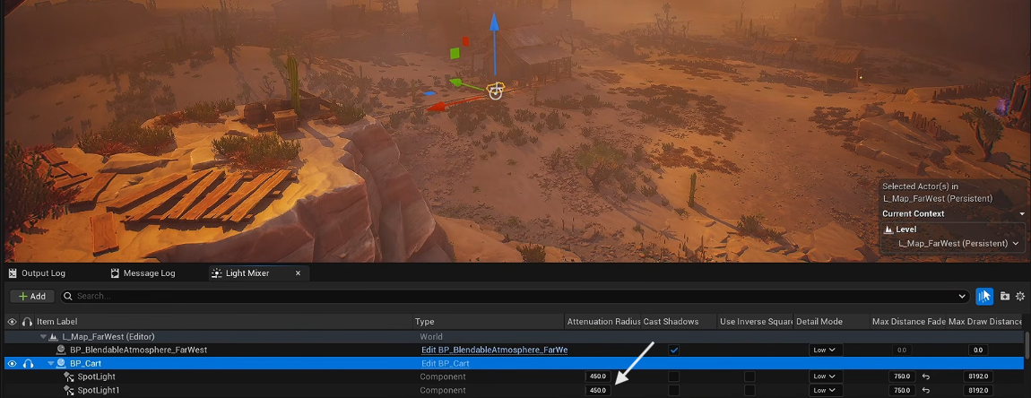
LIGHTING COST
Light fade and scalability
Inspect the fade settings
Check the distant Lit result
Max Draw Distance removes a local light at distance. Max Distance Fade Range softens the transition.
Walk across the boundary. Keep gameplay cues and focal objects readable.
Test each target quality tier; record r.LightMaxDrawDistanceScale.
47
Notes:
Distance is a quality decision. A candle inside a building may add little outside, but a navigation light can remain essential. Check the actual property tooltip and the running console variable. The historically captured command r.LightDrawDistanceScale is not reliable spelling: use engine console help to verify the available variable; Epic engine commonly uses r.LightMaxDrawDistanceScale. Do not copy the recorded 750 cm fade as a universal default. Source: Lighting & Shadows 7:41–10:34 and Dark Ruins 41–53 minute lighting audit. https://www.youtube.com/watch?v=1uFR9lXrpyQ https://www.youtube.com/watch?v=c2MH20OPSw0
Private integration ID: fade. Original source captures: 20261104221603, 20261104221624

Slide 48
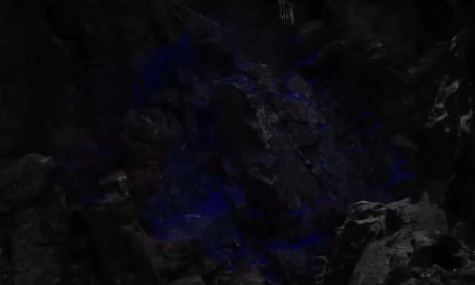
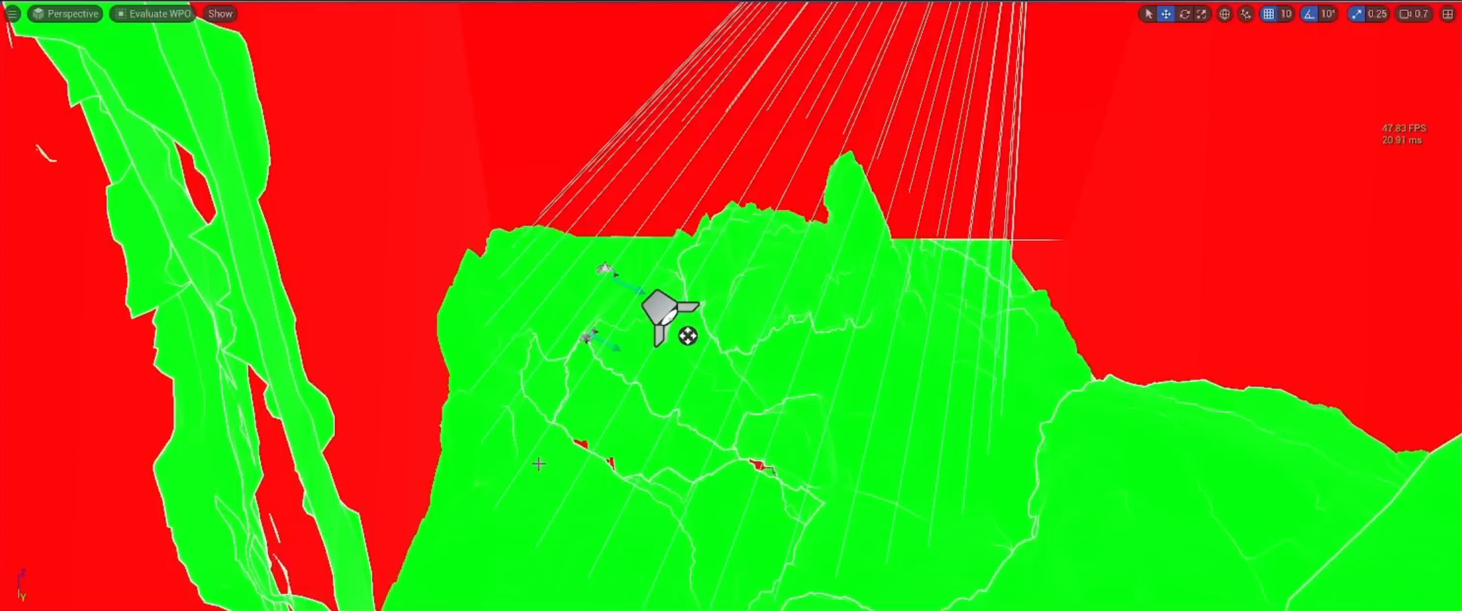
SHADOW COST
Stationary objects can invalidate shadows
Cached Page: dynamic invalidation
Evaluate WPO: vertex work enabled
World Position Offset (WPO) moves vertices in the material.
A fixed light can redraw shadow pages when a caster deforms.
Compare Cached Page and Evaluate WPO views. Confirm the change with Lit timing.
48
Notes:
Look at the same rock region in these two diagnostic views. In this recording, blue in Cached Page indicates dynamic invalidation, while green in Evaluate WPO means WPO evaluation. Neither color has a global good-or-bad meaning. The contact-shadows material function used in this sample participates in WPO; it is not the same control as a light's Contact Shadows property. Bypassing a shared function is a diagnostic experiment on a duplicate, not a safe global edit. Source: GPU Tips 4:47–13:23. The reported 0.7 ms was a source-workstation observation, not a course benchmark. https://www.youtube.com/watch?v=c2MH20OPSw0 https://dev.epicgames.com/documentation/en-us/unreal-engine/virtual-shadow-maps-in-unreal-engine?application_version=5.7
Private integration ID: cache. Original source captures: 20261104231710, 20261104232120

Slide 49
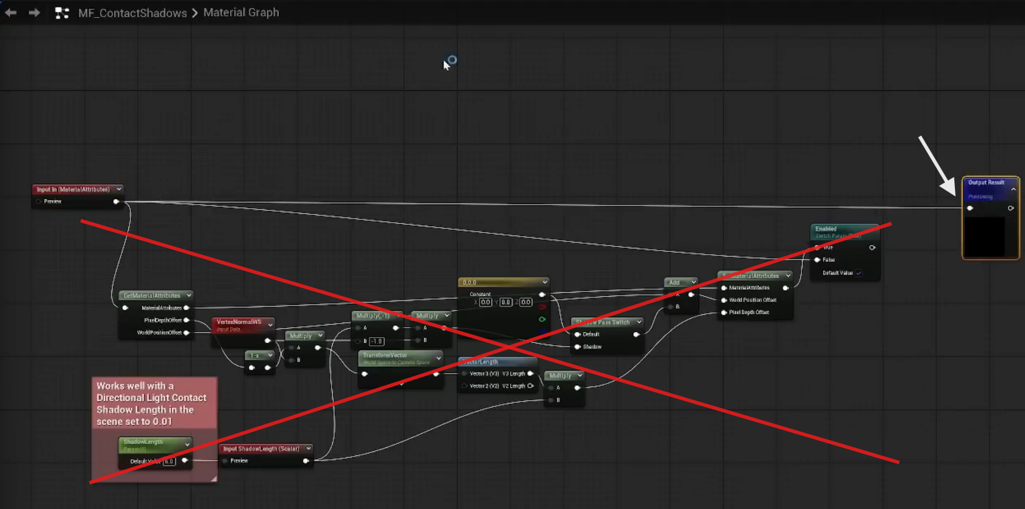
PERFORMANCE INVESTIGATION
Follow invalidation back to the material
Evaluate WPO shows an active material path; green is not a universal error color.
Inspect the specific function, deformation need and shadow result before changing it.
49
Notes:
The 04 video moves from an oversized light and invalidated VSM pages to Evaluate WPO and a material function named MF_ContactShadows. Its bypass is a diagnosis/quality trade in that sample, not a generic fix for every asset. The function name, the light Contact Shadow setting and VSM caching are distinct controls. Disable or blend WPO only where the visual requirement allows it. A fixed light and fixed-looking geometry can still produce recurring work. The quoted roughly 0.7 ms observation is from the source video, not our lab. Source: https://www.youtube.com/watch?v=c2MH20OPSw0 around 5–13 minutes; supplied WPO and function screenshots. The lounge Always-to-Auto experiment remains a different, measured cache-policy test.

Slide 50
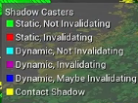
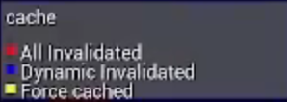
SHADOW COST
Read the visualization legend
Cached Page legend
Shadow Casters legend
Cached Page and Shadow Casters describe different states.
A cache override can leave a moving object with a frozen shadow.
Check motion, contact and page timings before keeping an override.
50
Notes:
The left legend labels cached page states. The right legend classifies shadow casters. Blue does not mean the same thing in both modes. Cached shadows may need refreshing after motion, lighting changes, camera changes or new page requests. A static cache policy does not mean render exactly once forever. Test the actual object in motion. Source: supplied lighting captures and GPU Tips. https://www.youtube.com/watch?v=1uFR9lXrpyQ https://www.youtube.com/watch?v=c2MH20OPSw0 https://dev.epicgames.com/documentation/en-us/unreal-engine/virtual-shadow-maps-in-unreal-engine?application_version=5.7
Private integration ID: legend. Original source captures: 20261104232026, 20261104224229

Slide 51
FRAME TIME AND BUDGETS
Texture memory and streaming
Disk size and runtime residency measure different things.
stat streaming reports texture streaming and pool pressure. Inspect the texture’s size, format and mip settings in the asset editor.
A memory fix can reduce streaming pressure without changing steady GPU frame time.
51
Notes:
Ask students to distinguish a runtime memory budget from a frame-time budget. Source: https://dev.epicgames.com/documentation/en-us/unreal-engine/stat-commands-in-unreal-engine?application_version=5.7

Slide 52
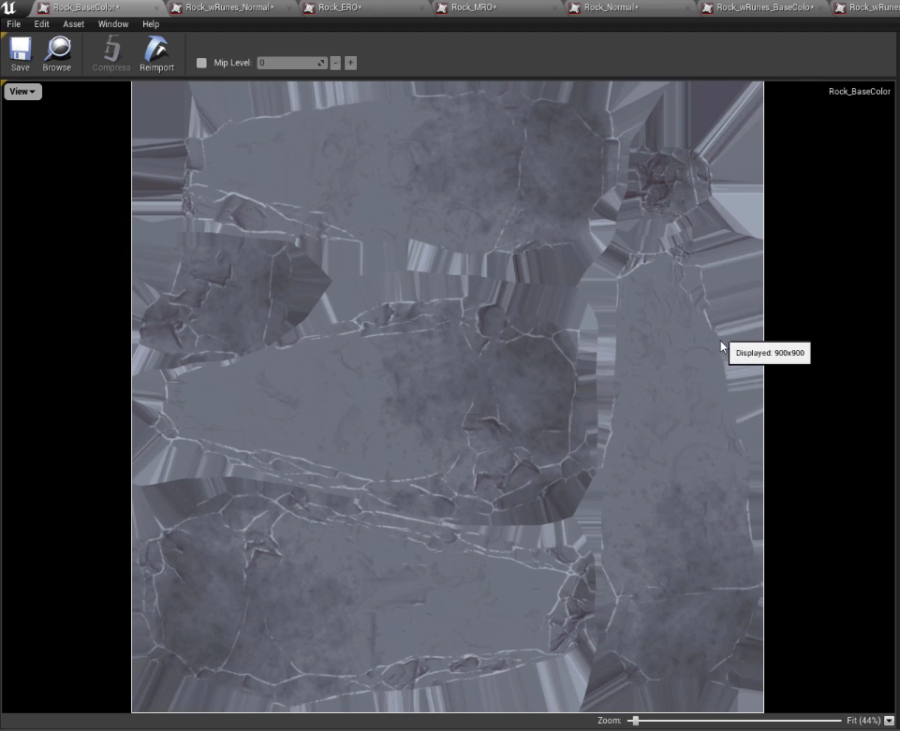
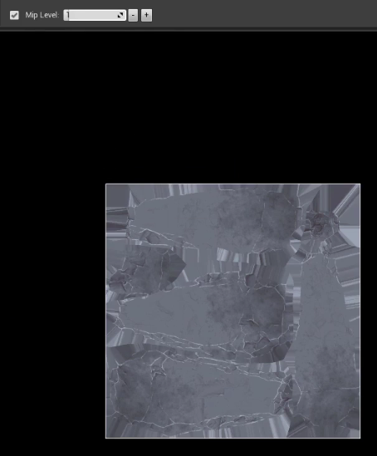
TEXTURE BUDGET
Mips, padding and texture size
Inspect mip levels and size
Set a tested texture limit
A mip is a lower-resolution texture level. Padding protects UV borders during filtering.
Inspect Max Texture Size, LOD Bias, mip count and resource size.
Keep the sign, rune or surface detail readable at the intended distance.
52
Notes:
Do not infer GPU frame savings from a smaller imported texture. Test memory and residency separately. Halving both dimensions gives roughly one quarter of the texels at a fixed format; compression and the mip chain affect actual bytes. A larger streaming pool spends more memory and does not fix oversized content by itself. Power-of-two texture dimensions and streamability depend on the asset type and settings; inspect the actual asset rather than treating every UI texture as a rule. Source: Gnomon 03 Materials & Textures Pt. 1.md, Unreal texture editor sequence.
Private integration ID: mips. Original source captures: 20261104102537, 20261104104632

Slide 53
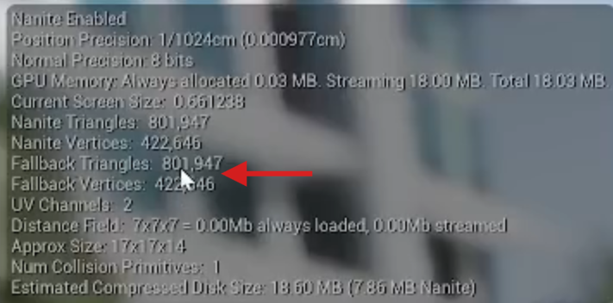
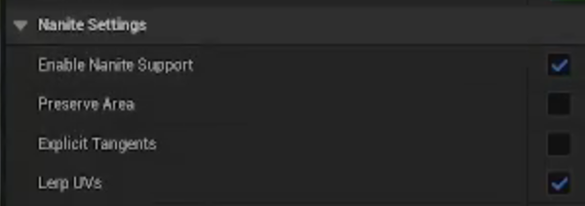
ASSET AUDIT
Render geometry, fallback and collision
Nanite is enabled
Fallback still has many triangles
Sort Primitive Statistics by resource size and inspect the largest assets.
Check Nanite support, fallback geometry and collision separately.
Retest ray queries, interaction and shading after changing the representation.
53
Notes:
Enabling Nanite does not remove fallback geometry or collision requirements. The helmet in the recording had a very detailed fallback despite Nanite being enabled. Inspect actual users: platform fallback, ray tracing path and collision settings differ by project and engine version. A memory change is not a measured FPS change. Source: GPU Tips 25:04–37:05. https://www.youtube.com/watch?v=c2MH20OPSw0 Use the supplied read-only audit and a duplicate asset; do not mass-enable Nanite or delete collision globally.
Private integration ID: assetmemory. Original source captures: 20261105005953, 20261105010024

Slide 54
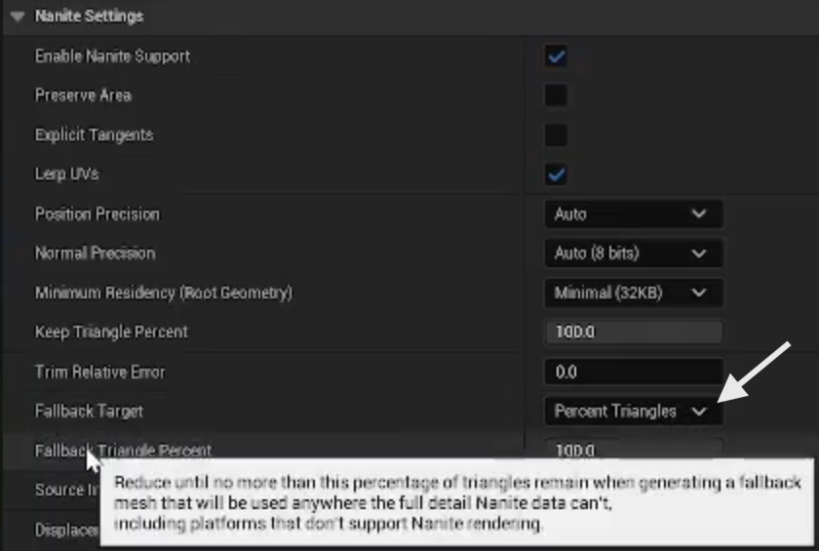
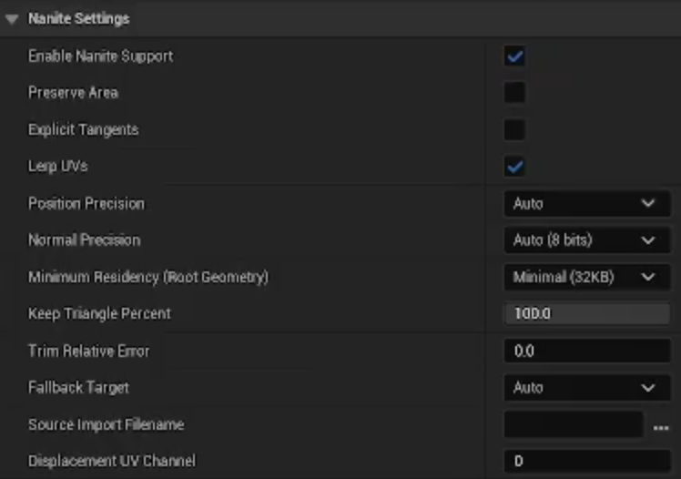
PERFORMANCE INVESTIGATION
A fallback is a separate representation
The source asset retains a 100% fallback; switching its target changes that representation.
Check unsupported rendering, relevant ray tracing and collision users before accepting a reduction.
54
Notes:
The panel on the left is Percent Triangles with Fallback Triangle Percent 100. The panel on the right uses Auto. This is not the Nanite visible-cluster count, and reducing fallback render geometry is not automatically equivalent to simplifying the collision actually used by gameplay. Inspect BodySetup, complexity policy and interaction traces separately. The correct fallback target is platform- and use-dependent; Auto is a comparison treatment, not a universal repair. Source: https://www.youtube.com/watch?v=c2MH20OPSw0 around 29–37 minutes; supplied screenshots Pasted image 20261105085732.png and 20261105085808.png. Preserve the original asset before changing build settings.

Slide 55
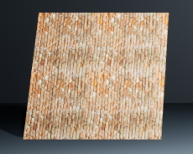
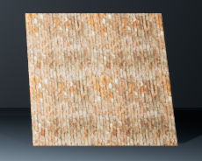
WEEK 9 GALLERY
Brick relief and sampling cost
Parallax samples height to give the flat brick surface apparent depth.
Hold height and camera fixed. Change the step count on a test copy.
Check mortar stability at a grazing angle. Which GPU pass would you time?
PBR / normal map
Parallax occlusion
Week 9 BrickStudy · Same gallery capture
55
Notes:
Show the existing Week 9 BrickStudy. Near and Far Height are staged at 0.04. Keep both fixed for a step-count test. The image is a qualitative gallery reference. Point out the fixed silhouette and explain that the height input lives in alpha in this material.

Slide 56
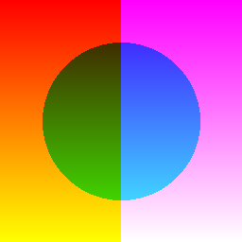



DEMO EXTENSIONS
Automated texture packing
→
R Ambient occlusion
G Roughness
B Metallic
Packed ORM
This is ORM. Week 9 brick uses MRAH with height in alpha. For ORM, use Masks compression with sRGB off.
56
Notes:
Run the packer and inspect its output. Ask how a swapped roughness and metallic channel would change the material.

Slide 57
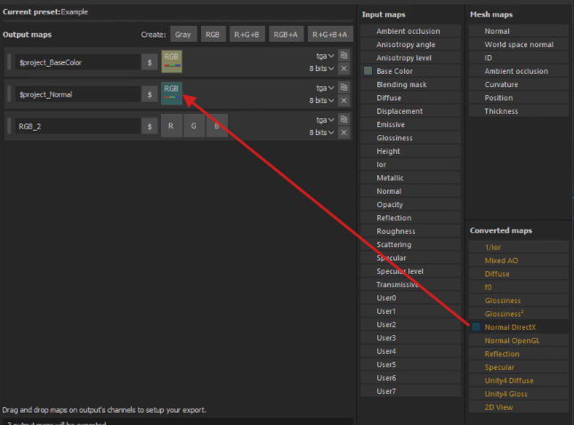
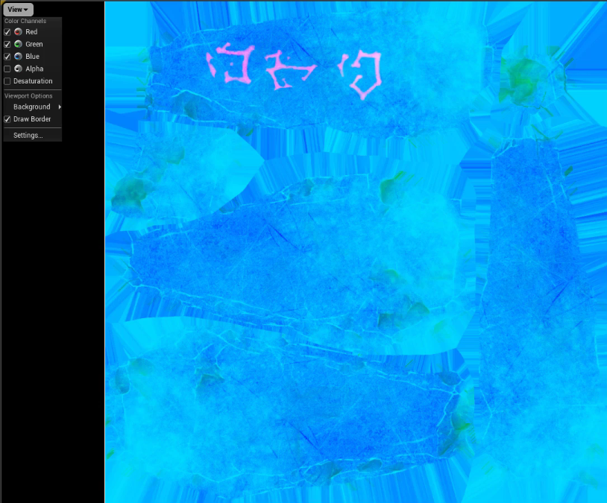
TEXTURE DATA
Packed channels are a contract
Painter output template
Emissive variant (not MRO)
Gnomon MRO: R = metallic, G = roughness, B = occlusion.
This lab ORM: R = occlusion, G = roughness, B = metallic.
Use linear mask data. Inspect channels before connecting the material.
57
Notes:
Week 9 MRAH and Gnomon MRO differ from this lab ORM. Names are clues; inspect the content. Base Color normally uses sRGB; normals and numeric masks use linear interpretation with suitable compression. A constant non-metallic value can replace an all-black metallic texture if no other variation is needed. Alpha can change the compressed resource format, so do not claim an extra packed channel is free. The Gnomon recording also shows emissive replacing a metallic channel; record that layout explicitly. Source: Gnomon 03 Materials & Textures Pt. 1.md.
Private integration ID: texturedata. Original source captures: 20261104023043, 20261104143527

Slide 58
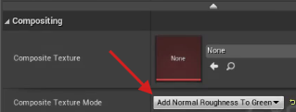

TEXTURE DATA
Normal detail and roughness stability
Choose the normal composite source
Select the roughness channel
Small normal details can shimmer as texture mips change.
Composite Texture can adjust the roughness channel using a matching normal map.
Compare a moving camera at the same lighting and mip distances.
58
Notes:
The Gnomon roughness channel is green. Select the corresponding composite mode rather than copying a channel blindly. Use a compatible normal texture and inspect each mip. This changes the appearance of the material; keep the intended roughness response. Do not evaluate shimmer from a single compressed still. Source: Gnomon 03 Materials & Textures Pt. 1.md, normal-map compositing sequence.
Private integration ID: roughness. Original source captures: 20261104144215, 20261104144258

Slide 59
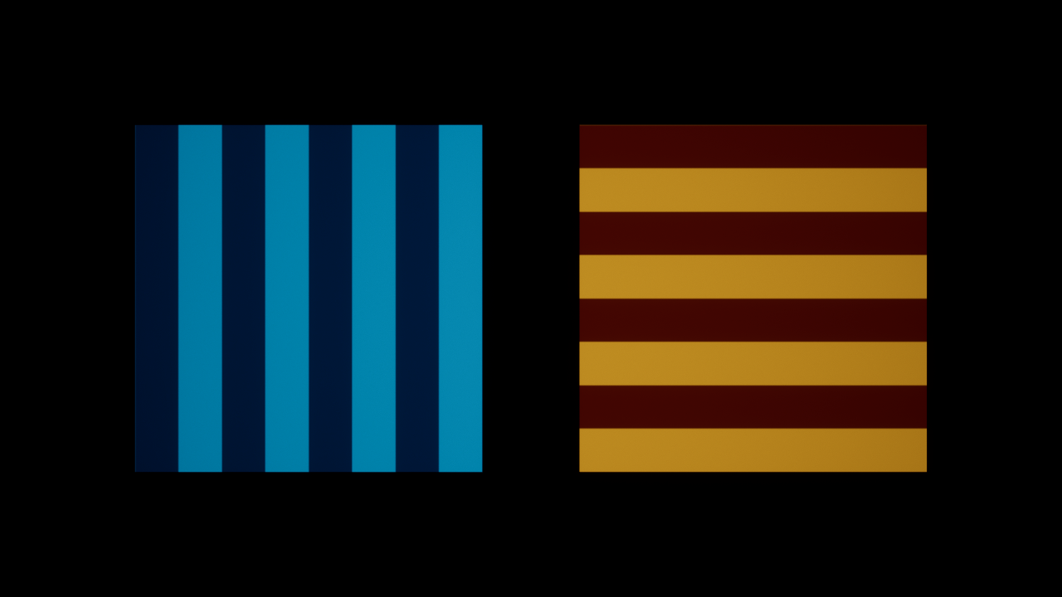
DEMO EXTENSIONS
Texture arrays
Slice 0
Slice 1
The same UV selects a point in either image. Slice chooses the image.
Both source images are 256 × 256. Check format, mips and resource size.
59
Notes:
Open TA_SliceDemo and show the two sources. Open MI_Array_Slice0 and MI_Array_Slice1. The parent material appends the Slice parameter to UV, then samples the array. Ask what changes as you switch the index.

Slide 60
MATERIAL AND SHADER LOGIC
What makes a material expensive?
Pixel work grows with shaded coverage, repeated layers and the compiled shader.
Texture fetches, arithmetic and memory access can limit different workloads.
Vertex deformation, shadow passes and material submissions add separate costs.
Fewer graph nodes do not guarantee a faster frame.
60
Notes:
Think about how often the compiled program executes and what work it does each time. A small object with a complex shader can matter less than a large layered surface with a simpler one. Materials can also affect depth, shadows and velocity through masking, displacement or motion. The compiler can fold constants and discard disconnected branches. We need a runtime lead and a quality requirement before choosing an edit. General foundation: https://dev.epicgames.com/documentation/unreal-engine/performance-guidelines-for-artists-and-designers?application_version=4.27 . Apply these principles to the active UE 5.7 renderer, not every historical recommendation on that older page.

Slide 61
MATERIAL AND SHADER LOGIC
Measure the compiled material and the scene
Open Material Editor Stats and Platform Stats for the target API and quality.
Record pixel / vertex instructions, texture samples and compiler errors.
Use Shader Complexity and Quad Overdraw to locate suspect coverage.
Confirm with the relevant Lit GPU pass and repeat the same camera.
61
Notes:
An instruction count is a diagnostic, not milliseconds. Texture operations and arithmetic have different hardware behavior. Platform, feature level, vertex factory and pass matter. Complexity colors use a visualization-specific scale and are not a complete model of caches or every rendering path. RenderDoc can identify draws, shaders and resources in one frame; use timings to evaluate the scene. Sources: https://dev.epicgames.com/documentation/en-us/unreal-engine/unreal-engine-material-editor-ui ; https://dev.epicgames.com/documentation/unreal-engine/viewport-modes-in-unreal-engine

Slide 62
MATERIAL AND SHADER LOGIC
Reduce texture sampling work
Reuse a sample when UVs, mip selection and sampler behavior match.
Pack compatible scalar masks; preserve channel meaning, compression and color space.
Shared samplers reduce sampler-state pressure; they do not erase texture fetches.
World-aligned layers and detail normals can multiply sampling work.
62
Notes:
Three projection axes or several blended layers can each require their own samples. A single texture sampled with different coordinates is still separate work. Packing masks is useful when their resolution, filtering and update needs align; forcing incompatible data together can lose quality. Mips and suitable resolution influence bandwidth and residency. Lower texture resolution does not remove arbitrary shader logic. Compare the compiled sample count and target pass, and check distant motion and roughness stability. Sources: https://dev.epicgames.com/documentation/unreal-engine/performance-guidelines-for-artists-and-designers?application_version=4.27 ; https://dev.epicgames.com/documentation/en-us/unreal-engine/unreal-engine-material-editor-ui . See the existing ORM packing and brick sampling examples in this deck.

Slide 63
MATERIAL AND SHADER LOGIC
Simplify logic without changing the look
Remove unused features from the compiled path, not just the visible graph layout.
Check repeated noise, trigonometry, power and layered blends before approximating.
Bake stable procedural detail when the texture / memory trade is acceptable.
Inspect compiler output: simple algebra may already be optimized.
63
Notes:
Material functions organize graphs; they do not automatically make repeated calculations free. A Custom HLSL node is not an optimization by itself. Replacing a high-cost procedure with a lookup spends texture memory and bandwidth and can change filtering or animation. Constant folding can make a large-looking graph cheap. Preserve the relevant close view, distance, motion and lighting; test one hypothesis rather than rewriting every node. Sources: https://dev.epicgames.com/documentation/unreal-engine/performance-guidelines-for-artists-and-designers?application_version=4.27 ; https://dev.epicgames.com/documentation/en-us/unreal-engine/unreal-engine-material-editor-ui

Slide 64
MATERIAL AND SHADER LOGIC
Runtime zero is not a static feature switch
A scalar-driven Lerp can blend away a feature while retaining its shader work.
A Static Switch removes the unused branch when that variant is compiled.
Static switches cannot change during play and create variant-management costs.
DynamicZero / MasterOff: 236 / 67 pixel instructions in the local editor API snapshot.
64
Notes:
The new DynamicZero material uses RippleWeight, a runtime scalar whose default is zero. The expensive ripple is still part of that program; inspect the actual compiled output rather than assuming a particular optimizer result. MasterOff selects the constant with a static switch. Both should render the same flat color in this test. MasterOn has a different picture, so its raw delta alone is not evidence of equal-quality optimization. Source: https://dev.epicgames.com/documentation/en-us/unreal-engine/material-parameter-expressions-in-unreal-engine?application_version=5.7 . Exact graphs and runnable modes: MaterialCostLab, Tools/build_shader_experiments.py. Local UE 5.7 editor API snapshots reported 236 versus 67 pixel instructions, with vertex counts 140 versus 136. Repeated overall GPU medians remained around 3.29 ms for both. The statistic is an editor aggregate, not a measured GPU duration or a certification for another pass/platform. This is why lower instruction counts and a measured frame improvement are separate conclusions.

Slide 65
MATERIAL AND SHADER LOGIC
Move suitable UV math to the vertex stage
For UV × scale + offset, test Customized UV0 or Vertex Interpolator.
Compute the coordinate before rasterization; keep the texture sample in the pixel stage.
Nonlinear math can change when evaluated only at vertices and interpolated.
UVPixel and UVVertex use the same texture, transform, plane and camera.
65
Notes:
The supplied pair transforms UVs by eight and adds (0.23, 0.17). In UVVertex, the transform feeds a Vertex Interpolator and its output feeds the pixel-stage texture sample. Customized UV0 with TexCoord 0 is another graph route. Affine math should preserve the result apart from precision/filtering effects. A sine wave or normalization moved in the same way can change across a coarse triangle. Vertex work and interpolator bandwidth are not free; a dense mesh or distant object can make the trade unhelpful. Source: https://dev.epicgames.com/documentation/unreal-engine/customized-uvs-in-unreal-engine-materials

Slide 66
MATERIAL AND SHADER LOGIC
Blend mode, coverage and hidden work
Opaque, Masked and Translucent use different visibility and shading paths.
Large transparent quads can shade overlapping regions repeatedly.
Tighter geometry and less overlap can help without simplifying every node.
Test two-sided rendering, refraction and extra layers against the visual requirement.
66
Notes:
Do not switch glass to Opaque and call the loss of transparency an acceptable optimization. Masked cutouts can still create expensive coverage, depth and shadow work, including on Nanite paths. Quad Overdraw is a lead about raster work, not a universal cost meter for every material path. Inspect the actual blend mode and relevant pass; a large translucent bounding box does not prove all its pixels are shaded. Source: https://dev.epicgames.com/documentation/unreal-engine/viewport-modes-in-unreal-engine ; https://dev.epicgames.com/documentation/en-us/unreal-engine/using-transparency-in-unreal-engine

Slide 67
MATERIAL AND SHADER LOGIC
WPO, pixel depth and shadow implications
World Position Offset adds vertex work and can invalidate cached shadows.
Pixel Depth Offset can change depth / shading behavior and platform cost.
A cheaper color graph can leave deformation or shadow cost unchanged.
Test distance policies with motion, bounds, shadows and silhouette intact.
67
Notes:
Material cost is not confined to Base Color. WPO and masking can also affect depth and shadow rendering. Nanite does not remove arbitrary material arithmetic or animation cost. Set a significance or distance policy only after checking which paths and features the project uses. Do not disable displacement globally to make a frozen screenshot pass. Source: https://dev.epicgames.com/documentation/en-us/unreal-engine/nanite-virtualized-geometry-in-unreal-engine?application_version=5.7 ; https://dev.epicgames.com/documentation/en-us/unreal-engine/virtual-shadow-maps-in-unreal-engine?application_version=5.7

Slide 68
MATERIAL AND SHADER LOGIC
Material instances and shader variants
Instances reuse a parent design; they do not automatically simplify its pixel shader.
Shared state and CPD can affect submissions separately from shader arithmetic.
Static parameters trade feature removal for compiled variants and cook / storage work.
Use Material Analyzer to inspect instance families and static overrides.
68
Notes:
The existing CPD versus MID demonstration measures a different question from the per-pixel logic tests. A material parent with a static-disabled feature can compile down to a small program; a lean-looking instance can still inherit expensive live features. Static combinations, usage flags, passes and platforms all contribute to the shader population. Do not describe every possible boolean combination as necessarily cooked: inspect the combinations actually used. Sources: https://dev.epicgames.com/documentation/en-us/unreal-engine/material-parameter-expressions-in-unreal-engine?application_version=5.7 ; https://dev.epicgames.com/documentation/unreal-engine/unreal-engine-material-analyzer-tool

Slide 69
MATERIAL AND SHADER LOGIC
Quality tiers need explicit shader policies
Choose detail normals, layers, refraction and deformation by target requirements.
Material Quality Switch / Feature Level Switch select supported alternatives.
Check variant stats and actual device behavior; desktop counts are not mobile timing.
Validate close / distant views, motion, lighting and texture residency.
69
Notes:
A tier should say what visual feature changes and under what platform or quality condition. Precision changes, simplified shading models and fewer interpolators need target-specific testing. Shader compile time, PSO preparation, runtime GPU time and texture memory are separate budgets; improvement in one is not evidence about the others. The supplied lab is a conventional unlit material experiment, not a full Substrate or mobile certification. Sources: https://dev.epicgames.com/documentation/en-us/unreal-engine/unreal-engine-material-editor-ui ; https://dev.epicgames.com/documentation/en-us/unreal-engine/material-parameter-expressions-in-unreal-engine?application_version=5.7

Slide 70
PERFORMANCE INVESTIGATION
Shader runtime, compile and cook budgets
A static-disabled path can reduce runtime work while creating another compiled variant.
Remove project permutations only when the feature is genuinely unsupported or unused.
In UE 5.7, ShaderTypeStats.csv helps compare shader growth between cooks.
Compile duration, cooked bytes, PSO preparation and GPU time need separate evidence.
70
Notes:
The shader-compilation article is a project-requirements checklist, not a promise that every project can halve shaders. Changing renderer capabilities can require recompilation and can break other maps or targets. Check the current engine settings instead of copying obsolete feature names. The 5.7 highlights describe ShaderTypeStats.csv for permutation counts and code size; it is not a direct VRAM total and packaging/chunk duplication matters. Sources: https://tomlooman.com/unreal-engine-optimize-shader-compile-time/ ; https://tomlooman.com/unreal-engine-5-7-performance-highlights/ . Do not disable features in the classroom project just to reduce a report count.

Slide 71
MATERIAL AND SHADER LOGIC
Shader logic experiments: predict, inspect, retest
A: DynamicZero versus MasterOff. Compare equivalent output and compiled work.
B: UVPixel versus UVVertex. Compare stage costs and texture alignment.
Record target, stats, GPU pass, repeated timings and a visual difference check.
Transfer one justified change to a duplicate lounge material; keep the source untouched.
71
Notes:
Use the shader practice section in the study guide. The expanded comparison project includes a separate Capture-Shader-Logic.ps1 so earlier CPD and material demonstrations retain their original runner. Timing runs exclude screenshots. The two-color checker lets us inspect alignment and filtering; tiny differences in a very small UV transform may not move overall frame time. Report an inconclusive result honestly. In the lounge, do not modify a shared Fab parent globally: duplicate the candidate, change one feature, and inspect all affected surfaces before keeping it. Source: local MaterialCostLab authored test assets and scripts.

Slide 72
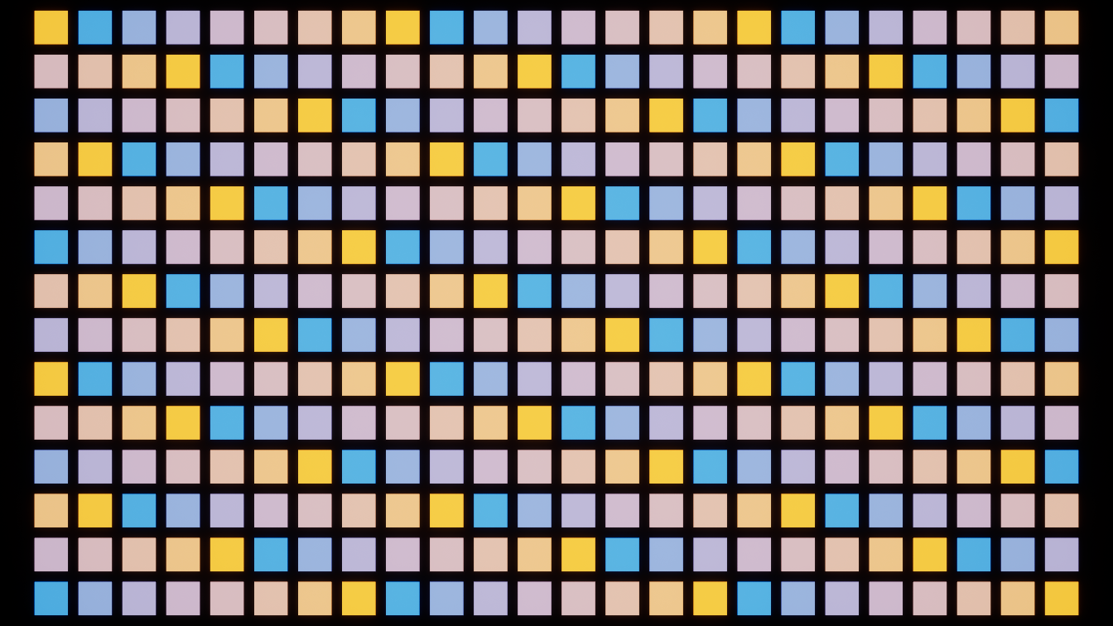
MATERIAL DATA
Same image, different parameter storage
Dynamic instances
Custom Primitive Data
Draw calls 699 Frame 3.99 ms
Draw calls 364 Frame 3.89 ms
Same 336 meshes and colors. The scalar lives on the MID or on the primitive.
72
Notes:
Both treatments use the same 336 meshes, camera, colors and material math. MID creates one dynamic instance per component. CPD writes the same number to slot 0 on each component and shares a material. The comparison tests this batching setup. Instanced Static Mesh Per Instance Custom Data is a different interface.

Slide 73


MATERIAL COST
Does a master material cost more?
Lean
Master · ripple off
Master · ripple on
GPU 3.28 ms
GPU 3.31 ms
GPU 3.29 ms
67 pixel instructions
67 pixel instructions
235 pixel instructions
Same plane and coverage. Off matches Lean. On adds a procedural ripple.
The feature raised instruction count. GPU timing did not separate in this run.
73
Notes:
First compare the lean material and master with its optional feature compiled out. Then enable the ripple in the same graph design. A parent label does not determine shader work. Static switches alter compiled paths and each used combination can create a permutation. Dynamic uniform values do not create static permutations by themselves. The editor-reported pixel instruction count rose from 67 to 235 when enabled. GPU launch medians overlap across these treatments, so this test does not establish a whole-frame GPU penalty. Compare runtime, shader compilation and batching separately.

Slide 74
ANIMATION AND VFX
Vertex animation textures
Author motion
→
Bake frames to texture
→
Sample by vertex + frame
→
Move vertices on GPU
Use for looping deformation, simulated debris or distant animated crowds.
Measure CPU animation, GPU time and texture memory. Check bounds and interactions.
74
Notes:
VAT can replace live deformation or simulation for the visual playback. It still draws geometry and fetches data. Crowd AI and collision are separate workloads. The sketch shows a simple fixed-topology position bake. Different encoders handle rigid transforms and dynamic topology differently. SideFX Labs VAT 3.0: https://www.sidefx.com/docs/houdini/nodes/out/labs--vertex_animation_textures-3.0.html

Slide 75
ANIMATION AND VFX
One debris burst, three treatments
A Live Chaos
B VAT
C Flipbook
Simulate rigid pieces
Replay baked 3D motion
Replay rendered frames
Contact and bounce
Silhouette and depth
Readability from the side
Match shot, trigger and burst count. Record CPU, GPU and texture memory.
Check matched views, then watch the loop for motion and interaction.
75
Notes:
Proposed rehearsal. Use a repeatable live debris burst as the reference. If feasible, derive B and C from the same approved take. Lock trigger, duration, framing, lighting, settings and concurrent effect count. A card can lose parallax, and a VAT can preserve the 3D silhouette while giving up live collision. Test an added obstacle separately when interactivity is required. Capture steady playback and burst peaks. No timings have been collected.

Slide 76
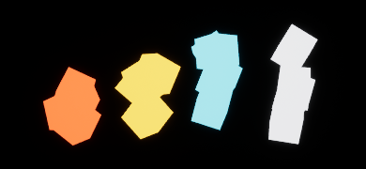


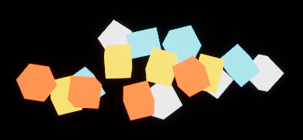


ANIMATION AND VFX
The same burst from two views
Live Chaos
VAT
Flipbook
Front
Side
0.4 s after trigger. The flipbook card stays aligned to the front view.
76
Notes:
Sample 12, about 0.4 seconds after triggering. Front and side captures use the same crop and scale. VAT reproduces the photographed 3D silhouette. The 192-pixel flipbook is visibly coarser up front and its front-view image compresses when seen from the side. These are matched stills. Show the live loops separately for motion.

Slide 77
ANIMATION AND VFX
CPU time fell. Frame time held.
24 synchronized bursts · 2560 × 1440 · Three launches per treatment
Game thread time
Frame time
Live Chaos
3.10 ms
Live Chaos
4.01 ms
VAT
1.21 ms
VAT
4.09 ms
Flipbook
1.15 ms
Flipbook
4.00 ms
GPU ≈ 3.35 ms each · Draw calls 415 → 98 · Bake textures 0 / 0.28 / 6.75 MiB
Median of three launch medians. Texture figures describe uncompressed bake data.
77
Notes:
This is a local stress test with 24 synchronized bursts and 16 pieces per burst. Each metric summarizes three launches using rows 192–575. CPU and GPU overlap, so do not add their times. Data-texture sizes are uncompressed payloads for this example, not total application memory. The setup uses one combined VAT mesh or one masked card per burst, compared with 16 separate live bodies. The draw-call reduction is part of this implementation. Avoid attributing it solely to the choice of encoding.

Slide 78
ANIMATION AND VFX
Which treatment fits the shot?
Distant scripted burst · Keep the silhouette and timing from the player view.
Close interactive burst · Pieces must react to a new obstacle.
Choose a candidate for each shot. Name one visual check and one timing check.
78
Notes:
Give students 30 seconds to pick independently. A flipbook is a candidate for the distant scripted shot, and VAT is a candidate when depth matters. Live simulation is the candidate if pieces must respond to a new obstacle. Those are predictions. Ask what the matched captures would have to show before approving any treatment. Compare the intended player view first, then the side view. Use the companion walkthrough for setup and commands.

Slide 79
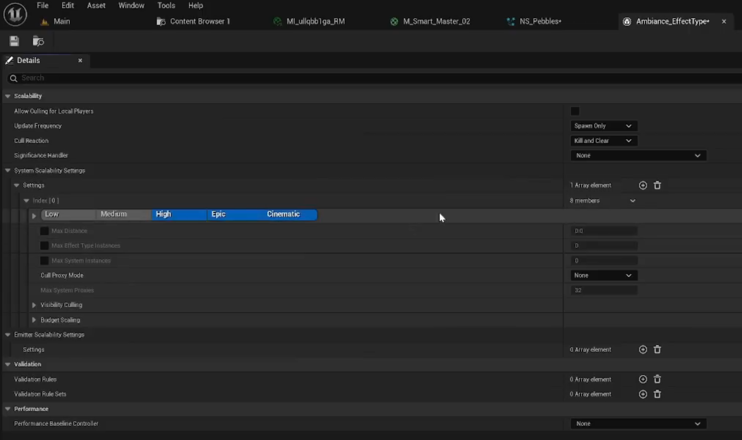
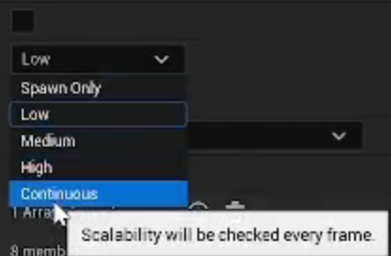
NIAGARA
Simulation target and effect policy
Effect Type policy
Update frequency choices
CPU versus GPU chooses where particle scripts run. System and emitter work can remain on the CPU.
An Effect Type defines when systems can run and which quality tiers use them.
Count active systems, inspect timing, and check what disappeared.
79
Notes:
These are two independent tests: changing simulation target while preserving output, and culling effects while changing workload. The Dark Ruins example checks persistent ambience repeatedly; a Spawn Only rule cannot react later to camera changes. The existing course Niagara distance comparison intentionally evaluates on spawn. Do not present it as a measured test of visibility-based culling. Choose bounds, update frequency and cull reaction together; test exit and return. Source: GPU Tips 14:00–24:30. https://www.youtube.com/watch?v=c2MH20OPSw0
Private integration ID: niagara. Original source captures: 20261105001405, 20261105002324

Slide 80
GPU WORK
Niagara GPU simulation dispatch
Particle state
Compute dispatch
Updated buffer
Renderer
→
→
→
Position, velocity
Thread groups update state
Positions for this frame
Sprites or meshes
Find simulation dispatches and rendering passes in GPU timing.
VAT samples baked motion in the vertex shader. Niagara compute can advance particle state.
80
Notes:
A GPU emitter can dispatch groups of threads to advance particle state. A simplified example is Position += Velocity × Delta Time. The companion illustrates how dispatches can cover extra lanes and why bounds matter. The renderer consumes that state in subsequent rendering work. In our VAT demo the vertex shader samples baked data. This schematic is explanatory and does not show captured engine scheduling. GPU simulation does not guarantee lower total frame time.

Slide 81

NIAGARA SIMULATION
Same effect, different simulation target
CPU simulation
GPU simulation
Game 1.99 ms · GPU 3.47 ms
Game 1.22 ms · GPU 3.52 ms
96 active systems in both. Frame 4.10 → 4.24 ms. Median of three launch medians.
81
Notes:
Use the same Simple Sprite Burst emitter template, placement, camera, bounds and repeat cadence. The selected CPU and GPU screenshots match pixel for pixel. This comparison uses one small Sprite Burst emitter per component. It does not establish visual equivalence for all Niagara effects. Compare motion as a separate check. GPU sim moves particle scripts, while System and Emitter scripts can still use the CPU.

Slide 82

NIAGARA SCALABILITY
A distance budget changes the workload
GPU · culling off
GPU · distance culling
Active 96 / 96 · Draw calls 314
Active 32 / 96 · Draw calls 122
Same GPU asset. Frame 4.24 → 4.17 ms. Median of three launch medians.
82
Notes:
Keep GPU simulation fixed. Apply the Effect Type distance rule on spawn using Kill and Clear. The number of placed components stays fixed. Only effects within the allowed distance activate. Decide whether that visual loss is acceptable for the shot.

Slide 83
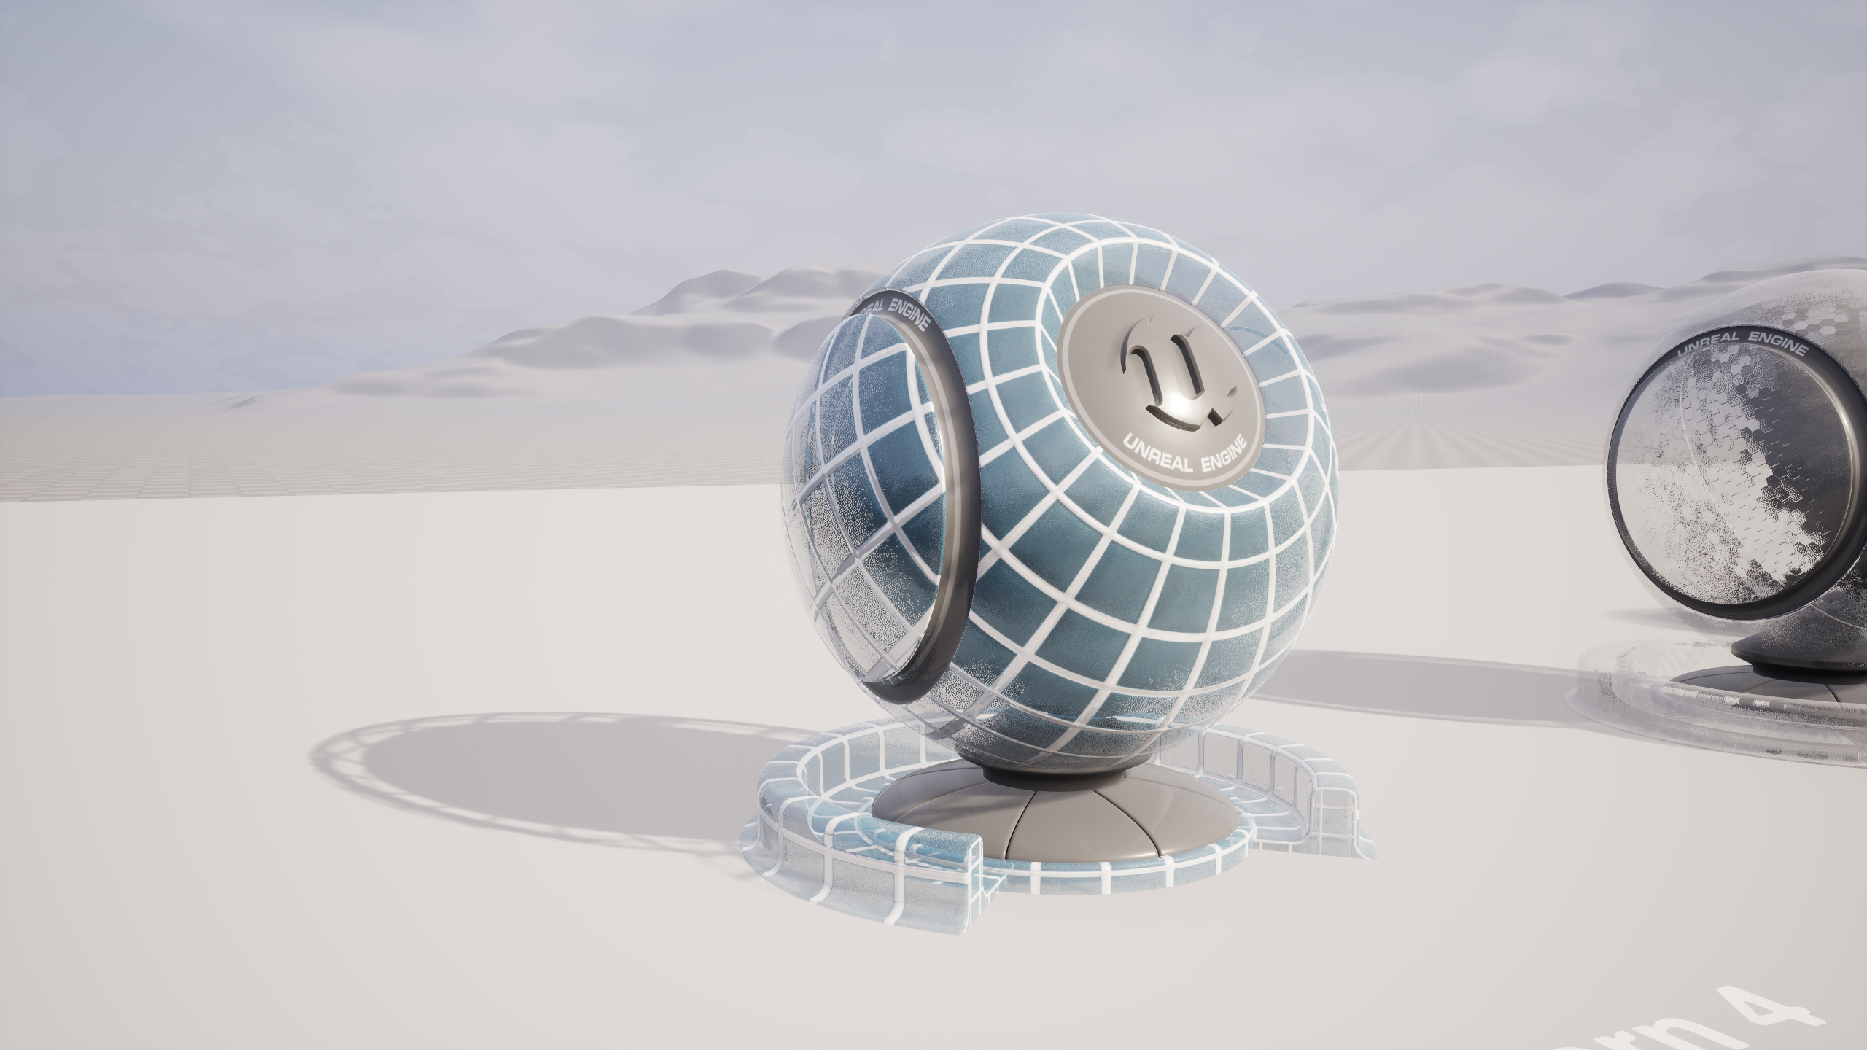
GUIDED DEMO
Showroom audit
The showroom needs to keep its focal display readable through the glass.
We will pin the view, capture the frame budget, and follow the most useful timing signal.
Before the edit, predict which number should move and what part of the image could change.
83
Notes:
Open the glass case in Standalone Game. Check Audit Camera and open the recorded baseline. Ask what the image must preserve. Use lighting as the other lab case.

Slide 84
GUIDED DEMO
Baseline and retest
Same camera, viewport size, scalability, screen percentage and editor mode.
Warm up. Record three Frame / Game / Draw / GPU readings and a screenshot.
Change one setting on a related group. Repeat the capture and compare median, spread and appearance.
84
Notes:
Test a single property across the suspected group. If the change does not move the observed limiting time, explain what that result rules out.

Slide 85
DEMO EXTENSIONS
Reading the profiler dashboard
Frame is the budget. Game, Draw and GPU help you choose where to investigate.
Compare the same steady interval in both captures. Timings use milliseconds. Draw calls are counts.
Open the pass breakdown and connect one timing change to work in the scene.
85
Notes:
Open the local evidence table and show the matching CSV. Point to the row window before reading the median. Use stat gpu for live pass timing.

Slide 86
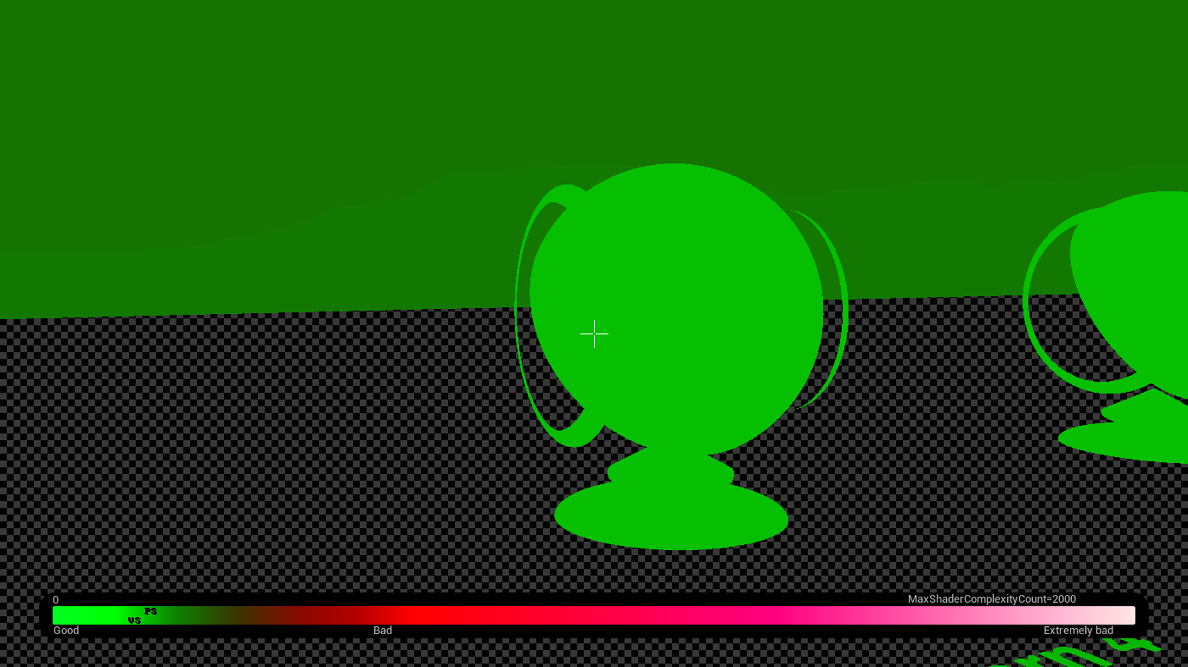
DEMO EXTENSIONS
Shader Complexity in Unreal
The glass stack is costly in Lit, yet this debug view looks mostly green.
Use Shader Complexity as a clue. Check the actors and measure in Lit.
86
Notes:
Hold the camera still while switching views. Ask where multiple surfaces cover the same pixels.

Slide 87

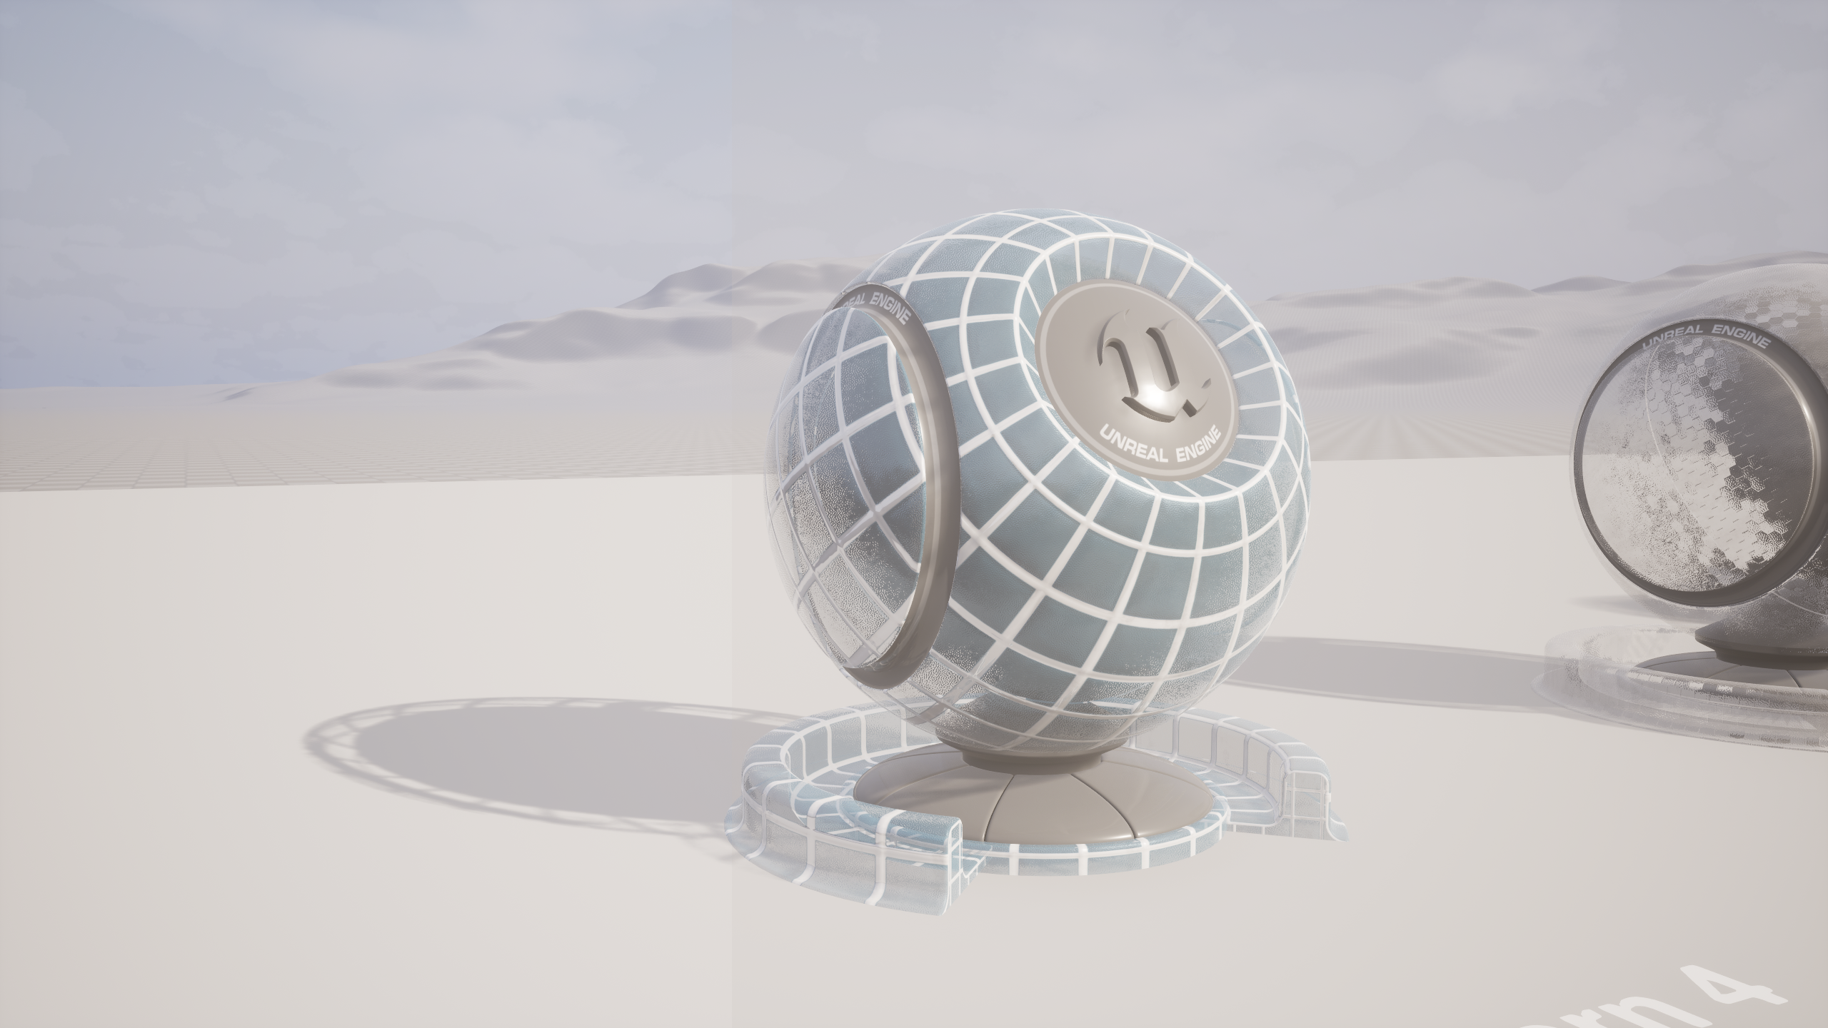
DEMO EXTENSIONS
Glass showroom A/B test
A Overlapping panes
B One pane retained
Frame 15.88 ms · GPU 15.33 ms
Frame 6.80 ms · GPU 5.98 ms
Medians at Audit Camera. What changed in the display, and what would you retest?
87
Notes:
Give students a moment to compare the display through the glass. Ask why a median under 16.67 ms is only part of the decision. In this capture, p95 frame time was 17.49 ms before and 8.10 ms after. Roughly 95% of measured frames met or beat that frame time. These captures describe one machine and one fixed view.

Slide 88
BREAK
10-minute break
88
Notes:
When we return, open the team copy and follow the student lab sheet.

Slide 89
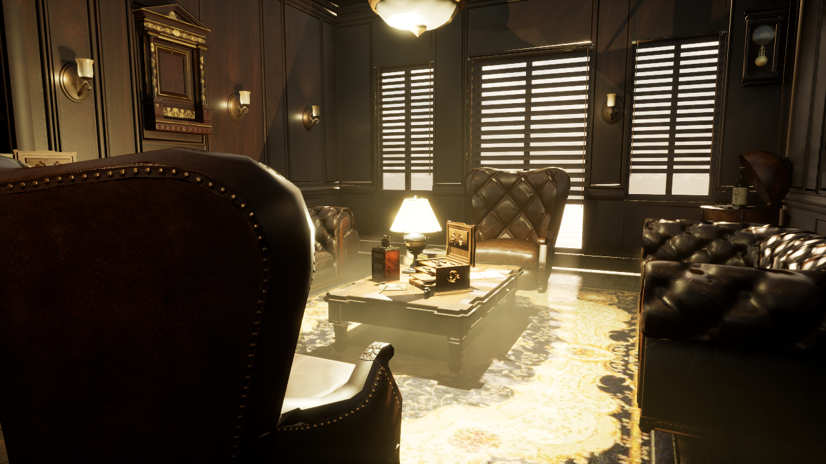
LAB
LAB: Optimize the furnished lounge
0-8 min Capture a baseline.
8-22 min Test one reversible change.
22-30 min Retest and recommend.
Keep the furniture, warm lighting and glass readable from two views.
Lounge_Unoptimized | Unreal Engine 5.7
89
Notes:
Open Lounge_Unoptimized in Week10Assessment. This furnished interior uses Hane Studios Cigar Room Environment from Fab. The classroom version deliberately introduces production mistakes; the original source layout is retained separately. Use the student worksheet. Establish the frame limit with stat unit and a relevant profiler, write one hypothesis, duplicate the map, then test one reversible change. Preserve furniture, warm interior lighting and glass from both the fixed Audit Camera and another view. Disable debug overlays before timing. Source: https://www.fab.com/listings/4da78da6-44b3-4adf-8883-219fe17b44d4 . Image is an actual standalone capture of the classroom build. Earlier showroom/primitive comparisons in this deck are separate measured demonstrations; do not substitute those numbers for this lounge.

Slide 90
LAB
Read-only scene audit
Choose a scene property you can inspect in Details or Python.
Report the actor, observed property and the rule that flagged it.
Check a known-good actor. Then measure whether changing the flagged group improves the limiting cost.
90
Notes:
Connect this to the Week 7 Unreal Python tooling. A rule can find candidates. The retest determines whether the edit helped this workload.

Slide 91
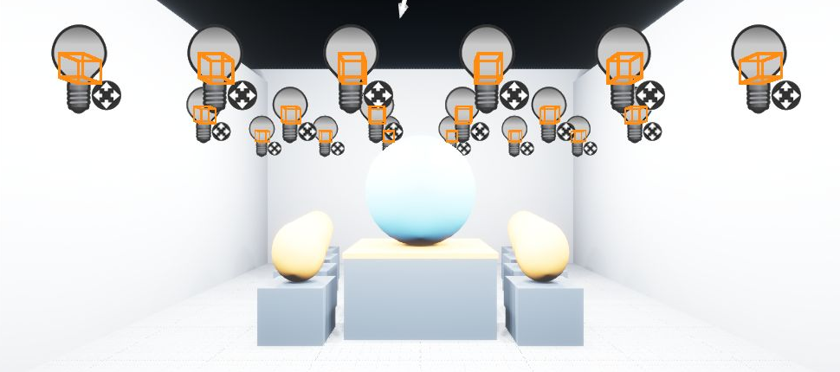
PROJECT TOOL
Custom Optimization View
Tools → Week 10 Optimization → Toggle Custom Optimization View.
Blue = information · Amber = review · Red = error.
The overlay marks rule candidates. It does not measure shader cost.
91
Notes:
This is the live editor overlay on the assessment Lighting map. The amber boxes mark the candidate light components. It draws temporary debug geometry over the current viewport, without material overrides or saved property changes. It is an editor visualization tool rather than a new engine shader ViewMode enum. Enable viewport Realtime; toggle to refresh cached bounds after edits. Disable it before timing, and read the rule and property in the report. Source: local UE 5.7.4 rehearsal, full original screenshot in Looman-Integration/Validation/Unreal-Overlay-Window.png; this crop is x230–1200, y1080–1510.

Slide 92
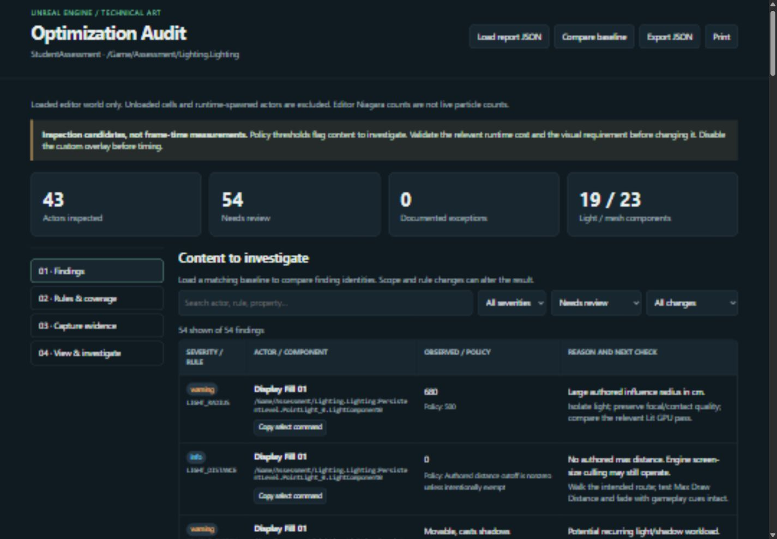
PROJECT TOOL
Validation to a web dashboard
Run Validate and Generate Dashboard from the same Tools menu.
92
Notes:
The tool writes report.json and a self-contained index.html under Saved/Week10Optimization. The Lighting map produced 54 candidates; these are not 54 proven bugs. Reference produced zero findings under these rules; that does not establish untested systems such as Niagara. The Glass test found 72 projected-bounds overlap candidates from Audit Camera. Open a row’s selection command in Unreal, check the actual surfaces and preserve the visual requirement. The private hosted snapshot can load fresh JSON locally and does not imply live synchronization.

Slide 93
PERFORMANCE INVESTIGATION
Give traces context and domain counters
A counter records quantity; a CPU scope records elapsed CPU work.
Use bookmarks or regions for route boundaries and quality changes.
Enable the relevant trace channels, including counters when needed.
Keep detailed diagnosis separate from the minimal timing run.
93
Notes:
Instrument the question you want answered. A counter for active display objects or systems can explain scaling; a CPU scope around submitting work does not measure completion of asynchronous GPU work. For a C++ extension, use TRACE_DECLARE_INT_COUNTER and TRACE_COUNTER_SET for a named count, TRACE_CPUPROFILER_EVENT_SCOPE for CPU work, and TRACE_BOOKMARK for context. The existing dashboard remains an editor content scan, not runtime instrumentation. Named-event detail can add overhead, so compare like capture modes and avoid applying a universal overhead percentage. Sources: https://tomlooman.com/unreal-engine-profiling-stat-commands/ ; https://tomlooman.com/unreal-engine-optimization-talk/ ; 5.5/5.6 highlights for trace-region and profiler changes.

Slide 94
WRAP-UP
Defending the tradeoff
Art director What changed in the image? Where would a player notice?
Engineering lead Which timing improved? How repeatable was it? Did the frame meet the target?
Recommendation Keep, revise or reject the change. Point to the evidence.
94
Notes:
Give each team a brief pitch, then compare two different diagnoses. Ask for the baseline, retest and one screenshot pair.

Slide 95
PERFORMANCE BUILDS
Packaged performance builds
Cook the same map and assets your players will run. Stage a build and give it a revision ID.
Use a Development package for the lab. Record target device, GPU driver, rendering API and quality settings.
Run the package outside the editor. Check the same scenario on the target hardware.
95
Notes:
We used Standalone Game to iterate quickly. A packaged build gives us a consistent artifact to install and compare on another machine. Unreal Automation Tool can automate cooking and staging.

Slide 96
PERFORMANCE INVESTIGATION
PSO preparation needs a shipped-build test
Precaching prepares supported pipeline states before use; bundled caches cover recorded states.
Validate the same first-encounter route in a packaged Development build on the target API.
Check misses / late preparation, load time and visual pop-in as well as frame spikes.
A working editor test is not proof that packaged PSO coverage is complete.
96
Notes:
For an appropriate packaged DX12 test, inspect r.PSOPrecaching and validation support, then trace the route. The stat psoprecache path described in the article requires a non-editor build; do not promise it in UnrealEditor -game. Static switches, vertex factories, passes, formats and quality changes can create different states. Precache proxy creation can delay rendering; check what a player actually sees. Bundled workflows need matching cook/stable-key artifacts and coverage collection, not a copied cache from another build. The article includes later-engine content; keep Advanced Shader Delivery out of the UE 5.7 setup. Source: https://tomlooman.com/unreal-engine-psocaching/ and Epic PSO documentation linked there. No PSO settings are silently changed by this lecture update.

Slide 97
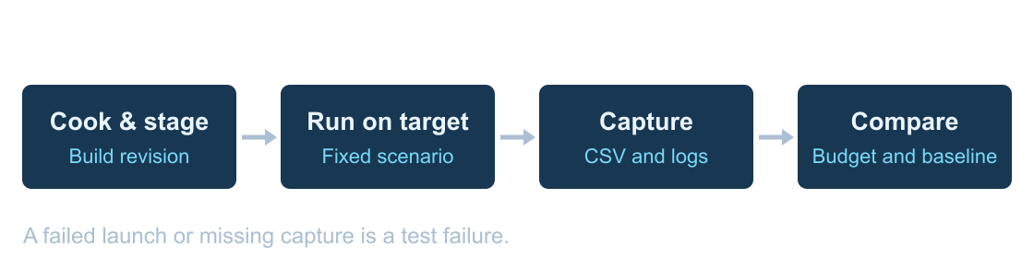
PERFORMANCE BUILDS
What a perf bot runs
Run the same build and scenario on the same target. Keep a CSV and log per launch.
97
Notes:
The bot can start with a fixed camera. Add a repeatable route for streaming or traversal. If the build crashes or the expected capture never arrives, report a failed run before judging performance.

Slide 98
PERFORMANCE BUILDS
Budgets and regressions
At 60 FPS, the frame budget is 16.67 ms.
A change from 10 ms to 13 ms still fits that budget. Investigate if the slowdown repeats on matched runs.
Use repeated baseline runs to estimate normal variation before setting a regression threshold.
98
Notes:
Ask whether a build can fit the budget and still regress. Then ask whether a 0.1 ms difference matters if the same build varies by 0.5 ms across launches.

Slide 99
PERFORMANCE INVESTIGATION
Calibrate quality tiers to the game
Hardware benchmarks return performance indices, not guaranteed FPS for your scene.
Tune quality thresholds on representative minimum and recommended devices.
Use Detail Mode for expendable components; keep required cues and interaction.
Re-test the route after automatic selection and allow a player override.
99
Notes:
RunHardwareBenchmark and ApplyHardwareBenchmarkResults are starting points for an options system, not certification of your level. A benchmark can briefly stall and belongs in a planned menu/loading flow. In our installed UE 5.7 BaseScalability.ini, Effects quality sets r.DetailMode, so a component Detail Mode policy can remove effects or lights; it is distinct from setting one light radius. The candle example in 04 trades local SSS/lighting fidelity for cost; a material gradient approximation is an art decision to validate, not an equivalent physical result. Sources: https://tomlooman.com/unreal-engine-optimal-graphics-settings/ ; https://tomlooman.com/unreal-engine-optimization-farfarwest/ ; https://www.youtube.com/watch?v=c2MH20OPSw0 around 49–53 minutes. Keep current lab quality fixed until an explicit tier experiment begins.

Slide 100
PERFORMANCE BUILDS
Reading a bot result
Check that the run used the expected build, hardware, map and capture window.
Compare median and p95 across launches. Keep raw captures for frames that need investigation.
If repeats disagree, rerun and inspect the logs. If the slowdown repeats, trace the affected workload.
100
Notes:
A result is a lead. The dashboard should let us go from the trend to the build, the test conditions and the raw evidence.

Slide 101
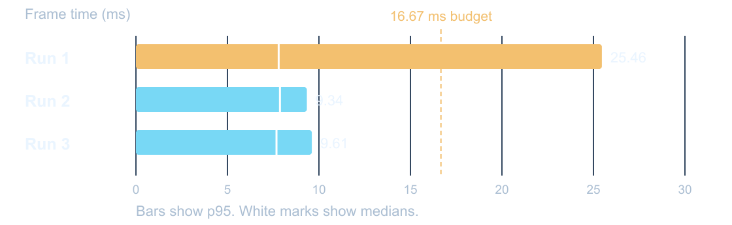
PERFORMANCE BUILDS
Three launches of the same build
p95 is the time 95% of measured frames met or beat. Which run needs a trace?
101
Notes:
The first run missed the p95 budget, and the next two passed. The medians alone would miss that spread. Pull up the first capture and look for the slow interval. Use a new trace to investigate if the result repeats. This was one local workstation.

Slide 102
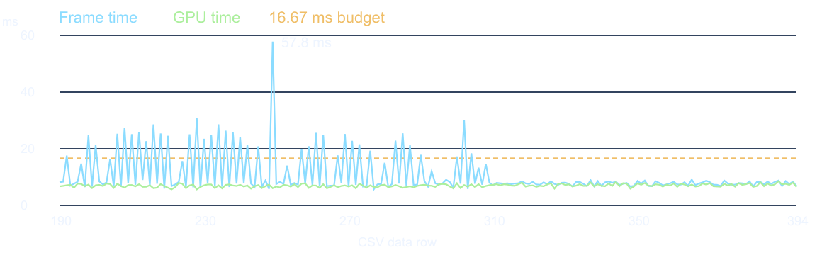
TRACE THE HITCH
A slow frame with a steady GPU
At CSV row 249, Frame reached 57.8 ms and GPU reported 6.1 ms.
RenderThread was 57.7 ms and RHIThread was 53.2 ms. Which tracks would you open?
102
Notes:
This is the original untraced bot run. The timing columns overlap. The next slide uses a different launch, where we collected a trace.

Slide 103

TRACE THE HITCH
Follow the waits in Unreal Insights
Open the traced repeat and zoom to 5.108–5.138 seconds.
Which dependency would you inspect next?
103
Notes:
Expand all three tracks. Wait scopes identify where execution paused. Their overlap is a lead. It does not establish which dependency or outside condition caused the original slow run.

Slide 104
WRAP-UP
The next measurement
GPU falls from 20.0 to 15.0 ms. Frame settles at 17.4 ms. The target is 16.67 ms.
Which measurement would you take next, and what decision would it inform?
104
Notes:
Look for evidence of a different limiter or synchronization. Accept different next measurements when they are tied to a specific decision.

Slide 105
EXPLORE FURTHER
Choose the next investigation
CPU: ticking, collision, component movement and animation update.
World: streaming route, occlusion workload and meaningful detail tiers.
GPU: water passes, lens flare, upscaling and Nanite detail.
Use the walkthroughs in this deck and the Week 10 reading guide.
105
Notes:
The broad JetBrains talk gives us a menu, not an instruction to apply every checkbox. Start with the limiter, then choose one test. Water and shadow toggles must be tested on each intended rendering API. Sharpening is a quality choice, not a free frame-time optimization. Oodle package compression does not directly shrink a texture's resident GPU format. Keep the original workload as the comparison. https://tomlooman.com/unreal-engine-optimization-talk/ https://tomlooman.com/unreal-engine-optimization-farfarwest/ https://www.youtube.com/watch?v=c2MH20OPSw0
Private integration ID: explore. Original source captures:

Slide 106
FIELD GUIDE
Unreal performance walkthroughs
WORKFLOW
WHAT TO CHECK
1 01–04 Set up, capture and diagnose
Use these walkthroughs alongside the Week 10 lecture and project README files.
2 05–09 Materials, geometry and baked motion
Follow the success check at the bottom before moving to the next step.
3 10–20 Compare results, automate, inspect GPU work and test lifecycle
Start with the walkthrough that matches your question.
106
Notes:
Use these walkthroughs alongside the Week 10 lecture and project README files.
Follow the success check at the bottom before moving to the next step.
Start with the walkthrough that matches your question.

Slide 107
01 SET UP
Prepare a matched A/B
WORKFLOW
WHAT TO CHECK
1 Write the visual requirement and the timing metric you expect to change.
Save a baseline image and capture before editing.
2 Record build, target machine, camera, resolution, screen percentage, scalability and frame cap.
Make one reversible change. Gather the retest with the same controls.
3 Warm both variants. Keep the test window and workload fixed. Repeat A/A to estimate variation.
Someone else can recreate your camera, workload and test settings.
107
Notes:
Save a baseline image and capture before editing.
Make one reversible change. Gather the retest with the same controls.
Someone else can recreate your camera, workload and test settings.

Slide 108
02 CAPTURE
Read Unreal’s live timings
WORKFLOW
WHAT TO CHECK
1 Launch Standalone Game at the intended view. Use stat unit.
If Game or Draw looks limiting, open a timing trace.
2 Compare Frame, Game, Draw and GPU over several observations. They can overlap.
Use spot checks for triage. Capture per-frame CSV data for percentiles.
3 If GPU tracks Frame, open stat gpu and record the relevant pass name on your build.
You have a timing lead and know what tool to open next.
108
Notes:
If Game or Draw looks limiting, open a timing trace.
Use spot checks for triage. Capture per-frame CSV data for percentiles.
You have a timing lead and know what tool to open next.

Slide 109
03 DIAGNOSE
From a CSV spike to Insights
WORKFLOW
WHAT TO CHECK
1 Find a slow frame in the CSV. Note its row, run and nearby timing columns.
Expand a wait and inspect what happens before it ends.
2 Open a trace from the same run when available. Otherwise label the trace as a separate repeat.
Use RenderDoc when the question is a specific draw, texture or pipeline state.
3 Zoom into the interval and compare Game, Render, RHI and GPU tracks.
Your explanation separates what the trace shows from the cause you still need to test.
109
Notes:
Expand a wait and inspect what happens before it ends.
Use RenderDoc when the question is a specific draw, texture or pipeline state.
Your explanation separates what the trace shows from the cause you still need to test.

Slide 110
04 VERIFY
Read Shader Complexity
WORKFLOW
WHAT TO CHECK
1 Pilot the same camera in the editor. Switch from Lit to Shader Complexity.
2 Look for a candidate region and check the mesh coverage, blend mode and overlapping surfaces.
3 Return to Lit and time the relevant rendering work.
Use the actual pass timing and the matched image to decide what to change.
You can point to a scene observation and a timed measurement that test the same hypothesis.
110
Notes:
In the worked glass scene, the debug colors understate the cost seen in Lit.
Use the actual pass timing and the matched image to decide what to change.
You can point to a scene observation and a timed measurement that test the same hypothesis.

Slide 111
05 MATERIALS
Test parallax step count
WORKFLOW
WHAT TO CHECK
1 Open Week 9 BrickStudy in a writable copy. Use one specimen and two instances of the same POM parent.
2 Hold Near and Far Height, camera, coverage and lighting fixed. Change only the step setting.
3 Warm both variants, record A/A variation, then capture equal windows in A–B–B–A order.
If the timing difference falls within repeat variation, report it as inconclusive for this view.
You can name what changed in the image and what the GPU evidence supports.
111
Notes:
Check the same mortar patch in Lit. Record a separate lateral move to see shimmer.
If the timing difference falls within repeat variation, report it as inconclusive for this view.
You can name what changed in the image and what the GPU evidence supports.

Slide 112
06 MATERIALS
Pack masks and verify channels
WORKFLOW
WHAT TO CHECK
1 Run Tools/pack_masks.py with AO, Roughness, Metallic and a fresh output filename.
2 Import the PNG. Choose Masks compression and disable sRGB.
3 Solo red, green and blue. Connect AO, Roughness and Metallic to the matching inputs.
Compare mip behavior and compression on the asset. Check the graph before repacking.
Each soloed channel matches the intended source, including lower mips.
112
Notes:
Week 9 brick uses MRAH. Its red and blue assignments differ from ORM and alpha carries height.
Compare mip behavior and compression on the asset. Check the graph before repacking.
Each soloed channel matches the intended source, including lower mips.
From Week10ProfilingLab: python Tools/pack_masks.py Tools/DemoInputs/AO.png Tools/DemoInputs/Roughness.png Tools/DemoInputs/Metallic.png Packed_ORM.png

Slide 113
07 MATERIALS
Inspect a texture array
WORKFLOW
WHAT TO CHECK
1 Open ArrayDemo in the verified texture demo project. Run Standalone.
2 Open TA_SliceDemo and verify that its two 256 × 256 sources are in the expected order.
3 Open M_ArrayDemo. Follow the appended UV and Slice input into the array sample.
Inspect format, mip settings and resource size. Measure sampling or batching effects in the intended workload.
A slice switch changes the image while the surface UVs stay fixed.
113
Notes:
Compare MI_Array_Slice0 and MI_Array_Slice1 on the same geometry.
Inspect format, mip settings and resource size. Measure sampling or batching effects in the intended workload.
A slice switch changes the image while the surface UVs stay fixed.

Slide 114
08 GEOMETRY
Build and review an LOD chain
WORKFLOW
WHAT TO CHECK
1 Duplicate the source mesh. Use conventional LODs on the test asset.
Walk the intended camera route and check transitions.
2 Generate the levels with Unreal reduction or a verified Simplygon LOD Recipe. Record triangle counts and screen-size thresholds.
For an A/B, keep placements, camera and materials fixed. Check GPU time and draw submissions.
3 Force each level in the mesh editor. Inspect silhouette, seams and material sections. Restore Auto.
The reduction preserves the required silhouette and transitions at the distances that matter.
114
Notes:
Walk the intended camera route and check transitions.
For an A/B, keep placements, camera and materials fixed. Check GPU time and draw submissions.
The reduction preserves the required silhouette and transitions at the distances that matter.

Slide 115
09 BAKED MOTION
Build the debris treatments
WORKFLOW
WHAT TO CHECK
1 Use the isolated DebrisComparison project. Live uses 16 Chaos rigid bodies per burst.
VAT moves a combined mesh. The flipbook replays masked frames on a fixed card.
2 Run with -DebrisMode=Bake to record one take. It writes per-vertex offsets and front-view atlas frames.
Check timing, axes, bounds and playback. The baked versions replay the recorded motion.
3 Replay with -DebrisMode=VAT or -DebrisMode=Flipbook. Use -Bursts=1 for inspection.
All three launch and show the intended burst. The baked outputs agree with the reference from the player view.
115
Notes:
VAT moves a combined mesh. The flipbook replays masked frames on a fixed card.
Check timing, axes, bounds and playback. The baked versions replay the recorded motion.
All three launch and show the intended burst. The baked outputs agree with the reference from the player view.
From Week10DebrisComparison: launch UnrealEditor.exe with DebrisComparison.uproject, -game -DebrisMode=Bake. Then launch -DebrisMode=Live, VAT or Flipbook, each with -Bursts=1. Use -SideView for the side shot.

Slide 116
10 CAPTURE
Capture the debris comparison
WORKFLOW
WHAT TO CHECK
1 From the debris project, run Tools/Capture-Comparison.ps1 with -Kind Visual and a new output directory.
Timing uses 24 synchronized bursts and three launches per treatment.
2 Inspect all six captures. They use sample 12 in the front and 65° side views.
Run Tools/summarize_comparison.py against the timing directory. Keep the per-launch results.
3 Run the same script with -Kind Timing and a different fresh directory.
You have matching views, nine timing captures and a report without screenshot overhead.
116
Notes:
Timing uses 24 synchronized bursts and three launches per treatment.
Run Tools/summarize_comparison.py against the timing directory. Keep the per-launch results.
You have matching views, nine timing captures and a report without screenshot overhead.
From Week10DebrisComparison: .\Tools\Capture-Comparison.ps1 -Kind Visual -OutputDirectory Saved/VisualCheck. Then .\Tools\Capture-Comparison.ps1 -Kind Timing -OutputDirectory Saved/TimingCheck. Run python Tools/summarize_comparison.py Saved/TimingCheck.

Slide 117
11 REVIEW
Choose the treatment for the shot
WORKFLOW
WHAT TO CHECK
1 Check the intended player view first. Compare silhouette, onset and motion.
Compare frame, GPU, game thread and draw calls alongside bake texture size.
2 Check a side view. In this take, VAT preserves 3D shape and the card compresses the front image.
In the recorded stress test, the baked variants reduced game-thread time while frame medians stayed near 4 ms.
3 Test a new obstacle separately if the effect must react during play.
Your recommendation names the workload, the tradeoff and the next check.
117
Notes:
Compare frame, GPU, game thread and draw calls alongside bake texture size.
In the recorded stress test, the baked variants reduced game-thread time while frame medians stayed near 4 ms.
Your recommendation names the workload, the tradeoff and the next check.

Slide 118

12 ASSESSMENT
Run the furnished lounge assessment
WORKFLOW
WHAT TO CHECK
1 Open Week10Assessment in UE 5.7. Keep Lounge_Reference unchanged.
2 Duplicate Lounge_Unoptimized. Launch Standalone at Audit Camera.
3 Capture a baseline. State your prediction and visual check. Make one reversible edit.
Give one next measurement that could change your recommendation.
Your report can be reproduced and defended even if the measured difference is inconclusive.
118
Notes:
Use the furnished Fab lounge as the current main assessment. Keep source and reference maps unchanged; edit a duplicate of Lounge_Unoptimized. Establish fixed capture conditions, then choose one cost supported by a relevant measurement. State a visual requirement, make one reversible change and retest. The earlier Lighting and Glass fixtures are separate optional comparisons. Consult the current student lab worksheet and guide. Do not substitute the source video timing numbers for the classroom baseline.

Slide 119
13 AUTOMATE
From packaged build to perf bot
WORKFLOW
WHAT TO CHECK
1 Stage a Win64 Development package with Project Launcher or RunUAT BuildCookRun. Record the build revision.
Keep the CSV and log for each launch. Compare the absolute budget and the known-good baseline separately.
2 Smoke-test map, camera, logs and CSV output on the target machine.
Treat a missing capture as a failed run. Keep mixed results for investigation.
3 Run repeated launches with a fixed workload, timeout and unique output directory.
Someone can go from a report point back to its build, device, scenario and raw capture.
119
Notes:
Keep the CSV and log for each launch. Compare the absolute budget and the known-good baseline separately.
Treat a missing capture as a failed run. Keep mixed results for investigation.
Someone can go from a report point back to its build, device, scenario and raw capture.

Slide 120
14 HANDOFF
Review and report the result
WORKFLOW
WHAT TO CHECK
1 Name the change, matched controls, tested workload and acceptance criterion.
For p95, use per-frame samples and document the window.
2 Show the image pair or motion clip. State which requirement passed or failed.
If one launch disagrees, keep it. Inspect the slow interval before changing the baseline.
3 Report the timing metric, spread and next test.
A teammate can reproduce the test and understand what would change your decision.
120
Notes:
For p95, use per-frame samples and document the window.
If one launch disagrees, keep it. Inspect the slow interval before changing the baseline.
A teammate can reproduce the test and understand what would change your decision.

Slide 121
15 MATERIAL DATA
Build a matched CPD test
WORKFLOW
WHAT TO CHECK
1 Duplicate the same mesh in a grid. Give every component the same parent material math and a predictable scalar value.
Hold dynamic instancing, pass, mesh sections, visibility and camera fixed.
2 In A, create one MID per component and set Variation. In B, enable Use Custom Primitive Data and set scalar index 0 on each component.
A draw-call change is conditional on eligible batching. Report frame and render timing separately.
3 Match images in Lit. Run stat scenerendering or compare RHI draw calls in matching CSV windows.
The same variation appears on screen and you can quantify what changed in submission.
121
Notes:
Use MaterialCostLab.uproject and the supplied comparison runner. CPD values live on primitive components. For individual instances in an ISM component, investigate Per Instance Custom Data separately.

Slide 122
16 MATERIAL COST
Test a master material in two steps
WORKFLOW
WHAT TO CHECK
1 A/B 1. Compare a lean graph with a master whose static feature is disabled. Match output, blend mode, shading model and coverage.
A static switch can remove its unused branch. Each used static combination can require a shader permutation.
2 A/B 2. Compare the same master design with the feature disabled and enabled. Record the image change and material settings.
A scalar or vector override may preserve shader code. Instance state can still affect batching.
3 Warm variants, capture repeated windows and compare GPU time. Review shader stats for the target permutation.
You can distinguish a graph organization question from feature cost and permutation cost.
122
Notes:
The lab uses one broad unlit plane. MasterOff and MasterOn are two copies of the same static-switch graph with opposite defaults. Lean has just the matching constant color. The ripple is deliberately heavy, so the result is a teaching demonstration.

Slide 123
17 COMPUTE
Trace a Niagara GPU emitter
1 Create a Niagara System from Simple Sprite Burst. In Emitter Properties, set Sim Target to GPUComputeSim and check Fixed Bounds.
Illustrative dispatch
10 items. Two groups of 8 threads.
2 In Particle Update, inspect Solve Forces and Velocity. Follow Particles.Position into the Sprite Renderer.
0
1
2
3
4
5
6
7
8
9
10
11
12
13
14
15
3 In a trace, locate Niagara GPU dispatches. Inspect the rendering work separately and compare frame time.
Threads 10–15 skip work. Group size here is illustrative.
You can explain which stage computes particle state and which stage draws it.
123
Notes:
Teaching setup from Epic Niagara profiling guidance. Use fixed bounds large enough for the entire burst. System and Emitter scripts can still run on CPU. Particle simulation is the work moved by Sim Target. Use the Niagara Lab CPU/GPU capture for measured timing. This graphic illustrates dispatch and is not a trace export. https://dev.epicgames.com/documentation/en-us/unreal-engine/how-to-create-a-gpu-sprite-effect-in-niagara-for-unreal-engine

Slide 124
18 SCALABILITY
Test an Effect Type rule
WORKFLOW
WHAT TO CHECK
1 Start with the same GPU system in both runs. Keep camera, placements, spawn cadence and particle settings fixed.
This lab uses Spawn Only, Kill and Clear, and 1,225 cm.
2 Create a Niagara Effect Type, enable distance culling and assign it in System Properties. Choose an update frequency and cull reaction.
Test an important impact near the boundary before reusing this policy elsewhere.
3 Compare culling disabled and enabled. Count active systems, then check frame timing and the image.
You can point to the effects removed, the cost change and the visible tradeoff.
124
Notes:
The runner toggles scalability eligibility on the same GPU asset to isolate the policy.

Slide 125
19 LIFECYCLE
Spawn and destroy versus pooling
Spawn / destroy
Allocate
→
Initialize
→
Activate
→
Destroy
Pool
Acquire
→
Reset
→
Activate
→
Return
Replay the same impacts. Compare spawn-frame CPU, garbage collection and retained memory.
Verify reset behavior. Separate pool priming from steady reuse.
The reuse path preserves the effect and makes its allocation and memory tradeoff visible.
125
Notes:
Instantiation creates runtime objects. Mesh instancing shares render work across copies. This demo pre-creates components and reactivates them in both treatments. Pooling is a follow-on test.

Slide 126
20 WORLD LOAD
Measure a streaming transition
WORKFLOW
WHAT TO CHECK
1 Choose a route across a streaming boundary and repeat the same movement and camera.
World Partition loads cells around streaming sources. Sublevel streaming loads map sections.
2 Capture a cold traversal and a warm traversal separately in a packaged build. Include the first frames after the content becomes visible.
Try a preload or range change, then compare both memory and transition quality.
3 In Insights, inspect loading and actor registration. Record resident memory, slow frames and any pop-in.
You can connect the hitch or memory change to a specific point on the route.
126
Notes:
The current Audit Camera exercise cannot answer traversal or streaming questions. Use a separate route and a project appropriate to the streaming system.

