Slide 1
Intro to Procedural
Content Generation
PCG in Unreal Engine
Amritha Immaneni
Game Design · Technical Art
01 / 15
Notes:
Welcome and thanks. Quick framing: what PCG is, then three hands-on tutorials in Unreal, then performance and next steps.

Slide 2
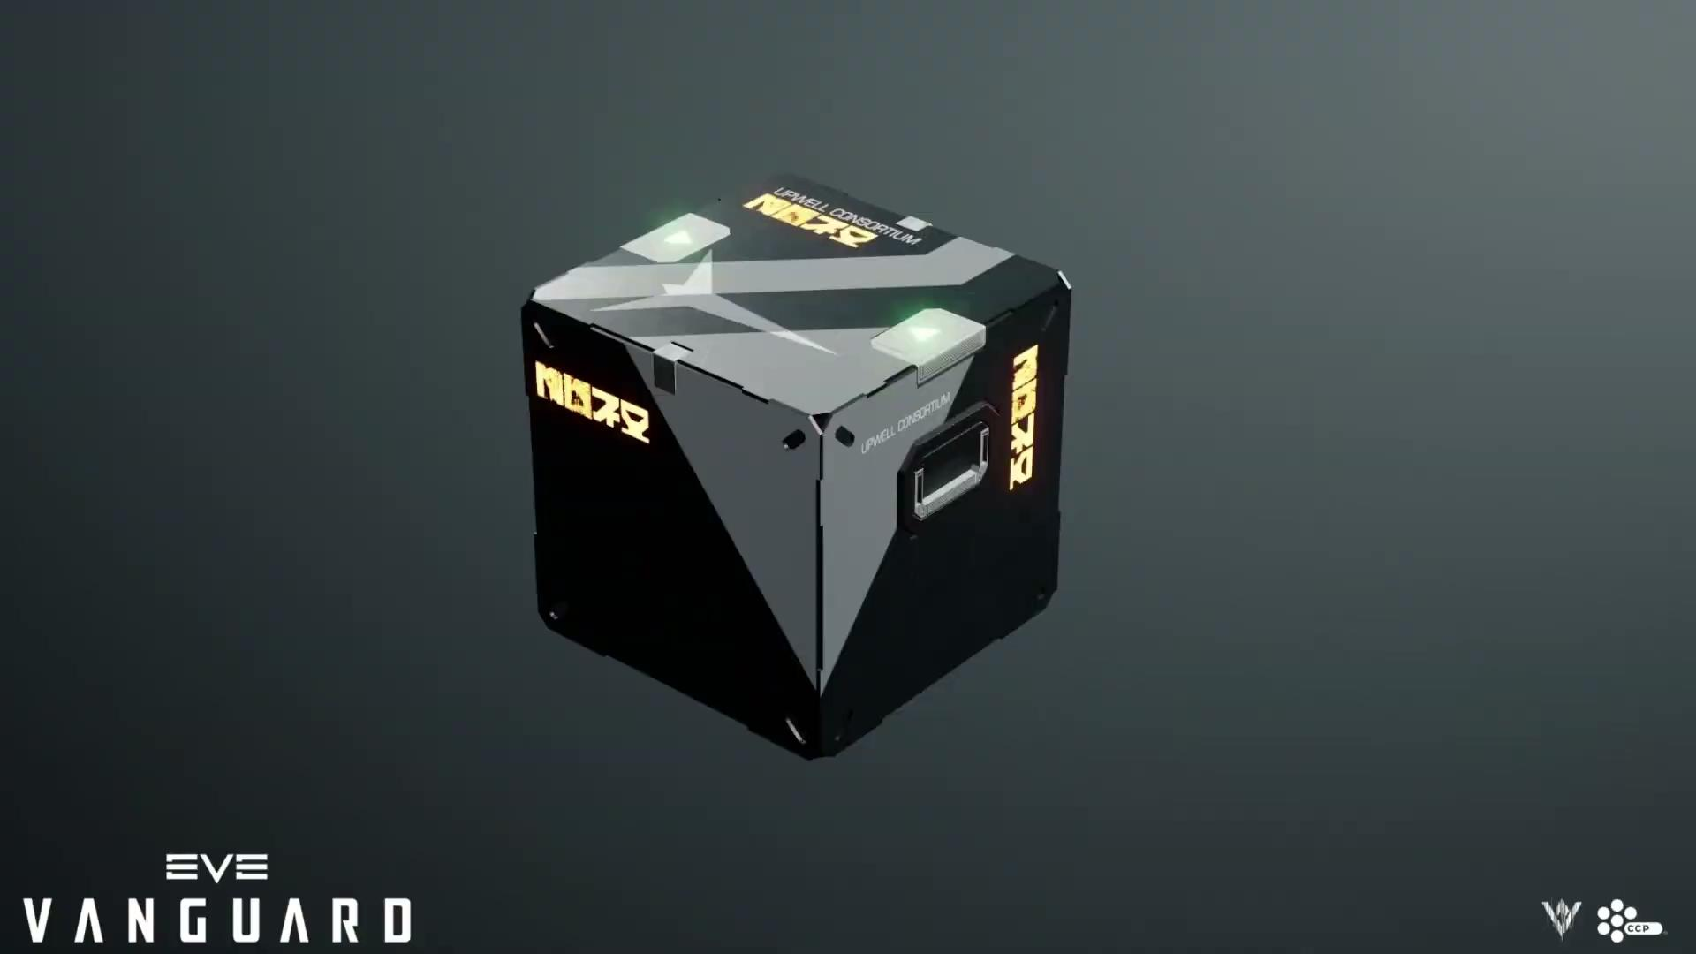
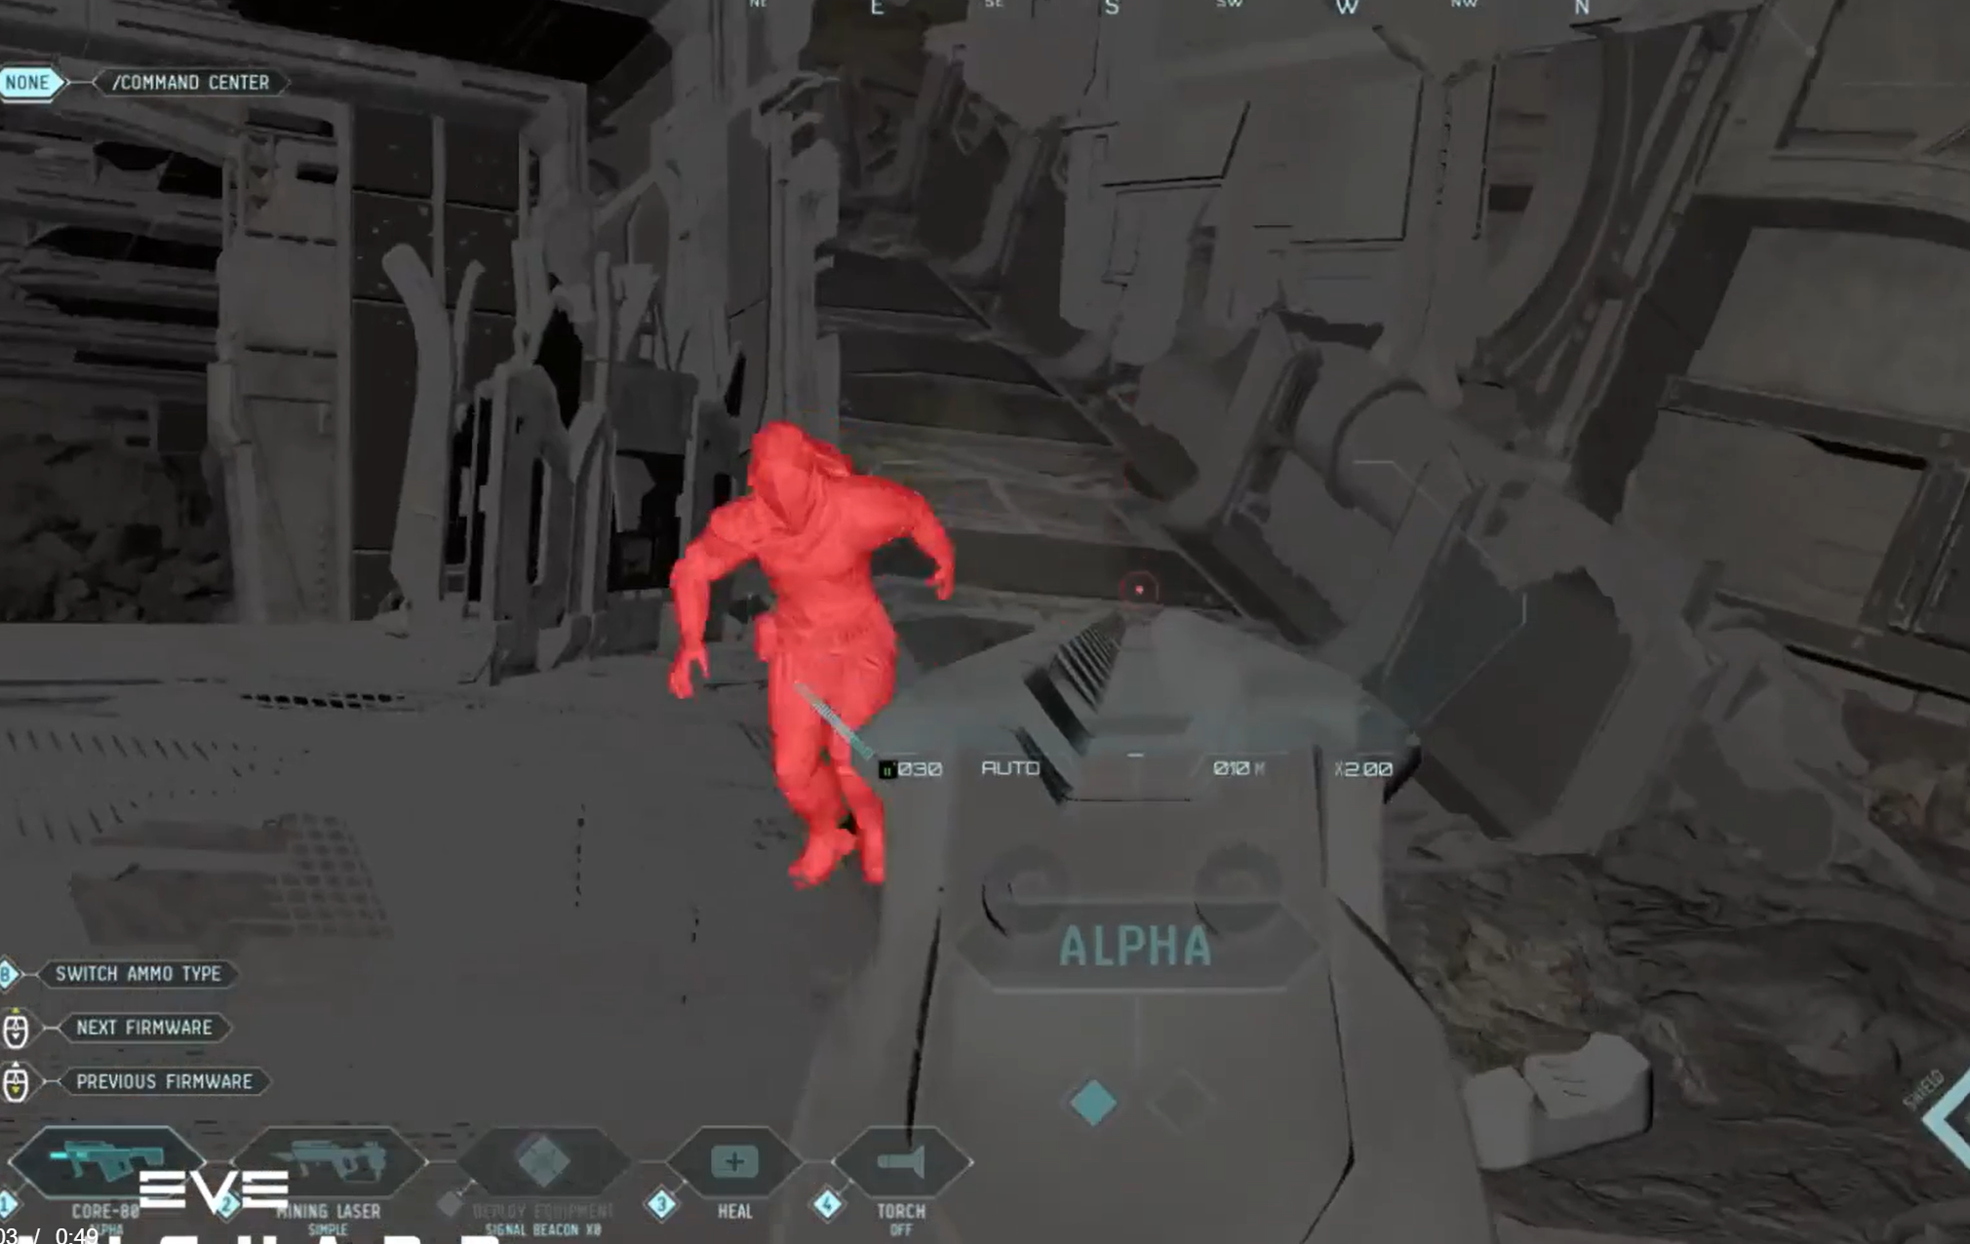
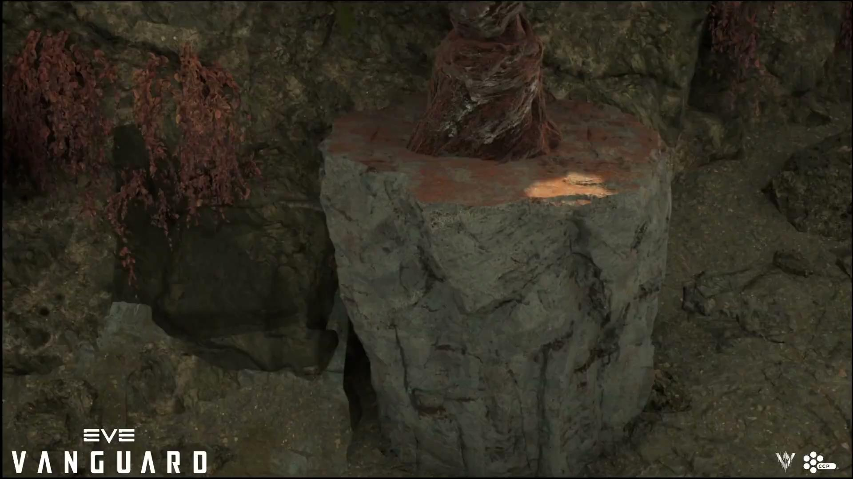
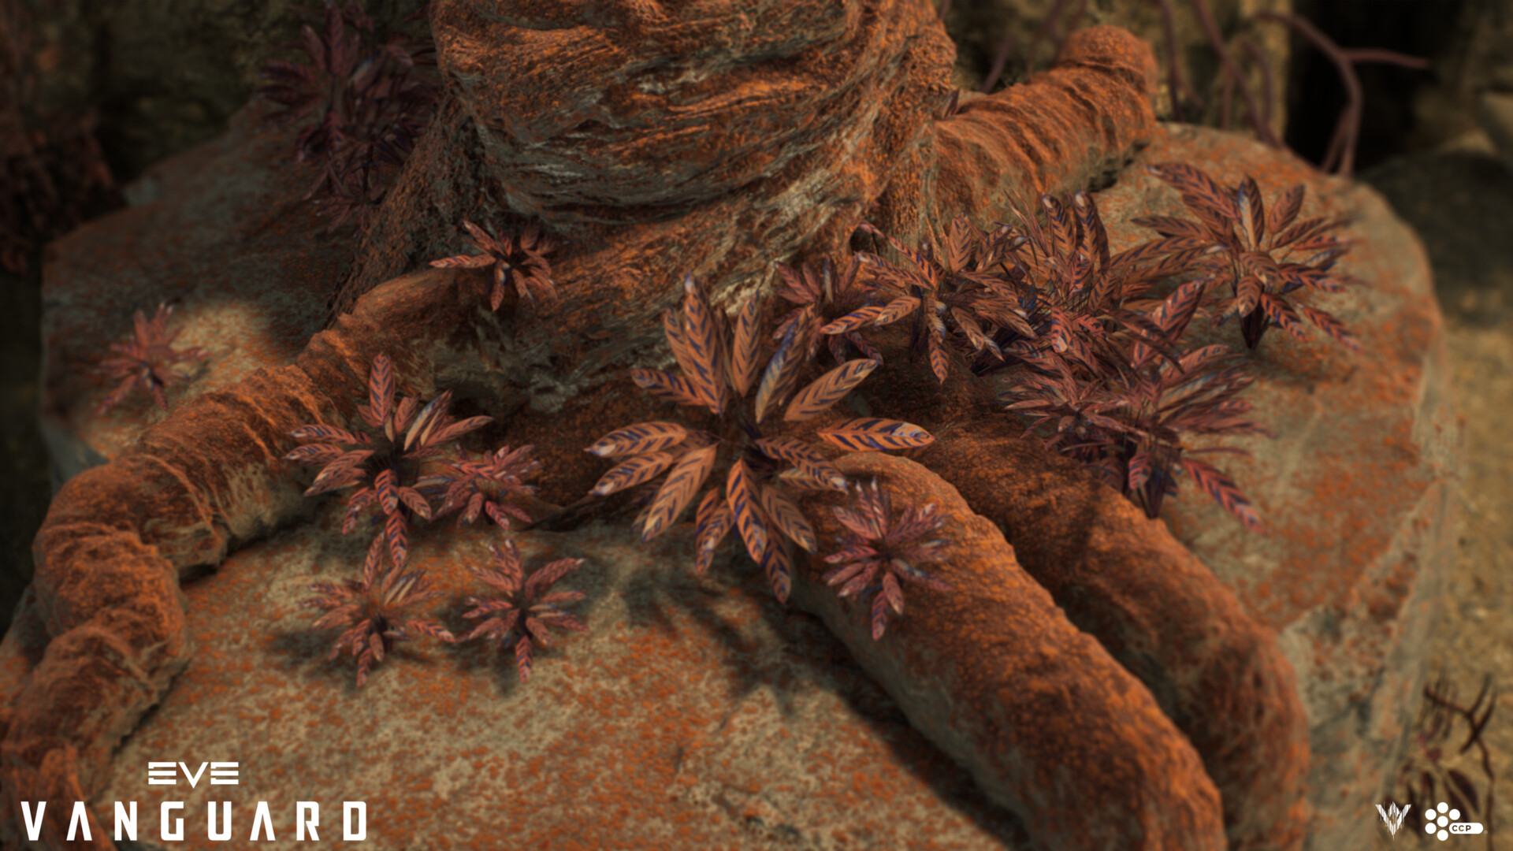
About Me
// 02 about_me
Amritha Immaneni
primary skills/ responsiblities:
› Editor tools
Technical Artist @ Rocksteady Studios Ltd
› PCG
› Previous Tech Art roles at CCP Games UK, Amazon Robotics
› C++
› Shaders
› MSc Interactive Entertainment (UCF FIEA), BE Electronics & Comms
› amrithaimmaneni.artstation.com/
› linkedin.com/in/amritha-immaneni/
Intro to PCG · Unreal Engine
02 / 15
Notes:
[Your intro — keep it to about a minute. Point to the portfolio pieces behind you as you talk.]

Slide 3
What is PCG?
// 03 what_is_pcg
01
02
03
Philosophy
PCG in Unreal Engine
Advantages
Data manipulation through rules and constraints
Separation of data and rules
Not automation
Node based system to make procedural tools
Allows for realtime iteration
Supports GPU-driven and runtime workflows
Flexibility & Adaptability
Ability to handle scale
Parametrization
Iteration
Visualization
Consistency
Key Takeaway: Understand how to build procedural systems
Intro to PCG · Unreal Engine
03 / 15
Notes:
[Examples of PCG in shipped games could go here.]

Slide 4
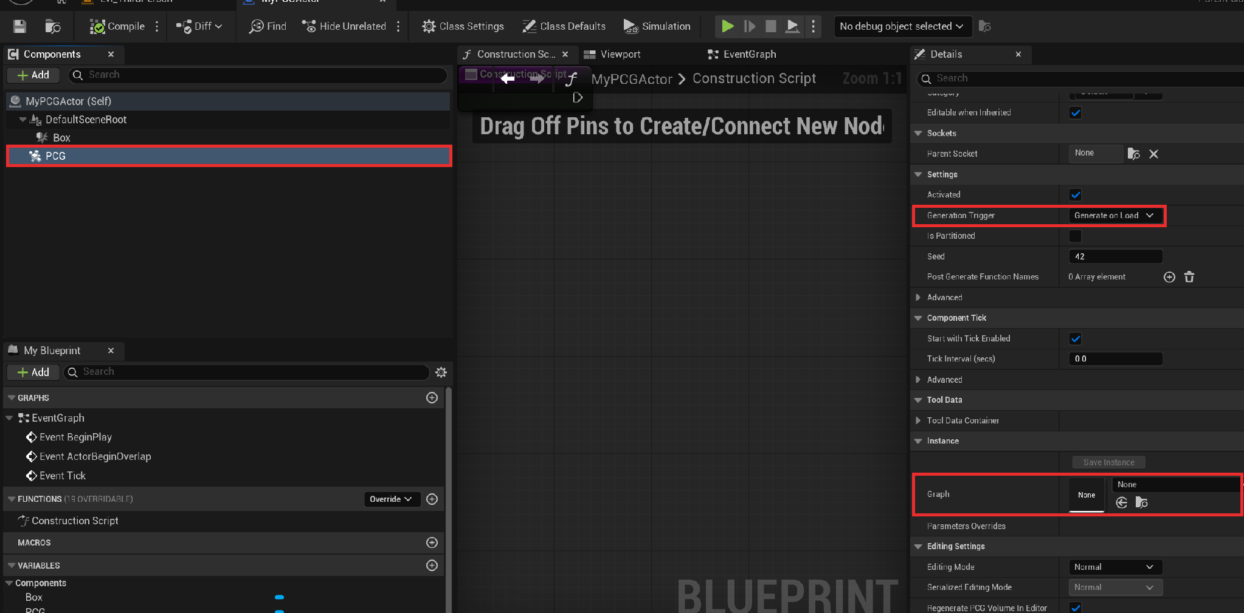
First Steps
engine_version: UE 5.7
// 04 setting_up
01 Enable plugins
PCG Framework,
PCG External Data Interop,
PCG Geometry Script Interop
02 Create a PCG Graph asset
03 Add a PCG Volume to the level
04 Create a blueprint with a PCG Component
05 Also grab some cool assets from Fab/Quixel!
Intro to PCG · Unreal Engine
04 / 15
Notes:
[Mention project template / sample files students can download.]

Slide 5
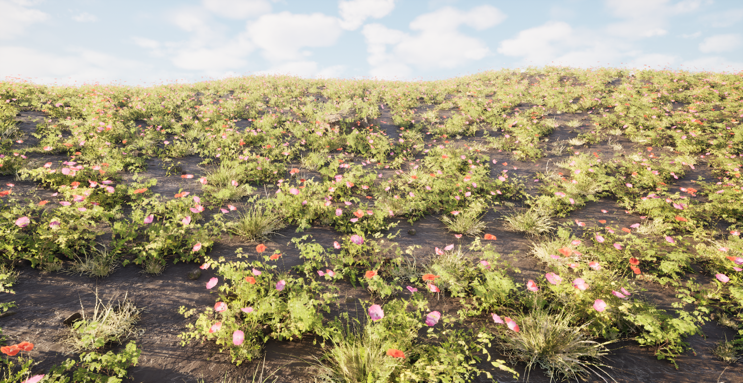
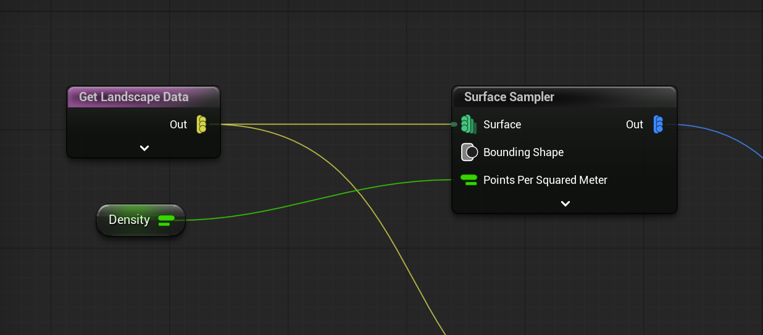
All About Points
// 05 tutorial_01
goal:
Spawn some grass on the Landscape
Sampling the landscape
Inject some "randomness" into the points
Graph parameters
takeaway:
Getting familiar with PCG graphs
Learning how to manipulate data
Intro to PCG · Unreal Engine
05 / 15
Notes:
[Demo steps for Tutorial 1.]

Slide 6
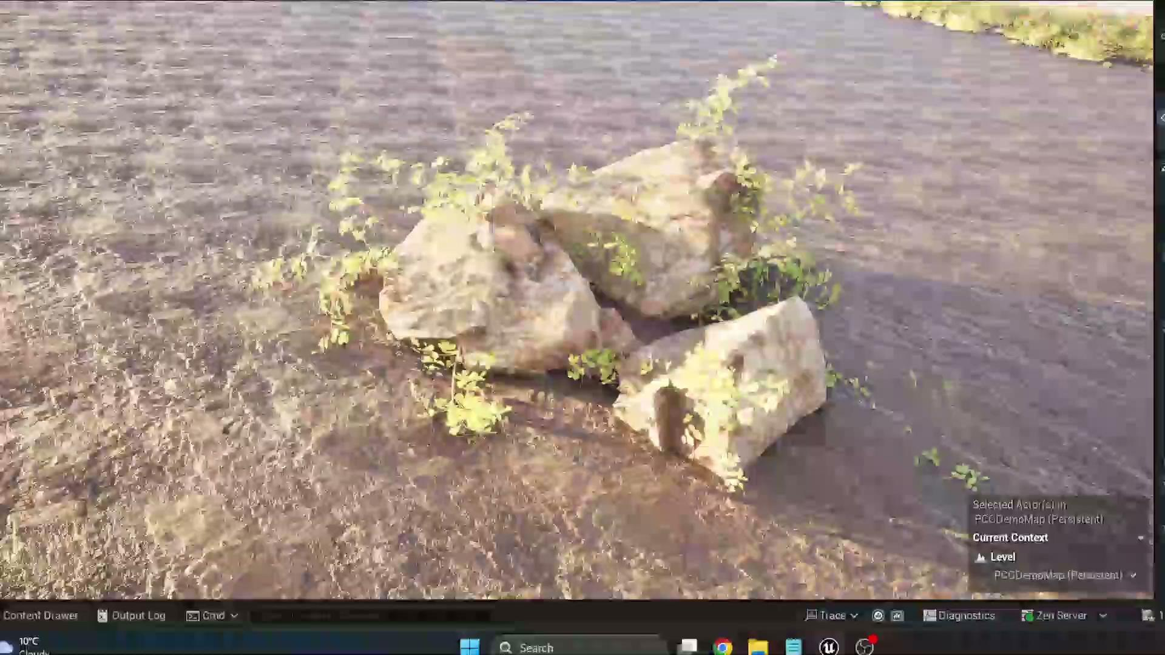
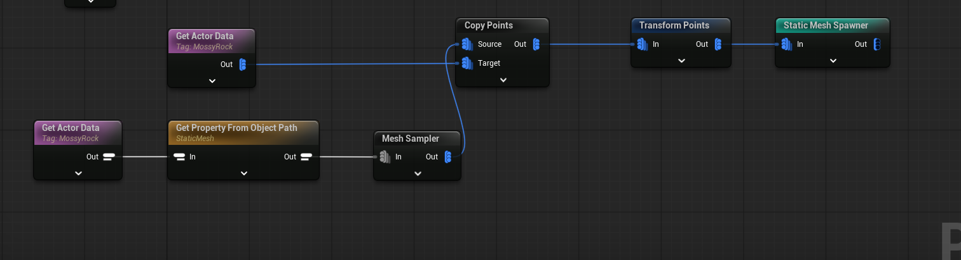
Sampling Meshes
// 06 tutorial_02
goal:
Graph that will allow them to sample a rock mesh and spawn foliage on it
Learn how to Get Actor Data
takeaway:
You can get a lot of data from the world, and
you can do a lot of cool things once you learn how to sample a mesh!
Intro to PCG · Unreal Engine
06 / 15
Notes:
[Demo steps for Tutorial 2.]

Slide 7
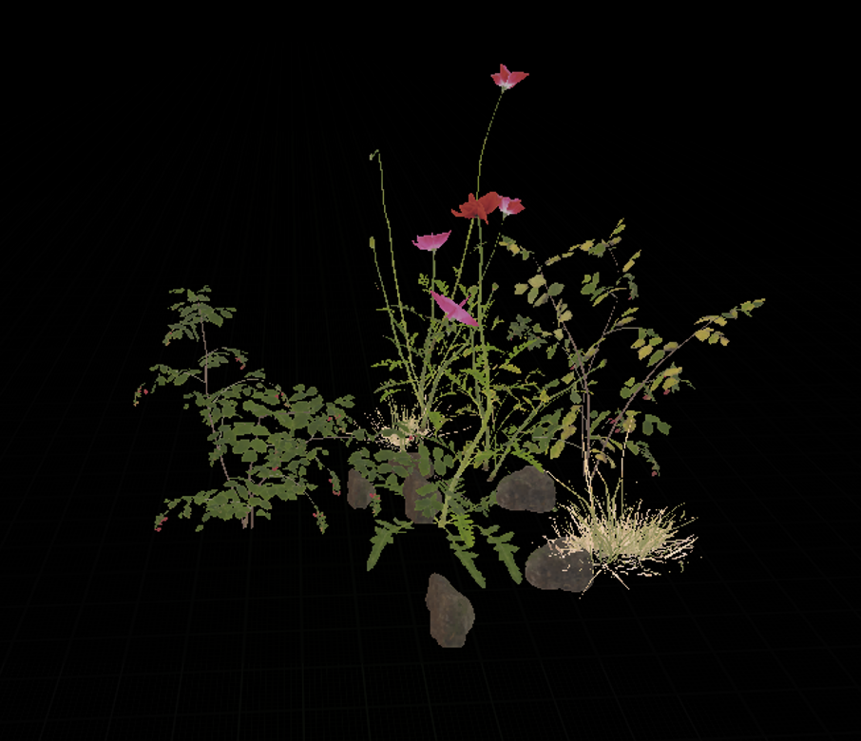
PCG Data Assets and Assemblies
// 07 tutorial_03
goal:
Learn about PCG Data Assets & Assemblies
See: https://dev.epicgames.com/documentation/unreal-engine/assembly-pcg?lang=en-US
takeaway:
You can still give Artists reasonable control while using proc gen
Intro to PCG · Unreal Engine
07 / 15
Notes:
[Demo steps for Tutorial 3.]

Slide 8
Performance and Memory
// 08 performance_and_memory
› Spawning many assets costs memory and performance
› Heavy graphs slow the editor; thousands of ISMs still add up
› Editor-only graphs keep point data out of the build
› GPU runtime generation: promising, but complex in production
› Profile as you go
Intro to PCG · Unreal Engine
08 / 15
Notes:
[Profiling tips, stats to show, real numbers from your projects.]

Slide 9
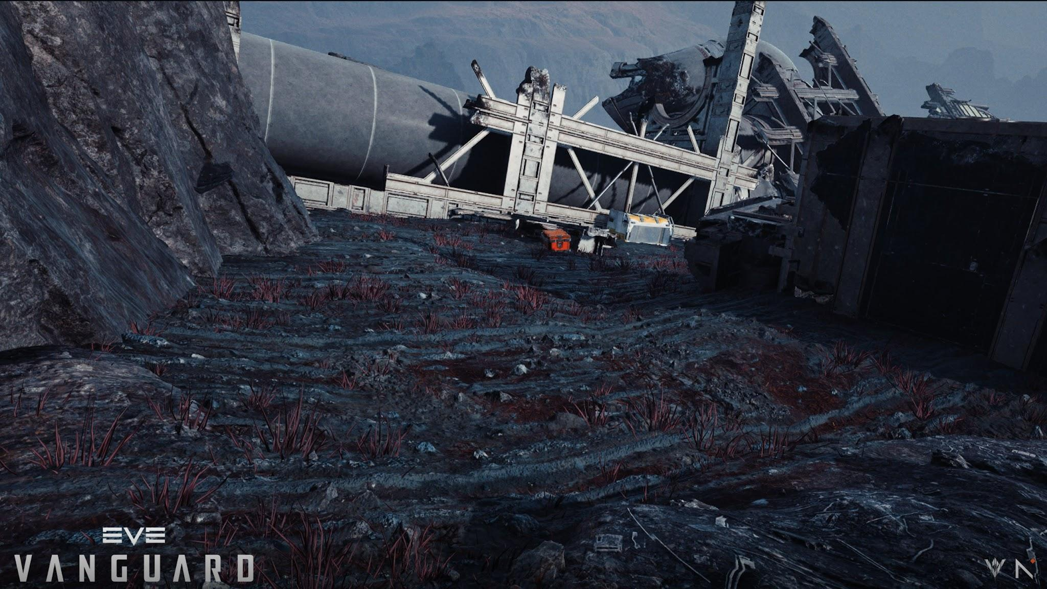
An in-game example
// 09 in_game_example
Intro to PCG · Unreal Engine
09 / 15

Slide 10
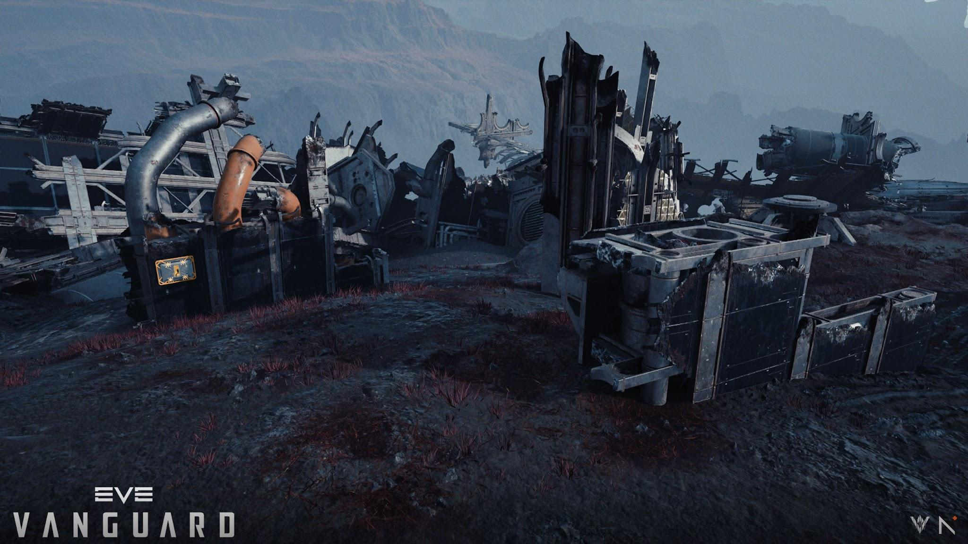
An in-game example
// 10 in_game_example
Intro to PCG · Unreal Engine
10 / 15

Slide 11
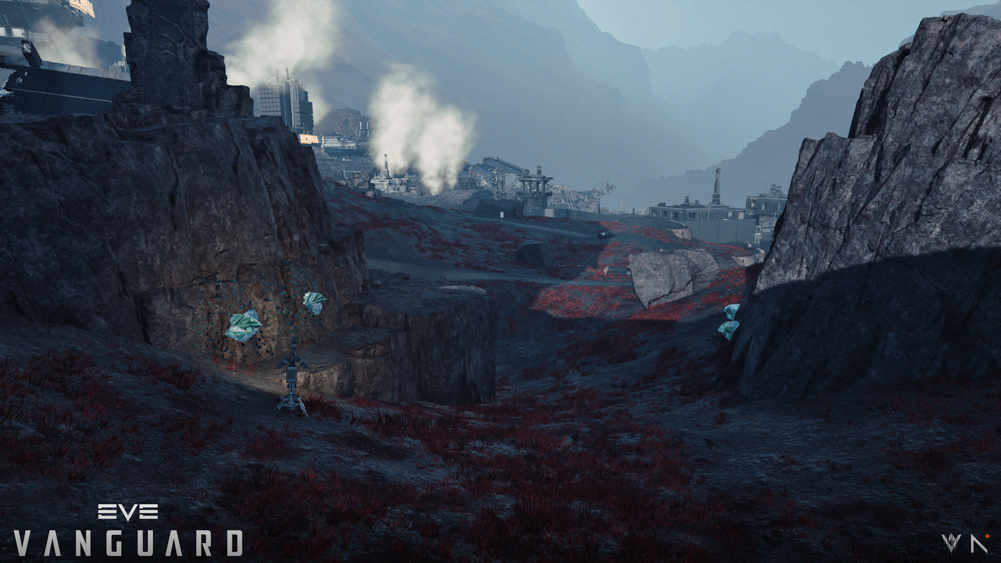
An in-game example
// 11 in_game_example
Intro to PCG · Unreal Engine
11 / 15

Slide 12
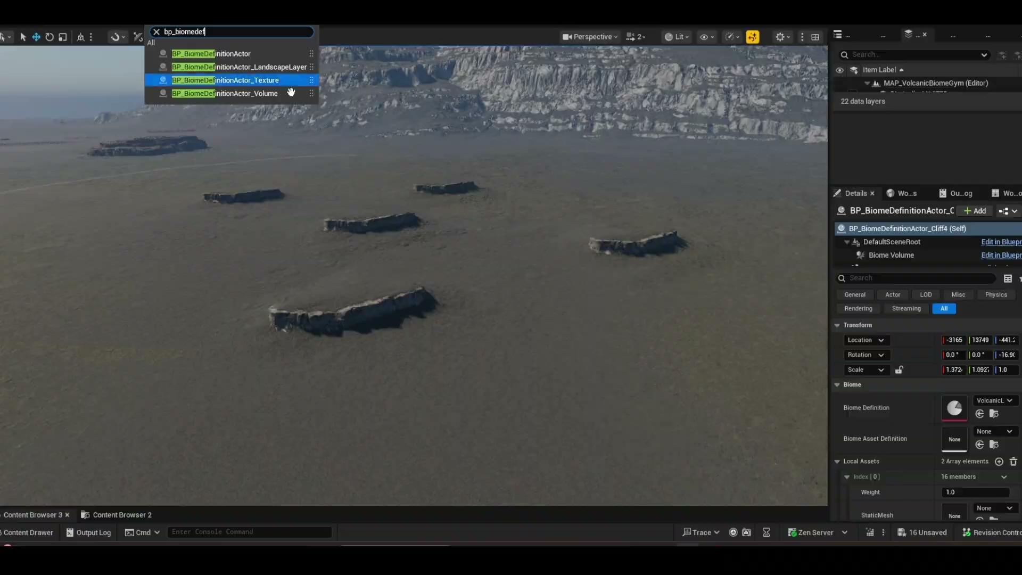
Cliff Dressing
// 12 cliff_dressing
Intro to PCG · Unreal Engine
12 / 15

Slide 13
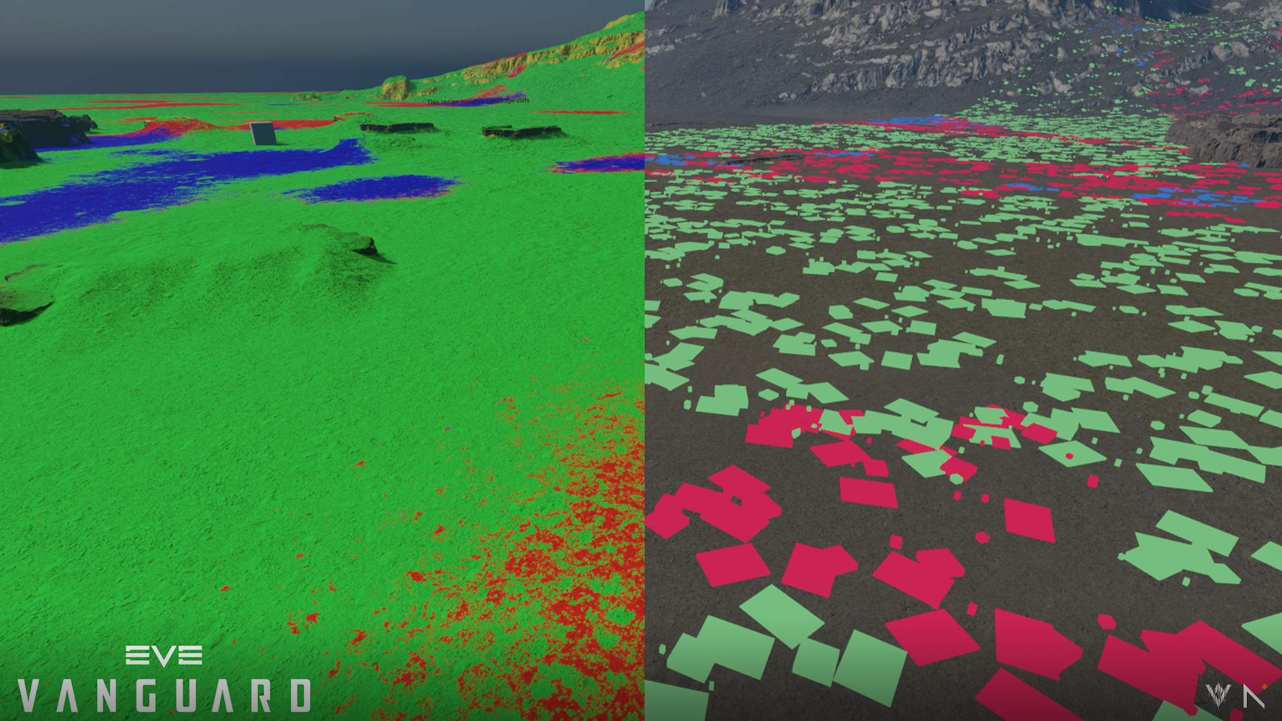
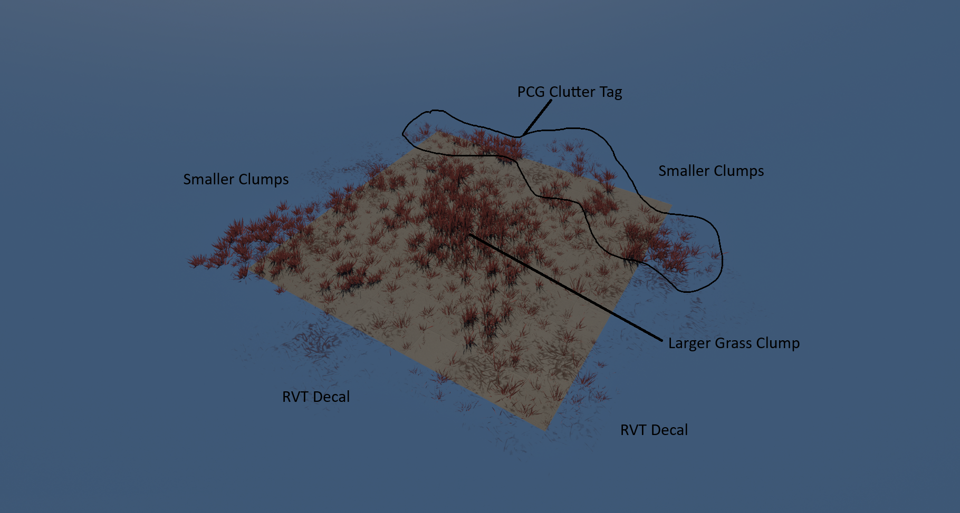
An in-game example
// 13 in_game_example
Using the Landscape for Biome Data
Foliage Tile
Intro to PCG · Unreal Engine
13 / 15
Notes:
[Walk through how PCG shaped this scene.]

Slide 14
Things We Have Not Covered
// 14 topics
TOPIC 02
TOPIC 01
TOPIC 03
PCG Geometry Script & Grammar
PCG Biome Core
Blueprint Elements in PCG
TOPIC 04
TOPIC 05
TOPIC 06
Polygon 2D
Custom PCG Data Exporters
Per Instance Data
Intro to PCG · Unreal Engine
14 / 15
Notes:
[Point students to where they can learn each of these.]

Slide 15
Closing thoughts
// 15 looking_ahead
PCG is more than foliage scattering
Think of it as a flexible data pipeline
e.g. modular structures, cable splines
Ask: what world data can it read and modify?
Example: the Cassini sample project
Thank you!
> questions?_
Intro to PCG · Unreal Engine
15 / 15
Notes:
[Wrap up, then open for Q&A.]

