Slide 1

WEEK 11
Proceduralism
Artistic control through reusable rules
Unreal Engine 5.7
Notes:
READ ALOUD
Procedural content generation (PCG) creates content by applying rules to inputs. Today we will use Unreal PCG to see what those rules do, then look beyond environment dressing. The cover is a graphic illustration, not a claim about our demo output.

Slide 2
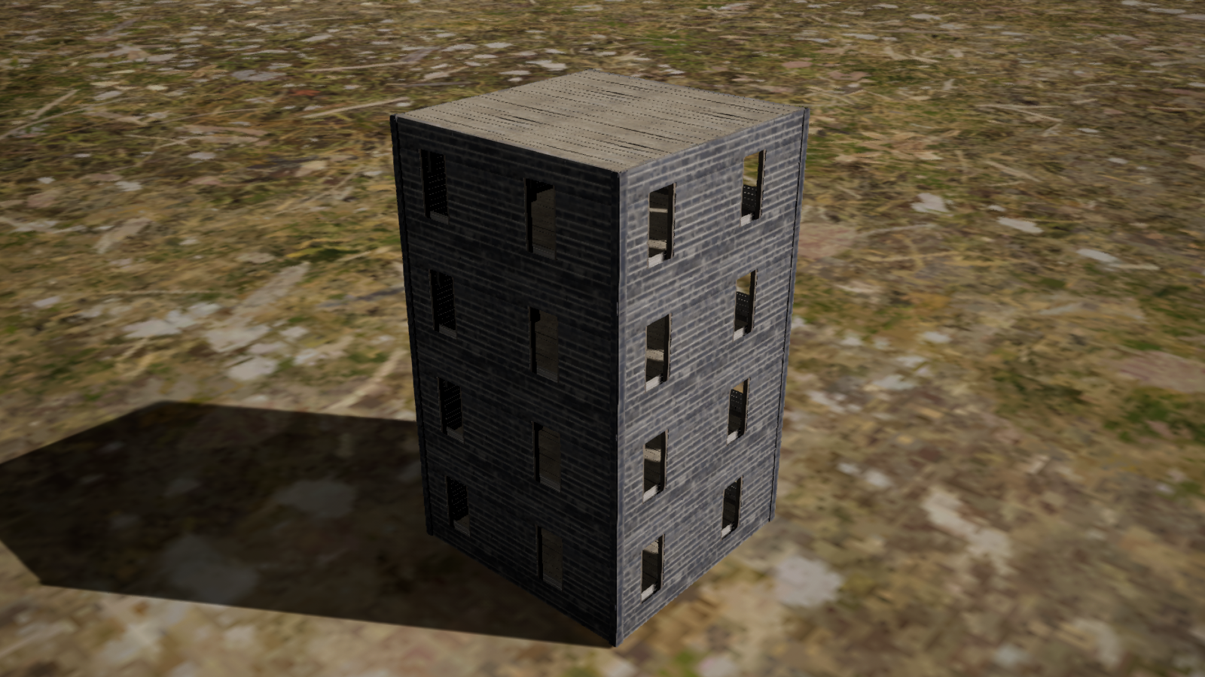
TODAY
Agenda
00–20 min
Procedural thinking and inputs
20–25 min
GOLF+ course-tool showcase
25–55 min
Guest: Amritha Immaneni — Intro to PCG in Unreal Engine
55–65 min
Break
65–95 min
Unreal PCG trail and building demos
95–103 min
Guided exercise: change one control
103–135 min
Production examples and broader applications
135–150 min
Final project check-in
150 minutes total. Times are measured from the start of class.
Notes:
READ ALOUD
This is the proposed 150-minute route. Amritha presents her introduction to Unreal PCG, including points, sampling and artist controls. After the break, our demos apply that foundation to exclusions, reusable region presets and a modular building. The exercise is eight minutes. We finish with broader inspiration and the final project check-in. The timings are elapsed minutes from the start of class.

Slide 3





FOUNDATIONS
Why use a procedural tool?
Purpose
Which repeated task should this tool solve?
Requirement
What must every result satisfy?
Variation
What is allowed to change?
Controls
What should an artist be able to adjust?
Cost
Will reuse justify building and maintaining it?
Notes:
READ ALOUD
A generator is useful when it solves a real repeated task. Its purpose might be faster revisions, consistent relationships or exploring alternatives under an art direction. Decide what must remain true and which decisions should stay in the artist’s hands. A small manual job may still be faster by hand.
ASK
What recurring task in your final project would benefit from a reusable rule?
SOURCES
https://www.pcgbook.com/chapter01.pdf

Slide 4
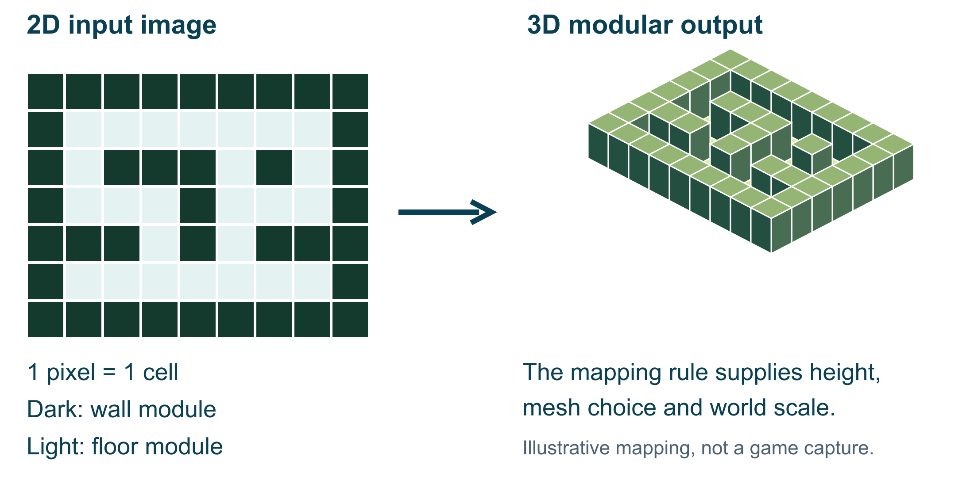
FOUNDATIONS
Inputs describe what the tool should work with
Splines, surfaces, images and asset collections can all supply data. Define what each input means.
Notes:
READ ALOUD
Inputs are part of the design of the tool. A small 2D image can encode a dungeon layout if we define what each pixel means. Here the white cells become floors and the dark cells become walls. The system still needs a policy for doors, connectivity and scale. This diagram illustrates the mapping; it is not our trail demo or a Diablo II implementation.
ASK
What information would a room generator need that a black-and-white image does not specify?
SOURCES
https://www.pcgbook.com/chapter01.pdf

Slide 5
FOUNDATIONS
A PCG graph works like a program
Read inputs
Create points
Apply rules
Spawn meshes
Get the terrain and path splines.
Propose positions for meshes.
Project to ground, filter density and remove points in exclusions.
Place trees or rocks at the surviving points.
Get Spline Data
Create Points Grid
Difference
Static Mesh Spawner
Each node performs an operation on the data passed through the graph.
Notes:
READ ALOUD
Think of the graph as a program operating on data. Each node performs a specific operation, and the connections pass data onward. Transform Points changes position, rotation or scale. Density Filter rejects points outside a range. Difference removes points in a supplied region. Static Mesh Spawner creates the visible mesh instances. The same reasoning transfers to code and to other procedural tools.
SOURCES
https://www.pcgbook.com/chapter01.pdf

Slide 6
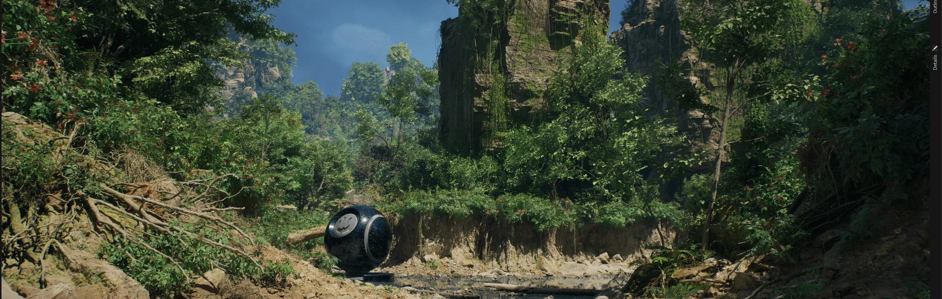
ART DIRECTION
The set dressing follows the artist’s input
The artist draws the route
The path describes where the player should be able to travel.
The tool responds
Vegetation regenerates around the revised input, using the same clearance rules.
Artist-authored layouts and procedural dressing can be revised together.
Notes:
READ ALOUD
Proceduralism can preserve art direction during revisions. The artist supplies the important composition, such as a path, and the system updates the repeated dressing around it. Epic’s Electric Dreams is an Unreal PCG example of combining authored work with procedural assembly. It is a production reference, not a screenshot of our class project.
SOURCES
https://www.unrealengine.com/electric-dreams-environment?lang=en-US
VISUAL REFERENCE
Unreal PCG reference: Epic Games, Electric Dreams (UE 5.2-era sample).

Slide 7
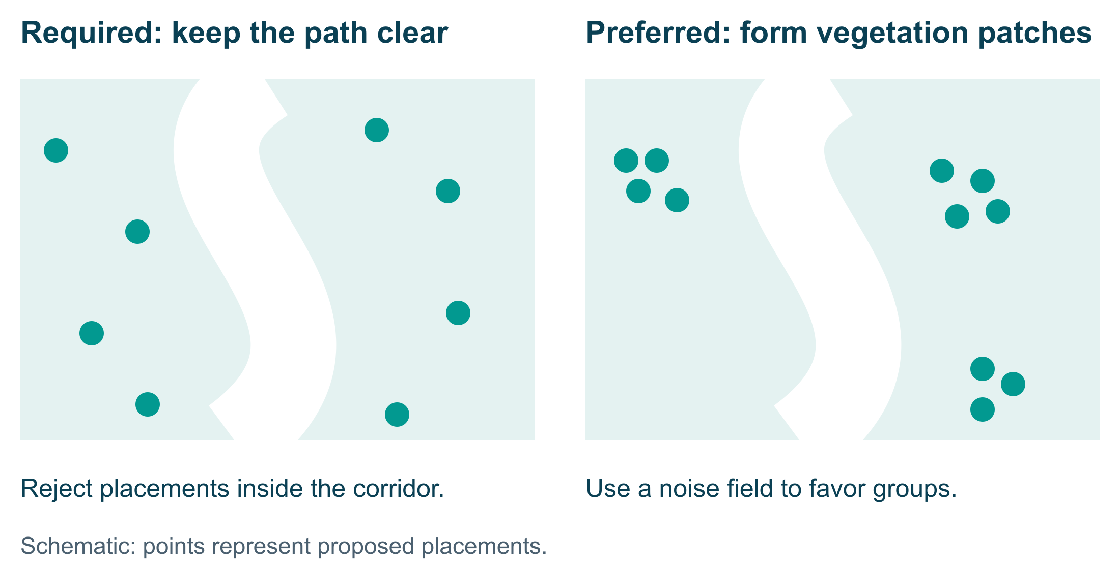
FOUNDATIONS
Requirements and heuristics make different decisions
A result can satisfy every requirement and still need an artist’s visual review.
Notes:
READ ALOUD
A requirement rejects an unacceptable result. A heuristic is a useful preference or rule of thumb, such as favoring patches instead of covering every suitable location evenly. A result can satisfy the path-clearance rule and still look repetitive. We inspect visual quality separately from technical validity.
ASK
If all trees avoid the path but their spacing looks artificial, which kind of rule needs work?
SOURCES
https://www.pcgbook.com/chapter01.pdf

Slide 8
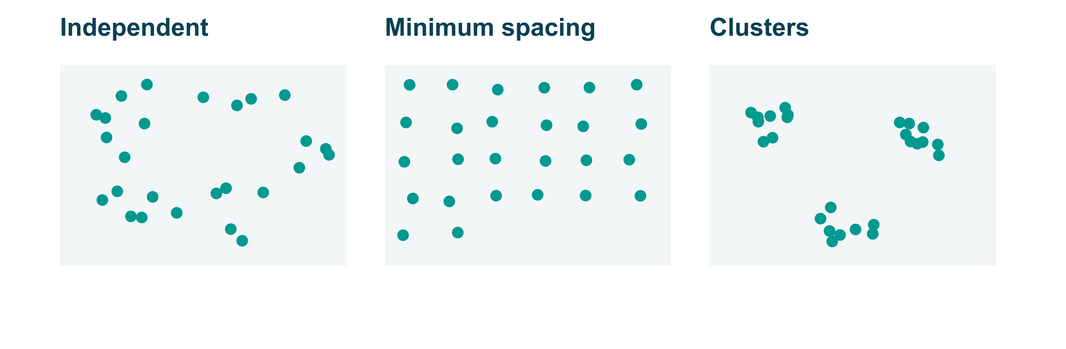
FOUNDATIONS
Three spatial distributions
These are schematic point patterns, before any meshes are spawned.
Notes:
READ ALOUD
Independent placement may create both clumps and empty gaps by chance. Minimum-distance sampling discourages nearby neighbors. A clustered distribution deliberately forms groups. Choose a distribution that supports the intended environment. A visually pleasing pattern does not, by itself, prove that meshes will avoid overlap.

Slide 9
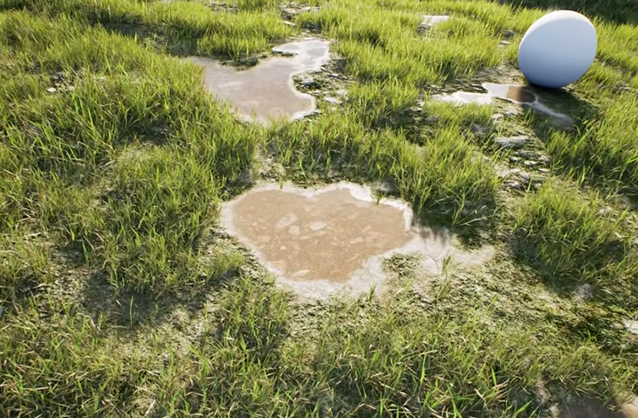
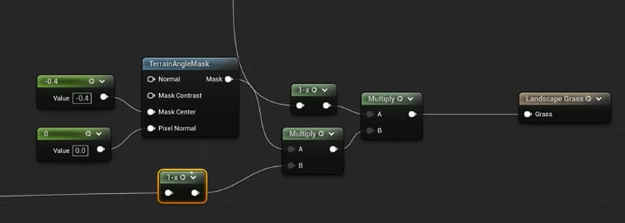
MASKS
A material mask controls where grass can grow
Mask calculation
Grass result
The material combines signals before PCG reads the grass mask.
The later output leaves puddles and unsuitable areas uncovered.
Material signals can exclude puddles and unsuitable slopes.
Notes:
READ ALOUD
A mask turns spatial information into a selection signal. In this tutorial, material logic combines terrain and surface conditions, then the PCG graph samples the resulting grass mask. The left image shows the calculation, not a bitmap preview of the right camera view. We removed the previous early slope-mask pairing because it did not represent this later result.
SOURCES
https://www.youtube.com/@BenCloward
VISUAL REFERENCE
Source study: Ben Cloward, PCG episode 03. Network and later output, not a same-camera bitmap comparison.

Slide 10
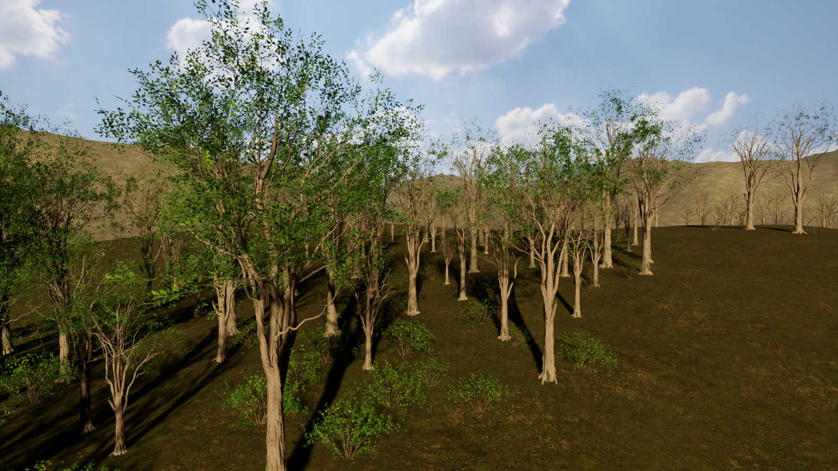
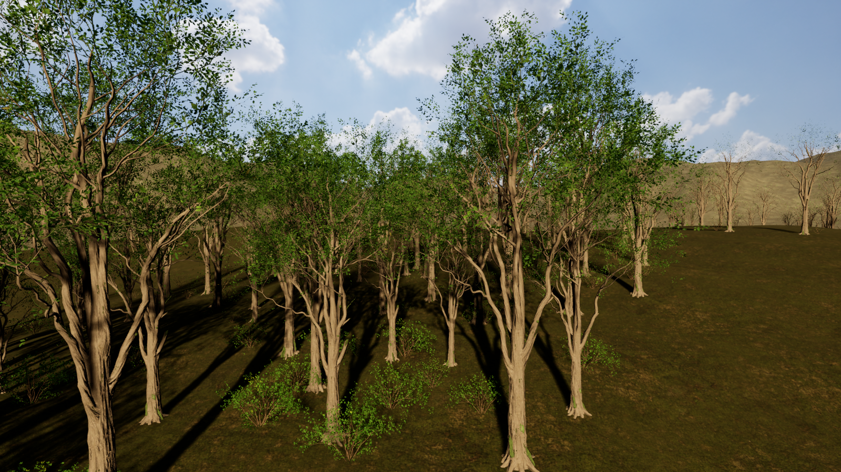
VARIATION
A seed lets us compare a repeatable variation
Trees seed 17
Trees seed 43
The same camera, inputs, graph and asset tables.
Different tree placement; other layer settings stay fixed.
A seed is repeatable only while inputs, rules, assets and settings stay the same.
Notes:
READ ALOUD
Hold the camera, inputs and settings fixed when comparing a seed change. A seed chooses a repeatable sequence of variation under those conditions. If we change the algorithm, assets or engine behavior, the same seed may produce a different result. A seed is not a substitute for rules that protect the path.
VISUAL REFERENCE
Actual class forest in UE 5.7.4, Shader Model 6. A seed is repeatable only under unchanged conditions.

Slide 11
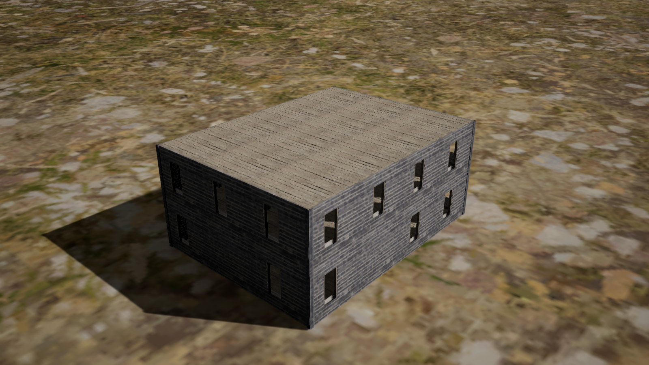
STRUCTURED GENERATION
Modular assembly combines pieces with connection rules
Pieces
A wall, a corner post, a floor and a roof panel.
Rules
Repeat bays, remove internal faces and place the roof above the top floor.
Notes:
READ ALOUD
A modular generator uses a vocabulary of authored pieces and rules for combining them. A grammar is a formal way to describe allowed replacements or arrangements. Our building demo uses explicit assembly rules; we are not claiming it implements a grammar solver. The connection and dimension rules let the modules form a structure instead of a random scatter.
SOURCES
https://www.pcgbook.com/chapter01.pdf

Slide 12
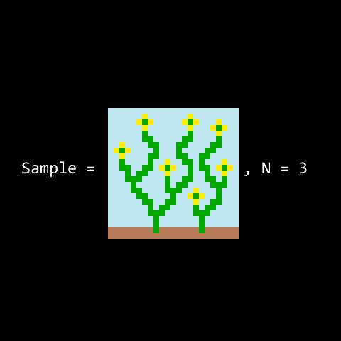
STRUCTURED GENERATION
Wave Function Collapse chooses compatible neighbors
Local rule
A tile may only touch permitted neighbors.
Propagation
Each choice removes incompatible options nearby.
Each tile must satisfy the allowed-neighbor rules.
Notes:
READ ALOUD
Wave Function Collapse is a different generation technique from our scatter graph. It chooses an option, updates the neighboring possibilities and repeats. If a cell has no permitted option, the implementation needs a recovery policy such as restarting or backtracking. Local compatibility does not guarantee a connected or playable level. The animation comes from the original implementation.
SOURCES
https://github.com/mxgmn/WaveFunctionCollapse
VISUAL REFERENCE
Maxim Gumin: WaveFunctionCollapse. Local compatibility still needs gameplay validation.

Slide 13
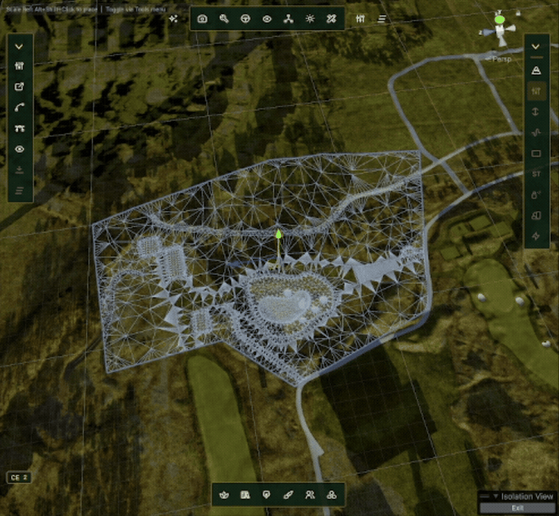
INSTRUCTOR SHOWCASE
GOLF+: from course inputs to a generated course
Authored input
Course layout and terrain settings describe the intended result.
Generated result
The tool rebuilds repeated terrain and course work from those inputs.
Generated course geometry follows the supplied layout.
Notes:
READ ALOUD
This is my actual course-generator recording. Watch the course output rather than only the settings panel. The practical value is that a revised input can update repeated work. The artist still checks the shape and the playable result. This is a Unity production example, not an Unreal PCG graph.
VISUAL REFERENCE
Instructor tool recording, Unity: the generated mesh and route are visible in the Scene viewport.

Slide 14
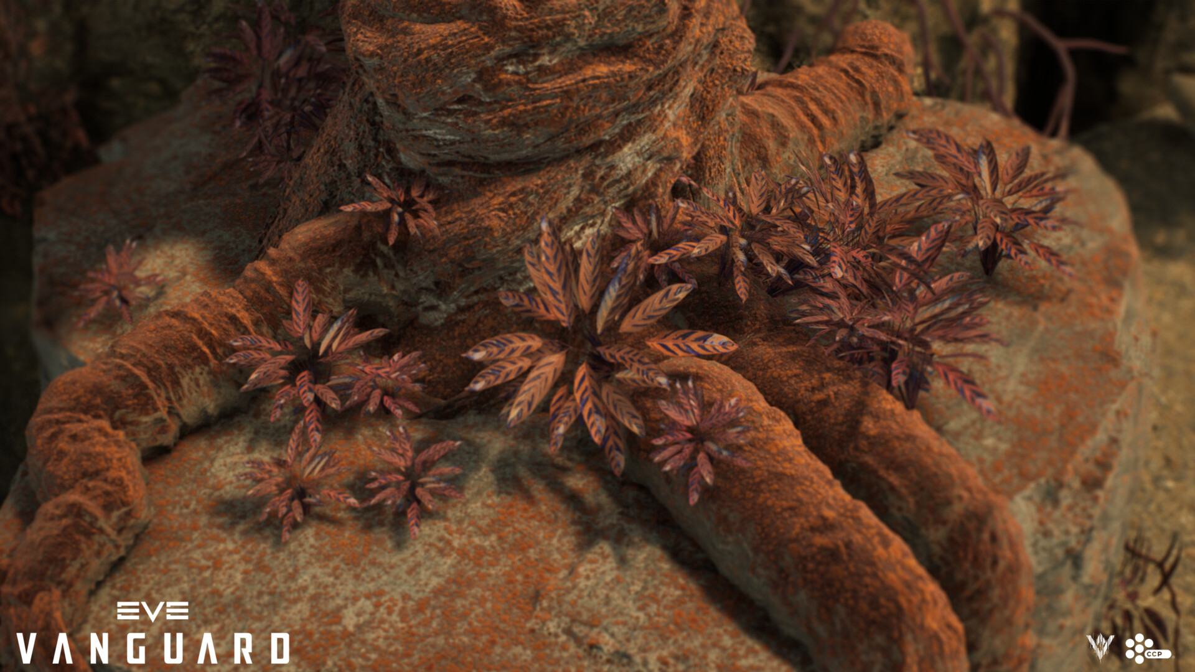
GUEST PRESENTATION
GUEST: Amritha Immaneni
Intro to PCG in Unreal Engine
Points, sampling and artist controls in a practical Unreal workflow.
Notes:
READ ALOUD
Introduce Amritha and switch to her supplied presentation, Intro to PCG in Unreal Engine. Her deck covers points, mesh sampling, data assets and assemblies, performance and production examples. Ask how she decides what artists should control and how a graph becomes maintainable. Return here after her presentation. The background is an guest-provided reference, not Amritha’s project.
ASK
Which part of a procedural tool usually needs the most artist feedback?
VISUAL REFERENCE
Guest: Amritha Immaneni · 30 minutes. EVE Vanguard image supplied in her guest deck; CCP Games.

Slide 15
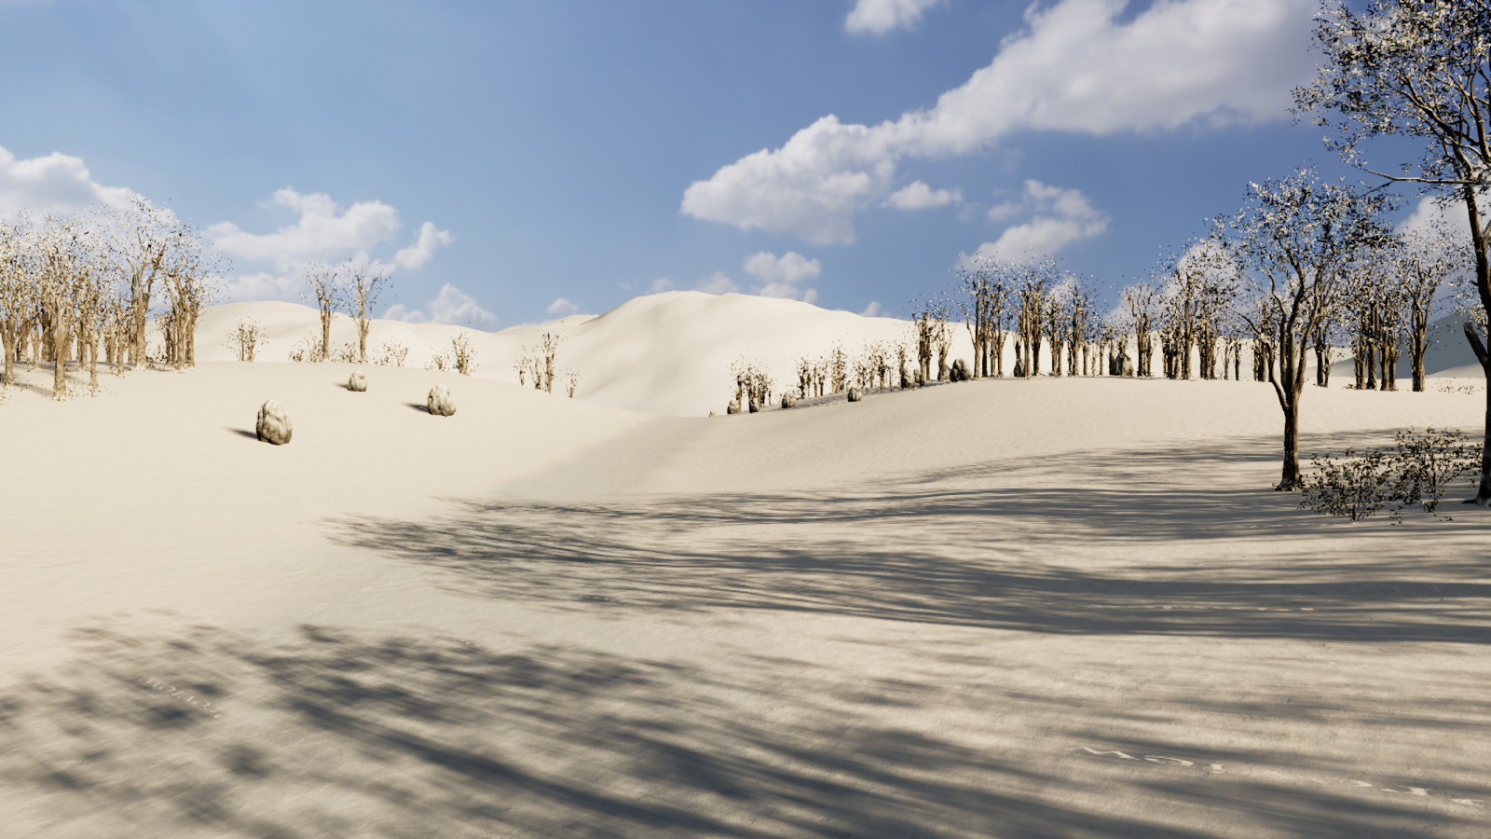
10 MINUTES
Break
Resume at minute 65
Next: the Unreal PCG trail and building demos.
55–65 minutes
Notes:
READ ALOUD
Take ten minutes. After the break, open the prepared Week 11 project. No student asset installation is needed.

Slide 16
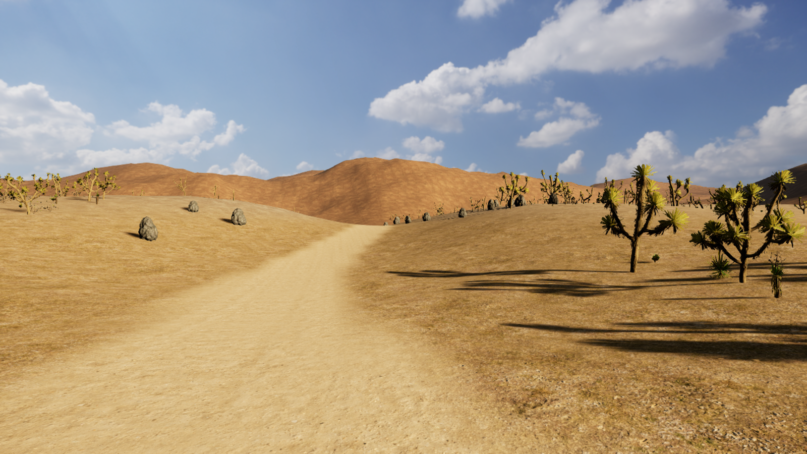
UNREAL ENGINE 5.7
DEMO: Unreal PCG trail
One graph, several asset profiles
Change a control, move an input and inspect why points survive.
65–95 minutes: trail and building demos
Notes:
READ ALOUD
Open the trail example from Tools, Week 11 PCG Museum, Full trail exercise. Show the shared parent graph, then the three population actors. Demonstrate one change at a time. Keep the path visible so students can connect exclusions to their practical purpose. This is an editor-generated environment demo.

Slide 17
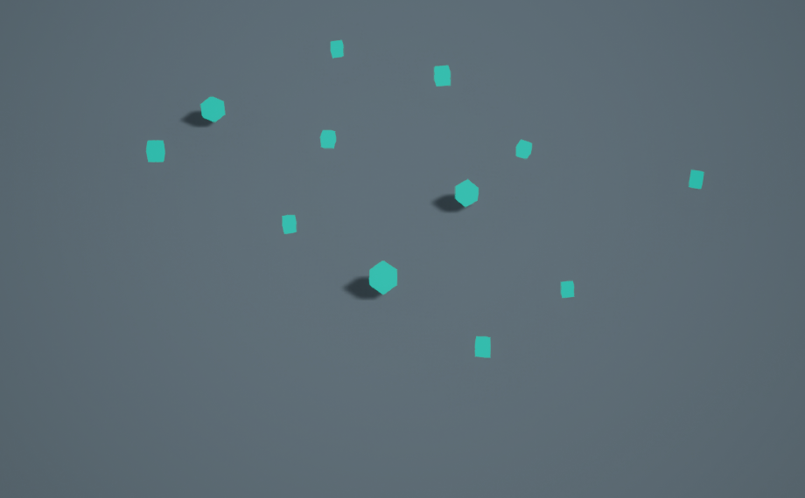
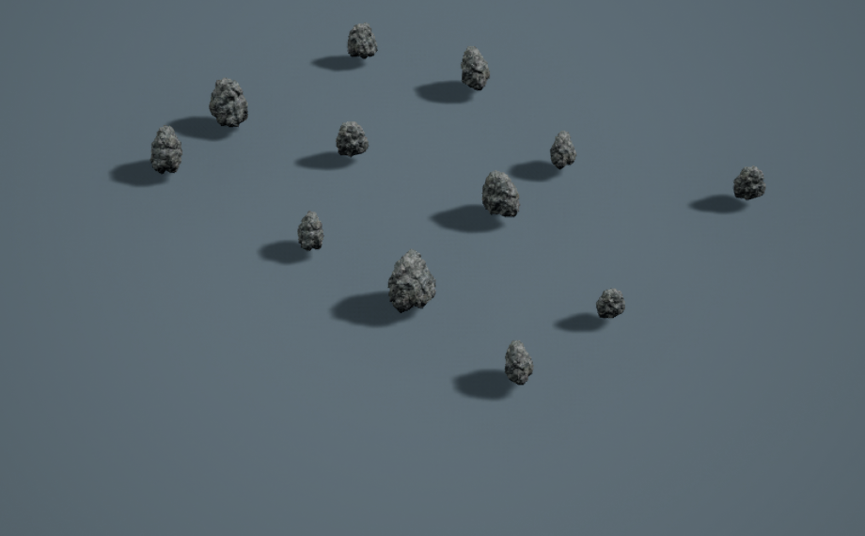
UNREAL PCG
Points describe placements before meshes appear
Point visualization
Mesh output
Boxes mark the 12 proposed placements.
The spawner uses those same transforms for rocks.
Actual class project. Same point transforms and camera; only the visualization mesh changes.
Notes:
READ ALOUD
A point stores placement information before it becomes a visible rock or tree. These two native captures use the same twelve point transforms and the same camera. The left renders cubes as teaching markers; the right uses the rock mesh. The cubes are an explicit point visualization, not a claim that PCG points are geometry. In the editor, we can also enable a node’s Debug display to inspect intermediate data.

Slide 18
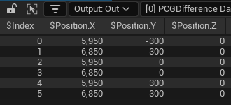
UNREAL PCG DATA
A point is a record of placement data
Transform
Position, rotation and scale describe a placement.
Other fields
Density, bounds and seed support later decisions. Metadata can carry additional attributes.
Our class graph: the Attribute List shows six output points after Difference.
Notes:
READ ALOUD
A point is a record with several fields. It can have a transform, density, bounds and a seed, plus associated metadata. The inspector lets us see values rather than infer everything from the final scene. One input pin can carry multiple datasets, and each dataset contains many point records. That distinction matters when writing custom nodes.
SOURCES
https://dev.epicgames.com/documentation/en-us/unreal-engine/procedural-content-generation-overview

Slide 19
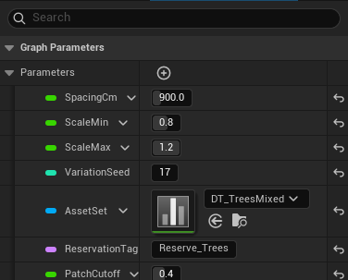
REUSABLE TOOLS
Graph instances reuse rules with different settings
Parent graph
PCG_BiomeScatter defines the shared operations.
Instance preset
A reusable asset supplies defaults such as an asset table and spacing.
Actor override
A component can change a parameter for one population in the scene.
SpacingCm sets the proposed point spacing in centimetres.
Notes:
READ ALOUD
A graph instance reuses a parent graph while storing parameter values. Our Trees, Rocks and Scrub presets point to PCG_BiomeScatter. AssetSet chooses a supplied mesh-and-weight table, while SpacingCm controls proposed point spacing. An actor’s component can override a value locally. The parent graph stays shared.
VISUAL REFERENCE
Actual class graph parameters. SpacingCm is measured in centimetres.

Slide 20
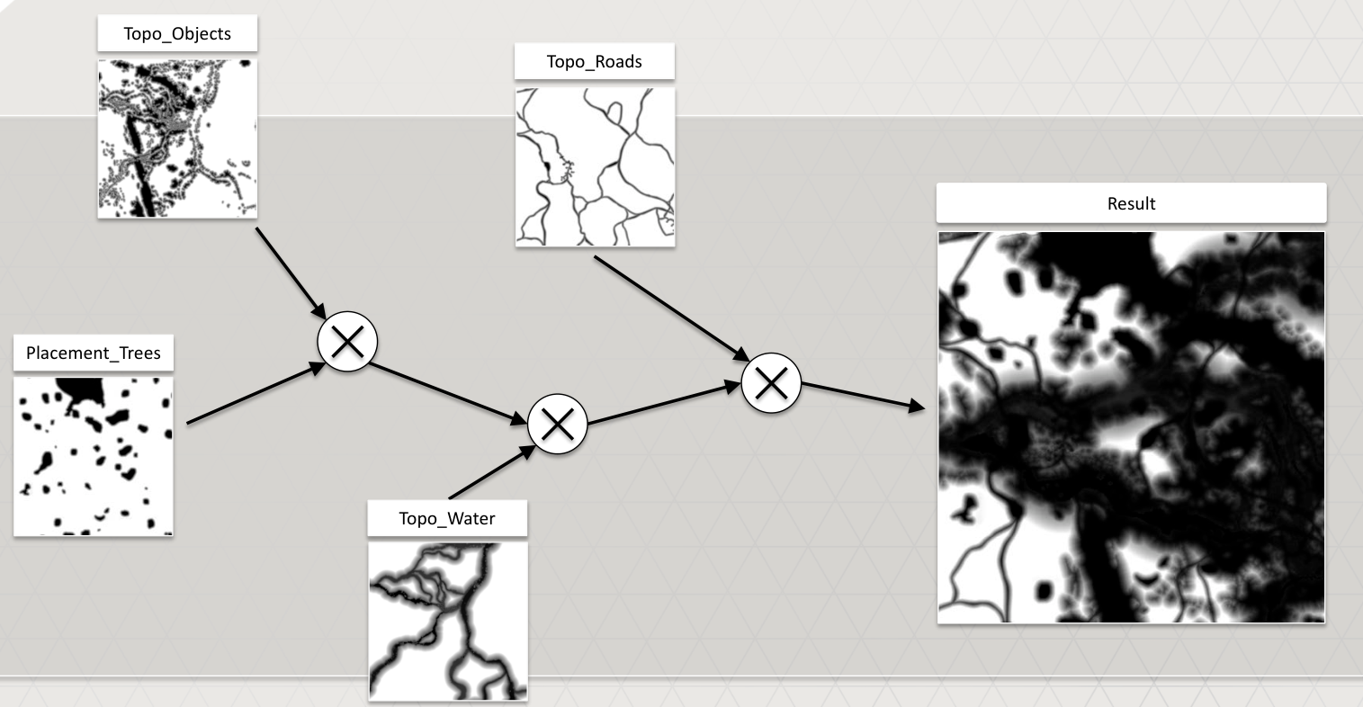
PRODUCTION EXAMPLE
GDC: Horizon Zero Dawn combines placement masks
Read several fields
Vegetation suitability, water, roads and existing objects affect placement.
Combine their meanings
An otherwise suitable location can still be excluded by a road or object.
Decima uses suitability fields to control placement. Our live examples use Unreal PCG.
Notes:
READ ALOUD
This is Guerrilla’s GDC 2017 explanation of procedural placement in Horizon Zero Dawn. Several spatial fields contribute to placement and exclusion. The transferable idea is how the meanings of those fields combine. Their implementation uses Decima and GPU-based placement, so this is not an Unreal node recipe or a performance claim for our class graph.
SOURCES
https://www.guerrilla-games.com/read/gpu-based-procedural-placement-in-horizon-zero-dawn
VISUAL REFERENCE
Jaap van Muijden, Guerrilla Games, GDC 2017. Diagram excerpt from page 15.

Slide 21
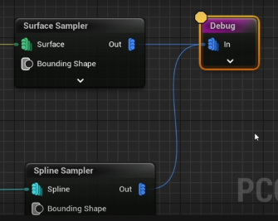
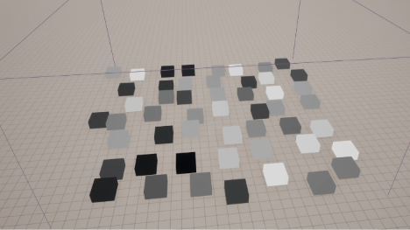
UNREAL PCG DEBUGGING
Debug a node, then inspect its scene output
In the graph
In the scene
Enable Debug on the stage you want to inspect.
Check positions, density and the region that survives before blaming the mesh.
Interface shown: UE 5.4. The class demo uses UE 5.7.
Notes:
READ ALOUD
Debug a specific stage to find the first place where the data becomes wrong. Check whether the points exist, whether they are on the expected surface, and whether a filter removes the intended region. The two images are the instructor’s ordered captures of the Udemy lesson, using UE 5.4. The class uses 5.7, so verify the current panel location instead of memorizing the old UI.
SOURCES
https://www.udemy.com/course/unreal-engine-pcg-english/
VISUAL REFERENCE
Brandon Vox course study, UE 5.4 source captures. Class implementation: UE 5.7.

Slide 22
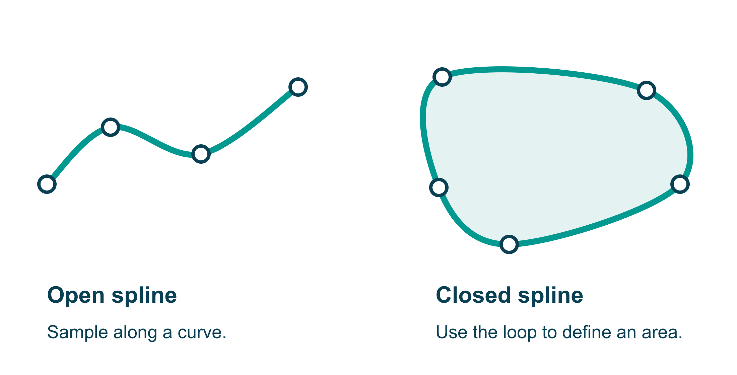
SPLINES
Open and closed splines describe different inputs
An open spline describes a curve; a closed spline can define the interior of a region.
Notes:
READ ALOUD
A spline is a curve described by control points. An open spline is useful for a route or fence. A closed spline can bound a region, but the graph must use the interior as a surface when it needs an area. Sampling along a curve and sampling inside a region are different operations.

Slide 23
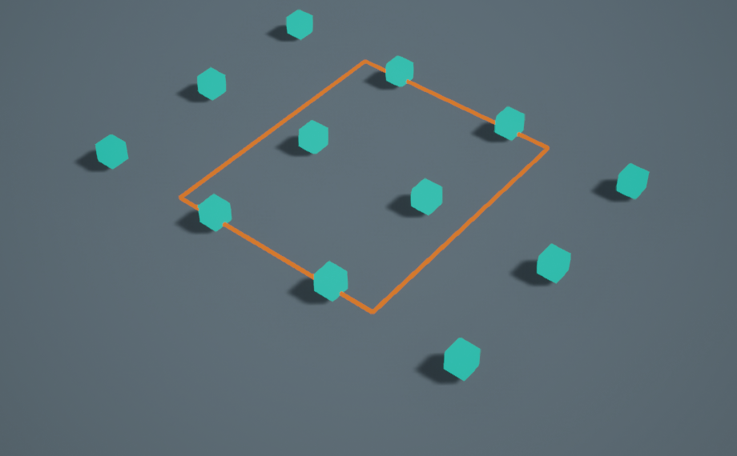
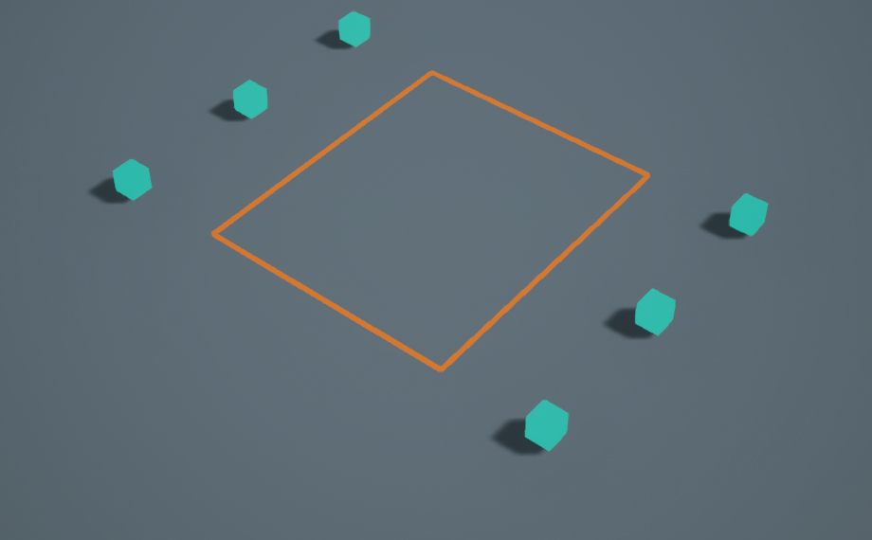
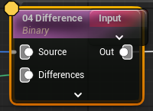
EXCLUSIONS
Difference removes points inside a closed spline
Before: 12 points
After: 6 points
Difference node
The closed orange spline supplies the region to remove from the source points.
Bypassing Difference keeps all 12 points; enabling it leaves 6.
Notes:
READ ALOUD
Difference subtracts the supplied region from the source point data. Here a closed spline becomes a surface. The binary Difference rejects the six point centres inside it, leaving six outside. The orange outline is an actual scene input. This filters point placements; it does not perform a Boolean cut on the terrain mesh or guarantee full mesh collision clearance.
VISUAL REFERENCE
Actual class graph and scene. The before view bypasses Difference; the after view enables it.

Slide 24
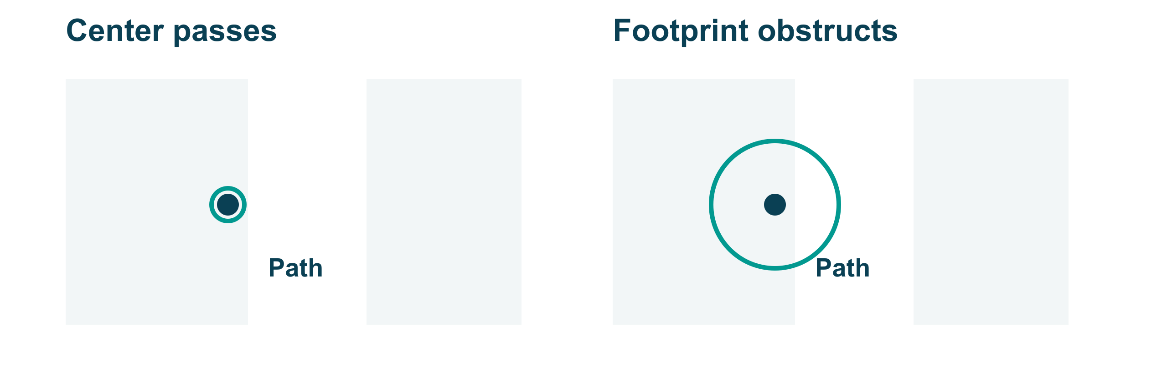
CLEARANCE
A clear point centre can still leave a blocked path
Inspect the final mesh footprint as well as its point centre.
Notes:
READ ALOUD
The point centre may lie outside a path while the tree canopy or rock footprint extends into it. Reserve space for the final asset size and maximum scale, then inspect the actual mesh. Bounds-based pruning and path exclusion are approximations. This diagram explains the issue; it is not a collision or navigation test.
ASK
What needs to change when an artist swaps small rocks for much larger ones?

Slide 25

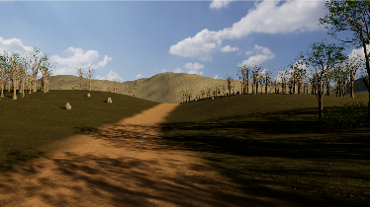
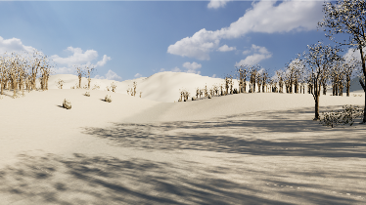
BIOME PROFILES
Desert, forest and snow reuse the same graph
Desert
Forest
Snow
Dry vegetation and warm ground.
Trees, undergrowth and forest materials.
Snow-region assets and surface materials.
One shared placement graph can support distinct region presets.
Notes:
READ ALOUD
These regions share the same parent placement graph. Their asset tables, instance presets and materials provide the regional identity. The framework is a compact biome-like teaching system. It does not simulate a complete ecosystem. New assets can need different scale and clearance settings even when the graph stays the same.
VISUAL REFERENCE
Actual class regions. Shared rules; different compatible assets, presets and materials.

Slide 26
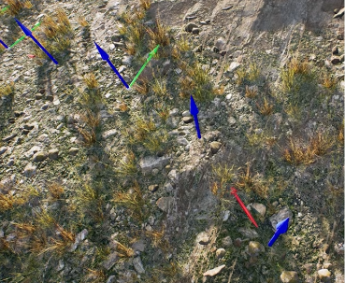
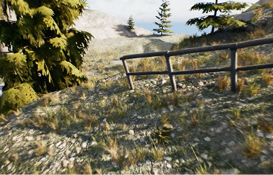
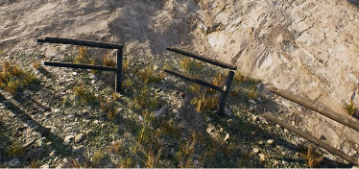
SPLINE-TOOL PROGRESSION
Building a fence spline tool
Space the modules
Align each segment
Handle turns and ends
Use the mesh length to choose sample spacing.
Orient the piece along the spline direction.
Check pivots, gaps and the final partial segment.
Notes:
READ ALOUD
Build the fence tool in visible stages. First use a module length that matches the sample spacing. Next align each piece with the curve direction. Then inspect sharp turns, pivots and the endpoint. Rigid modules and deformed spline meshes solve different problems. These source captures show the progression and its failure cases, rather than a list of mysterious troubleshooting rules.
VISUAL REFERENCE
Ben Cloward episode 08, instructor’s ordered source captures. Rigid and deformed fence pieces behave differently.

Slide 27
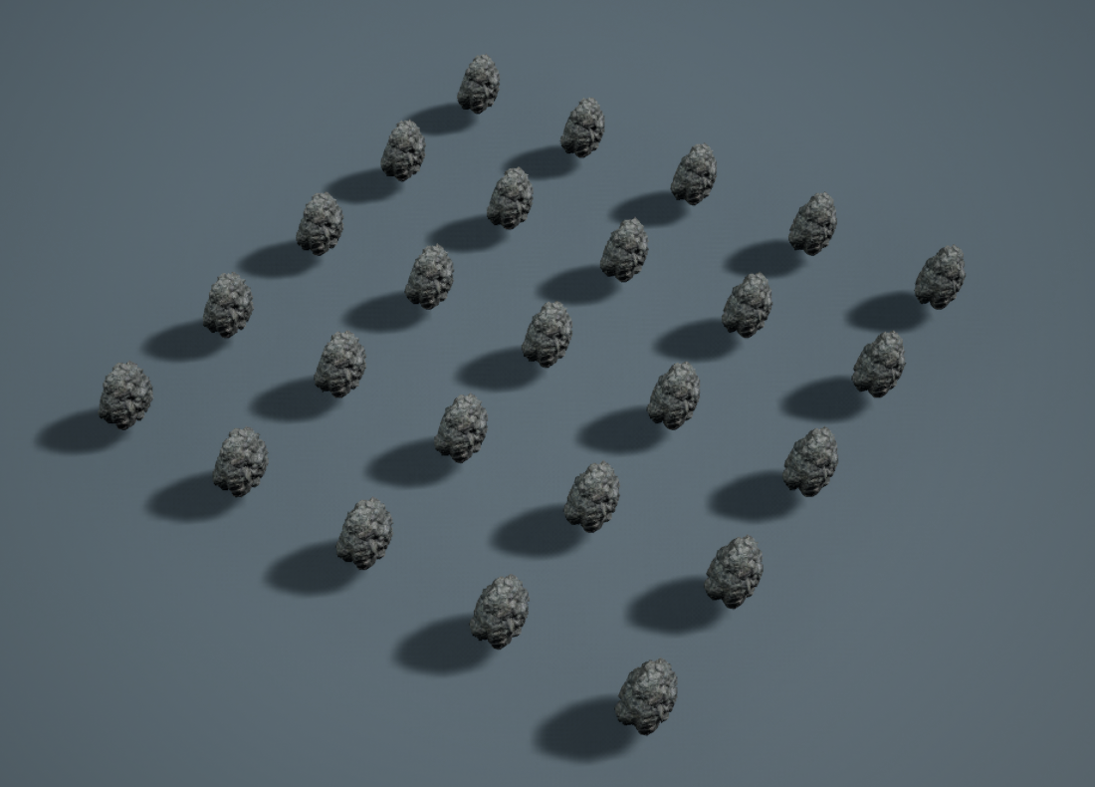
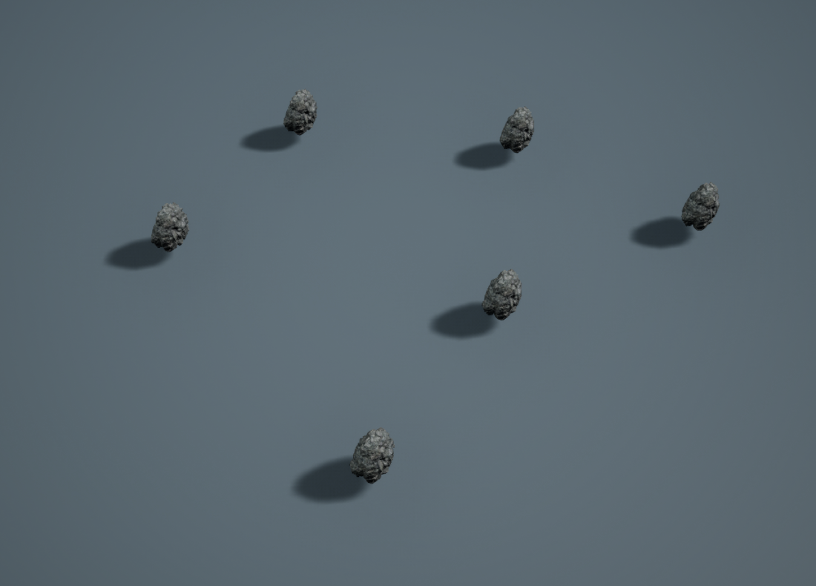
NEIGHBORHOOD RULES
Overlap filtering changes the visible result
Before pruning
After pruning
Twenty-five competing rock placements.
Six remain after Self Pruning.
Self Pruning tests point bounds; it does not solve full mesh collisions.
Notes:
READ ALOUD
These captures show the same proposed rock population before and after Self Pruning. The raw branch has twenty-five placements; the pruned branch has six. Their spatial offsets are only for the museum comparison. The influence bounds determine which points compete. This is a point-bound approximation, not a full mesh collision solve.
VISUAL REFERENCE
Actual class museum station 06. Native camera views of the two comparison branches.

Slide 28
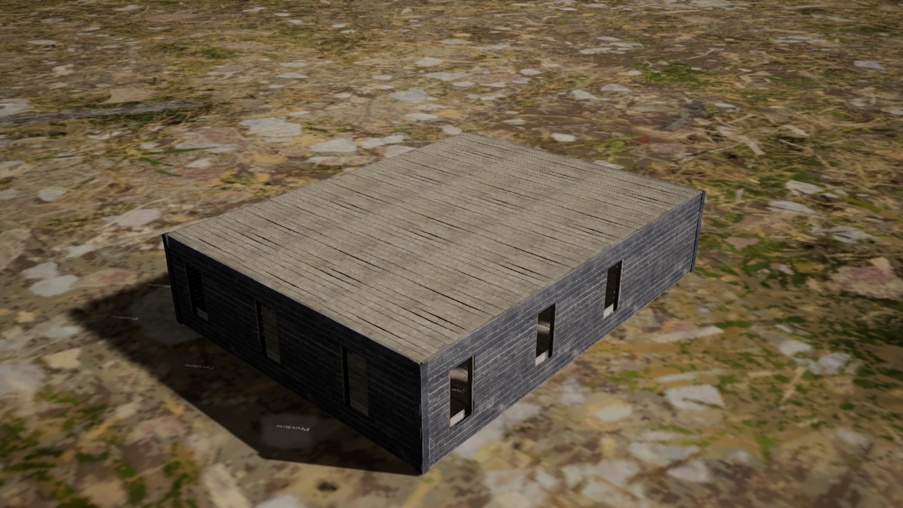
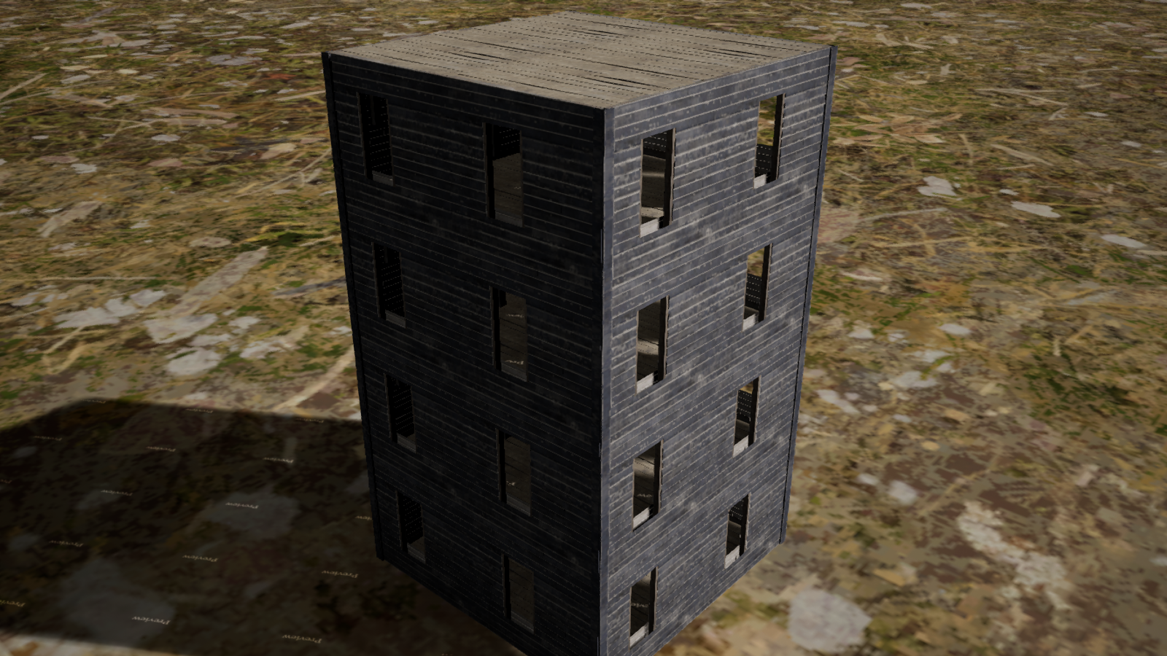
BUILDING RULES
The building generator repeats and connects modules
Footprint and floors
Dependent parts
Cells X/Y count bays. Cells Z counts floors.
The outer walls, corner posts and roof follow those dimensions.
Notes:
READ ALOUD
The class building graph creates a rectangular cell structure. It removes internal faces, places compatible facade modules and moves the flat roof above the top floor. Different dimensions reuse the same rules. This is an original teaching graph informed by course study, not a redistribution of the Udemy building project. Entrances, circulation and pitched roofs remain outside its current scope.

Slide 29
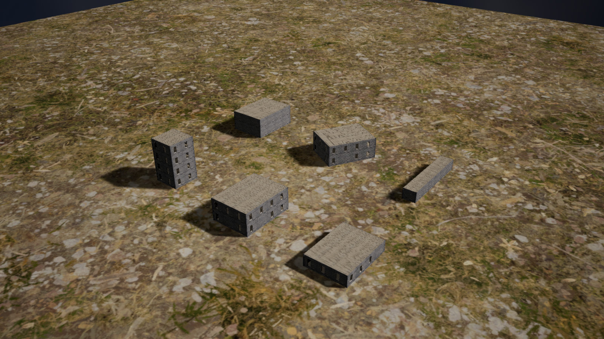
UNREAL ENGINE 5.7
DEMO: Unreal PCG building generator
Change Cells on Lodge
Compare (3,4,2) with (5,2,3), then restore the original values.
Notes:
READ ALOUD
Open Tools, Week 11 PCG Museum, Building examples. Select Lodge and its PCG component. Change Cells from three by four bays and two floors to five by two bays and three floors. Regenerate, show how the roof follows the top floor, and restore the baseline. Then show that the same graph produces Cabin and Tower. Keep the flat-roof and rectangular-footprint limits explicit.

Slide 30
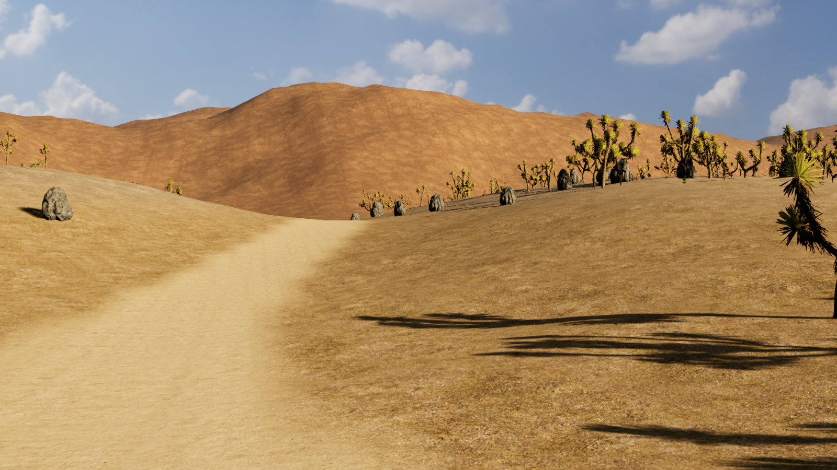
8 MINUTES
GUIDED EXERCISE: change the scrub density
2 min: open
Tools > Week 11 PCG Museum > Full trail exercise. Select PCG_Scrub and its PCG component.
4 min: compare
Change KeepFraction from 0.78 to 0.50. Keep seed 41. Click Generate.
2 min: restore
Reset KeepFraction to 0.78 and Generate. Explain why trees and rocks stayed stable.
Follow the supplied Student-Lab handout.
Notes:
READ ALOUD
Use the supplied project and assets. This is one controlled change, not a new graph-building assignment. Everyone works on the scrub actor. Keep the seed and all other inputs fixed. Ask students to predict the result before generating, then restore the supplied values. Optional asset swaps and moved splines belong after the guided task.
ASK
Why does KeepFraction = 0.50 not promise exactly half as many final meshes?
VISUAL REFERENCE
Student-Lab.html has the exact steps. No extra asset download or plugin setup.

Slide 31
VALIDATION
A tool must work on more than one input
Repeat
Does the same input and seed regenerate the same result?
Revise
Does moving a spline update the intended exclusion?
Stress a limit
What happens with a tight bend, large asset or narrow region?
Restore
Can the artist return to the supplied result?
Test the same input, a revised input and a limiting case before handing a tool to another artist.
Notes:
READ ALOUD
Test the rule rather than just a favorable screenshot. Repeat the baseline, move an input, try a difficult case and restore it. Check terrain contact and the final asset footprint. Our automated checks cover map loading, graph outputs and repeatable transforms. They do not establish playable navigation or good level design.
ASK
Which failure would a beautiful single screenshot fail to reveal?

Slide 32
PRODUCTION DECISIONS
Generation costs and rendering costs
GENERATION
RENDERING
When the editor graph runs
Every displayed frame
Sampling, filters, asset reads and mesh-instance creation take editor time. A heavy graph can make revisions slow.
Visible meshes still cost CPU/GPU work, memory and draw submission. More instances do not become free because PCG placed them.
Tool development and maintenance also take time. Judge that investment against future reuse.
This class demo generates in the editor. Runtime generation is a separate design choice.
Notes:
READ ALOUD
In this project, generation happens in the editor when we generate or revise the prepared scene. That is different from the rendering cost paid every frame while the scene is displayed. Instancing can reduce submission overhead, but geometry, materials, shadows and memory still matter. Building and maintaining the tool is a third cost to weigh against future reuse.
TERMS
CPU means central processing unit; GPU means graphics processing unit. Generation evaluates the graph to construct content. Rendering draws that content for each displayed frame. These costs can occur at different times and need separate measurements.

Slide 33
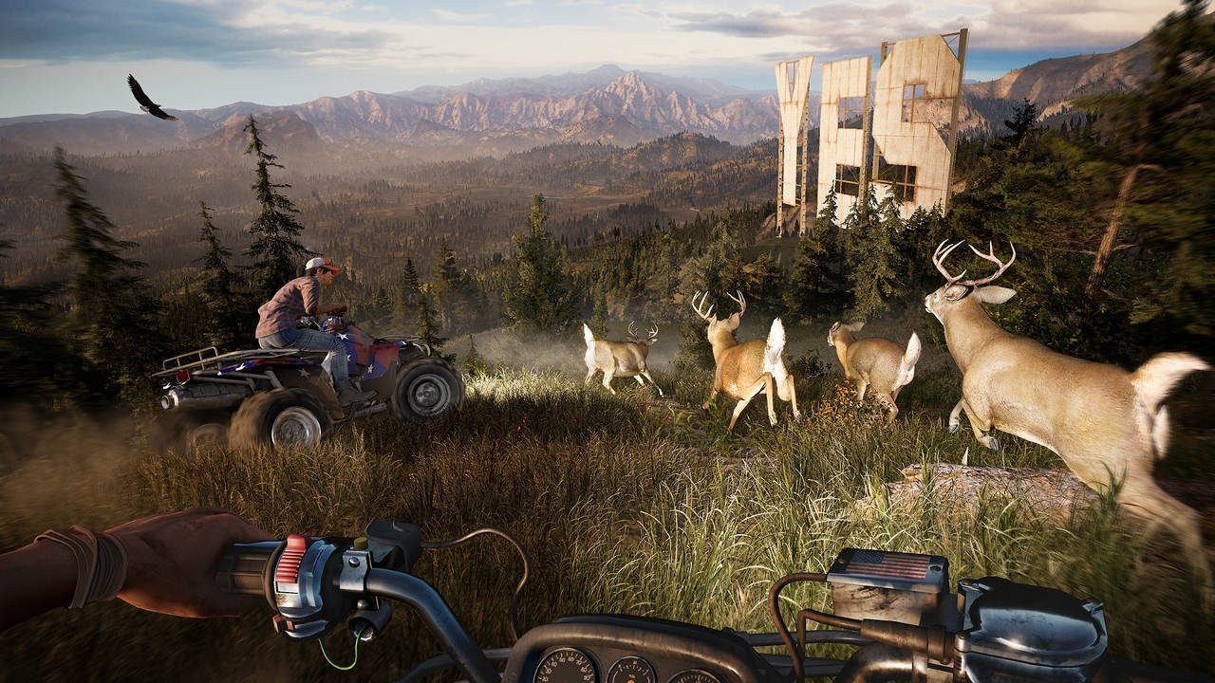
PRODUCTION EXAMPLE
GDC: Far Cry 5 makes world revisions reusable
Production problem
A large world needs many related terrain and vegetation decisions to stay consistent during revisions.
Tool investment
Reusable rules can save repeated rebuilding, but the team must author, maintain and validate those rules.
This workflow uses Houdini with Dunia. Our live demos use Unreal PCG.
Notes:
READ ALOUD
Etienne Carrier’s GDC talk describes procedural world generation for Far Cry 5. The team used Houdini and Houdini Engine with Ubisoft’s Dunia engine. This supports the production argument for reusable rules and fine-tuning during world revisions. It is a supporting example, not the main implementation reference for our Unreal PCG demo.
SOURCES
https://www.gdcvault.com/play/1025215/Procedural-World-Generation-of-Far
https://blog.playstation.com/?p=199418
VISUAL REFERENCE
Etienne Carrier, Ubisoft, GDC 2018. Houdini/Dunia workflow, not Unreal PCG.

Slide 34
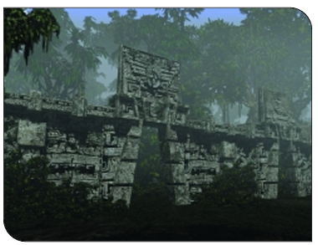
BEYOND ENVIRONMENT DRESSING
Procedural level design: Diablo II
What changes
Levels, monster combinations and treasure create different runs.
What still needs design
Traversal, encounters and progression must remain understandable and playable.
Random variation still needs reliable traversal and progression.
Notes:
READ ALOUD
Diablo II uses random generation for levels, monsters and treasure. Erich Schaefer’s postmortem describes how that variation supports replay and how much testing its combinations required. This is a gameplay application of proceduralism, beyond placing decorative objects. A different layout is only useful if the resulting play experience works.
ASK
What would you validate in a generated dungeon that our scenery generator does not test?
SOURCES
https://www.gamedeveloper.com/design/postmortem-blizzard-s-i-diablo-ii-i-
VISUAL REFERENCE
Erich Schaefer, Diablo II postmortem (2000). Environment image from the original article.

Slide 35
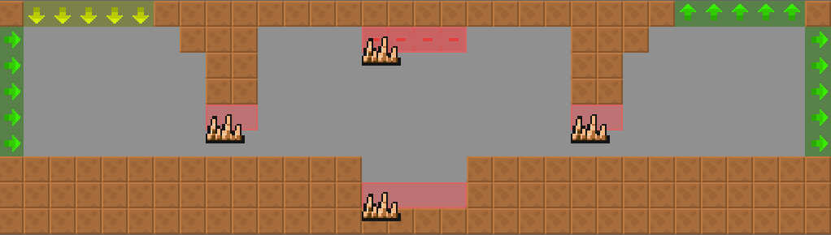
AUTHORED AND GENERATED CONTENT
When full procedural generation weakens a level
Dead Cells uses a hybrid
Designers author room chunks and the overall world connections. The system assembles and varies parts of the level.
Keep the important decisions
Handcraft a specific encounter or composition when variation would weaken its purpose.
Handmade room chunks preserve local design; procedural assembly varies the run.
Notes:
READ ALOUD
Dead Cells is a useful example of choosing the boundary between authored and generated work. Its lead designer describes a fully procedural prototype that felt incoherent, then a hybrid using hand-designed room chunks and procedural assembly. The lesson is not that the shipped game abandoned proceduralism. Reserve the parts that need deliberate pacing or composition, and generate variation where it improves play.
ASK
Which part of your project would lose value if it changed on every generation?
SOURCES
https://www.gamedeveloper.com/design/building-the-level-design-of-a-procedurally-generated-metroidvania-a-hybrid-approach-
VISUAL REFERENCE
Sebastien Bénard, 2017 developer article. Authored rooms plus procedural assembly.

Slide 36
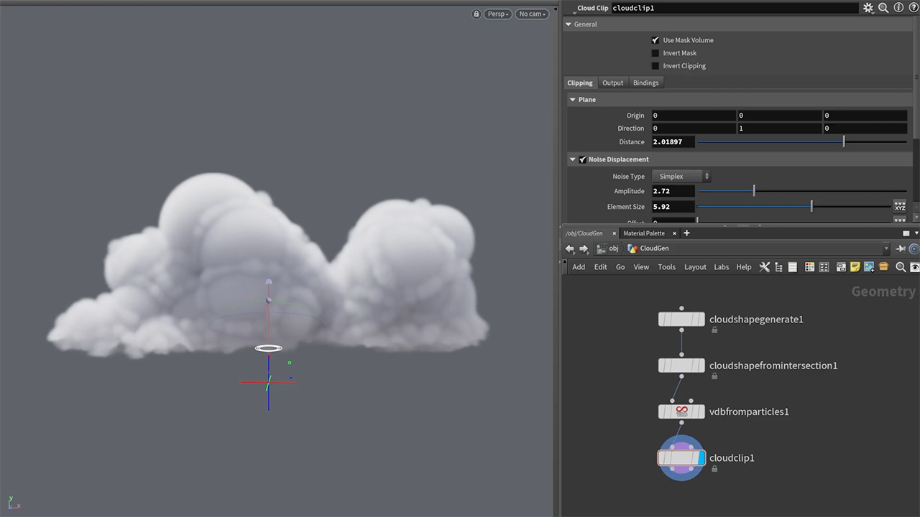
HOUDINI INTRODUCTION
HOUDINI: procedural tools beyond scattering
A node-based authoring application
Artists build detailed modeling, animation and simulation systems for games and film, with granular geometry and attribute control.
Notes:
READ ALOUD
Houdini is a separate procedural authoring application used in games and film. Its granular geometry and attribute operations let skilled artists build high-quality assets and precise reusable systems. It supports much more than scattering: procedural modeling, rigging and animation, effects and simulation. That depth takes expertise; it is not an automatic quality guarantee. Students do not need Houdini for this class.
SOURCES
https://www.sidefx.com/products/houdini/
Houdini is used in games and film. More granular control makes sophisticated assets possible for artists with the expertise; it does not automatically make a high-quality result. We are introducing possibilities, not teaching an internal network.
VISUAL REFERENCE
Official SideFX example. Inspiration for possible future tools, not a student setup requirement.

Slide 37
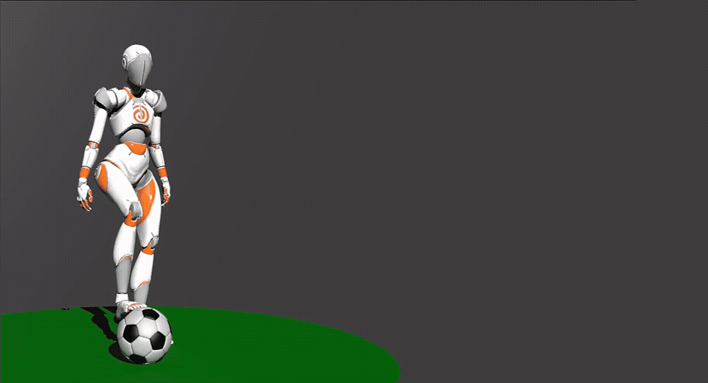
BEYOND ENVIRONMENT DRESSING
Procedural animation computes or adapts movement
Inputs can change over time
A target, contact point or terrain surface can affect the pose.
Rules adapt the motion
IK, retargeting or physical simulation can modify an authored performance.
Inputs that change over time can drive a changing pose.
Notes:
READ ALOUD
Procedural thinking also applies to movement. A foot-placement rule can adapt a pose to the ground. Retargeting can adapt an animation to a different character structure. Physical simulation can compute motion from forces and constraints. This SideFX Dynamic Motion example shows procedural motion tools; it does not mean every frame of every animation must be generated from scratch.
SOURCES
https://www.sidefx.com/products/whats-new-in-h20/animation/
VISUAL REFERENCE
SideFX Houdini 20 Dynamic Motion example. Optional final-project inspiration.

Slide 38
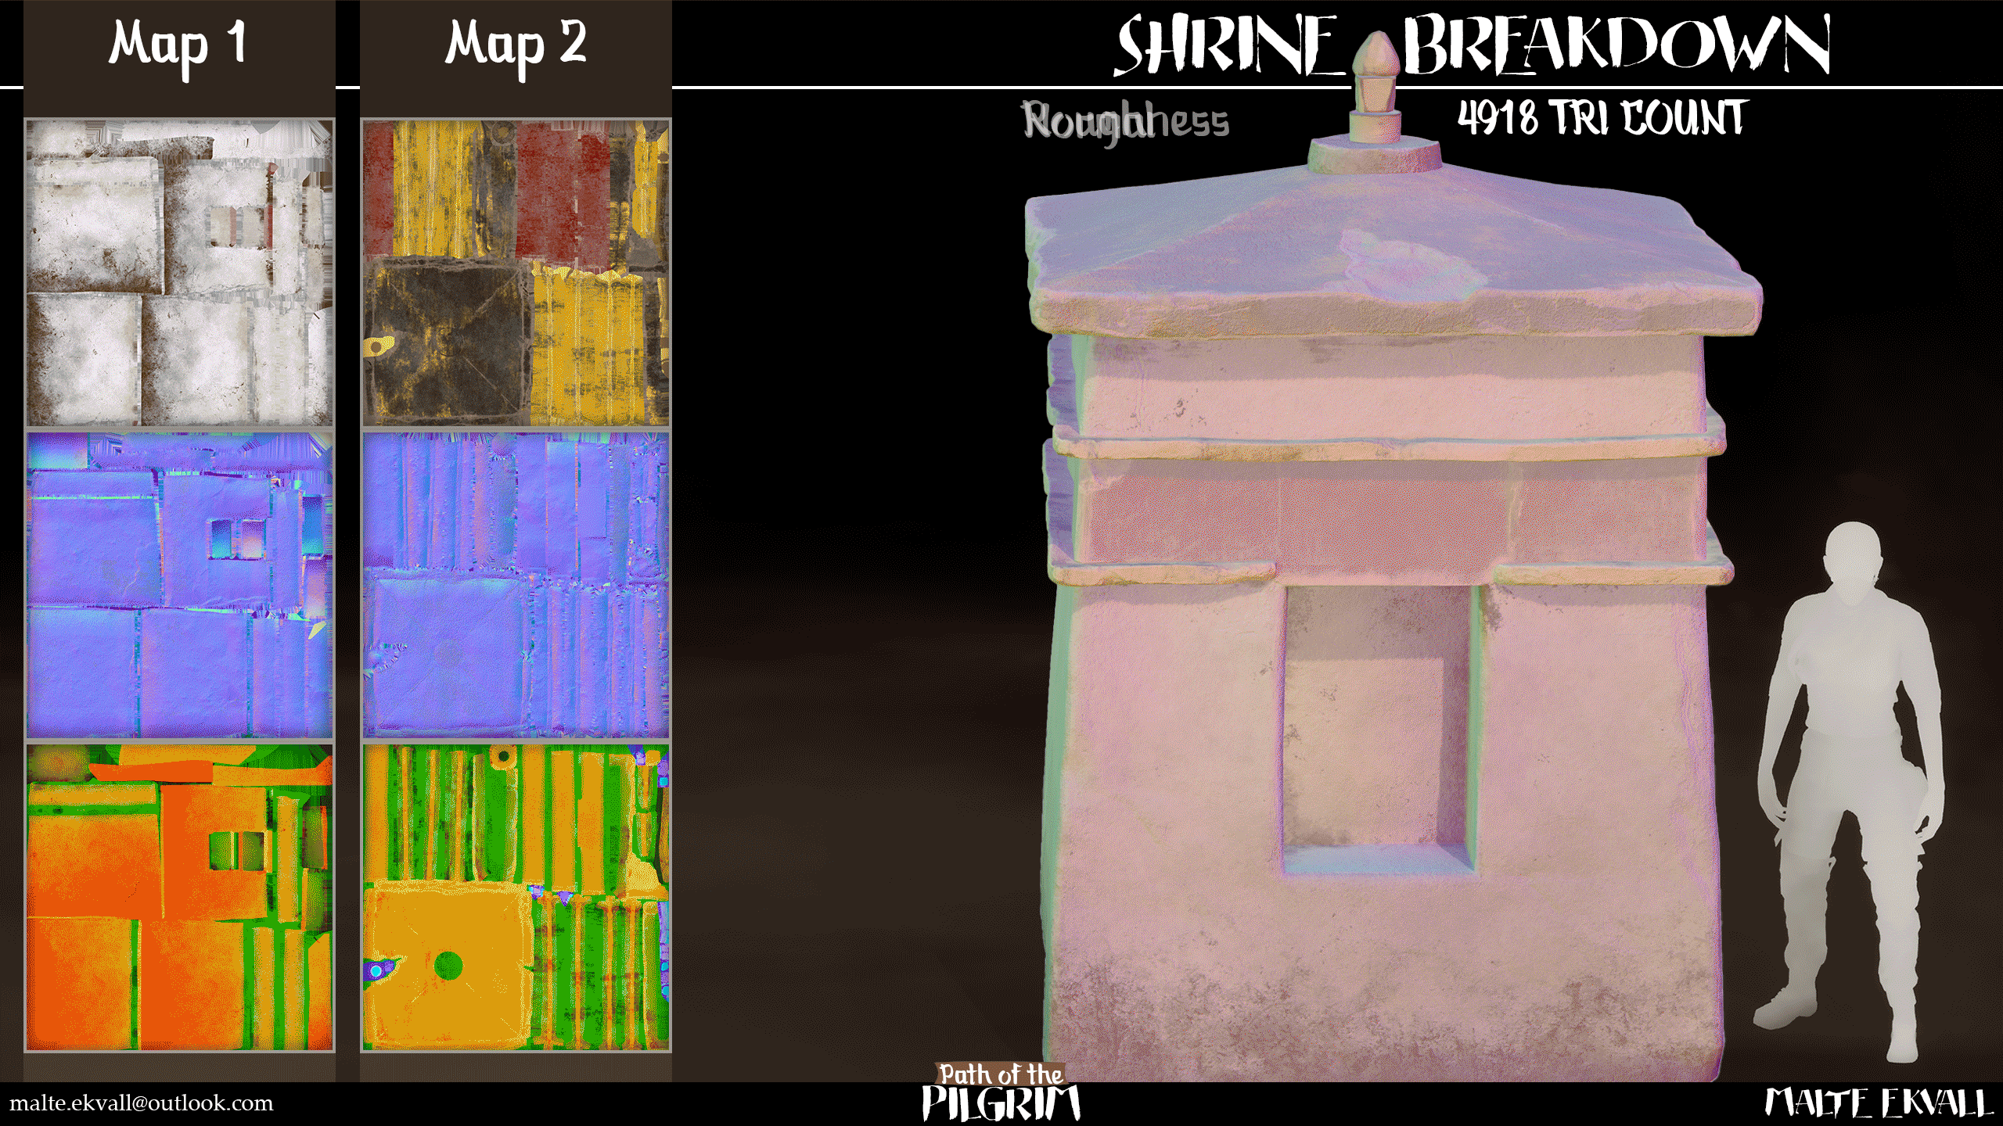
BEYOND ENVIRONMENT DRESSING
Procedural modeling must also handle surfaces
Geometry
Generate useful shape, topology and normals.
UVs
Define how textures map onto the generated shape.
Materials
Assign surfaces and control texture scale and repetition.
Export
Check scale, pivots, collision and the receiving engine.
UV mapping and material assignment must remain valid as geometry changes.
Notes:
READ ALOUD
A procedural mesh is not finished when its geometry looks right in one view. UVs, material assignments and texture scale need to survive changes in dimensions. Normals, pivots and collision also affect whether another artist can use the output. The image is a separate surface-breakdown example, not evidence that this asset was procedurally modeled or made in Houdini.
VISUAL REFERENCE
Surface example: Malte Ekvall, Path of the Pilgrim. Tool-independent asset considerations.
CLASS CONNECTION
Our building repeats existing modules and reuses their authored UVs. A tool that creates or deforms geometry must also decide how its texture mapping should respond.

Slide 39
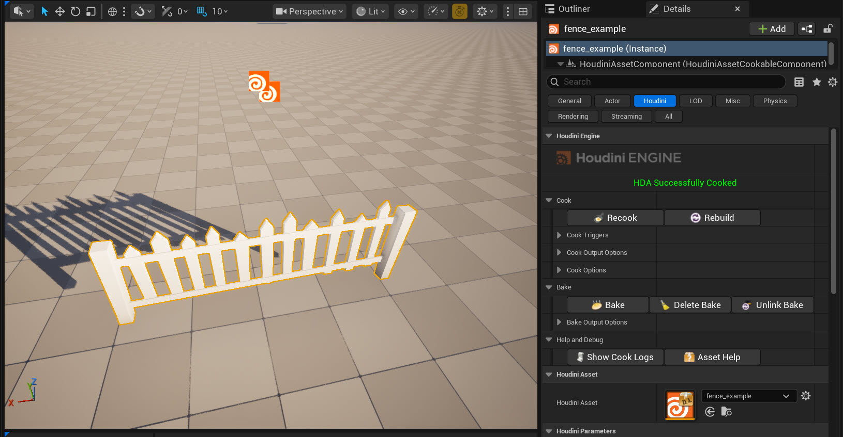
HOUDINI ENGINE
An HDA exposes a Houdini tool inside Unreal
Cook
Recalculate the tool after changing an input or parameter.
Bake
Keep a native Unreal result that is independent of the live HDA.
Houdini Engine reference: a fence HDA in Unreal.
Notes:
READ ALOUD
A Houdini Digital Asset packages a tool for reuse. Houdini Engine connects that tool to Unreal and exposes its intended inputs and parameters. Cooking requires a compatible plugin, HDA and license. Baking can turn suitable outputs into native Unreal assets. Our isolated local test creates an Engine session but currently reports No License Found when cooking. Use the official example here unless the licensed cook has been retested. The main PCG kit has no Houdini dependency.
SOURCES
https://www.sidefx.com/docs/houdini/unreal/intro.html
REFERENCE STATUS
This picture is the official SideFX example, not a local cook. Our isolated test reached an Engine session but failed to cook with No License Found. Explain inputs, promoted controls, cooking and baking; use this reference unless licensing is verified before class.
VISUAL REFERENCE
SideFX official fence HDA example in Unreal. Optional showcase; not required by the student kit.

Slide 40
DEVELOPER CONTROL
AI inputs still need explicit rules and review
Proposed input
Procedural rules
Review
Concept, asset or parameter suggestion
Dimensions, allowed regions and budgets
Test the result and keep the artist’s approval
Rules make constraints explicit; review determines whether the result is useful.
Notes:
READ ALOUD
AI and procedural tools can work together, but they offer different kinds of control. We can inspect a rule that reserves a path or limits a count, and test whether its output satisfies the requirement. AI suggestions may provide an input or propose alternatives. The developer still defines the contract and validates the result. Neither an AI label nor a procedural graph guarantees correctness, determinism or good art direction.
VISUAL REFERENCE
Proposed workflow, not an implemented feature of the class project.

Slide 41
DUE AT THE END OF NEXT WEEK
FINAL PROJECT CHECK-IN
Due at the end of next week
Show the current project
Demonstrate what is working and describe the intended player or artist experience.
Name the next useful improvement
Identify the biggest unresolved issue and what you will test next.
Show the work itself: a running tool, playable scene or current asset.
Notes:
READ ALOUD
The final project check-in is due at the end of next week. Refer to the established assignment for its requirements. Today’s procedural examples are optional inspiration, not new grading criteria. Ask students to show their current result, explain its purpose and name the next improvement they can evaluate.

Slide 42



OPTIONAL PROJECT IDEAS
A small procedural feature can support your final project
Environment tool
Modular asset
Gameplay or animation
Dress an authored route while protecting its playable space.
Change dimensions while preserving UV scale and material assignment.
Assemble a small room sequence, or adapt a pose to a changing target.
Optional inspiration for the project you already intend to make.
Notes:
READ ALOUD
Choose a small feature that supports the project you already intend to make. Start with one clear input, one useful control and one observable requirement. You do not need to attempt a large biome generator or learn Houdini overnight. A narrow tool that can be revised and explained is a stronger project contribution than a broad system that is difficult to control.
ASK
What would be the smallest useful procedural feature for your existing project?

Slide 43
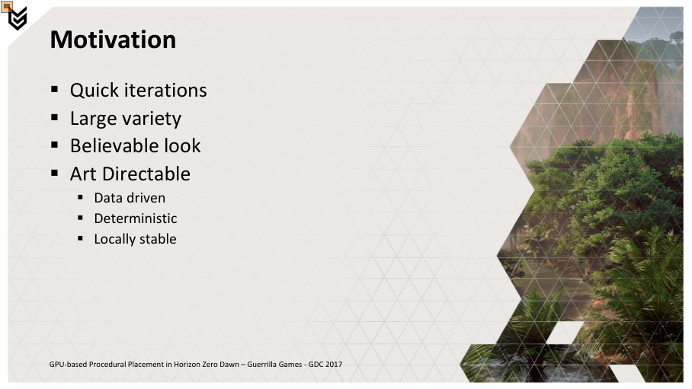
REFERENCES
Sources: Unreal and production examples
Epic Games
Unreal PCG documentation and Electric Dreams environment.
GDC: Horizon Zero Dawn
Jaap van Muijden, Guerrilla Games, 2017.
GDC: Far Cry 5
Etienne Carrier, Ubisoft, 2018.
Instructor material
Original class graphs, demo project and GOLF+ tool recording.
Full links and image credits are in the instructor notes and offline reader.
Notes:
READ ALOUD
These are the implementation and production references used in the lecture. The actual class project is an original, editable Unreal 5.7 teaching example. A production screenshot supports an explanation of that production’s system; it does not prove that our project implements the same technology.
SOURCES
https://www.unrealengine.com/electric-dreams-environment?lang=en-US
https://dev.epicgames.com/documentation/en-us/unreal-engine/procedural-content-generation-overview
https://www.guerrilla-games.com/read/gpu-based-procedural-placement-in-horizon-zero-dawn
https://www.gdcvault.com/play/1025215/Procedural-World-Generation-of-Far

Slide 44
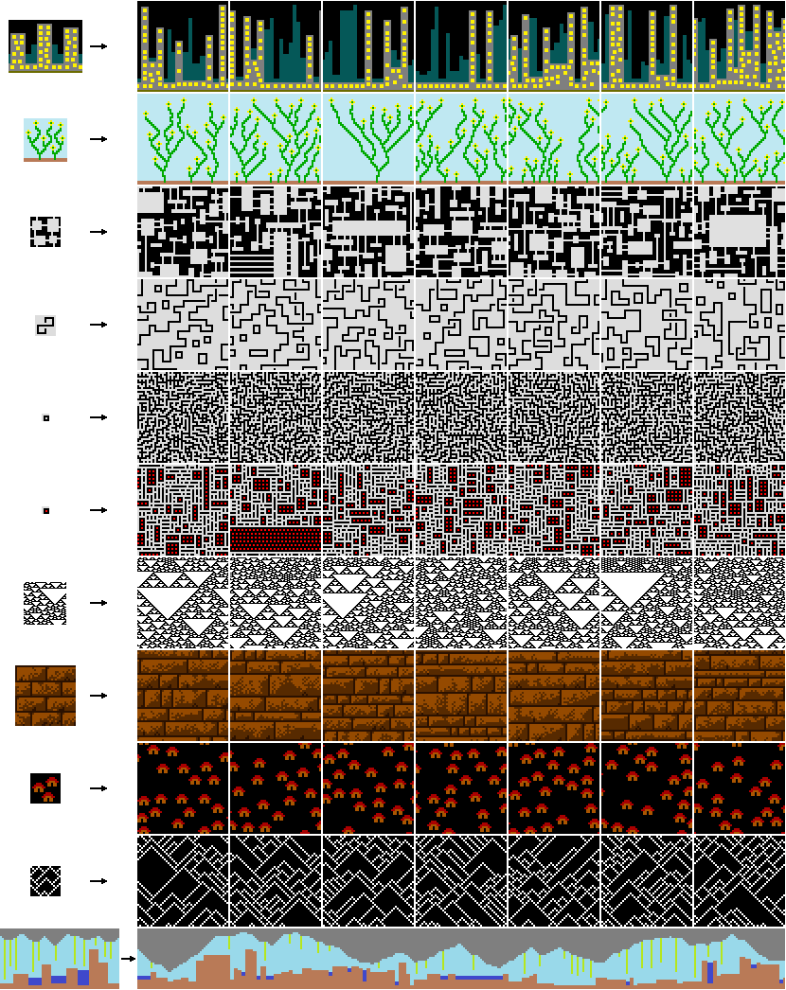
REFERENCES
Sources: methods and broader applications
Procedural methods
Shaker, Togelius and Nelson, Procedural Content Generation in Games. Maxim Gumin, WaveFunctionCollapse.
Game design
Erich Schaefer, Diablo II postmortem. Sebastien Bénard, Dead Cells hybrid level design.
Houdini
SideFX product, animation and Houdini Engine documentation.
Source studies
Ben Cloward PCG and Brandon Vox UE 5.4 course. Captures by Anthony Monteagudo.
Full links and image credits are in the instructor notes and offline reader.
Notes:
READ ALOUD
Use the linked primary references for further study. The course captures remain attributed teaching studies. Do not redistribute paid course files or describe a tutorial network as our original work. Graphic and icon provenance, image-stage notes and licensing are recorded in the preparation materials.
SOURCES
https://www.pcgbook.com/chapter01.pdf
https://github.com/mxgmn/WaveFunctionCollapse
https://www.gamedeveloper.com/design/postmortem-blizzard-s-i-diablo-ii-i-
https://www.gamedeveloper.com/design/building-the-level-design-of-a-procedurally-generated-metroidvania-a-hybrid-approach-
https://www.sidefx.com/docs/houdini/unreal/intro.html
https://www.youtube.com/@BenCloward
https://www.udemy.com/course/unreal-engine-pcg-english/
ADDITIONAL VISUAL CREDITS
Guest EVE Vanguard image: supplied Amritha Immaneni deck, CCP Games. Surface breakdown: Malte Ekvall, Path of the Pilgrim. Icons: Lucide, ISC with Feather-origin MIT notices. Original schematic sources and generated cover provenance are included with the preparation files. Paid course captures are attributed teaching excerpts; the custom-node pseudocode and class graphs are original.

Slide 45
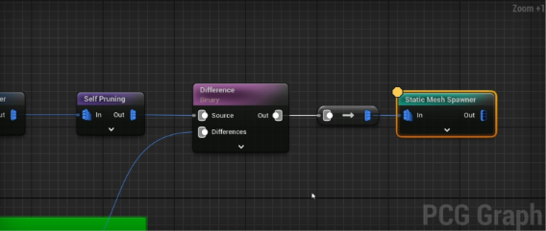
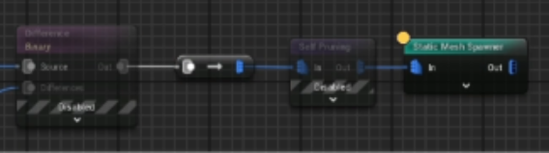
OPTIONAL DEPTH
OPTIONAL: node order changes the result
Prune, then subtract
Subtract, then prune
Rejected interior points may already have displaced nearby candidates.
Only the permitted points compete for space.
Notes:
READ ALOUD
These operations can produce different accepted subsets. If points inside an exclusion participate in pruning first, they can remove nearby points even though they are later discarded. State the intended semantics before choosing the order. The source example is UE 5.4; verify the current node settings in 5.7.

Slide 46
OPTIONAL MATH
OPTIONAL: slope is a dot-product test
normal · up = cos(slope angle)
Compare directions
Use the ground normal dotted with world up.
Interpret the value
1 is flat ground. A higher minimum accepts a narrower range of slopes.
A minimum dot product of 0.94 accepts approximately 0–20° slopes.
Notes:
READ ALOUD
For a unit surface normal and unit world-up vector, the dot product is the cosine of the angle between them. A minimum of about 0.94 corresponds to accepting slopes up to about twenty degrees. Read the surface normal after projection, before restoring upright tree rotations. This test measures orientation; it does not assess whether a whole tree footprint fits.

Slide 47
OPTIONAL PROGRAMMING
OPTIONAL: an exact count needs a different selection rule
Probability
Original quota example
KeepFraction gives each candidate a chance to survive. Final counts can vary.
Shuffle point indices with a seed.
Choose the first min(N, count).
Keep the other points separately.
Preserve the input metadata.
Quota
Shuffle a suitable point set with a seed, then choose the first min(N, count) points.
Define whether N applies per dataset or to the entire input collection.
Pseudocode only. A UE 5.7 implementation must also preserve metadata.
Notes:
READ ALOUD
The newest custom-node notes distinguish a random ratio from an exact quota. An original extension could select four camp locations from an already suitable point set. Preserve metadata when constructing the selected and discarded outputs. Define whether the quota applies per dataset or across the whole input. Test empty input, zero, N larger than the available count and downstream attribute access. UE 5.4 examples need a 5.7 data-type check before being offered as executable Blueprint instructions.
VISUAL REFERENCE
Inspired by study of Brandon Vox lessons 34–37. Original pseudocode example; not a copied course graph.

