Slide 1
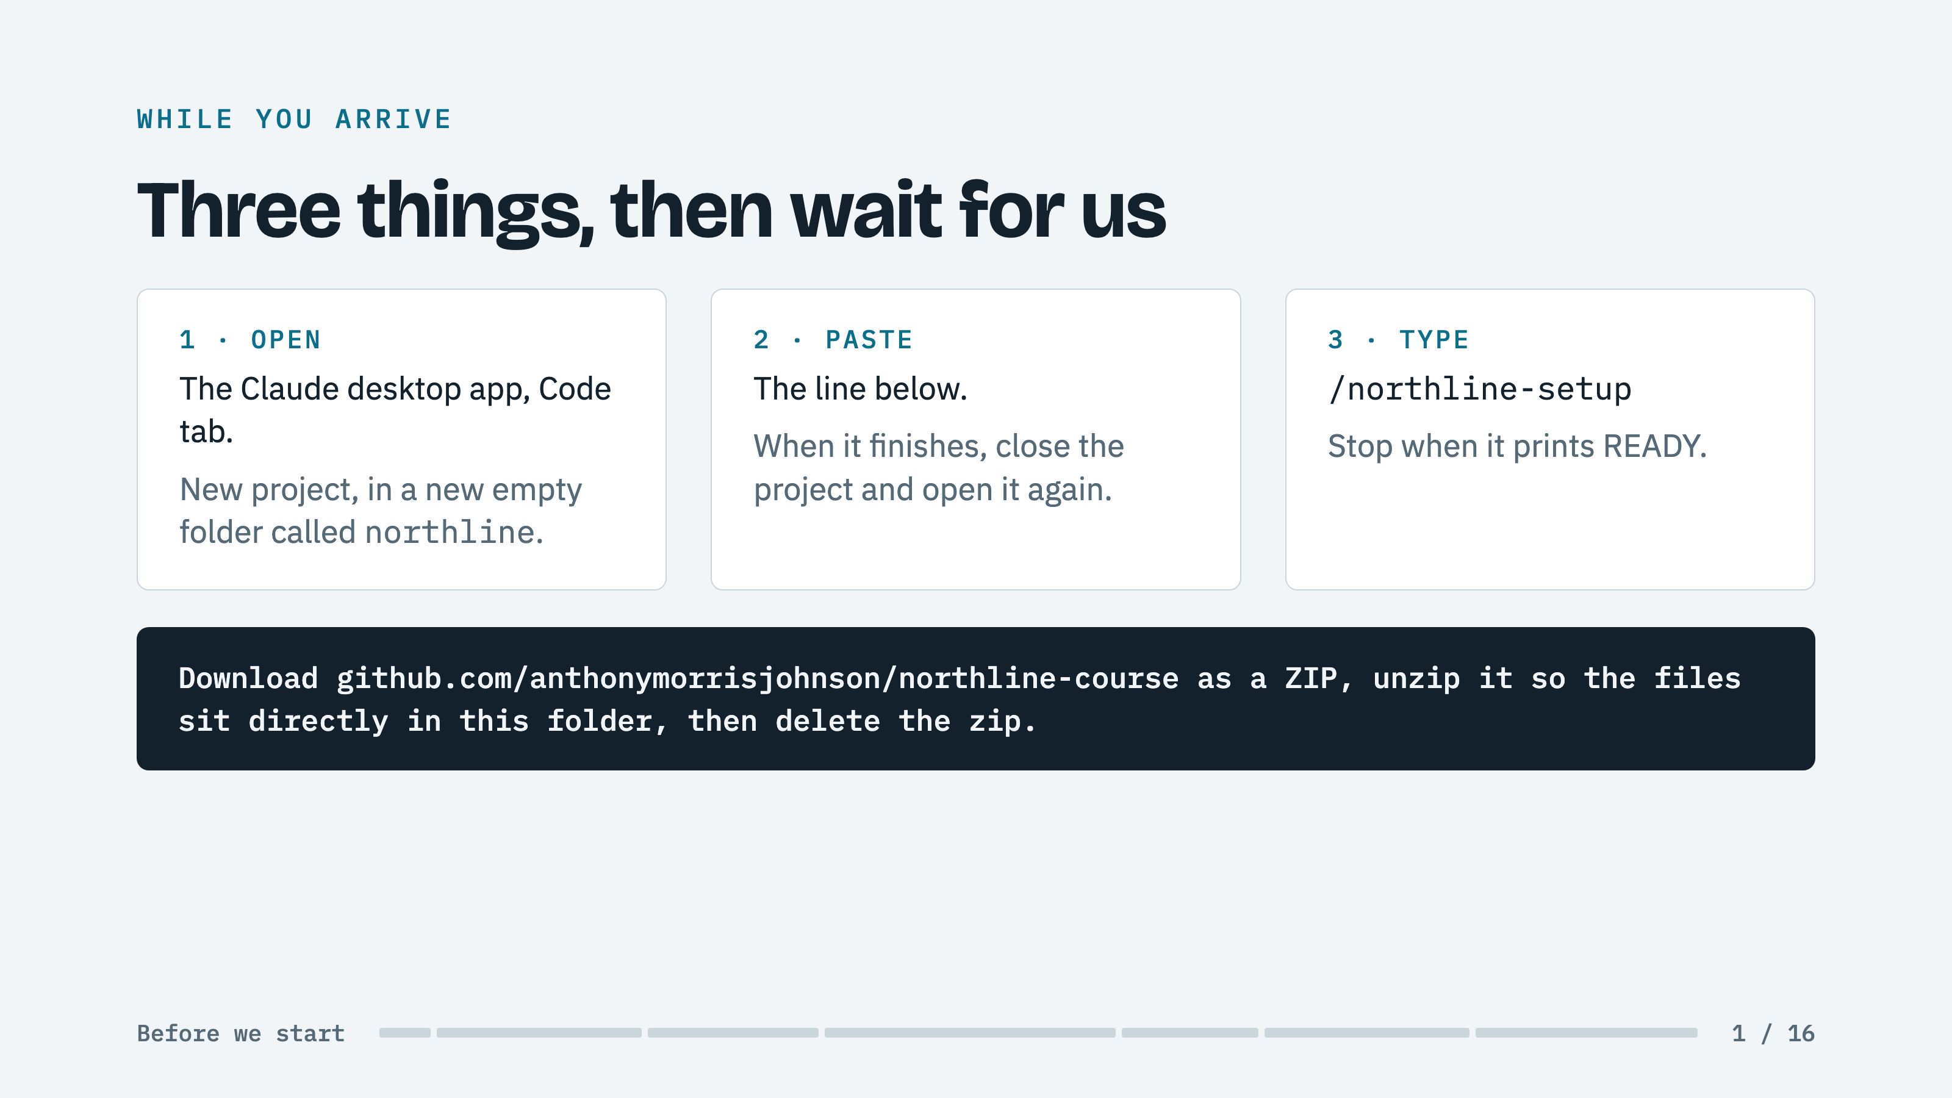
Notes:
BOTH: Do not present this slide. Point at it. Leave it up until the last READY line.
ROOM: Walk the room. Anyone stuck on step 1 is the person to help before anything else.
KNOW: Each laptop makes 40 to 70 model calls over the hour on its own Claude account. The two commands are cued from the front at minute 25.

Slide 2
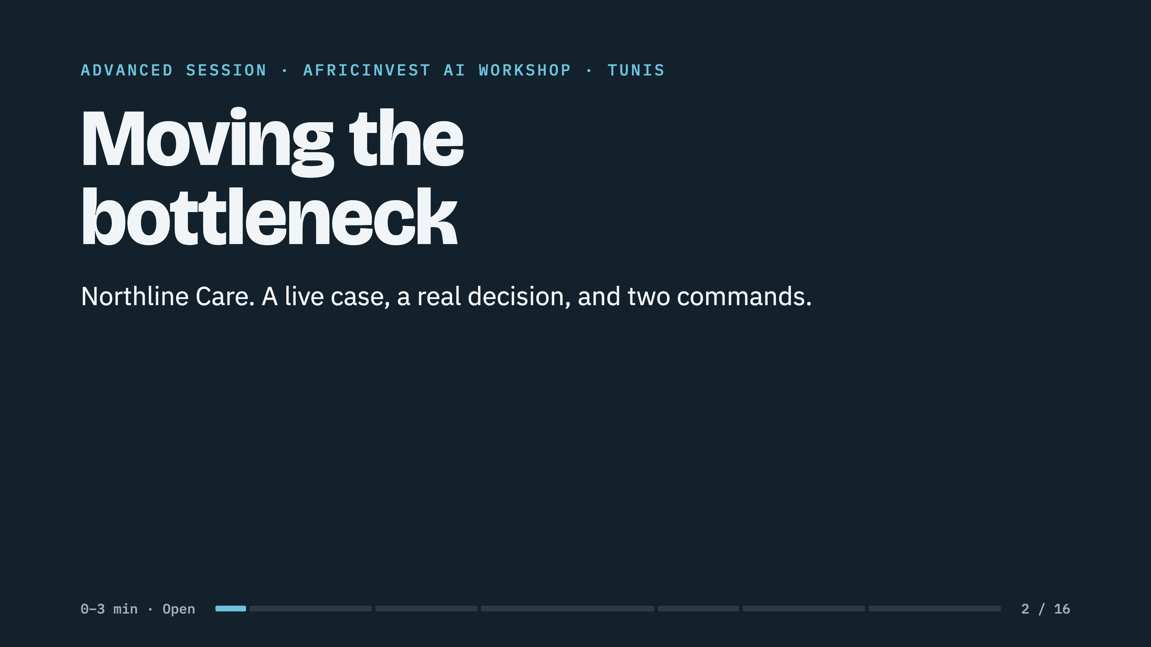
Notes:
ROOM: Welcome. Say what the next 75 minutes are: read a case in role, argue one decision, then open laptops and type two commands. Nobody writes code.
DO NOT: Name the lesson. The room has to find it.
SCREEN: Dashboard in the next tab, server running, only the check-in agent deployed.

Slide 3
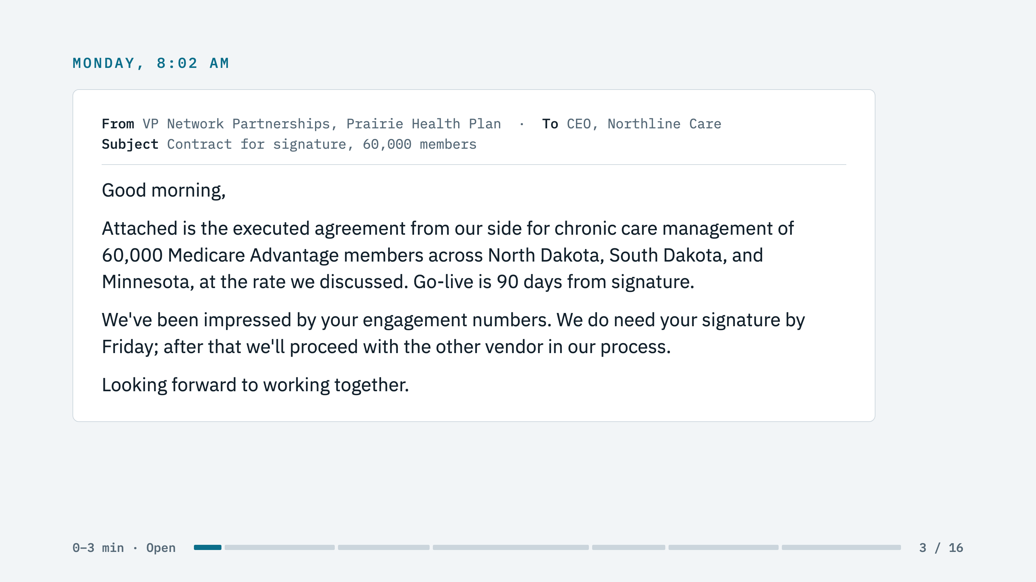
Notes:
ROOM: Read the email aloud, slowly, exactly as written.
ASK: "Hands up. Sign, sign with conditions, or decline?" Count each out loud and remember the numbers. You bring them back at the board meeting.
TIME: You should be at two minutes.

Slide 4
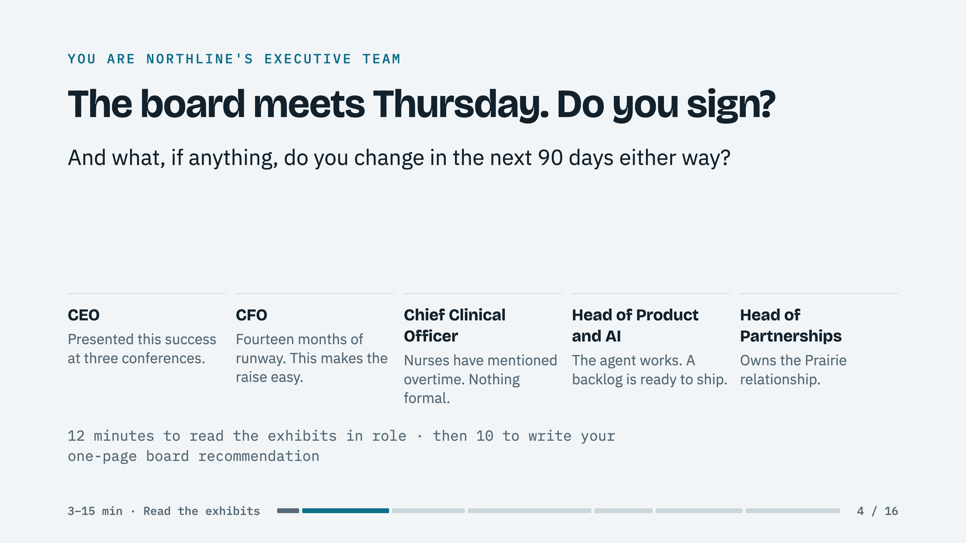
Notes:
ROOM: Teams of four or five, mixed across companies. Role cards against type: a CTO plays the clinical lead. The question is neutral on purpose.
MINUTES 3 TO 15: They read. Screen switches the projector to the dashboard; it is Exhibit B, live. Pocket memo at minute 12 to any team that has not found the problem.
MINUTES 15 TO 25: Board recommendation on paper, no laptops. Listen for line 2, "the problem the board doesn't see". Blank or generic means they missed it; note who to call on. Land: "Hold on to your recommendation. You are about to check it against the logs."

Slide 5
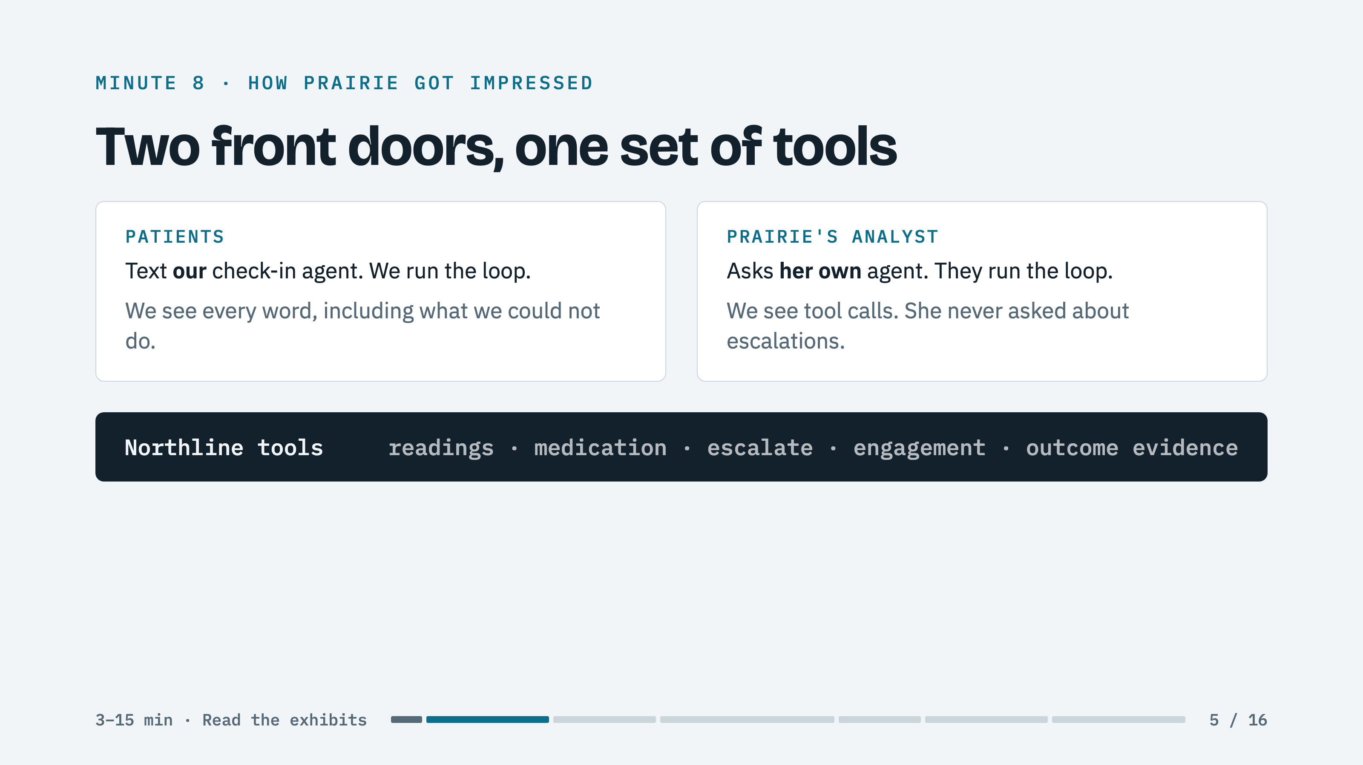
Notes:
SCREEN: Show Claude Code, not this slide, first. Type: "You are Prairie Health Plan's analyst. Using the northline tools, report engagement and outcome evidence for plan-prairie." Then come to this slide to name what they saw.
EXPECT: 78% weekly response, satisfaction 72, readings up tenfold. Use the id plan-prairie exactly. Three minutes, no more.
LAND: "That is the customer's agent, not ours. We built the tools; they run the loop. She never asked for escalations. The answer would have been 2,400 a week."

Slide 6
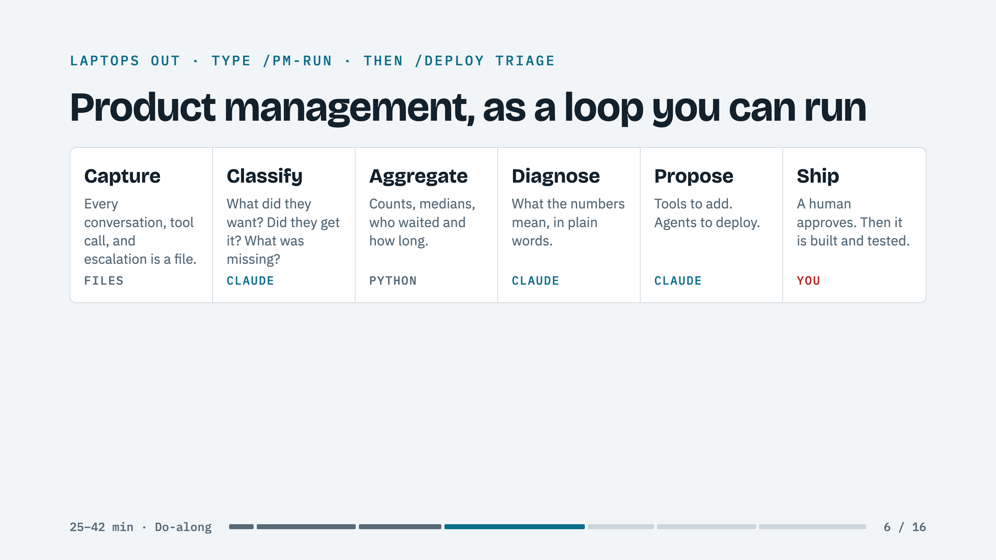
Notes:
SCREEN: Show Claude Code and type /pm-run, out loud, so the room can follow. Then put this slide up for the wait. About five minutes end to end; classification is the first two and a half.
ROOM: This wait is the best two and a half minutes you have. Talk, do not type. It is reading 160 conversations and 31,215 rows of the nurse queue. "Judgment goes to the model. Arithmetic goes to Python. You never ask a model to count."
EXAMPLE: One record: a patient reports 181 over 104, then asks for a lisinopril refill. The agent logs the reading, escalates, and says plainly it cannot do refills. The record says: intent refill, outcome escalated, unmet need yes, proposed tool request_refill. Notice where the refill went: also to a nurse.
IF A LAPTOP FALLS BEHIND: They watch the screen. Nobody debugs during this block.

Slide 7
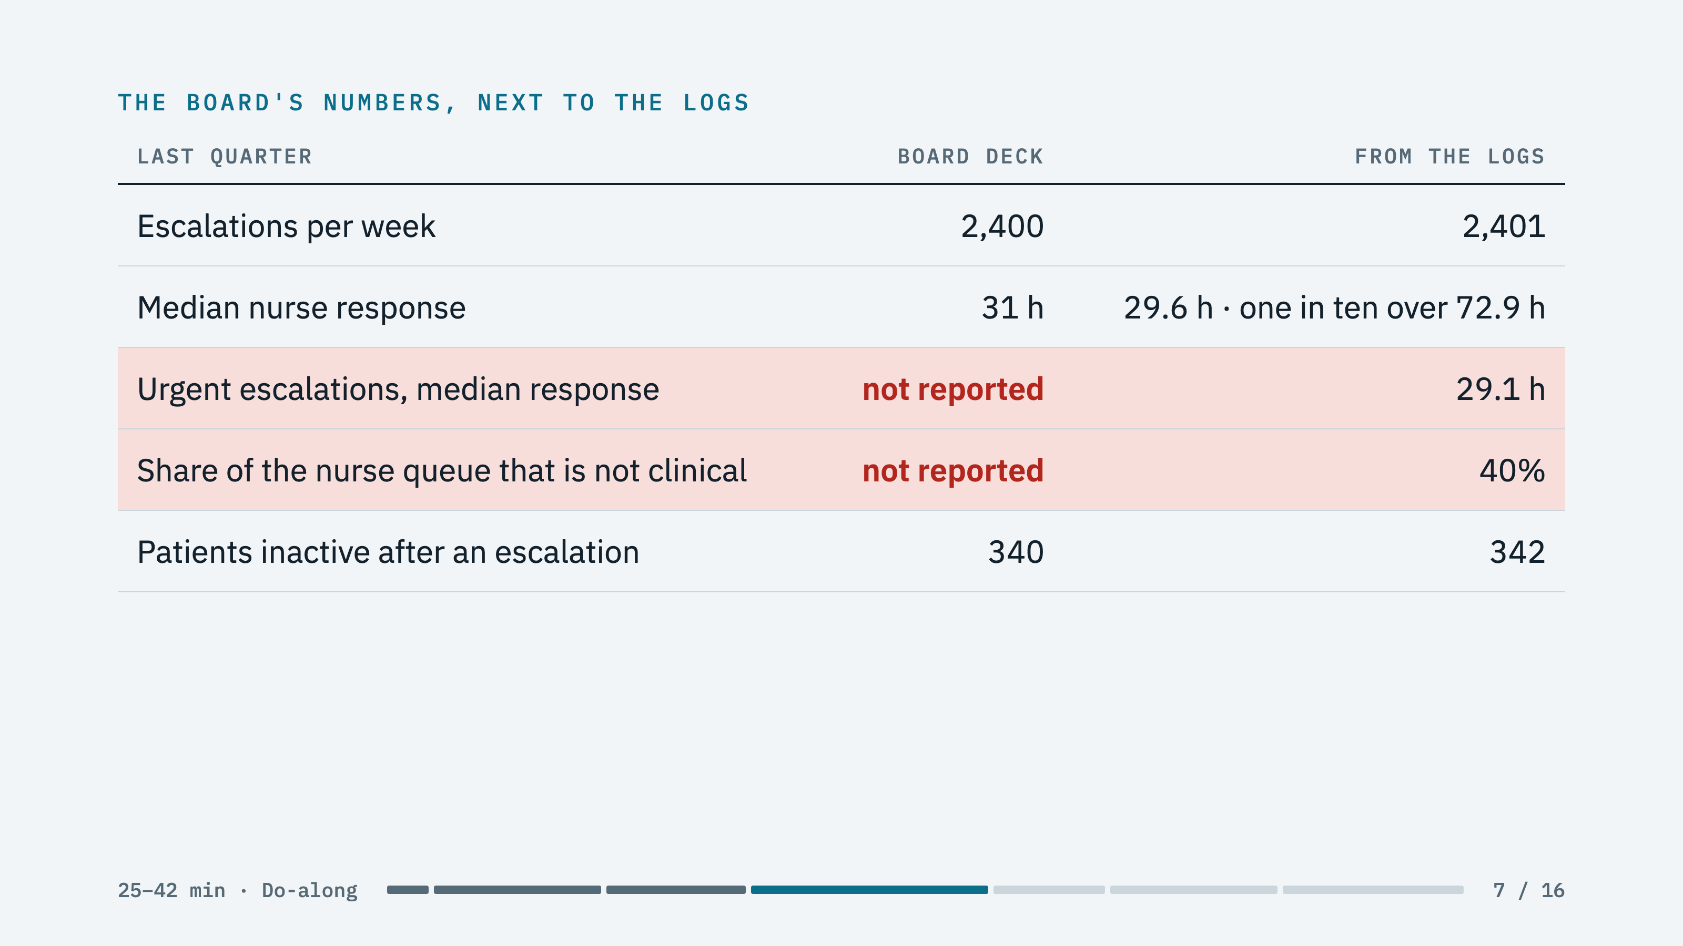
Notes:
ROOM: Read the left column first. "The board was not wrong. Every number it has is true."
THEN: The two red rows. An urgent case waits 29 hours, the same as a routine one. Four in ten things a nurse touches are not clinical at all.
DO NOT: Draw the conclusion. The next slide asks them to.

Slide 8
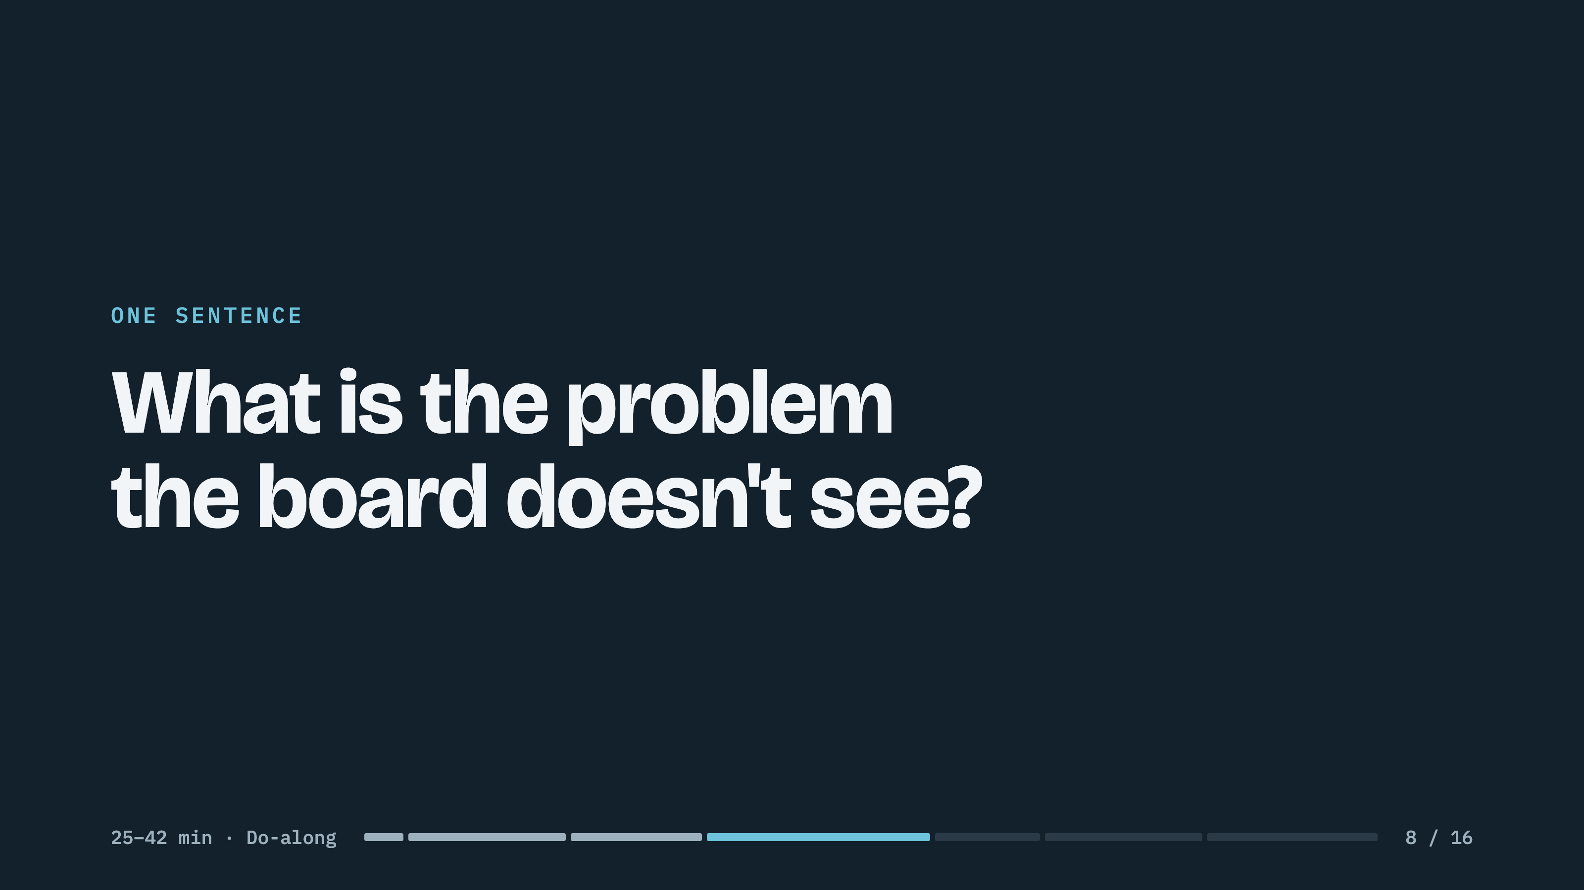
Notes:
ROOM: The tool is asking the same thing on every laptop. Take three answers from the room. Do not grade them. Call on a team whose line 2 was blank and ask what changed their mind.
SCREEN: Type the room's best answer into Claude Code and show the diagnosis it reveals. Its headline: nurses become the bottleneck at scale, and today's load is small enough to hide it.

Slide 9
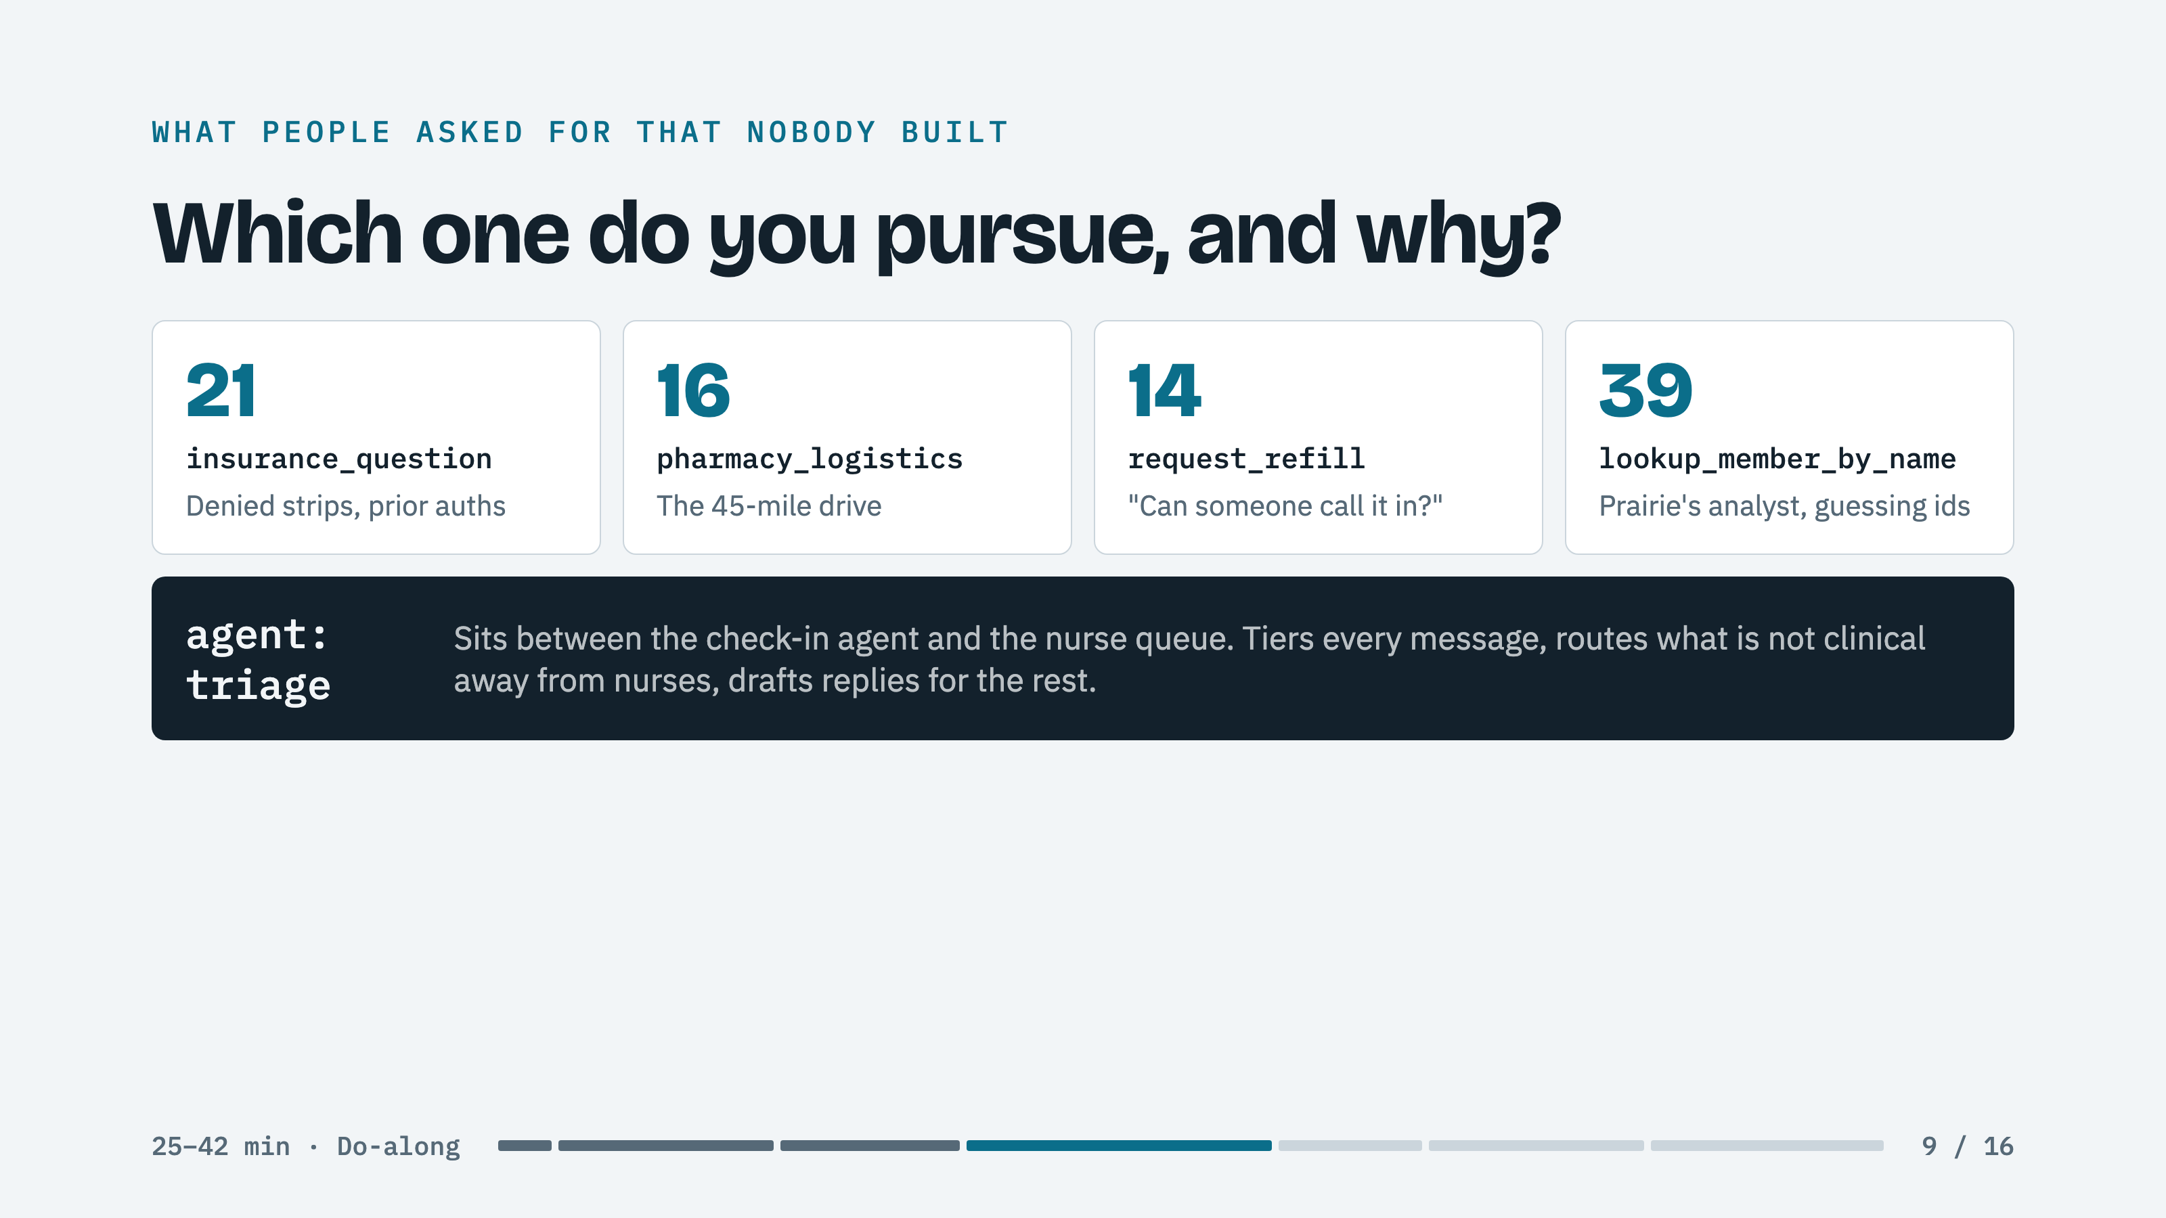
Notes:
ROOM: Ask for a vote and a reason. Steer toward triage by asking which card changes the two red rows.
IF THEY PICK A TOOL: The skill pushes back once: "Refills are 12% of conversations. Median nurse response is 30 hours. Which metric does a refill tool move?" Let it. Then accept what they say.

Slide 10
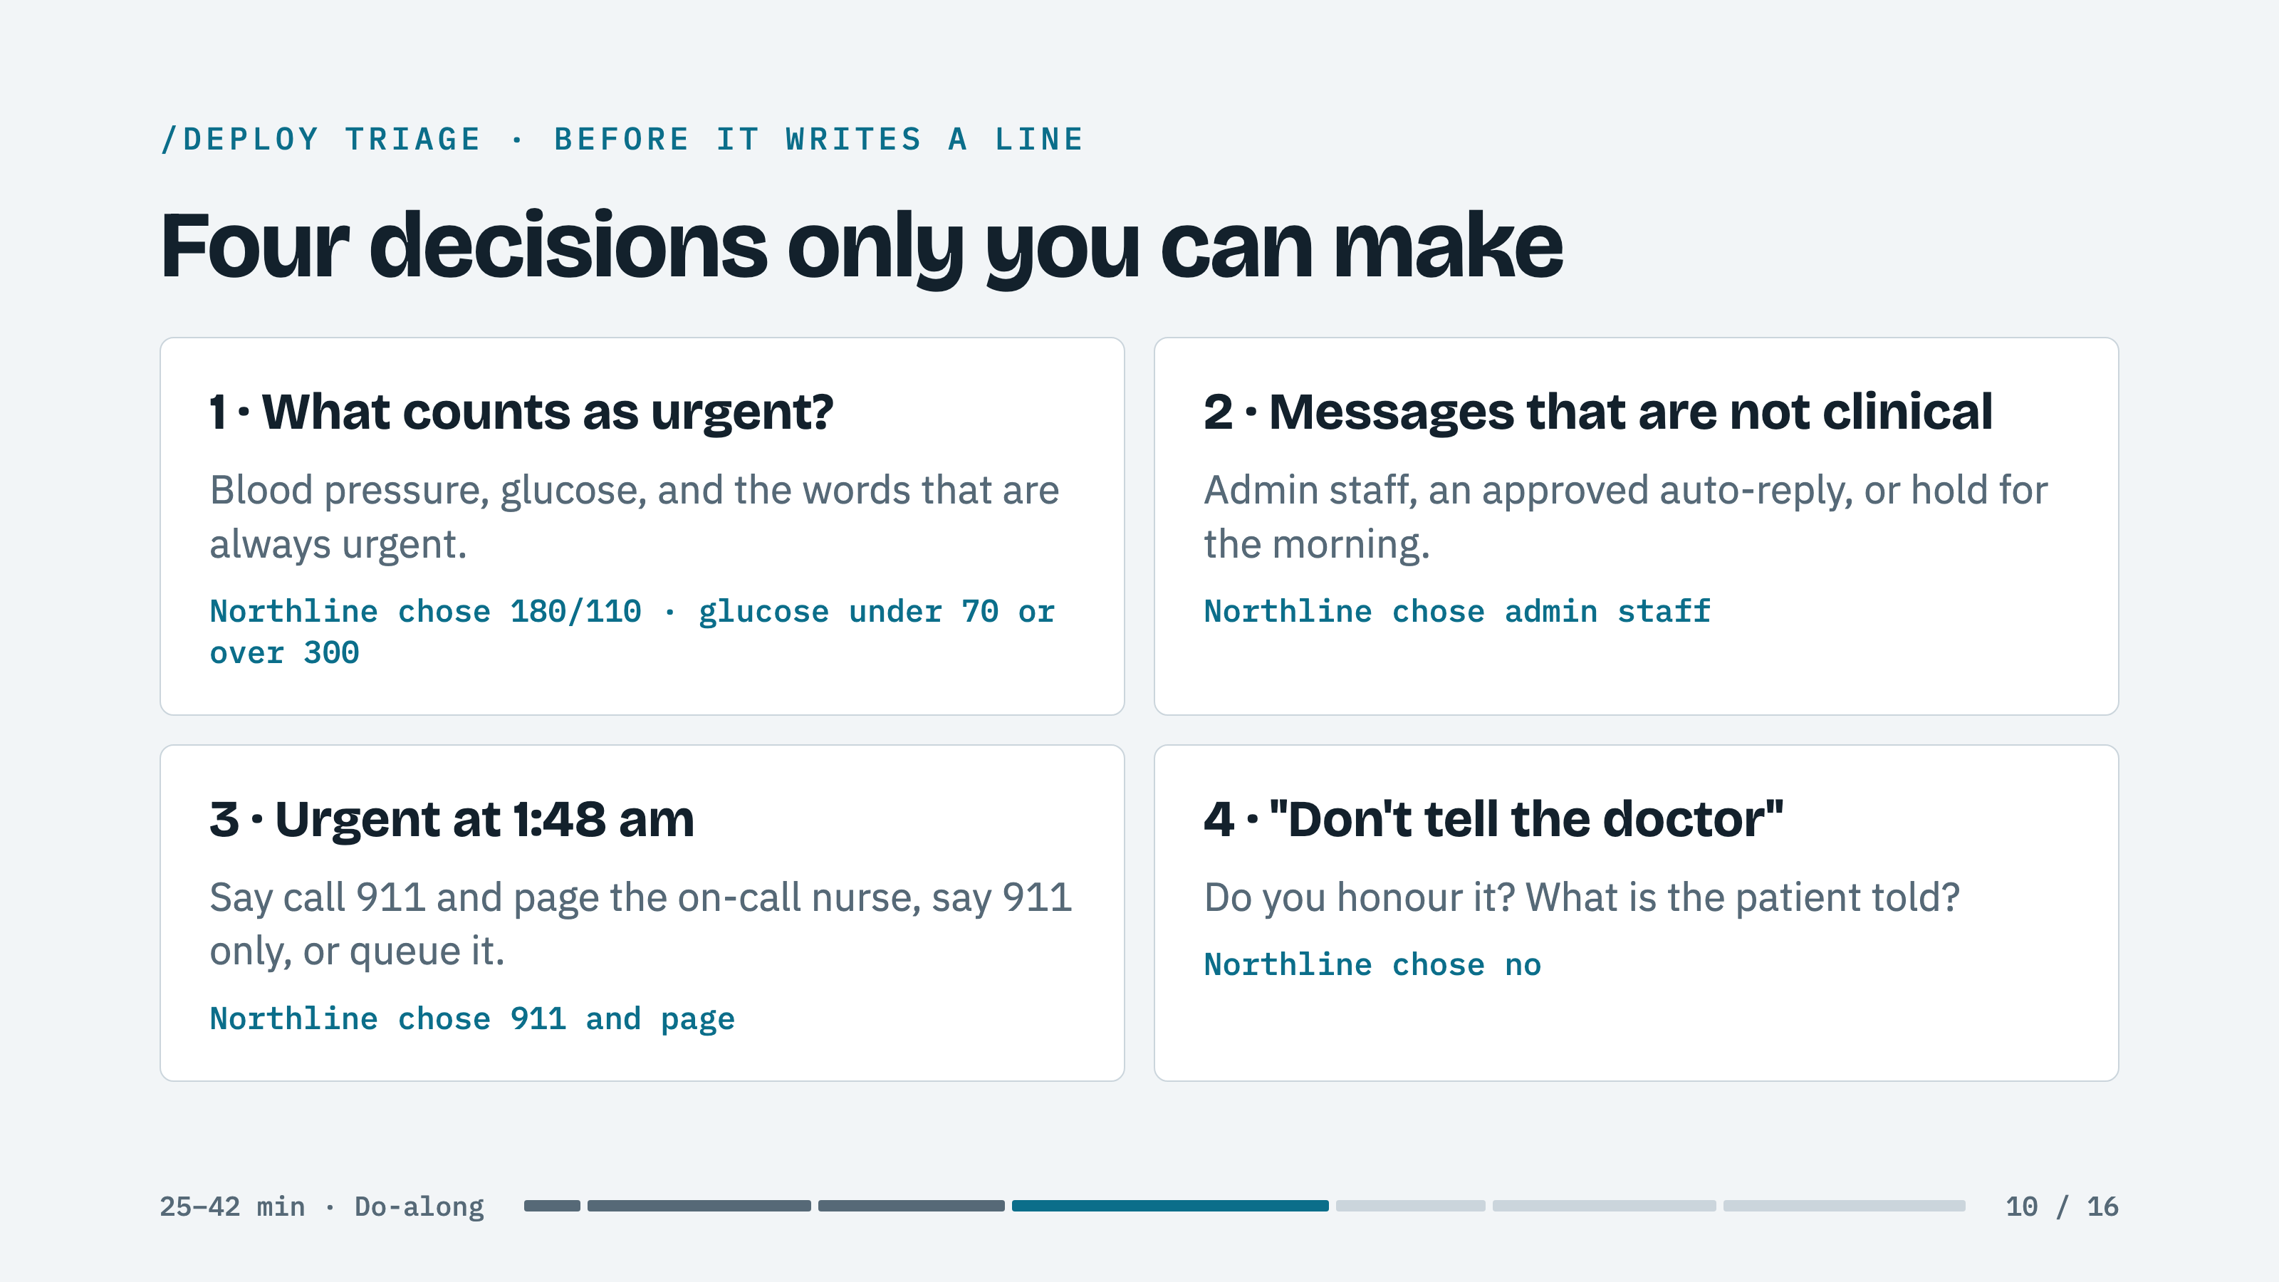
Notes:
SCREEN: Type /deploy triage in Claude Code, then bring this slide up while the room votes. Go back to Claude Code to type each answer.
ROOM: Vote each one. Do not let all four defaults pass without a hand count. Taking the default is a decision and it is recorded as one.
LINGER: On thresholds. Ask the CFO role and the clinical role to defend different numbers. Someone will argue a higher bar saves nurse time. Let them win if the room agrees.

Slide 11
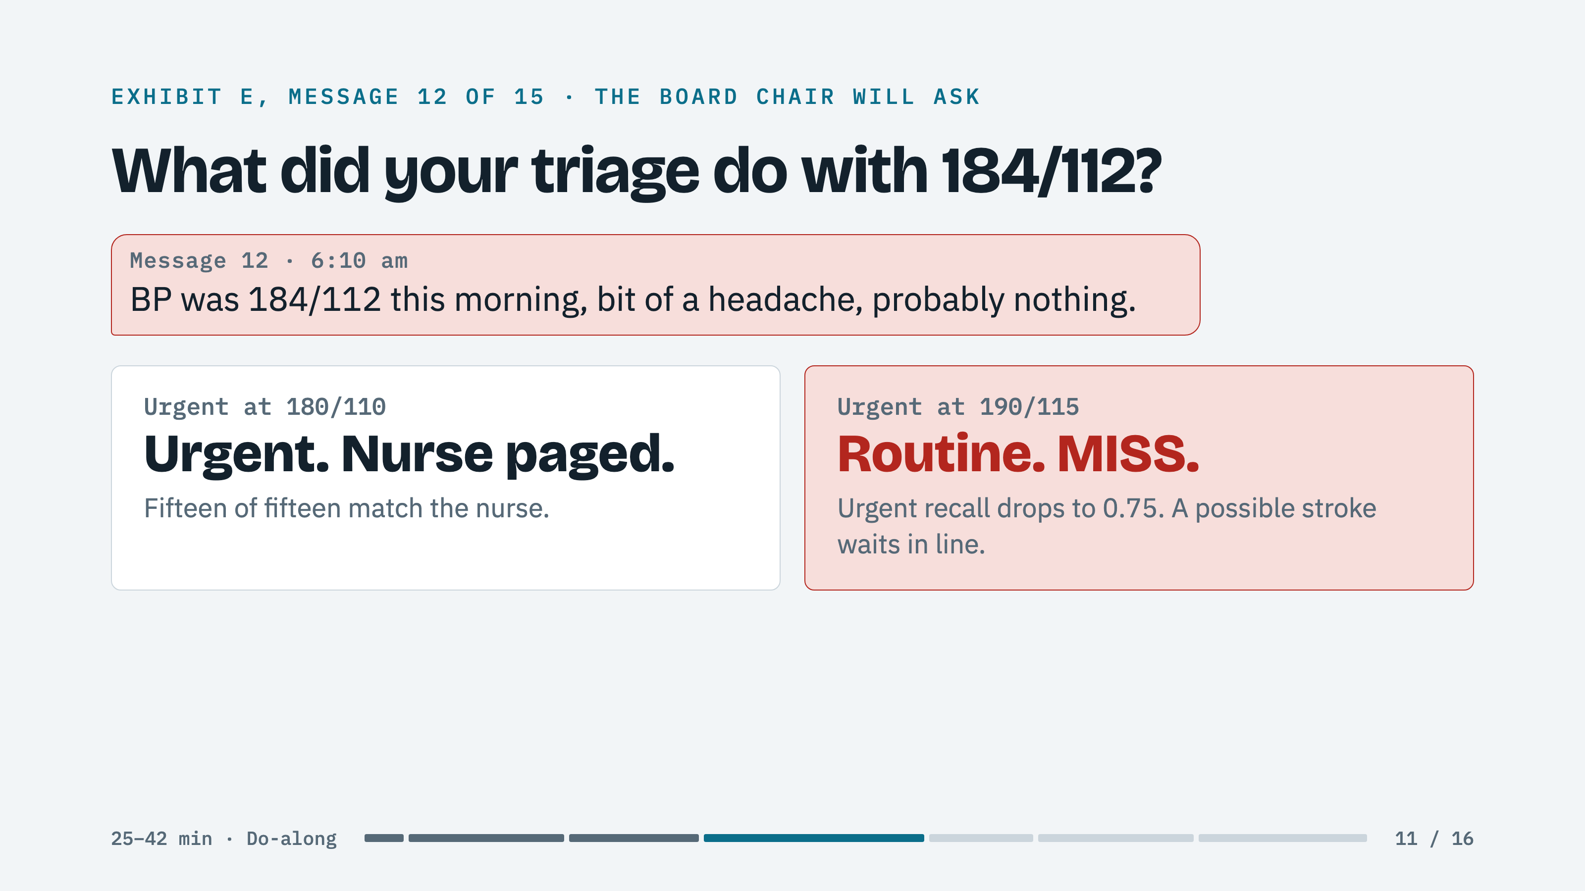
Notes:
WHILE THE TEST RUNS: About a minute. It scores the triage on the fifteen night texts in Exhibit E against a nurse's key. Ask: "Which of these scares you?" Most say 10. Wait for 12, 9, or 5. The traps are 5, 9, 12, and 13.
SCREEN: Show the table Claude Code prints. Stop and read the misses before anything else. If the room voted the defaults and nothing missed, say "a cost-minded team might raise the bar to 190/115" and re-test once. Then this slide.
ASK: "You just made a clinical decision with a parameter. Who signs off on that number in your company?"
THEN THE DASHBOARD: In this order: the urgent-cases-missed tile, the nurse response line after week 40, then Sign Prairie, without and then with. At the defaults: next quarter falls from about 84 hours to about 4; under Prairie about 42 hours instead of the two-week cap with 19 nurses left. You should be at minute 42.

Slide 12
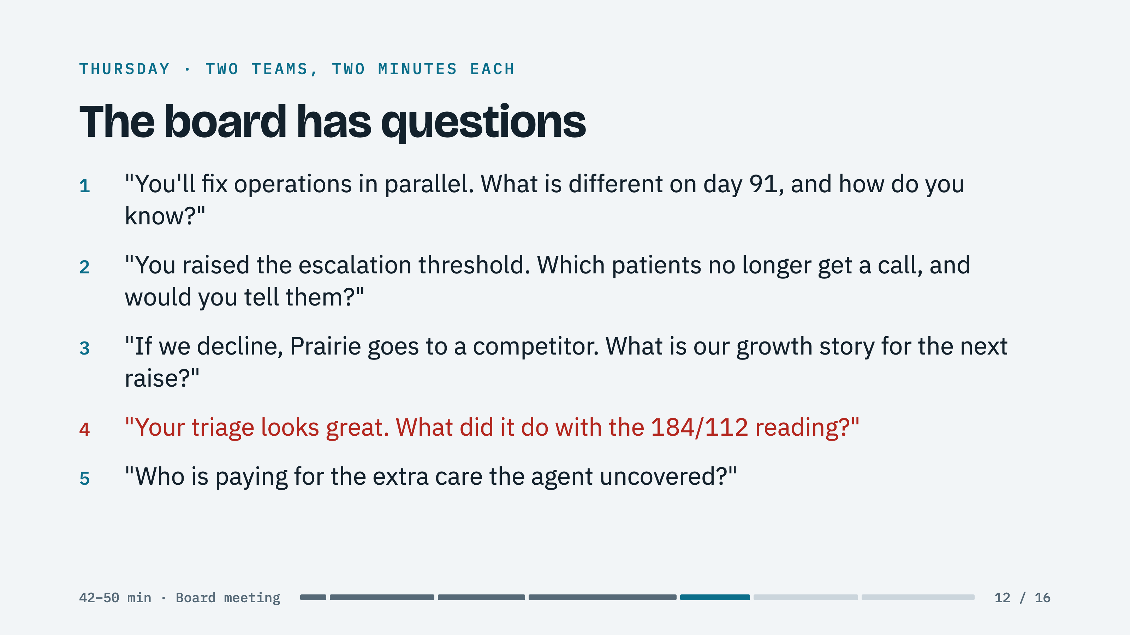
Notes:
ROOM: You are the board chair. Pick one team that caught the bottleneck and one that did not. One question per click.
SCREEN: Between questions, put the presenting team's Sign Prairie projection on the dashboard.
BRING BACK: The hand count from minute two. "Eleven of you said sign. How many still would, unchanged?"

Slide 13
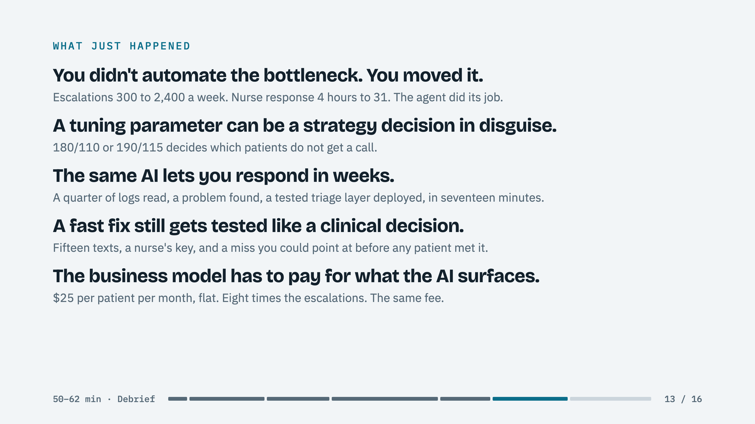
Notes:
ROOM: Now you may name it. One line per click, and a beat on each. Nothing on the board deck was false. It was the wrong half of the system.
ON LINE 2: Call back to whoever argued for the higher bar. It was a reasonable cost argument. That is the point.
ON LINE 5: Name the teams that proposed renegotiating with Prairie. docs/04-operating.md has the fee argument.

Slide 14
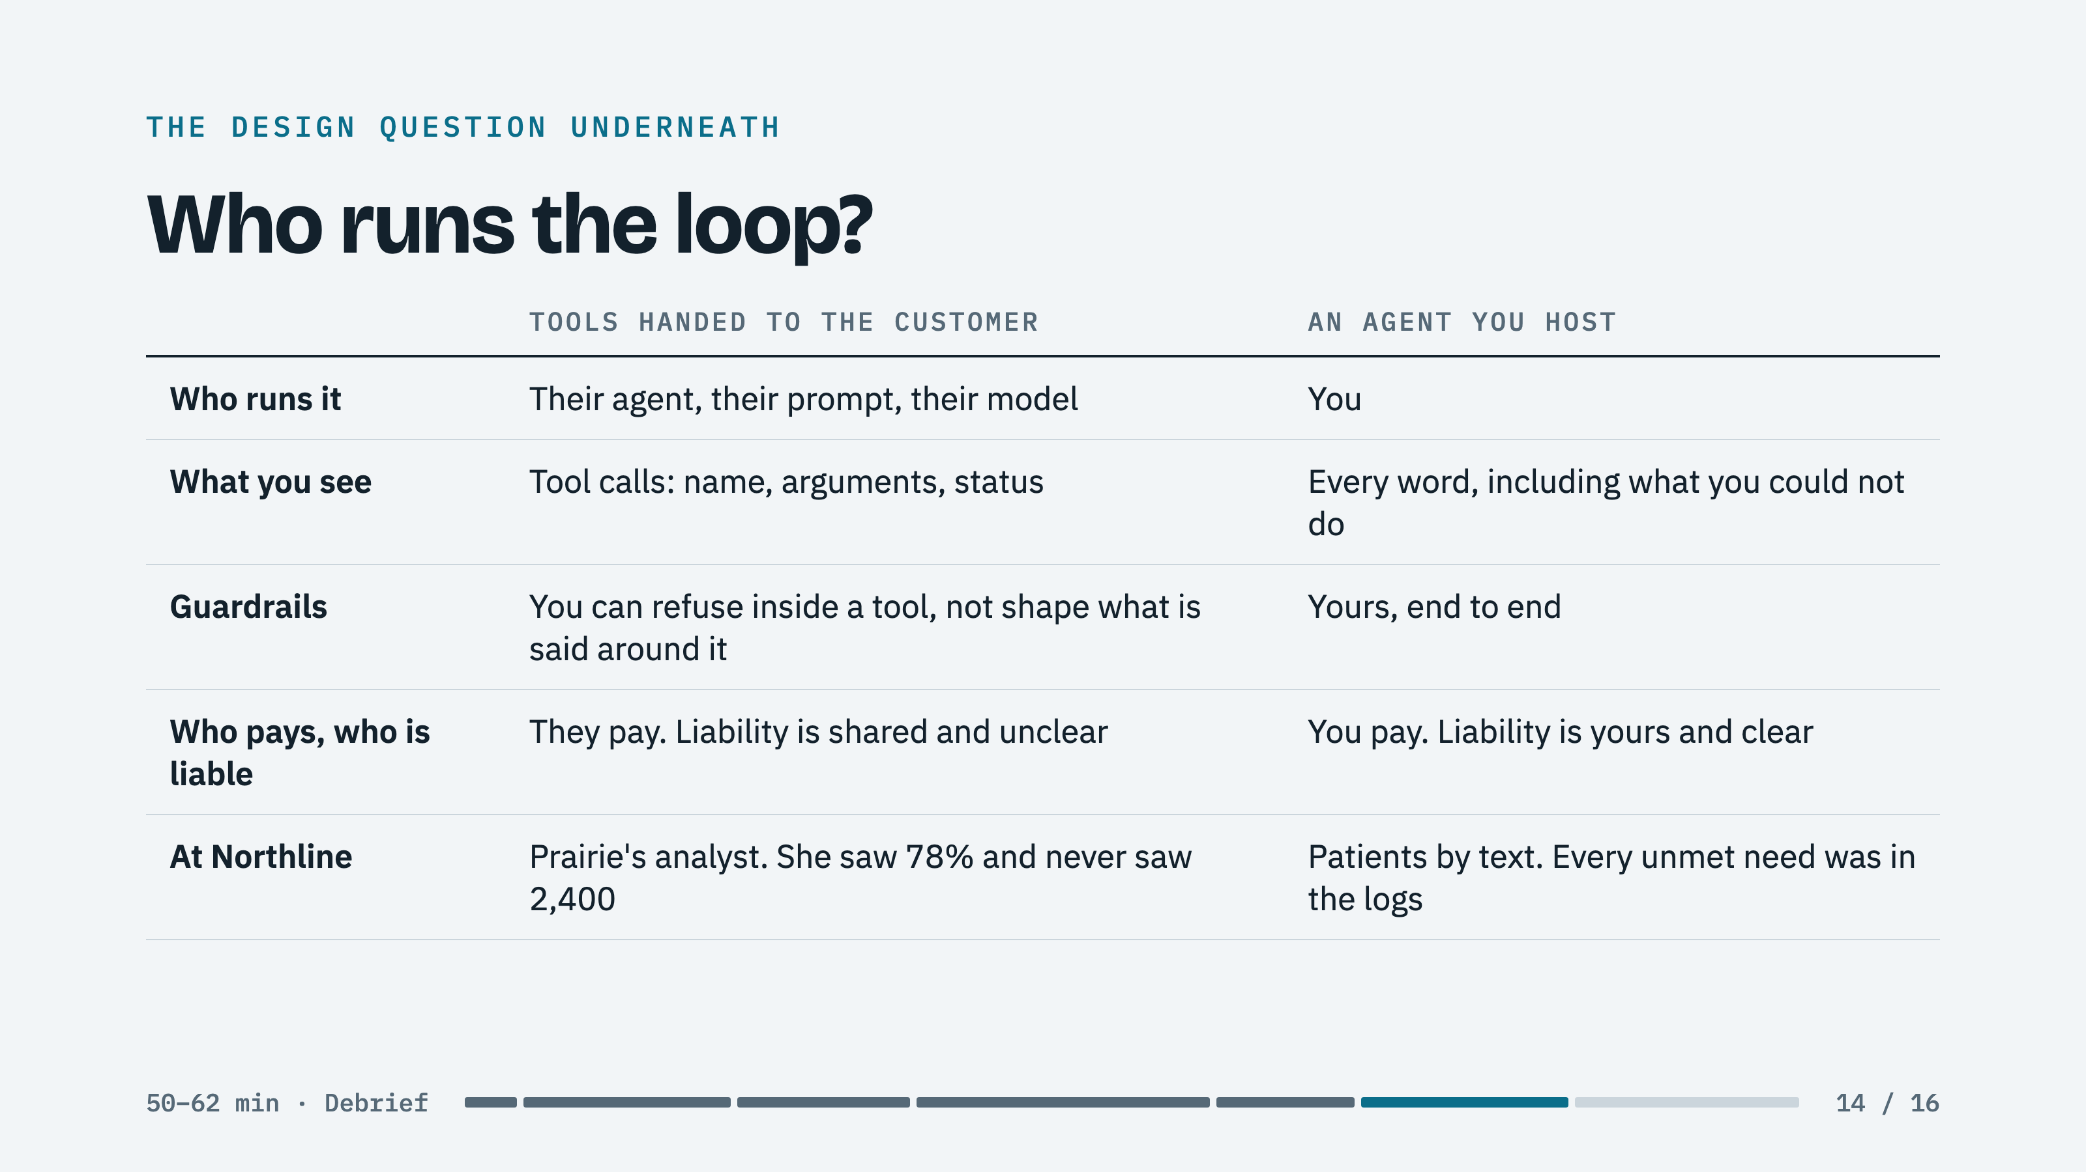
Notes:
ROOM: The tools were the same. Who ran the loop decided who could see the problem.
SAY: "Most of you will do both. Build the tools once. Decide per customer who runs the loop, and know what you stop seeing when it is not you."

Slide 15

Notes:
ROOM: Go around the room. One sentence each. The US setting kept the case neutral; this question makes it theirs.
PROMPT: "When your AI works, whose queue grows? Who is watching that number this week?"

Slide 16
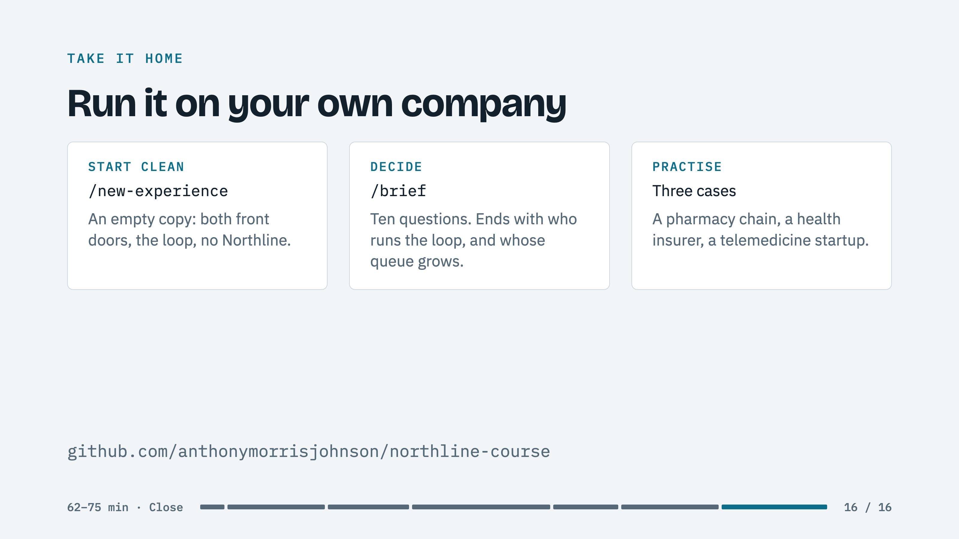
Notes:
ROOM: Everything they used today is in their folder. A new experience has no corpus on purpose: the loop runs on their first real conversations.
IF THERE IS TIME, CASE ONE IN A SENTENCE: "Build versus buy is a go-to-market question. Good enough to sell in one country may not be good enough in another, so sequence your markets around what your product can credibly meet."
CLOSE: "The agent worked. The operating model around it did not, and that was a decision, not a fact about the technology."

