Slide 1
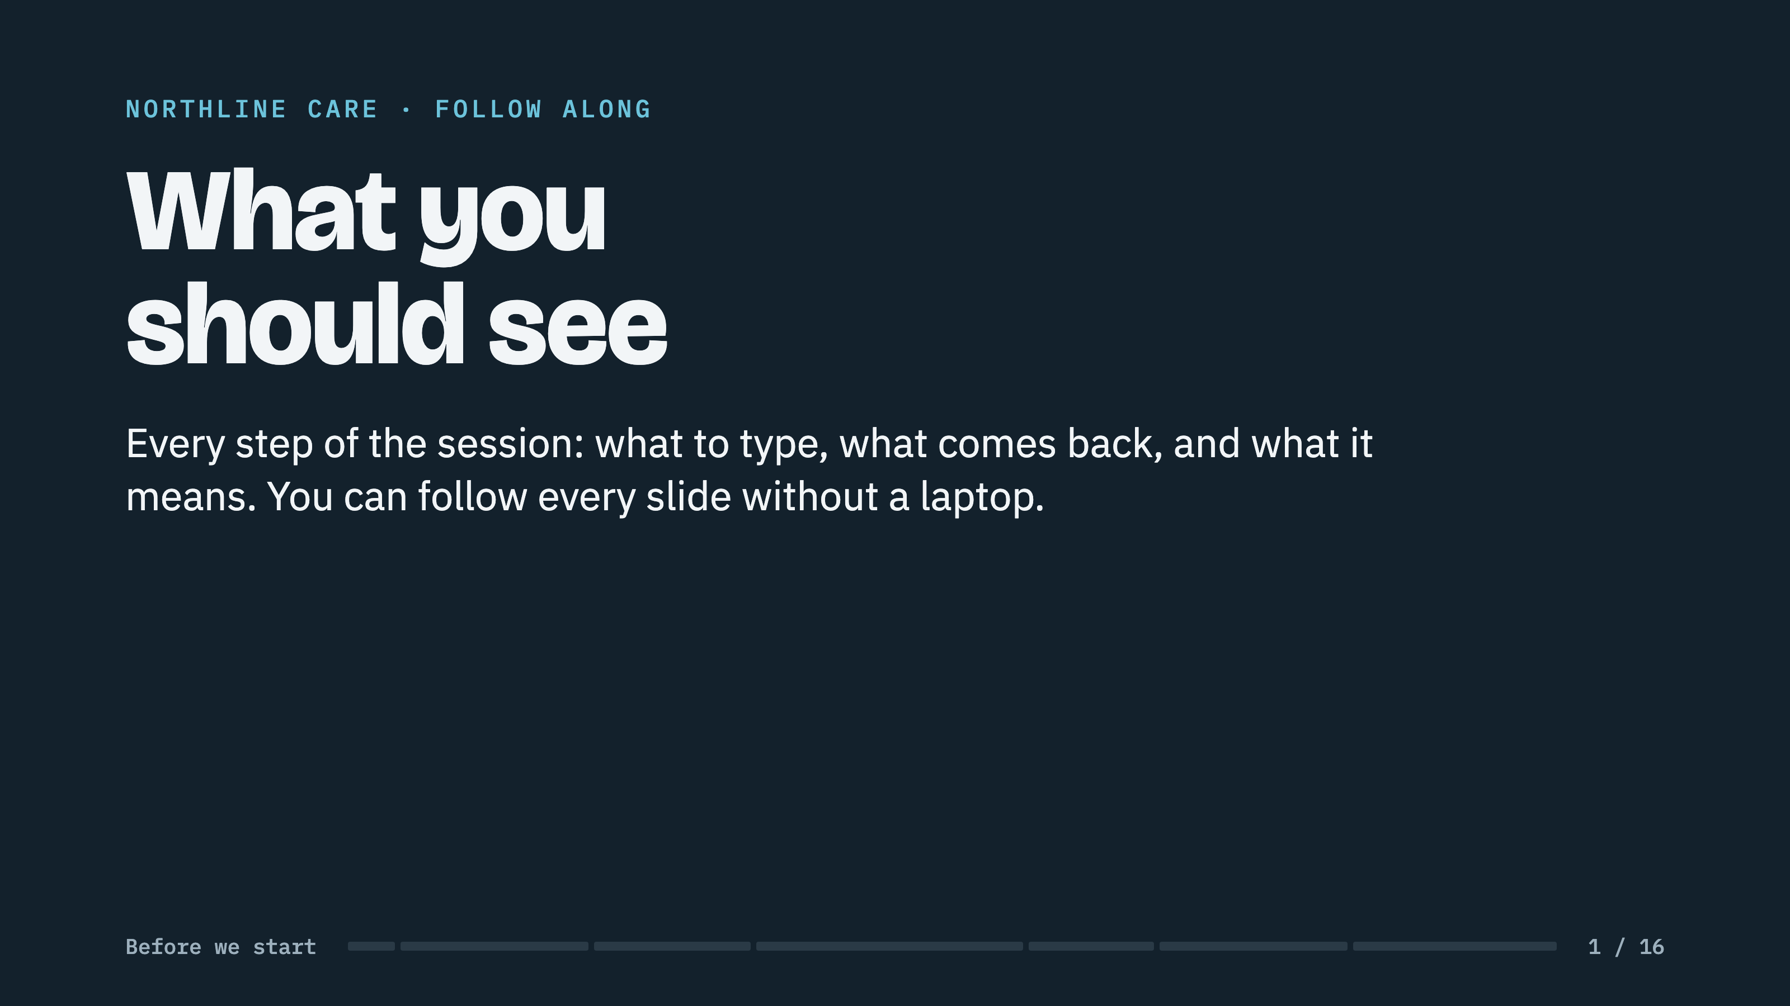
Notes:
USE: Three ways. On the projector during the do-along instead of switching windows. As a handout for anyone without a laptop. As the fallback if the wifi dies: every capture here is real.
KNOW: Attendees' own screens will differ in wording, because Claude phrases things its own way each time. The tables and numbers will match.

Slide 2
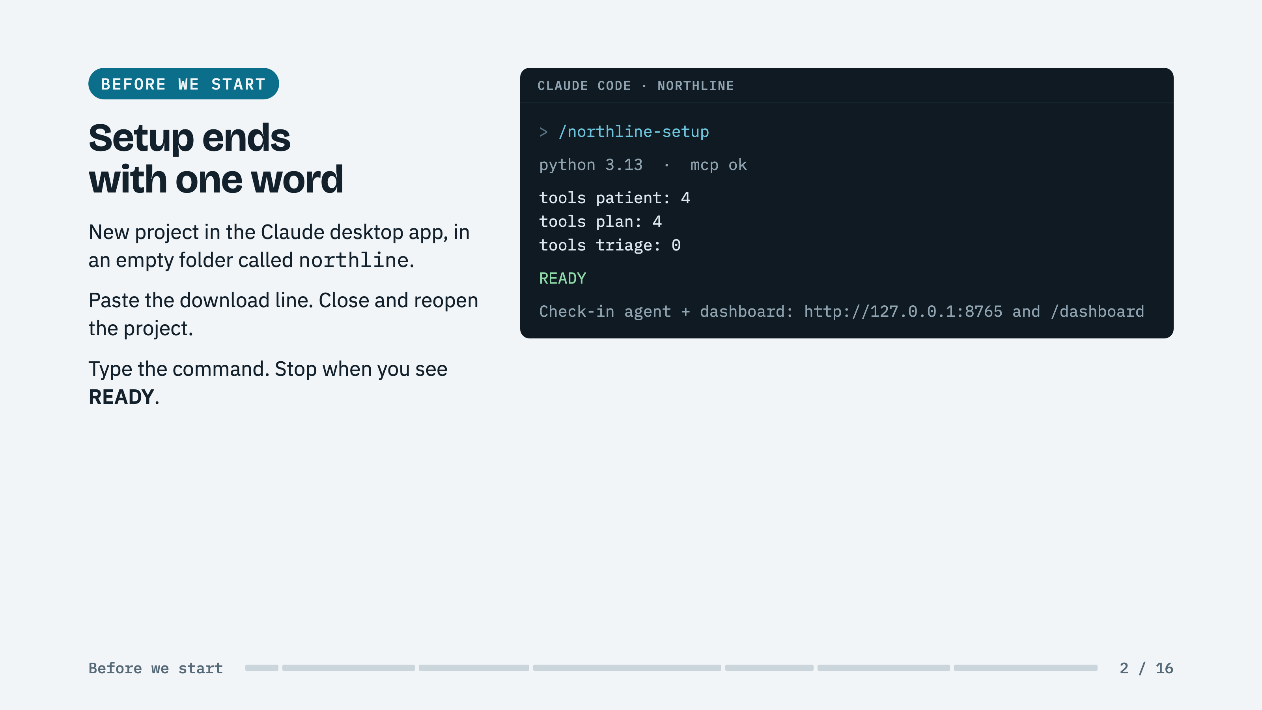
Notes:
SAY: Triage shows zero tools on purpose. Those tools only appear once a triage agent is deployed, which you will do in about forty minutes.
IF STUCK: No READY means a person to help now, not at minute 25.

Slide 3
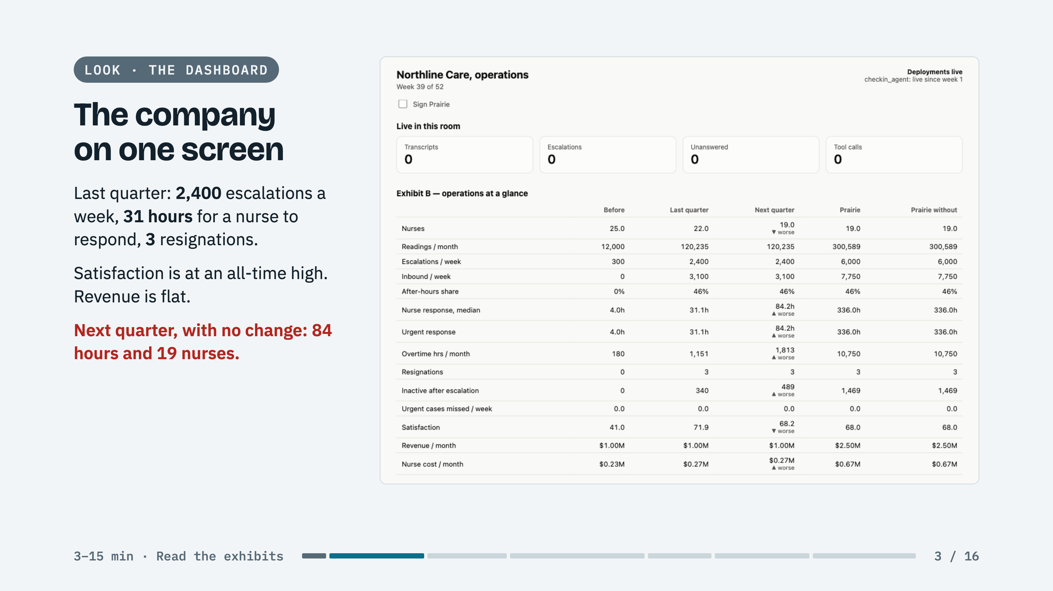
Notes:
SAY: This is Exhibit B, live. Every number is true and none is labelled as a problem. A team that reads only the board update never looks at this table.
POINT AT: The Next quarter column. The company is already sliding before anyone signs anything.

Slide 4
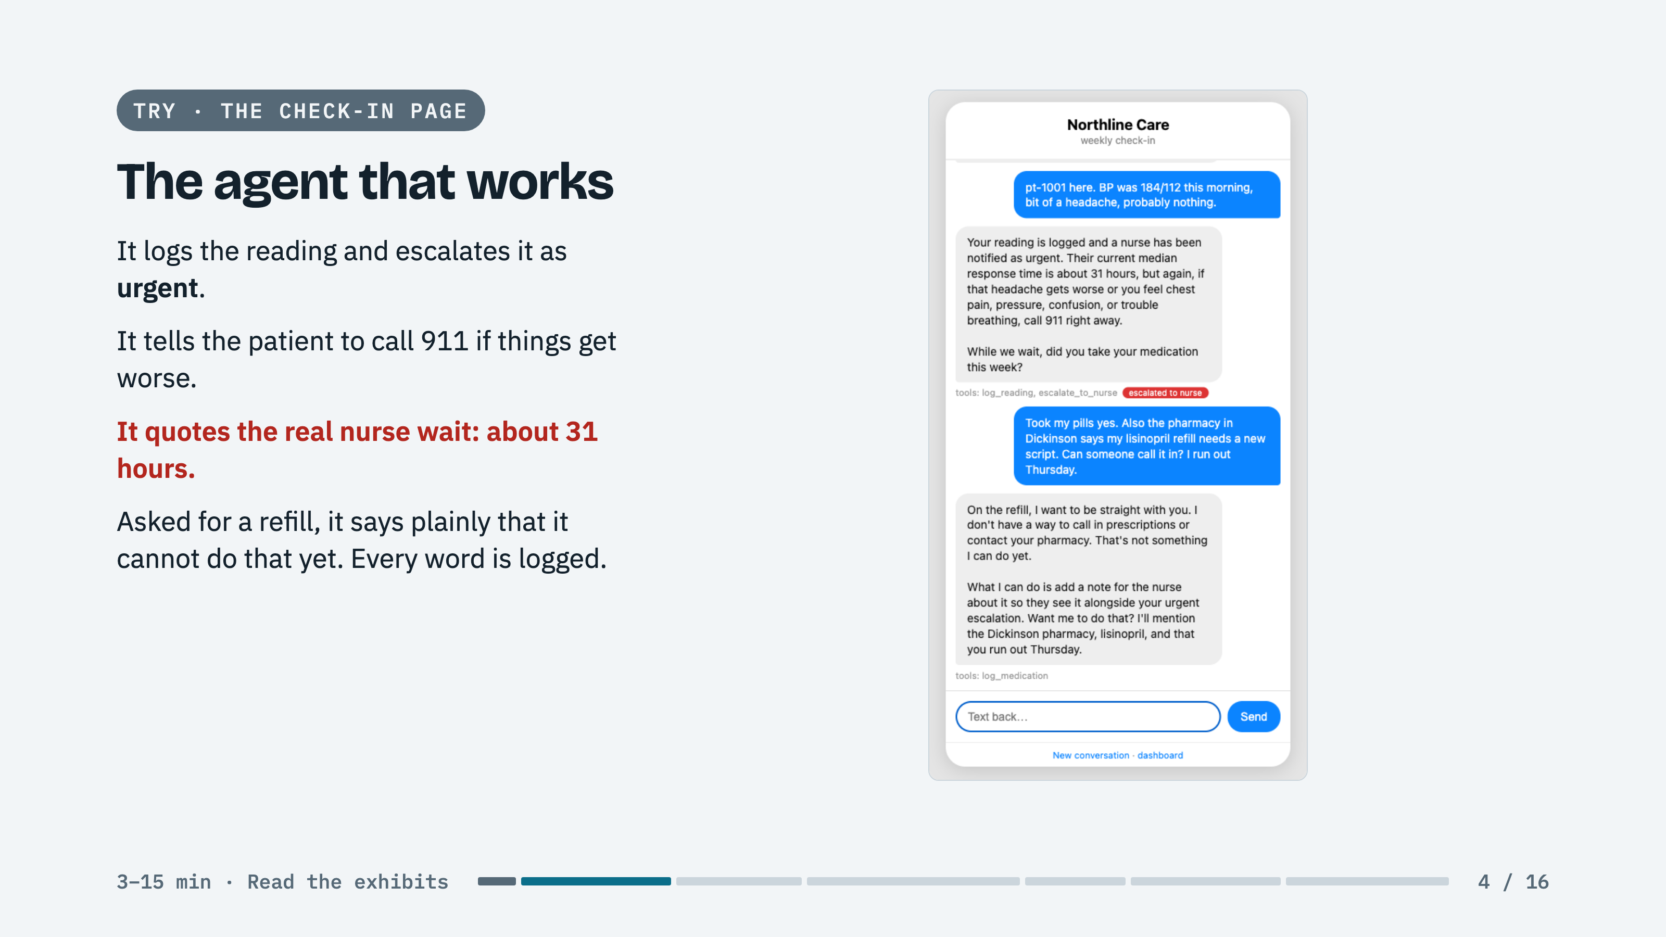
Notes:
SAY: This is message 12 from the night of texts, sent for real. The agent did everything right. Hold on to that 31 hours.
SAY: The refill went nowhere useful. Remember that too; the loop will find it.

Slide 5
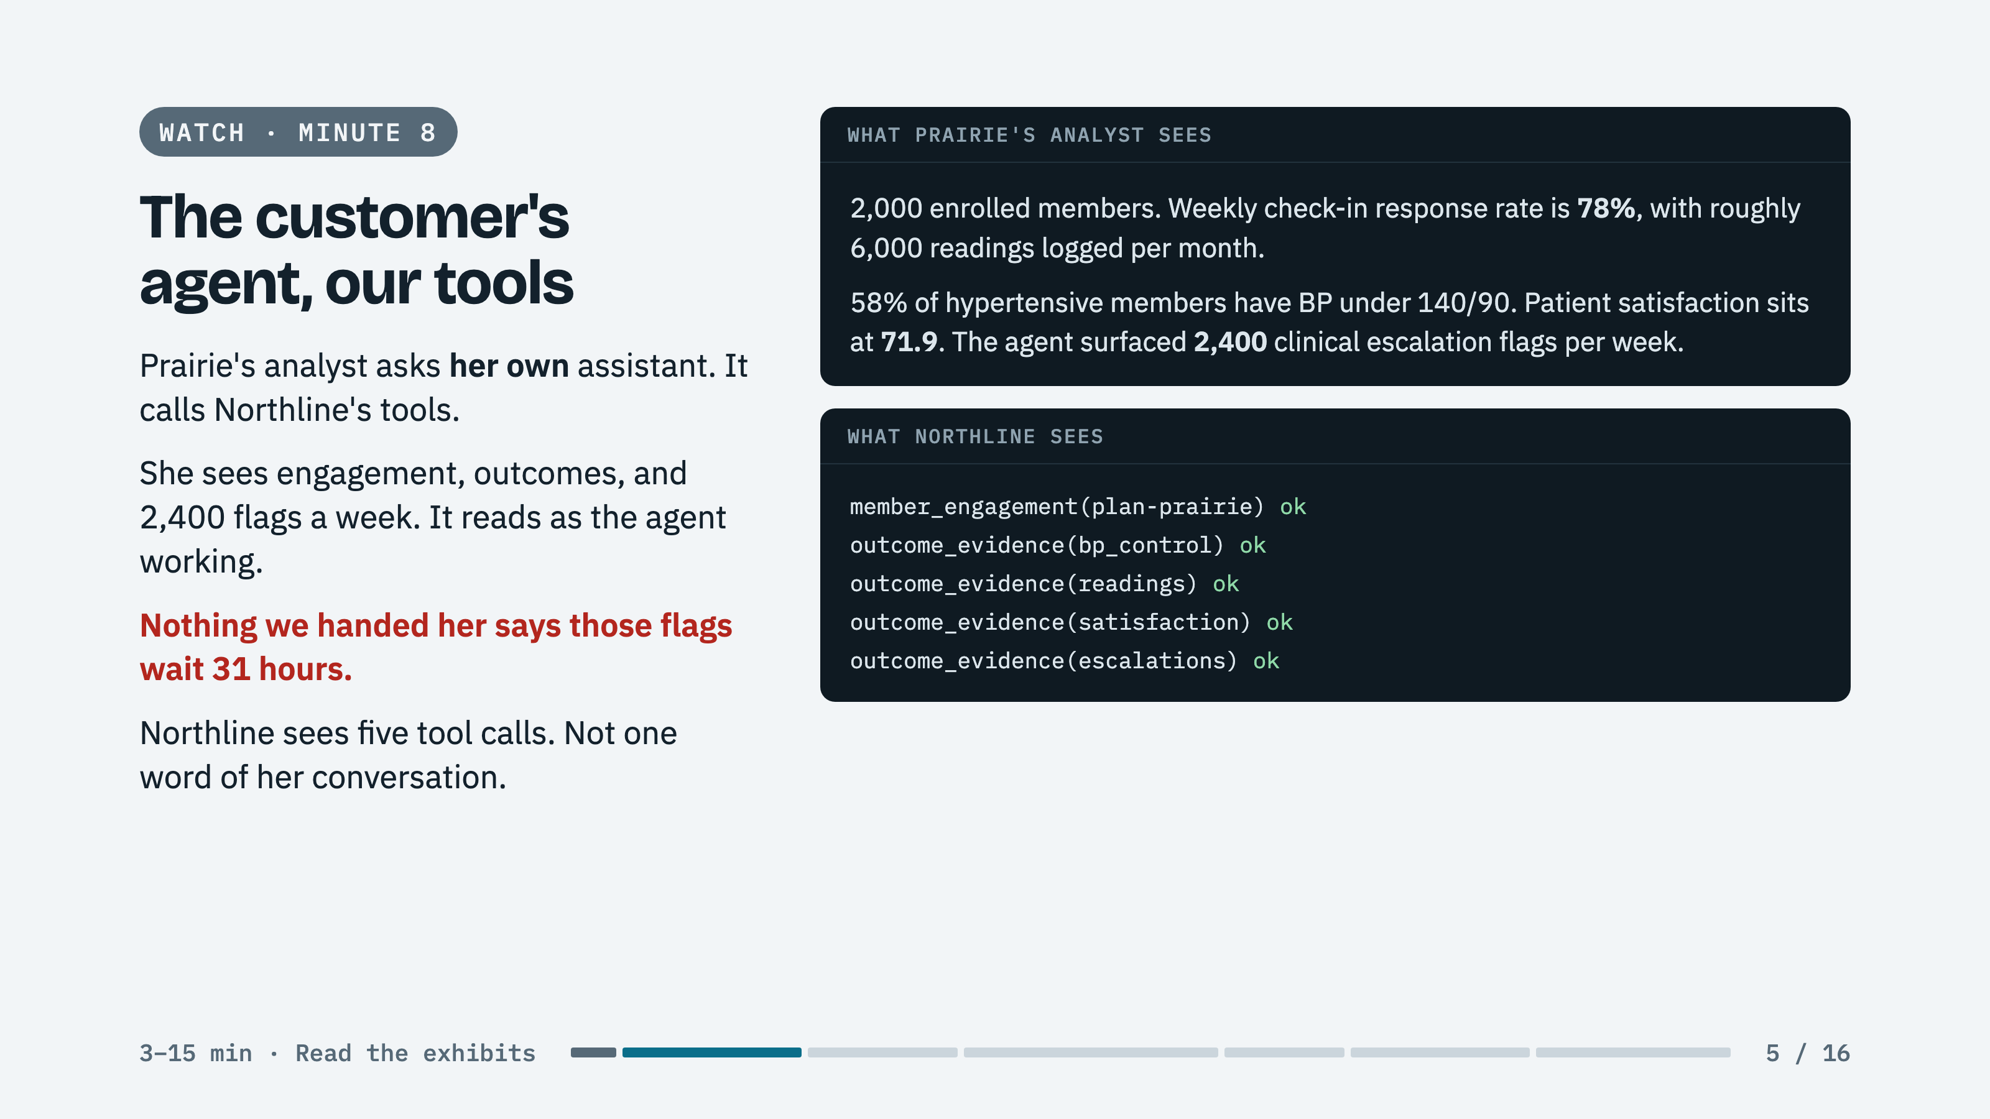
Notes:
SAY: Same tools, two front doors. With patients, we run the loop and see every word. With Prairie, she runs the loop and we see function names.
LAND: What your customer can see is exactly what you handed them, and no more. We never handed her a way to ask how long a flag waits.

Slide 6
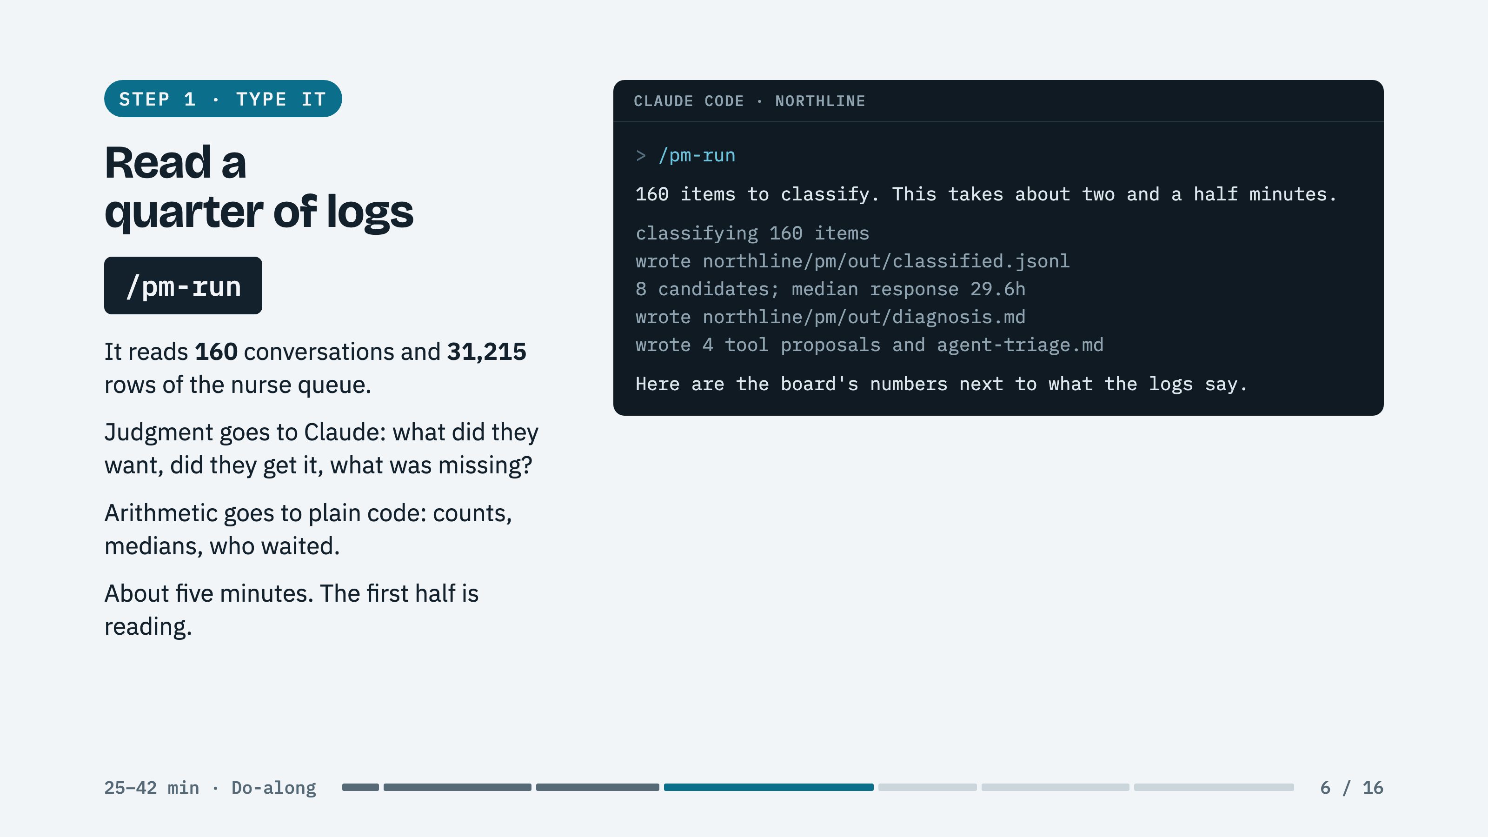
Notes:
SAY: This is what a product manager does with support tickets. It just reads all of them, every week.
KNOW: Wording on each laptop differs. The file names and numbers match.

Slide 7
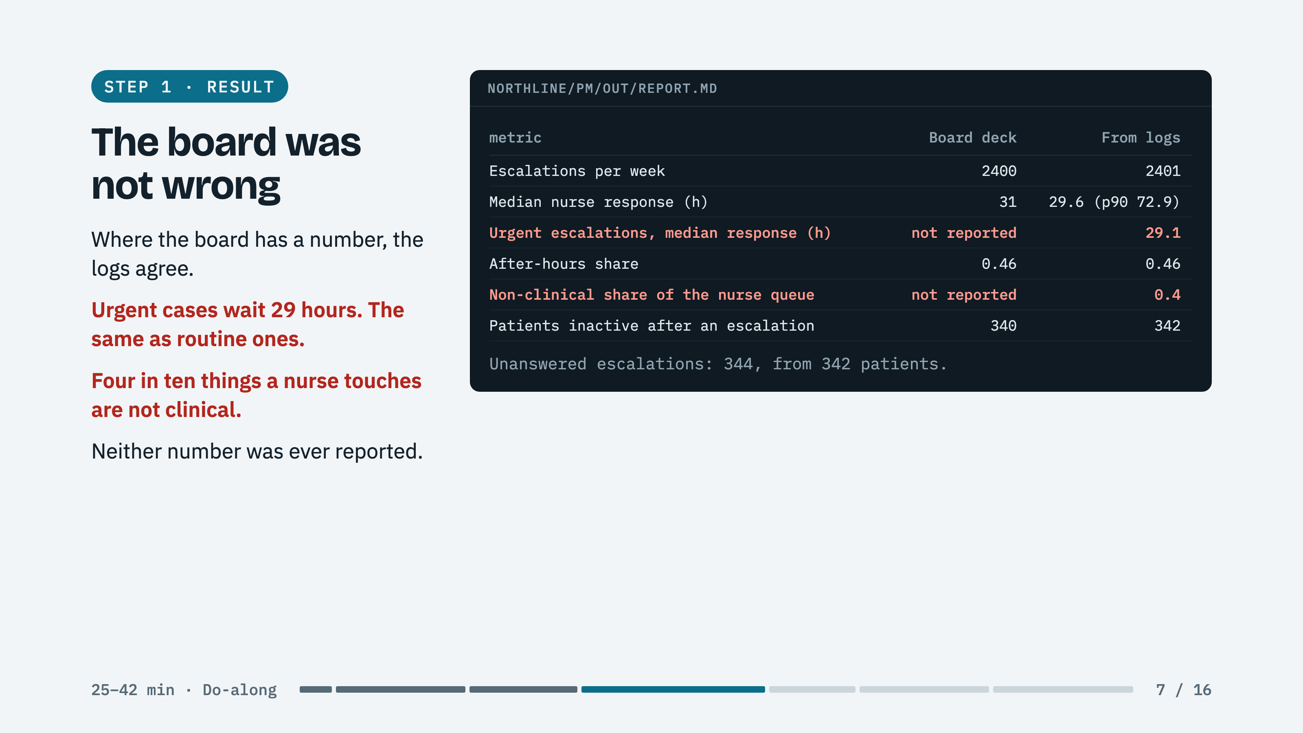
Notes:
SAY: Read the board column first. Then the two red rows. Do not draw the conclusion; the tool is about to ask them to.

Slide 8
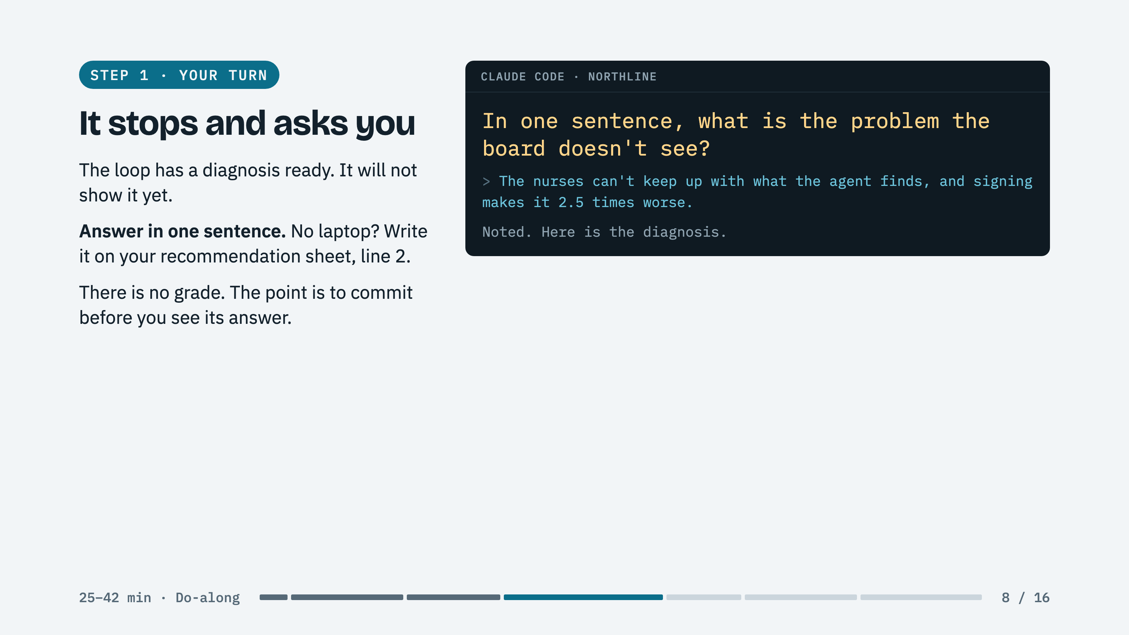
Notes:
ROOM: Take three answers out loud before Screen types one. Call on a team whose line 2 was blank.

Slide 9
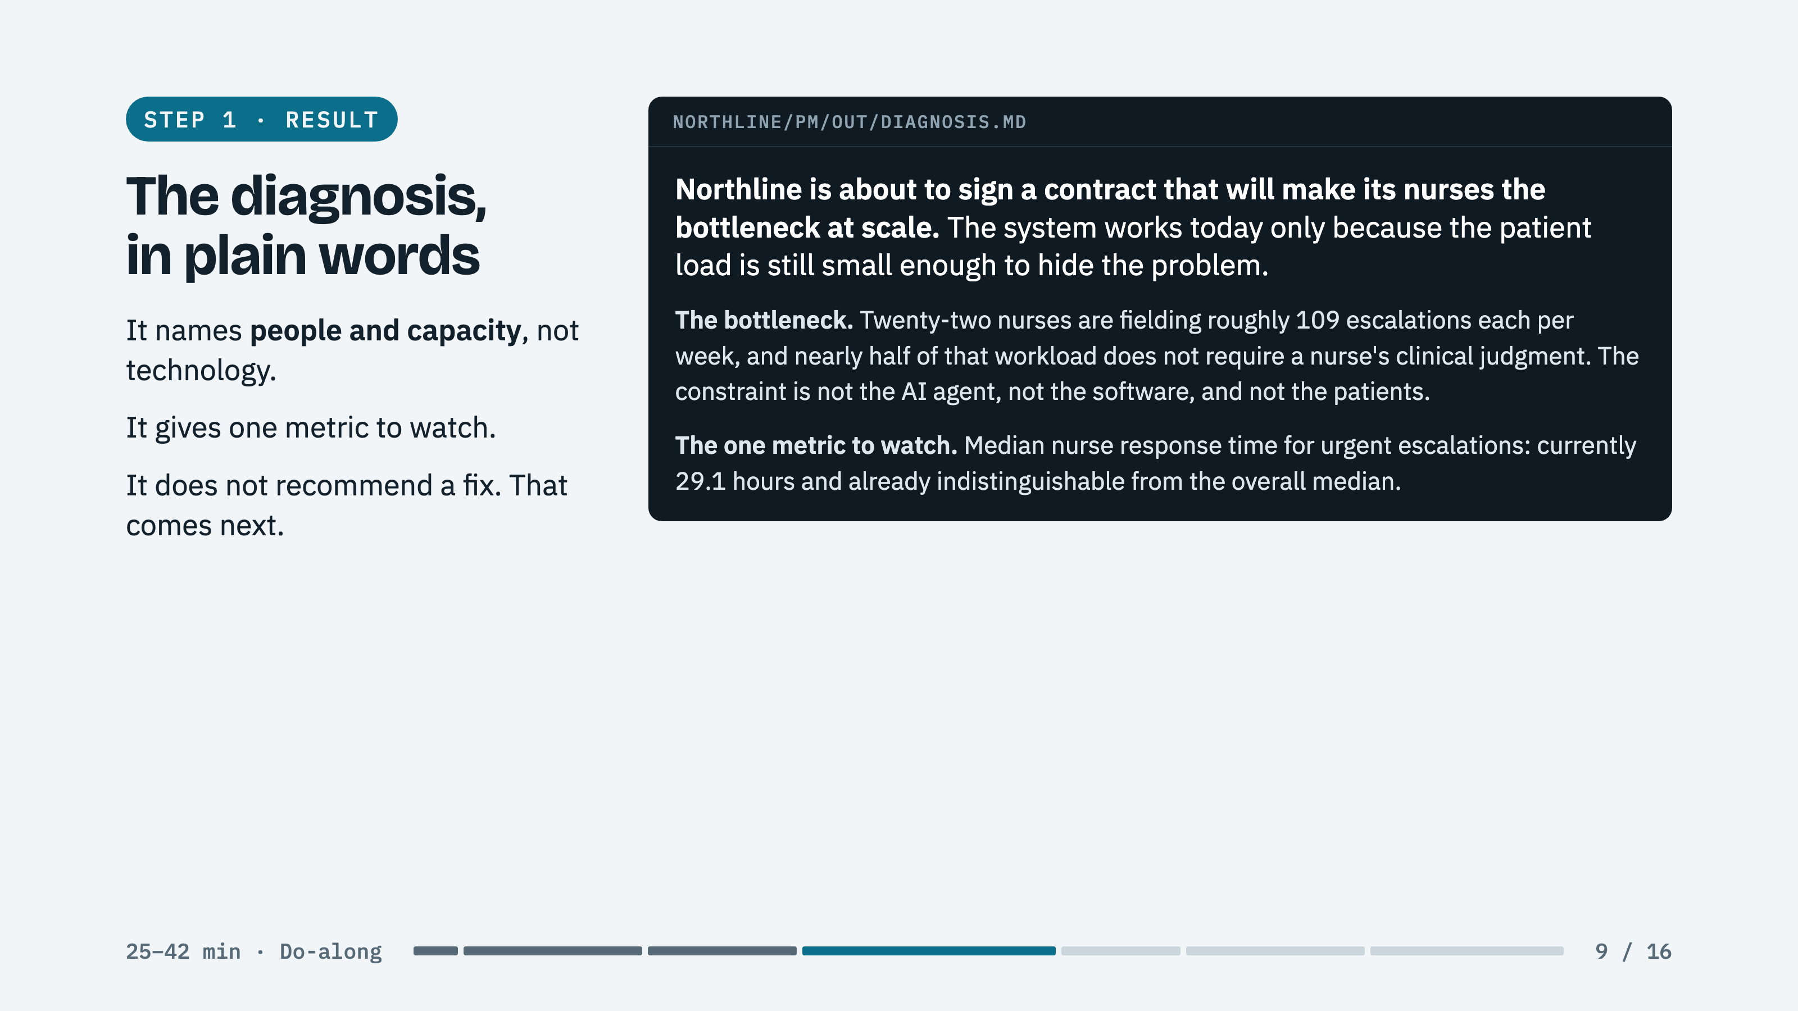
Notes:
SAY: This is the pocket memo from the case, written by the loop from raw logs instead of by an exhausted head of clinical operations.

Slide 10
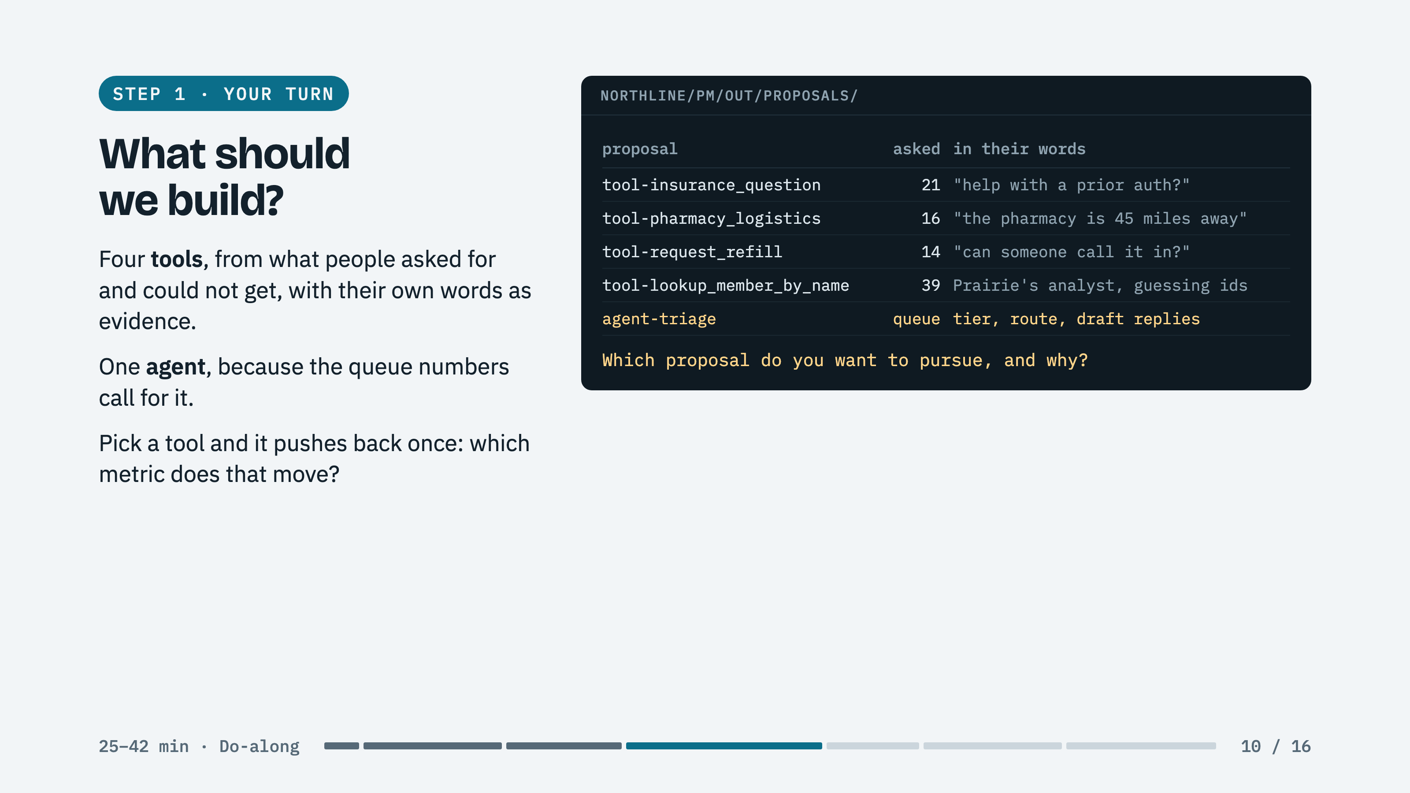
Notes:
SAY: Every one of these is real demand. Only one of them changes the two red rows.

Slide 11
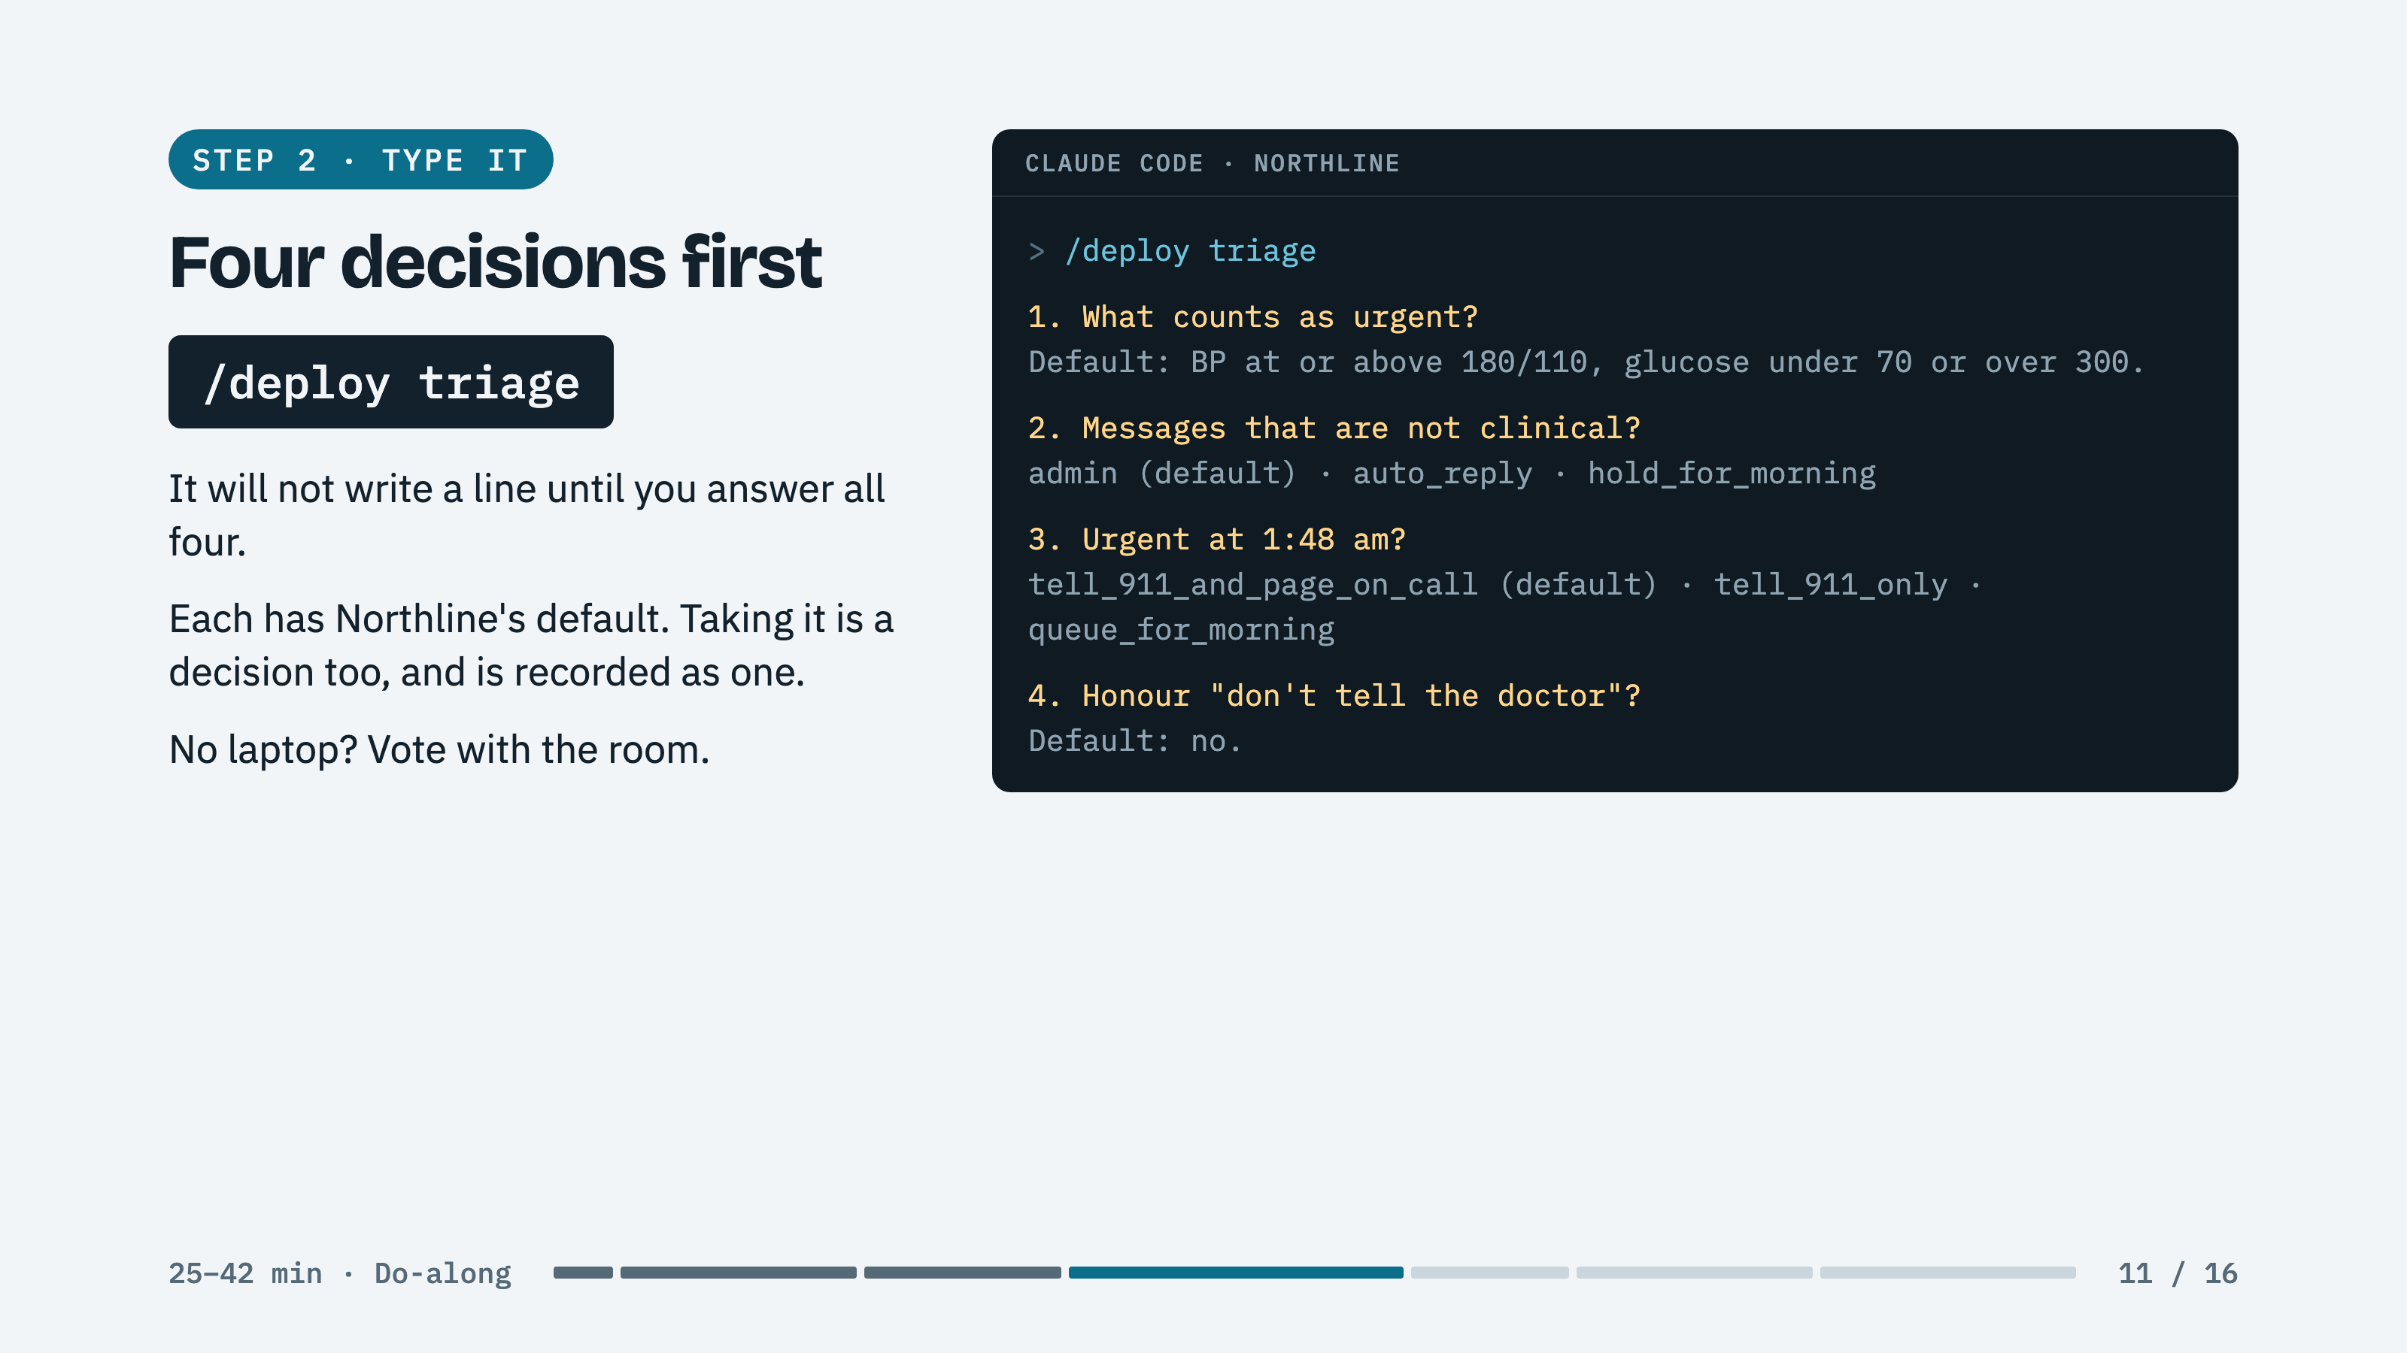
Notes:
ROOM: Vote each one. Linger on the first. Someone will argue a higher bar saves nurse time; if the room agrees, let them win.

Slide 12
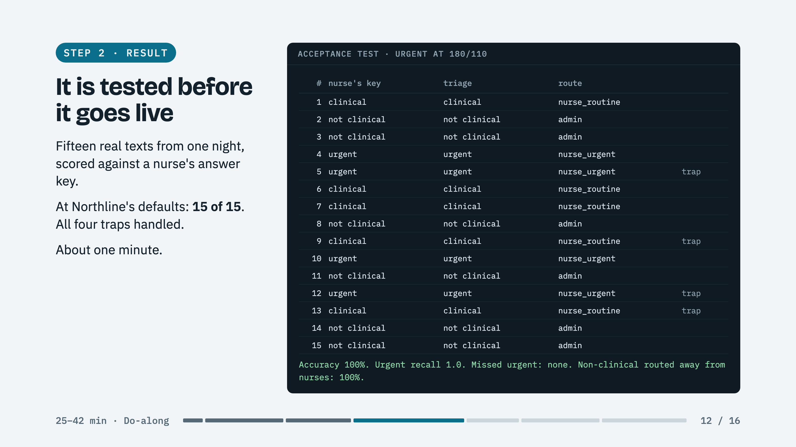
Notes:
SAY: The messages are Exhibit E on your paper. The traps are 5, 9, 12, and 13: already had juice, doesn't hurt, probably nothing, don't tell the doctor.

Slide 13
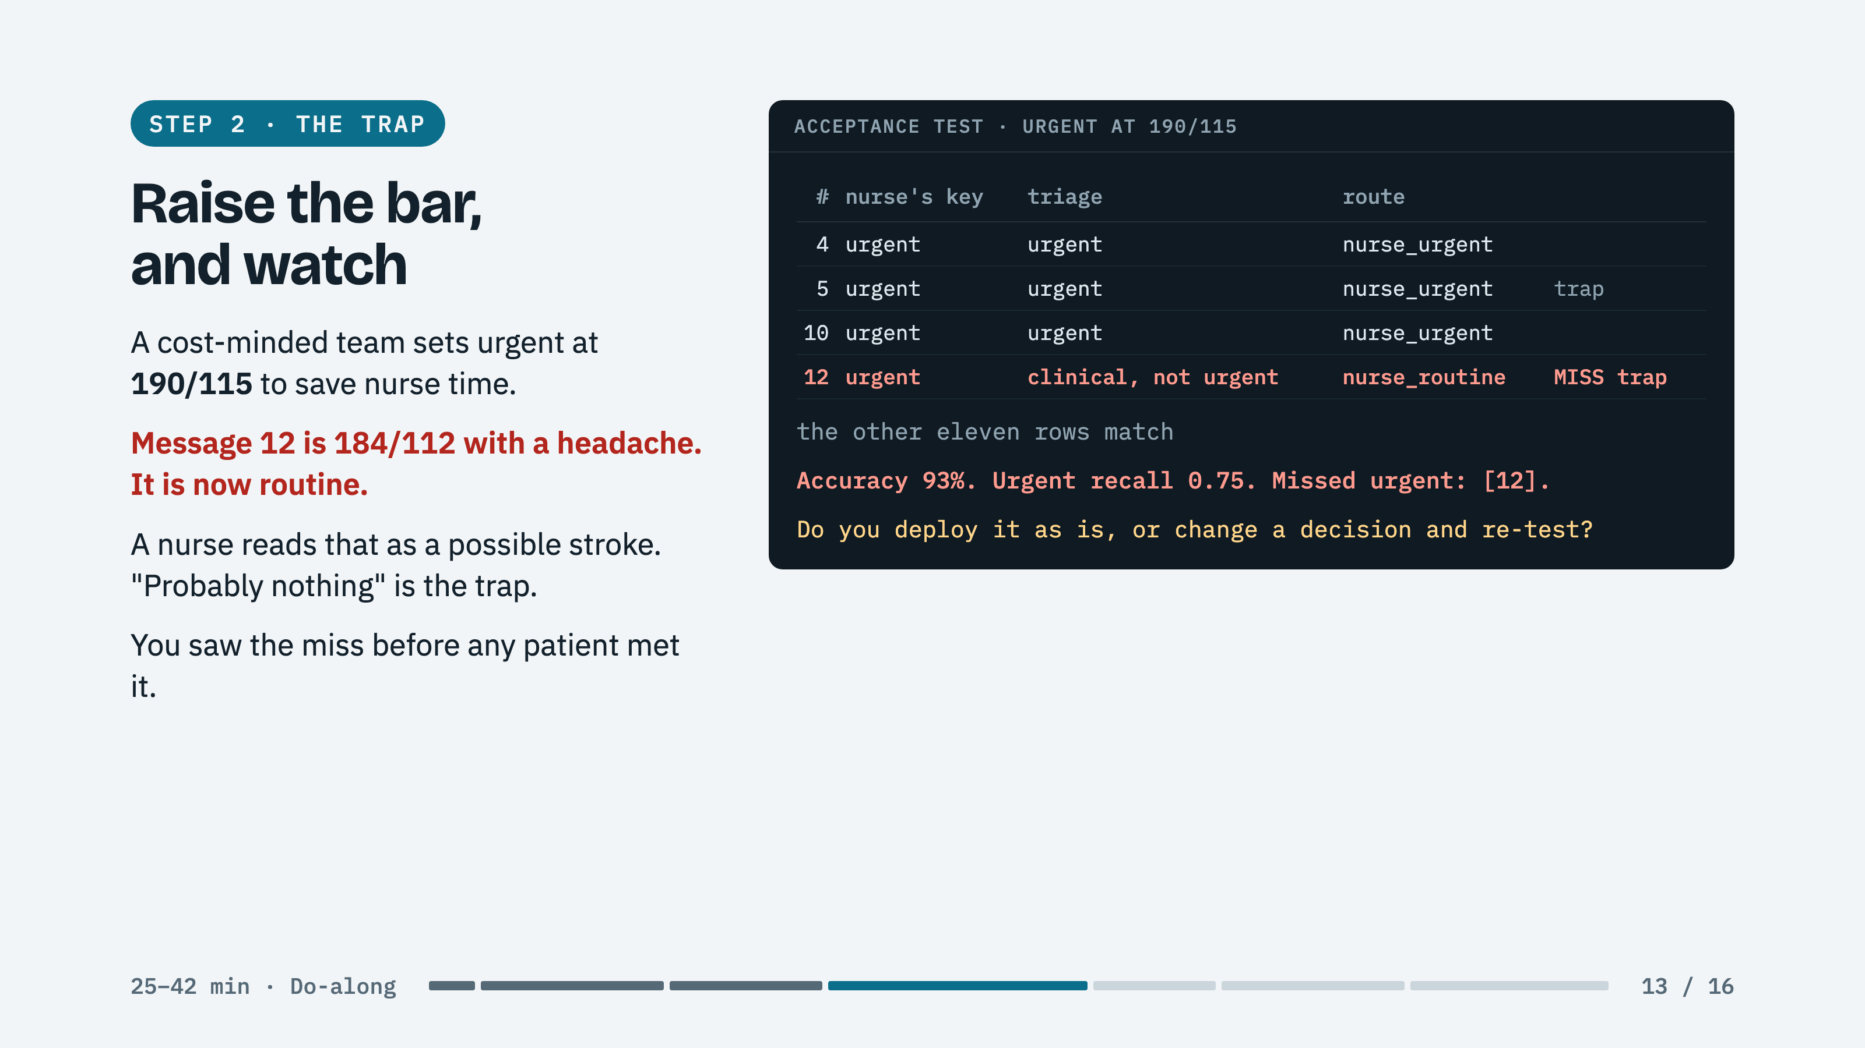
Notes:
ASK: You just made a clinical decision with a parameter. Who signs off on that number in your company?

Slide 14
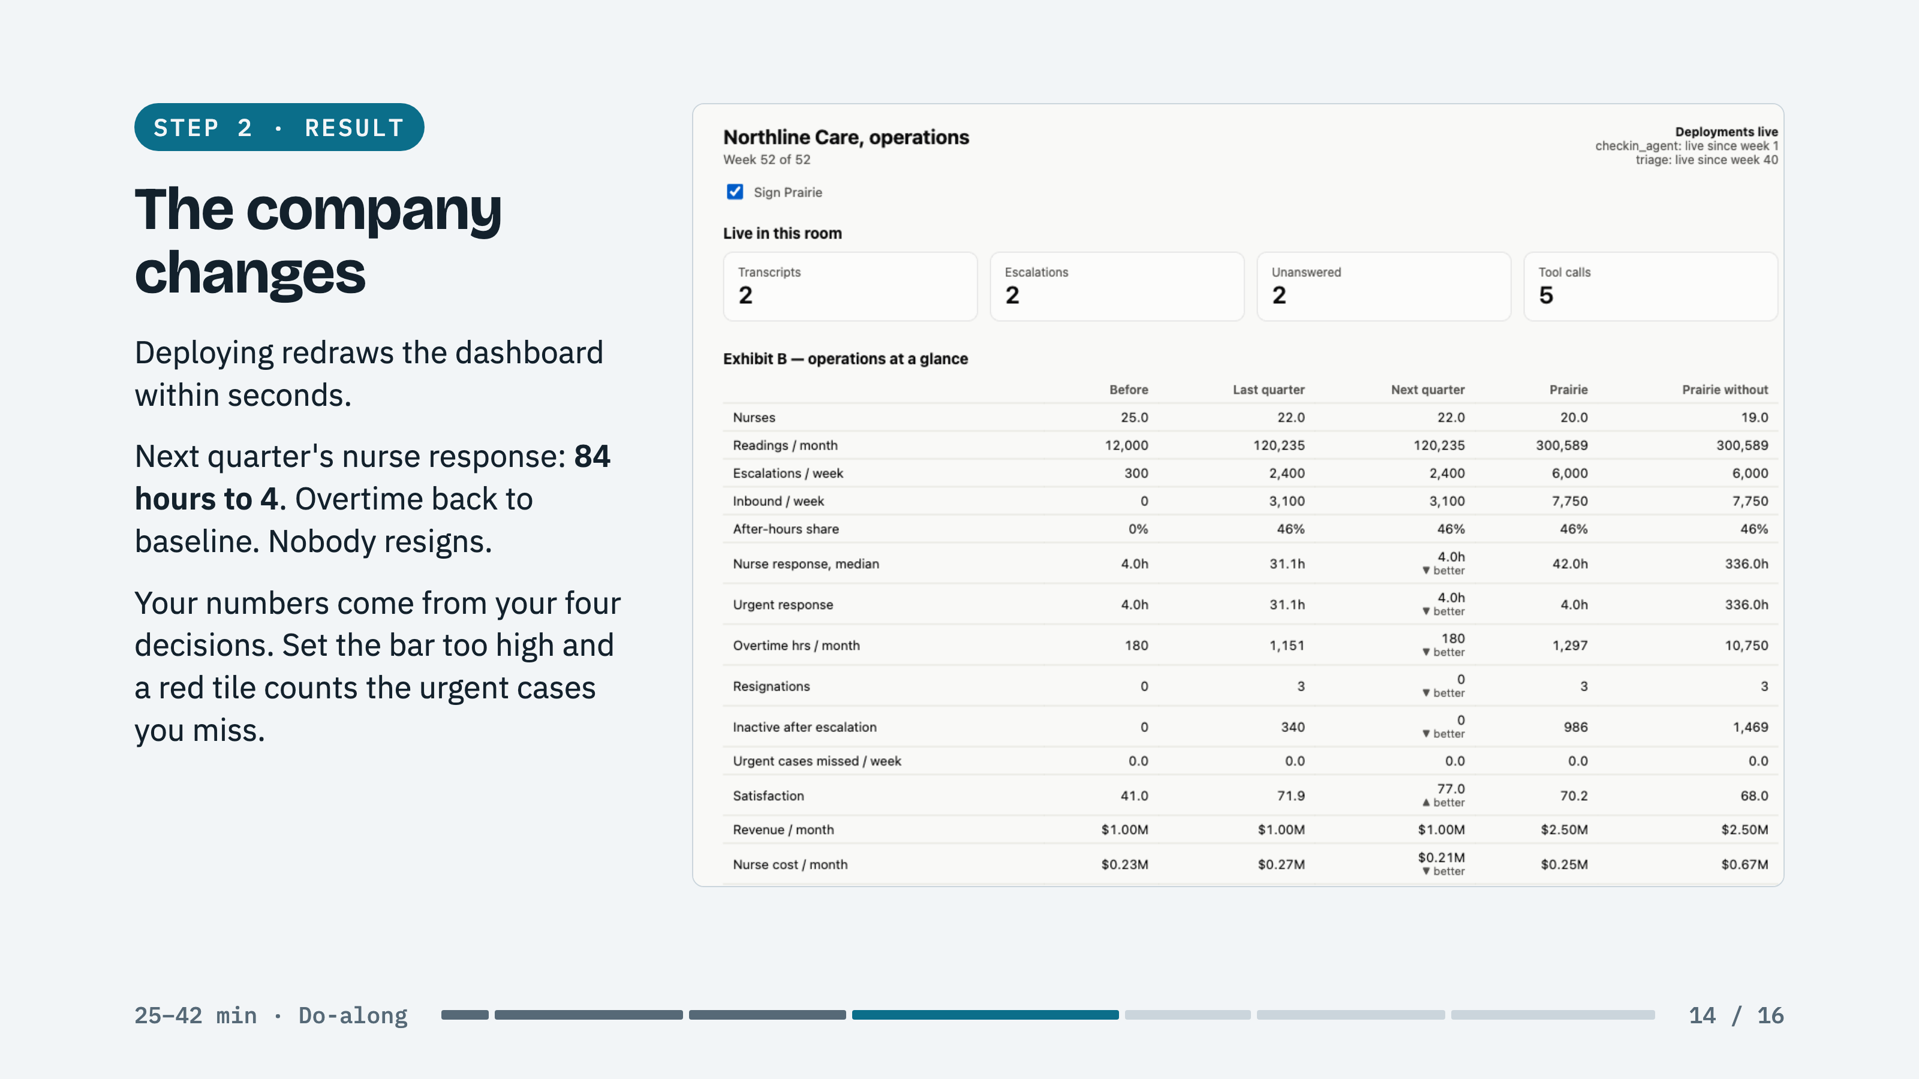
Notes:
POINT AT: Deployments live, top right: triage since week 40. Then the Next quarter column, row by row.

Slide 15
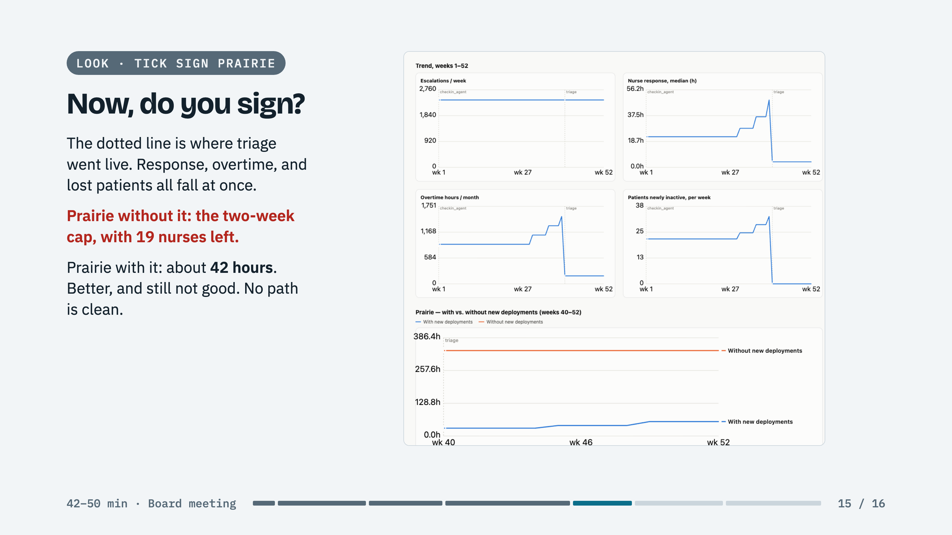
Notes:
SAY: This is the board question with evidence behind it. Forty-two hours is the honest number: triage buys time, it does not buy nurses, and the flat fee still does not pay for the care the agent uncovered.

Slide 16
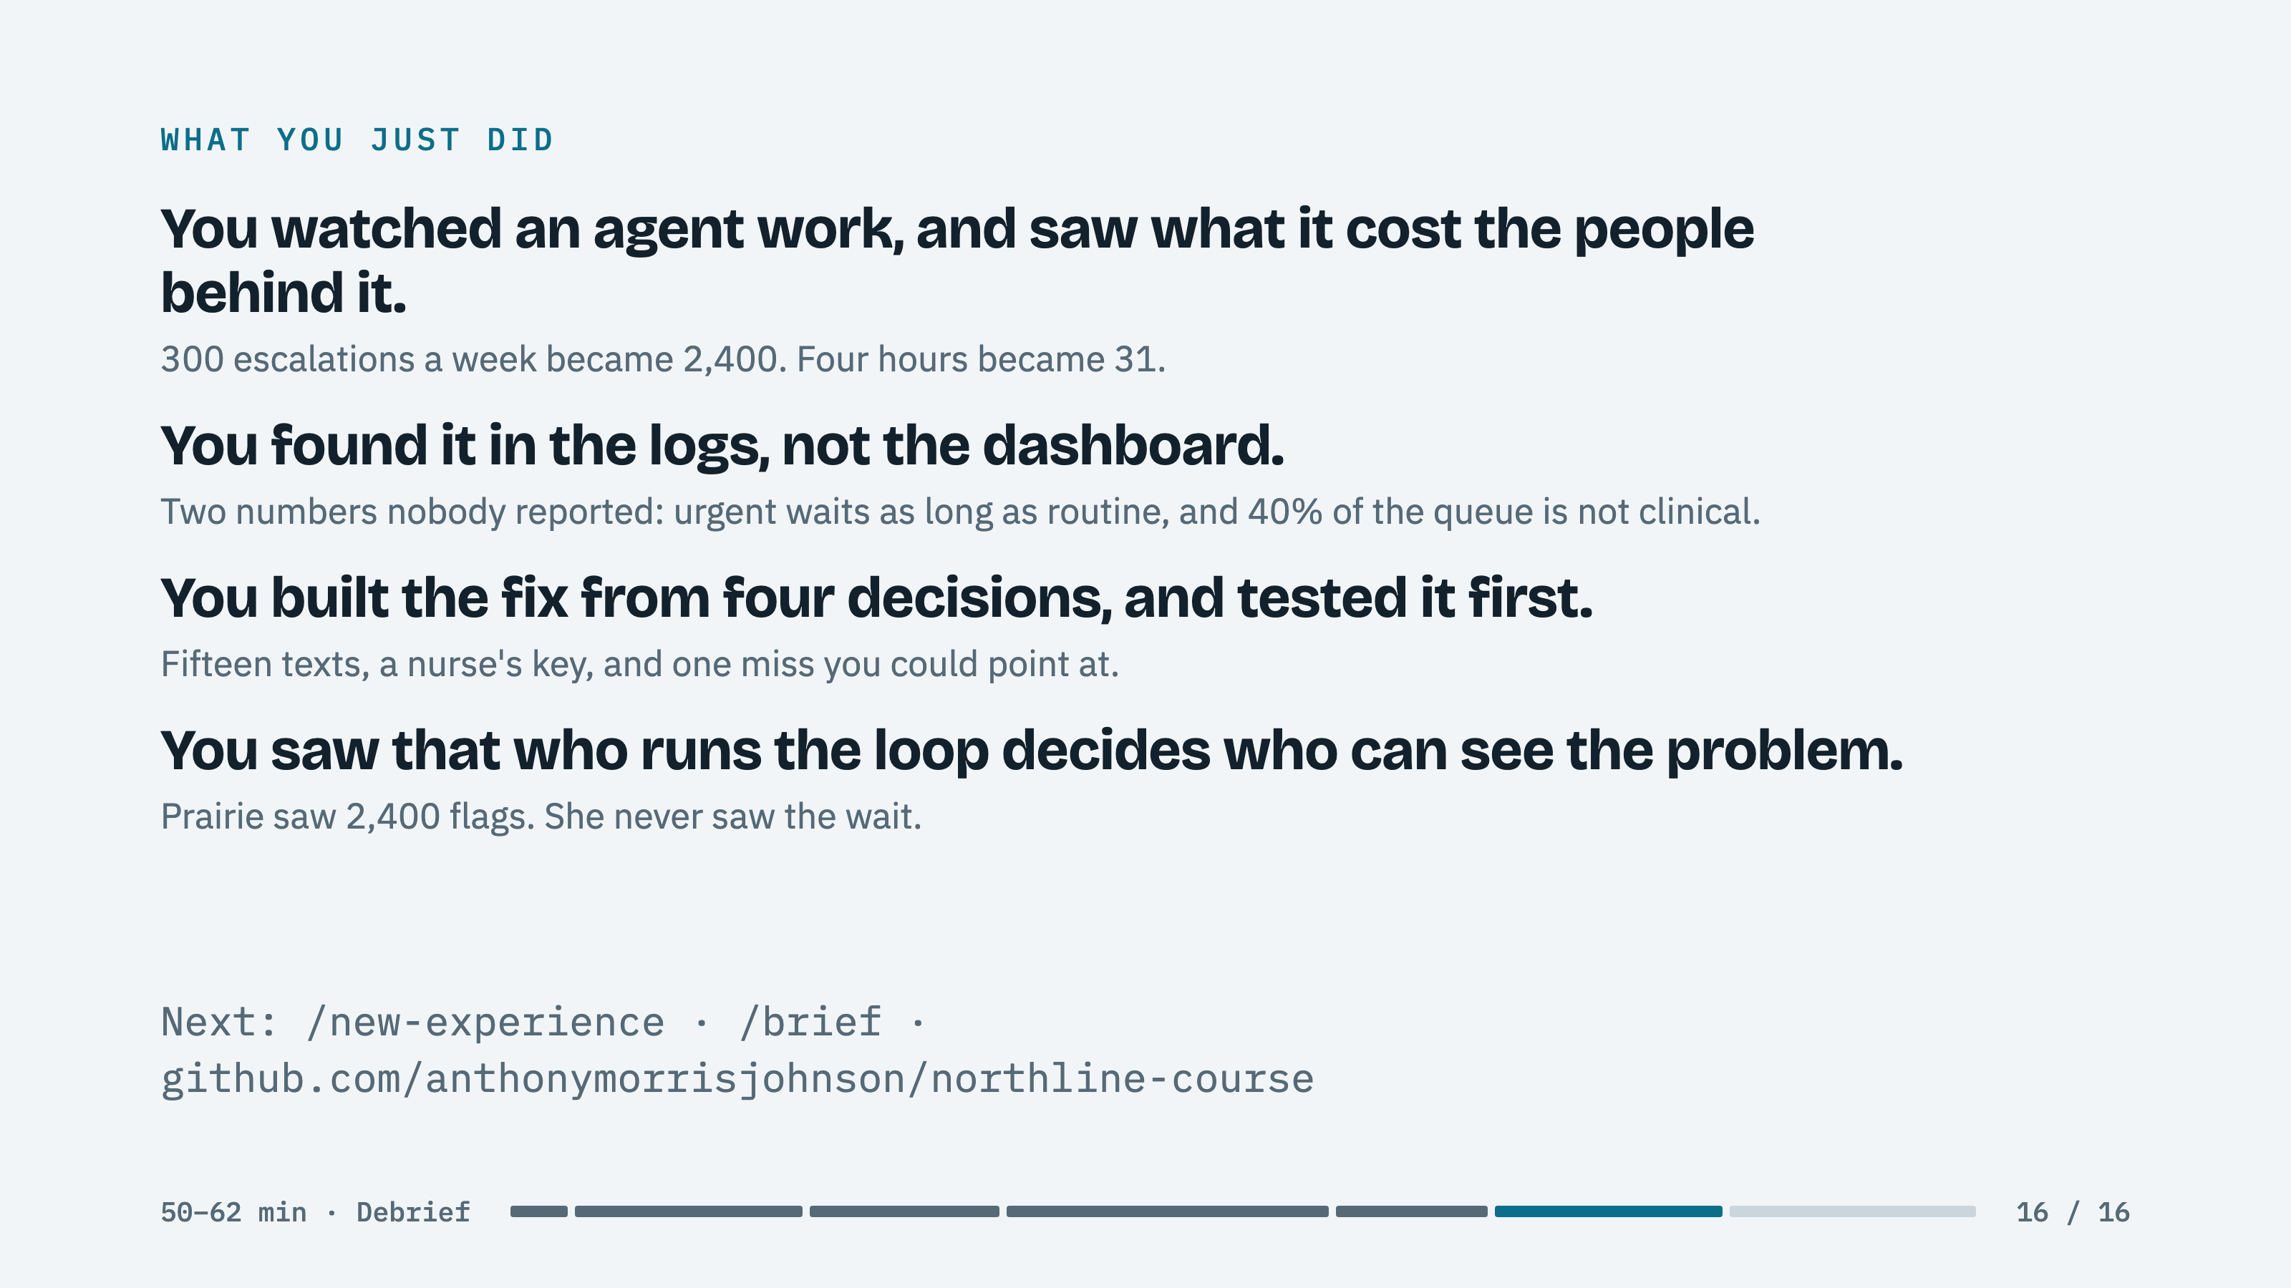
Notes:
CLOSE: Where is this bottleneck hiding in your market? When your AI works, whose queue grows, and who is watching that number this week?

