Slide 1
Dynamic Policy Modeling for CTE Policy and Resarch
ACTER 2026
Dr. Anthony Perruy
Notes:
Please Note: This template has been created using the University of North Dakota brand guidelines. All colors and typefaces/fonts are within the brand guidelines and altering them isn’t suggested. Please visit UND.edu/brand for more information on using the UND brand or email identity@UND.edu with any UND branding questions.
TIPS:
Check out the Layout Dropdown for more layout design options
It’s recommended not going below 24-point font size for presentations
If your text overflows a placement text box it’s recommended to edit/delete down text content instead of increasing size of text box to accommodate more text
Guides are available under View tab > check Guides checkbox

Slide 2
CTE as a Complex System
Education and the Labor Market are complex systems (Ghaffarzadegan et al., 2017; Jacobson et al., 2019)
Nested, interconnected, history-dependent systems
Feedback loops
Non-linearity
Bounded rationality
Concerned with change over time
Notes:
TIPS:
Check out the Layout Dropdown for more layout design options
It’s recommended not going below 24-point font size for presentations
If your text overflows a placement text box it’s recommended to edit/delete down text content instead of increasing size of text box to accommodate more text
Guides for textboxes are available under View tab > check Guides checkbox

Slide 3
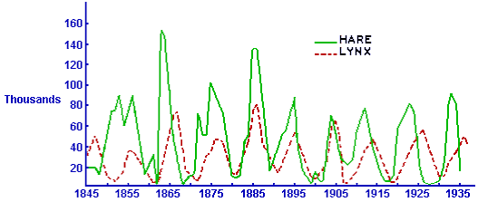
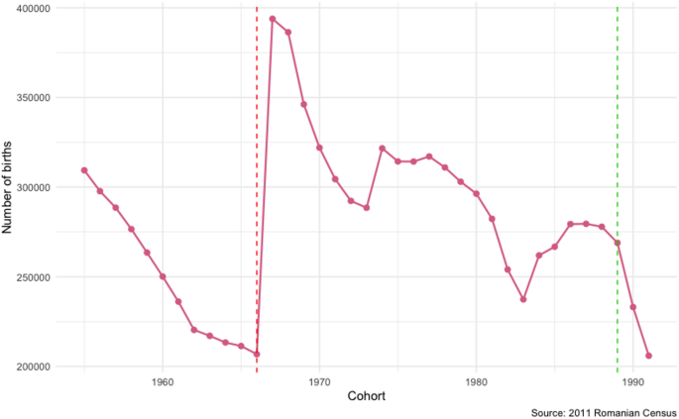
System Dynamics as a Method
Applying mathematical modeling to complex systems to investigate how structure impacts behavior (Sterman, 2009).
Constructivist approach model-building and –testing based on qualitative data
Notes:
TIPS:
Check out the Layout Dropdown for more layout design options
It’s recommended not going below 24-point font size for presentations
If your text overflows a placement text box it’s recommended to edit/delete down text content instead of increasing size of text box to accommodate more text
Guides for textboxes are available under View tab > check Guides checkbox

Slide 4
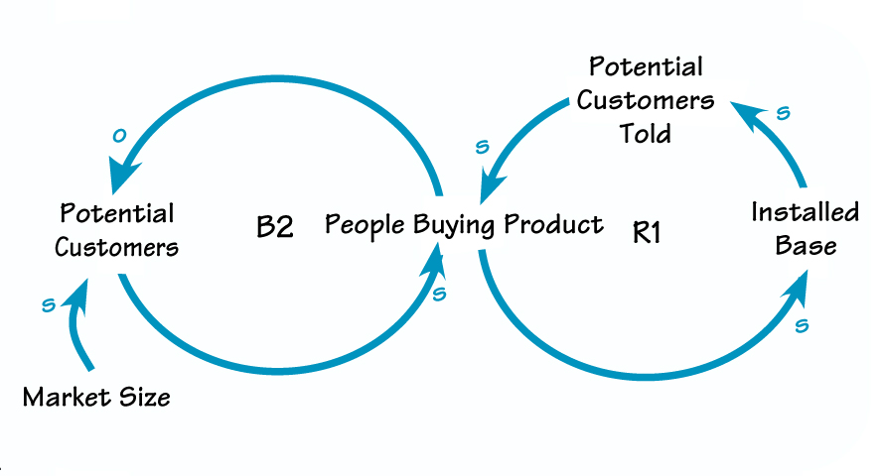
Causal Loop Diagrams
Reinforcing Loop (Positive Feedback) causes exponential growth
Balancing Loop (Negative Feedback) causes stabilizing or goal-seeking behavior
CLD->system of equations
(often modeled in software like Vensim or Stella)

Slide 5
SD Process
Identify Reference modes (change in key variables over time)
Construct CLD based on literature, policy documents, interviews (Luna-Reyes & Anderson, 2003)
Turn CLD into quant model; benchmark against reference modes
Test policies to understand system behavior and suggest possible interventions
Notes:
TIPS:
Check out the Layout Dropdown for more layout design options
It’s recommended not going below 24-point font size for presentations
If your text overflows a placement text box it’s recommended to edit/delete down text content instead of increasing size of text box to accommodate more text
Guides for textboxes are available under View tab > check Guides checkbox

Slide 6
Two vignettes extending CTE papers
How do school and industry partners establish engaging WBL experiences (Perry, 2026).
- Established with successful schools, but how can other communities learn to build?
Why are STEM-related CTE pathways segregated by gender despite significant federal investment (Leu & Arbeit, 2020)?
Federal data establishes the issue, but what mechanisms are causing it to persist?
Notes:
TIPS:
Check out the Layout Dropdown for more layout design options
It’s recommended not going below 24-point font size for presentations
If your text overflows a placement text box it’s recommended to edit/delete down text content instead of increasing size of text box to accommodate more text
Guides for textboxes are available under View tab > check Guides checkbox

Slide 7
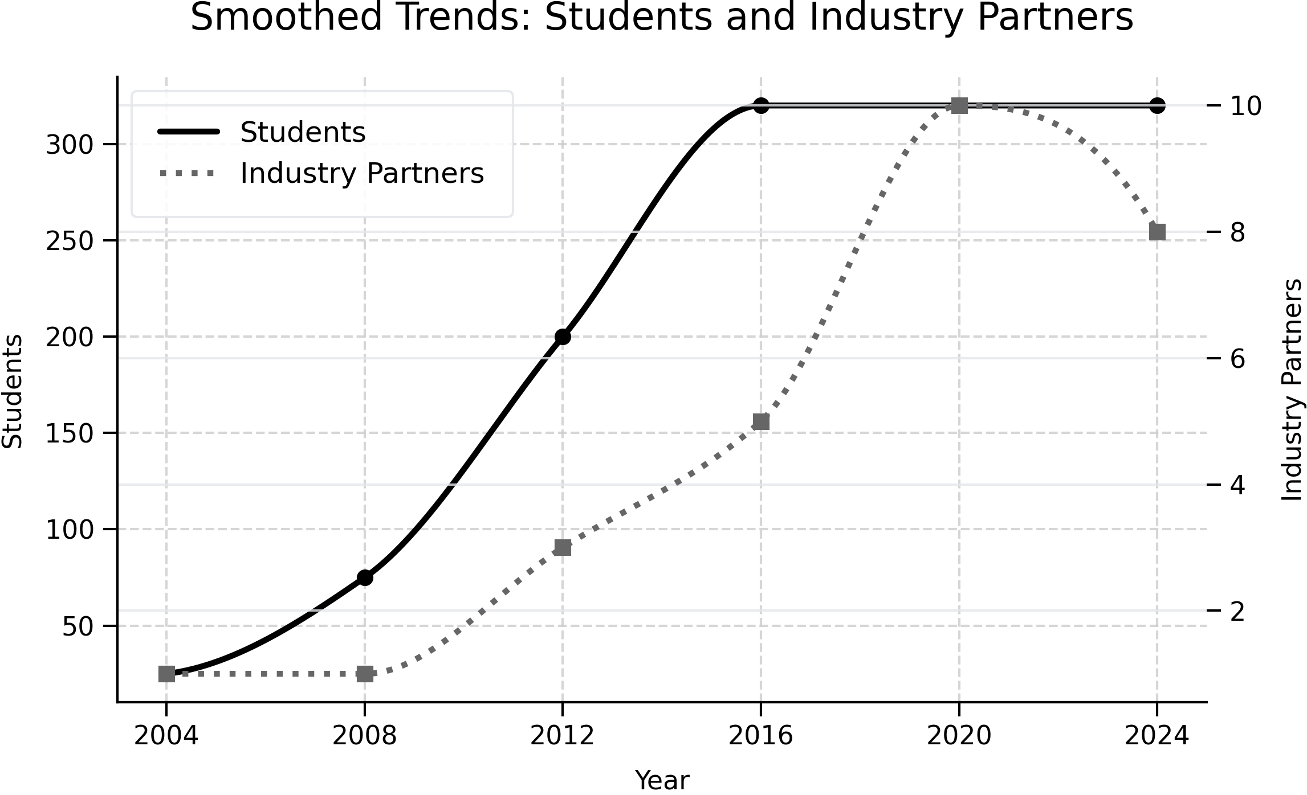
WBL Systems Reference mode
20 years of growth
from 20 students to whole school (now at capacity)
#of industry partners growth rate lags student growth rate
Notes:
TIPS:
Check out the Layout Dropdown for more layout design options
It’s recommended not going below 24-point font size for presentations
If your text overflows a placement text box it’s recommended to edit/delete down text content instead of increasing size of text box to accommodate more text
Guides for textboxes are available under View tab > check Guides checkbox

Slide 8
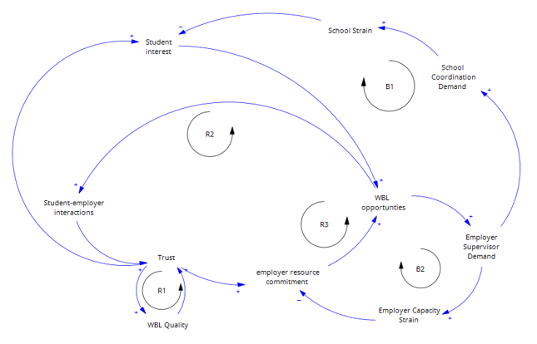
CLD for the WBL system
R1: Quality improves trust
R2: Positive student-employer interactions improve trust
R3: Student interest build trust
B1: School administrative capacity limits system
B2: employer capacity limits system

Slide 9
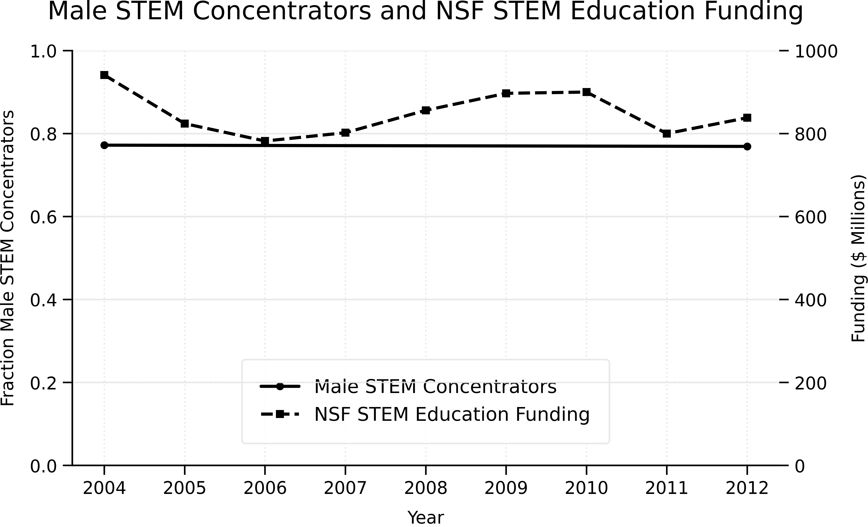
Occupational Segregation Reference Mode
Dynamic steady-state for fraction of male STEM-CTE concentrators
Roughly steady federal investment in NSF STEM Education funding (towards broadening the workforce pipeline)
Notes:
TIPS:
Check out the Layout Dropdown for more layout design options
It’s recommended not going below 24-point font size for presentations
If your text overflows a placement text box it’s recommended to edit/delete down text content instead of increasing size of text box to accommodate more text
Guides for textboxes are available under View tab > check Guides checkbox

Slide 10
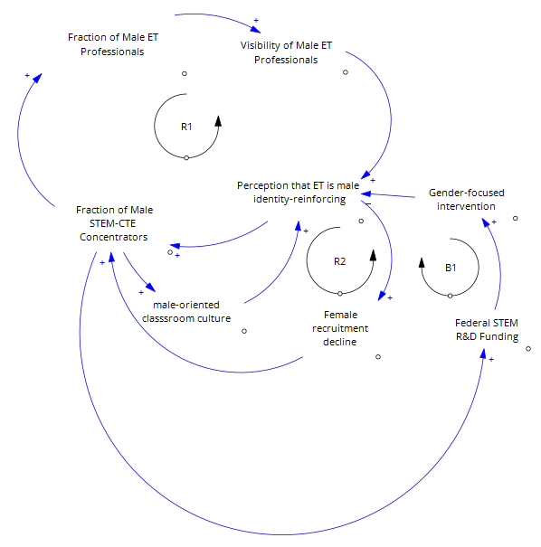
CLD for Occupational Segregation
R1: Occupational segregation in the labor market causes segregation in STEM-CTE concentrators
R2: Male-oriented classroom cultures increase the perception that STEM-CTE is male-identity-reinforcing
B1: Increased federal attention leads to gender-focused intervention in STEM education

Slide 11
Next Steps w/SD
Newly funded project to understand WBL growth in secondary CTE
  Looking for a GRA—join Fall 27!
Newly funded project to understand school-industry-government partnerships in higher education
  Looking for a postdoc—posting forthcoming with earliest possible start date Jan 27
Work with local and state policymakers and practitioners to develop useful mapping tools
Notes:
ALTERNATIVE TEXT:
Don’t forget to add Alternative Text to photos to help people with visual impairments understand what the photo is conveying.
Alt text is read aloud by screen readers or other assistive technology and can also be displayed if the image fails to display properly.
1.) Right-click the image, then select Edit Alt Text.
2.) Type a description of the image in the text box on the Alt Text pane.
Some tips for writing alt text for images:
Be brief: Usually one or two sentences.
Give context: Explain how the image relates to the page content.
Don’t duplicate text: Avoid using text that’s already in the slide.
End with a period: Make sure the alt text sentence ends with a period.
GENERAL POWERPOINT TIPS:
Check out the Layout Dropdown for more layout design options
To Insert Picture from File, click on the picture icon in the center of gray photo frame
It’s recommended not going below 24-point font size for presentations
If your text overflows a placement text box it’s recommended to edit/delete down text content instead of increasing size of text box to accommodate more text
Guides are available under View tab > check Guides checkbox

