Slide 1

Holiday Effect on Libor and Treasury Rates
By Knights >>
Anthony, Davood, Samantha, Vik, Xing

Slide 2
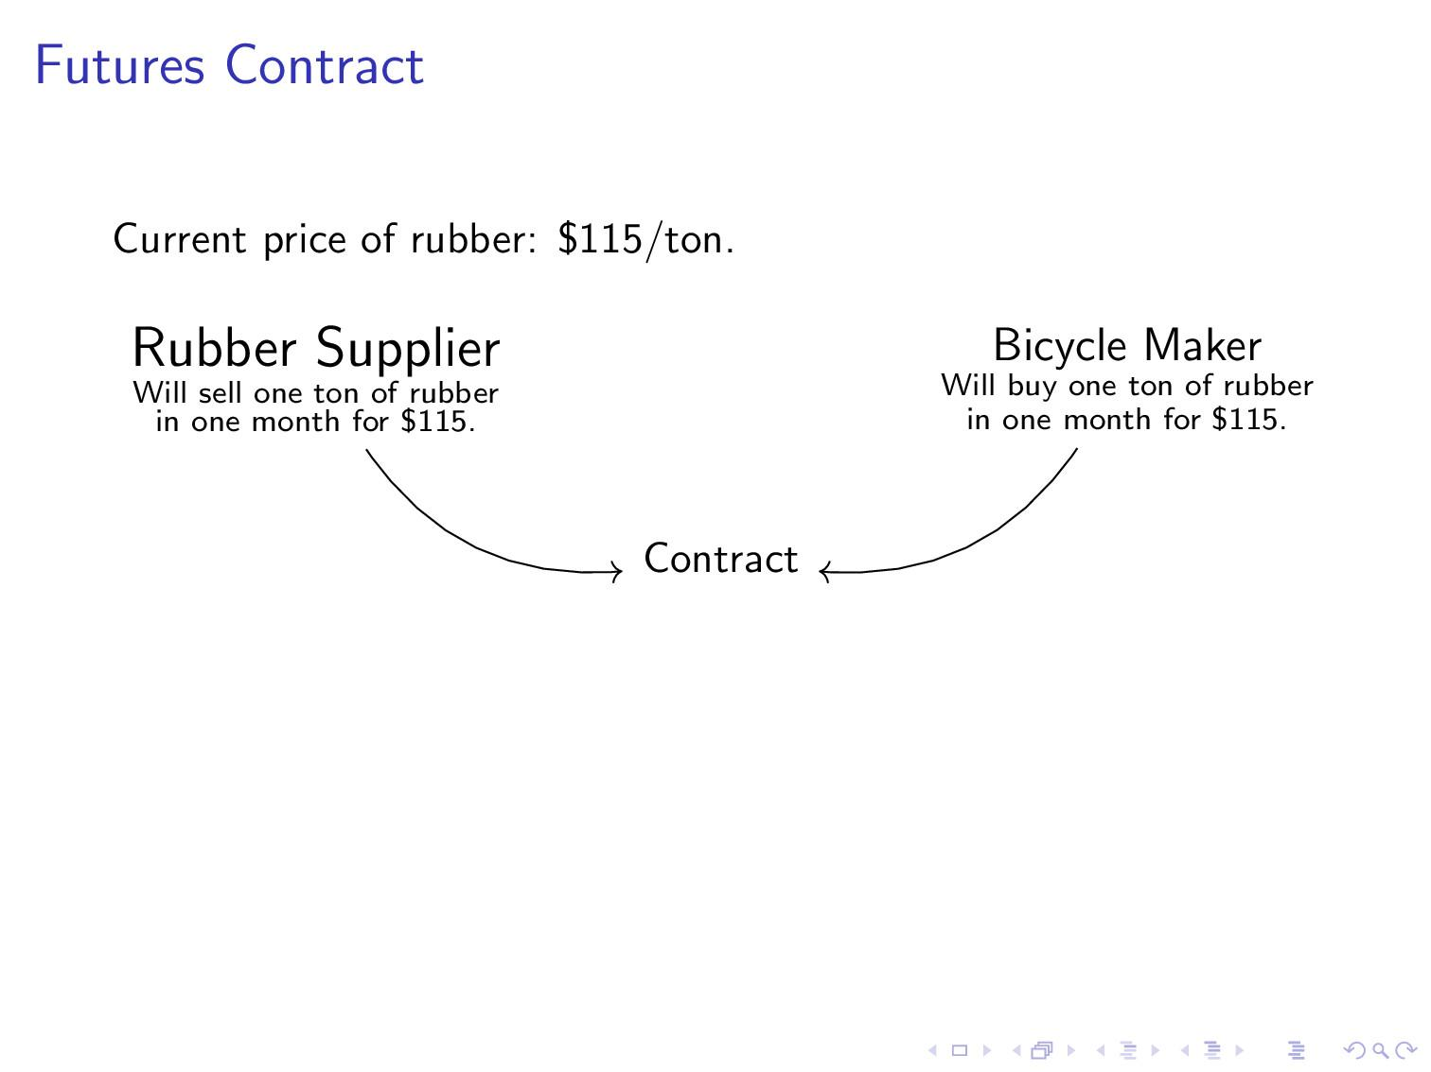

Slide 3
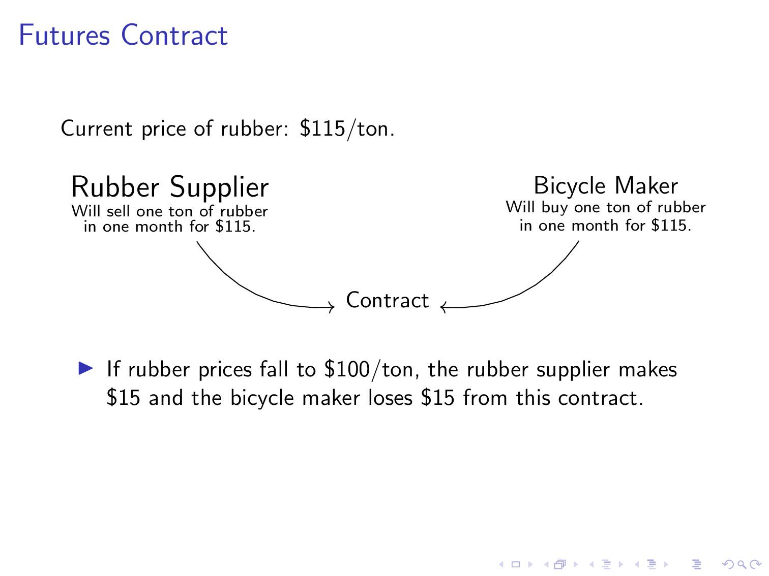

Slide 4
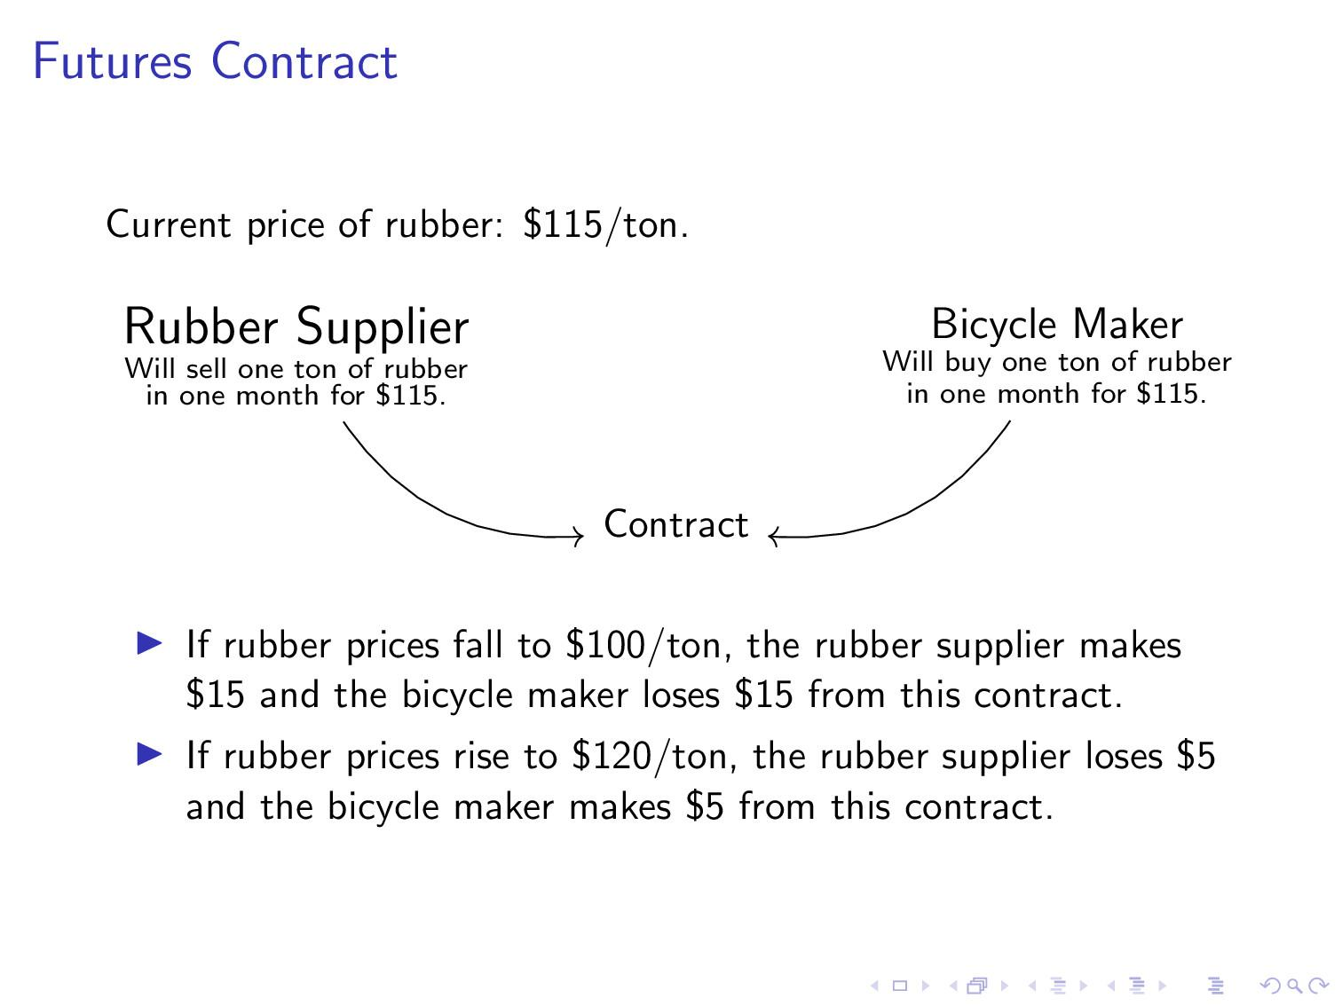

Slide 5
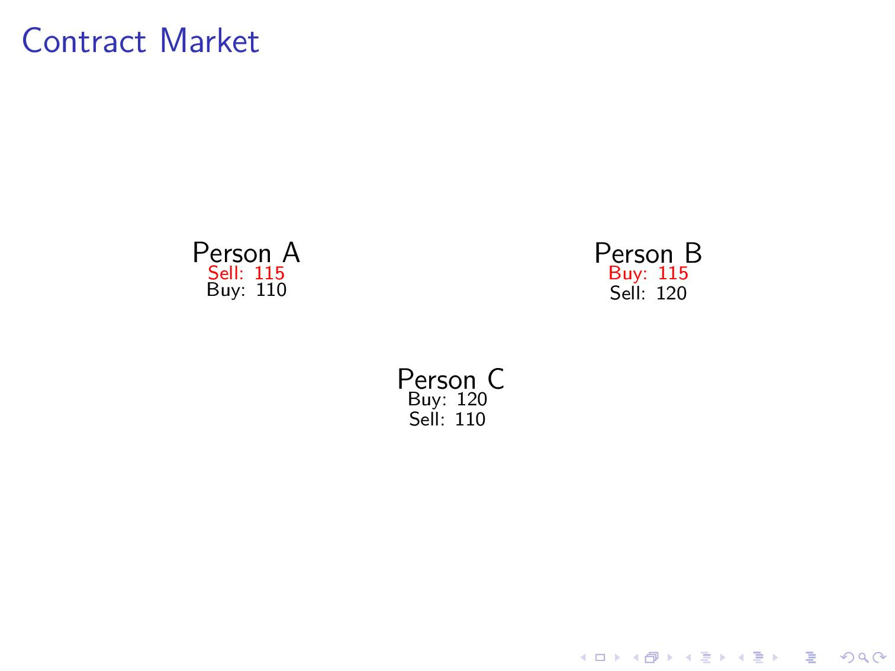

Slide 6
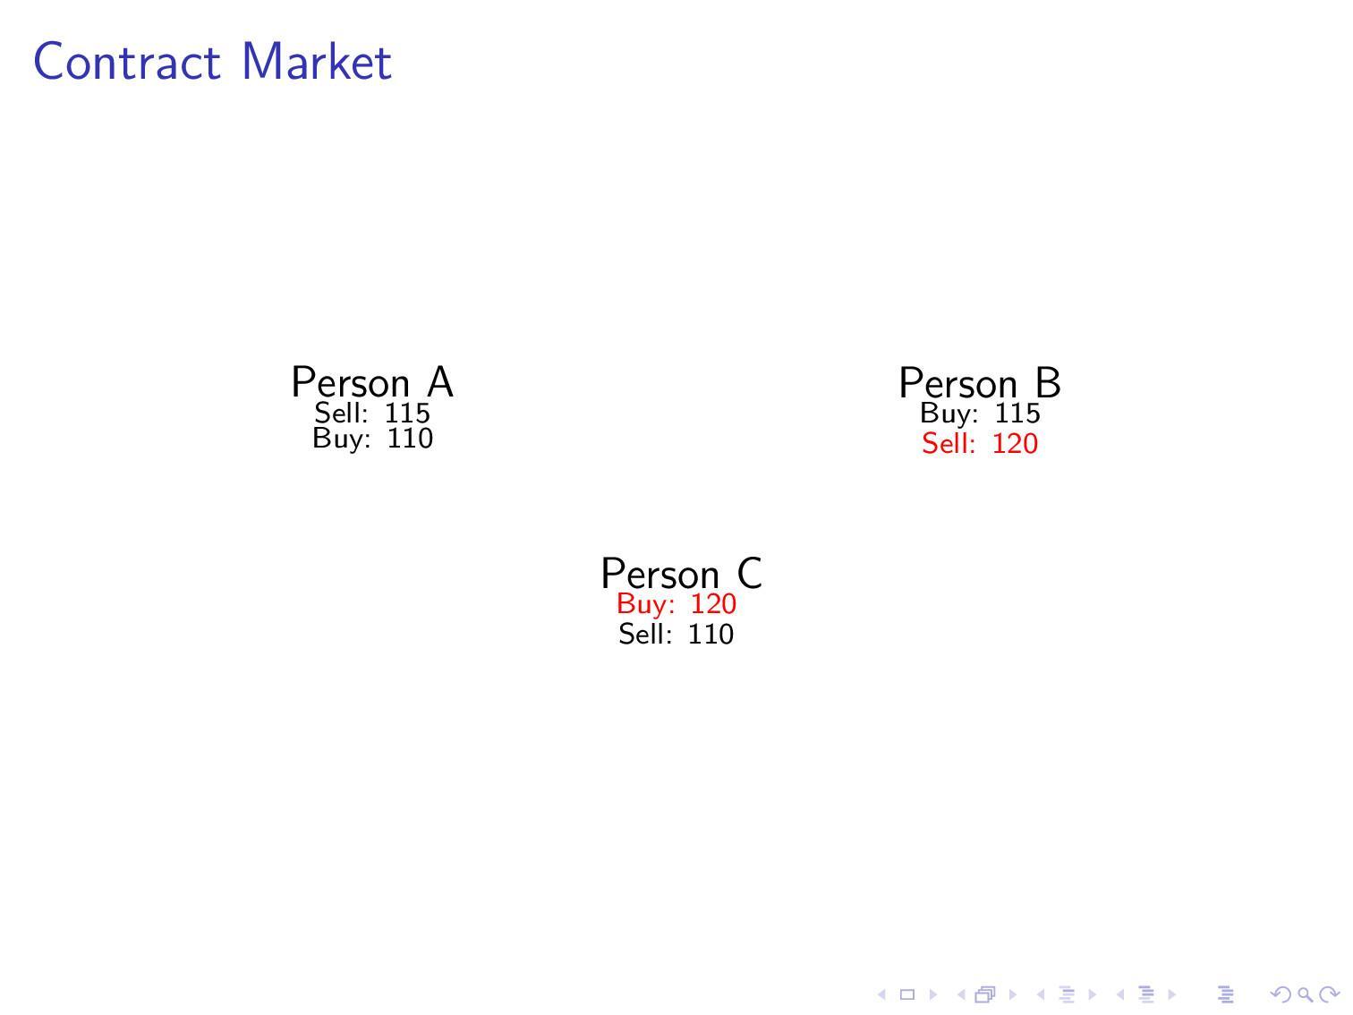

Slide 7
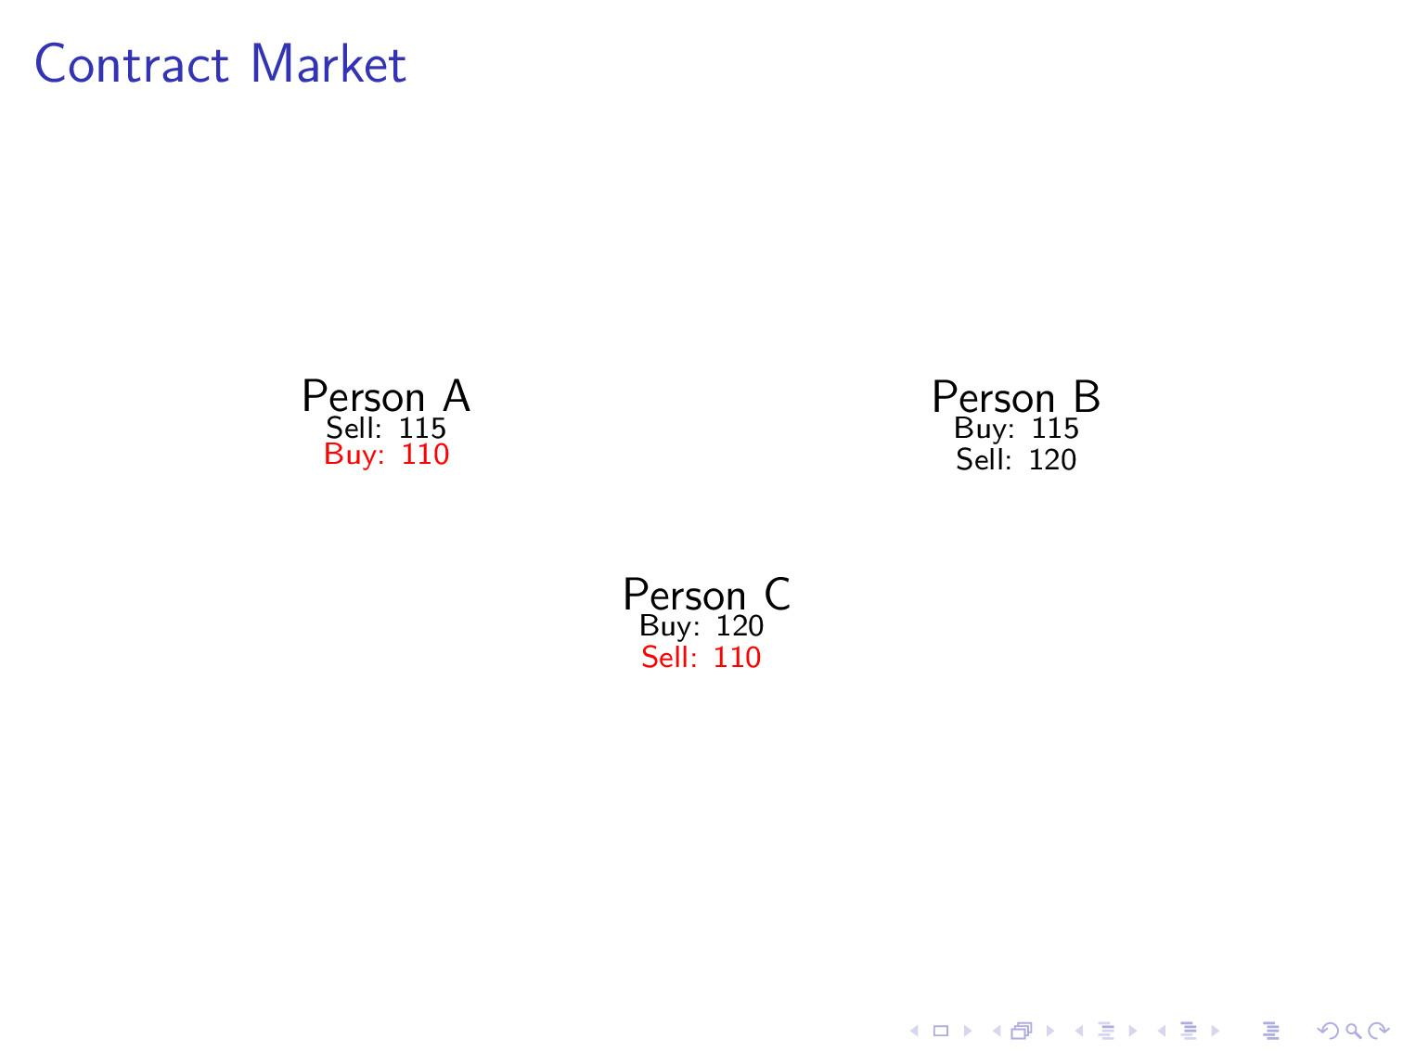

Slide 8
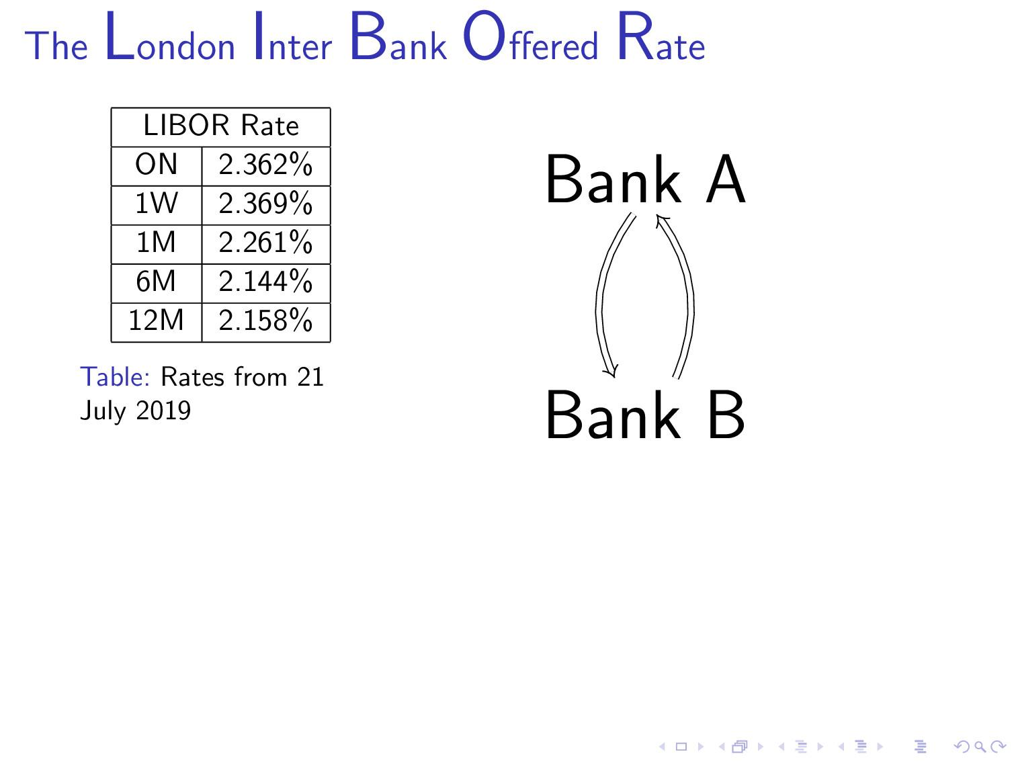

Slide 9
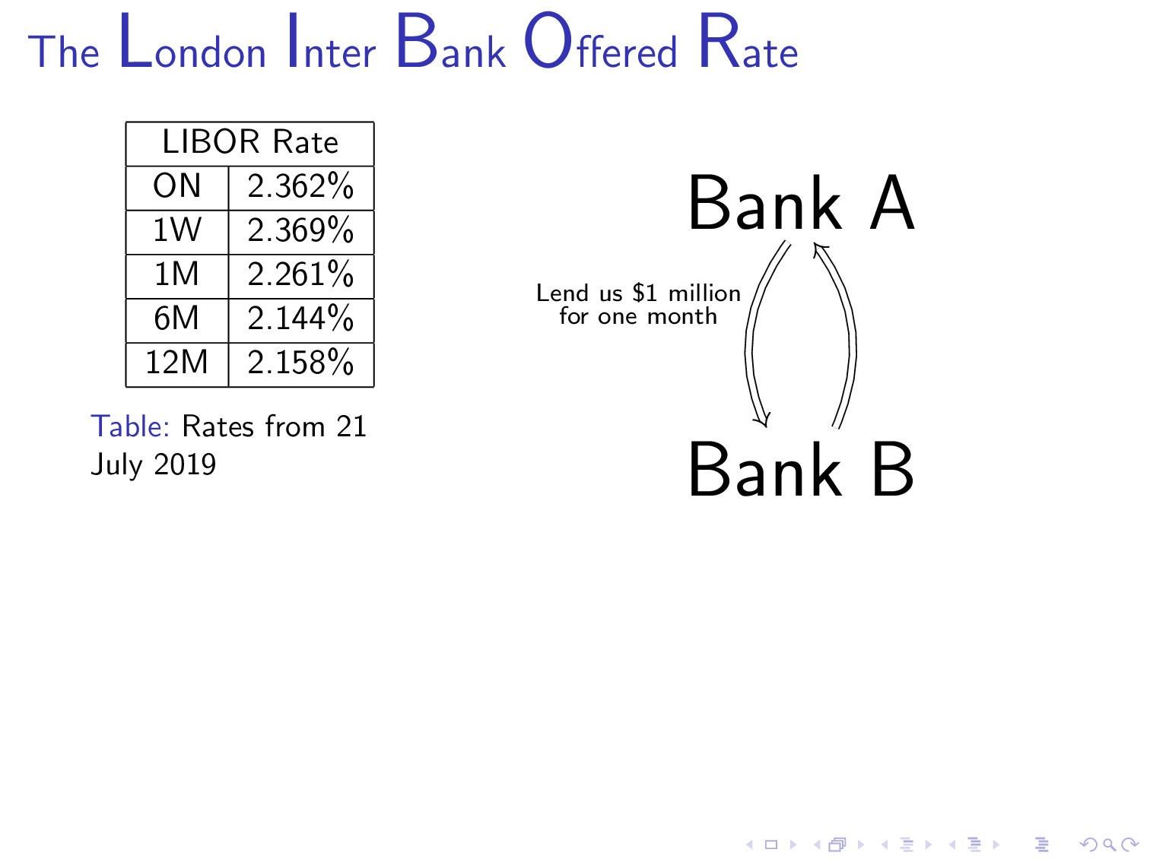

Slide 10
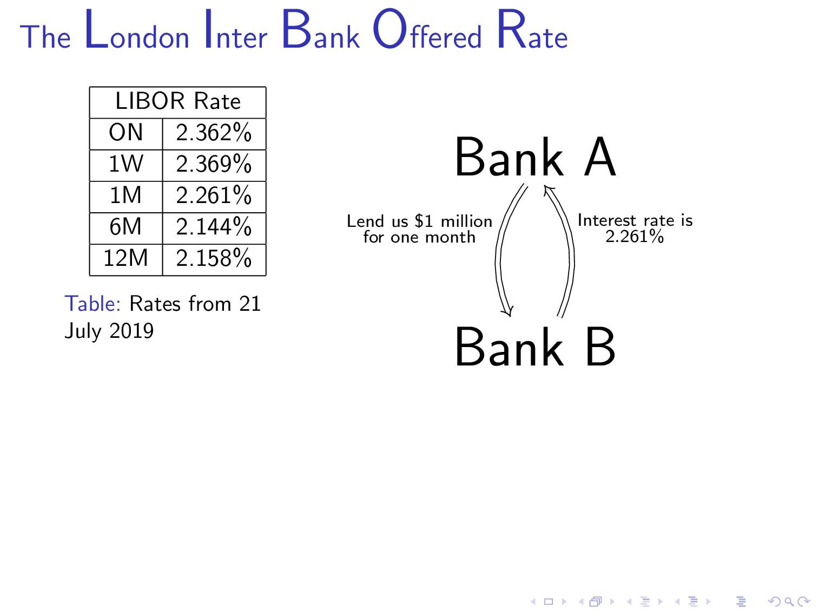

Slide 11
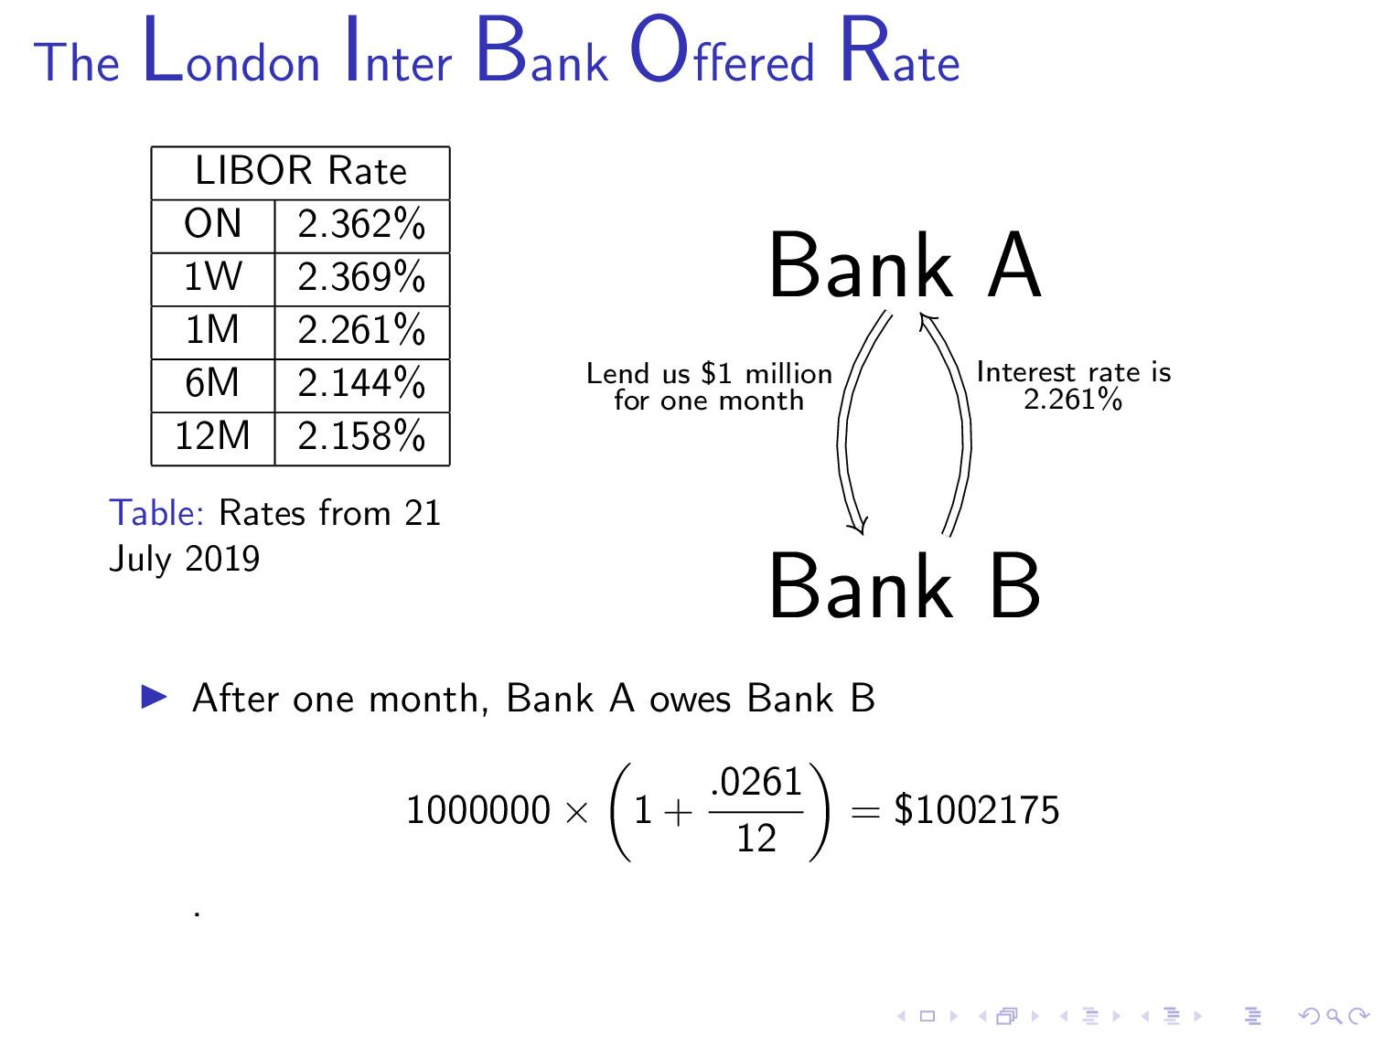

Slide 12
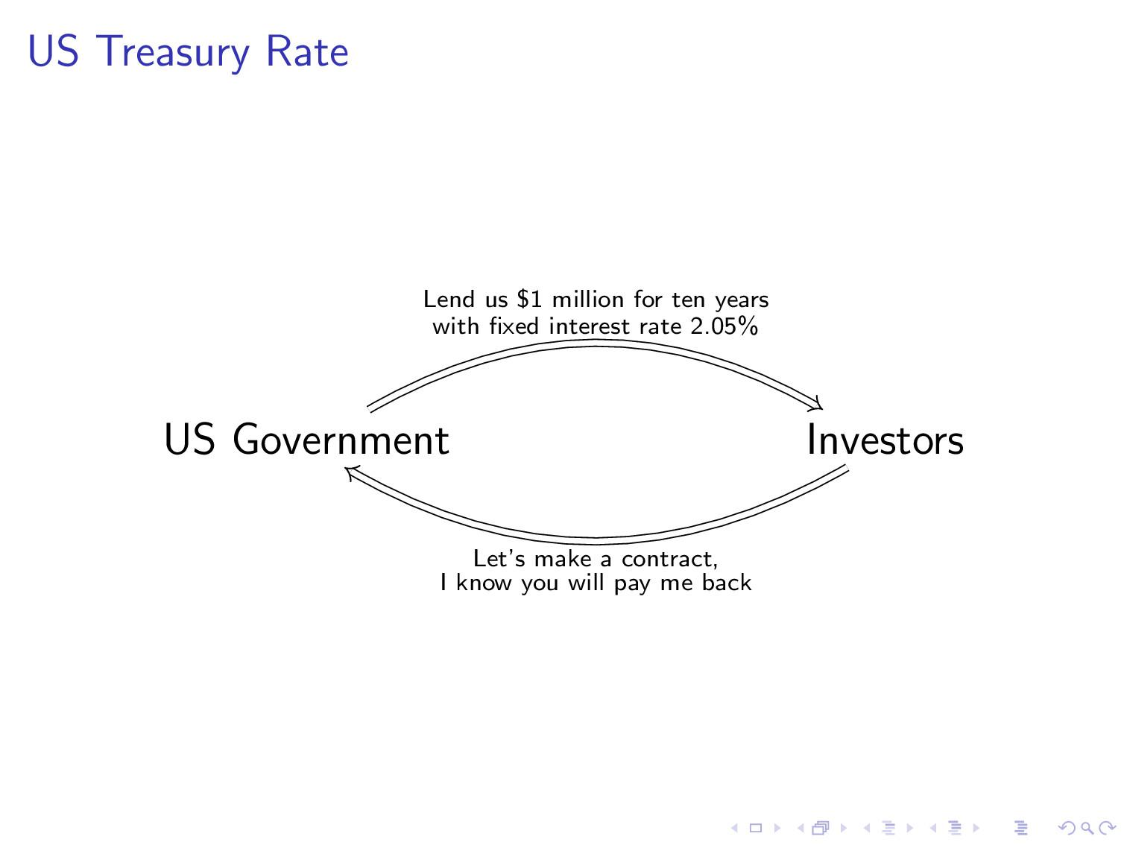

Slide 13
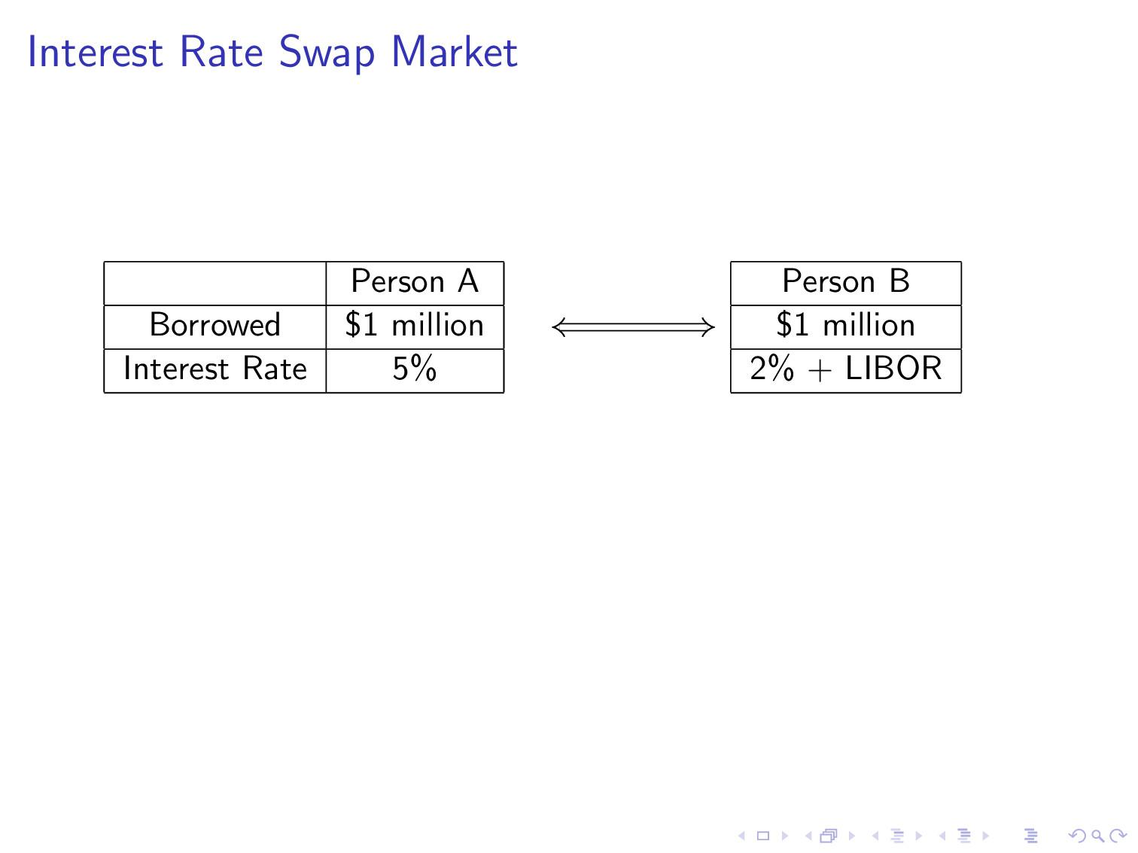

Slide 14
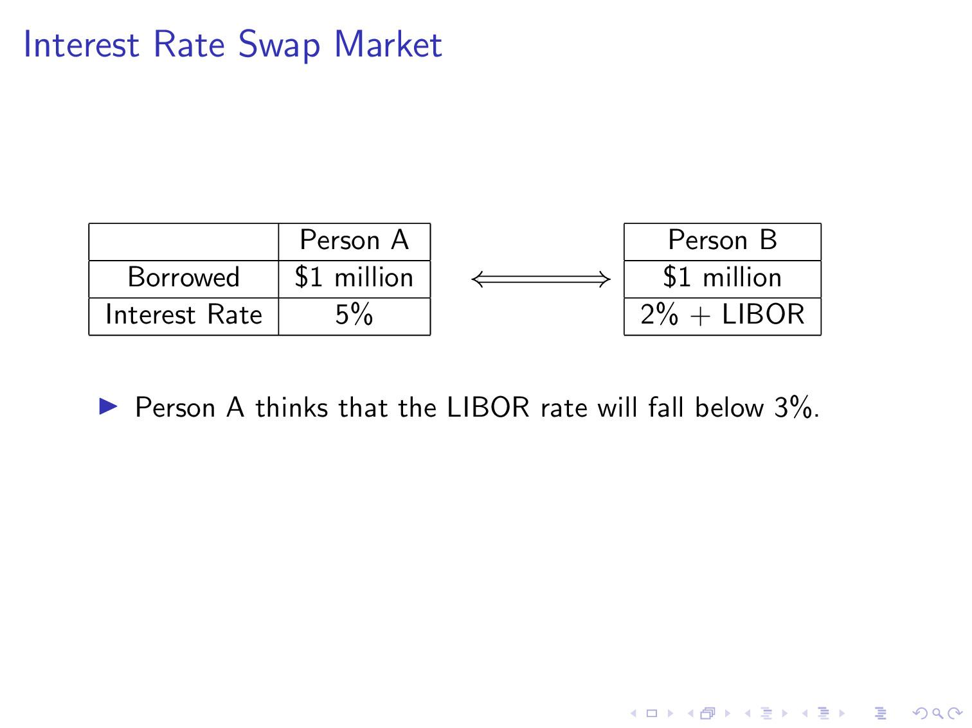

Slide 15
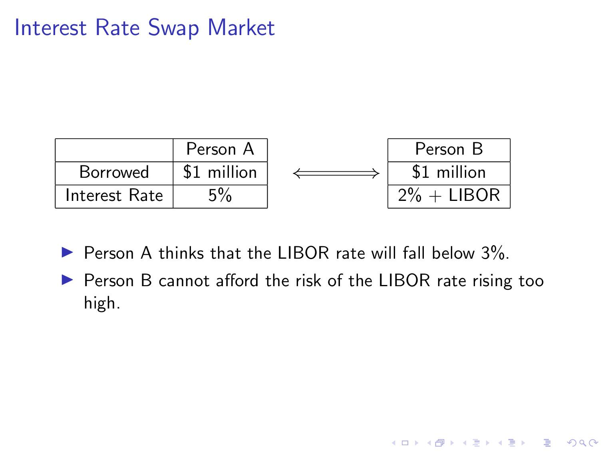

Slide 16
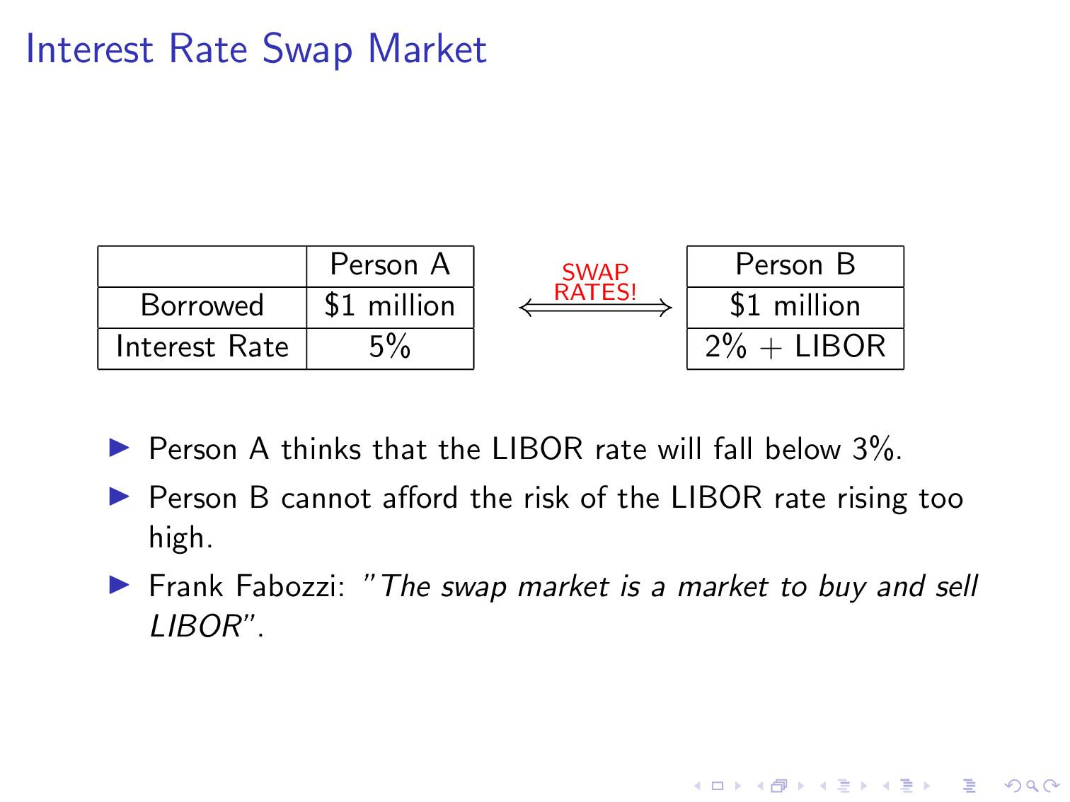

Slide 17
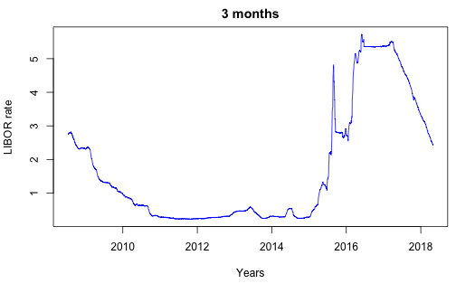

Slide 18
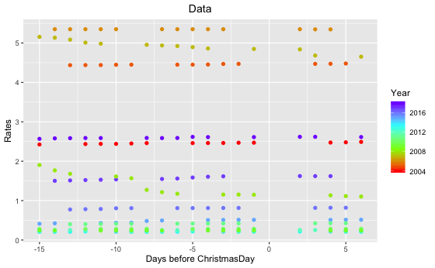

Slide 19
Take away changes accumulated over years to localize holiday effect:
Adjusted_Rates_j = Rates_j - mean(Rates_j),
where j is a year from 2004 to 2018

Slide 20
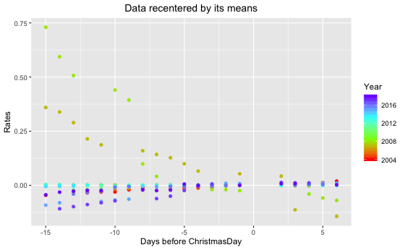

Slide 21
Take those slopes away:
Normolized_Rates_j = Adjusted_Rates_j / slope_j,
where slope_j are obtained thru linear regression with linear functions on each year j from 2004 to 2018.
Now we should expect data look like y = x with noise and a potentially a jump

Slide 22
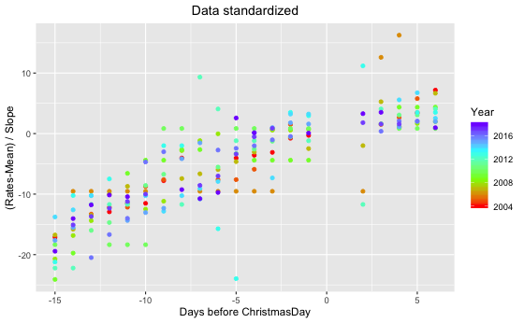

Slide 23
Building the model, finally...
Now we can combine data from all years and run linear regression on them to detect jump.

Slide 24
Results of LIBOR 15d before 6d after Christmas
2M Normalized_Rate = \beta_0 + \beta_1 * relative_date + \beta_{2} * X^{Pre}
Before Holiday: Rate = 2.28180 + 1.23930 * Relative_Date
After Holiday: Rate = (2.28180 - 4.60371) + 1.23930 * Relative_Date
 | 𝛽_0 (p-value) | 𝛽_1 (p-value) | 𝛽_2 (p-value) | R^2Adj | Overall Pval
2004 - 2018 | 2.28180** (0.00123) | 1.23930*** (< 2e-16) | -4.60371*** (0.00012) | 0.7022 | < 2.2e-16

Slide 25
Conclusion
Christmas holiday effect does exist.
We suggest expecting a jump computed as
Jump = -4.60371*s,
where s is slope on 15 days before Christmas current year.

Slide 26

Now you can give us your money.
Thank you!

