Slide 1
LLM Citation Bias
A Compounding Inequality in AI-Generated Academic Text
Multi-Generational Citation Propagation Experiment · GPT-4.5-mini · Knowledge Distillation
30
Seed Papers
6
Generations
210
Papers Total
~4,255
Citations

Slide 2
Key Terms & Definitions
SEED PAPER
NODE / GENERATION
Seed Paper
Node (Generation)
One of 30 real arXiv papers on knowledge distillation / model compression that seed the experiment. Each is assigned a randomized author surname and publish year (2017–2022) before entering the pool, preventing the LLM from recognizing it by name or author identity.
A batch of 30 AI-generated papers produced by GPT-4.5-mini. There are 6 generations (Node 0–5). Each generated paper is shown a random sample of 30 papers from the current pool and asked to cite 5–10 of them. Generated papers receive random author names and years (2017–2025).
CITATION / EXPOSURE RATE
GINI COEFFICIENT
Citation / Exposure Rate
Gini Coefficient
For a given paper, the fraction of times it is cited when it appears in the model's context window. Rate = 1.0 means cited every single time it is shown. Rate = 0.0 means never cited despite being in context. This is the key per-paper signal for detecting LLM preference.
A measure of inequality in the citation distribution, ranging from 0 (all papers equally cited) to 1 (one paper receives everything). Borrowed from economics (income inequality). Calculated here at each generation over cumulative citation counts across the full pool.

Slide 3
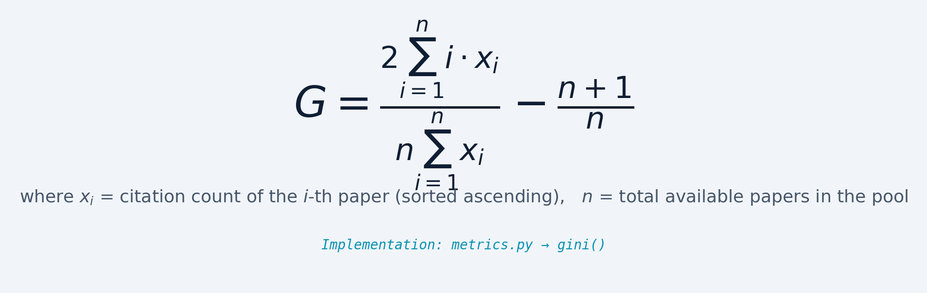
Gini Coefficient — Measuring Citation Inequality
Real-world reference points:
Scandinavia (income): G ≈ 0.27 · USA (income): G ≈ 0.40 · This experiment: G starts at 0.106 and reaches 0.321 · Random citation baseline starts at G ≈ 0.049, confirming the LLM introduces additional concentration beyond what structure alone would produce.

Slide 4
Experiment Progression: How the Design Evolved Across Three Versions
Feature | v1 (Feb 2, 2026) | v2 (Feb 22, 2026) | alpha_0.2.0 (Mar 1, 2026)
Topic | Attention mechanisms in NLP | Attention mechanisms in NLP | Knowledge distillation / model compression
Seed papers | 50 (20–100 citation bucket) | 30 (100–249 citation bucket) | 30 (100–249 citation bucket)
Generations | 5 (stopped — token cost) | 6 | 6
Author anonymization | None — real names/years used | None | Fake names + years (seeds: 2017–2022, generated: 2017–2025)
Paper types | Literature reviews only | Literature reviews only | Literature reviews + position papers
Generated papers cited | Never (~0 citations) | Rarely | Yes — avg. rate ~0.72
Starting Gini (Node 0) | 0.79 (extreme) | Lower (not tracked) | 0.106

Slide 5
Central Claim
When LLMs generate academic papers that cite prior work — and those generated papers are fed back as references for future generations — citation inequality compounds steadily. The driver is not topical relevance but a persistent LLM preference for human-written papers.
Inequality compounds 3× across 6 generations (Gini: 0.106 → 0.321), exceeding random and semantic-relevance baselines at every step.
Seed papers (human-written) are cited at 85–93% rates; AI-generated papers decline toward 0. The gap is not explained by topic relevance — it correlates inversely (r = −0.693).
If LLMs assist literature review at scale, they risk amplifying existing citation concentration via machine preference, creating a new Matthew Effect in science.

Slide 6
Experiment Design — alpha_0.2.0
SETUP
SEED
GEN 0
GEN 1
GEN 2
30 real arXiv papers on knowledge distillation / model compression. Each is anonymized with a random author surname and publish year (2017–2022) before entering the pool.
30 papers
30 papers
30 papers
30 papers
GEN 3
GEN 4
GEN 5
PROCESS
30 papers
30 papers
30 papers
GPT-5-mini generates 30 papers per generation (6 total). Each paper is shown 30 randomly sampled papers from the current pool and must cite 5–10 inline. Generated papers receive random author names + years 2017–2025.
Pool grows each generation: 30 → 60 → 90 → 120 → 150 → 180 → 210 total
Fake author names + publication years on ALL papers ensure the LLM cannot recognize individual papers by identity. Paper types: ~50% literature reviews, ~50% position papers.
RESEARCH QUESTION
~4,255 citations generated · 0.16% hallucination rate
Does citation inequality grow as AI-generated papers are fed back as references for future AI-generated papers? And what drives the inequality — topic relevance, or something else?

Slide 7
Methodology — Paper Structure & Data Collection
PAPER INPUT
OUTPUT
Exposed Paper Fields
Generated Paper Types
Each paper shown to the LLM contains only: title, abstract, body text, and author name. No metadata like citation counts, journal, or publication venue.
The LLM produces literature reviews and position papers. All inline citations appear in the generated text body, mirroring how the seed papers were structured.
CONSISTENCY
CITATION COUNT
Input Standardization
Inline Citation Extraction
Seed papers follow the same title/abstract/body/author structure. This ensures the random pool papers have consistent formatting with the real arXiv seed papers.
Citations were counted using regex pattern matching on inline references (e.g. Smith, 2020). This avoids reliance on LLM self-reporting of citation counts.
NAME FILTERING
SEED CUTOFF
Fake Author Name Generation
Pre-November 2022 Seeds
Author names generated via Python Faker library (not LLM). Names with multiple words or apostrophes were discarded. Duplicate name-year combinations were also removed.
All 30 seed papers predate GPT's training cutoff (Nov 2022). A future experiment could add post-cutoff papers to test whether the model over/undercites pre-cutoff work.

Slide 8
Methodology — Design Rationale & Future Directions
ANONYMIZATION
POOL GROWTH
Why Fake Names & Years?
Expanding Context Pool
Prevents the LLM from recognizing papers by author reputation or recency. Seeds get years 2017–2022; generated papers get 2017–2025 to create overlap without a clean temporal signal.
Pool grows from 30 to 210 papers across 6 generations. Each generation, the LLM sees a random sample of 30 papers from the current pool and must cite 5–10 of them.
SINGLE TOPIC
SINGLE MODEL
Only Knowledge Distillation
GPT-4.5-mini Only
Only one research topic was tested. v1 used attention mechanisms and produced extreme Gini (0.79). Topic familiarity is a significant variable worth exploring across domains.
Only one LLM was tested. Different models with different training data, RLHF tuning, or temperature settings may produce different citation distributions and preference patterns.
FUTURE WORK
FUTURE WORK
Post-Cutoff Paper Injection
Cross-Topic & Multi-Model
Adding papers published after Nov 2022 would test whether the model systematically over/undercites papers from its training window vs. truly unseen research.
Repeating the experiment across multiple topics and LLMs would reveal whether citation bias is a universal LLM behavior or specific to certain model-topic combinations.

Slide 9
Scope, Limitations & Potential Biases
SINGLE MODEL
SINGLE TOPIC
Single Model: GPT-4.5-mini
Single Topic: Knowledge Distillation
Only one model was tested. Different LLMs with different training data, RLHF, or temperature settings may cite differently. The specific magnitude of inequality may not generalize.
Only one research topic was used. v1 (attention mechanisms) produced extreme Gini (0.79) because the LLM had strong priors about famous attention papers. Topic familiarity is a significant confound.
TRAINING BIAS
FIRST-MOVER
LLM Training Data Familiarity
First-Mover Structural Advantage
GPT-4.5-mini may have encountered real seed papers during pretraining. Even with anonymized names and years, abstract content and terminology could make real papers subtly recognizable to the model.
Seed papers appear in citation pools for all 6 generations; papers added in Gen 3 can only be cited in 3 remaining gens. Some inequality is structural — not purely a quality preference.
TEMPORAL SIGNAL
POOL SAMPLING
Date Range Overlap
Random 30-Paper Sampling
Seeds use years 2017–2022; generated papers 2017–2025. If the LLM associates recency with relevance, the partial overlap introduces a mild temporal preference signal.
Each paper sees only 30 randomly sampled context papers (not the full pool). Low-quality papers may appear in fewer samples by chance, confounding citation rate estimates.

Slide 10
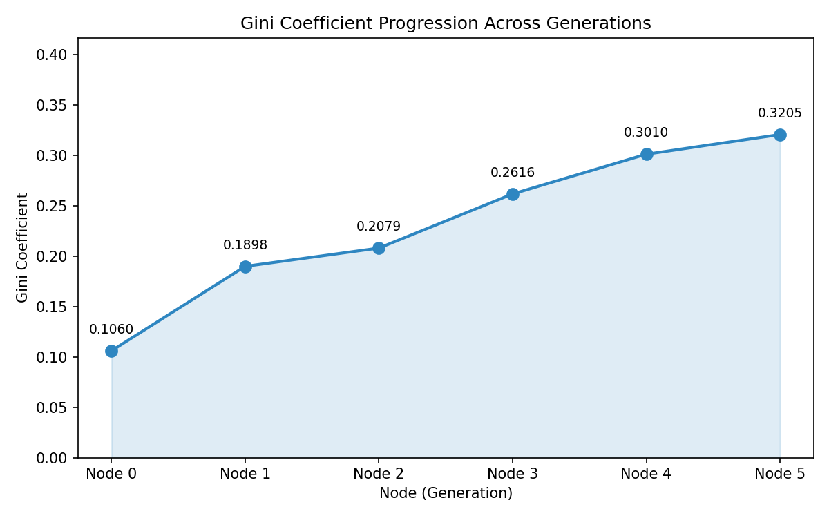
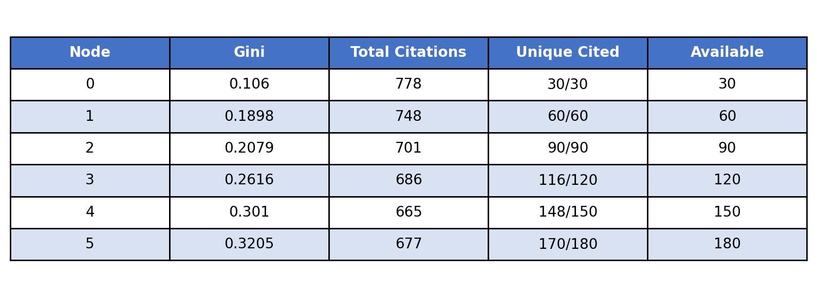
Finding 1: Citation Inequality Nearly Triples Over 6 Generations
3×
0.321
Increase in Gini
Gini at Gen 5
(from 0.106)
The Gini rises monotonically — 0.106 → 0.190 → 0.208 → 0.262 → 0.301 → 0.321 — with no regression at any generation. This monotonicity is critical: it rules out a transient initialization artifact and points to a stable, persistent mechanism. For reference, a Gini of 0.3+ is comparable to moderate income inequality in developed economies.

Slide 11
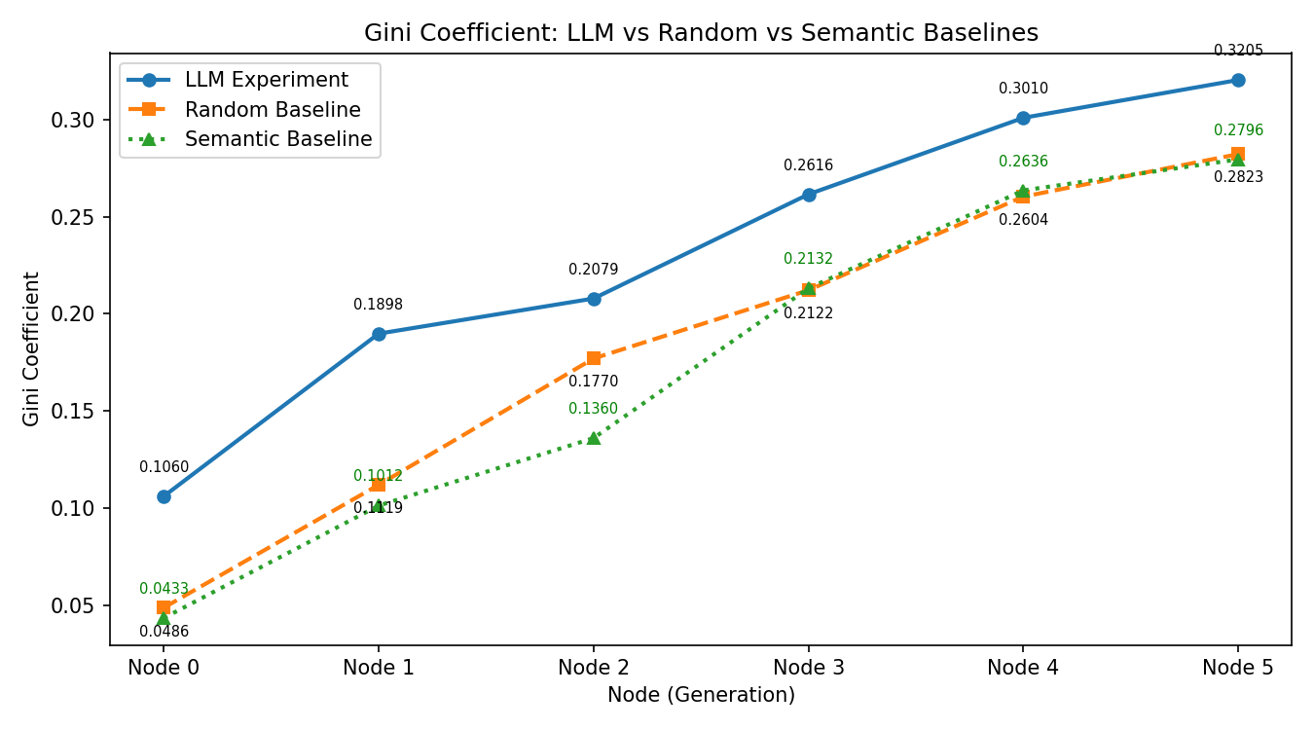
Finding 2: LLM Inequality Exceeds Random & Semantic Baselines at Every Generation
Two baselines were constructed: Random (citations assigned uniformly at random from the available pool) and Semantic (citations assigned by cosine similarity between abstracts). The LLM exceeds both at every generation. Gap is largest early (Gen 0: LLM 0.106 vs. baselines ~0.04–0.05) and narrows by Gen 5 (0.321 vs. ~0.28), confirming that the LLM introduces additional concentration beyond what pool structure or relevance alone would produce.

Slide 12
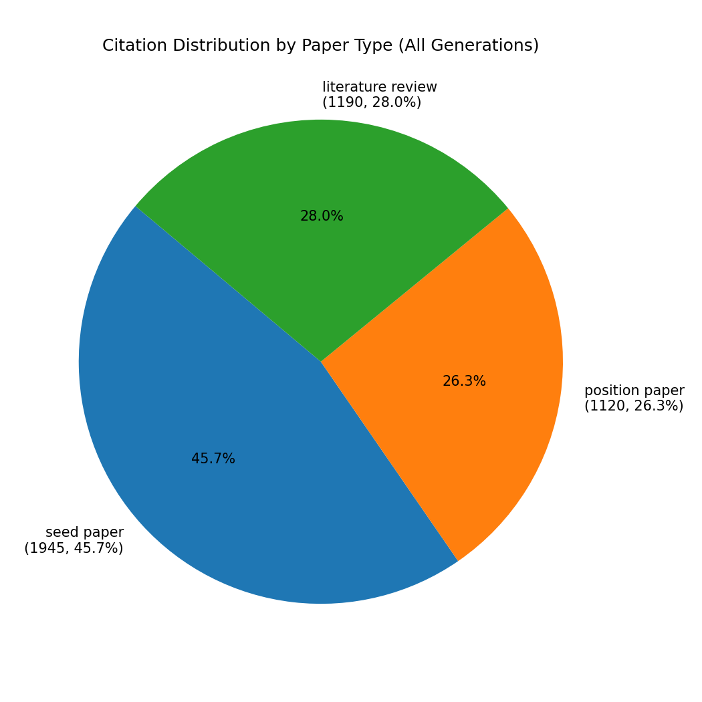
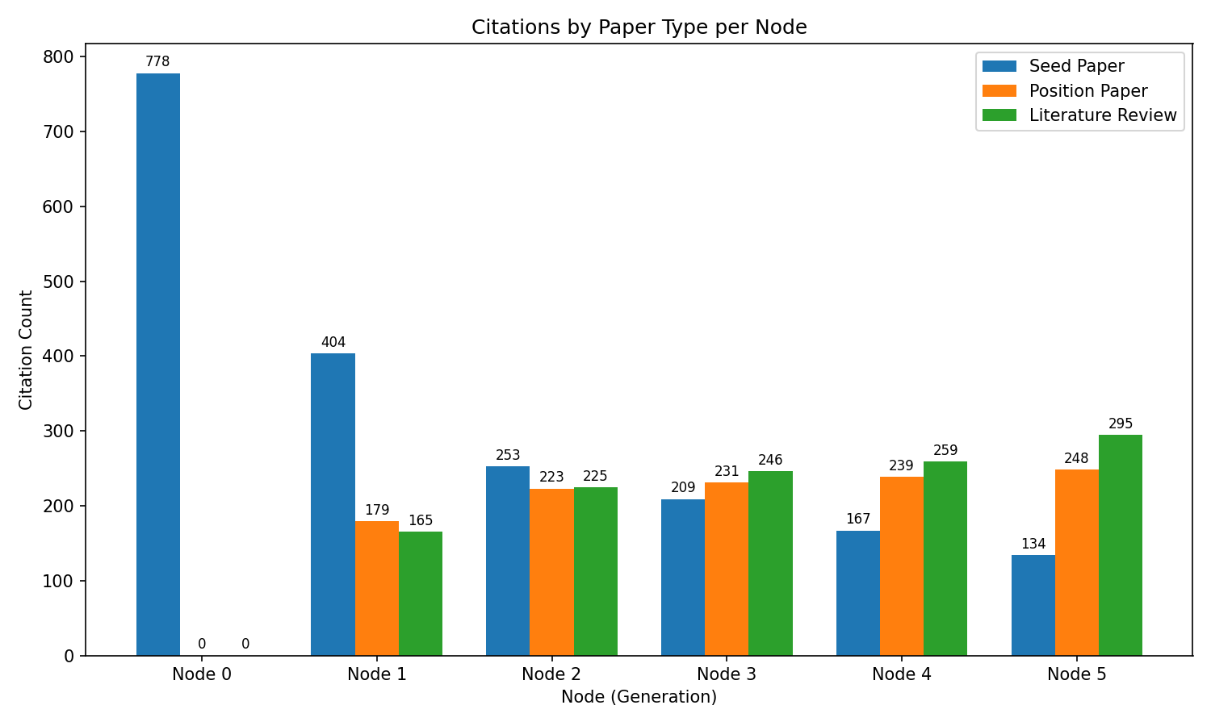
Finding 3: Seed Papers Capture a Disproportionate Share of Citations
14.3% of the pool (30/210 papers) → 45.7% of all citations (ratio 3.2:1) · Top 27 globally most-cited papers are ALL seed papers · First AI paper appears at rank 28

Slide 13
Why Do Seed Papers Dominate? Two Compounding Mechanisms
① First-Mover Structural Advantage
② Real-Paper Quality Preference
Seed papers participate in all 6 generations of citation accrual. A paper added at Generation 3 can only be cited in Generations 3–5 (3 opportunities). A seed paper is cited across all 6. Example: A seed paper with a citation/exposure rate of 0.85 is shown in prompts for all 6 generations. A Gen 3 paper with the same rate has only half the opportunities. This temporal structural advantage would produce some concentration even with perfectly uniform citation rates — but the model adds further preference on top of it.
Even controlling for exposure timing, seed papers are cited at significantly higher rates than generated papers: Seeds: 0.85–0.93 citation/exposure rate Generated: 0.70–0.75, declining in later generations Several papers (N4P20, N2P27, N2P28) have rates near or at 0.0 — completely ignored despite being shown repeatedly. Likely drivers: Real abstracts are more polished, have higher technical density, and use well-structured academic register. The LLM may treat these signals as proxies for citation-worthiness — independent of whether the paper is topically relevant.

Slide 14
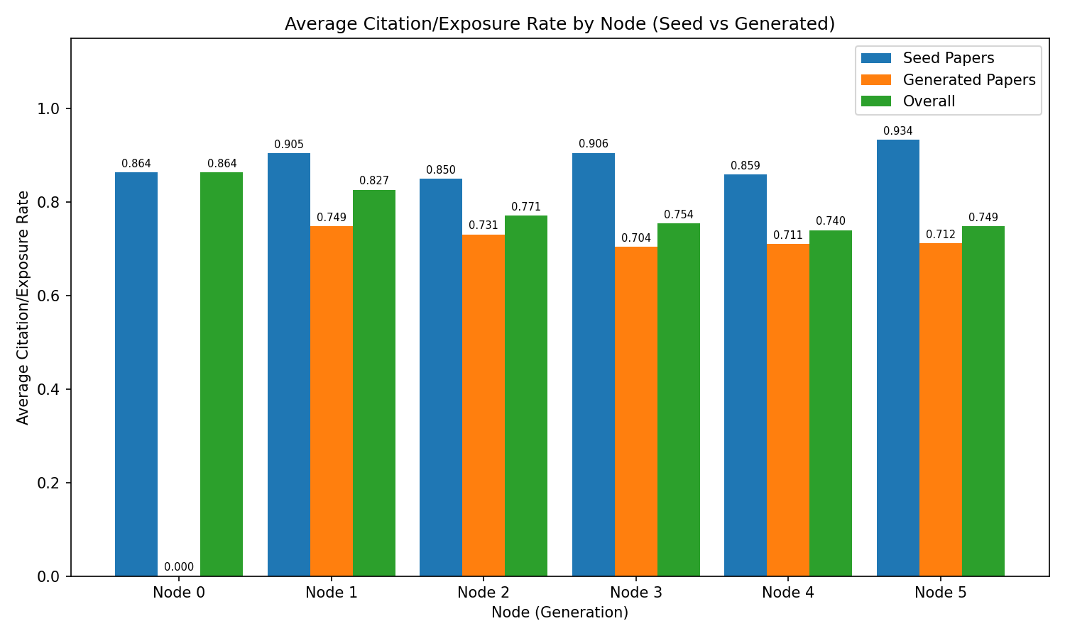
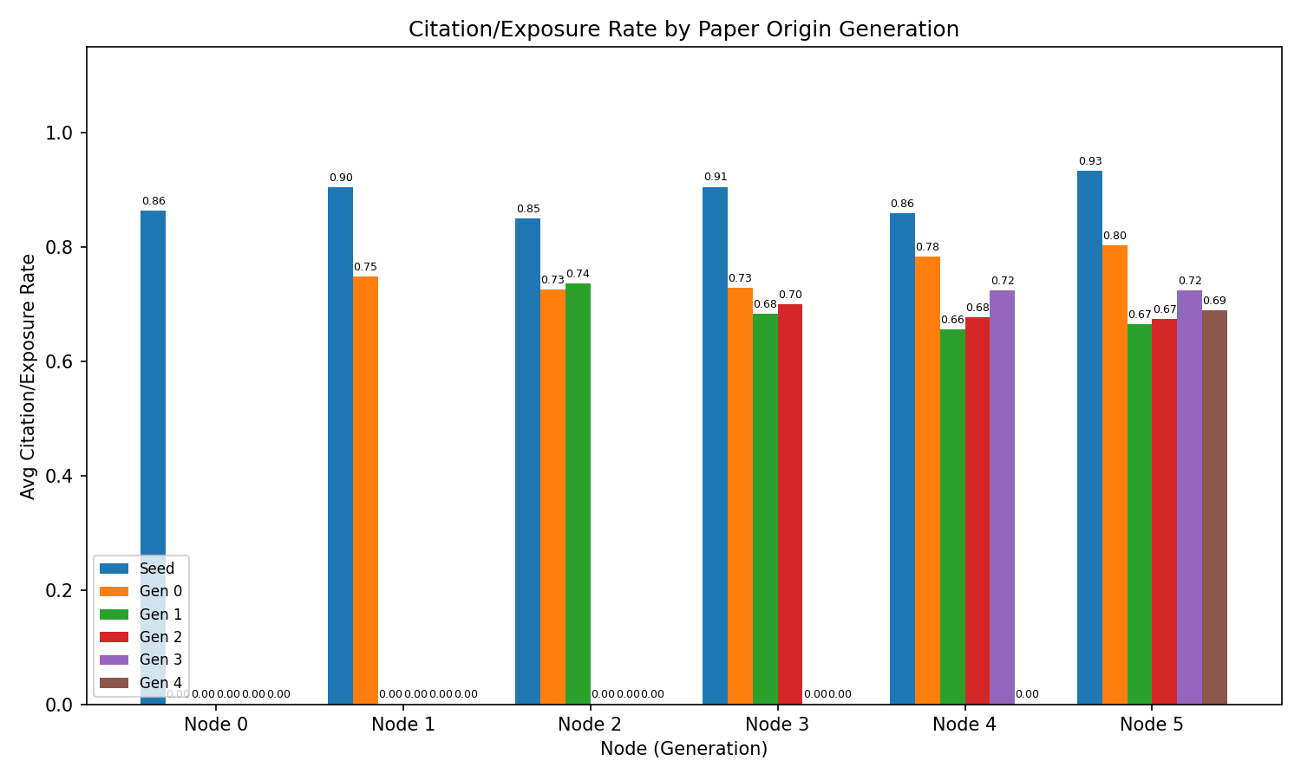
Mechanism: Seeds Cited Near-Perfectly; Generated Papers Declining with Each Generation
Seeds: 0.85–0.93 citation rate
Generated papers: declining by generation of origin
Shown any real paper and it is almost always cited. Rates remain stable across all six generations, confirming durable LLM preference.
Gen 0 papers cited at ~0.77; Gen 1 at ~0.70; Gen 2+ at ~0.66. N4P20: rate = 0.0. The gradient by origin generation reveals compounding discrimination.

Slide 15
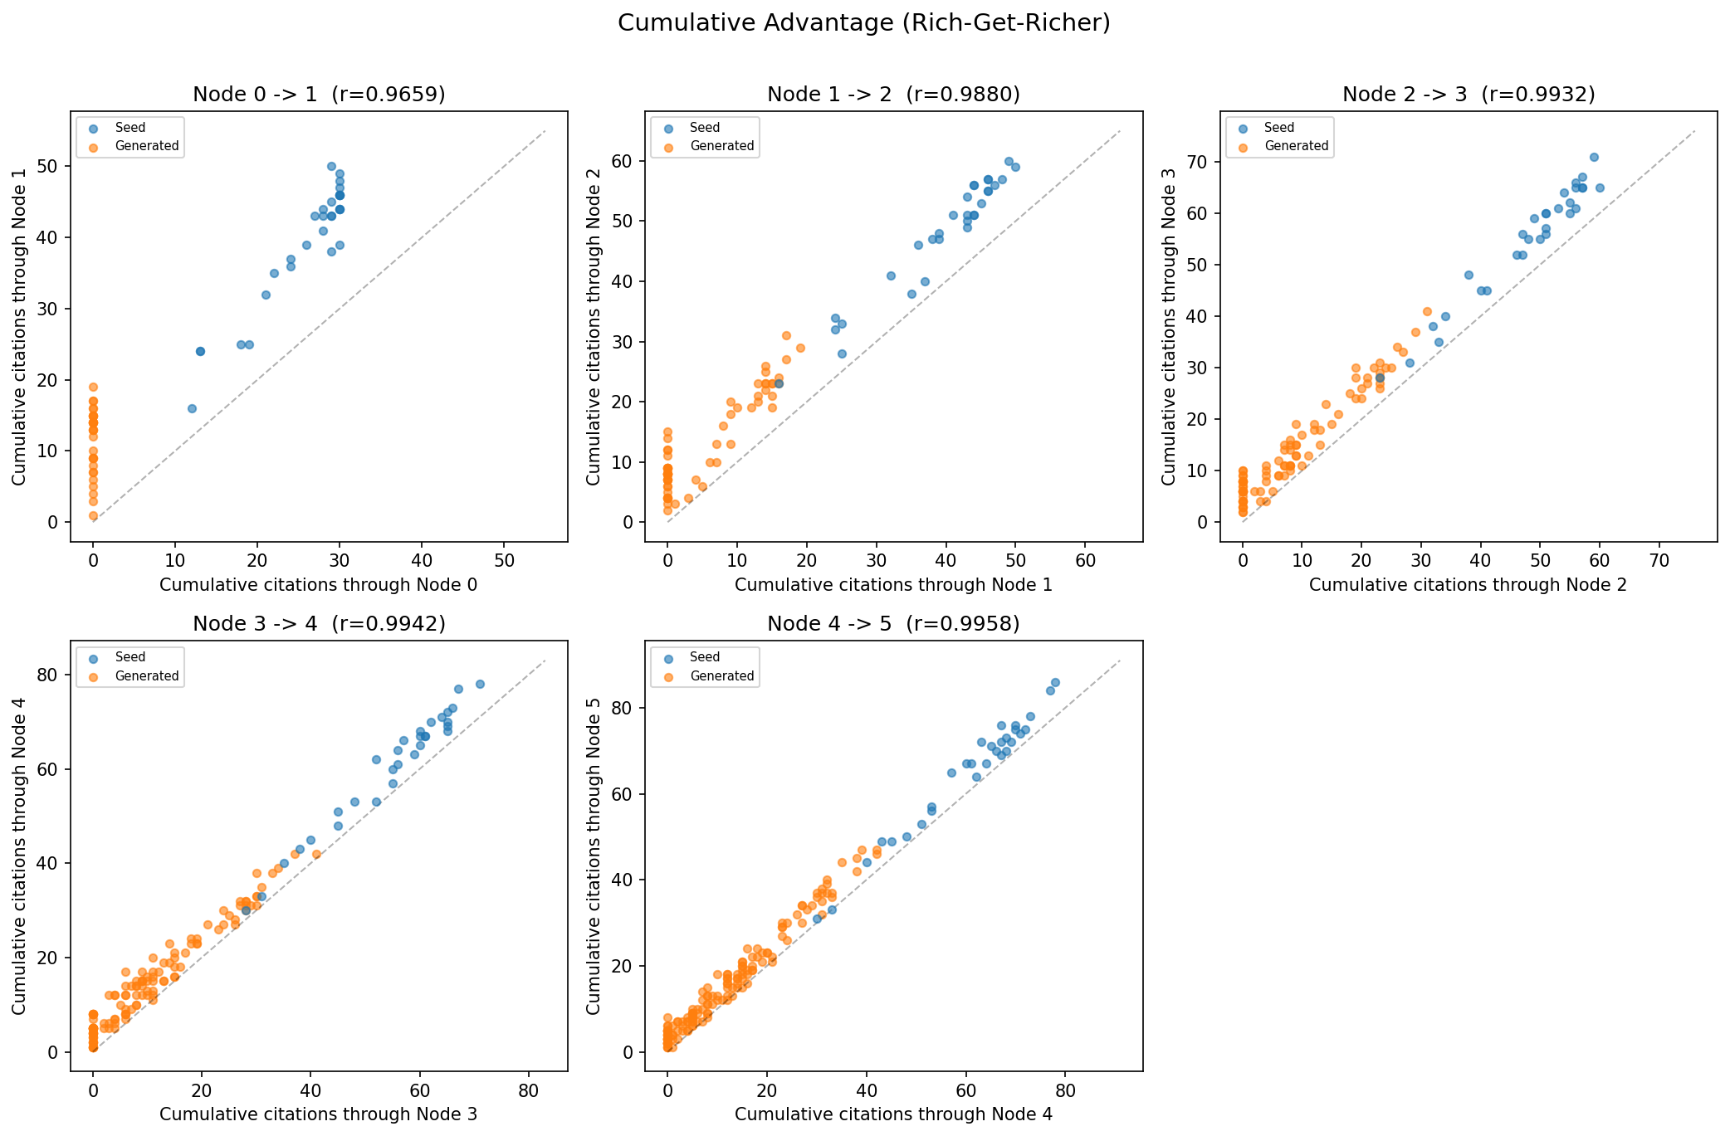
Finding 4: Rich-Get-Richer — Cumulative Citations Predict Future Citations
Correlations r ≈ 0.97–0.996 between consecutive generations, approaching 1.0 as the distribution locks in. Seed papers (blue) cluster upper-right; generated papers (orange) cluster lower-left. A paper that starts behind almost never catches up. Once excluded, always excluded.

Slide 16
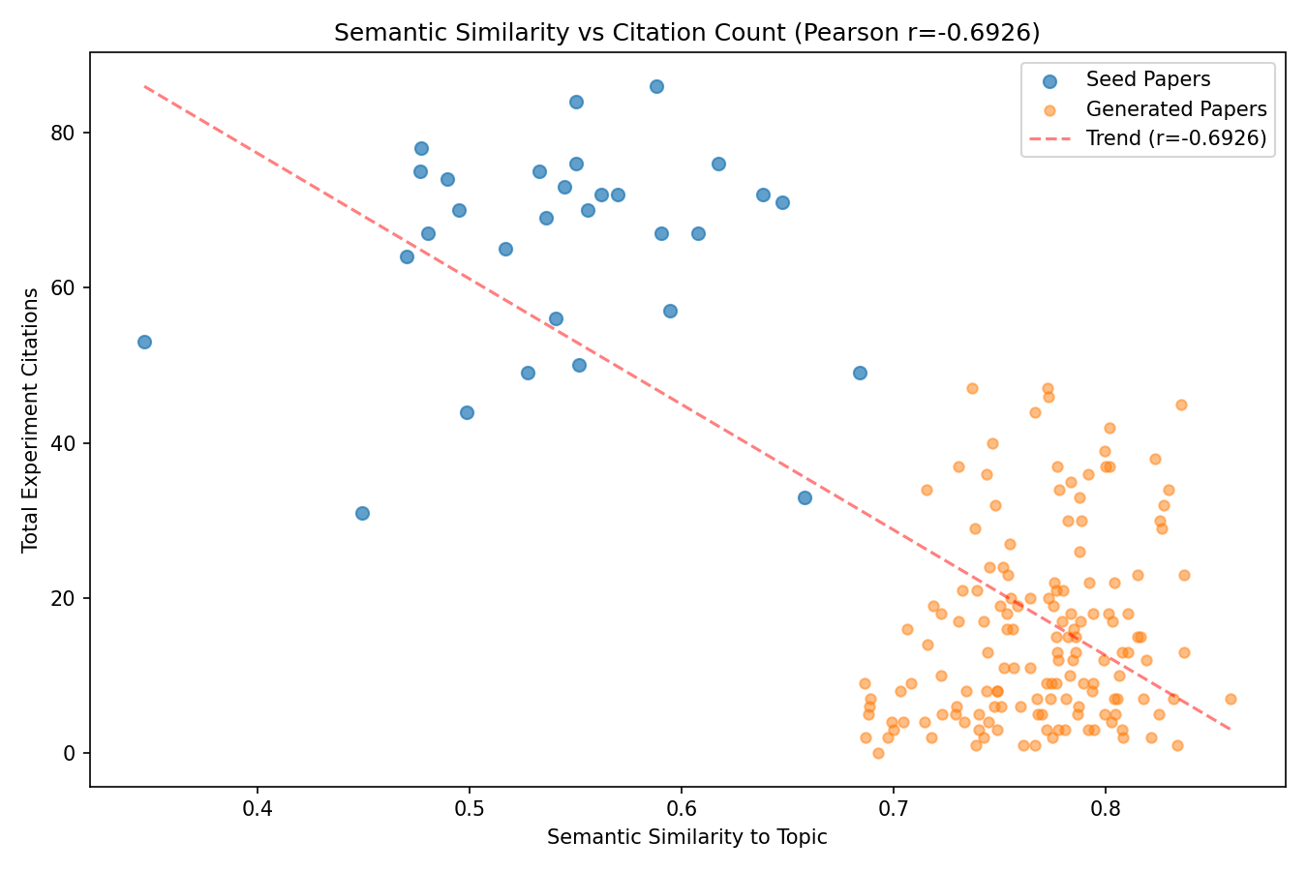
Finding 5: Inverse Relationship — More Topically Relevant Papers Are Cited Less
Pearson r = −0.693
Semantic similarity vs. total citations
If the model cited by relevance, we would expect a positive correlation. Instead: Seed papers score lower semantic similarity to the topic (foundational concepts, broader scope) yet receive far more citations. Generated papers score higher similarity (directly on-topic) yet are cited less. Conclusion: The LLM responds to abstract writing quality and academic register — not topical alignment.

Slide 17
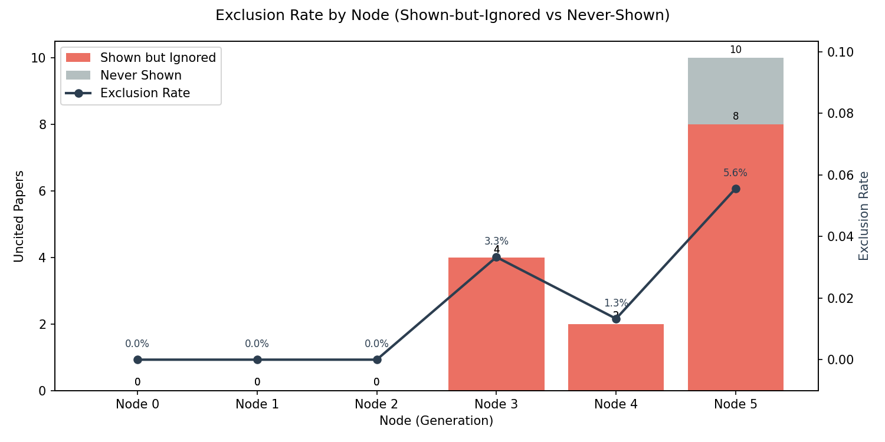
Finding 6: A Growing Tail of Papers Is Completely Excluded from Citation
10
0
Papers never cited
in Gen 5 (5.6%)
Uncited in
Gens 0, 1, 2
Exclusion progression:
Gen 0–2: 0 uncited · Gen 3: 4 papers (3.3%) · Gen 4: 2 papers (1.3%) · Gen 5: 10 papers (5.6%) — a notable acceleration. These 10 papers were not merely under-cited — they were never cited despite appearing in multiple context windows. This indicates active discrimination, not sampling unluck. The model consistently refuses to cite them even when they are placed directly in front of it. As the pool grows to 180 papers and only 30 are shown per context, a subset of papers falls permanently below the model's attention threshold.

Slide 18
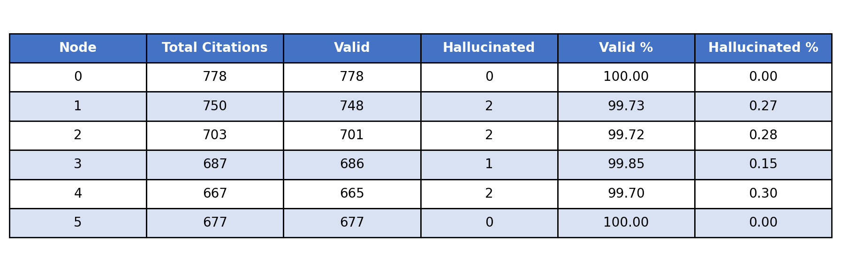
Finding 7: Near-Zero Hallucinations — Inequality Reflects Genuine LLM Selection
Only 7 citations out of ~4,255 total were hallucinated (0.16%). This extremely low rate is essential: it confirms that the inequality patterns are not noise or confabulation artifacts. When the model omits a paper, it is not 'forgetting' or inventing alternatives — it is actively choosing not to cite it from among the papers placed directly in front of it. All citation behavior in this experiment therefore reflects real, reproducible LLM selection preferences that compound across generations.

Slide 19
Formalized Analysis
The evidence converges on a single mechanism: LLMs exhibit a persistent, measurable preference for human-written text that compounds across generations. This is not driven by topical relevance but by latent quality signals in academic writing.
Compounding inequality: Gini triples 0.106 → 0.321 monotonically across 6 generations, exceeding random (0.049–0.280) and semantic (0.043–0.282) baselines at every step. [Findings 1–2]
Mechanism identified: Seeds cited at 85–93% rates vs. generated papers at 70–75% (declining by origin generation). Inverse correlation with semantic similarity (r = −0.693) rules out relevance as the driver. [Findings 3–5]
Growing exclusion tail: 10 papers (5.6%) receive zero citations by Gen 5, despite repeated exposure. Combined with 0.16% hallucination rate, this confirms active LLM selection, not noise. [Findings 6–7]

Slide 20
Conclusion
Inequality compounds significantly across generations
Gini triples (0.106 → 0.321) across 6 generations, exceeding both random and semantic-relevance baselines at every step. The progression is monotonic, pointing to a stable and persistent mechanism.
The driver is LLM preference for 'real-looking' papers, not relevance
Seeds are cited at 85–93% rates vs. declining rates for generated papers. The preference correlates inversely with semantic similarity (r = −0.693), ruling out topic relevance as the cause. Writing quality and abstract polish appear to be the key signals.
Implication: A New, Machine-Driven Matthew Effect in Science
LLMs assisting literature review may systematically amplify citation concentration — not through human prestige biases, but through latent quality-signal preferences. A growing tail of papers (10 uncited by Gen 5) falls permanently below the model's attention threshold.

Slide 21
Questions?
Thank you for your attention.
Anthony Qin · alpha_0.2.0 · March 2026
30
Seed Papers
6
Generations
210
Papers Total
~4,255
Citations

