Slide 1
LLM Citation Bias
Scaled Experiment Results
Anthony Qin · 03/09/2026

Slide 2
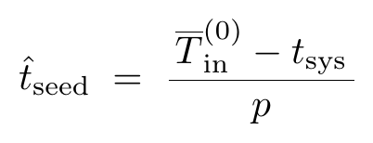
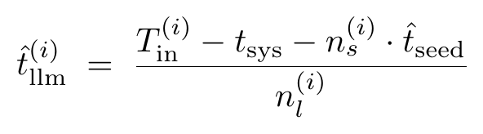
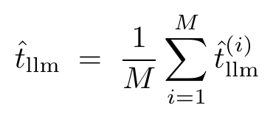
Cost Model — Step 1: Estimate Token Sizes
Seed paper token size (from Node 0, after removing system prompt overhead):
Per-prompt LLM paper token size (nodes 1–2, using exact paper counts):
Averaged across all M prompts in nodes 1–2:

Slide 3
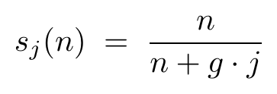
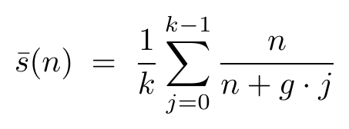
Cost Model — Step 2: Average Seed Fraction
Seed fraction at node j (nodes indexed j = 0, 1, ..., k−1):
Averaged uniformly across all k nodes (each node generates exactly g papers):
As the pool grows across nodes, the seed fraction decreases — early nodes see mostly seed papers, while later nodes are dominated by LLM-generated content.

Slide 4
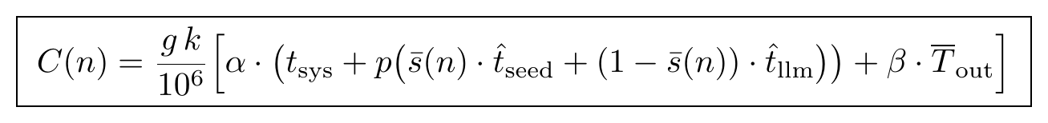
Cost Model — Step 3: Total Experiment Cost
Key insight: tsys is fixed overhead per prompt, independent of pool composition. The compositional shift between seed and LLM papers across nodes is captured by s̄(n); its effect on cost depends on the empirically measured gap between t̂seed and t̂llm.
Sensitivity: t̂llm is the most volatile pilot estimate — LLM-generated abstracts vary in length across runs. We report both a conservative (pilot) and pessimistic (+20%) scenario.

Slide 5
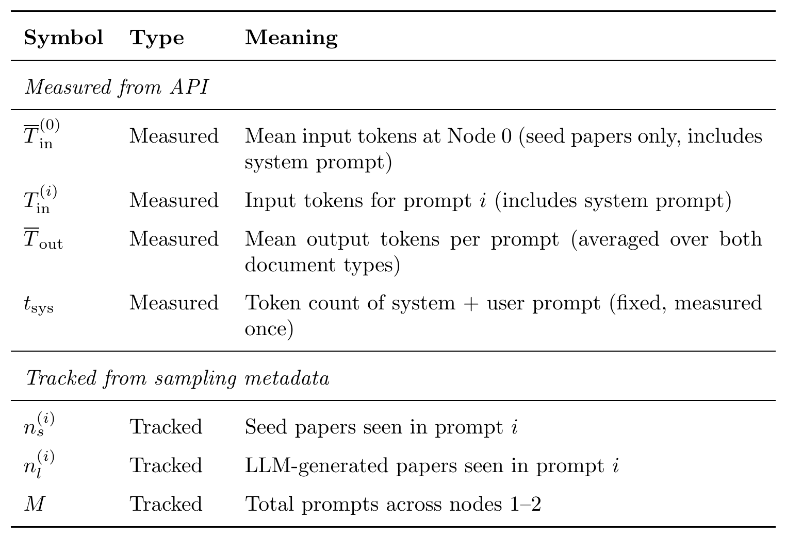
Variables & Constants — Measured & Tracked

Slide 6
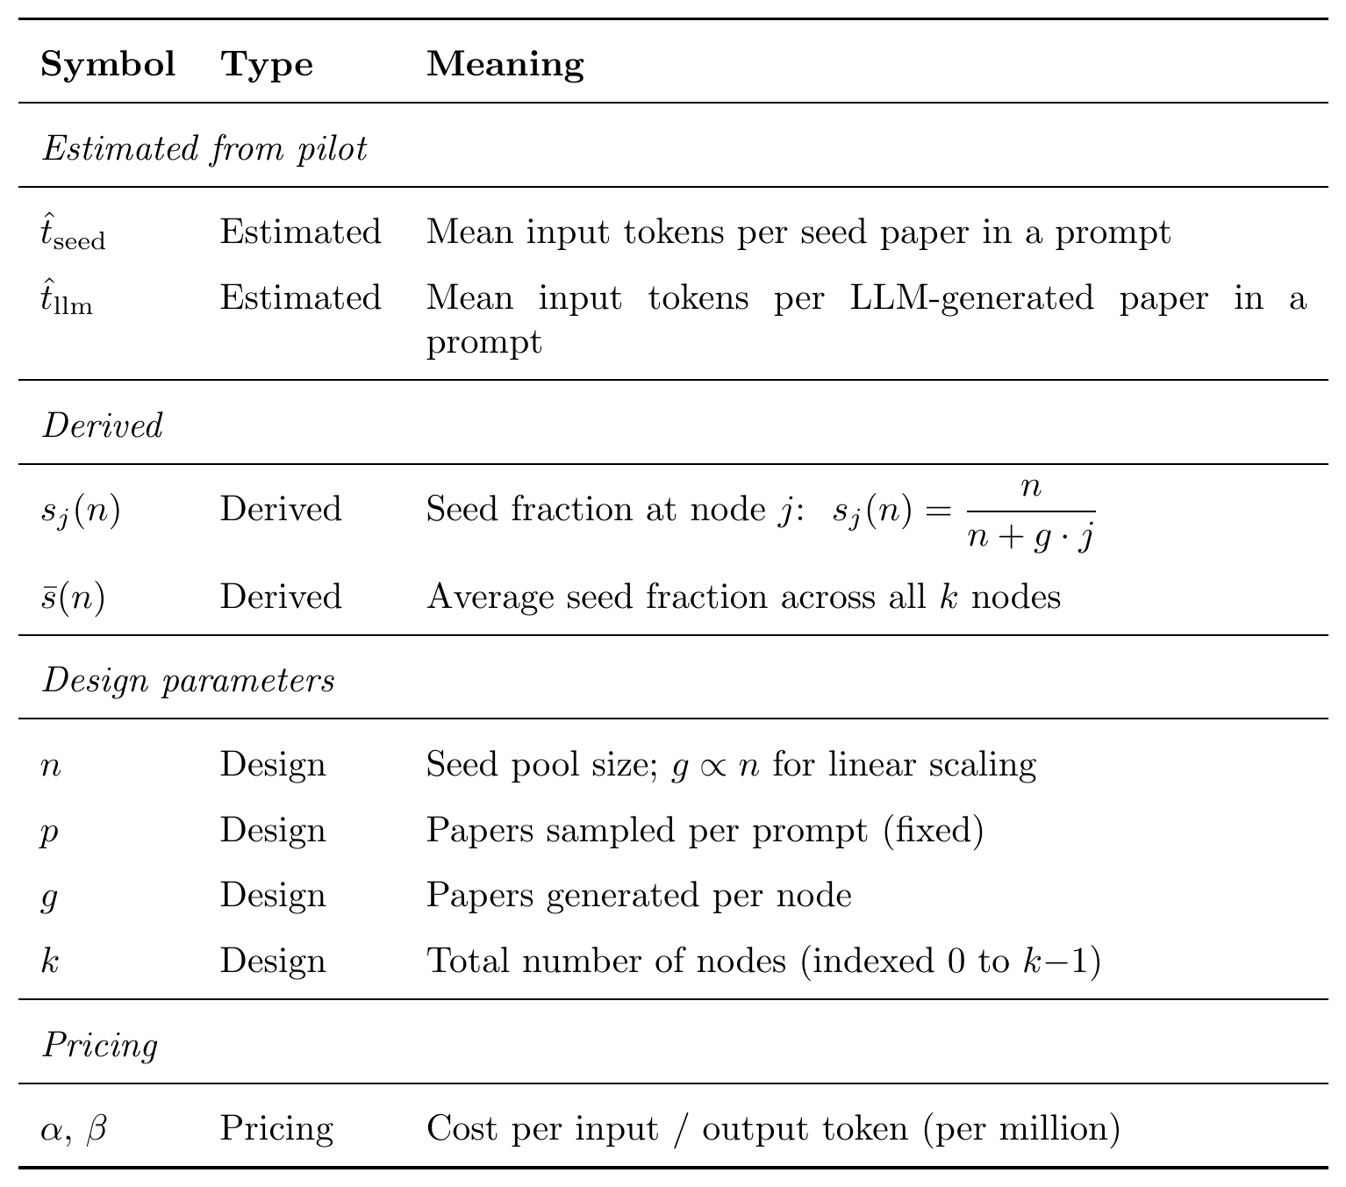
Variables & Constants — Estimated, Derived, Design

Slide 7
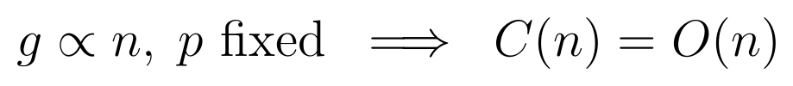
Cost Growth Rate — O(N) Scaling
Why linear?
When g ∝ n and p is fixed, the n in the numerator and denominator of every term in s̄(n) cancels, making s̄ constant. Total prompts g·k then grow linearly in n.
Holds when:
g ∝ n (papers/node scales with seeds)
p is fixed (prompt sample size constant)
Breaks when:
p scales with n (super-linear prompt cost)
g is fixed while n grows (s̄ no longer cancels)

Slide 8
Projected vs Actual Cost
CONSERVATIVE
PESSIMISTIC
ACTUAL
$10.75
$11.06
$9.98
pilot estimate
+20% scenario
real experiment cost
Model came in $0.77 under conservative and $1.08 under pessimistic.
The cost model over-estimated by ~7–10%, a comfortable margin for budgeting.

Slide 9
Scaled Experiment — Design Changes
NODES
SEED PAPERS
PAPERS / NODE
12
120
120
generations (up from 6)
real arXiv papers (up from 30)
generated per node (up from 30)
RANDOM SAMPLE
TOPIC
SCALE FACTOR
30
KD
4×
papers per prompt (unchanged)
knowledge distillation (same)
overall increase in experiment size

Slide 10
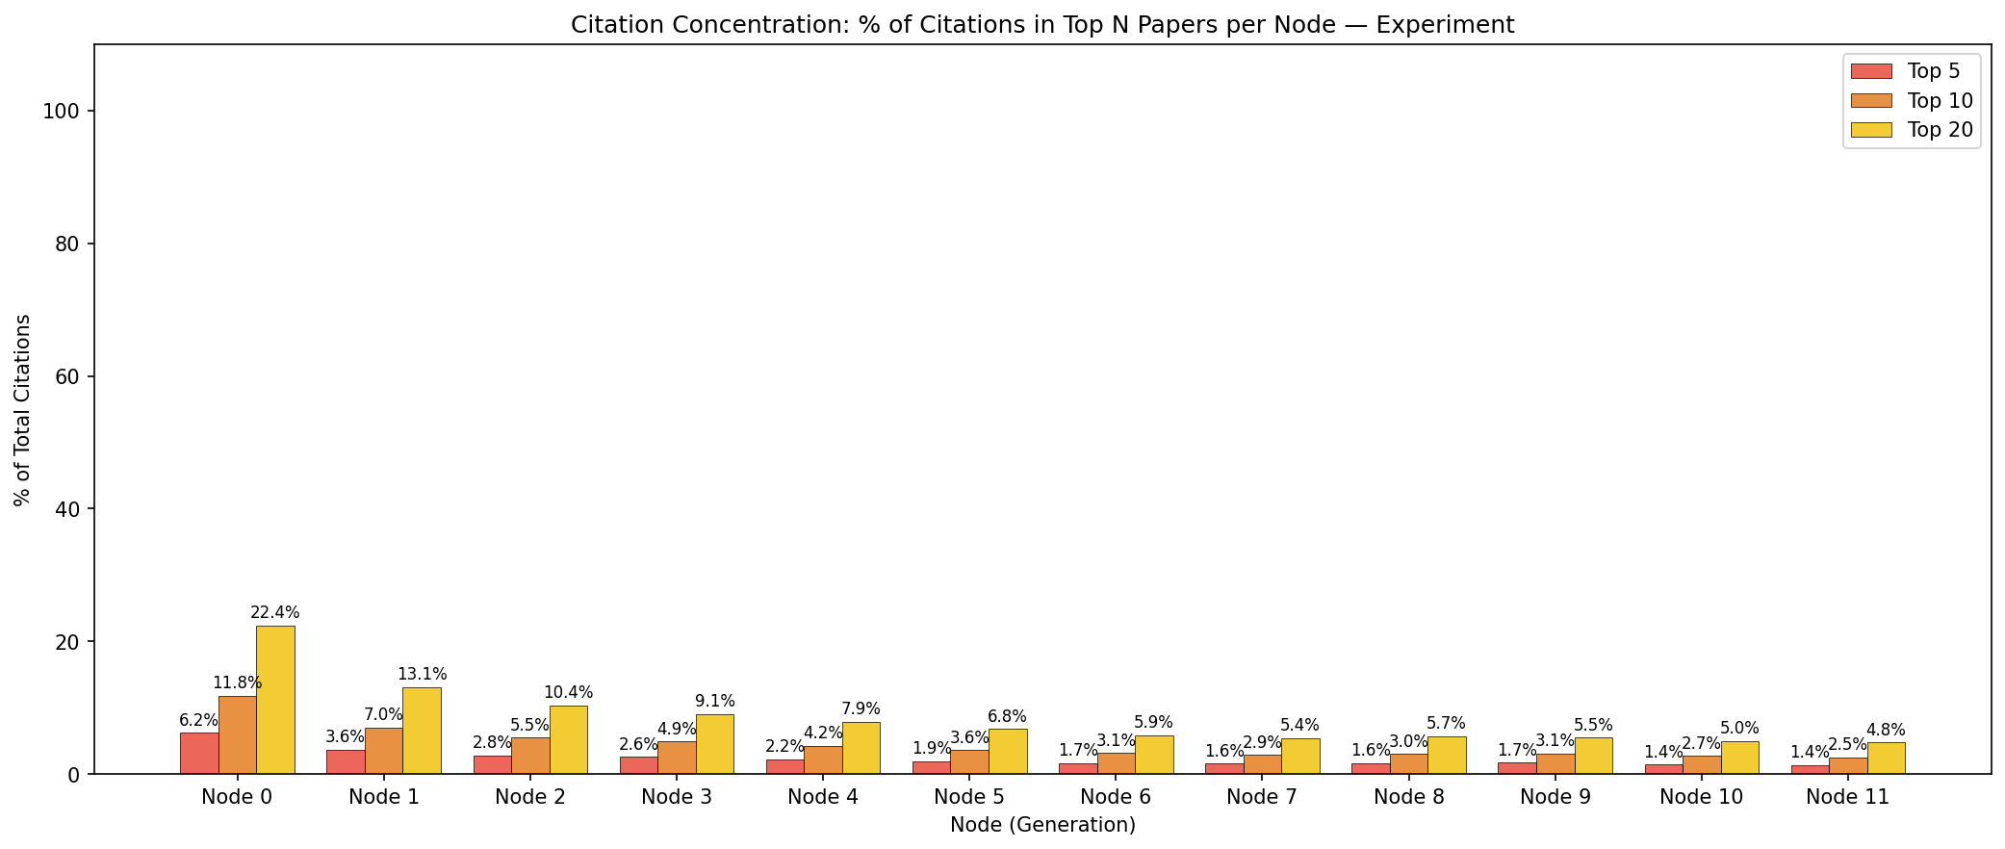
Findings — Main Experiment: Citation Concentration
Node 0’s top 20 papers capture 22.4% of citations — this drops steadily to ~5% by Node 11, indicating early seed papers dominate and concentration dilutes as the pool grows.

Slide 11
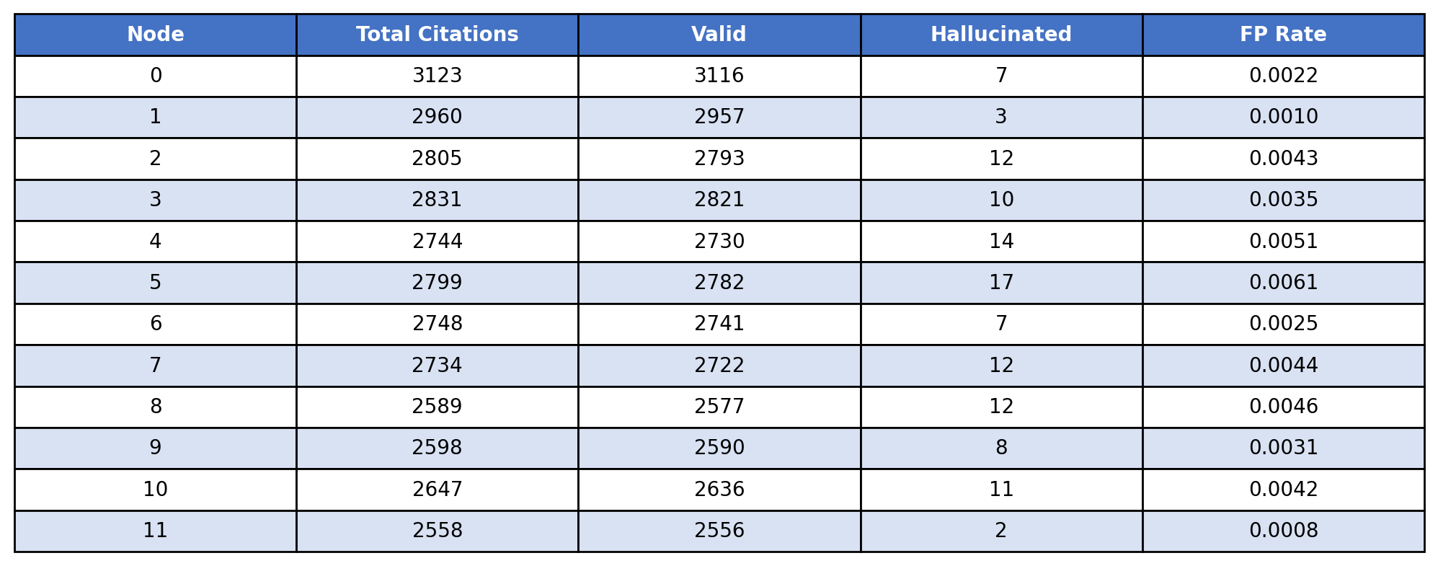
Findings — Main: False Positives (Hallucinations)
Hallucinations remain low (FP rate 0.001–0.006 across nodes). Node 5 peaks at 17 hallucinated citations but rates stay well under 1%, showing the LLM rarely fabricates references.

Slide 12
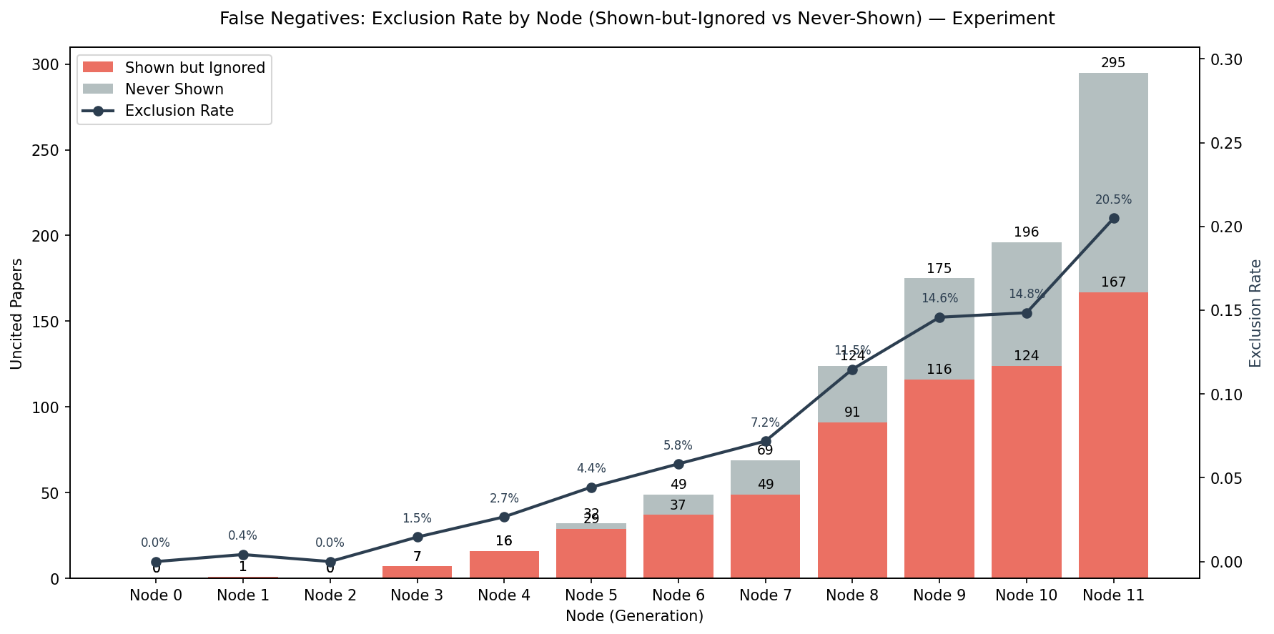
Findings — Main Experiment: False Negatives (Exclusion Rate)
Exclusion rate rises from 0% at Node 0 to 20.5% by Node 11. Most uncited papers were "never shown" rather than shown-but-ignored, reflecting sampling limitations as the pool grows large.

Slide 13
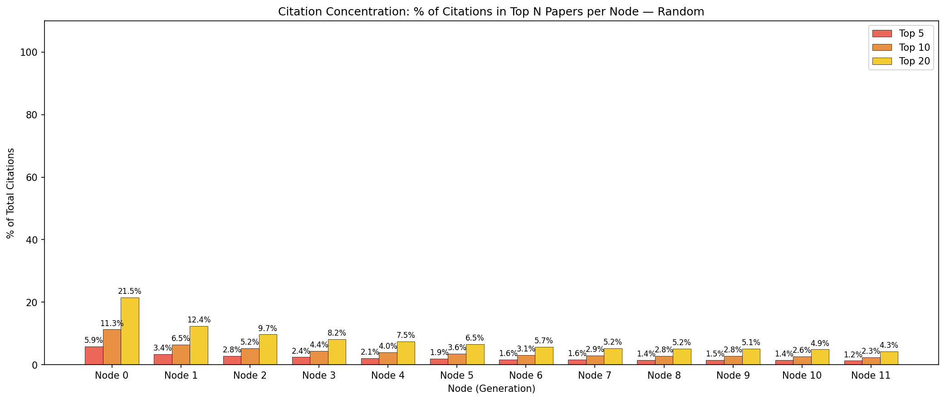
Findings — Random Citer: Citation Concentration
Random citer shows a very similar concentration pattern — top 20 at Node 0 capture 21.5% vs 22.4% in main. Both dilute to ~4–5% by Node 11.

Slide 14
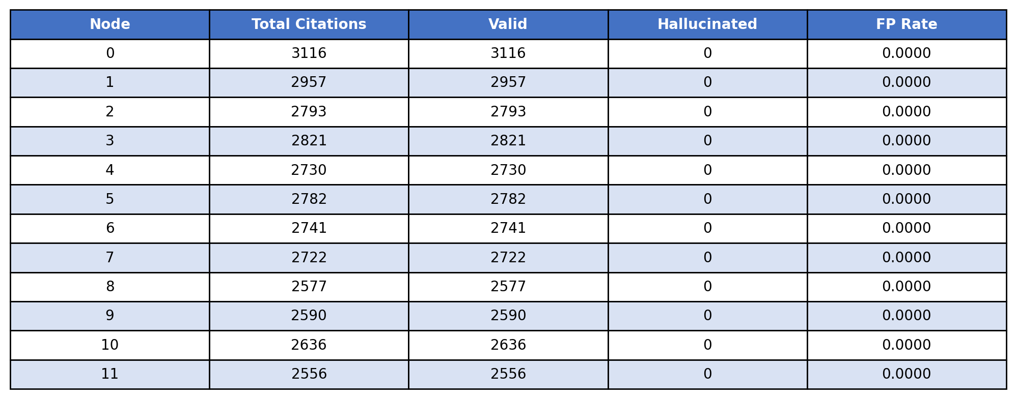
Findings — Random: False Positives (Hallucinations)
Zero hallucinations across all 12 nodes. The random citer assigns citations uniformly at random — it never fabricates, as expected since it only picks from existing papers.

Slide 15
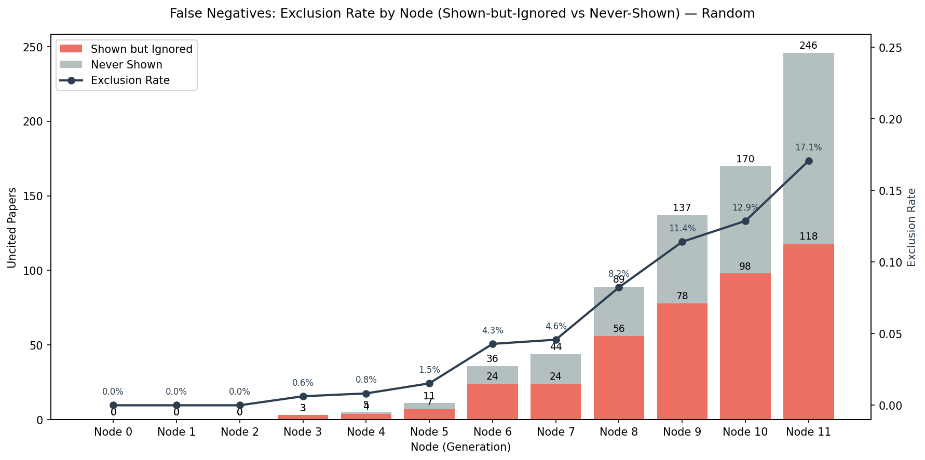
Findings — Random Citer: False Negatives (Exclusion Rate)
Random citer exclusion rises to 17.1% at Node 11 vs 20.5% in main experiment. The LLM excludes slightly more papers than random chance would predict, hinting at selective citation behavior.

Slide 16
Conclusion
Cost model validated
Actual cost ($9.98) came in 7–10% below projections ($10.75–$11.06). O(n) scaling confirmed — the model is reliable for budgeting future scale-ups.
Concentration dilutes at scale
Citation concentration follows the same decay pattern at 4× scale: top papers dominate early but dilute as the pool grows. Main and random baselines show similar structural decay.
Hallucinations stay low
The LLM’s FP rate remains ≤ 0.6% even at 12 nodes and 1,440 total papers. The random citer produces zero hallucinations — a useful clean baseline.
Exclusion grows with pool size
By Node 11, ~20% of papers go uncited in the main experiment (vs 17% random). Most are never-shown rather than shown-and-ignored, suggesting sampling is the bottleneck — but the LLM is slightly more selective than random.

