Slide 1
Getting Started
introduction to python development
Notes:
Welcome! Let’s take a look at how we can easily run python programs on any device, without needing to install any software, so that you can get up & running your first python program super fast!

Slide 2


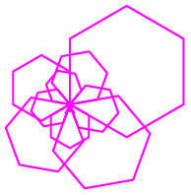
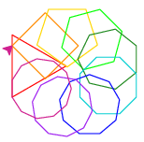
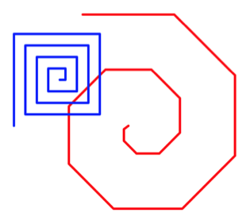
Challenge Overview
Day 1: Getting started
Day 2: Variables & Turtle
Day 3: Loops
Day 4: Writing Functions
Day 5: Putting it all together!
Hello, World!
Notes:
Day 1 is designed for learners who have NEVER programmed before. If you’ve used python print already, feel free to move on to Day 2.
In Day 5 we’ll also discuss next steps in your learning & a really great opportunity available to you just for participating in the challenge!

Slide 3
Printing Output
print is a special command or function that allows us to display information to the screen:
Function Name
Parentheses
outputs:
Hello!
print("Hello!")
Function Parameter: What is printed
Text is enclosed in quotes (single or double)
Notes:
The first command we learn in any language is how to display information to the screen.
This is so we can figure out if our program is working correctly or not.
Let’s look at another example…

Slide 4
Printing Output
print is a special command or function that allows us to display information to the screen:
First parameter to be printed
Second parameter to be printed
outputs:
Hello!
print("Hello!")
outputs:
Challenge # 5
print("Challenge #", 2 + 3 )
Comma
Notes:
Let’s look at another example…
Are you ready to try it out?

Slide 5
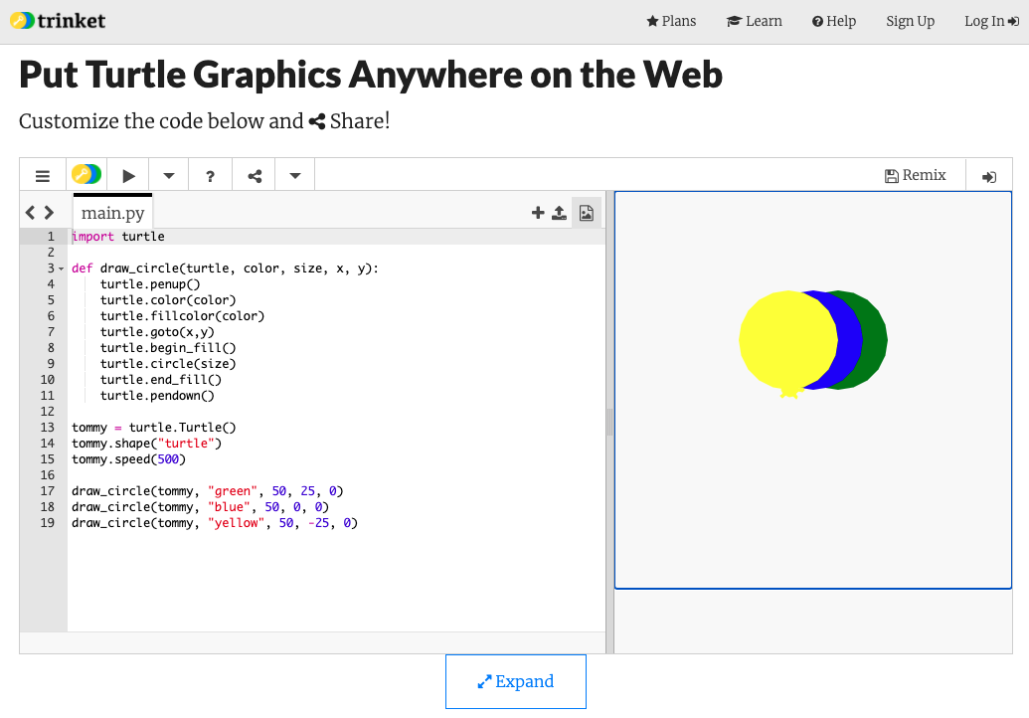
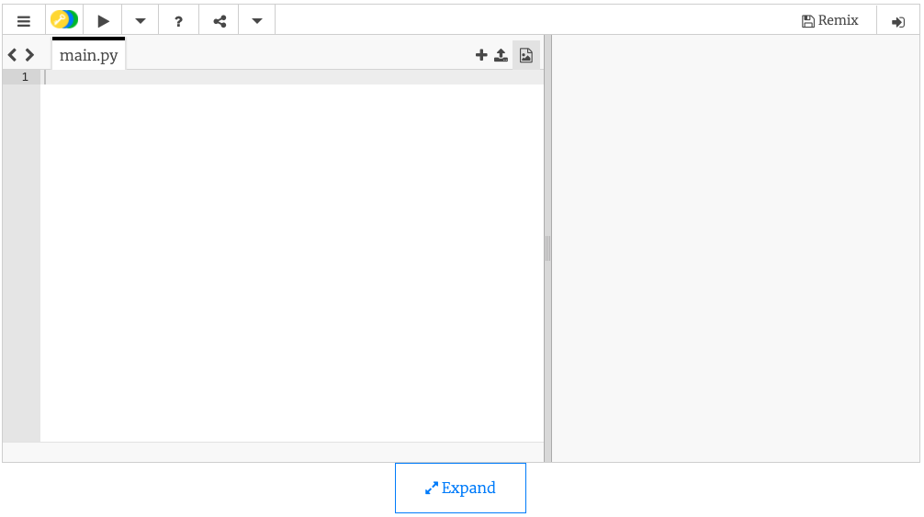
Let’s try it!
Go to trinket.io/turtle
Not working? Try repl.it/languages/python_turtle or skulpt.org
Remove any code:
Notes:
Are you ready to try it out?
Remove any code – we want to start with a blank canvas!

Slide 6
Let’s try it!
Go to trinket.io/turtle
Not working? Try repl.it/languages/python_turtle or skulpt.org
Remove any code:
Try printing “Hello, World!”
See worksheet for details & video solution: bit.ly/beginning-python-challenge-day1
See you in Day 2!
Notes:
“Hello, World!” is the traditional first program in any programming language. For more details & a video walk thru, check out the link to the worksheet.
Can’t wait to see you for Day 2!

