Slide 1
Variables & Libraries
storing data & quickly adding functionality
Notes:
Welcome! In this video we’re going to talk about …

Slide 2
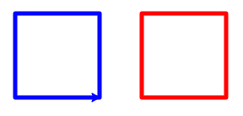
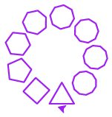
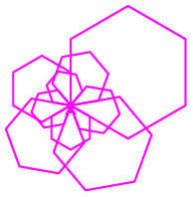
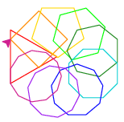
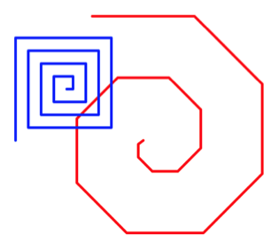
Challenge Overview
Day 1: Getting started
Day 2: Variables & Turtle
Day 3: Loops
Day 4: Writing Functions
Day 5: Putting it all together!
Hello, World!
Notes:
Day 1 is designed for learners who have NEVER programmed before. If you’ve used python print already, feel free to move on to Day 2.
In Day 5 we’ll also discuss next steps in your learning & a really great opportunity available to you just for participating in the challenge!

Slide 3
Why Variables?
Variables allow us to store data in memory (or RAM) so that we can work with this information in our programs
For example:
calculate the average run time or speed of 5 runners
calculate the amount of sales tax on a purchase
display text to the screen (like in “Hello, World!”)
Help us make our code easier to change & modify
Make changes to one location & use in many
Saves time & frustration!
Notes:
Let’s dive in deeper into how variables in python work.

Slide 4
Defining Variables
Memory (aka RAM)
Variable
Name
Variable
Assignment
Value
Name
Value
aka variable declaration, definition or initialization
x
4
Assignment Statement
x = 4
NOT asking the question: “is x equal to 4?”
Notes:
Let’s dive in deeper into how variables in python work.

Slide 5
Defining Variables
Memory (aka RAM)
Variable
Name
Value
x
4
x = 4
y = 2 + 3
z = x + y
z += 1
z
10
+ 1
9
y
5
Equivalent to: z = z + 1
Notes:
Let’s look at a couple more examples

Slide 6
Variables: Names & Types
Variables have names (aka identifiers)
Have meaningful names (i.e., not x or y unless storing coordinates)
Use letters, numbers, or _
Cannot be a keyword like for, def, etc. or begin with a number
Typically begin with a lower case letter
Variable values have types:
string 'hello' "c" "That's me!"
int (integer) 4 237 -58 0 923,872,355
float (floating point) -2.5 55.67 346.978001 0.00000017
complex 4+6j 2+5j
boolean True False
objects or collections lists arrays files dictionaries turtles
Notes:
In addition to its value, every variable has two components: name & type
We’ll get to work with turtles later today!
Next we’ll introduce a way to add additional information to our code: comments!

Slide 7
Comments
Comments allow us to write notes to ourselves and others about our code & save “hidden” code for later
Best practice to begin with a description of your code & author info
“Hidden” code
Code notes
Notes:
Next we’ll introduce a way to add additional information to our code: comments!
Notice the different behavior with print between comma & plus (aka string concatenation)
Our final topic of the day is taking advantage of expertly written code so that we can quickly write bigger & better programs using python libraries

Slide 8
Why Libraries?
The fastest way to build programs is by taking advantage of code that others have already written, tested, & debugged in libraries
Saves time & frustration!
Different time investment (learning & writing less vs writing more & testing)
In python, libraries are organized into modules, like:
math sqrt, floor, ceil, log, sin, cos, tan, pi, e
statistics mean, median, mode, stdev
random generate random numbers within a given range
webbrowser display web documents to user
re regular expression matching for processing text
turtle simple commands to draw shapes on screen
Notes:
Our final topic of the day is taking advantage of expertly written code so that we can quickly write bigger & better programs using python libraries

Slide 9
Using Libraries: Import
In python, there are two ways to import library functions:
vs
import module
from module import function
import math
print(math.sqrt(25))
from math import sqrt
print(sqrt(25))
Notes:
We can take advantage of libraries in our python programs by importing modules: using the import keyword
We can do this in one of two ways, and it changes how we call the functions in the module
Let’s look at an example using the sqrt function in the math module
Let’s unpack this a little bit

Slide 10
Using Libraries: Import
In python, there are two ways to import library functions:
vs
import module
from module import function
Module Name
Module Name
Library Function
Keyword
Keyword
Keyword
import math
print(math.sqrt(25))
from math import sqrt
print(sqrt(25))
Module Name
Library Function Call
Library Function
Library Function Call
Notes:
Are you ready to try it out?

Slide 11
Let’s try it!
Go to trinket.io/turtle
Not working? Try repl.it/languages/python_turtle or skulpt.org
Remove any code that you didn’t write
Draw a triangle using python turtle!
See worksheet for details & video solution: bit.ly/beginning-python-challenge-day2
See you in Day 3: Loops!
Notes:
For more details & a video walk thru, check out the link to the worksheet.
Can’t wait to see you for Day 3, where we learn how to use loops to automate repetitive tasks!

