Slide 1
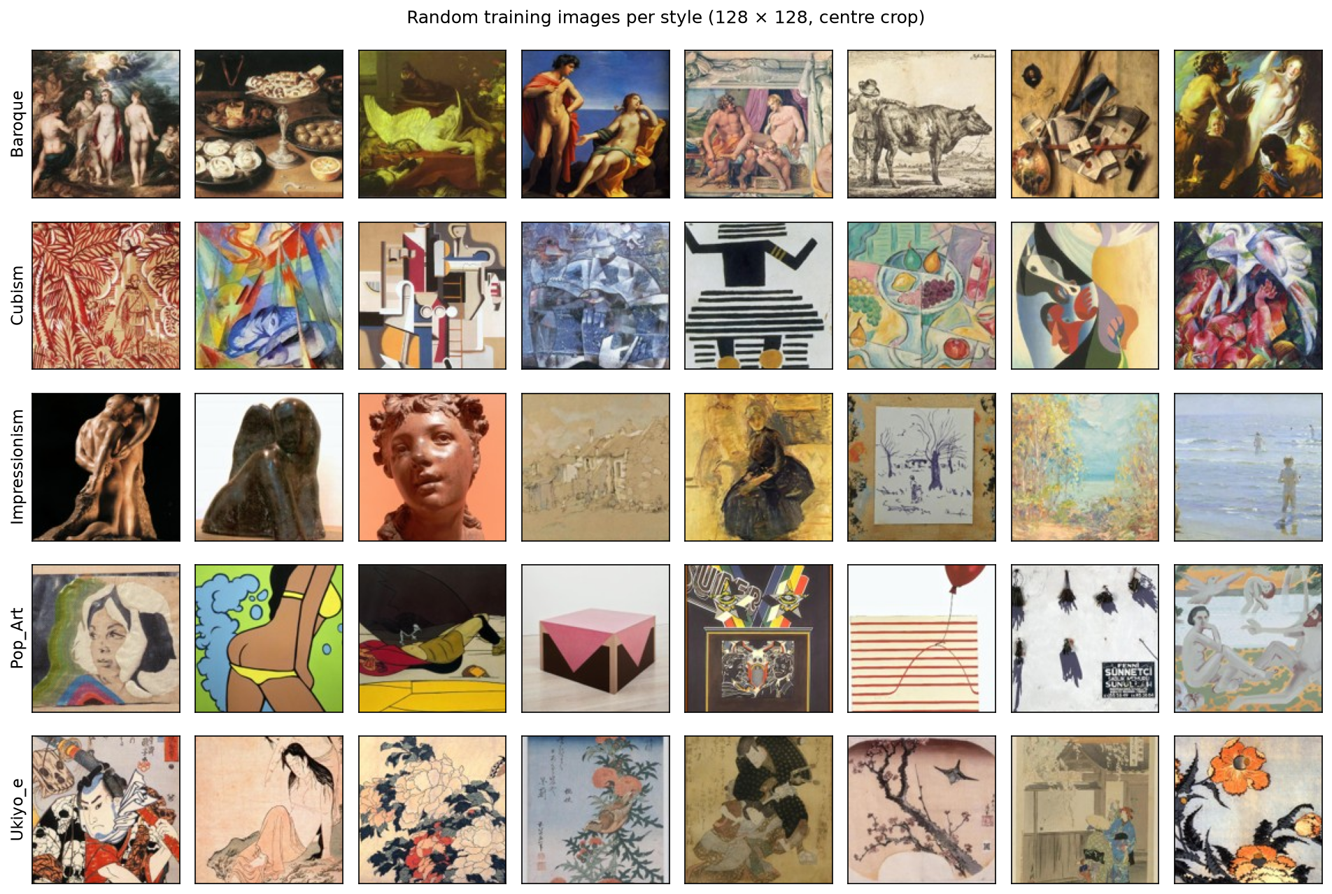
A museum guide that recognises painting styles
NEURAL NETWORKS AND DEEP LEARNING · FINAL PROJECT
Is a neural network worth it on the museum's kiosks?
Anthony · Antoine · Lenny | October 2026
Notes:
Hi, we're Anthony, Antoine and Lenny. Our project is a museum guide: you point your phone or a kiosk at a painting, it tells you the style and the story behind it. Behind that there's one real question from the director, and that's what the next 10 minutes answer.

Slide 2
What the museum asked for
THE BRIEF · ANTHONY
A guide on phones and gallery kiosks: point the camera at a painting, get its style and the story of the movement
Five styles: Baroque, Cubism, Impressionism, Pop Art, Ukiyo-e
The director's question: kiosks have modest CPUs and the budget is small. Is a neural network worth it, or would a classical model do?
≥ 85 %
accuracy on the test set, and clearly better than the classical model (McNemar, p < 0.05)
≤ 40 ms
per image on one CPU thread: the 200 ms kiosk budget divided by a safety factor of 5
We fixed the three criteria before seeing any result. Our recommendation is the cheapest model that passes all three.
≤ 100 MB
on disk, and trainable in under an hour on a laptop
Notes:
The museum wants a guide for phones and kiosks, with five styles. The director's question is simple: kiosks are slow and the budget is small, so is a neural network worth it? Before training anything, we wrote down three criteria: at least 85 % on the test set and clearly better than a classical model, under 40 milliseconds per image on one CPU thread, because our laptops are much faster than a kiosk, and under 100 MB. The cheapest model that passes all three wins.

Slide 3
1,500 paintings, five styles, and their limits
THE DATA · ANTHONY
1,050 / 225 / 225
train / validation / test images, the same split for every model (210 / 45 / 45 per style)
Most images have no artist (85 to 100 % per style), so we can't split by artist
Impressionism comes from a single source file, Pop Art from two
Some are photos of sculptures, not paintings: about 7 % of Impressionism and 18 % of Pop Art
With 225 test images, an accuracy is only known to about ±5 points
Notes:
The data is a WikiArt subset: 300 images per style, 128 pixels. We split it once, stratified, and every model uses the same split. The test set is only used once, at the very end. It has limits: most images have no artist, two styles come from only one or two source files, and some 'paintings' are actually photos of sculptures. We checked later that our network didn't use that as a shortcut.

Slide 4
Our feed-forward network
FEED-FORWARD NETWORK · ANTHONY
Image 32×32
3,072 numbers
Linear + ReLU
256 units
Linear + ReLU
128 units
Linear
5 scores, one per style
820,229 parameters, 96 % of them in the first layer. He initialisation and a small last layer, so the network starts with no favourite style: initial loss 1.61 = ln 5.
Bigger images don't help: 15× more parameters, no gain. We keep 32 px.
Notes:
Our network is a plain feed-forward network: we flatten the image into one long vector, then two hidden layers and five scores. Almost all the parameters are in the first layer, because every pixel connects to every unit. We checked the initialisation: at the start the loss is ln 5, so the network doesn't prefer any style. Then we tried three image sizes. Bigger images don't help at all, they just add parameters, so we kept 32 pixels.

Slide 5
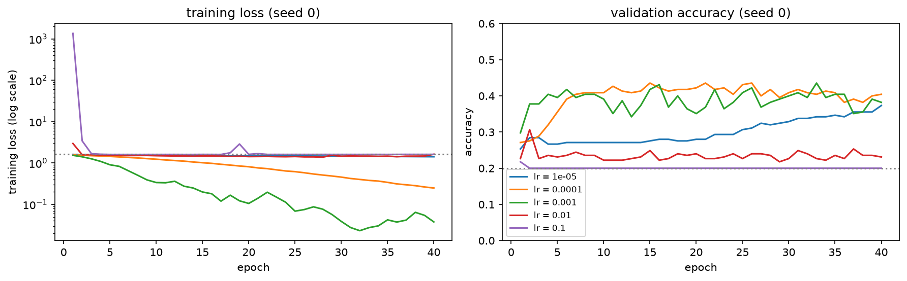
Checking that the training works
TRAINING MONITORING · ANTHONY
1.61
7 steps
1e-4
96 %
initial loss = ln 5: no favourite style at the start
to memorise a batch of 32 images: the code works
best learning rate: 44 % validation accuracy (3 seeds)
of ReLUs dead at learning rate 0.01: it stops learning
Notes:
Before blaming the model, we checked the training itself. The initial loss is right, and the network can memorise one batch in seven steps, so the code works. Then the learning rate: too small and nothing moves, too big and it breaks. At 0.01, 96 % of the second-layer ReLUs are dead: they output zero for every image and never come back, so the network predicts the same thing for everything. 1e-4 was the best.

Slide 6
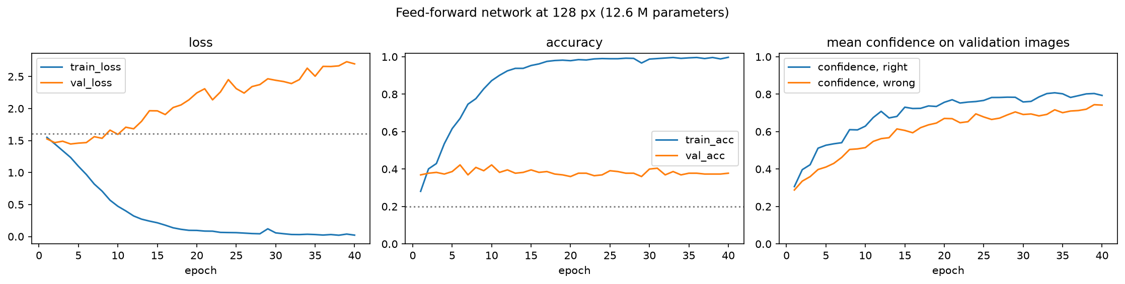
It memorises instead of learning style
FAILURE DIAGNOSIS · ANTHONY
99.7 % vs 38 %
0.29 → 0.74
99.3 %
training vs validation accuracy (128 px, 12.6 M parameters)
its confidence on the paintings it gets wrong
training accuracy on randomly shuffled labels: it can memorise pure noise
Notes:
Here's the real problem. The big network gets almost 100 % on the training images but only 38 % on new ones. And it becomes more and more confident even when it's wrong, which is why the validation loss goes up. The strongest proof: when we shuffle the labels randomly, it still reaches 99 % on training. So that 99 % means nothing: it memorises, it doesn't learn style.

Slide 7
Fixing the overfitting, one change at a time
THE FIXES · ANTHONY
62 → 12
points of gap between training and validation
Augmentation and early stopping do the work. Removing them one at a time shows dropout and weight decay add nothing on top
Our final FFN: 45.8 % validation accuracy, 0.08 ms per image, 3.3 MB
It mostly reads colours: dark paintings become Baroque, beige paper Ukiyo-e
Notes:
We added the fixes one at a time, three seeds each. Augmentation, so it never sees exactly the same image twice, and early stopping, so we keep the best epoch, do almost all the work: the gap goes from 62 points to 12. Removing each fix one at a time confirmed it. Our final network is tiny and very fast, but it only reaches about 46 %. It mostly reads colours. That's the limit of a network that sees pixels one by one, and it's where Antoine takes over.

Slide 8
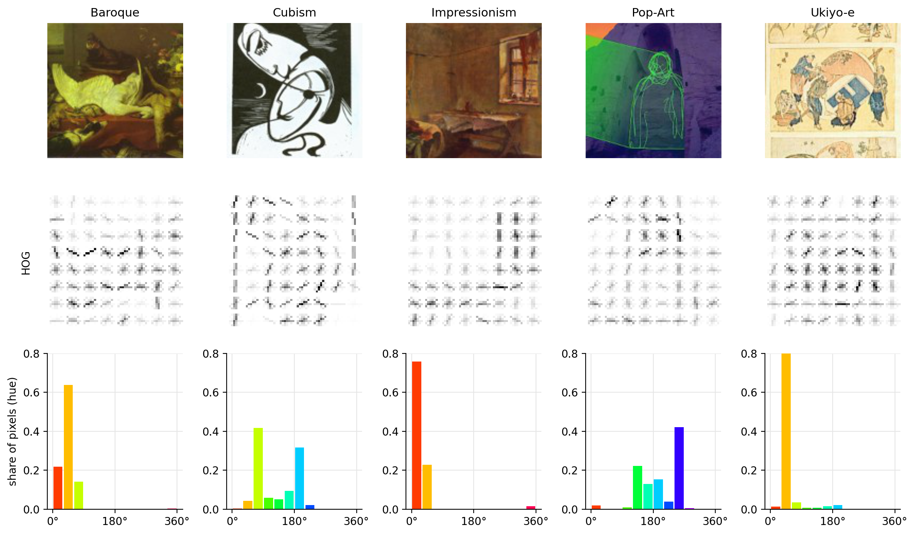
Colour and edges alone reach 55 %
THE CLASSICAL BASELINE · ANTOINE
55.1 %
validation accuracy of our best model without a neural network: an SVM on colour and edge features
Colour histogram (HSV, 192 numbers): which colours the painting uses
HOG (1,764 numbers): the direction of edges and brush strokes
Colour does most of the work: 52 % alone, edges alone 43 %
2.98 ms per image, 16.5 MB, trained in 3 s
Cheap and fast, but far from 85 %. This is the bar a neural network has to beat.
Notes:
Before any neural network, the baseline. We describe each painting with two hand-made features: a colour histogram, which colours it uses, and HOG, the direction of its edges and strokes. An SVM on both reaches 55 % on validation. Colour does most of the work. It is very cheap, 3 milliseconds per image, but far from 85 %. That is the bar any neural network has to beat.

Slide 9
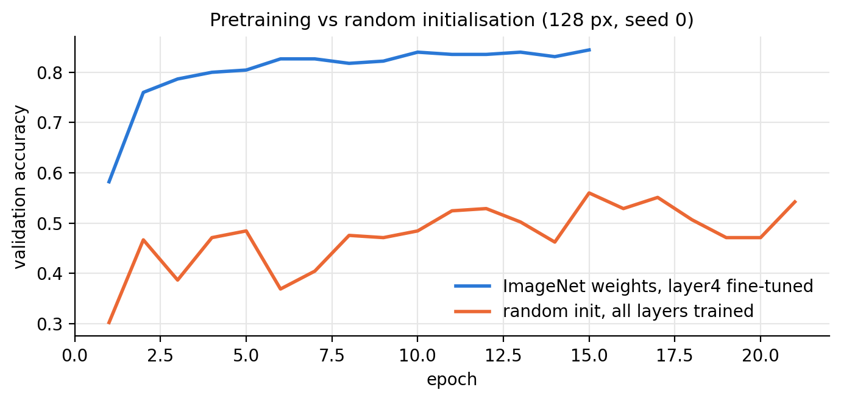
Reusing ImageNet features changes everything
PRETRAINED CNN · ANTOINE
84.0 %
frozen: the ImageNet layers are kept, only a new last layer is trained (2,565 numbers)
86.2 %
fine-tuned: the last block (layer4) is retrained too, with a small learning rate (8.4 M numbers)
Images upsampled to 224 px: the pretrained filters expect ImageNet scale (+5 to +8 points)
Both run in 17 to 19 ms on one CPU thread, inside the 40 ms budget
52.4 %
About 30 points come from pretraining, not from the architecture. (Validation accuracies.)
the same network trained from random weights (128 px): below the classical model
Notes:
Now a pretrained CNN. ResNet18 was trained on 1.2 million ImageNet photos, so its layers already detect edges, textures and shapes. First we freeze it and train only a new last layer, 2,565 numbers: 84 % on validation. Then we also retrain its last block with a small learning rate: 86 %. The control on the left: the same network from random weights only reaches 52 %, below the classical model. So about 30 points come from pretraining. And both run in under 20 milliseconds on one CPU thread.

Slide 10
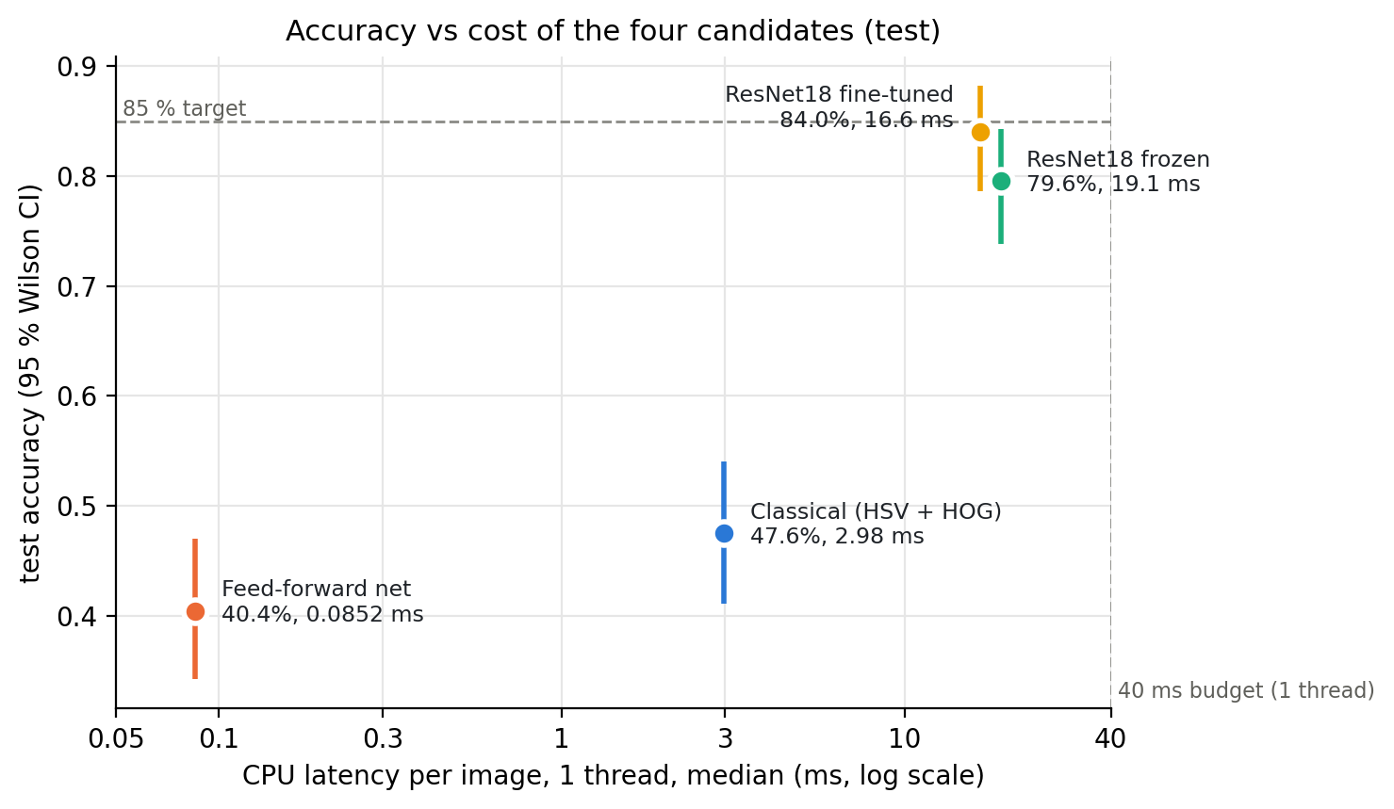
On the test set, no model reaches 85 %
THE TEST SET · ANTOINE
MODEL | TEST | VS 85 %
Classical (HSV + HOG) | 47.6 % | −37.4
Feed-forward net | 40.4 % | −44.6
ResNet18 frozen | 79.6 % | −5.4
ResNet18 fine-tuned | 84.0 % | −1.0
3 images
short of 85 % for the fine-tuned ResNet: 189 of 225 right, 95 % interval 78.6 to 88.2 %
Scored once, after every choice was frozen. Both ResNets beat the classical model (p < 0.001).
Notes:
This is the test set, opened once, after every model was frozen. Horizontally the cost per image, vertically the accuracy with its 95 % interval. Both ResNets are far ahead of the classical model and the FFN, and that difference is significant. The fine-tuned ResNet is the best at 84.0 %: 3 images short of our 85 % bar. Its interval goes from 79 to 88 %, so with 225 images we cannot tell whether it is really above or below. Every model scored a bit lower than on validation, which is expected after choosing on validation.

Slide 11
A supervised pilot, not a full deployment
RECOMMENDATION · ANTOINE
84.0 %
16.6 ms
44.8 MB
on test, fine-tuned ResNet18: 1 point under our 85 % bar
per image on one CPU thread, against a 40 ms budget
on disk (limit 100 MB), trained in 78 s on a laptop
OUR RECOMMENDATION
NEXT STEPS
A pretrained CNN is worth it: +36 points over the classical model, within the CPU budget
The fine-tuned ResNet18 (224 px), in a supervised pilot
With its “not sure” answer on: it asks for a new photo instead of guessing
More Impressionism and Pop Art source images
Blur and perspective augmentation (blur costs 15 points)
Measure on a real kiosk: the ×5 factor is an assumption
A bigger test set, split by artist (±5 points today)
By the rule we fixed in advance, no model qualifies, and we don't move the bar after the fact.
Notes:
So, our answer to the director. A pretrained CNN is worth it: 36 points above the classical model, at 17 milliseconds, well inside the budget. But by the rule we fixed before any result, no model qualifies: the fine-tuned ResNet misses 85 % by one point, and we do not move the bar. So we recommend a supervised pilot, with the guide's “not sure” answer turned on. To close the gap: more Impressionism and Pop Art images, blur augmentation since blur costs 15 points, a measurement on a real kiosk, and a bigger test set.

Slide 12
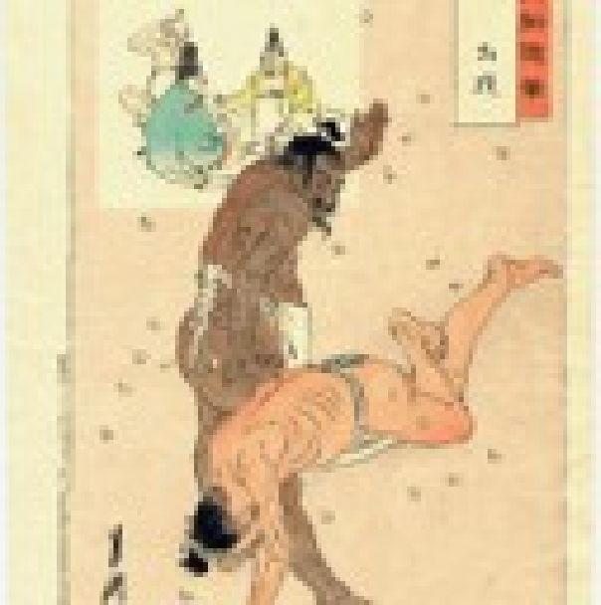
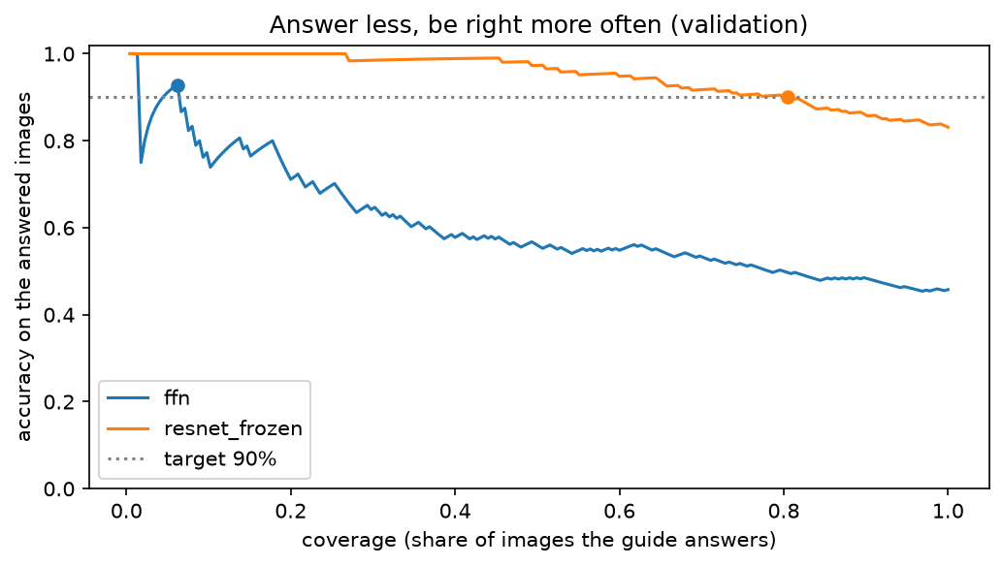
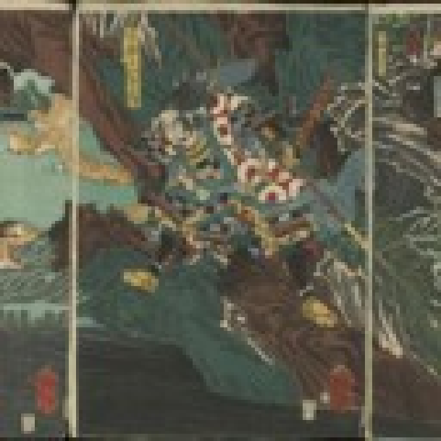
The guide in front of a painting
THE GUIDE · ANTHONY
Ukiyo-e
80 %
90 %
100 % sure
of visitors get an answer
of those answers are right
“Ukiyo-e means ‘pictures of the floating world’. It is a kind of Japanese art…”
Below a confidence threshold it says "not sure" instead of guessing. The FFN would have to stay silent 94 % of the time.
Not sure
26 % sure
“Sorry, I'm not sure which style this is. Try taking the photo again…”
Notes:
This is what a visitor sees. The guide gives the style, how sure it is, and a short story about the movement. If it isn't sure enough, it says so instead of making something up. We chose that threshold on validation so it's right 90 % of the time when it answers, and it still answers 4 visitors out of 5. With our FFN it would have to stay quiet almost all the time. These numbers use the frozen ResNet on validation; we update them with the final model after the test run.

Slide 13
Thank you
Questions?
github.com/anthonyrascle43-stack/Neural-Network-Project

