Slide 1
Harsh Environment Sensor Board (Part II)
Joseph Portera, Jordan Anger, Jasper Everitt, Anthony Sedore

Slide 2



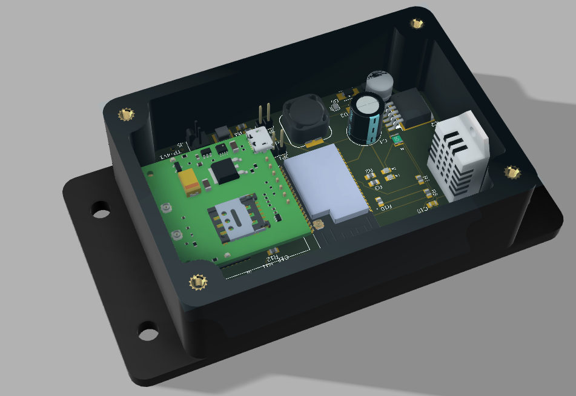
Introduction
The Harsh Environment Sensor Board is a hardware and software solution aimed at monitoring and reporting telemetry data from various sensors to remote operators. This PCB is meant to be small and efficient for clients who need to monitor systems in harsh environmental conditions. It reports its data through cellular networks to users.

Slide 3
Requirements
Product must be able to operate between -30° and 150° degrees Fahrenheit -Use temperature resistant electronics and encase in an enclosure
Product must read environmental data with sensors -Sensors will be connected to the PCB and controlled with microcontroller
Product shall transmit data over cellular transmission -Cellular transmission module will be connected to the PCB and controlled with microcontroller
Product will operate through an 18650 Li-ion battery -Implement 18650 hardware and battery management system
Product shall communicate with external sensors -Separate connection to the PCB will connect with external sensors
Product shall have battery charging capabilities -Battery recharging circuit integrated onto PCB with Voltage Regulator
Product must read board temperature -Sensor integrated onto PCB that can read current temperature

Slide 4
System Diagram
5VDC Input
5v
Lithium Battery Interface
18650
5V Bus
5v
4.1v
USB-C
5v
5v
Ser Data
3.3v Regulator
3.3V
3.3v
ESP-32
Serial DATA
Converter
status
Ser Data
High/Low
BOOT_CMD
24VDC Input
Analog Volts
High/Low
SLP_CMD
High/Low
CFG_CMD
Analog Signal Input
Analog Volts
High/Low
RST_CMD
Networking CCA (4G LTE)
Ser Data
Compressed Data
Temp 1
3.3v

Slide 5
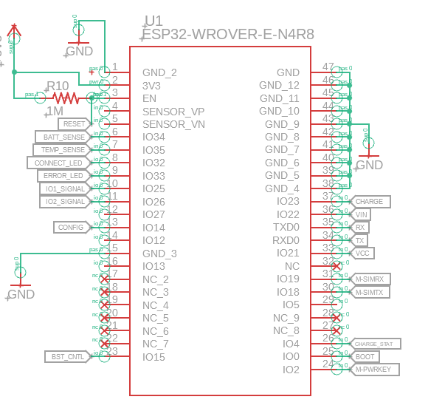
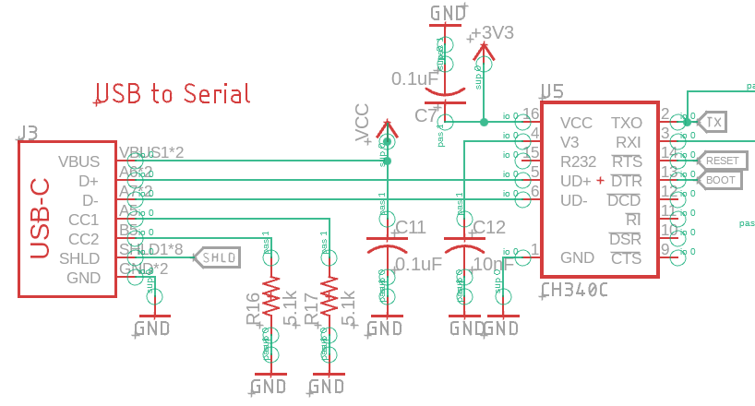
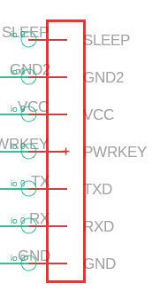
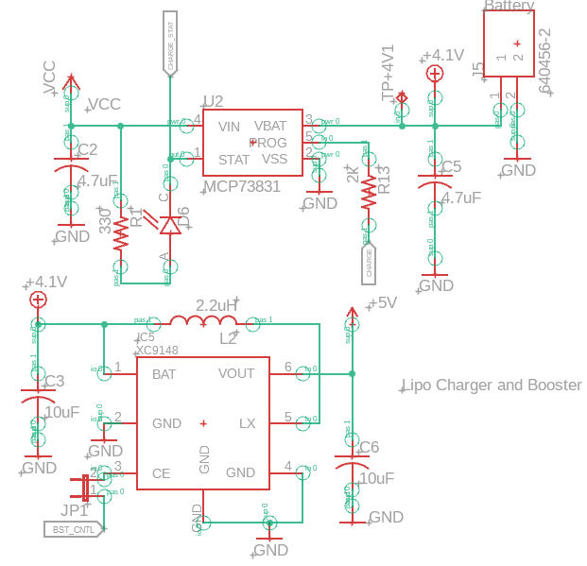
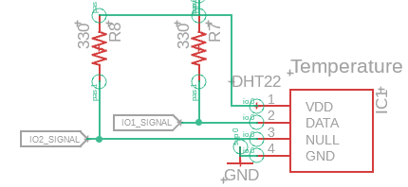
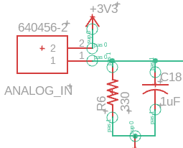
System Diagram

Slide 6

Technical Trades
Power Source Selection:
Trade: Choosing between a rechargeable 18650 battery versus a non-rechargeable but higher capacity alternative
Rationale: The rechargeable battery was selected for its balance between power capacity and sustainability, allowing for long-term use without the need for frequent replacements in remote locations
Communication Protocols:
Trade: Implementing a 4G LTE module as opposed to a lower power but shorter range communication option like LoRa
Rationale: 4G LTE was chosen for its widespread availability and reliability in data transmission, ensuring remote monitoring capabilities without significant geographical limitations
Enclosure Material:
Trade: Selection of enclosure material considering factors such as thermal resistance, weight, and durability
Rationale: The chosen material provides an optimal balance between thermal insulation, structural integrity, and weight, making it suitable for various harsh environments
Temperature Range Adaptability:
Trade: Designing for the extreme temperature range with trade-offs between component cost and operating range
Rationale: The chosen components offer the best compromise between the ability to withstand extreme temperatures and cost-effectiveness

Slide 7
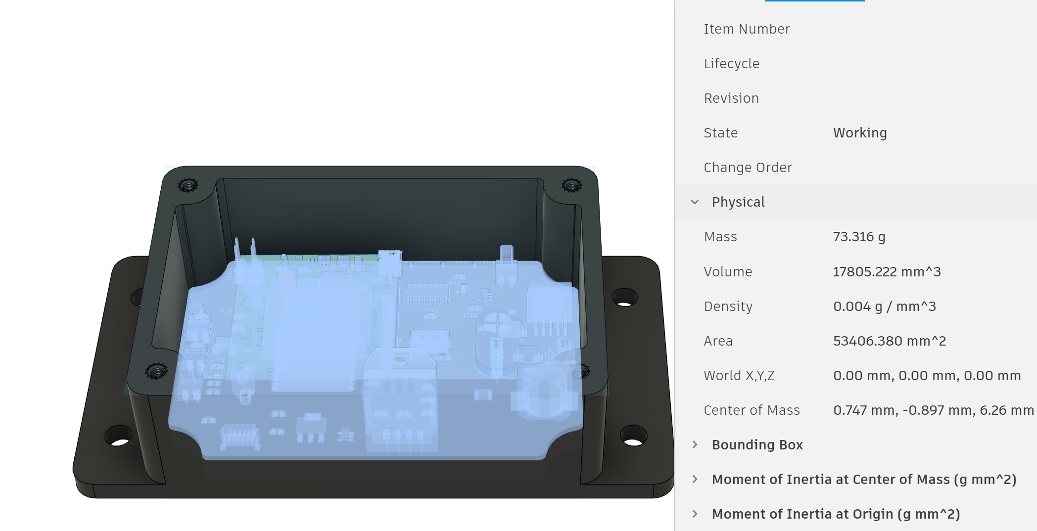
SWaP and Performance
Size
PCB Size - 2.3” x 3.6”
Enclosure – 7.87" x 4.72" x 2.95"
Weight
Two 18650 Cells: 45g * 2 = 90g
Weight of 4-Layer PCB & Components = 73 g
Waterproof ABS Plastic Enclosure = 43 g
Total Weight = 206 g (0.45 pounds)
Power Requirements
Capacity of 14 Wh for one 18650 Cell = 14 Wh * 2 = 28 Wh
ESP32 Microcontroller sleep energy consumption of 0.8mA, 240mA transmitting WiFi
Estimated Power Consumption of 1w, Battery Lifespan of ~1 Days
Transmission Time of 60 seconds per hour
Performance
One Day on battery power with full capabilities, or could be extended to 2 days in a low power state.

Slide 8
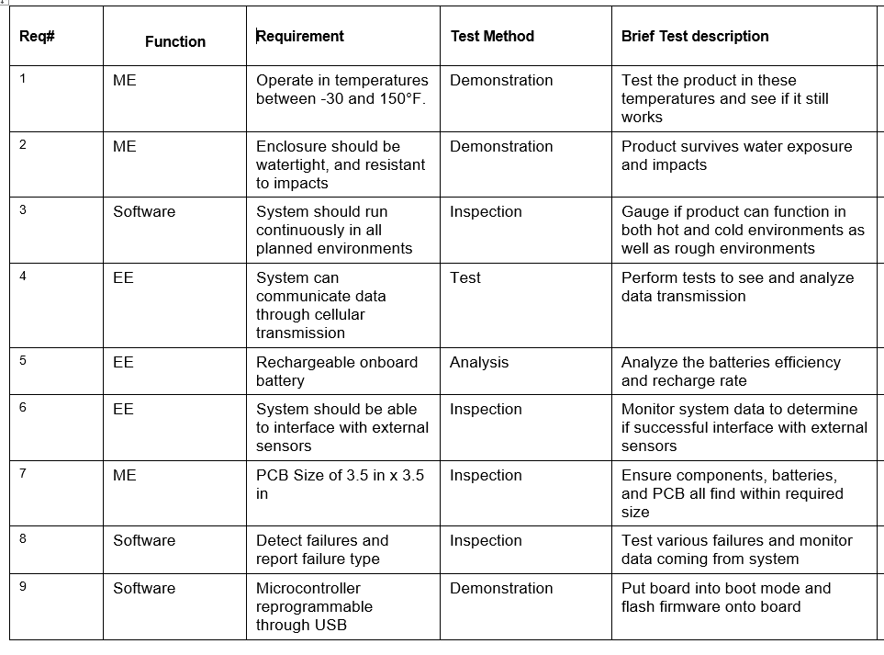
Testing and Integration

Slide 9
Risks
Component and PCB prototype delivery not arriving on time
Finalize bill of materials and components so orders can be placed sooner
Component Shortages
Choose parts with lots of stock
Order parts early
Identify Alternatives
Assembly of prototype
Make sure to use functional pick and place machines
Failure of cellular data transmission
Incorporate interface onto PCB to directly obtain data if cellular transmission fails
Sensor Interface Accommodations
PCB will be designed to fit standard sensor interface designed by Software Logistics
PCB doesn’t work as intended
Conduct extensive analysis of systems and plan to have extra time for additional PCBs
Verification for correct use of different components using data sheets

Slide 10

Risk Analysis
Most Critical Risks
Failure of initial PCB’s
Failure of cellular communication
Integrating all systems of the PCB together

Slide 11

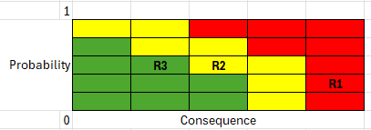



Risk Mitigation
Most Critical Risks
Failure of initial PCB’s
Failure of cellular communication
Integrating all systems of the PCB together
Mitigation Plans
Build small prototypes to test on first. Order multiple PCBs. Order PCB’s ahead of schedule.
Test communication system before implementing onto PCB
Perform checks on PCB design and simulate to evaluate all systems are integrated.

Slide 12
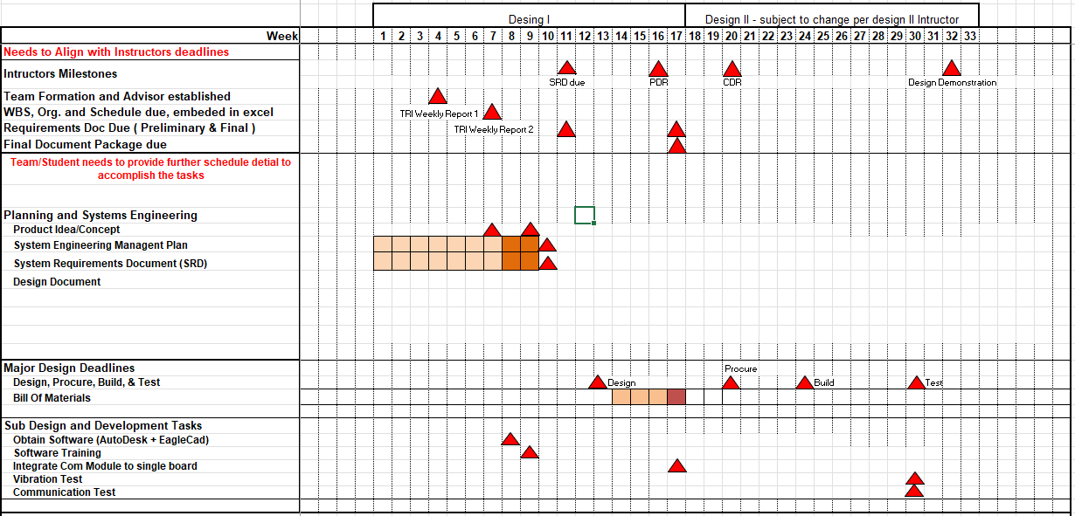
Project Schedule

Slide 13
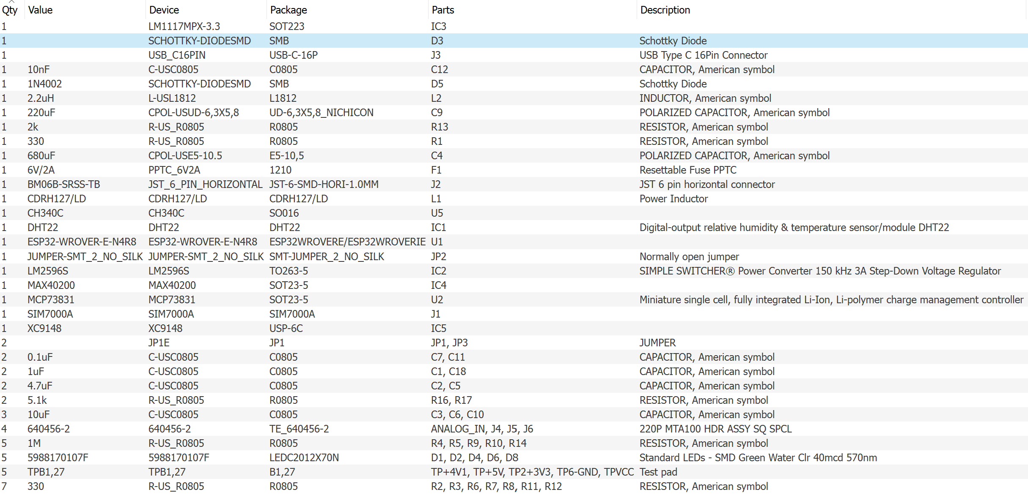
Bill Of Materials

Slide 14
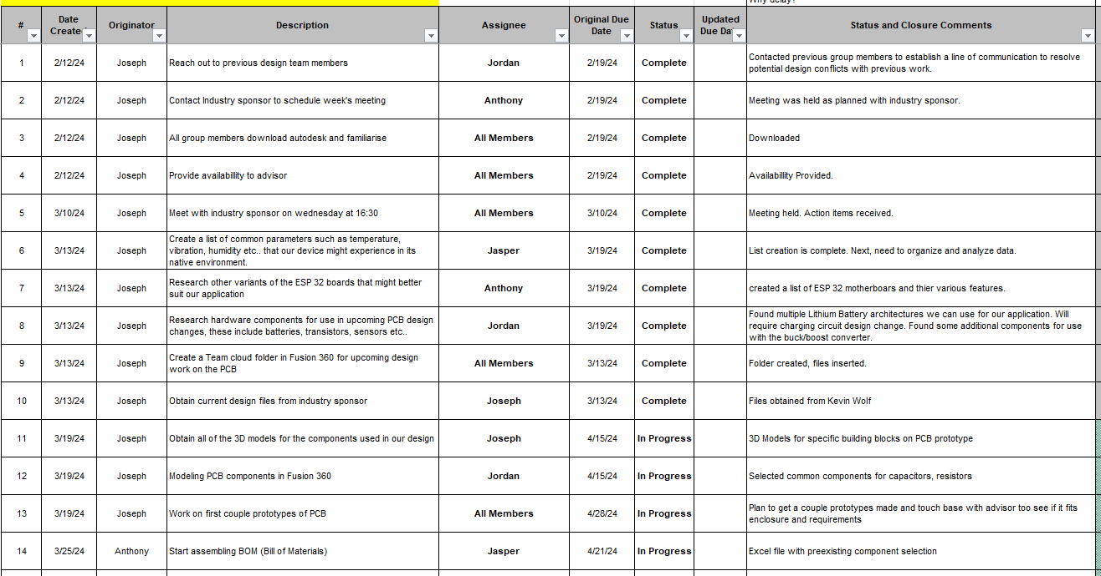
Action Register

