Slide 1
NLI: Identifying the CHARACTERistics of a Native Language

Slide 2
Introduction
We show that it is possible to learn to identify the mother tongue of TOEFL test takers from the content of the essays they wrote. Our method uses a character level model based on convolutional neural networks to predict the most probable native language from a set of 11 possibilities.
2

Slide 3
Background
Initial thoughts
How would a human approach this task?
Misspellings
Specific to each language
Words? Characters?
Character embedding motivation
NLI Shared Task
Groningen (3rd place, 1-9 character n-grams)
Google Brain 2016
Evaluated on 1B Word benchmark
Outperformed state of the art word embedding technologies
Capture complex aspects of language
2

Slide 4
Background
Initial Thoughts
How would a human approach this task?
Misspellings: Specific to each language? Words? Characters?
Character Embedding Motivation
NLI Shared Task: Groningen (3rd place, 1-9 character n-grams)
Google Brain 2016:
Evaluated on 1B Word benchmark
Outperformed state of the art word embedding technologies
Capture complex aspects of language
2

Slide 5
Model
3

Slide 6
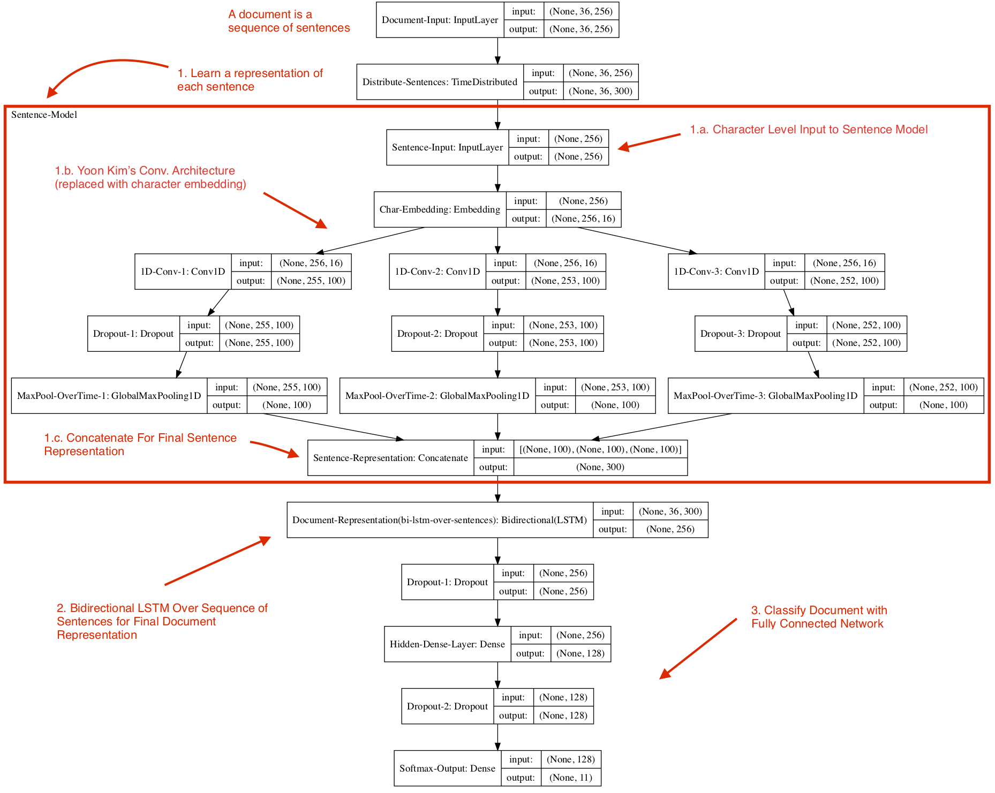
Model Overview
A Document is Considered a Sequence of Sentences
A Sentence is Considered a Sequence of Characters
Learn Vector Repr. of Each Unit
Character (Initial Embedding Layer)
Sentence (Variant of Yoon Kim’s Conv. Architecture)
Document (Bidirectional LSTM)
Classify Based on Final Doc Repr.
Dense Layers with Softmax Output for Class Probabilities
2

Slide 7
A document is considered a sequence of sentences
A sentence is considered a sequence of characters
Learn vector representations of each unit
Character (Initial embedding Layer)
Sentence (Variant of Yoon Kim’s Conv. Architecture)
Document (Bidirectional LSTM)
Classify based on final document representation
Dense Layers with Softmax output for class probabilities
Model Overview
2

Slide 8
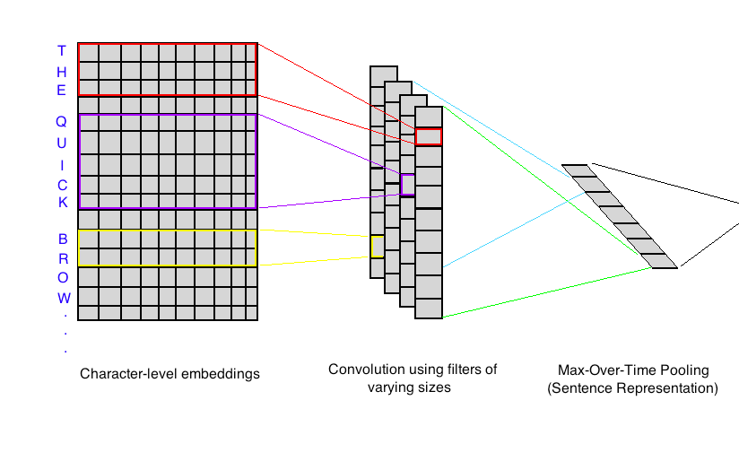
Input Learned Character Embedding
1D Convolutions by 100 filters of varying sizes (2, 4, 5)
Capture short-sequences of characters and small words
Identify things like misspellings
Max-Pooling Over-Time
Remember most important aspects
Concatenate Values for Vector Representation
Sentence Representation
Sentence Representation
Input Learned Character Embedding
1D Convolutions by 100 filters of varying sizes (2, 4, 5)
Capture short-sequences of characters and small words
Identify things like misspellings
Max-Pooling Over-Time
Remember most important aspects
Concatenate Values for Vector Representation
2

Slide 9
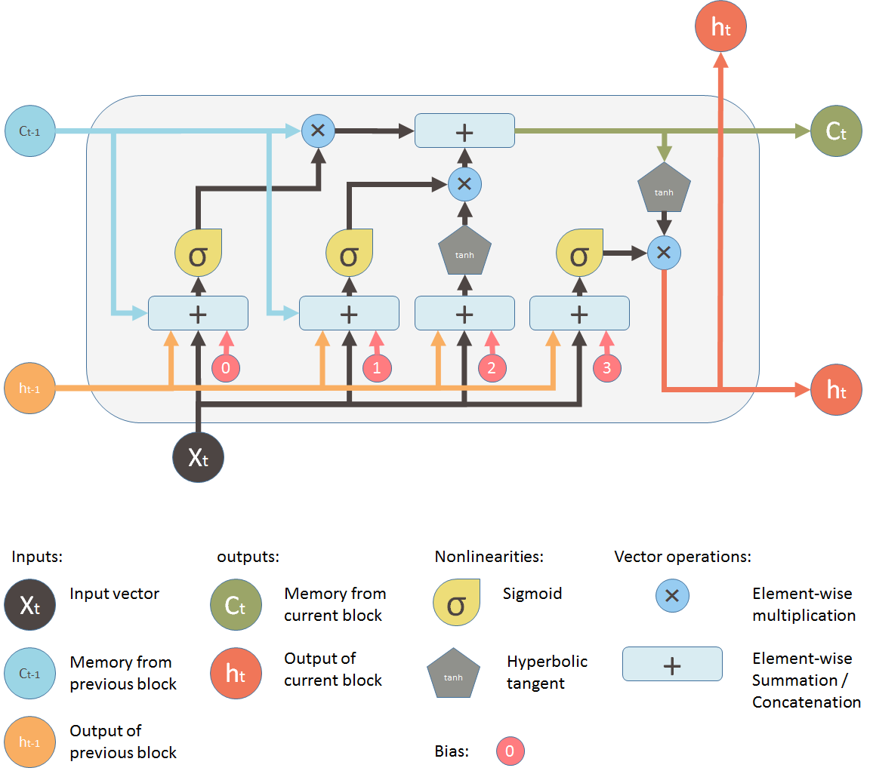
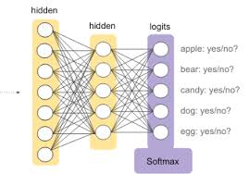
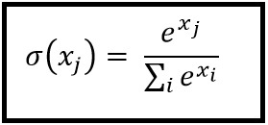
Input Learned Sentence Representations
LSTM over sequence of sentences for document representation
Each cell receives information from previous cells and current input from sequence
Use of sigmoid layers to decide what old information should be forgotten and new information added
Dense Layers with Softmax output for class probabilities
Dropout throughout model for regularization
Document Representation
Document Representation
Input Learned Sentence Repr.
LSTM over sequence of sentences for document representation
Each cell receives information from previous cells and current input from sequence
Use of sigmoid layers to decide what old information should be forgotten and new information added
https://medium.com/mlreview/understanding-lstm-and-its-diagrams-37e2f46f1714
Dense Layers with Softmax output for class probabilities
Dropout throughout model for regularization
https://jamesmccaffrey.wordpress.com/2016/03/04/the-max-trick-when-computing-softmax/
2
https://developers.google.com/machine-learning/crash-course/multi-class-neural-networks/softmax

Slide 10
Results
3

Slide 11
Precision on Test Set
70.9%
64.6%
64.1%
64.5%
67.3%
63.9%
57.9%
55.1%
47.0%
43.9%
39.1%
ARA
DEU
FRA
HIN
ITA
JPN
KOR
SPA
TEL
TUR
ZHO
2

Slide 12
According to phonotactics (“arrangements of sounds”), Italian allows V, CV, CCV, CCCV for a syllable. Every syllable ends with a vowel. That includes the last syllable. (vowel, consonant)
Relatively High Precision on Italian
Title One
2

Slide 13
Recall on Test Set
73.6%
71.0%
69.0%
58.0%
59.0%
56.0%
50.0%
53.0%
44.0%
43.0%
35.0%
ARA
DEU
FRA
HIN
ITA
JPN
KOR
SPA
TEL
TUR
ZHO
2

Slide 14
German
Hindi
Japanese
550/900 High
526/900 High
160/900 High
2

Slide 15
F1 Score on Test Set
68.5%
66.7%
62.6%
56.2%
56.6%
57.9%
50%
50%
48.3%
47%
46.1%
ARA
DEU
FRA
HIN
ITA
JPN
KOR
SPA
TEL
TUR
ZHO
2

Slide 16
Thanks!
ANY QUESTIONS?
Team Members:
Anthony Sicilia
Brian Falkenstein
Yunkai Tang

Slide 17
Brief Introduction
Here something
2

Slide 18
SECTION BREAK
Successful people do what unsuccessful people are not willing to do.
4

Slide 19
Hello!
David Porter
Refers to a good or service being offered by a company. Ideally, a product should meet a certain consumer demand, or it should be so compelling that consumers believe they need it.
3

Slide 20
Transition Headline
Refers to a good or service being offered by a company.
4

Slide 21
“
Successful people do what unsuccessful people are not willing to do. Don't wish it were easier; wish you were better.
“
4

Slide 22

This Is A Slide Title
The Problem
Some fifty years ago there was a curious case of whale trover litigated. Likewise a fish is technically fast when it bears a waif.
The Solution
Some fifty years ago there was a curious case of whale trover litigated. Likewise a fish is technically fast when it bears a waif.
Service
Some fifty years ago there was a curious case of whale trover litigated. Likewise a fish is technically fast when it bears a waif.
2

Slide 23
SECTION BREAK
Successful people do what unsuccessful people are not willing to do.
4

Slide 24
Use Charts To Explain Your Ideas
One
Two
Tree
Four
Five
2

Slide 25
Use Charts To Explain Your Ideas
One
Two
Tree
Four
$4390
$193
$67
$290

Slide 26
Maps
2

Slide 27
2,895,730.00
That’s a big number
2

Slide 28
285,637
7,845,958
80%
That’s a big number
That’s a big number
That’s a big number
2

Slide 29
Our process is easy
Unsuccessful people are not willing to do. Don't wish it were easier; wish you were better.
Title One
One
Two
Tree
2

Slide 30
Bulleted List Sample
The Problem
Some fifty years ago there was a curious case of whale trover litigated. Likewise a fish is technically fast when it bears a waif. These are scientific commentaries; but the commentaries of the whale men themselves sometimes consist in hard words and harder knocks—the Coke-upon-Littleton of the fist.
The Solution
Some fifty years ago there was a curious case of whale trover litigated. Likewise a fish is technically fast when it bears a waif. These are scientific commentaries; but the commentaries of the whale men themselves sometimes consist in hard words and harder knocks—the Coke-upon-Littleton of the fist.
Service
Some fifty years ago there was a curious case of whale trover litigated. Likewise a fish is technically fast when it bears a waif. These are scientific commentaries; but the commentaries of the whale men themselves sometimes consist in hard words and harder knocks—the Coke-upon-Littleton of the fist.
2

Slide 31
iPhone Project
iPhone
Refers to a good or service being offered by a company. Ideally, a product should meet a certain consumer demand, or it should be so compelling that consumers believe they need it. To be successful, marketers should understand the life cycle of a product, and business executives should have a plan for dealing with products at every stage of their life cycles. Some fifty years ago there was a curious case of whale-trover litigated in England.

Slide 32

iPad Project
iPad
Refers to a good or service being offered by a company. Ideally, a product should meet a certain consumer demand, or it should be so compelling that consumers believe they need it. To be successful, marketers should understand the life cycle of a product, and business executives should have a plan for dealing with products at every stage of their life cycles. Some fifty years ago there was a curious case of whale-trover litigated in England.

Slide 33

MacBook
MacBook
Refers to a good or service being offered by a company. Ideally, a product should meet a certain consumer demand, or it should be so compelling that consumers believe they need it. To be successful, marketers should understand the life cycle of a product, and business executives should have a plan for dealing with products at every stage of their life cycles. Some fifty years ago there was a curious case of whale-trover litigated in England.

Slide 34
MacBook
MacBook
Refers to a good or service being offered by a company. Ideally, a product should meet a certain consumer demand, or it should be so compelling that consumers believe they need it. To be successful, marketers should understand the life cycle of a product, and business executives should have a plan for dealing with products at every stage of their life cycles. Some fifty years ago there was a curious case of whale-trover litigated in England.

Slide 35
A BIT OF OUR STORY
Write here a line of text
But what plays the mischief with this masterly code is the admirable brevity of it, which necessitates a vast volume of commentaries to expound it. First: What is a Fast-Fish? Alive or dead a fish is technically fast, when it is connected with an occupied ship or boat, by any medium at all controllable by the occupant or occupants,—a mast, an oar, a nine-inch cable.
A telegraph wire, or a strand of cobweb, it is all the same. Likewise a fish is technically fast when it bears a waif, or any other recognized symbol of possession; so long as the party waiting it plainly evince their ability at any time to take it alongside, as well as their intention so to do.
These are scientific commentaries; but the commentaries of the whale men themselves sometimes consist in hard words and harder knocks—the Coke-upon-Littleton of the fist. True, among the more upright and honorable whale men allowances are always made for peculiar cases, where it would be an outrageous moral injustice for one party to claim possession of a whale previously chased or killed by another party. But others are by no means so scrupulous.
Some fifty years ago there was a curious case of whale-trover litigated in England, wherein the plaintiffs set forth that after a hard chase of a whale in the Northern seas; and when indeed they (the plaintiffs) had succeeded in harpooning the fish; they were at last, through peril of their lives, obliged to forsake not only their lines, but their boat itself. Ultimately the defendants (the crew of another ship) came up with the whale, struck, killed, seized, and finally appropriated it before the very eyes of the

Slide 36
GENERAL

