Slide 1

Project 4 Machine Learning
Group members:
Riwas Karki Sima Moghadam Anthony Tran Jackson Sandler

Slide 2

Detecting Fraud in Financial Transactions with Machine Learning
Overview:
Objective: Develop a machine learning model to detect fraudulent transactions efficiently.
Significance: Protects financial institutions from fraud, ensuring customer trust and financial security.
Integration: The model is accessible via a user-friendly web application, making it easy to implement for banking systems.

Slide 3
Key Objectives of Our Fraud Detection Project
Model Development: Utilize advanced machine learning algorithms such as Random Forest and XGBoost to accurately identify fraudulent transactions.
Web Application Deployment: Create a seamless interface using Flask, enabling real-time transaction analysis.
Real-Time Analysis: Ensure the system can rapidly process and provide fraud detection results on new transaction data.
Evaluation Metrics: Achieve high accuracy, precision, and recall, minimizing false positives and negatives to ensure reliability.
Expected Impact:
Fraud Reduction: Significantly lower instances of fraudulent transactions.
Enhanced Decision Support: Empower financial entities to make informed, instant decisions about transaction authenticity.
Customer Confidence: Boost trust in financial systems by providing robust fraud detection measures.

Slide 4
Data processing and feature engineering
Data Processing:
Source: Kaggle dataset stored in AWS PostgreSQL.
Secure Access: Connect securely using credentials.
Cleansing: Fix missing or inconsistent data.
Feature Engineering:
Normalization: Scale features for uniformity.
Correlation Analysis: Use Seaborn to highlight key feature relationships with fraud.
Encoding for Categorical Variable: conversion of categorical variables into numeric values.

Slide 5
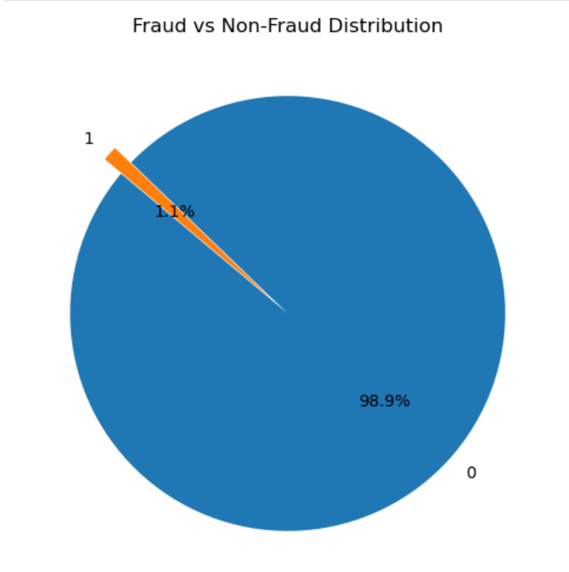
Problem: Bias Towards the Majority Class
With such a significant imbalance, the model might prioritize correctly predicting the majority (non-fraud) class while largely ignoring the minority (fraud) class, leading to low recall for fraud detection.
Solution might be undersampling/oversampling and using other methods to balance the class.

Slide 6
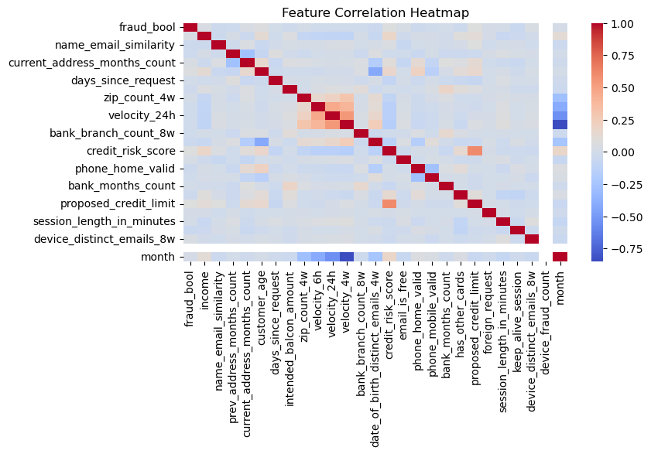

Slide 7
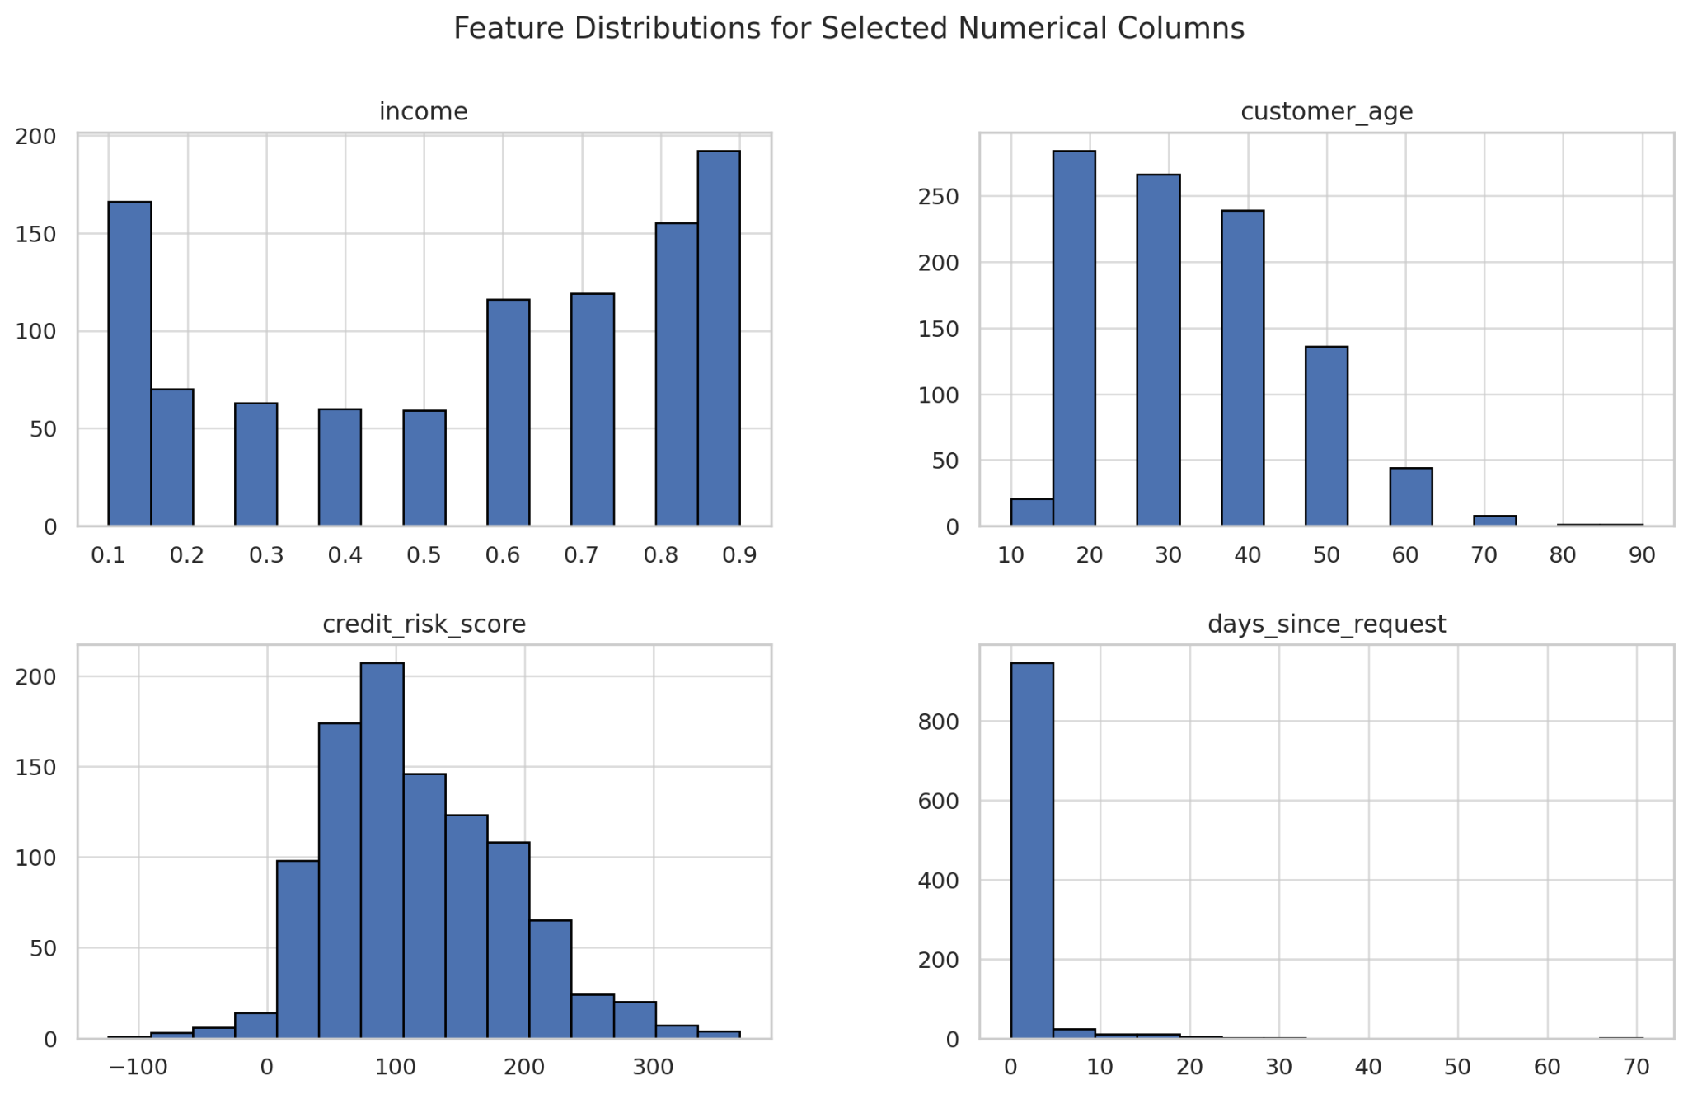

Slide 8
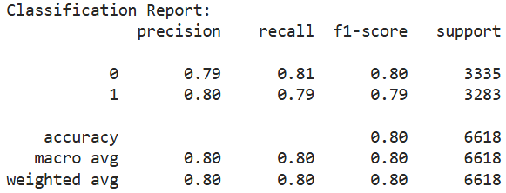
RANDOM FOREST MODEL
MODEL OPTIMISATION
Class Balancing: Undersampled the majority class to match the minority (fraud) class for a balanced dataset.
Model Training and Evaluation: Trained a balanced Random Forest model and evaluated it using precision, recall, and F1-score metrics.
Outcome: The Random Forest model showed improved sensitivity to fraud cases, balancing prediction accuracy across both classes

Slide 9
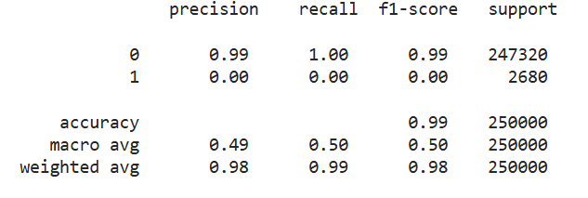
Linear Regression
Model Limitation: Linear Regression struggled with classifying fraud cases, showing 0.00 precision, recall, and F1-score for the fraud class.
High Accuracy but Misleading: Achieved 99% accuracy; however, this metric is misleading due to severe misclassification of the minority class (fraud).
Imbalance Impact: The model heavily favored the majority class (non-fraud), failing to identify fraud cases accurately, as indicated by the skewed classification report.

Slide 10
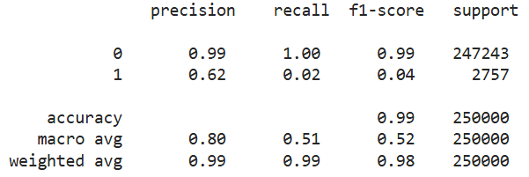
Gradient Boosting
Better Fraud Precision: Precision for fraud improved to 0.62, showing better identification of fraud cases.
Low Fraud Recall: Recall remains low at 0.02, meaning the model misses most fraud cases
.
High Accuracy, Low Sensitivity: Overall accuracy is 99%, but fraud detection remains weak with an F1-score of 0.04 for fraud.

Slide 11
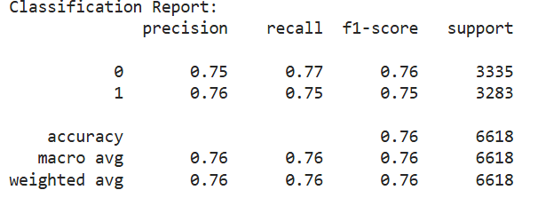
Final Model (RF Classifier)
Data Preparation: Loaded and explored data, applied Undersampling for class balance.
Feature Engineering: One-hot encoded categorical features; scaled numerical features and filtered out the unnecessary features.
.
Model: Trained a balanced Random Forest classifier focused on fraud sensitivity.
Results: Achieved 76% precision, recall, and F1-score, indicating balanced performance across classes.

Slide 12
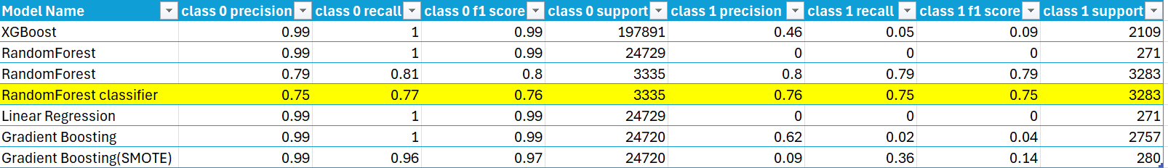
Results from all models
Although the random forest was the best model using SMOTE, there were downsides.
By adding synthetic data to the learning process, it could lead to biased predictions.
the Random Forest model performed the best out of all the models
Linear Regression was the least accurate since it relies on a linear relationship

Slide 13
Areas for Improvement
K-Means SMOTE Could have been implemented and useful as it would be focused on clusters, producing synthetic samples more relevant to the model.
Neural Networks with Class Weights Allowing us users to assign different weights to different classes. Ensuring that the model pays more attention to the minority class which would have been very useful for us since we had trouble getting a high accuracy score for class 1.
SVM SMOTE By balancing the dataset with synthetic samples, the SVM can learn better decision boundaries for the minority class, leading to improved recall and F1 scores.

Slide 14
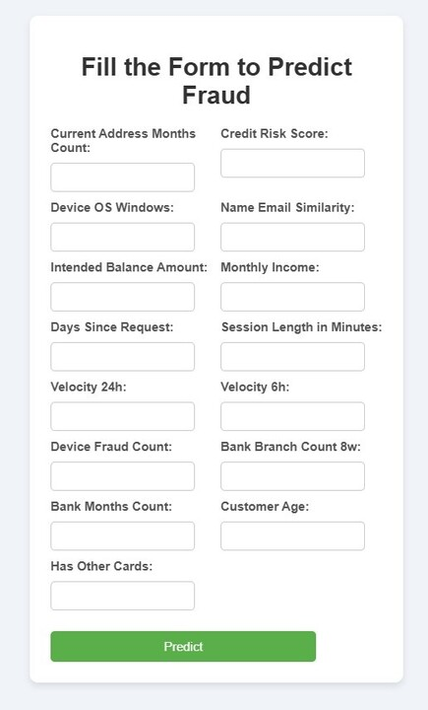
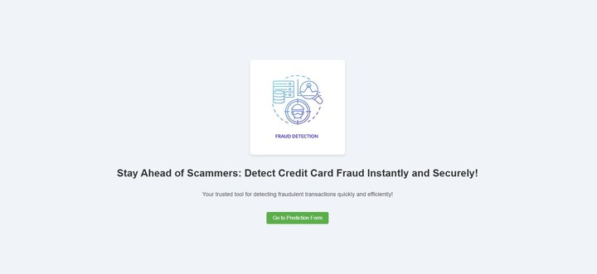
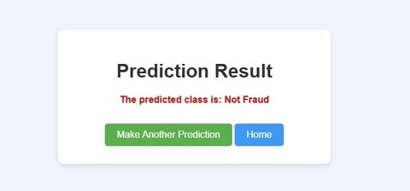
Flask API to serve the model.

Slide 15
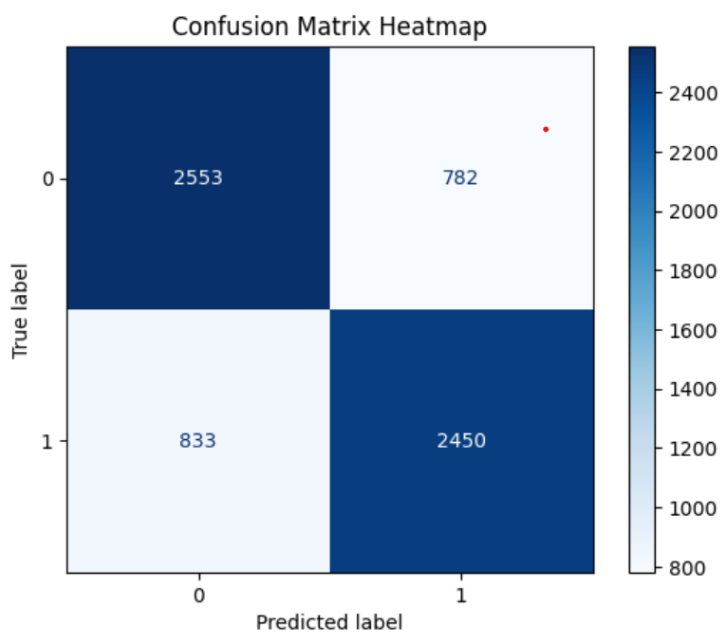
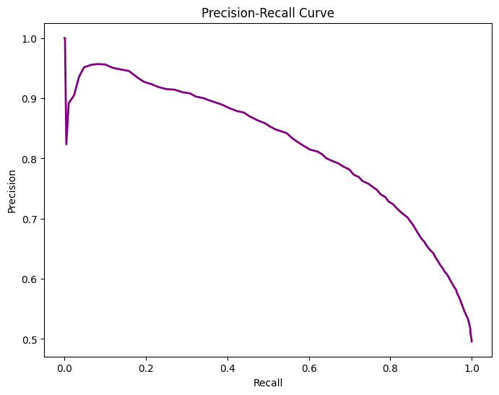
Key insights from a ML Model

Slide 16
Conclusion
Our machine learning model, mainly a Random Forest Classifier, detects fraud with high accuracy by focusing on balanced metrics for real-time transactions.
By analyzing transaction patterns, our model supports financial teams in making informed, split-second decisions to prevent fraud.
We built an interface with Flask, making the model deployable and accessible for financial institutions without complex integration.
With careful feature engineering—like scaling and encoding—the model maintains consistent accuracy across different transaction types.
Improvements like K-Means SMOTE and neural networks could further boost detection rates, adapting our model to future fraud patterns.

Slide 17


Slide 18


