Slide 1
Development and Evaluation of Data-Driven Models using High Frequency Time Series
Anthony Wertz
Research Analyst
Auton Lab
Carnegie Mellon University
26 April 2018

Slide 2

Motivation
Patient care can benefit from knowledge of patient state and disease progression.
Monitoring systems can help…
...but we need models to really describe them.
Alone, models aren’t very intelligent, but we can evaluate our models to determine how to use them intelligently.
How can we use high density data collected from patients in research and in practice?

Slide 3
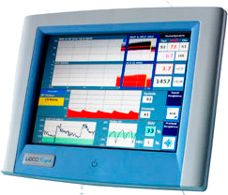
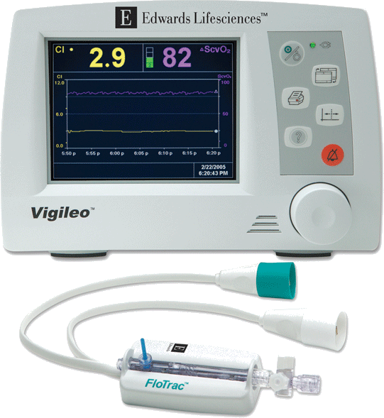
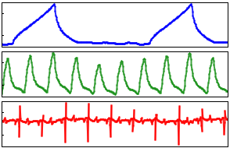
Motivation
Patient care can benefit from knowledge of patient state and disease progression.
Monitoring systems can help…
...but we need models to really describe them.
Alone, models aren’t very intelligent, but we can evaluate our models to determine how to use them intelligently.
How can we use high density data collected from patients in research and in practice?
Flotrac
LiDCO
Vitals

Slide 4
Motivation
Patient care can benefit from knowledge of patient state and disease progression.
Monitoring systems can help…
...but we need models to really describe them.
Alone, models aren’t very intelligent, but we can evaluate our models to determine how to use them intelligently.
How can we use high density data collected from patients in research and in practice?
Flotrac
LiDCO
Vitals
Model

Slide 5

Motivation
Patient care can benefit from knowledge of patient state and disease progression.
Monitoring systems can help…
...but we need models to really describe them.
Alone, models aren’t very intelligent, but we can evaluate our models to determine how to use them intelligently.
How can we use high density data collected from patients in research and in practice?
Flotrac
LiDCO
Vitals
Model
Improve
Patient
Outcomes

Slide 6
Motivation
Patient care can benefit from knowledge of patient state and disease progression.
Monitoring systems can help…
...but we need models to really describe them.
Alone, models aren’t very intelligent, but we can evaluate our models to determine how to use them intelligently.
How can we use high density data collected from patients in research and in practice?
Flotrac
LiDCO
Vitals
?
Model
?
Improve
Patient
Outcomes

Slide 7
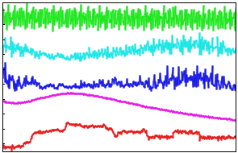
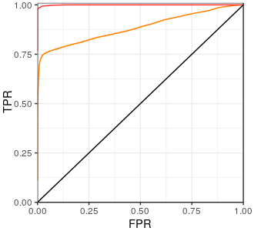
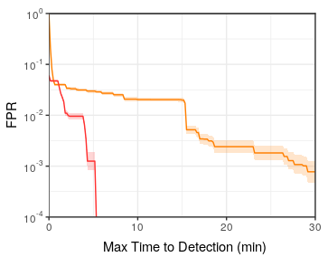
Computational Experimental Design
Featurization: Pull out information that might be difficult for a model to discover automatically.
Training and Validation: Build a good model.
Evaluation: Understand the model’s performance.
Operationalize: (Optional) Use the model in a clinical setting.
Training Set
Testing Set
ROC
AMOC

Slide 8
Computational Experimental Design
Featurization: Pull out information that might be difficult for a model to discover automatically.
Training and Validation: Build a good model.
Evaluation: Understand the model’s performance.
Operationalize: (Optional) Use the model in a clinical setting.
Training Set
Testing Set
ROC
AMOC

Slide 9
Computational Experimental Design
Featurization: Pull out information that might be difficult for a model to discover automatically.
Training and Validation: Build a good model.
Evaluation: Understand the model’s performance.
Operationalize: (Optional) Use the model in a clinical setting.
Training Set
Testing Set
ROC
AMOC

Slide 10

Computational Experimental Design
Featurization: Pull out information that might be difficult for a model to discover automatically.
Training and Validation: Build a good model.
Evaluation: Understand the model’s performance.
Operationalize: (Optional) Use the model in a clinical setting.
Training Set
Testing Set
ROC
AMOC

Slide 11
Featurization

Slide 12
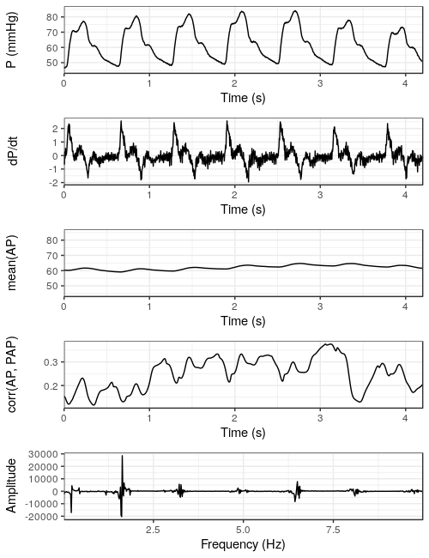
Time Series Featurization
Monitoring devices can produce high density time signals. How do we analyze them?
We can use instantaneous values.
We can look at integrals and derivatives.
We can compute features in a sliding window (statistics, trend lines, test statistics, …).
We can look at signal correlations, and apply all of the above techniques (e.g. rolling correlation).
We can extract frequency components (Fourier transform, wavelet, spectral power, …).

Slide 13

Time Series Featurization
Monitoring devices can produce high density time signals. How do we analyze them?
We can use instantaneous values.
We can look at integrals and derivatives.
We can compute features in a sliding window (statistics, trend lines, test statistics, …).
We can look at signal correlations, and apply all of the above techniques (e.g. rolling correlation).
We can extract frequency components (Fourier transform, wavelet, spectral power, …).

Slide 14
Time Series Featurization
Monitoring devices can produce high density time signals. How do we analyze them?
We can use instantaneous values.
We can look at integrals and derivatives.
We can compute features in a sliding window (statistics, trend lines, test statistics, …).
We can look at signal correlations, and apply all of the above techniques (e.g. rolling correlation).
We can extract frequency components (Fourier transform, wavelet, spectral power, …).

Slide 15
Time Series Featurization
Monitoring devices can produce high density time signals. How do we analyze them?
We can use instantaneous values.
We can look at integrals and derivatives.
We can compute features in a sliding window (statistics, trend lines, test statistics, …).
We can look at signal correlations, and apply all of the above techniques (e.g. rolling correlation).
We can extract frequency components (Fourier transform, wavelet, spectral power, …).

Slide 16
Time Series Featurization
Monitoring devices can produce high density time signals. How do we analyze them?
We can use instantaneous values.
We can look at integrals and derivatives.
We can compute features in a sliding window (statistics, trend lines, test statistics, …).
We can look at signal correlations, and apply all of the above techniques (e.g. rolling correlation).
We can extract frequency components (Fourier transform, wavelet, spectral power, …).

Slide 17
Time Series Featurization
Monitoring devices can produce high density time signals. How do we analyze them?
We can use instantaneous values.
We can look at integrals and derivatives.
We can compute features in a sliding window (statistics, trend lines, test statistics, …).
We can look at signal correlations, and apply all of the above techniques (e.g. rolling correlation).
We can extract frequency components (Fourier transform, wavelet, spectral power, …).

Slide 18
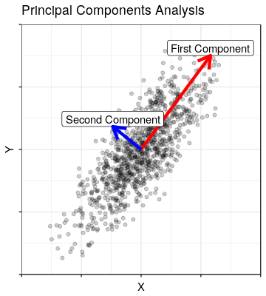
Structure of Variance in Data
Principal Components Analysis (PCA)
  Which correlations explain the most variation in the data?
  Dimensionality reduction.
  Anomaly detection.
Canonical Correlation Analysis (CCA)
  Which correlations between features of two datasets explain the most variation in the data?
Canonical Autocorrelation Analysis (CAA)
  Which correlations between subsets of features in a single dataset explain the most variation in the data?

Slide 19
Structure of Variance Across Datasets
Principal Components Analysis (PCA)
  Which correlations explain the most variation in the data?
  Dimensionality reduction.
  Anomaly detection.
Canonical Correlation Analysis (CCA)
  Which correlations between features of two datasets explain the most variation in the data?
Canonical Autocorrelation Analysis (CAA)
  Which correlations between subsets of features in a single dataset explain the most variation in the data?
Dataset A
Dataset 2
A
1
B
2
C
3
ρ
D
4
E
5
F
6
G
7
H
I
J
K
L

Slide 20
Structure of Variance Across Features Subsets in a Single Dataset
Principal Components Analysis (PCA)
  Which correlations explain the most variation in the data?
  Dimensionality reduction.
  Anomaly detection.
Canonical Correlation Analysis (CCA)
  Which correlations between features of two datasets explain the most variation in the data?
Canonical Autocorrelation Analysis (CAA)
  Which correlations between subsets of features in a single dataset explain the most variation in the data?
Dataset A
A
B
C
ρ
D
E
F
G
H
I
J
K
L

Slide 21
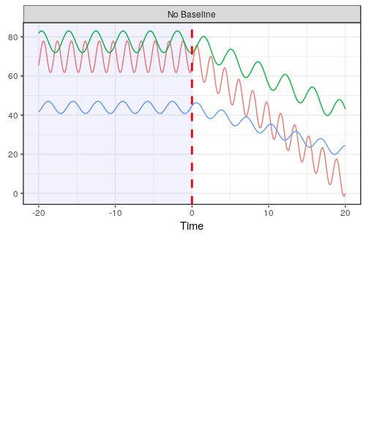
Significant Variability may be Seen in Patient Vitals
Patients can be very different when stable.
Stable before some
event.
After time t=0, something
interesting starts to happen
to the signals.

Slide 22
Difficult to Set Good Detection Threshold
Patients can be very different when stable.
What threshold yields fast detection of event at t=0 and few false alarms for all patients?
Stable before some
event.
After time t=0, something
interesting starts to happen
to the signals.

Slide 23
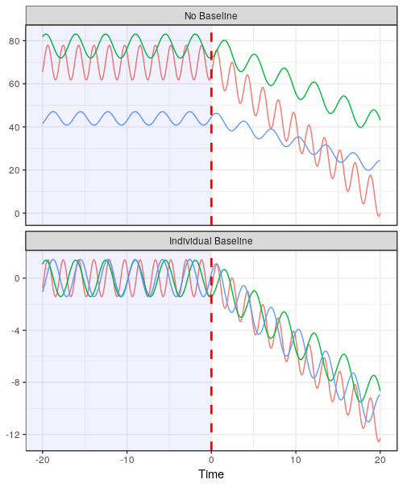
Personalized Normalization Reduces Variation
Patients can be very different when stable.
What threshold yields fast detection of event at t=0 and few false alarms for all patients?
Assume some regularity in the baseline period:
  Center on the mean.
  Scale by its standard deviation.

Slide 24
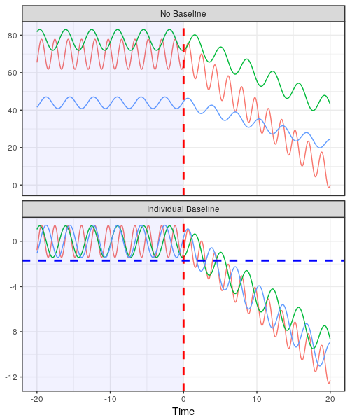
Detection Threshold can be Set After Normalization
Patients can be very different when stable.
What threshold yields fast detection of event at t=0 and few false alarms for all patients?
Assume some regularity in the baseline period:
  Center on the mean.
  Scale by its standard deviation.
  Now we can find a threshold for this data the yields fast detections and few false positives.

Slide 25
Personalized Normalization has Caveats
Patients can be very different when stable.
What threshold yields fast detection of event at t=0 and few false alarms for all patients?
Assume some regularity in the baseline period:
  Center on the mean.
  Scale by its standard deviation.
  Now we can find a threshold for this data the yields fast detections and few false positives.
For this to work we need to collect data when we know the patient is stable.
  Not available for every patient.
  But can be captured for patients prior to, for example, surgery.

Slide 26
Model Training and Validation

Slide 27
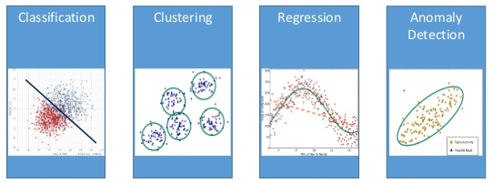
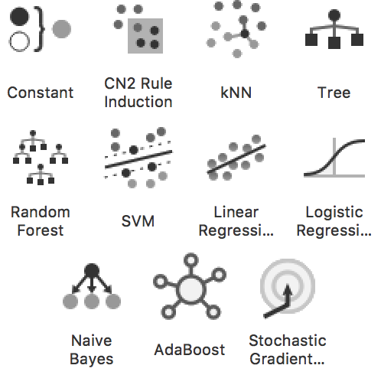
Algorithm Selection
Which algorithm will depend on what type of task:
  Classification?
  Clustering?
  Regression?
  Anomaly detection?
We’ll focus on building classifiers.
  Training and validation is largely the same between types.
  Evaluation will change.
In practice random forests generally perform very well.

Slide 28
Many Classification Models to Choose From
Which algorithm will depend on what type of task:
  Classification?
  Clustering?
  Regression?
  Anomaly detection?
We’ll focus on building classifiers.
  Training and validation is largely the same between types.
  Evaluation will change.
In practice random forests generally perform very well.

Slide 29
Random Forest is a Good Start
Which algorithm will depend on what type of task:
  Classification?
  Clustering?
  Regression?
  Anomaly detection?
We’ll focus on building classifiers.
  Training and validation is largely the same between types.
  Evaluation will change.
In practice random forests generally perform very well.

Slide 30
Building the “Perfect” Model
Training on all data may fool us into training a “perfect” model: simply return the class associated with each input.
  100% accuracy! A+!
  Except…
...applying model to new data often yields poor performance due to model overfitting.
Instead, train on one subset and test on another to estimate expected performance on new data. This forces us to train models that generalize.
Do this multiple times to determine expected performance with confidence bounds (called cross validation).
  We can split by each patient in a “leave one patient out” cross validation.
This lets us compare model algorithms and instances (specific hyper-parameter choices).
  We can also use cross validation to choose hyper-parameters.
Input
“Perfect” Model
A
B
A
B
B
Output

Slide 31
“Perfect” Models Overfit the Data
Training on all data may fool us into training a “perfect” model: simply return the class associated with each input.
  100% accuracy! A+!
  Except…
...applying model to new data often yields poor performance due to model overfitting.
Instead, train on one subset and test on another to estimate expected performance on new data. This forces us to train models that generalize.
Do this multiple times to determine expected performance with confidence bounds (called cross validation).
  We can split by each patient in a “leave one patient out” cross validation.
This lets us compare model algorithms and instances (specific hyper-parameter choices).
  We can also use cross validation to choose hyper-parameters.
Input
“Perfect” Model
A
B
A
B
B
Output

Slide 32
Train and Test Models on Different Datasets
Training on all data may fool us into training a “perfect” model: simply return the class associated with each input.
  100% accuracy! A+!
  Except…
...applying model to new data often yields poor performance due to model overfitting.
Instead, train on one subset and test on another to estimate expected performance on new data. This forces us to train models that generalize.
Do this multiple times to determine expected performance with confidence bounds (called cross validation).
  We can split by each patient in a “leave one patient out” cross validation.
This lets us compare model algorithms and instances (specific hyper-parameter choices).
  We can also use cross validation to choose hyper-parameters.
Test Set Inputs
B
A
A
Training Set Model
B
A
A
B
Test Set Outputs
B
A
A

Slide 33
Validate on Multiple Train and Test Splits
Training on all data may fool us into training a “perfect” model: simply return the class associated with each input.
  100% accuracy! A+!
  Except…
...applying model to new data often yields poor performance due to model overfitting.
Instead, train on one subset and test on another to estimate expected performance on new data. This forces us to train models that generalize.
Do this multiple times to determine expected performance with confidence bounds (called cross validation).
  We can split by each patient in a “leave one patient out” cross validation.
This lets us compare model algorithms and instances (specific hyper-parameter choices).
  We can also use cross validation to choose hyper-parameters.
Test Set Inputs
Test Set Inputs
Test Set Inputs
B
A
A
A
A
B
A
B
B
Training Set Model
Training Set Model
Training Set Model
B
B
A
A
B
B
A
A
A
A
B
B
A
Test Set Outputs
Test Set Outputs
Test Set Outputs
B
A
A
A
A
B
A
B
B

Slide 34
Validate on Multiple Train and Test Splits
Training on all data may fool us into training a “perfect” model: simply return the class associated with each input.
  100% accuracy! A+!
  Except…
...applying model to new data often yields poor performance due to model overfitting.
Instead, train on one subset and test on another to estimate expected performance on new data. This forces us to train models that generalize.
Do this multiple times to determine expected performance with confidence bounds (called cross validation).
  We can split by each patient in a “leave one patient out” cross validation.
This lets us compare model algorithms and instances (specific hyper-parameter choices).
  We can also use cross validation to choose hyper-parameters.
Test Set Inputs
Test Set Inputs
Test Set Inputs
B
A
A
A
A
B
A
B
B
Training Set Model
Training Set Model
Training Set Model
B
B
A
A
B
B
A
A
A
A
B
B
A
Test Set Outputs
Test Set Outputs
Test Set Outputs
B
A
A
A
A
B
A
B
B

Slide 35
Evaluating Performance with
Receiver Operating Characteristic (ROC) Curves

Slide 36
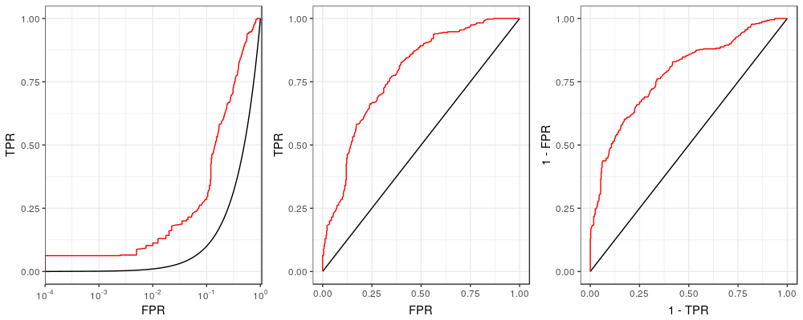
Introducing the ROC (Receiver Operating Characteristic) Curve
This is the model we want to compare with random guessing.
An ROC curve characterizes the performance tradeoffs made when tuning a classifier threshold.
We generally include at least a random choice model and one or more other models we want to compare.
This model (call it “Random”) chooses a class at random with uniform probability.

Slide 37
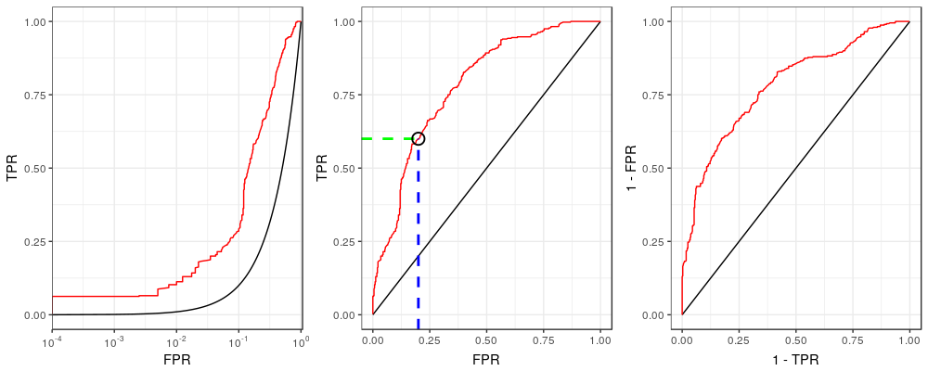
Purpose an ROC Curve
TPR: What fraction of the positive cases did we correctly identify?
An ROC curve characterizes the performance tradeoffs made when tuning a classifier threshold.
We generally include at least a random choice model and one or more other models we want to compare.
This curve characterizes the tradeoff between improving true positive rate (TPR) or false positive rate (FPR).
For a given FPR we can lookup the expected TPR.
FPR: How often are we incorrectly alerting of a condition that is not really present?
(Or: How much do the nurses hate the new monitor?)

Slide 38
Evaluating an ROC Curve
Best to be up here
An ROC curve characterizes the performance tradeoffs made when tuning a classifier threshold.
We generally include at least a random choice model and one or more other models we want to compare.
This curve characterizes the tradeoff between improving true positive rate (TPR) or false positive rate (FPR).
For a given FPR we can lookup the expected TPR.
A better performing classifier will tend to move the curve toward the top left corner (i.e. more positive detections made with fewer false detections).

Slide 39
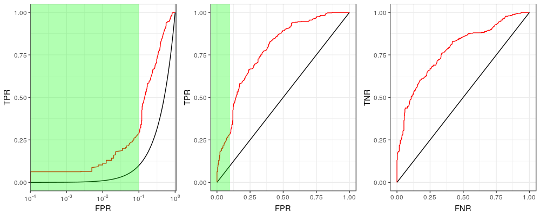
Low False Positive Rates on an ROC Curve
We are often most interested in the low FPR range in operation...
We want to look at this region.
Low FPR = Fewer false alarms.

Slide 40
Low False Positive Rates on an ROC Curve
We are often most interested in the low FPR range in operation…
...so we plot FPR on the log scale to zoom in to the smaller values.
Now it’s much clearer.

Slide 41
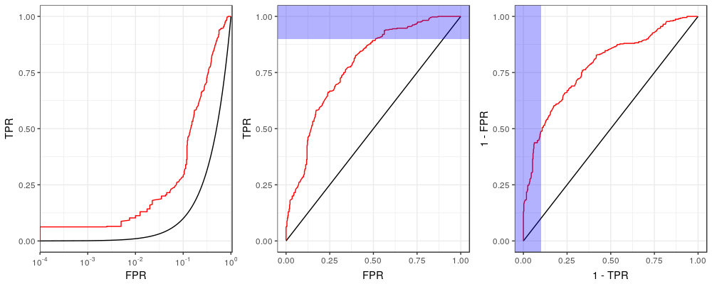
Low False Negative Rates on an ROC Curve
The other end of the ROC is also interesting, so we want to zoom there too…
This side is interesting too…

Slide 42
Low False Negative Rates on an ROC Curve
The other end of the ROC is also interesting, so we want to zoom there too…
…so we can invert the rates and swap the axes…
We flipped and rotated the ROC… Why?

Slide 43
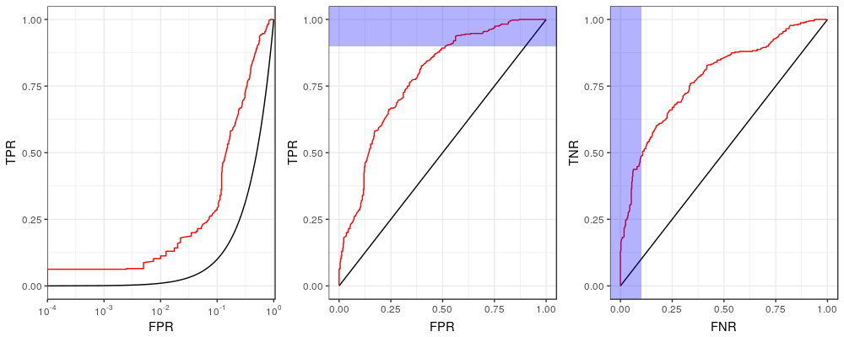
Low False Negative Rates on an ROC Curve
The other end of the ROC is also interesting, so we want to zoom there too…
…so we can invert the rates and swap the axes…
TNR: How much time do we spend on patients who need it by avoiding too much focus on those who don’t?
FNR: How often do we miss something potentially really bad?
Note that:
1-FPR=TNR
1-TPR=FNR

Slide 44
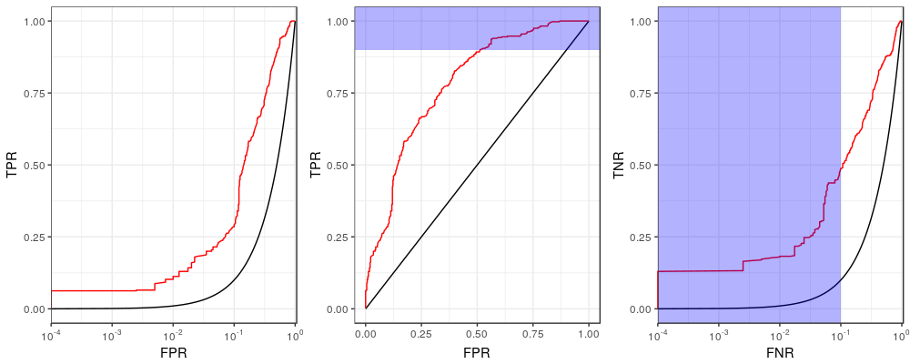
Low False Negative Rates on an ROC Curve
…then plot the false negative rate (FNR) on the log scale.

Slide 45
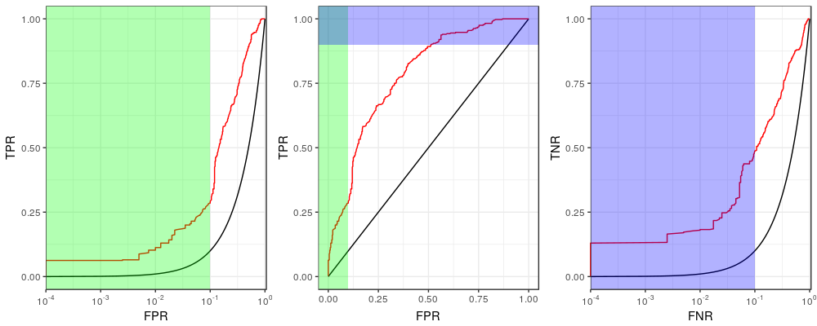
ROC Curve
…then plot the false negative rate (FNR) on the log scale.
Now we see both interesting regions clearly!

Slide 46
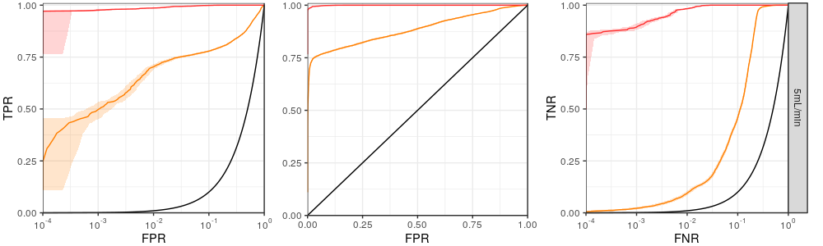
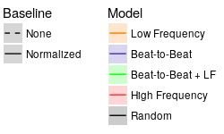
Case Study: Higher Granularity in Data Improves Detection of Hemorrhage in Pig Models
ROC curves for two different hemorrhage detection models
Higher density
Better
Lower density
?
Clear how much better here!
How much better at FPR of 10⁻³?
A University of Pittsburgh and Carnegie Mellon University study* evaluated the importance of data granularity in detection of hemorrhage in pig models.
The ROC curves make it very clear how performance at low error rates compare between two of the models.
* (In progress) Wertz et al. Increasing sampling frequency and referencing to baseline improve hemorrhage detection. 2018.

Slide 47
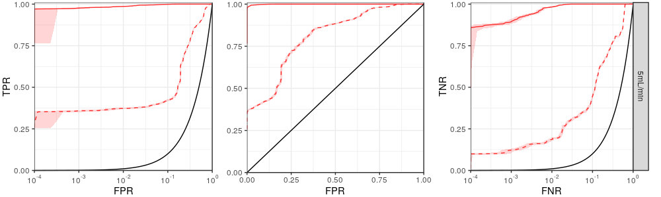
Case Study: Personal Baseline Normalization Improves Detection of Hemorrhage in Pig Models
ROC curves for the same model with and without normalized features
Normalized
Better
Non-normalized
A University of Pittsburgh and Carnegie Mellon University study* evaluated the importance of data granularity in detection of hemorrhage in pig models.
The ROC curves make it very clear how performance at low error rates compare between two of the models.
The study also looked at the impact of normalization on personalized baselines, showing marked improvement.
* (In progress) Wertz et al. Increasing sampling frequency and referencing to baseline improve hemorrhage detection. 2018.

Slide 48
Evaluating Performance with
Activity Monitoring Operating Characteristic (AMOC) Curves

Slide 49
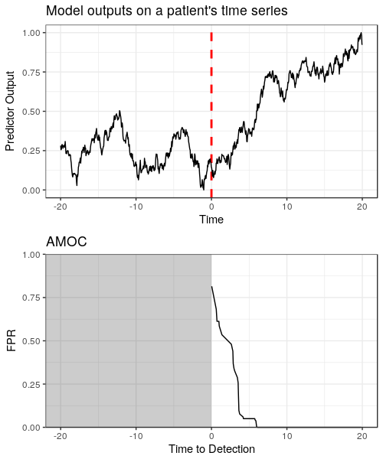
Purpose of the AMOC (Activity Monitoring Operating Characteristic) Curve
Given a time series of predictor outputs generated by our model…
...we want to characterize the tradeoff between detection latency (time to detection) and false alarms (FPR).
How do we compute this?
  Call a “detection” an output greater or equal to 0.2. Assigning this threshold gives us
    A time to detection (the first true positive).
    A number of false positives (thus, FPR).
  Do this again for another threshold, 0.3, and now there are two points on the AMOC.
  Keep doing this for all thresholds for the complete curve.
Lower FPR values are generally more operationally useful… so we put FPR on the log scale to zoom in to this region.
Interesting event
starts here

Slide 50
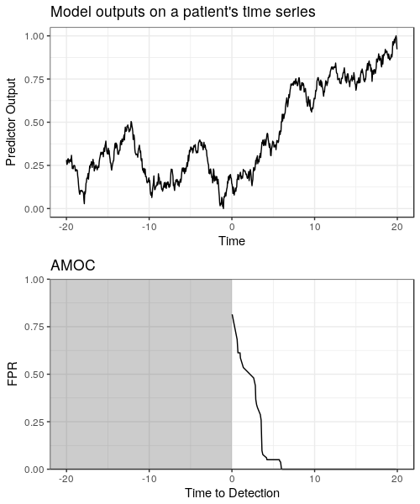
Purpose of the AMOC Curve
Given a time series of predictor outputs generated by our model…
...we want to characterize the tradeoff between detection latency (time to detection) and false alarms (FPR).
How do we compute this?
  Call a “detection” an output greater or equal to 0.2. Assigning this threshold gives us
    A time to detection (the first true positive).
    A number of false positives (thus, FPR).
  Do this again for another threshold, 0.3, and now there are two points on the AMOC.
  Keep doing this for all thresholds for the complete curve.
Lower FPR values are generally more operationally useful… so we put FPR on the log scale to zoom in to this region.
You can ignore this grayed region. We can’t detect the event before it occurs.

Slide 51
Computing an AMOC Curve
Given a time series of predictor outputs generated by our model…
...we want to characterize the tradeoff between detection latency (time to detection) and false alarms (FPR).
How do we compute this?
  Call a “detection” an output greater or equal to 0.2. Assigning this threshold gives us
    A time to detection (the first true positive).
    A number of false positives (thus, FPR).
  Do this again for another threshold, 0.3, and now there are two points on the AMOC.
  Keep doing this for all thresholds for the complete curve.
Lower FPR values are generally more operationally useful… so we put FPR on the log scale to zoom in to this region.

Slide 52
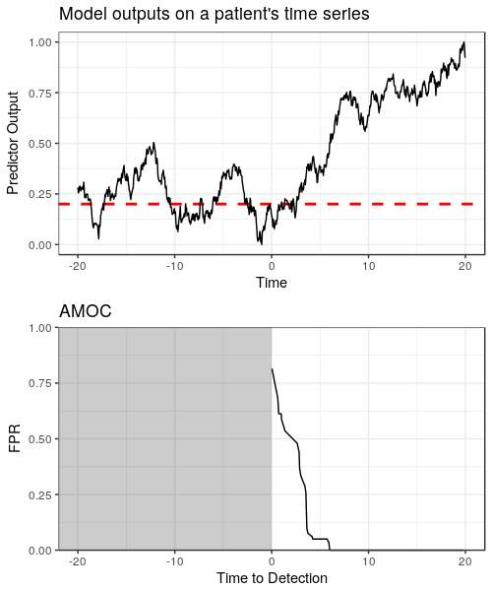
Computing an AMOC Curve
Given a time series of predictor outputs generated by our model…
...we want to characterize the tradeoff between detection latency (time to detection) and false alarms (FPR).
How do we compute this?
  Call a “detection” an output greater or equal to 0.2. Assigning this threshold gives us
    A time to detection (the first true positive).
    A number of false positives (thus, FPR).
  Do this again for another threshold, 0.3, and now there are two points on the AMOC.
  Keep doing this for all thresholds for the complete curve.
Lower FPR values are generally more operationally useful… so we put FPR on the log scale to zoom in to this region.

Slide 53
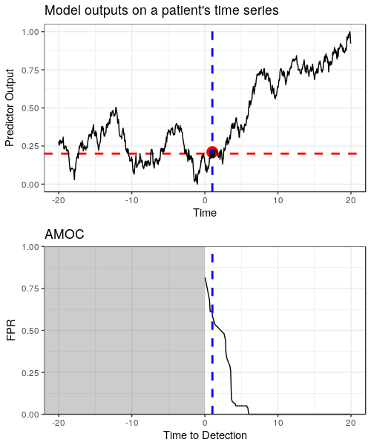
Computing an AMOC Curve
Given a time series of predictor outputs generated by our model…
...we want to characterize the tradeoff between detection latency (time to detection) and false alarms (FPR).
How do we compute this?
  Call a “detection” an output greater or equal to 0.2. Assigning this threshold gives us
    A time to detection (the first true positive).
    A number of false positives (thus, FPR).
  Do this again for another threshold, 0.3, and now there are two points on the AMOC.
  Keep doing this for all thresholds for the complete curve.
Lower FPR values are generally more operationally useful… so we put FPR on the log scale to zoom in to this region.

Slide 54
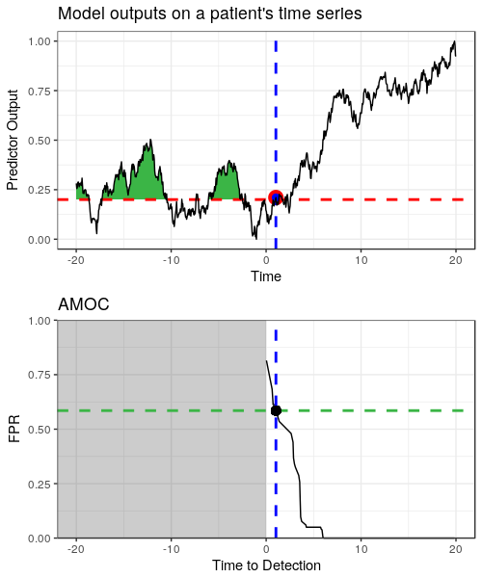
Computing an AMOC Curve
Given a time series of predictor outputs generated by our model…
...we want to characterize the tradeoff between detection latency (time to detection) and false alarms (FPR).
How do we compute this?
  Call a “detection” an output greater or equal to 0.2. Assigning this threshold gives us
    A time to detection (the first true positive).
    A number of false positives (thus, FPR).
  Do this again for another threshold, 0.3, and now there are two points on the AMOC.
  Keep doing this for all thresholds for the complete curve.
Lower FPR values are generally more operationally useful… so we put FPR on the log scale to zoom in to this region.

Slide 55
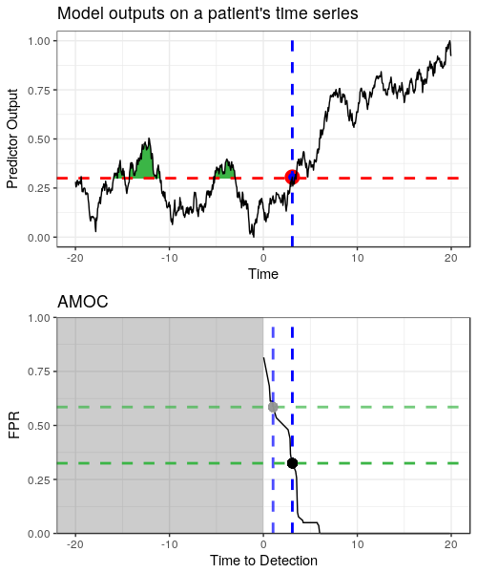
Computing an AMOC Curve
Given a time series of predictor outputs generated by our model…
...we want to characterize the tradeoff between detection latency (time to detection) and false alarms (FPR).
How do we compute this?
  Call a “detection” an output greater or equal to 0.2. Assigning this threshold gives us
    A time to detection (the first true positive).
    A number of false positives (thus, FPR).
  Do this again for another threshold, 0.3, and now there are two points on the AMOC.
  Keep doing this for all thresholds for the complete curve.
Lower FPR values are generally more operationally useful… so we put FPR on the log scale to zoom in to this region.
More latency
Fewer false alarms

Slide 56
Computing an AMOC Curve
Given a time series of predictor outputs generated by our model…
...we want to characterize the tradeoff between detection latency (time to detection) and false alarms (FPR).
How do we compute this?
  Call a “detection” an output greater or equal to 0.2. Assigning this threshold gives us
    A time to detection (the first true positive).
    A number of false positives (thus, FPR).
  Do this again for another threshold, 0.3, and now there are two points on the AMOC.
  Keep doing this for all thresholds for the complete curve.
Lower FPR values are generally more operationally useful… so we put FPR on the log scale to zoom in to this region.

Slide 57
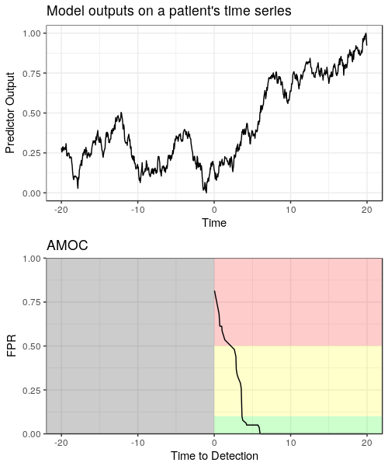
Low False Positive Rates on an AMOC Curve
Given a time series of predictor outputs generated by our model…
...we want to characterize the tradeoff between detection latency (time to detection) and false alarms (FPR).
How do we compute this?
  Call a “detection” an output greater or equal to 0.2. Assigning this threshold gives us
    A time to detection (the first true positive).
    A number of false positives (thus, FPR).
  Do this again for another threshold, 0.3, and now there are two points on the AMOC.
  Keep doing this for all thresholds for the complete curve.
Lower FPR values are generally more operationally useful… so we put FPR on the log scale to zoom in to this region.

Slide 58
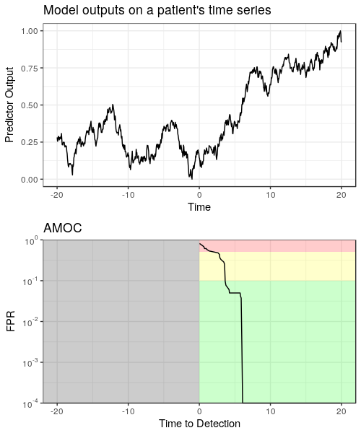
Low False Positive Rates on an AMOC Curve
Given a time series of predictor outputs generated by our model…
...we want to characterize the tradeoff between detection latency (time to detection) and false alarms (FPR).
How do we compute this?
  Call a “detection” an output greater or equal to 0.2. Assigning this threshold gives us
    A time to detection (the first true positive).
    A number of false positives (thus, FPR).
  Do this again for another threshold, 0.3, and now there are two points on the AMOC.
  Keep doing this for all thresholds for the complete curve.
Lower FPR values are generally more operationally useful… so we put FPR on the log scale to zoom in to this region.

Slide 59
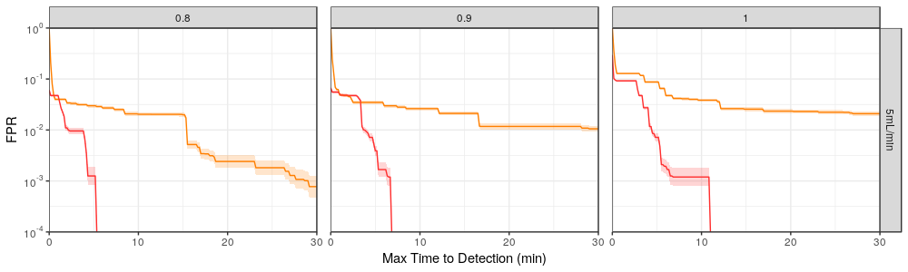
Case Study: Higher Granularity in Data Reduces Detection Latency
AMOC curves for two different hemorrhage detection models
≥ 80%
≥ 90%
100%
Lower density
Better
Higher Density
A University of Pittsburgh and Carnegie Mellon University study* evaluated the importance of data granularity in detection of hemorrhage in pig models.
The AMOC curves make it very clear how detection latency at low error rates compare between two of the models.
* (In progress) Wertz et al. Increasing sampling frequency and referencing to baseline improve hemorrhage detection. 2018.

Slide 60
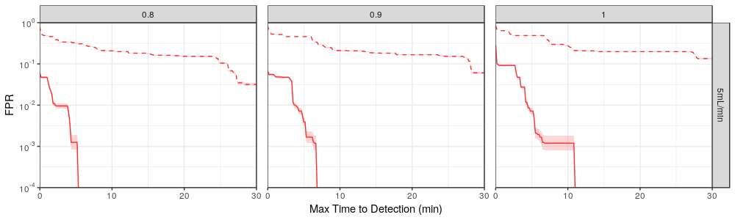
Case Study: Personal Baseline Normalization Reduces Detection Latency
AMOC curves for the same model with and without normalized features
≥ 80%
≥ 90%
100%
Non-normalized
Better
Normalized
A University of Pittsburgh and Carnegie Mellon University study* evaluated the importance of data granularity in detection of hemorrhage in pig models.
The AMOC curves make it very clear how detection latency at low error rates compare between two of the models.
The study also looked at the impact of normalization on personalized baselines, showing marked improvement.
* (In progress) Wertz et al. Increasing sampling frequency and referencing to baseline improve hemorrhage detection. 2018.

Slide 61
Three Steps to Building Great Models
Featurize signals to uncover interesting information.
Evaluate models to understand performance.
Validate models through cross validation.
Questions?

