Slide 1
Learning Multi-granular Models of Physiology
for Detection of Bleeding
Anthony Wertz Research Analyst Auton Lab
Carnegie Mellon University
October 3rd, 2017
Funded by: R01GM126811
Carnegie Mellon University Dr. Artur Dubrawski
Dr. Mathieu Guillame-Bert
University of Pittsburgh
Dr. Michael Pinsky
Dr. Gilles Clermont

Slide 2

Questions
Given observations of a patient’s vitals can we determine whether or not the patient is bleeding?

Slide 3
Questions
Given observations of a patient’s vitals can we determine whether or not the patient is bleeding?
If so,
How quickly?
How often will we get false alarms?
How much data do we need?
How does the a priori knowledge of a patient’s normal vitals affect our ability to detect bleeding?

Slide 4
Questions
Given observations of a patient’s vitals can we determine whether or not the patient is bleeding?
If so,
How quickly?
How often will we get false alarms?
How much data do we need?
How does the a priori knowledge of a patient’s normal vitals affect our ability to detect bleeding?
Can we design an experiment to collect the hemodynamic data from patients before and while controlled bleeding takes place to evaluate these questions?

Slide 5
Questions
Given observations of a patient’s vitals can we determine whether or not the patient is bleeding?
If so,
How quickly?
How often will we get false alarms?
How much data do we need?
How does the a priori knowledge of a patient’s normal vitals affect our ability to detect bleeding?
Can we design an experiment to collect the hemodynamic data from patients before and while controlled bleeding takes place to evaluate these questions?
It turns out, we can!

Slide 6

Questions
Given observations of a patient’s vitals can we determine whether or not the patient is bleeding?
If so,
How quickly?
How often will we get false alarms?
How much data do we need?
How does the a priori knowledge of a patient’s normal vitals affect our ability to detect bleeding?
Can we design an experiment to collect the hemodynamic data from patients before and while controlled bleeding takes place to evaluate these questions?
It turns out, we can! With pigs* (* Ethical restrictions limit our ability to bleed humans, even in the name of science.)

Slide 7
Experimental Design
Pigs are anesthetized and connected to various sensors for data collection…

Slide 8
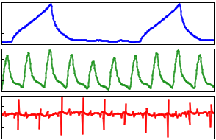
Experimental Design
Pigs are anesthetized and connected to various sensors for data collection, including:
Vital sensor data (arterial, central venous, and pulmonary artery pressure, ECG, plethysmograph, SpO₂) at 250Hz and SvO₂ once every two seconds.
Vitals

Slide 9
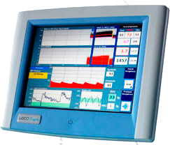
Experimental Design
Pigs are anesthetized and connected to various sensors for data collection, including:
Vital sensor data (arterial, central venous, and pulmonary artery pressure, ECG, plethysmograph, SpO₂) at 250Hz and SvO₂ once every two seconds.
Beat-to-beat LiDCO data.
LiDCO
Vitals

Slide 10
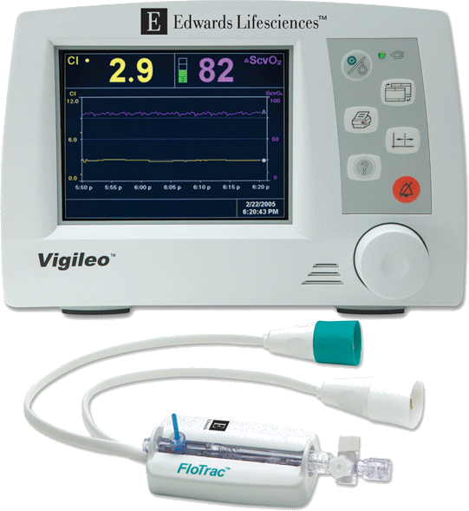
Experimental Design
Pigs are anesthetized and connected to various sensors for data collection, including:
Vital sensor data (arterial, central venous, and pulmonary artery pressure, ECG, plethysmograph, SpO₂) at 250Hz and SvO₂ once every two seconds.
Beat-to-beat LiDCO data.
Flotrac data every 20 seconds.
Flotrac
LiDCO
Vitals

Slide 11
Experimental Design
Pigs are anesthetized and connected to various sensors for data collection, including:
Vital sensor data (arterial, central venous, and pulmonary artery pressure, ECG, plethysmograph, SpO₂) at 250Hz and SvO₂ once every two seconds.
Beat-to-beat LiDCO data.
Flotrac data every 20 seconds.
They are left to rest for 30 minutes while baseline data is collected.
Flotrac
LiDCO
Vitals

Slide 12
Experimental Design
Pigs are anesthetized and connected to various sensors for data collection, including:
Vital sensor data (arterial, central venous, and pulmonary artery pressure, ECG, plethysmograph, SpO₂) at 250Hz and SvO₂ once every two seconds.
Beat-to-beat LiDCO data.
Flotrac data every 20 seconds.
They are left to rest for 30 minutes while baseline data is collected.
The pigs are then bled at a constant rate, either:
5mL/min until mean arterial pressure drops below 40mmHg, or
20mL/min until mean arterial pressure drops below 30mmHg.
Flotrac
LiDCO
Vitals
Bleed starts
5mL/min
20mL/min

Slide 13
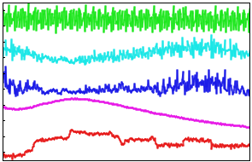
Computational Experimental Design
The data is featurized and those features are split into different (though not mutually exclusive) groups.
(Featurization and the groups will be discussed soon.)

Slide 14

Computational Experimental Design
The data is featurized and those features are split into different (though not mutually exclusive) groups.
Those feature sets are used to validate random forest models that classify a pig as bleeding or not in a leave - one - pig - out cross validation framework.
Training Set
Testing Set
(These will also be discussed briefly.)

Slide 15
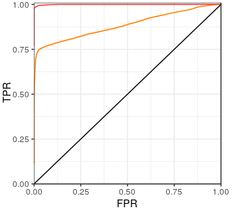
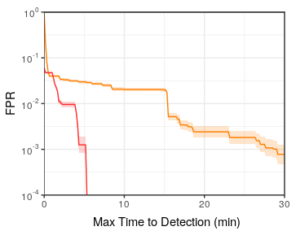
Computational Experimental Design
The data is featurized and those features are split into different (though not mutually exclusive) groups.
Those feature sets are used to validate random forest models that classify a pig as bleeding or not in a leave-one-pig-out cross validation framework.
The detection results are evaluated by means of Receiver Operator Characteristic (ROC) and Activity Monitoring Operator Characteristic (AMOC) curves.
Training Set
Testing Set
(These will be described in a bit more detail since
they’re necessary to understand the results.)
ROC
AMOC

Slide 16
Featurizations and Groups
A featurization is, simply put, a transformation of the original input data.
E.g. given a time series of blood pressures the mean is computed every five minutes.

Slide 17
Featurizations and Groups
A featurization is, simply put, a transformation of the original input data.
E.g. given a time series of blood pressures the mean is computed every five minutes.
We are especially interested in time series featurizations since these are directly impacted by data granularity.

Slide 18
Featurizations and Groups
A featurization is, simply put, a transformation of the original input data.
E.g. given a time series of blood pressures the mean is computed every five minutes.
We are especially interested in time series featurizations since these are directly impacted by data granularity.
To assess the impact of data granularity we grouped the featurizations in four blocks:

Slide 19
Featurizations and Groups
A featurization is, simply put, a transformation of the original input data.
E.g. given a time series of blood pressures the mean is computed every five minutes.
We are especially interested in time series featurizations since these are directly impacted by data granularity.
To assess the impact of data granularity we grouped the featurizations in four blocks:
Low Frequency (LF)
Low Frequency (LF) - 7 Features
Instantaneous vital data only. Assuming a low frequency of data collection (around one observation every two minutes) useful time featurizations are not possible without incurring very long detection latencies.

Slide 20
Featurizations and Groups
A featurization is, simply put, a transformation of the original input data.
E.g. given a time series of blood pressures the mean is computed every five minutes.
We are especially interested in time series featurizations since these are directly impacted by data granularity.
To assess the impact of data granularity we grouped the featurizations in four blocks:
Low Frequency (LF)
Beat-to-Beat (B2B)
Beat-to-Beat (B2B) - 158 Features Data from LiDCO device every heart beat, and data from Flotrac device every 20 seconds. Flotrac featurizations include additional features provided by Flotrac group that are not ordinarily available.
Low Frequency (LF) - 7 Features
Instantaneous vital data only. Assuming a low frequency of data collection (around one observation every two minutes) useful time featurizations are not possible without incurring very long detection latencies.

Slide 21
Featurizations and Groups
A featurization is, simply put, a transformation of the original input data.
E.g. given a time series of blood pressures the mean is computed every five minutes.
We are especially interested in time series featurizations since these are directly impacted by data granularity.
To assess the impact of data granularity we grouped the featurizations in four blocks:
Low Frequency (LF)
Beat-to-Beat (B2B)
Beat-to-Beat + Low Frequency (B2B+LF)
Beat-to-Beat + Low Frequency (B2B+LF)
Beat-to-Beat (B2B) - 158 Features Data from LiDCO device every heart beat, and data from Flotrac device every 20 seconds. Flotrac featurizations include additional features provided by Flotrac group that are not ordinarily available.
Low Frequency (LF) - 7 Features
Instantaneous vital data only. Assuming a low frequency of data collection (around one observation every two minutes) useful time featurizations are not possible without incurring very long detection latencies.

Slide 22
Featurizations and Groups
A featurization is, simply put, a transformation of the original input data.
E.g. given a time series of blood pressures the mean is computed every five minutes.
We are especially interested in time series featurizations since these are directly impacted by data granularity.
To assess the impact of data granularity we grouped the featurizations in four blocks:
Low Frequency (LF)
Beat-to-Beat (B2B)
Beat-to-Beat + Low Frequency (B2B+LF)
High Frequency
High Frequency (HF) - 323 Features
Includes various featurizations of vital waveforms along with featurizations of B2B data.
Beat-to-Beat + Low Frequency (B2B+LF)
Beat-to-Beat (B2B) - 158 Features Data from LiDCO device every heart beat, and data from Flotrac device every 20 seconds. Flotrac featurizations include additional features provided by Flotrac group that are not ordinarily available.
Low Frequency (LF) - 7 Features
Instantaneous vital data only. Assuming a low frequency of data collection (around one observation every two minutes) useful time featurizations are not possible without incurring very long detection latencies.

Slide 23
Featurizations and Groups
A featurization is, simply put, a transformation of the original input data.
E.g. given a time series of blood pressures the mean is computed every five minutes.
We are especially interested in time series featurizations since these are directly impacted by data granularity.
To assess the impact of data granularity we grouped the featurizations in four blocks:
Low Frequency (LF)
Beat-to-Beat (B2B)
Beat-to-Beat + Low Frequency (B2B+LF)
High Frequency
We also compare models with and without baseline normalization.
High Frequency (HF) - 323 639 Features
Includes various featurizations of vital waveforms along with featurizations of B2B data.
Beat-to-Beat + Low Frequency (B2B+LF)
Beat-to-Beat (B2B) - 158 312 Features Data from LiDCO device every heart beat, and data from Flotrac device every 20 seconds. Flotrac featurizations include additional features provided by Flotrac group that are not ordinarily available.
Low Frequency (LF) - 7 14 Features
Instantaneous vital data only. Assuming a low frequency of data collection (around one observation every two minutes) useful time featurizations are not possible without incurring very long detection latencies.

Slide 24
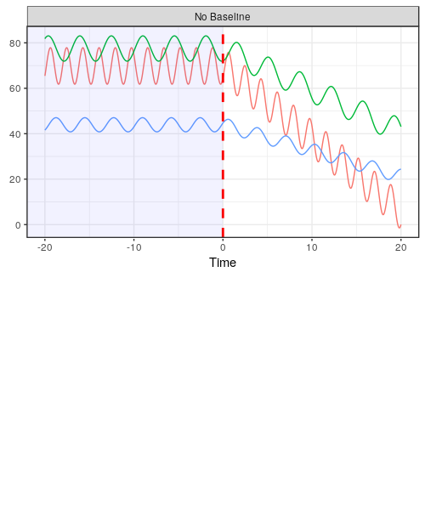
Individual Baseline Normalization
Patients can be very different when stable.
Stable before event.
After t=0 something
interesting starts to
happen to the signals.

Slide 25
Individual Baseline Normalization
Patients can be very different when stable.
What threshold yields fast detection of event at t=0 and few false alarms for all patients?
Stable before event.
After t=0 something
interesting starts to
happen to the signals.

Slide 26
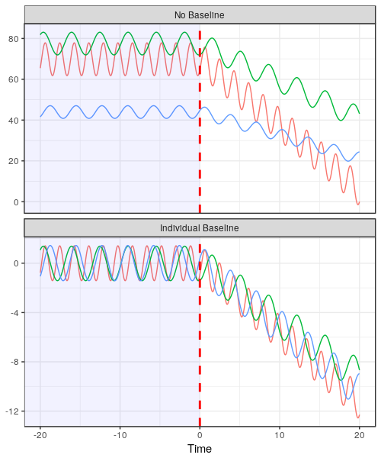
Individual Baseline Normalization
Patients can be very different when stable.
What threshold yields fast detection of event at t=0 and few false alarms for all patients?
Assume some regularity in the baseline period:
Center on the mean.
Scale by its standard deviation.

Slide 27
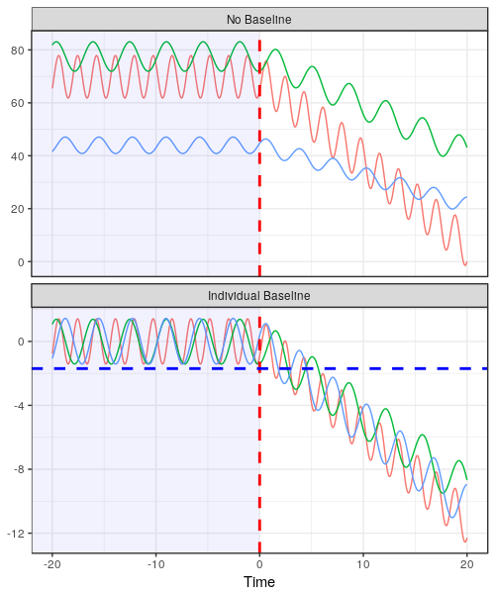
Individual Baseline Normalization
Patients can be very different when stable.
What threshold yields fast detection of event at t=0 and few false alarms for all patients?
Assume some regularity in the baseline period:
Center on the mean.
Scale by its standard deviation.
Now we can find a threshold for this data the yields fast detections and few false positives.

Slide 28
Individual Baseline Normalization
Patients can be very different when stable.
What threshold yields fast detection of event at t=0 and few false alarms for all patients?
Assume some regularity in the baseline period:
Center on the mean.
Scale by its standard deviation.
Now we can find a threshold for this data the yields fast detections and few false positives.
For this to work we need to collect data when we know the patient is stable.
Not available for every patient.
But can be captured for patients prior to, for example, surgery.

Slide 29
Evaluation Methodology
Separate models are trained for combinations of
5mL/min (n=14) or 20mL/min (n=46)
LF, B2B, B2B+LF, HF
No normalization or Individual baseline normalized
16 different models in total.
LF - 5mL/min - Non-normalized
B2B - 5mL/min - Non-normalized
B2B+LF - 5mL/min - Non-normalized
HF Model - 5mL/min - Non-normalized
LF - 5mL/min - Non-normalized
B2B - 5mL/min - Non-normalized
B2B+LF - 5mL/min - Non-normalized
HF Model - 5mL/min - Non-normalized
LF - 5mL/min - Non-normalized
B2B - 5mL/min - Non-normalized
B2B+LF - 5mL/min - Non-normalized
HF Model - 5mL/min - Non-normalized
LF - 5mL/min - Normalized
B2B - 5mL/min - Normalized
B2B+LF - 5mL/min - Normalized
HF Model - 5mL/min - Normalized

Slide 30
Evaluation Methodology
Separate models are trained for combinations of
5mL/min (n=14) or 20mL/min (n=46)
LF, B2B, B2B+LF, HF
No normalization or Individual baseline normalized
16 different models in total.
Each model is a random forest classifier built to distinguish non-bleeding instances (before t=0) from bleeding instances (after t=0).
LF - 5mL/min - Non-normalized
B2B - 5mL/min - Non-normalized
B2B+LF - 5mL/min - Non-normalized
HF Model - 5mL/min - Non-normalized
LF - 5mL/min - Non-normalized
B2B - 5mL/min - Non-normalized
B2B+LF - 5mL/min - Non-normalized
HF Model - 5mL/min - Non-normalized
LF - 5mL/min - Non-normalized
B2B - 5mL/min - Non-normalized
B2B+LF - 5mL/min - Non-normalized
HF Model - 5mL/min - Non-normalized
LF - 5mL/min - Normalized
B2B - 5mL/min - Normalized
B2B+LF - 5mL/min - Normalized
HF Model - 5mL/min - Normalized
Yes
Bleeding?
No

Slide 31
Evaluation Methodology
Separate models are trained for combinations of
5mL/min (n=14) or 20mL/min (n=46)
LF, B2B, B2B+LF, HF
No normalization or Individual baseline normalized
16 different models in total.
Each model is a random forest classifier built to distinguish non-bleeding instances (before t=0) from bleeding instances (after t=0).
Models are evaluated in a leave-one-pig-out cross validation framework.
LF - 5mL/min - Non-normalized
B2B - 5mL/min - Non-normalized
B2B+LF - 5mL/min - Non-normalized
HF Model - 5mL/min - Non-normalized
LF - 5mL/min - Non-normalized
B2B - 5mL/min - Non-normalized
B2B+LF - 5mL/min - Non-normalized
HF Model - 5mL/min - Non-normalized
LF - 5mL/min - Non-normalized
B2B - 5mL/min - Non-normalized
B2B+LF - 5mL/min - Non-normalized
HF Model - 5mL/min - Non-normalized
LF - 5mL/min - Normalized
B2B - 5mL/min - Normalized
B2B+LF - 5mL/min - Normalized
HF Model - 5mL/min - Normalized
Yes
Bleeding?
No
Training Set
Testing Set

Slide 32
Evaluation Methodology
Separate models are trained for combinations of
5mL/min (n=14) or 20mL/min (n=46)
LF, B2B, B2B+LF, HF
No normalization or Individual baseline normalized
16 different models in total.
Each model is a random forest classifier built to distinguish non-bleeding instances (before t=0) from bleeding instances (after t=0).
Models are evaluated in a leave-one-pig-out cross validation framework.
Model performance is evaluated using ROC and AMOC curves.
LF - 5mL/min - Non-normalized
B2B - 5mL/min - Non-normalized
B2B+LF - 5mL/min - Non-normalized
HF Model - 5mL/min - Non-normalized
LF - 5mL/min - Non-normalized
B2B - 5mL/min - Non-normalized
B2B+LF - 5mL/min - Non-normalized
HF Model - 5mL/min - Non-normalized
LF - 5mL/min - Non-normalized
B2B - 5mL/min - Non-normalized
B2B+LF - 5mL/min - Non-normalized
HF Model - 5mL/min - Non-normalized
LF - 5mL/min - Normalized
B2B - 5mL/min - Normalized
B2B+LF - 5mL/min - Normalized
HF Model - 5mL/min - Normalized
Yes
Bleeding?
No
Training Set
Testing Set
ROC
AMOC

Slide 33
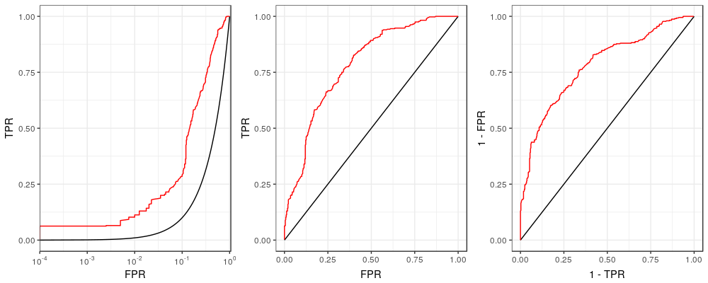
Purpose of the Receiver Operating Characteristic (ROC) Curve
This is the model we want to compare with random guessing.
An ROC curve characterizes the performance tradeoffs made when tuning a classifier threshold.
We generally include at least a random choice model and one or more other models we want to compare.
This model (call it “Random”) chooses a class at random with uniform probability.

Slide 34
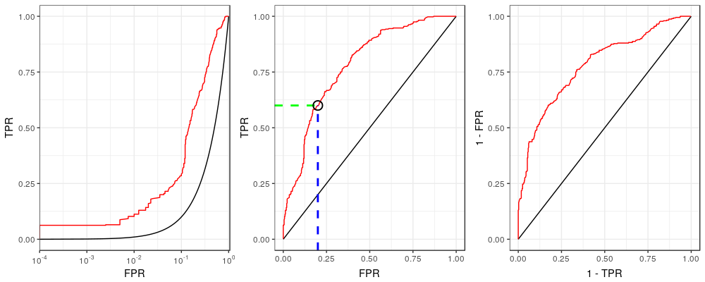
Purpose of the ROC Curve
TPR: What fraction of the positive cases did we correctly identify?
An ROC curve characterizes the performance tradeoffs made when tuning a classifier threshold.
We generally include at least a random choice model and one or more other models we want to compare.
This curve characterizes the tradeoff between improving true positive rate (TPR) or false positive rate (FPR).
For a given FPR we can lookup the expected TPR.
FPR: How often are we incorrectly alerting of a condition that is not really present?
(Or: How much do the nurses hate the new monitor?)

Slide 35
Evaluating an ROC Curve
Best to be up here
An ROC curve characterizes the performance tradeoffs made when tuning a classifier threshold.
We generally include at least a random choice model and one or more other models we want to compare.
This curve characterizes the tradeoff between improving true positive rate (TPR) or false positive rate (FPR).
For a given FPR we can lookup the expected TPR.
A better performing classifier will tend to move the curve toward the top left corner (i.e. more positive detections made with fewer false detections).

Slide 36
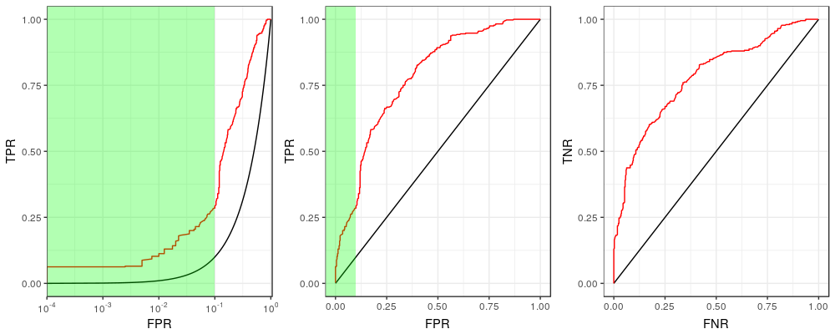
Low False Positive Rates on an ROC Curve
We are often most interested in the low FPR range in operation...
We want to look at this region.
Low FPR = Fewer false alarms.

Slide 37
Low False Positive Rates on an ROC Curve
We are often most interested in the low FPR range in operation…
...so we plot FPR on the log scale to zoom in to the smaller values.
Now it’s much clearer

Slide 38
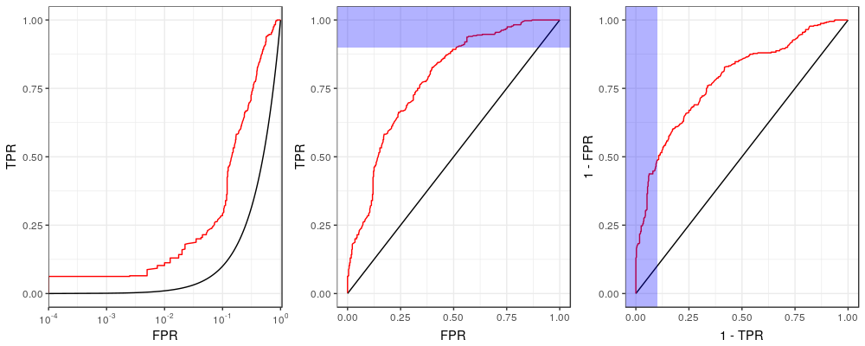
Low False Negative Rates on an ROC Curve
The other end of the ROC is also interesting, so we want to zoom there too…
This side is interesting too…

Slide 39
Low False Negative Rates on an ROC Curve
The other end of the ROC is also interesting, so we want to zoom there too…
…so we can invert the rates and swap the axes…
We flipped and rotated the ROC… Why?

Slide 40
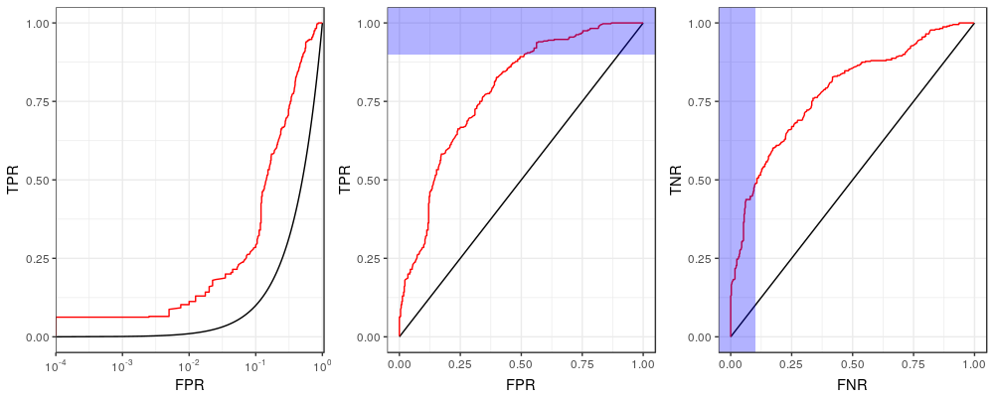
Low False Negative Rates on an ROC Curve
The other end of the ROC is also interesting, so we want to zoom there too…
…so we can invert the rates and swap their axes…
TNR: How much time do we spend on patients who need it by avoiding too much focus on those who don’t?
FNR: How often do we miss something potentially really bad?
Note that:
1-FPR=TNR
1-TPR=FNR

Slide 41
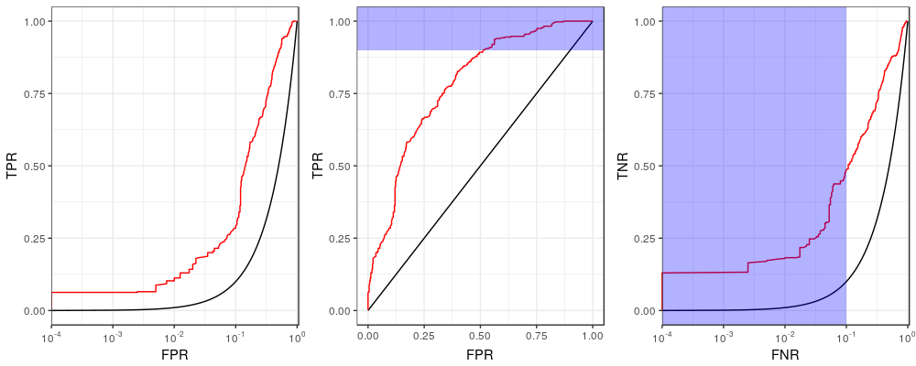
Low False Negative Rates on an ROC Curve
The other end of the ROC is also interesting, so we want to zoom there too…
…so we can invert the rates and swap their axes…
…then plot the false negative rate (FNR) on the log scale.

Slide 42
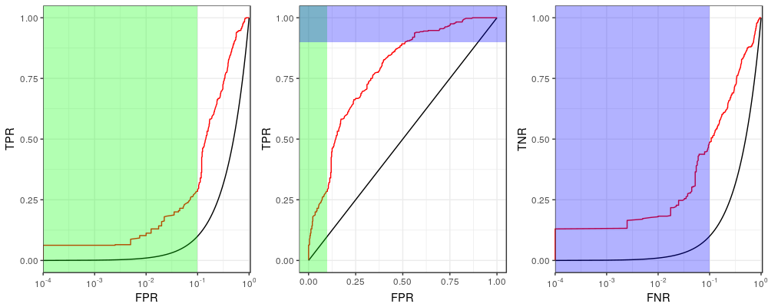
ROC Curve
The other end of the ROC is also interesting, so we want to zoom there too…
…so we can invert the rates and swap their axes…
…then plot the false negative rate (FNR) on the log scale.
Now we see both interesting regions clearly!

Slide 43
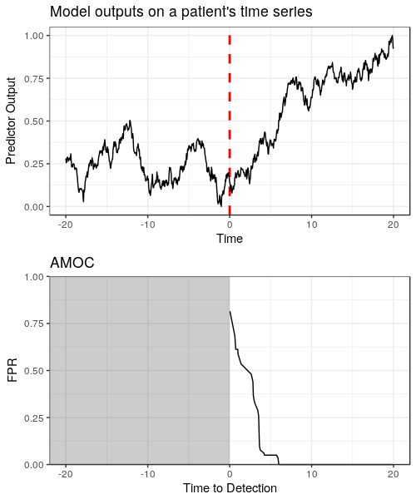
Purpose of the Activity Monitoring Operating Characteristic (AMOC) Curve
Given a time series of predictor outputs generated by our model…
Interesting event
starts here

Slide 44
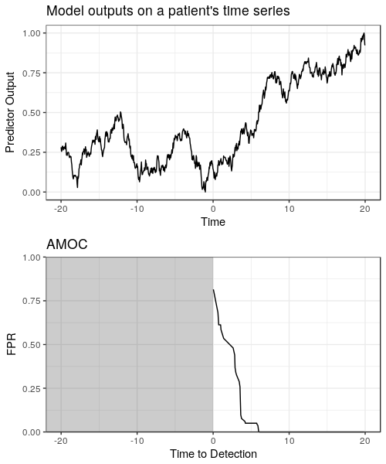
Purpose of the AMOC Curve
Given a time series of predictor outputs generated by our model…
...we want to characterize the tradeoff between detection latency (time to detection) and false alarms (FPR).
You can ignore this grayed region. We can’t detect the event before it occurs.

Slide 45
Computing an AMOC
Given a time series of predictor outputs generated by our model…
...we want to characterize the tradeoff between detection latency (time to detection) and false alarms (FPR).
How do we compute this?

Slide 46
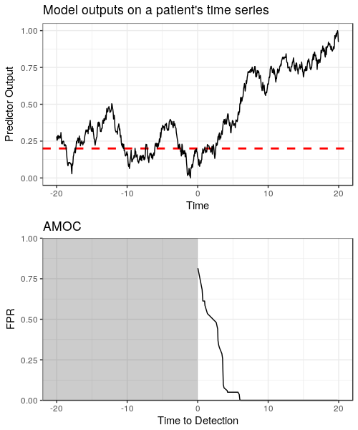
Computing an AMOC
Given a time series of predictor outputs generated by our model…
...we want to characterize the tradeoff between detection latency (time to detection) and false alarms (FPR).
How do we compute this?
Call a “detection” an output greater or equal to 0.2.

Slide 47
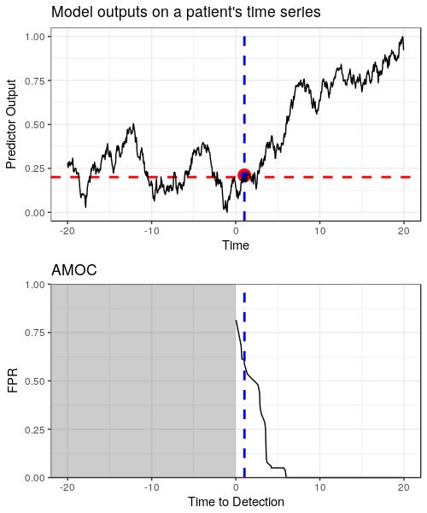
Computing an AMOC
Given a time series of predictor outputs generated by our model…
...we want to characterize the tradeoff between detection latency (time to detection) and false alarms (FPR).
How do we compute this?
Call a “detection” an output greater or equal to 0.2. Assigning this threshold gives us
A time to detection (the first true positive).

Slide 48
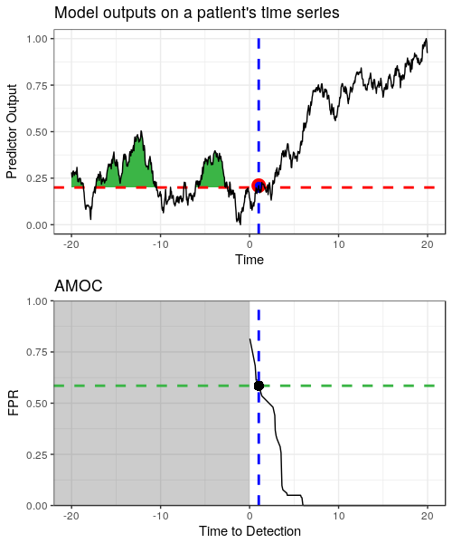
Computing an AMOC
Given a time series of predictor outputs generated by our model…
...we want to characterize the tradeoff between detection latency (time to detection) and false alarms (FPR).
How do we compute this?
Call a “detection” an output greater or equal to 0.2. Assigning this threshold gives us
A time to detection (the first true positive).
A number of false positives (thus, FPR).

Slide 49
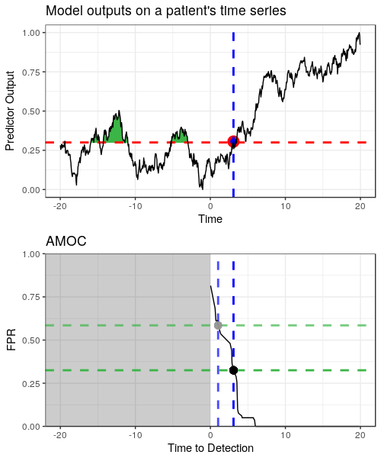
Computing an AMOC
Given a time series of predictor outputs generated by our model…
...we want to characterize the tradeoff between detection latency (time to detection) and false alarms (FPR).
How do we compute this?
Call a “detection” an output greater or equal to 0.2. Assigning this threshold gives us
A time to detection (the first true positive).
A number of false positives (thus, FPR).
Do this again for another threshold, 0.3, and now there are two points on the AMOC.
More latency
Fewer false alarms

Slide 50
Computing an AMOC
Given a time series of predictor outputs generated by our model…
...we want to characterize the tradeoff between detection latency (time to detection) and false alarms (FPR).
How do we compute this?
Call a “detection” an output greater or equal to 0.2. Assigning this threshold gives us
A time to detection (the first true positive).
A number of false positives (thus, FPR).
Do this again for another threshold, 0.3, and now there are two points on the AMOC.
Keep doing this for all thresholds for the complete curve.

Slide 51
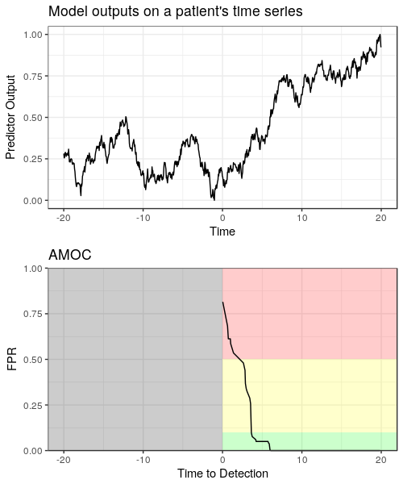
Low False Positive Rates on an AMOC
Given a time series of predictor outputs generated by our model…
...we want to characterize the tradeoff between detection latency (time to detection) and false alarms (FPR).
How do we compute this?
Call a “detection” an output greater or equal to 0.2. Assigning this threshold gives us
A time to detection (the first true positive).
A number of false positives (thus, FPR).
Do this again for another threshold, 0.3, and now there are two points on the AMOC.
Keep doing this for all thresholds for the complete curve.
Lower FPR values are generally more operationally useful…

Slide 52
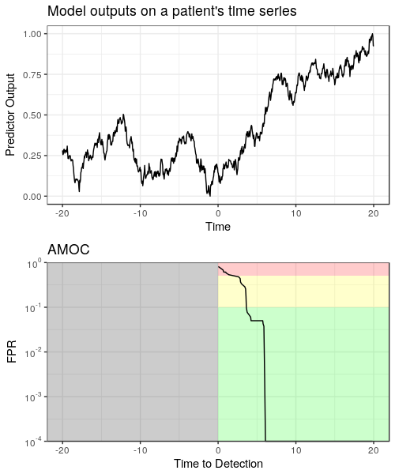
Low False Positive Rates on an AMOC
Given a time series of predictor outputs generated by our model…
...we want to characterize the tradeoff between detection latency (time to detection) and false alarms (FPR).
How do we compute this?
Call a “detection” an output greater or equal to 0.2. Assigning this threshold gives us
A time to detection (the first true positive).
A number of false positives (thus, FPR).
Do this again for another threshold, 0.3, and now there are two points on the AMOC.
Keep doing this for all thresholds for the complete curve.
Lower FPR values are generally more operationally useful… so we put FPR on the log scale to zoom in to this region.

Slide 53
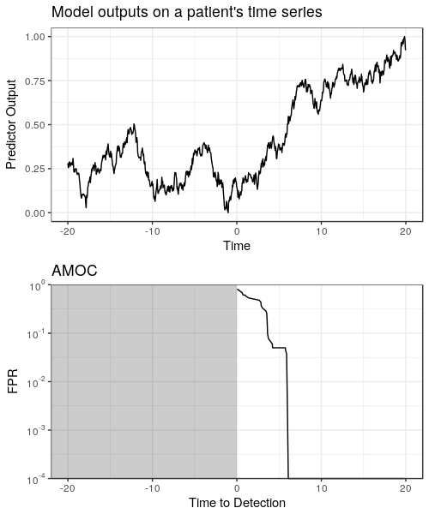
Missing Detections on AMOCs
When computing AMOCs using multiple time series, not all series will have a detection for every output threshold.
If an event in a time series is not detected (i.e. zero true positives) we call that a “miss”.
As will be shown on subsequent slides, relaxing the minimum fraction of time series that must be detected can greatly reduce detection latency at the cost of missing some detections.

Slide 54
Aggregating AMOC Curves
When computing AMOCs using multiple time series, not all series will have a detection for every output threshold.
If an event in a time series is not detected (i.e. zero true positives) we call that a “miss”.
As will be shown on subsequent slides, relaxing the minimum fraction of time series that must be detected can greatly reduce detection latency at the cost of missing some detections.
The AMOCs on the next slides show the “maximum” time to detection for a given threshold.

Slide 55
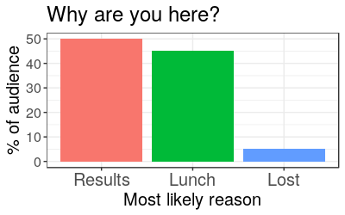
Results

Slide 56
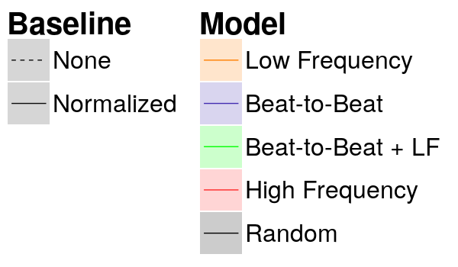
Understand the Legend
We’ll start with classifications results for the 5mL/min cohort. But first, the legend:

Slide 57
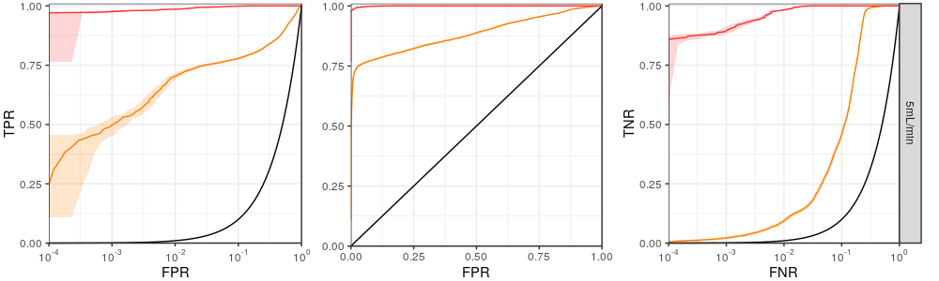
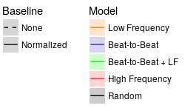
Performance Improves with Increasing Granularity
ROC curves for 5mL/min bleed group
Higher density
Better
Lower density
?
Clear how much better here!
How much better at FPR of 10⁻³?
These results are for the 5mL/min cohort.
In general we see that greater data density yields better classification performance.

Slide 58
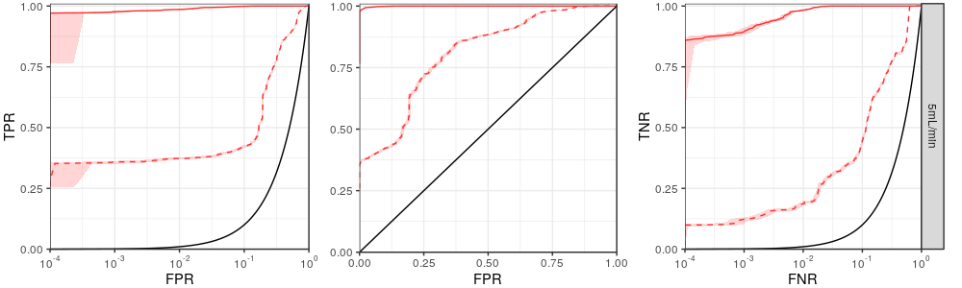
Performance Improves with Normalization
ROC curves for 5mL/min bleed group
Normalized
Better
Non-normalized
These results are for the 5mL/min cohort.
In general we see that greater data density yields better classification performance.
Knowledge of individual baselines vastly improves performance.

Slide 59
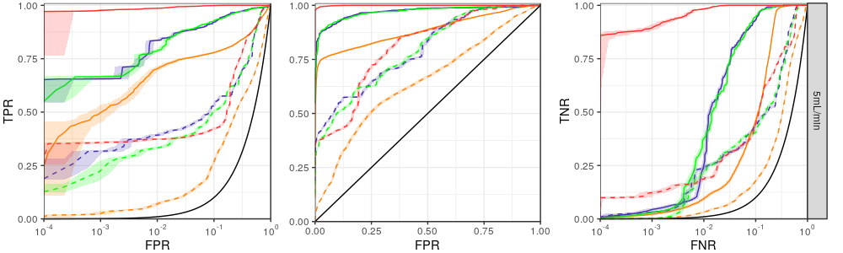
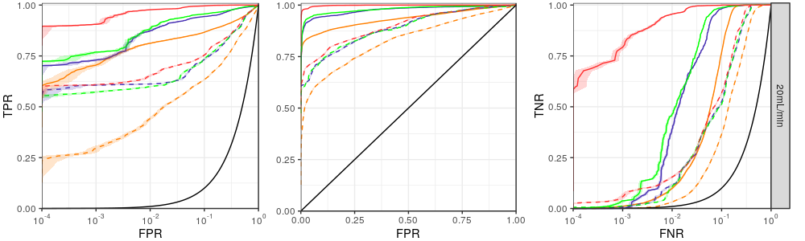
Performance is Similar Between Bleed Groups
ROC curves for 5mL/min and 20mL/min bleed groups
5mL/min
20mL/min
This is true in the
20mL/min group as well.

Slide 60
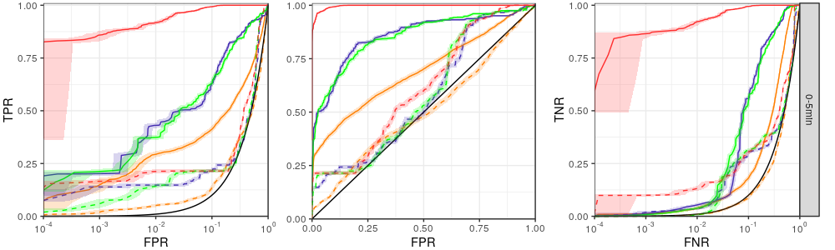
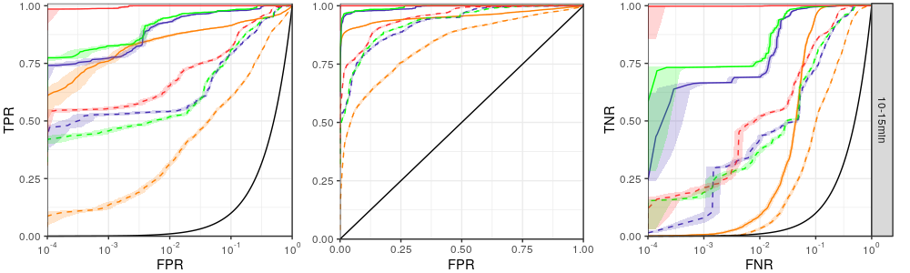
Early Performance is Much Better with Higher Granularity
ROC curves for 5mL/min bleed group 0-5 minutes (top) vs 10-15 minutes (bottom) into the bleed
0-5 min
10-15 min

Slide 61
Moving from the ROC to the AMOC
The ROC shows of the trade-off between correct and incorrect classifications.
What about the timeliness of a detection?

Slide 62
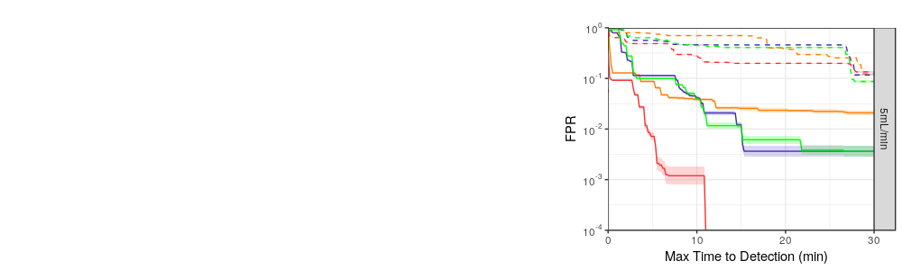
Evaluating Time to Detection (Latency)
These results are for the 5mL/min cohort.
AMOC curve for 5mL/min bleed group

Slide 63
Evaluating Time to Detection (Latency)
These results are for the 5mL/min cohort.
The performance is better when we move to the bottom left of the plot (lower FPR, lower latency).
AMOC curve for 5mL/min bleed group
Better

Slide 64
Evaluating Time to Detection (Latency)
These results are for the 5mL/min cohort.
The performance is better when we move to the bottom left of the plot (lower FPR, lower latency).
This AMOC enforces the constraint that a detection is made on all pigs…
AMOC curve for 5mL/min bleed group

Slide 65
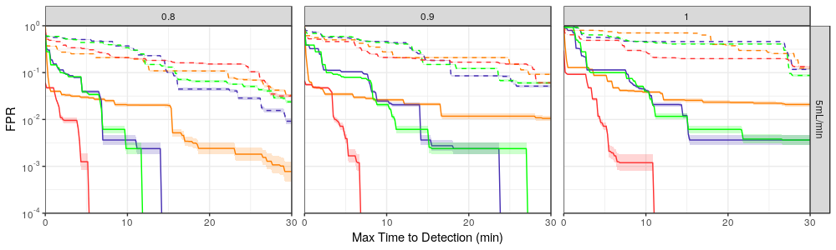
Faster Detections when Minimum Detected Fraction is Lower
At least 90% of bleeds detected
All bleeds detected
AMOC curves for 5mL/min bleed group
≥ 80%
≥ 90%
100%
Faster detection
Slower detection
These results are for the 5mL/min cohort.
The performance is better when we move to the bottom left of the plot (lower FPR, lower latency).
This AMOC enforces the constraint that a detection is made on all pigs… but we can loosen that constraint for faster detections at the expense of some missed detections.

Slide 66
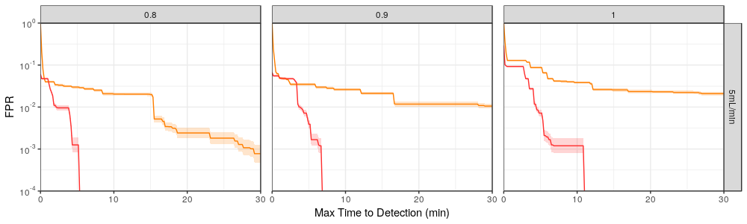
Faster Detections and Fewer False Alarms with Higher Granularity
AMOC curves for 5mL/min bleed group
≥ 80%
≥ 90%
100%
Lower density
Better
Higher Density
These results are for the 5mL/min cohort.
The performance is better when we move to the bottom left of the plot (lower FPR, lower latency).
This AMOC enforces the constraint that a detection is made on all pigs… but we can loosen that constraint for speedier detections at the expense of some missed detections.
We see that greater data density generally yields faster detections for the same FPR on normalized models.

Slide 67
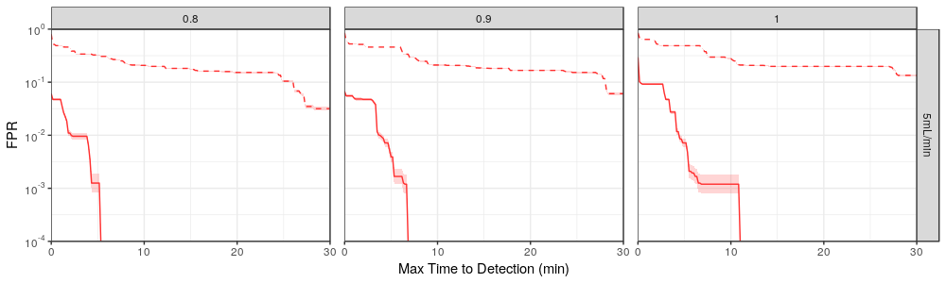
Faster Detections and Fewer False Alarms with Normalization
AMOC curves for 5mL/min bleed group
≥ 80%
≥ 90%
100%
Non-normalized
Better
Normalized
These results are for the 5mL/min cohort.
The performance is better when we move to the bottom left of the plot (lower FPR, lower latency).
This AMOC enforces the constraint that a detection is made on all pigs… but we can loosen that constraint for speedier detections at the expense of some missed detections.
We see that greater data density generally yields faster detections for the same FPR on normalized models.
Knowledge of individual baselines allows faster detections for the same FPR.

Slide 68
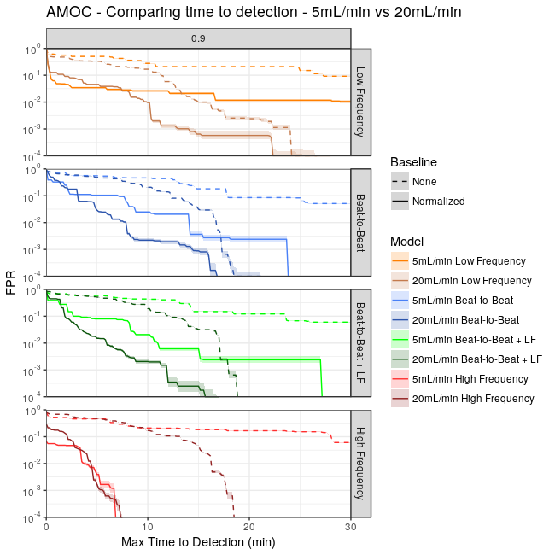
Detection Performance by Time Latency
≥ 90%
Lower granularity models detect more slowly for the slower bleeding pigs.

Slide 69
Detection Performance by Time Latency
≥ 90%
Lower granularity models detect more slowly for the slower bleeding pigs.
But the highest granularity model detects them with the same latency.

Slide 70
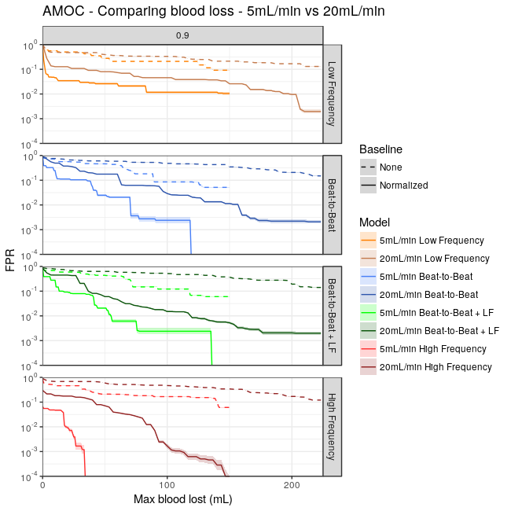
Detection Performance by Volume Lost
Lower granularity models detect more slowly for the slower bleeding pigs.
But the highest granularity model detects them with the same latency.
Comparing by volume of blood loss reveals earlier detections in terms of volume of blood lost for the slower bleeding cohort.
≥ 90%

Slide 71
Detection Performance by Volume Lost
Lower granularity models detect more slowly for the slower bleeding pigs.
But the highest granularity model detects them with the same latency.
Comparing by volume of blood loss reveals earlier detections in terms of volume of blood lost for the slower bleeding cohort.
This is especially true in the case of the high frequency models.
≥ 90%

Slide 72
Detection Performance by Time and Volume Lost
≥ 90%
Lower granularity models detect more slowly for the slower bleeding pigs.
But the highest granularity model detects them with the same latency.
Comparing by volume of blood loss reveals earlier detections in terms of volume of blood lost for the slower bleeding cohort.
This is especially true in the case of the high frequency models.
Presence of a detectable response appears more dependent on some time delay from the onset of bleed rather than
volume of blood lost or
severity (5 vs 20 mL/min) of the bleeding.

Slide 73
Detection Performance by Time and Volume Lost
≥ 90%
Lower granularity models detect more slowly for the slower bleeding pigs.
But the highest granularity model detects them with the same latency.
Comparing by volume of blood loss reveals earlier detections in terms of volume of blood lost for the slower bleeding cohort.
This is especially true in the case of the high frequency models.
Presence of a detectable response appears more dependent on some time delay from the onset of bleed rather than
volume of blood lost or
severity (5 vs 20 mL/min) of the bleeding.
But seeing this requires denser data.

Slide 74
Discussion
Clinical Implications:
Our results show that we can detect bleeding quickly at a low rate of false alarms, in particular when baseline data is available. (e.g. for patients prior to surgery, soldiers, astronauts…)
Performance is improved when more granular data can be utilized, suggesting bedside monitoring equipment capable of capturing and processing higher density data can be beneficial.
What’s next?
Can models quantify the amount of blood lost?
Can we eliminate the necessity of individualized baselines?
How well can we do with non-invasive monitoring?
Can we differentiate from other disease states? (e.g. anaphylactic shock, septic shock…)

Slide 75
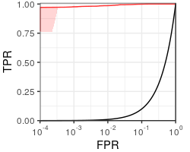
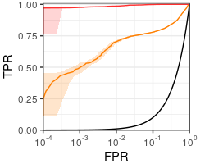
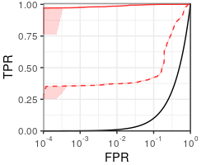
The Main Take-Aways
Machine learning enables building powerful multi-variate models for bleeding detection.
Higher granularity data improves detection performance.
Knowledge of a personal baseline improves detection performance.

