Slide 1
STOCK PREDICTION
CAPSTONE PROJECT
NOVEMBER, 2021
BY
ANTHONY NNAMANI

Slide 2
QUESTION
BUSINESS QUESTION
How can we know the good stock to invest in?
DATA QUESTION
Can we train a machine learning algorithm that can predict if a company stock is buy worthy or not?

Slide 3
SIGNIFICANCE OF THIS PROJECT AND THE STAKEHOLDERS
A lot of people invest in stock market for good number of reason
Some invest in stock market as a retirement plan
And some people also invest in stock as a wealth creation strategy
Because it is a very volatile market, people lose money
This project will be very useful in financial institutions such as banks and stock trading companies
It will also be useful in a financial research institutions like Morning Star Inc

Slide 4
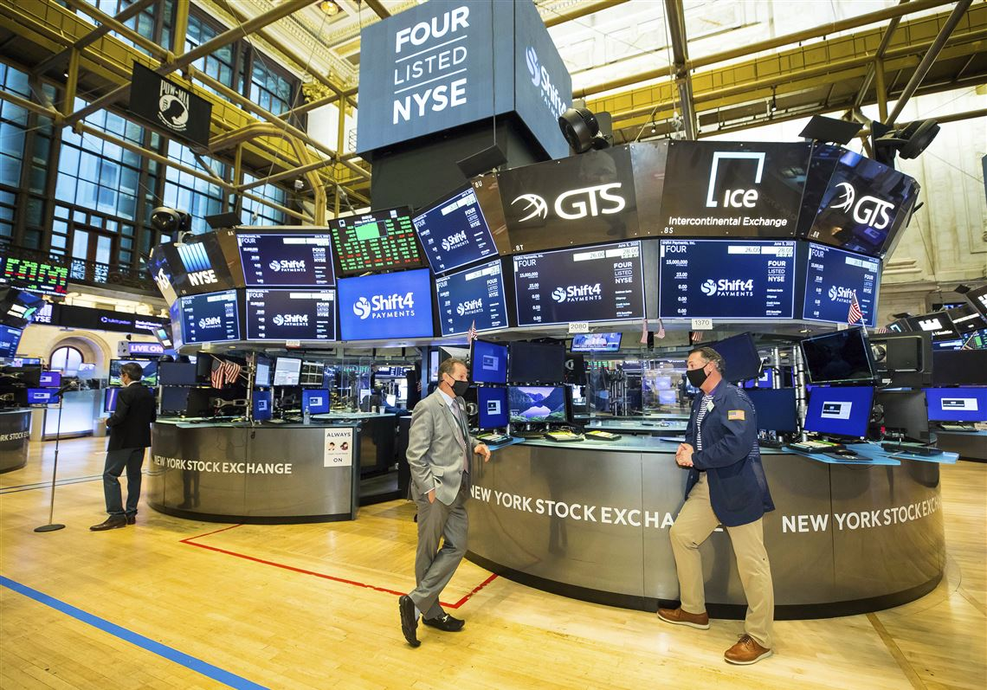
DATA OVERVIEW
US Financial data available on Kaggle
The data was collected from 2015 to 2018 separately
The data was combined for the purpose of this study
Combined data has 17957 observations and 224 features

Slide 5
PROJECT PIPLINE
Define
Data acquisition
Business questions
Strategy
Data Cleaning & EDA
Exploring data
Cleaning
Formatting
Visualization
Preprocessing
Label encoding
Standardization
Feature Engineering
Modelling
RandomForest
Logistic Regression
Naïve Bayes
Boosting
SVM
Anlysis
Discuss result
Choose the best model
Make recommendation
Further Steps
Deployment

Slide 6
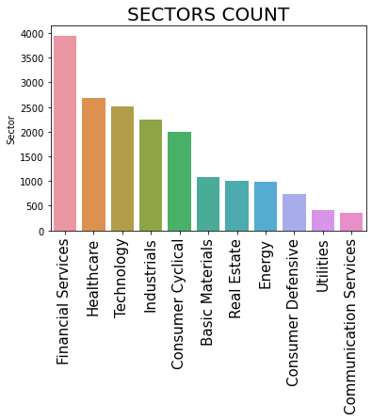
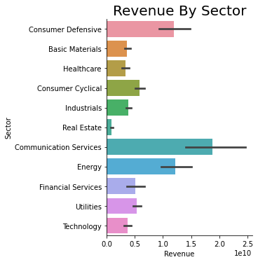
Distribution of stock by Sectors

Slide 7
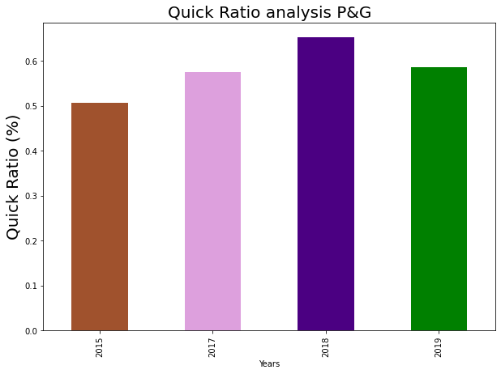
QUICK RATIO ANALYSIS OF P&G
P&G has average quick ration of 0.57 over the last 4 years
P&G has more liabilities than their current assets
This means that they can not meet up with short term obligation

Slide 8
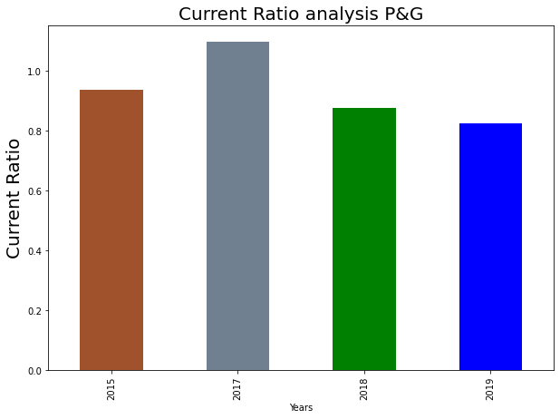
CURRENT RATIO ANALYSIS OF P&G
Company has average current ratio of 0.95 which is good
But with average quick ratio of 0.57, P&G still has more liabilities than their current assets

Slide 9
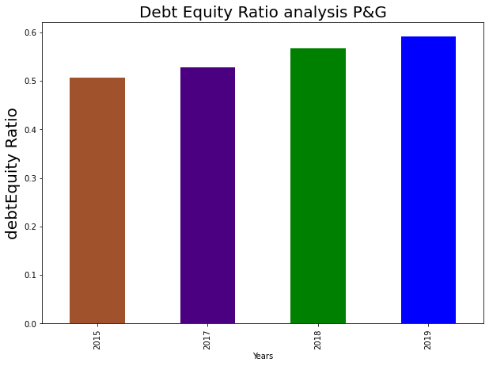
DEBT EQUITY RATIO ANALYSIS
With the average debt equity ratio of 0.53
This is good for investors as investors mainly have confidence to invest in a company with average debt equity ration of between 0.3 and 0.6

Slide 10
PREPROCESSING
Imputation of missing value using information from the sector
Used StandardScaler to normalize the dataset
Converted categorical variables to numeric using label encoding
Divided the dataset into train and test

Slide 11
RESULT
RESULT SUMMARY
ACTUAL VS PREDICTED
Model Result
 | ACCURACY | PRECISSION | RECALL | F1 SCORE
REGRESSION | 0.58 | 0.59 | 0.69 | 0.53
RANDOMFOREST | 0.67 | 0.69 | 0.67 | 0.68
NAÏVE BAYES | 0.52 | 0.64 | 0.16 | 0.65
GBOOST | 0.64 | 0.65 | 0.68 | 0.67
XGBOOST | 0.65 | 0.66 | 0.68 | 0.67
 | Actual | LR | SVC | RF | NB | GB | XGB
SLCT | 1 | 1 | 1 | 1 | 1 | 0 | 1
LTRX | 0 | 1 | 1 | 0 | 1 | 1 | 0
AHH | 1 | 1 | 1 | 1 | 1 | 1 | 0
XOM | 1 | 0 | 0 | 1 | 0 | 1 | 1
VERU | 0 | 0 | 0 | 1 | 1 | 1 | 1
... | ... | ... | ... | ... | ... | ... | ...
PEBO | 1 | 0 | 1 | 1 | 1 | 1 | 1
TRNS | 1 | 1 | 1 | 0 | 1 | 1 | 1
EEP | 0 | 0 | 0 | 0 | 0 | 0 | 0
CINR | 0 | 0 | 0 | 0 | 1 | 1 | 0
VNRX | 0 | 0 | 0 | 0 | 0 | 0 | 0

Slide 12
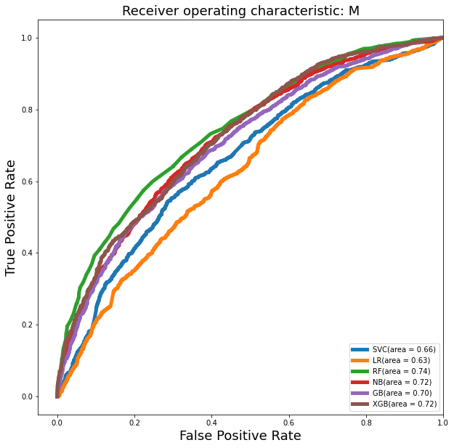
RESULT ANALYSIS
In this study, precision is very important as well as accuracy
RandomForest classifier has highest accuracy and precision as well as AUC, hence the recommended model

Slide 13
SUMMARY AND RECCOMENDATION
Stock trading and investment is one of the investment strategy globally
A lot of people invest in stock for so many reasons ranging from retirement plan and wealth creation
It can be difficult to understand the stock market to know which stock to invest in
In this study, financial dataset was analysed and machine learning algorithm trained to predict what stock to buy.
And from the analysis, RandomFroest was recommended as it has better accuracy and precision

Slide 14
NEXT STEP
Further work on this project will be to deploy the trained model.
Deploying the model will enable it to be used on live data to predict stock by financial organisations where this model will be useful
This can be done either on AWS or any other related platform

Slide 15
THANK YOU

Slide 16
QUESTIONS

