Slide 1
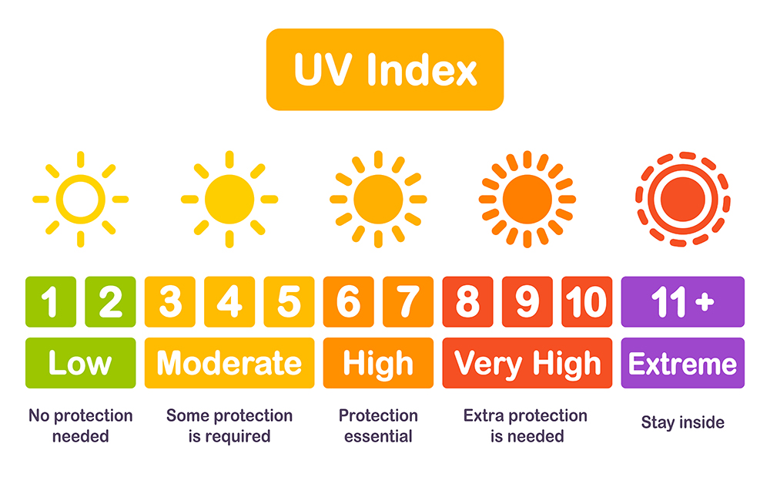
Western Australia UV Index Analysis
Tourism WA has started a campaign to raise awareness of the UV Index values in WA.
They have engaged us to present the UV index and its values to residents and tourists to ensure they
SLIP, SLOP, SLAP, SEEK, SLIDE
to prevent skin cancer.

Slide 2
Western Australia UV Index
Analysis
Our Team (SASA)
http://127.0.0.1:5000/about
The purpose of this analysis:
Analysing the UV index across Western Australia
Helping to prepare for a trip within Western Australia
Why only Western Australia?
Tourism WA has engaged us to do an analysis on the UV index which has set the location
On the plus side, as long as our borders are closed, the local population will travel inside WA as well. Where else we can go during Covid-19 😝

Slide 3


Western Australia UV Index
Data Sources
UV Index for Western Australia:
https://openweathermap.org/api
Western Australia Cities Info:
https://simplemaps.com/data/au-cities

Slide 4


Western Australia UV Index
Extract Historical Data from OpenWeather API
OpenWeather API
csv and Json

Slide 5

Western Australia UV Index
Historical Data Storage
Python
Flask
csv file
SQLITE

Slide 6
Western Australia UV Index
Why SQLITE?
Structured data
The license for SQLite is open-source
SQLite does not require a server to run

Slide 7
Western Australia UV Index
Current UV Index
Explanation of UV values
Health advice
Map of UV values at any location
Current UV Index of today
7-day forecast
http://127.0.0.1:5000/index

Slide 8
Western Australia UV Index
Historical UV Index
Contour map of UV Index
UV index of last year
Current UV Index
History on the UV Index
http://127.0.0.1:5000/historical

Slide 9
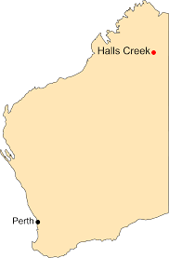
Western Australia UV Index
Analysis Summary
The highest UV Index in Year 2020
City: Halls Creek
UV index: 18.21
Date: 20th December 2020
Average UV index in Halls Creek:
Average: 11.74
Winter: 7.6
Spring: 13.43
Summer: 15.30
Autumn: 10.71

Slide 10
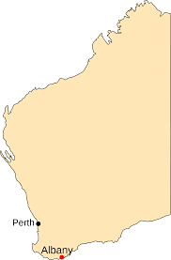
Western Australia UV Index
Analysis Summary
The lowest UV Index in Year 2020
City: Albany
UV index: 1.87
Date: 13th June 2020
Average UV index in Albany:
Average: 6.92
Winter: 2.64
Spring: 7.82
Summer: 11.98
Autumn: 5.37

Slide 11
Western Australia UV Index
Analysis Summary
Average UV Index Comparison (Halls Creek vs Albany)
 | Halls Creek | Albany | %
Average | 11.74 | 6.92 | 70%
Winter | 7.6 | 2.64 | 188%
Spring | 13.43 | 7.82 | 72%
Summer | 15.3 | 11.98 | 28%
Autumn | 10.71 | 5.37 | 99%

Slide 12
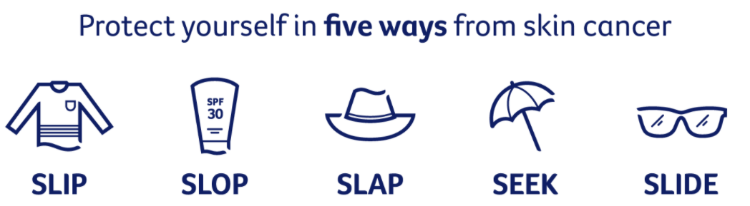
Western Australia UV Index
Analysis Conclusion/Summary
After consumer testing, we can conclude that this analysis will raise awareness of the high UV index in WA throughout the year.
In general, WA has a very high UV index, therefore it is important that we always remember Slip, Slop, Slap, Seek and Slide.

Slide 13
Limitations
We used a free API. Paying for the API provides a lot more options on the available information and therefore for the information that can be displayed on the website.
We were limited in time. If we had our team for a full two weeks, we could have accomplished more types of maps showing more information.
If we had more time
We could have provided a heatmap showing the UV index on the opening page with a time slider showing the full 7 day forecast.
We could have provided a time slider for the historical UV index.
We could have added more layers of information showing the influence of, for example, the cloud coverage on the UV index.
We could have linked the maps to the filters in the search fields.

Slide 14
?? Questions ??

