Slide 1
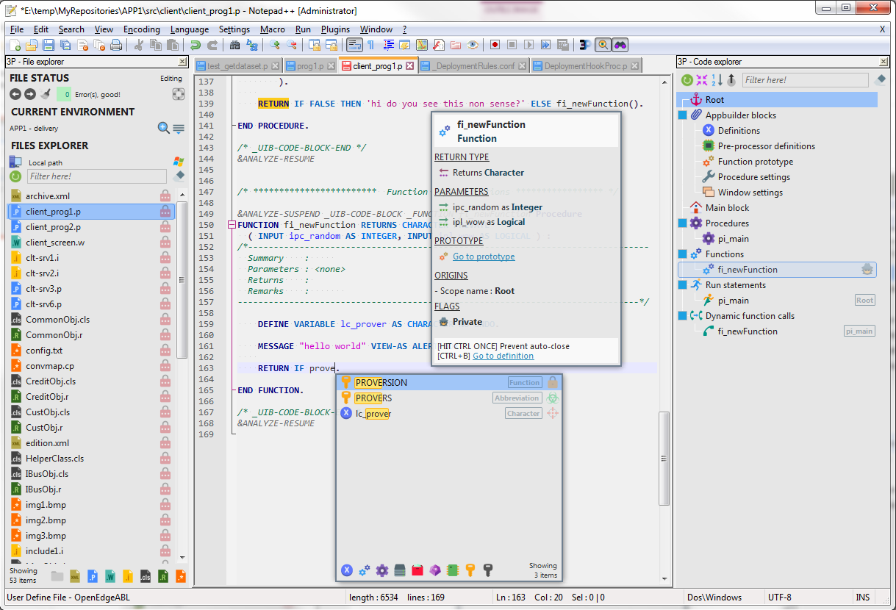
Quick access to the features of 3P
Tool-tips
File explorer
Strong search capability to browse your project files
Code explorer
Quickly get info and navigate through your code
Powerful
Auto-completion

