Slide 1
deCAPTCHA
A CAPTCHA Solver and Analysis Tool

Slide 2
AGENDA
INTRODUCTION
SCOPE
DOMAIN
SYSTEM DESIGN
IMPLEMENTATION
RESULTS
CONCLUSION & FURTHER WORK
REFERENCES

Slide 3

INTRODUCTION
Completely Automated Public Turing test to tell Computers and Humans Apart

Slide 4
APPLICATIONS
Preventing Comment Spam in Blogs
Protecting Website Registration
Protecting Email Addresses from Scrapers
Online Polls
Preventing Dictionary Attacks
Search Engine Bots
Worms and Spam

Slide 5
PROBLEM DEFINITION
A CAPTCHA recognizer that interprets characters from text based CAPTCHA of selected websites
Use of various robust Feature Extraction techniques and developing Artificial Neural Networks for classification
Analysis of the strength of CAPTCHAs

Slide 6
SCOPE
Break CAPTCHA from 10 websites
50 alphanumeric characters in consideration
Linear segmentation for disjoint characters
Efficient preprocessing techniques to remove CAPTCHA background and noise

Slide 7











DOMAIN EXPLANATION

Slide 8

EXISTING METHODS
Insecure Implementation
Discovering security flaws
Template Matching
Human Solvers

Slide 9
METHODOLOGY USED
OCR using Neural Networks
Implementing basic techniques in IP
Linear Segmentation
Statistics and Geometry based Feature Extraction
Artificial Neural Network based Character Recognition using Error Back Propagation Training Algorithm

Slide 10
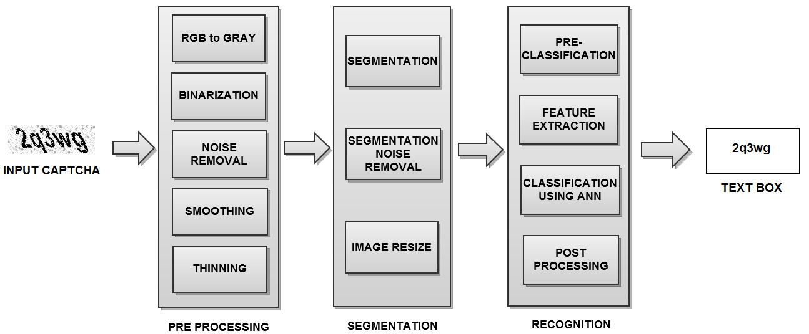
SYSTEM DESIGN

Slide 11
PREPROCESSING
Gray scaling
Color image → Gray scale

Slide 12
PREPROCESSING
Binarization
Gray scale → Binary

Slide 13
PREPROCESSING
Noise removal

Slide 14
PREPROCESSING
Smoothing

Slide 15
PREPROCESSING
Thinning

Slide 16
SEGMENTATION
Linear Segmentation

Slide 17
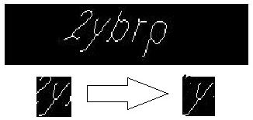
SEGMENTATION
Segmentation Noise Removal

Slide 18
RECOGNITION
Pre Classification
Euler number
en = -1 en = 0 en = 1
2 characters 16 characters 32 characters

Slide 19
RECOGNITION
Feature Extraction
Centroid based Zoning
Contour based Zoning
Region properties
Horizontal and Vertical Profiles

Slide 20
RECOGNITION
Zoning (Centroid based)
16 zones
Zone Centroid
Image Centroid
Feature Vector size = 16 * 2 = 32
Zone 1 | Zone 2 | Zone 3 | Zone 4
Zone 5 | Zone 6 | Zone 7 | Zone 8
Zone 9 | Zone 10 | Zone 11 | Zone 12
Zone 13 | Zone 14 | Zone 15 | Zone 16

Slide 21
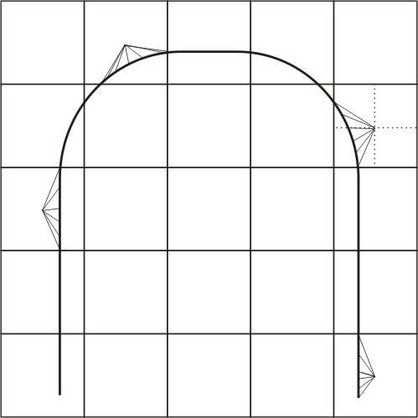
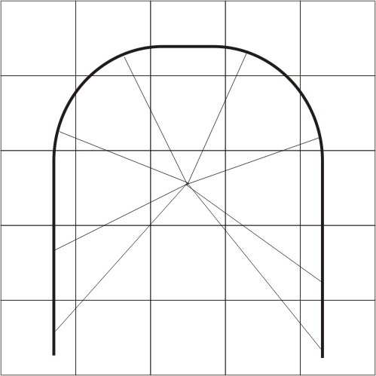
RECOGNITION
Zone Centroid
Image Centroid

Slide 22
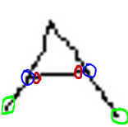
RECOGNITION
Zoning (Contour based)
9 features from 9 zones
Number of horizontal lines.
Number of vertical lines.
Number of Right diagonal lines.
Number of Left diagonal lines.
Normalized Length of all horizontal lines.
Normalized Length of all vertical lines.
Normalized Length of all right diagonal lines.
Normalized Length of all left diagonal lines.
Normalized Area of the Skeleton.
Feature Vector size = 9 * 9 = 81

Slide 23
RECOGNITION
Region Properties based Features
Area
Perimeter
Minor Axis Length
Major Axis Length
Eccentricity
Equivalent Diameter
Orientation
Solidity
Reflection X coefficient and Reflection Y coefficient.
Feature vector size = 8

Slide 24
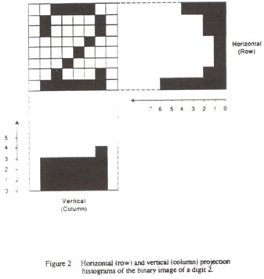
RECOGNITION
Horizontal and Vertical Profiles
Image size = 24 x 20
Feature vector = 44

Slide 25
RECOGNITION
Neural Network Training
Input nodes
Hidden nodes
Output nodes
Learning rate
Momentum
Performance Goal
Training Function
Training on 60 images of each character.

Slide 26
RECOGNITION
Post Processing
Resolving known errors in character recognition of specific CAPTCHAs
Passport
PayPal
MP3Raid etc.

Slide 27
DESIGN ISSUES
Separate preprocessing for every type of CAPTCHA
Segmentation of joint characters
Efficient Neural Network architecture for training

Slide 28
SYSTEM DESIGN

Slide 29
IMPLEMENTATION
ALGORITHM for DECAPTCHER
Read the path of the CAPTCHA image
Determine the type and apply corresponding preprocessing
The preprocessed image is then segmented
Euler number (en) of every segmented character image is determined
Pass the image to appropriate network
The result of each simulation is concatenated to get a string of recognized text.
Apply post processing techniques for accuracy enhancement

Slide 30
IMPLEMENTATION ISSUES
Thresholding of Register and PayPal CAPTCHA
Identifying the dot ( . ) on character i
Managing rotation invariant features for characters
e.g. 6 and 9 , a and e
Distinguishing similar characters
b, 6
9, g
O, 0
I, 1, i

Slide 31
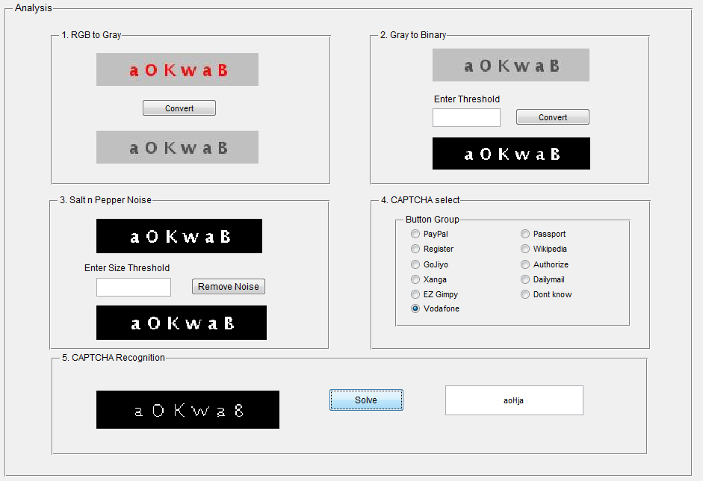
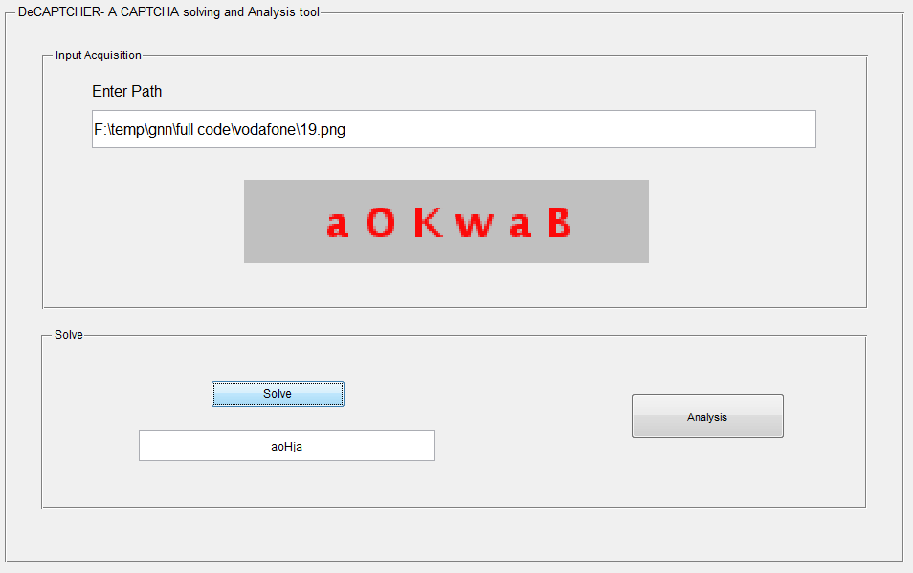
GUI

Slide 32
RESULTS
Pre-processing
Segmentation
Network Accuracy
CAPTCHA Accuracy

Slide 33








RESULTS
Pre-processing
CAPTCHA | Original Image | Preprocessed Image
Authorize
MP3Raid
GoJiyo
Wikipedia

Slide 34




RESULTS
Segmentation
CAPTCHA | Preprocessed Image | Segmented Images | Accuracy %
MP3Raid |  |  | 100
GoJiyo |  |  | 100
Authorize |  |  | 90
Wikipedia |  |  | 85
EZ Gimpy |  |  | 70

Slide 35
RESULTS
Network Accuracy
Euler No. | Feature Vector | Recall Accuracy
-1 | Zoning (Contour) | 100 %
0 | Region properties + Profiles | 97.81 %
1 | Zoning (Contour) | 84 %

Slide 36




RESULTS
CAPTCHA Accuracy
CAPTCHA | Image | Results | Accuracy (%)
Passport |  | u32490 | 96
IIM Kozikode |  | B9cA | 44
MP3Raid |  | wktgkr | 86
PayPal |  | bk57u | 26

Slide 37
CONCLUSION
Single neural network based system for recognition of 10 different classes of CAPTCHA
Good CAPTCHA accuracy rates
Not a hacking project but it enables security professionals, developers and testers to evaluate existing and new CAPTCHA designs and to make their implementations more secure

Slide 38
FURTHER WORK
Improving the overall recognition accuracy of the system
Segmentation of joint characters in certain types of CAPTCHA
Interfacing the system with the Web

Slide 39
SUMMARY
Attempt to break wide range of CAPTCHA by a single Tool
Unique feature extraction techniques for different characters
High accuracy for characters with loops

Slide 40
REFERENCES
The Official CAPTCHA Website http://www.CAPTCHA.net/
L von Ahn, M Blum and J Langford. “Telling Humans and Computer Apart Automatically”, CACM, V47, No2, 2004.
Grossman, Lev (2008-06-05). "Computer Literacy Tests: Are You Human?". Time (magazine). Retrieved 2008-06-12
Handwritten Character Recognition, Available: http://tcts.fpms.ac.be/rdf/hcrinuk.htm
HeroSvm 2.1 http://www.cenparmi.concordia.ca/~jdong/HeroSvm.html Error rates of different methods on NIST lowercase database
S.V. Rajashekararadhya and P. VanajaRanjan, ''Isolated handwritten Kannada digit recognition: A novel approach'', Proceedings of the International Conference on Cognition and Recognition”, pp.134-140, 2008.
S.V. Rajashekararadhya, and P. VanajaRanjan, ''Handwritten numeral recognition of three popular South Indian scripts: A novelapproach: '', Proceedings of the second International Conference on information processing ICIP, pp.162-167, 2008.

Slide 41
REFERENCES
S.V. Rajashekararadhya, Dr P. Vanaja Ranjan “Efficient Zone Based Feature Extration Algorithm For Handwritten Numeral Recognition Of Four Popular South Indian Scripts”
Debasish Basa, Sukadev Meher “Handwritten O Dia Character Recognition”
Self Organizing Map http://en.wikipedia.org/wiki/Self-organizing_map
Support Vector Machines http://en.wikipedia.org/wiki/Support_vector_machine
Srinivasa Kumar Devireddy, Settipalli Appa Rao “Hand Written Character Recognition Using Back Propagation Network”
A CAPTCHA Breaker Project http://network-security-research.blogspot.in/
Dinesh Dileep “A Feature Extraction Technique Based On Character Geometry For Character Recognition”
Dhawal S Wazalwar “License Plate Recognition In Complex Scenes”
“Introduction to Artificial Neural Systems” Jacek M. Zurada. (St. Paul,. MN:. West Publishing Company,. 1992
Software Testing en.wikipedia.org/wiki/Software_testing
“linear skeletons from square cupboards”, in Machine Intell.(B. Meltzer and D. Michie, Eds.). New York : Amer. Elsevier, 1969, pp 403-420, vol 4.

Slide 42
THANK YOU
Devanshu Save 084027
Gaurav Narang 084032
Vishal Punjabi 084118

