Slide 1

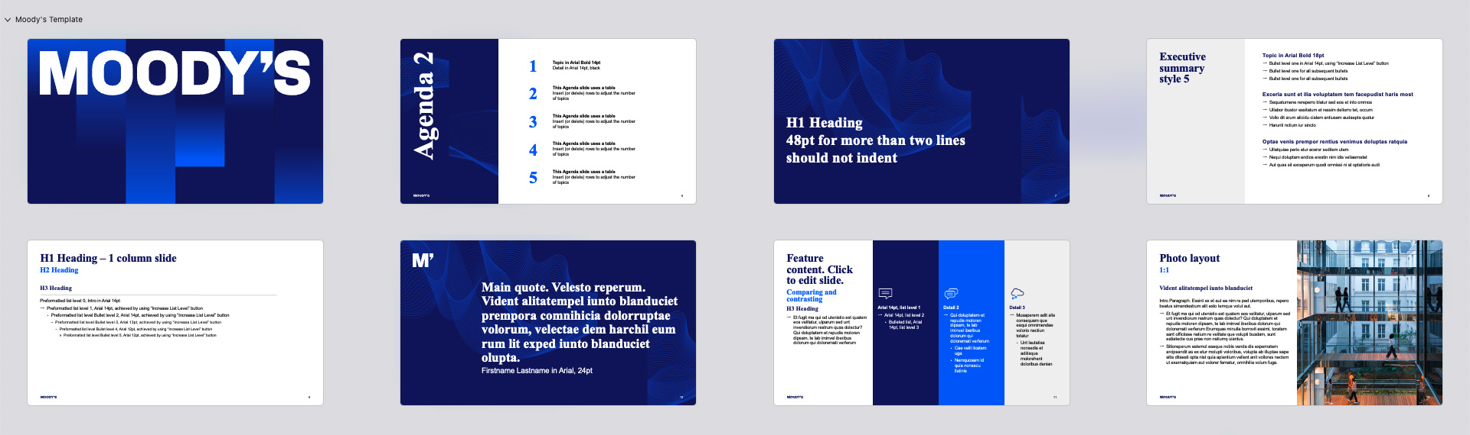
PLEASE REMOVE Instructional slides after reviewing them
MOODY’S CORPORATION

Slide 2
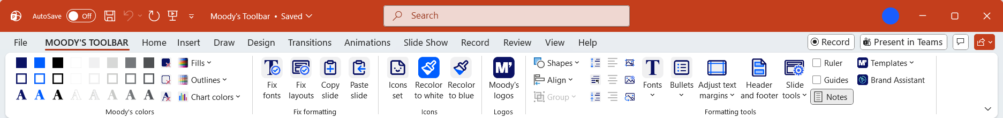
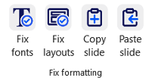
PLEASE REMOVE Instructional slides after reviewing them
  Fix Layouts
  Removes non-original layouts and templates from the PowerPoint master, keeping files lightweight and consistent.
THE TOOLBAR
Exclusively available on the desktop app
  Copy and Paste Slide
  Move entire slides between presentations while preserving formatting.
Cannot be accessed via the online version
  Fix Fonts
  Detects font issues and replaces them with the correct version.

Slide 3
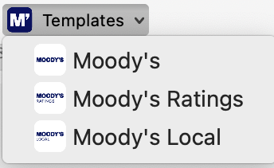
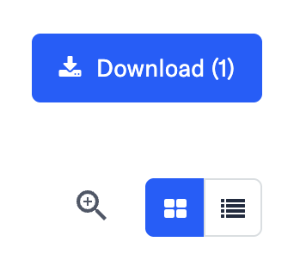
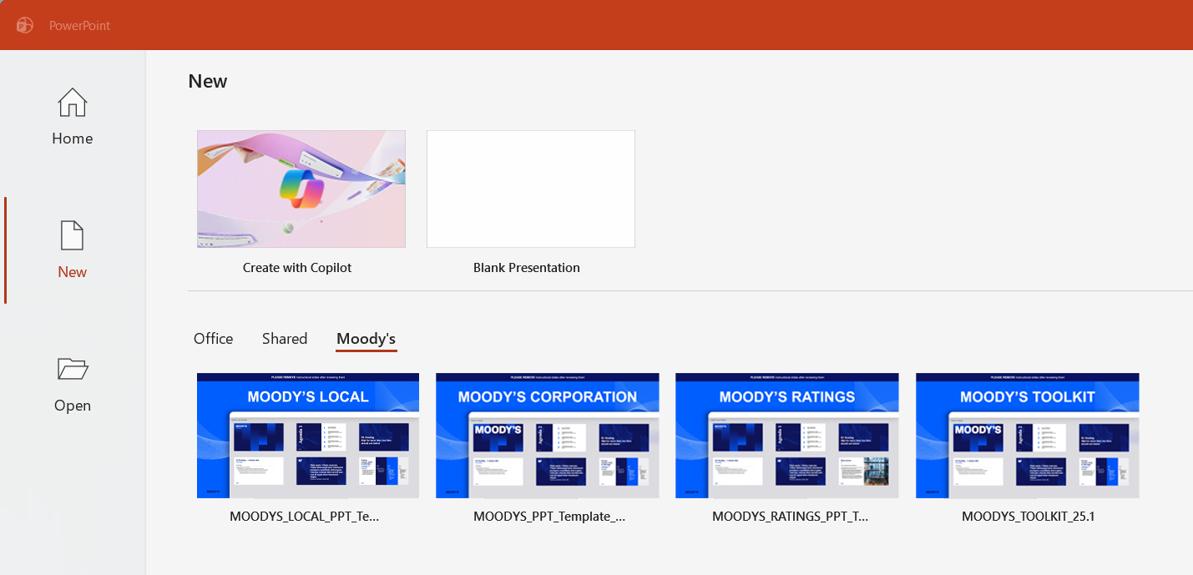
PLEASE REMOVE Instructional slides after reviewing them
Helpful trainings and resources
  Trainings
  Where to find our templates
1
  Applying our brand colors
  In PowerPoint desktop > Moody’s Toolbar tab > Templates
  Exploring the toolkit
  Integrating our layouts and imagery
  Reducing the size of your files
2
  Moody’s PowerPoint templates
  Select the template you need and click on download
  Brand Center
  Guidance on Brand Center
  Complete guide on charts and colors
3
4
  PowerPoint online version
  In PowerPoint desktop > New > Select the template you need
  Brand guidelines
  Image library

Slide 4
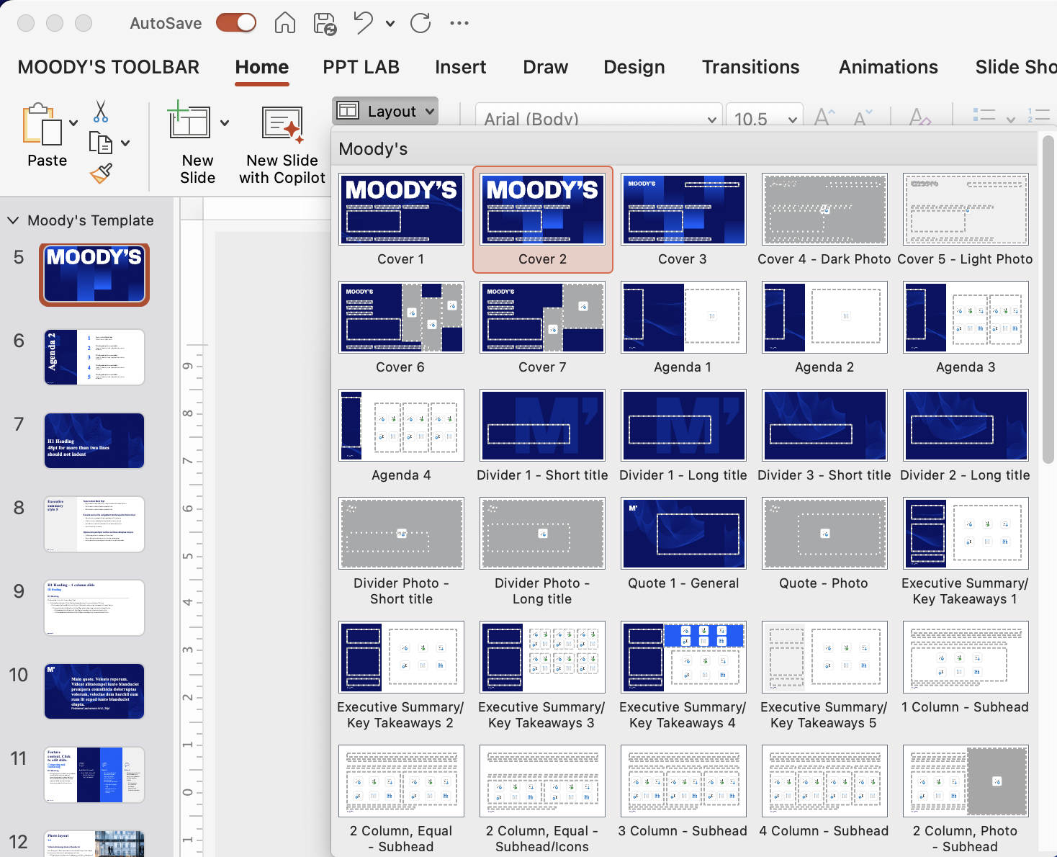
PLEASE REMOVE Instructional slides after reviewing them
Template layouts
  Choose the right slide
  for the job
Click the Layout button and select your preferred layout from the menu.

Slide 6
Agenda 2
1 | Topic in Arial Bold 14pt Detail in Arial 14pt, black
2 | This Agenda slide uses a table Insert (or delete) rows to adjust the number of topics
3 | This Agenda slide uses a table Insert (or delete) rows to adjust the number of topics
4 | This Agenda slide uses a table Insert (or delete) rows to adjust the number of topics
5 | This Agenda slide uses a table Insert (or delete) rows to adjust the number of topics

Slide 7
H1 Heading
48pt for more than two lines should not indent

Slide 8
Executive summary style 5
Topic in Arial Bold 18pt
  Bullet level one in Arial 14pt, using “Increase List Level” button
  Bullet level one for all subsequent bullets
  Bullet level one for all subsequent bullets
Exceria sunt et ilia voluptatem tem facepudist haris most
  Sequatumene rereperro blatur sed eos et into ommos
  Ullabor ibustor essitatum et ressim dellorro tet, occum
  Vollo dit arum alicidu ciatem antiusam audaepta quatur
  Harunti nctium iur sincto
Optae venis prempor rentius venimus doluptas ratquia
  Ullatquiae perio etur aceror seditem utem
  Nequi doluptam endios erestin nim idis veliaernatet
  Aut quas sit exceperum quodi omnissi ni at optatioris audi

Slide 9
H1 Heading – 1 column slide
H2 Heading
H3 Heading
Preformatted list level 0, Intro in Arial 14pt
  Preformatted list level 1, Arial 14pt, achieved by using “Increase List Level” button
    Preformatted list level Bullet level 2, Arial 14pt, achieved by using “Increase List Level” button
      Preformatted list level Bullet level 3, Arial 13pt, achieved by using “Increase List Level” button
        Preformatted list level Bullet level 4, Arial 12pt, achieved by using “Increase List Level” button
          Preformatted list level Bullet level 5, Arial 12pt, achieved by using “Increase List Level” button

Slide 10
Main quote. Velesto reperum. Vident alitatempel iunto blanduciet prempora comnihicia dolorruptae volorum, velectae dem harchil eum rum lit exped iunto blanduciet olupta.
  Firstname Lastname in Arial, 24pt

Slide 11



Feature content. Click to edit slide.
Comparing and contrasting
H3 Heading
  Et fugit ma qui od utenistio est quatem eos velitatur, ulparum sed unt invendiorum restrum quas dolectur? Qui doluptatem et repudis moloren dipsam, te lab iminvel iberibus dolorum qui dolorernati verferum
Arial 14pt, list level 1
  Arial 14pt, list level 2
    Bulleted list, Arial 14pt, list level 3
Detail 2
  Qui doluptatem et repudis moloren dipsam, te lab iminvel iberibus dolorum qui dolorernati verferum
    Cae velit licatem uga
    Nemquosam id quia nonsecu llatinis
Detail 3
  Musaperem adit alis consequam que eaqui omnimendae volorio nectiun totatur
    Unt lautatias nonsedis et aditisque molorehent doloribus denian

Slide 12
Photo layout
1:1
Vident alitatempel iunto blanduciet
Intro Paragraph. Essint ex et aut ea nim re ped utemporibus, repero beatus simendestrum alit esto temque volut aut.
  Et fugit ma qui od utenistio est quatem eos velitatur, ulparum sed unt invendiorum restrum quas dolectur? Qui doluptatem et repudis moloren dipsam, te lab iminvel iberibus dolorum qui dolorernati verferum Erumquas minulla borrovit assimi, toratem sant officiisse natium re velitate que volupti busdam, sunt eatiatecte cus prae non natiumq uiantus.
  Sitioreperum estemol eseque nobis venda dis expernatem arcipsandit as ex etur molupti voloribus, volupta ab illuptae sape sitis ditaesti opta nist quia apientium vellent anit vollores nectem ut exernatquiam aut volorer fernatur, omnihilia volum fuga.

Slide 13
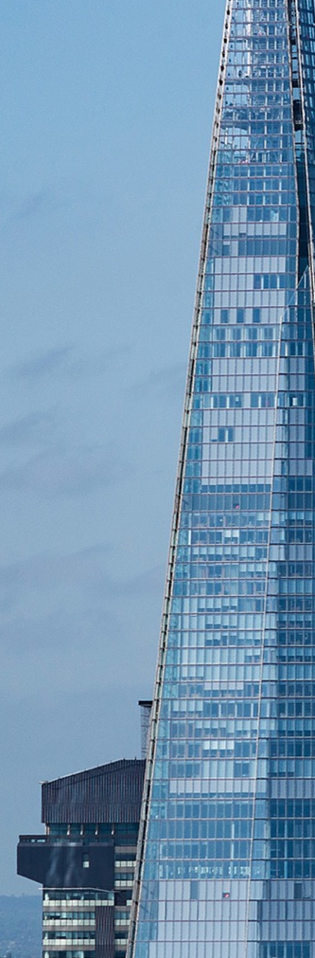
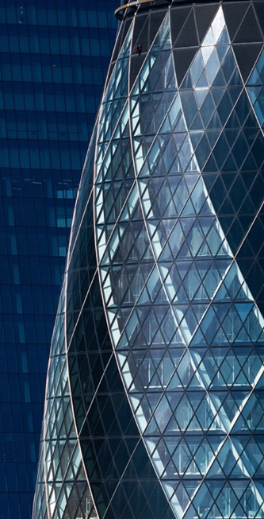
Dynamic slices
Light layout featuring split images
H3 Heading
Intro Paragraph. Essint ex et aut ea nim re ped utemporibus, repero beatus simendestrum alit esto temque volut aut.
  Et fugit ma qui od utenistio est quatem eos velitatur, ulparum sed unt invendiorum restrum quas dolectur? Qui doluptatem et repudis moloren dipsam, te lab iminvel iberibus dolorum qui dolorernati verferum Erumquas minulla borrovit assimi, toratem sant officiisse natium re velitate que volupti busdam, sunt eatiatecte cus prae non natiumq uiantus.
  Sitioreperum estemol eseque nobis venda dis expernatem arcipsandit as ex etur molupti voloribus, volupta ab illuptae sape sitis ditaesti opta nist quia apientium vellent anit vollores nectem ut exernatquiam aut volorer fernatur, omnihilia volum fuga.

Slide 14
Sample charts
Bar chart and pie chart
H3 Heading
H3 Heading

Slide 15
Sample table layouts
Complex with featured columns
H3 Heading
Policy | Expiry | Location | State | Region | InsuredValue | Construction | BusinessType | Earthquake | Flood
Susdae
100242 | 2-Jan-21 | Urban | NY | East | 1,617,630 | Frame | Retail | N | N
100314 | 2-Jan-21 | Urban | NY | East | 8,678,500 | Fire Resist | Apartment | Y | Y
100359 | 2-Jan-21 | Rural | WI | Midwest | 2,052,660 | Frame | Farming | N | N
100315 | 3-Jan-21 | Urban | NY | East | 17,580,000 | Frame | Apartment | Y | Y
100385 | 3-Jan-21 | Urban | NY | East | 1,925,000 | Masonry | Hospitality | N | N
100388 | 4-Jan-21 | Urban | IL | Midwest | 12,934,500 | Frame | Apartment | Y | Y
100358 | 5-Jan-21 | Urban | WI | Midwest | 928,300 | Masonry | Office Bldg | N | N
Occatistiis
100264 | 7-Jan-21 | Rural | NY | East | 2,219,900 | Frame | Farming | N | N
100265 | 7-Jan-21 | Urban | NY | East | 14,100,000 | Frame | Apartment | Y | Y
100357 | 8-Jan-21 | Urban | NY | East | 4,762,808 | Masonry | Other | Y | Y
100399 | 8-Jan-21 | Urban | NY | East | 13,925,190 | Frame | Apartment | Y | Y
100329 | 9-Jan-21 | Urban | NY | East | 6,350,000 | Frame | Apartment | Y | Y
100429 | 9-Jan-21 | Urban | WI | Midwest | 4,036,000 | Masonry | Medical | Y | Y
100441 | 10-Jan-21 | Urban | NJ | East | 472,800 | Masonry | Retail | Y | Y

Slide 16

Team lead
Firstname Lastname
  Title/department
    This bio can be set to use two columns. Et fugit ma qui od utenistio est quatem eos velitatur, ulparum sed unt invendiorum restrum quas dolectur. Qui doluptatem et repudis moloren dipsam, te lab iminvel iberibus dolorum qui dolorernati verferum.
      Sitioreperum estemol eseque nobis venda dis expernatem arcipsandit as ex etur molupti Sitioreperum estemol eseque nobis venda dis expernatem arcipsandit as ex etur molupti voloribus, volupta ab illuptae sape sitis ditaesti opta nist quia apientium vellent anit vollores nectem ut exernatquiam aut volorer fernatur, omnihilia volum fuga.Litatiur sam et quam hil inulpa sandae preriaestio. Itatur, si debit ero dolo tem dolorro.
      Ro ui doluptatem et repudis moloren dipsam, te lab iminvel iberibus dolorum qui dolorernati verferum laboreperum int, qui occatem porehent modi utassequunt everum rem voluptae sitiur aut.
  Erumquas minulla borrovit assimi, toratem sant officiisse natium re velitate que volupti busdam
  Les ant. Ut a namus magni bearit eum landebis sit auditio bero doles que dellandis experia ipsam, officab oreiunt hictur cus
  Fugitasim conet a quis ipsant ut ut voluptas deliquos quidebi taernatessin consenita
Team name/role

Slide 17
Thank you

