Slide 1
NYSE: MP — Investment Decision Frame
MP Materials
Competitive Landscape & Investment Read
As of May 2026
Peer set: Lynas · Energy Fuels · USA Rare Earth · China Northern Rare Earth · Albemarle
Built using `competitive-analysis` + `comps-analysis` skills (financial-services repo)
Companion workbook: MP-Comps-Analysis.xlsx

Slide 2
Only scaled US rare-earth play; DoD as anchor shareholder rewrites the risk profile
1. The setup
MP is the only fully scaled US rare-earth miner and the only Western producer with end-to-end mine-to-magnet ambition. Q1 2026 marked an inflection: revenue $90.6M (+49% YoY), record 917 MT NdPr oxide (+63%), Adj EBITDA flipped positive to $36.6M.
2. The moat
US Department of Defense holds ~15% via preferred + warrant at $30.03/sh (Jul 2025 deal). The 10-year DoD offtake includes a $110/kg NdPr price floor — structural downside protection no peer has. MP is the only US public-company peer with this asymmetry.
3. The risk
Market cap ~$9.8B on TTM revenue $275M = priced for the magnet ramp. Stage III first commercial product is 2028. China still controls >70% of mining, >80% of processing — NdPr is exposed to Chinese export policy.
4. The read
Long thesis intact for investors who accept multi-year execution risk in exchange for asymmetric upside on Section 232 / decoupling tailwinds and a 2028 magnet revenue inflection. Pair-trade vs CNREG offers tighter risk profile.
Sources: MP Q1 2026 10-Q (mp-20260331); MP DoD partnership press release (Jul 2025); CNBC, S&P Global. See companion .xlsx Notes tab for full source list.

Slide 3
The question this analysis answers
"Can MP convert rare-earth scarcity and US industrial policy into durable cash flow ahead of a competitive peer ramp — and is today's ~$10B market cap a reasonable entry on that thesis?"
We test that question across five lenses:
(1) Market — is the NdPr price environment supportive?
(2) Competitive — does MP have a defensible position vs Western and Chinese peers?
(3) Financial — what does the valuation look like vs peer comps?
(4) Strategic — what's the moat and how durable is it?
(5) Decision — what's the cleanest expression of conviction (or wait)?
Framework adapted from the `competitive-analysis` skill (financial-services/plugins/vertical-plugins/financial-analysis).

Slide 4
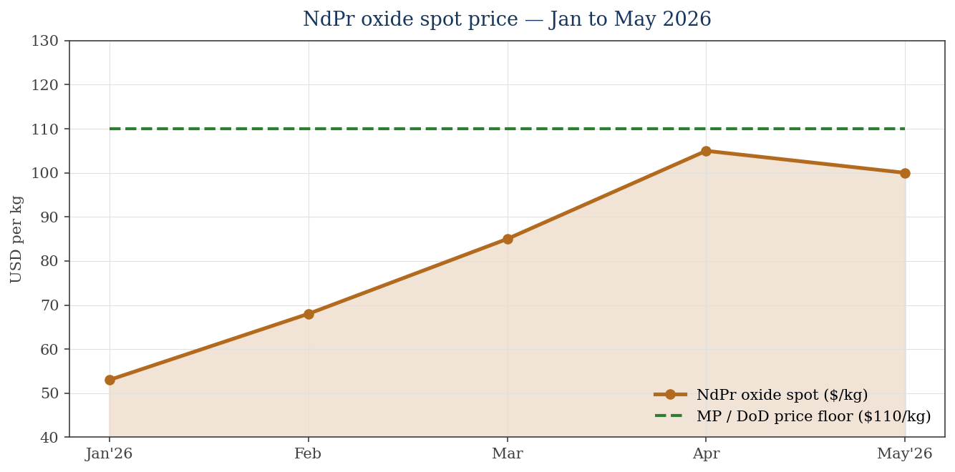
Rare-earth demand structurally tight; NdPr +>100% YTD with $110/kg DoD floor under MP
What the chart says
• NdPr spot opened 2026 ~$53/kg.
• By end-April hit ~$140/kg in some retail benchmarks; SMM industrial ~$100/kg in May.
• Roughly +100–160% YTD depending on benchmark.
• MP's $110/kg DoD price floor sits above current SMM spot.
• MP earns the floor on volume covered by the PPA; otherwise sells at spot.
• Lynas, UUUU, USAR are unhedged — they ride spot in both directions.
• Drivers: China export quotas tightening, accelerating EV magnet demand, US decoupling capex.
NdPr prices: SMM, strategicmetalsinvest.com (May 2026). MP–DoD price floor: MP investor relations, Jul 2025.

Slide 5
China owns >70% of mining and >80% of processing — value pools sit downstream
Mining
Cracking & Leaching
Separation (NdPr / HRE)
Metal / Alloy
Sintered Magnets
Downstream apps
Typical margin:
10–20%
5–10%
15–25%
5–10%
20–30%
—
China share:
~70%
~80%
~85%
~90%
~90%
n/a
What this means for investors
• The highest-margin stages (Separation, Sintered Magnets) are where strategic value sits — and where China is most dominant.
• MP and USAR are the only Western names targeting Sintered Magnets at scale. Lynas is strong through Separation but does not produce magnets.
• Energy Fuels is a processing pivot from uranium — capacity optionality, but no magnets.
• China Northern Rare Earth is fully integrated AND state-controlled — sets the marginal price for the global market.
• This is why MP's Stage III magnet facility (Independence, TX, commercial 2028) is the thesis-critical milestone.
Market shares: Discovery Alert, Farmonaut, SMM (2025/26 industry reports). Margins are typical-industry ranges, not company-specific.

Slide 6
MP profile — Q1'26 inflection: revenue +49%, NdPr +63%, Adj EBITDA flipped to +$36.6M
Metric | Value | YoY change | Source / note
Q1 2026 Revenue | $90.6M | +49% | Q1 2026 earnings release
Q1 2026 NdPr oxide production | 917 MT | +63% | Record quarter
Q1 2026 NdPr oxide sales | 1,006 MT | +117% | Sales outpaced production via inventory draw
Q1 2026 Adj EBITDA | $36.6M | +$49.9M | Driven by $110/kg DoD price floor (PPA, eff. Oct 2025)
Magnetics segment revenue | $21.1M | +$15.9M | Magnetic precursor products
TTM revenue | $275M | n/a | Sum of trailing four quarters
Market cap | $9.81B | n/a | May 15, 2026 (StockAnalysis)
52-week range | $18.64 – $100.25 | n/a | Stock $61.74 (May 21)
FY 2026 consensus revenue growth | +67% | n/a | Analyst aggregate
MP Materials Q1 2026 earnings release; 10-Q FY2026 Q1 (mp-20260331); StockAnalysis.com (May 2026).

Slide 7
DoD ~15% stake + 10-yr offtake + $110/kg NdPr floor = public–private moat
Element | Detail
Form | DoD purchases $400M of newly-created preferred stock, convertible to common + warrant for additional common
Aggregate stake | ~15% of MP common (post-conversion + warrant exercise) as of Jul 9, 2025
Conversion price | $30.03 per share of common stock
Close date | July 11, 2025
DoD position | Becomes MP's LARGEST single shareholder
Offtake commitment | 10-year DoD off-take of MP magnet/REE output
NdPr price floor (PPA) | $110/kg on NdPr products covered by the agreement; effective Oct 1, 2025
Use of proceeds | Expand separation & processing AND magnet production capacity
Stage III magnet facility | Construction begins 2026; first commercial product expected 2028
Sources: MP Materials press release (Jul 10, 2025); CNBC; Center on Global Energy Policy (Columbia SIPA); Payne Institute explainer.

Slide 8
Peer set — four strategic groups, two of which MP competes in directly
Tier 1 — Western pure-plays
• MP Materials (NYSE: MP) — only scaled US name
• Lynas Rare Earths (ASX: LYC) — only scaled non-US Western name
Tier 2 — US juniors / ramping
• Energy Fuels (NYSE: UUUU) — uranium with REE pivot
• USA Rare Earth (Nasdaq: USAR) — magnet-focused, $1.6B US gov't investment
Tier 3 — Chinese majors (context)
• China Northern Rare Earth (SHA: 600111) — world's largest, state-owned
• (Shenghe, JL Mag, etc. — not investable for most Western mandates)
Tier 4 — Critical-minerals adjacent
• Albemarle (NYSE: ALB) — lithium leader, not REE
• Included for broader critical-minerals reference only
Peer set per `comps-analysis` 4–6 rule. Excluded: Chinese mid-caps (not investable), early-stage exploration plays without near-term cash flow.

Slide 9
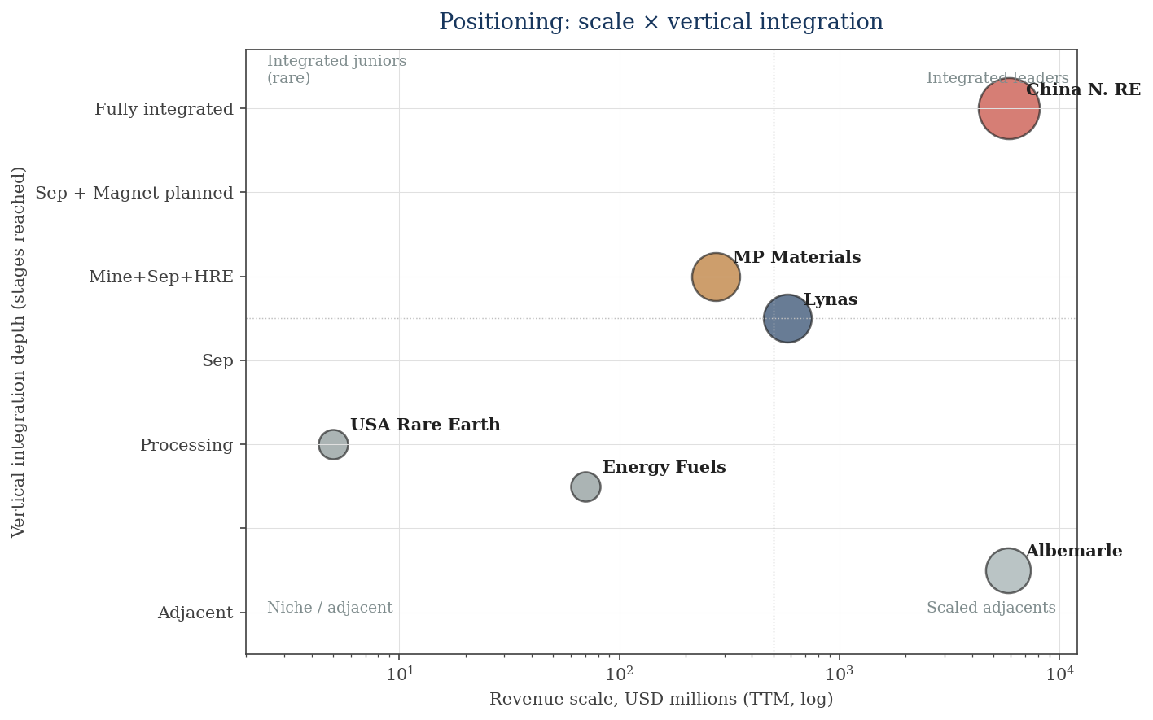
Scale × Integration: MP and Lynas alone occupy the Western 'fully-integrated' quadrant
What the matrix says
• China Northern RE is the only fully integrated, scaled producer globally — but un-investable for many.
• MP sits in the top-right Western quadrant, alone with Lynas — and uniquely targets sintered magnets (vs Lynas which does not).
• USAR is a magnet-only pure-play; small scale.
• Energy Fuels is processing-only with REE optionality.
• Albemarle is in the adjacent lithium / bromine space — not a true comp.
Integration score derived from public stage disclosures. Bubble size reflects market cap (qualitative).

Slide 10
Peer deep dive: Lynas — Most-profitable Western pure-play, slower up the value chain
Metric | Value
Market cap | ~US$10.8B (A$15.1B)
Q3 FY26 revenue | A$265M (+115% YoY, +31% QoQ)
H1 FY26 revenue / NI | A$413.7M / A$80.2M
FY26 forecast revenue | ~A$1.1B (~2x FY25)
FY26 NdPr volume | ~8,800 MT (+35% YoY)
FY26 NdPr avg realised | A$118/kg (+48%)
TTM EBITDA / Margin | US$211M / ~36%
TTM P/E | ~209x (forward ~37x)
Key asset | Mt Weld, WA — highest-grade REE deposit globally
Processing | Kuantan, Malaysia; Kalgoorlie cracking; Seadrift, TX (heavy REE, DoD-funded)
Category | Assessment
Business | Mine → Crack/Leach → Separation, including Heavy REE (Dy/Tb) at US Seadrift facility. Does NOT produce magnets.
Strengths | • Highest-grade asset globally • Already profitable (EBITDA +$211M TTM) • US heavy-REE pivot with DoD support
Weaknesses | • Stops at separation — no magnet revenue • Single-mine concentration risk (Mt Weld) • Currency exposure (AUD revenue, USD pricing)
Strategy | Volume growth (8,800 MT NdPr in FY26) + US footprint expansion. Will compete with MP in heavy REE.
Lynas H1 FY26 results (Dec 2025); Q3 FY26 update; StockAnalysis.com; S&P Global Market Intelligence (Dec 2025).

Slide 11
Peer deep dives: US juniors — capacity optionality, execution risk, long-dated
Energy Fuels (UUUU)
Business | US uranium producer; pivoting into REE processing at White Mesa Mill (Utah)
Phase 2 plan | 6,000 tpa NdPr + 240 tpa Dy + 66 tpa Tb
Latest data | BFS published Jan 15, 2026 — "lowest-cost NdPr in the world"
Strengths | Existing milling infrastructure; low CAPEX vs greenfield
Weaknesses | REE revenue still pre-commercial; uranium-dominated
Read | Optionality play; thesis hinges on FID and ramp execution
USA Rare Earth (USAR)
Business | Mine-to-magnet integrated supply chain (Texas to Oklahoma)
Q2 2026 event | Stillwater, OK magnet line commercial production begins
Financing | $1.5B PIPE closed (Inflection Point anchor); $1.6B US gov't investment
Strengths | Magnet pure-play; gov't backing; first commercial magnets in scope
Weaknesses | Pre-meaningful revenue; small scale; integration not fully proven
Read | Single-thesis bet: can it deliver US magnets at scale on schedule?
UUUU Phase 2 BFS (Jan 2026); USAR 8-K (Q2 2026 magnet commissioning); Motley Fool (Feb 2026 US$1.6B investment).

Slide 12
Peer context: China Northern Rare Earth — sets the price; un-investable for most Western capital
Metric | Value
Global share — mining | ~60–70% controlled by China; CNREG largest single producer
Global share — processing | >80%
FY2025 revenue | ¥42.6B (US$5,910M) — up 29% YoY
FY2025 net income | ¥2.25B (US$313M) — up 124% YoY
H1 2025 NI growth | +1,882% to +2,014% YoY (off low base, rare-earth price recovery)
Q1 2026 net profit guidance | US$125–131M (+109% to +118% YoY)
Parent / ownership | Baogang Group (state-owned, Inner Mongolia)
Strategic role | Sets global NdPr benchmark price; vertical integration mine → magnet
Why this matters for MP
• CNREG's price actions set the marginal NdPr clearing price — MP's economics ride on that benchmark for any volume outside the DoD floor.
• China can introduce export quotas / restrictions on heavy REE (Dy/Tb) at policy speed — direct upside for MP/Lynas, but execution-risk lever.
• CNREG profits +124% YoY says: China is winning today even as the West tries to decouple. Decoupling theme is real but slow.
• Pair-trade idea: long MP / short CNREG offers a cleaner geopolitical-decoupling expression than MP outright.
Shanghai Metals Market (SMM); Discovery Alert; Farmonaut (2025/26 industry reports).

Slide 13
Comparative scoreboard — MP leads scale & integration vector; lags near-term margins
Dimension | MP | Lynas | UUUU | USAR | CNREG | Albemarle
Revenue scale (TTM) | ●●○ $275M | ●●○ $578M | ●○○ $70M[E] | ○○○ Pre-rev | ●●● $5.9B | ●●● $5.85B
Vertical integration | ●●● Mine→Mag plan | ●●○ Mine→Sep+HRE | ●○○ Proc | ●○○ Magnet only | ●●● Full | ○○○ Adjacent
TTM profitability | ●○○ Neg→Pos Adj | ●●● +36% EBITDA | ○○○ Neg | ○○○ Neg | ●●○ +12% EBITDA | ●●● +43% EBITDA
Govt backing / floor | ●●● DoD 15% + $110 floor | ●●○ US/AU grants | ●○○ Modest | ●●● $1.6B US inv. | ●●● State-owned | ●○○ IRA / DoE
China-policy upside | ●●● Direct | ●●● Direct | ●●○ Modest | ●●● Direct | ○○○ Negative | ●○○ Indirect
Valuation absorb-shock | ●●○ Floor protects | ●●● Profitable | ●○○ Capacity bet | ●○○ Optionality | ●●● Cheap | ●●○ Improving
Investability for US mandate | ●●● Yes | ●●○ ASX-listed | ●●● Yes | ●●● Yes | ○○○ No | ●●● Yes
● = Strong ○ = Weak. Subjective ratings calibrated to data in companion .xlsx Operating Metrics / Valuation / REE-Specific tabs.

Slide 14
Strategic synthesis — Moat: integration + govt partnership · Risk: NdPr cycle + Stage III timing
Moat type | MP | Lynas | UUUU | USAR | CNREG | What it means
Network effects | Weak | Weak | Weak | Weak | Mod | Limited — REE is industrial supply chain, not platform
Switching costs | Strong | Mod | Weak | Mod | Strong | Mag spec-in is sticky; 10-yr offtake hard-wires customers
Scale economies | Mod | Mod | Weak | Weak | Strong | Cost curve favors integrated scale players (CNREG)
Intangibles (govt) | Strong | Mod | Weak | Mod | Strong | MP–DoD relationship is the single biggest Western intangible
Permits / location | Strong | Mod | Mod | Mod | Mod | Mountain Pass is the only operating US REE mine
Net moat assessment
MP's durable advantages: (i) only operating US REE mine, (ii) DoD anchor + price floor, (iii) only Western mine→magnet ambition at scale.
MP's structural vulnerabilities: (i) magnet revenue not until 2028, (ii) NdPr spot still drives marginal volume, (iii) capex-heavy through 2028.
Moat framework per `competitive-analysis` skill Step 9. Ratings: Strong / Moderate (Mod) / Weak — calibrated against peer comparison.

Slide 15
Range of outcomes anchored by $110/kg floor (downside) and 2028 magnet revenue (upside)
Scenario | Prob. | Key driver | Implied direction
Bull | 30% | Section 232 tariffs on REE imports; China heavy-REE export restrictions; Apple/GM expand magnet volume; Stage III on schedule | MP re-rates 50–100% on multi-year magnet revenue visibility; magnet revenue 2028 → 2–3x
Base | 50% | NdPr ranges $80–$150/kg; DoD floor protects covered volume; Stage III breaks ground on time; Lynas/USAR add competitive supply but market absorbs | MP delivers TTM revenue growth >50%; stock tracks NdPr + magnet ramp milestones; ~20–40% upside over 18 months
Bear | 20% | China–US trade détente collapses NdPr; Stage III delays past 2028; USAR/UUUU ramp faster than expected, eroding pricing power | MP re-rates 30–40% lower; trades closer to 4x EV/Sales (peer median) on stalled magnet narrative
Signposts to watch (next 3 events that re-rate the scenario weighting)
1) NdPr spot vs $110/kg floor 2) Stage III construction milestone in H2 2026 3) Section 232 / export-control decisions on critical minerals
Probabilities are author's judgment, not consensus. For investment use, calibrate to your own conviction and time horizon.

Slide 16
Catalysts & signposts — 2026 → 2028
When | Who | Event | Impact on MP thesis
Q2 2026 | USAR | Stillwater (OK) sintered NdFeB magnet line commercial production begins | Competitive supply tick-up
H2 2026 | MP Materials | Stage III magnet facility construction commences (Independence, TX) | Capex spike; long-dated optionality
H2 2026 | Lynas | US heavy-REE (Dy/Tb) plant at Seadrift TX ramps | First non-China heavy-REE supply
Q4 2026 | Energy Fuels | Phase 2 REE circuit final investment decision expected | Validates 6,000 tpa NdPr capex
Ongoing | US Policy | Section 232 review / China export-quota decisions | Sets relative price for non-China REE
2027 | MP Materials | Apple / GM magnet supply expansion expected | Revenue mix shifts toward magnets
2028 | MP Materials | First commercial sintered magnet product (Independence, TX) | THESIS-CRITICAL — completes mine-to-magnet
Catalysts compiled from MP investor commentary, peer guidance, and recent media. Track via /catalysts skill in production usage.

Slide 17
Decision frame — four ways to express the rare-earths thesis
Long MP outright (highest conviction)
Triggers: NdPr sustainably > $110/kg floor; Stage III milestones on schedule; new offtake volume from Apple/GM. Risk: magnet ramp slips past 2028; China relaxes export rules and NdPr collapses. Position sizing reflects multi-year hold.
Pair trade: long MP / short CNREG
Triggers: Section 232 tariffs on REE imports; escalating US–China decoupling. Risk: CNREG profits +124% YoY says China is winning today — short side may be early. Cleaner geopolitical expression than MP outright.
Basket via REMX (theme exposure)
REMX YTD ~25–42% — diversified critical-minerals exposure. Trade-off: significant Chinese name weight inside the ETF; less direct US-domestic-supply exposure than MP single-name.
Avoid / wait
Triggers to re-enter: (i) Stage III magnet line achieves first commercial output (~2028), (ii) trailing EBITDA turns sustainably positive, (iii) NdPr breaks below $80/kg without sufficient floor-protected volume mix. Acknowledges 2026 valuation already prices in significant ramp.
This deck is research and decision framing — not investment advice. Cross-check valuation against a primary terminal (CapIQ / FactSet / Bloomberg) before acting.

Slide 18
Sources, data gaps, and caveats
Primary sources
• MP Materials Q1 2026 10-Q (mp-20260331) and Q1 2026 earnings release
• MP Materials – DoD partnership press release (Jul 10, 2025); CNBC (Pentagon largest shareholder)
• Lynas H1 FY26 results; Q3 FY26 trading update; StockAnalysis.com LYC.AX statistics
• S&P Global Market Intelligence — Lynas 2026 outlook (Dec 2025)
• Energy Fuels Phase 2 BFS press release (Jan 15, 2026); Q1 2026 results
• USA Rare Earth 8-K filings (Jan/Feb 2026 PIPE close); magnet-line commissioning press release
• China Northern Rare Earth FY25 results — Shanghai Metals Market (SMM); Discovery Alert
• Albemarle Q1 2026 earnings; SWOT analysis (Investing.com)
• NdPr pricing: SMM, strategicmetalsinvest.com, rare-earth-mining.com (May 2026)
• Market context: VanEck REMX ETF, Center on Global Energy Policy (Columbia SIPA)
Data gaps and caveats (read before using in a binding decision)
• MCP data sources (CapIQ / FactSet / Daloopa) WERE NOT USED — the financial-services plugin connectors were not configured in this environment. Numbers should be cross-checked against a terminal before action.
• [E] flags in the companion .xlsx Inputs tab identify figures estimated from public commentary; cell comments document each assumption.
• Chinese major financials reported in CNY — conversions use ~7.2 CNY/USD (May 2026 indicative); rerun if FX moves materially.
• Forward consensus (P/E forward, FY26 EPS estimates) drawn from public aggregators rather than sell-side feeds. Variance to consensus may exist.
• This research is for educational/decision-framing use only and is not investment advice.
Built per the `competitive-analysis` and `comps-analysis` skills in financial-services/plugins/vertical-plugins/financial-analysis. Companion file: MP-Comps-Analysis.xlsx.

