Slide 1
Decarbonizing Water Desalination with Renewable Energy and Battery Storage Using Optimization Algorithms
Om Sanan
December 2024

Slide 2
Vision
Vision
Resilient Water Supply Infrastructure
Water Security and Energy Independence
Decarbonization Desalination
Hybrid Renewable Energy and Battery Storage
AI-driven Solutions
Uniqueness
Decarbonization solution for new and existing water desal. plants
4 Real-life desal plants case studies
Creation of an Automated Energy Management System (EMS) that can:
Process data from multiple sources in real time
Automatically obtain data via APIs
Use ML forecasting models & optimization algorithms to align RE generation with energy demand on an hourly basis

Slide 3
Background
Global Water Scarcity 2 billion (26%) people lack access to clean water— expected to double by 2050 (U.N.) Global Warming and Population growth are exacerbating the issue | Problem Statement Desalination can provide an abundant source of water, however, it is: Expensive: Energy is 40% of total desal. cost Results in significant carbon emission
Renewable Energy & Battery Storage Abundant RE source; can replace 100% electricity RE cost has reduced ~80% over the last decade Currently powers only 1% of Desalination High initial CAPEX & Intermittent nature of RE Battery storage: Facilitates the efficient utilization of RE, enabling grid stabilization, peak shaving, and load shifting but expensive | Gap in Research / Problem Statement Current studies use data that is either simulated or collected on a small scale Lack comprehensive assessment of multiple RE sources and optimization

Slide 4
Research Overview
Objective: Obtain the optimal system sizing of hybrid RE sources and battery storage to decarbonize desalination
Minimizing cost and carbon footprint
Protects against energy price volatility
Obtain energy independence
Real-life, mid-large size desalination plants
Systems Evaluated: PV, CSP, Wind Energy, Hydro Energy, Battery Storage
Methods: (i) Sophisticated ML models to forecast water demand, energy consumption, and weather/environmental data; and (ii) Optimization algorithms to design an optimal RE and battery mix

Slide 5
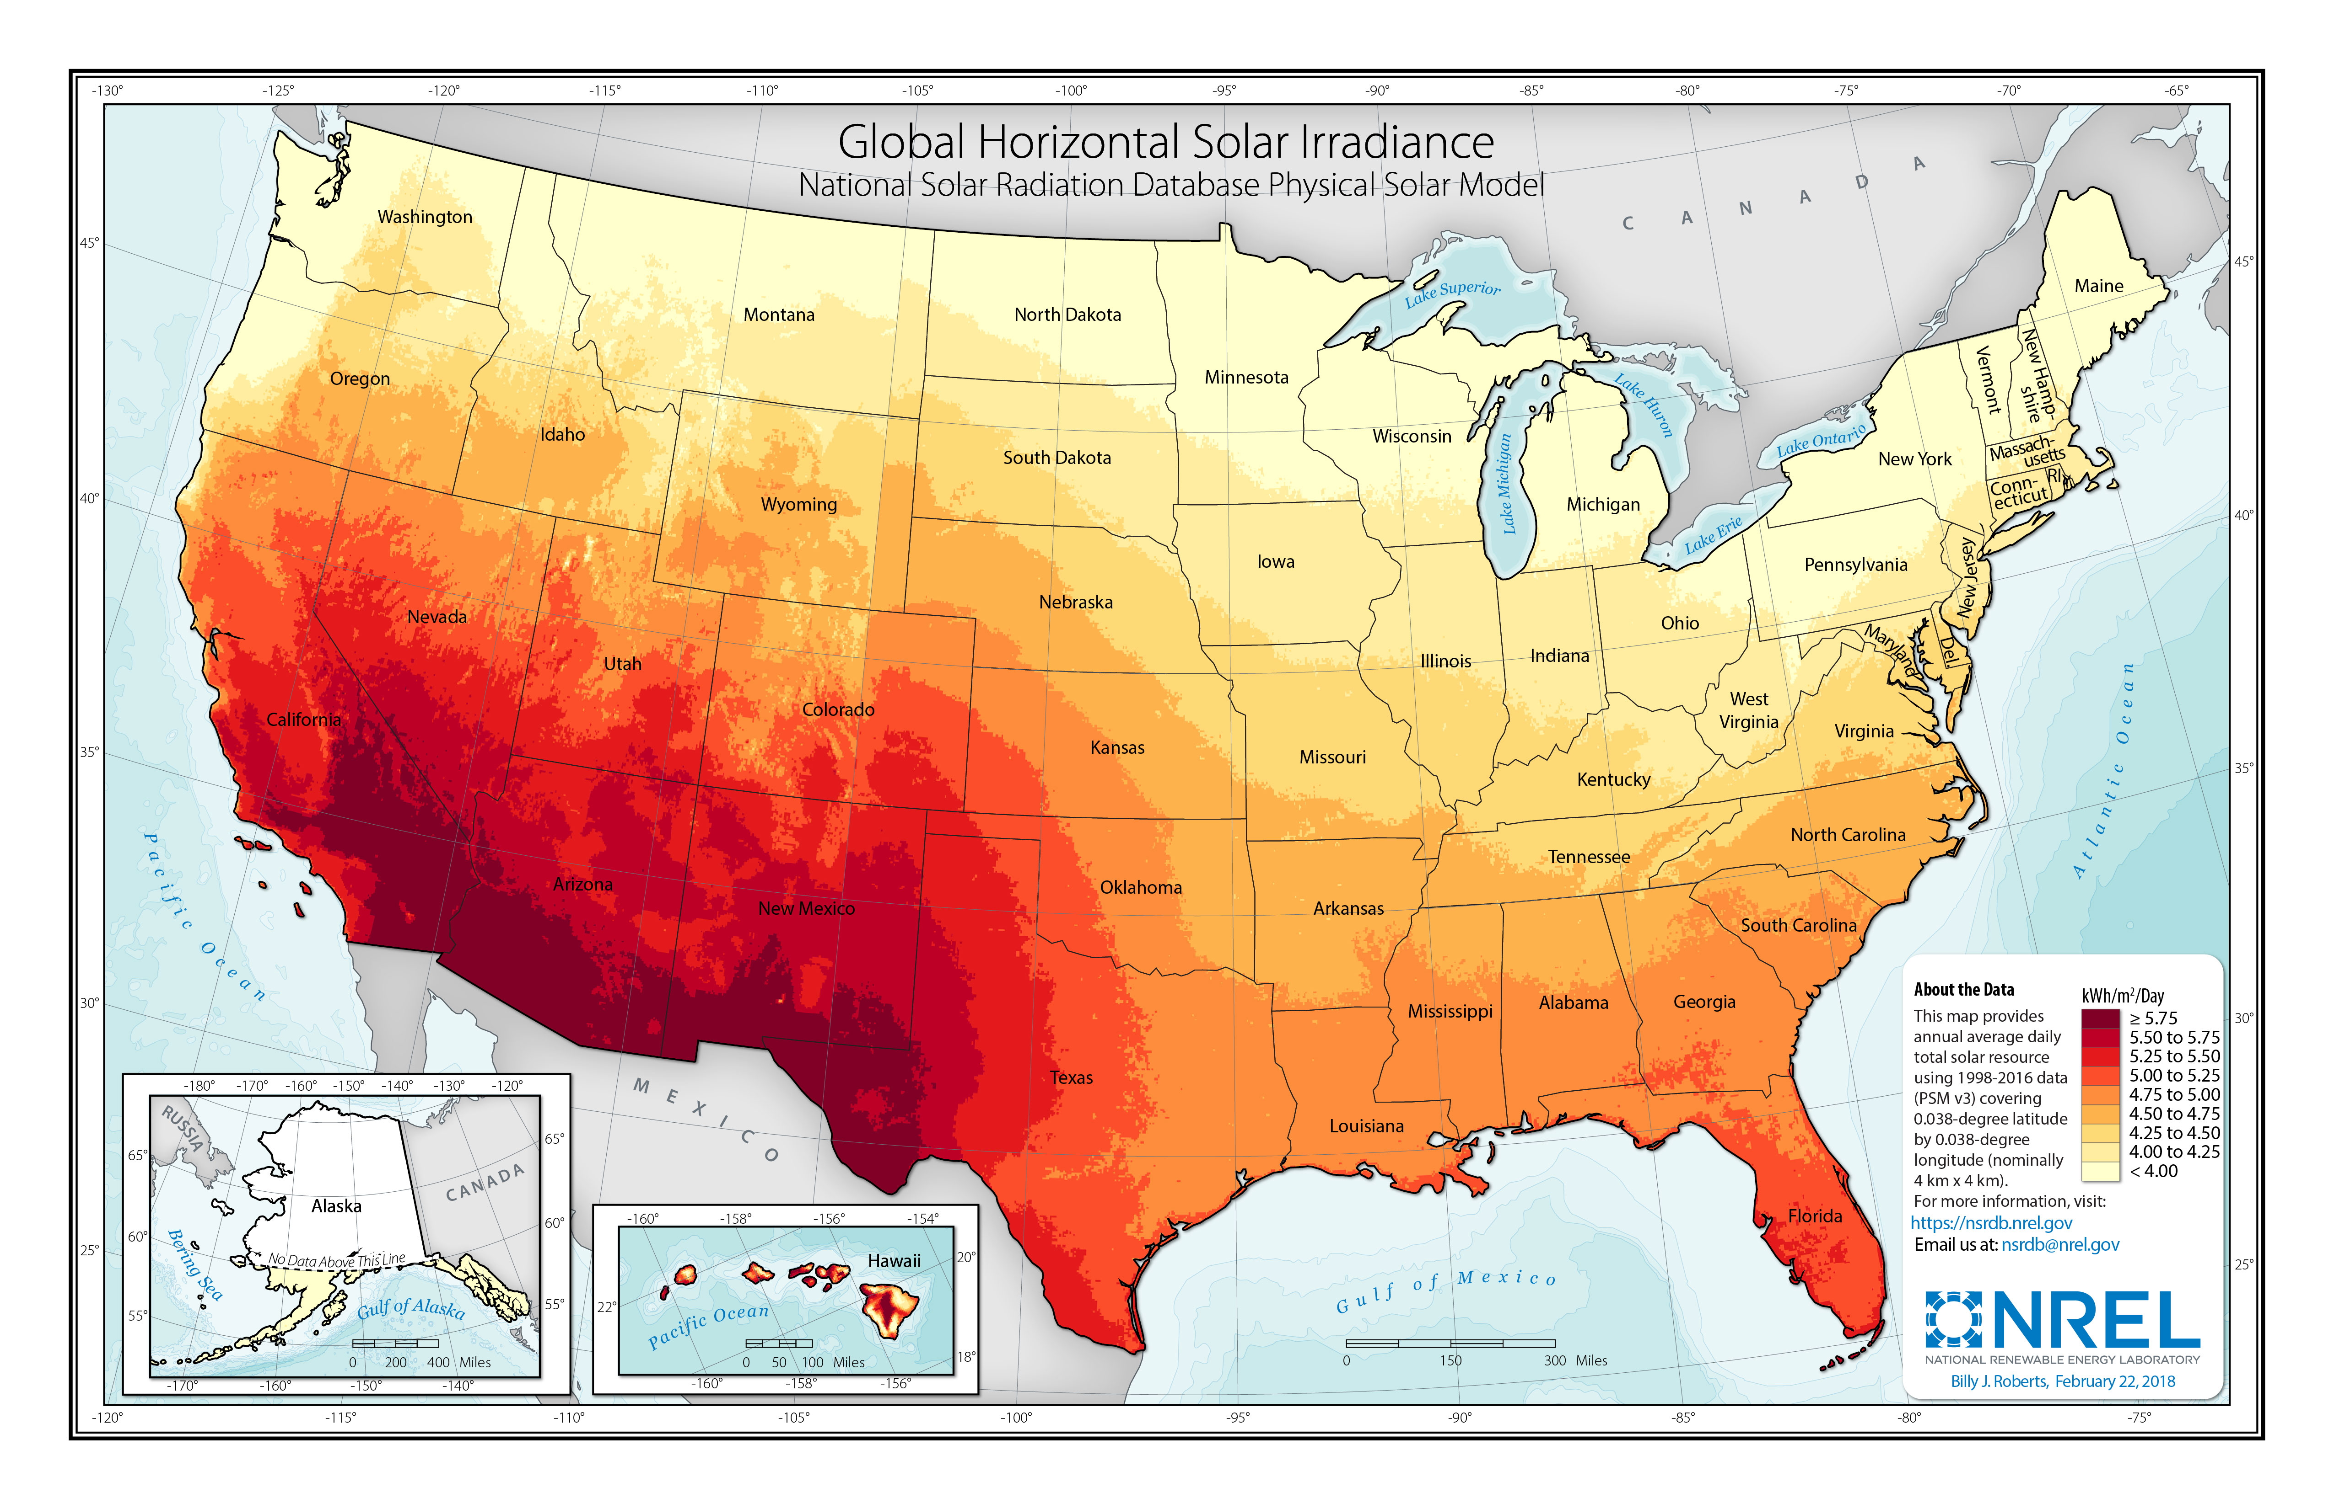


Summary of Four Desalination Facilities
Desalination facilities:
Alameda, CA
Hutchinson, TX
SAWS, TX
Tampa Bay, FL
Combined electricity usage = 75 million kWh
Conversion to 100% RE = ↓ 32,000 metric tons of annual carbon emissions = planting 1.2 million trees
Alameda
Hutchinson
SAWS
Tampa Bay
https://www.nrel.gov/gis/assets/images/solar-annual-ghi-2018-usa-scale-01.jpg

Slide 6
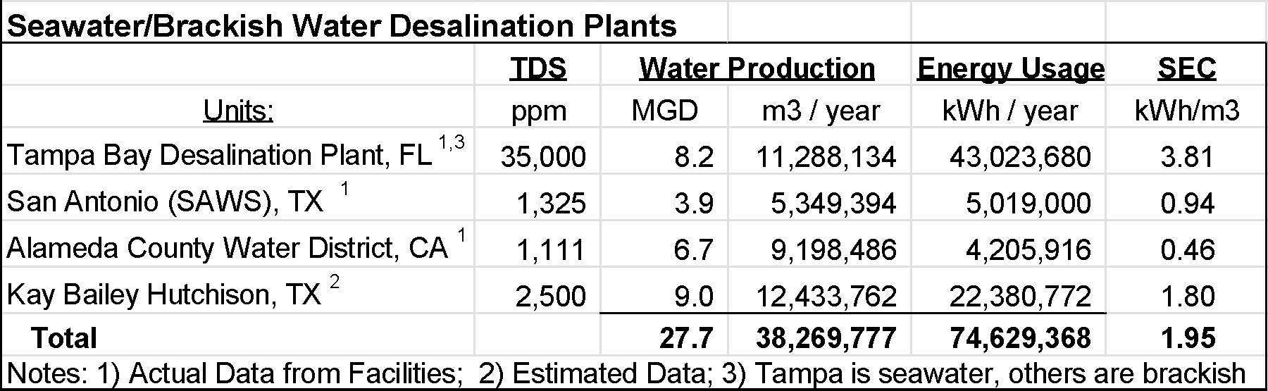
Desalination Plant Data

Slide 7
Methodology
Step 1
Step 2
Step 3
Step 4
Forecasting Inputs (2023-2027)
Energy Consumption & Treated Water
Wind, Temperature, and Solar Irradiance
Estimate RE Generation for Wind, PV, and CSP
Total Cost & CO2 Emissions for RE & BS
Multi-objective Optimization
Minimize CO2
Minimize Cost

Slide 8
Methodology
Step 1
Step 2
Step 3
Step 4
Forecasting Inputs (2023-2027)
Energy Consumption & Treated Water
Wind, Temperature, and Solar Irradiance
Estimate RE Generation for Wind, PV, and CSP
Total Cost & CO2 Emissions for RE & BS
Multi-objective Optimization
Minimize CO2
Minimize Cost

Slide 9
Forecast Treated Water, Energy Usage, Weather
Forecast of Daily Treated Water Flows and Energy Consumption
Data Used: Rainfall, Hours in Operation, Raw Water Flows, Backwash Water Usage, Peak Demand, Avg Turbidity, Max Turbidity
Data Forecast: Water Flows, Energy Consumption
Models Used: SARIMA, Random Forest, XGBoost, Gradient Boosting, Ensemble
Forecast of Weather Data (Climate & Hydro)
Why: To determine RE generation potential
Data Used: Temperature, Solar Irradiance, Humidity, Wind Speed
Data Forecast: Solar Irradiance, Wind Speed, Temperature
Models Used: XGBoost, LSTM, Linear/Polynomeal Regression

Slide 10
Forecast Treated Water/Energy Consumption
Daily/monthly 5-year data from desal plants: energy use, water flow, TDS, turbidity, temperature, pH
Preprocessing/Feature Engineering: Log transformations, lag creation, train/test split
Model Training
Regression based models: Random Forest, Gradient Boosting, SARIMA
Hyperparameter tuning through GridSearchCV (cross-validation)
Model Forecast
Used each model to obtain test set predictions
Ensemble approach - averages model predictions to mitigate individual model biases

Slide 11
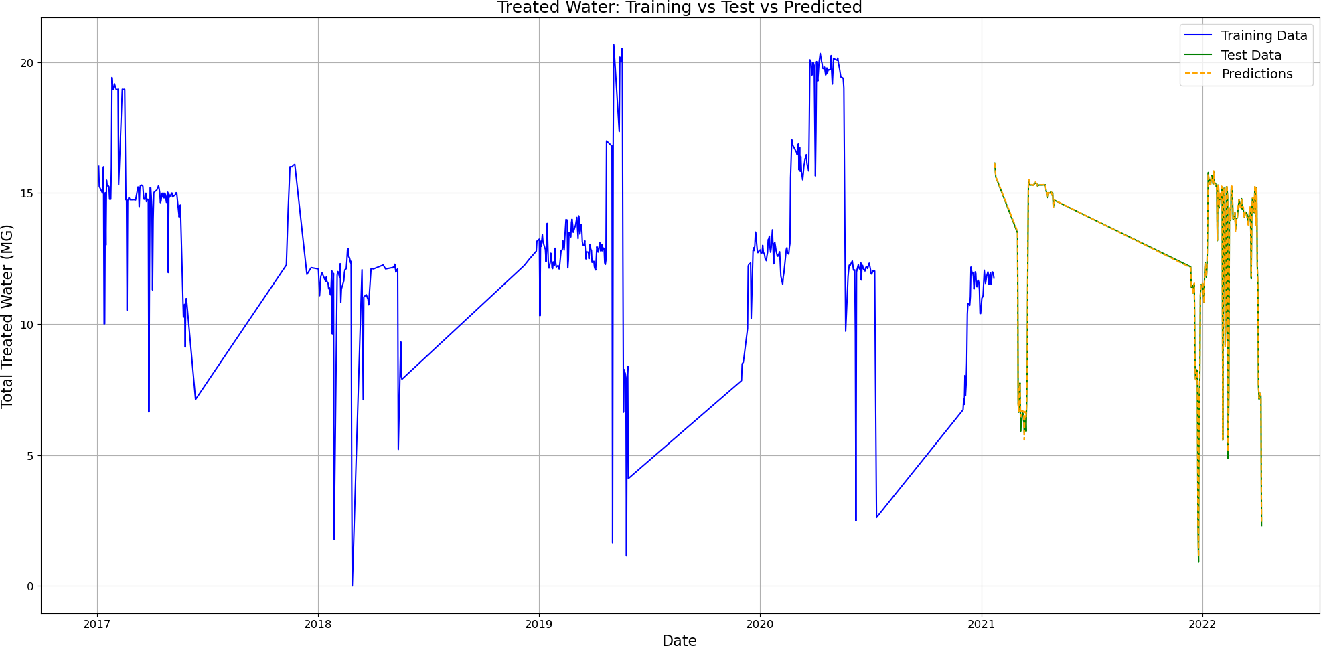
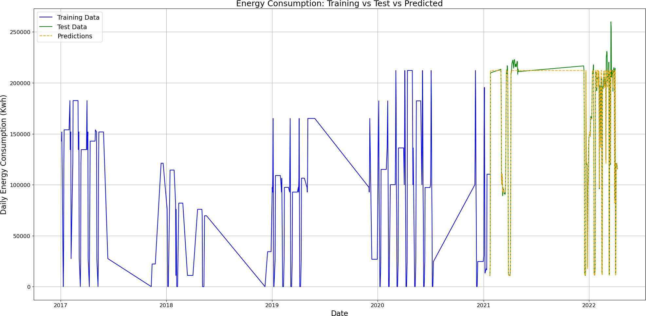
Treated Water & Energy Consumption (Tampa Bay)
Total Treated Water (MGD)
Daily Energy Consumption (kWh)
Training Data: 2017-2021
Test Data: 2022-2023

Slide 12
Forecast Treated Water & Energy (Tampa Bay)
Model Forecast: 2023-2027

Slide 13
Forecast Wind Speed/Temperature/GHI
Integrated into Streamlit application
Data Preparation and Preprocessing
20 year hourly climate data using NSRDB API
60:20:20% split for Training:Testing:Validation
Feature Engineering: Lag Features, Rolling Window Statistics, Differencing
Model Training and Validation
Parameter Tuning: Use grid search to find optimal parameters
XGBoost: Employs gradient boosting decision trees
Prophet: Daily observations with strong seasonal effects; time-series forecating
Average Method: Forecasts future values as the average of past observations
Autoregressive Validation: Past data points as inputs to forecast
Forecasting: Iterative Forecast + Optional Noise Injection

Slide 14
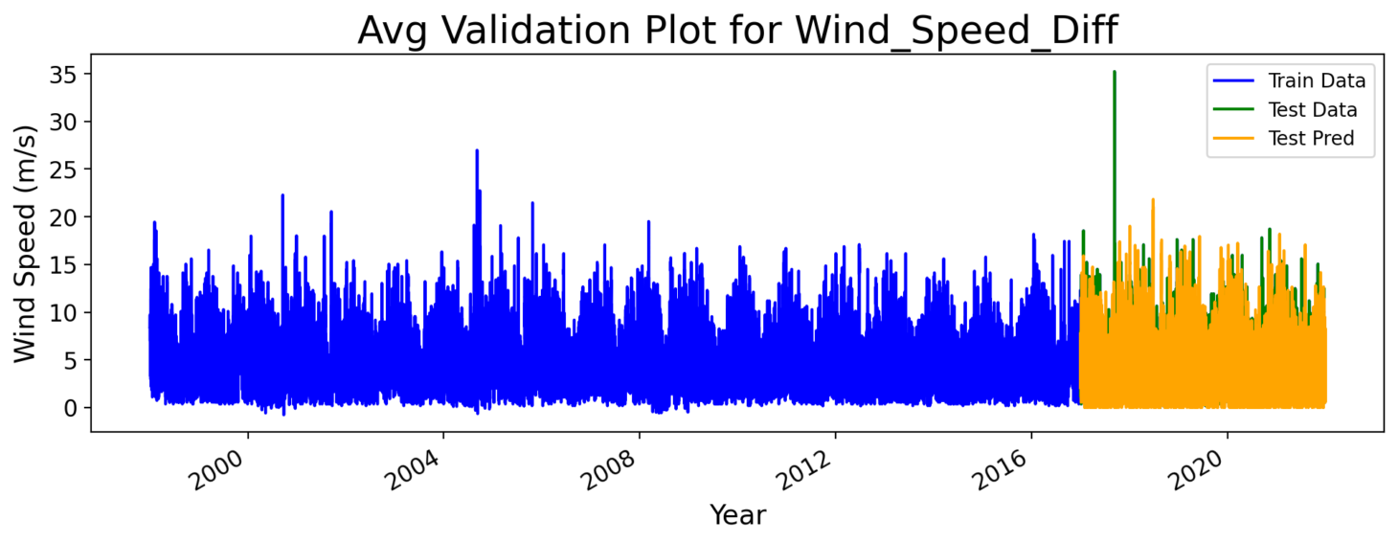
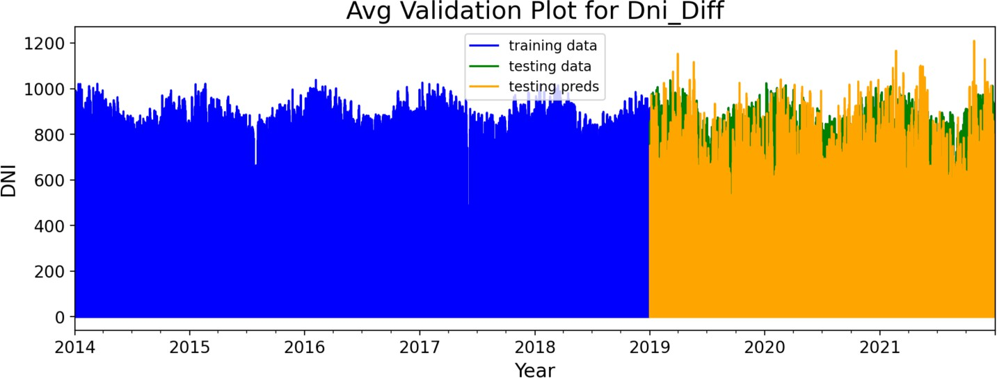
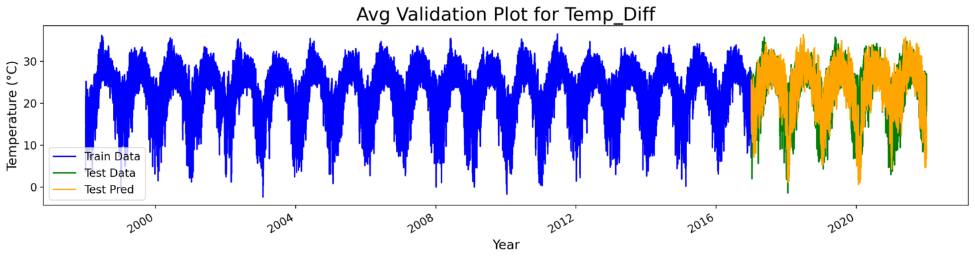
Forecast Wind Speed, Temp., GHI (Tampa Bay)
XGBoost Average Method Model
Test data used to validate the accuracy of the training model
Training Data: 1998-2016
Test Data: 2017-2021
Avg Validation Plot for GHI_Diff
GHI (W/m²)

Slide 15
Wind Speed/Temperature/GHI Forecast Trends
Monthly temperature and wind speed expected trends (2023-2027)
Average monthly solar irradiance expected trends (2023-2027)

Slide 16
Daily and Seasonal Trends in Weather

Slide 17
Results: Forecasted Variable Error Rates (RMSE)
Forecasted models show normalized Root Mean Square Error of less than 10% for key metrics such as treated water flows, energy demand, temperature, and wind speed, and less than 20% for solar irradiance (GHI)

Slide 18
Methodology
Step 1
Step 2
Step 3
Step 4
Forecasting Inputs (2023-2027)
Energy Consumption & Treated Water
Wind, Temperature, and Solar Irradiance
Estimate RE Generation for Wind, PV, and CSP
Total Cost & CO2 Emissions for RE & BS
Multi-objective Optimization
Minimize CO2
Minimize Cost

Slide 19
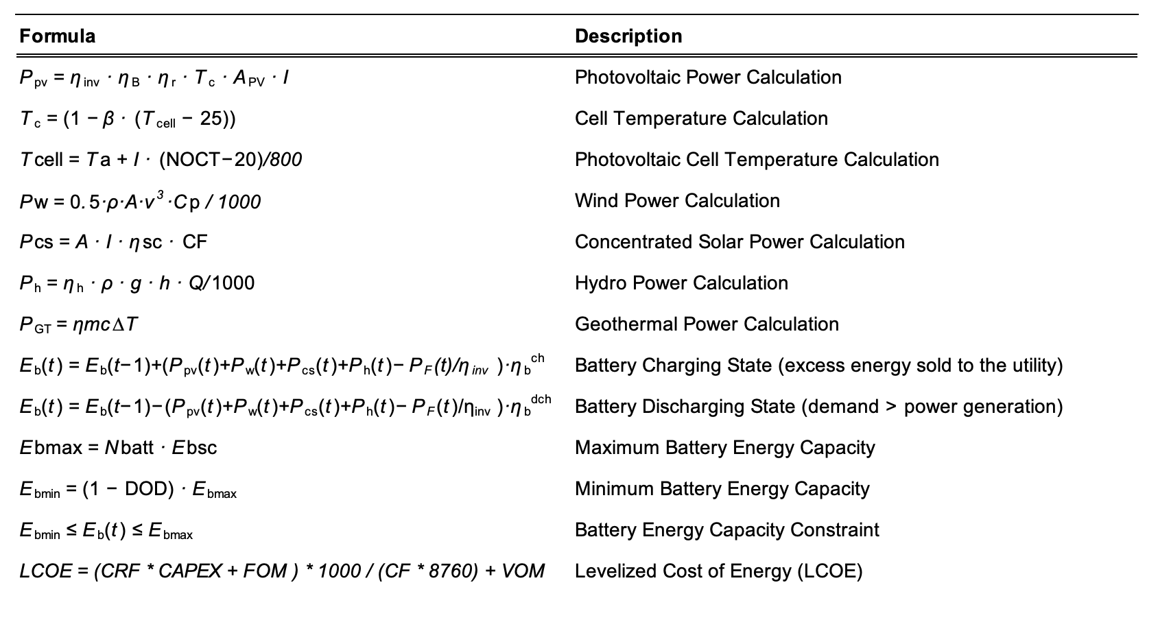
Step 2: RE and BS Generation Formulas

Slide 20
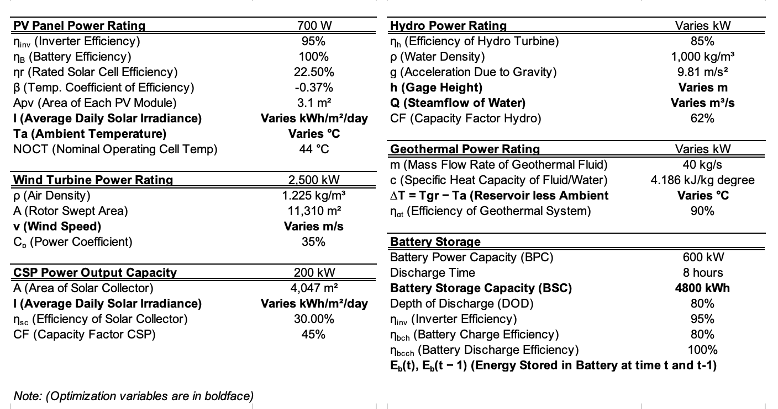
Step 2: RE and BS - Variables and Constants

Slide 21
Results: RE Generation Forecast
Forecast Temperature, Wind Speed, GHI (solar irradiance)
Calculated Renewable Energy Generation

Slide 22
Methodology
Step 1
Step 2
Step 3
Step 4
Forecasting Inputs (2023-2027)
Energy Consumption & Treated Water
Wind, Temperature, and Solar Irradiance
Estimate RE Generation for Wind, PV, and CSP
Total Cost & CO2 Emissions for RE & BS
Multi-objective Optimization
Minimize CO2
Minimize Cost

Slide 23
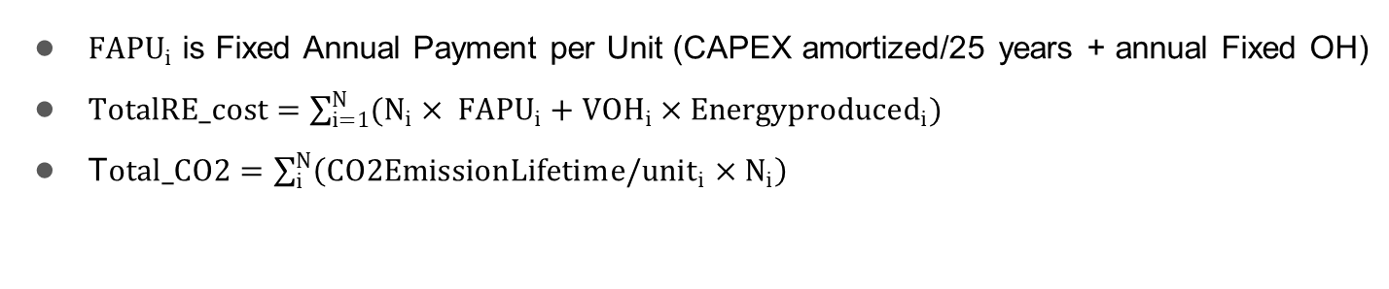
RE CAPEX, OpEx, CO2 Emissions: Assumptions
$F{APU}_{i}$ is Fixed Annual Payment per Unit (CAPEX amortized/25 years + annual Fixed OH)
$TotalRE_cost=\sum_{i=1}^{N}{(N_{i}× F{APU}_{i}+VOH_{i}×Energyproduced_{i})}$
T$otal_CO2=\sum_{i}^{N}{\left(CO2EmissionLifetim{e/unit}_{i}×N_{i}\right)}$
Source:
CAPEX, FOH, VOH, are sourced from NREL Annual Technology Baseline Database 2023
Lifetime CO2 emissions are sourced from NREL
High-end RE system specs are sources from leading vendors of RE systems

Slide 24
Methodology
Step 1
Step 2
Step 3
Step 4
Forecasting Inputs (2023-2027)
Energy Consumption & Treated Water
Wind, Temperature, and Solar Irradiance
Estimate RE Generation for Wind, PV, and CSP
Total Cost & CO2 Emissions for RE & BS
Multi-objective Optimization
Minimize CO2
Minimize Cost

Slide 25
Optimizing the RE Supply and Plant Energy Demand
Desalination Plant - Treated Water + Energy Consumption Forecasting
Multi-objective Optimization
Engine
Optimal RE & Battery Storage Mix for each Desalination Plant
Weather / Solar Radiation
Forecasting
Renewable Energy
Parameters
Minimize Cost
Minimize CO₂

Slide 26
Optimization Algorithm Overview
Utility
Utility is used when battery + RE cannot meet the demand
Wind
n_{wt}
Desalination Plant Energy Demand
n_{pv}
PV
n_{csp}
Battery
Usage
Battery
Charging
CSP
n_{b}
Optimization algorithm calculates optimal energy mix to supply the energy demand, as well as battery capacity on a monthly basis in 2023-2027.
Unit Capacity
(Forecasted hourly for each location)
Number of units
Battery

Slide 27
Optimization Scenarios
Scenario 1: 100% RE with Battery Storage (No Utility)
Grid independence
Scenario 2: 50-100% RE-mix with Utility (No Battery Storage)
Transition towards grid independence
Scenario 3: 0-30% RE with Utility (No Battery Storage)
Test benefits of partial RE adoption
All Scenarios assume no net metering

Slide 28
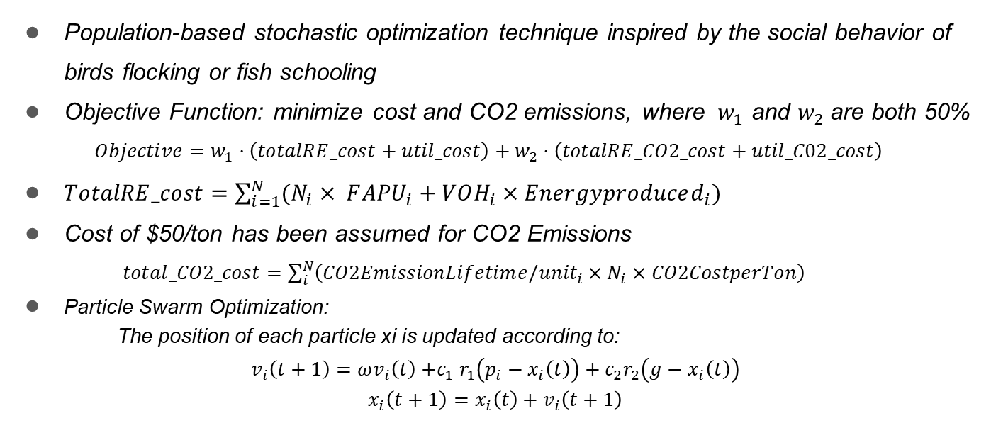
PSO Optimization Model
Population-based stochastic optimization technique inspired by the social behavior of birds flocking or fish schooling
Objective Function: minimize cost and CO2 emissions, where ${ w}_{1}$ and $w_{2}$are both 50%
$$Objective=w_{1}⋅\left(totalRE_cost+util_cost\right)+w_{2}⋅\left(totalRE_CO2_cost+util_C02_cost\right)$$
$TotalRE_cost=\sum_{i=1}^{N}{(N_{i}× F{APU}_{i}+VOH_{i}×Energyproduced_{i})}$
Cost of $50/ton has been assumed for CO2 Emissions
$total_CO2_cost=\sum_{i}^{N}{\left(CO2EmissionLifetim{e/unit}_{i}×N_{i}×CO2CostperTon\right)}$
Particle Swarm Optimization:
The position of each particle xi is updated according to:
$$v_{i}\left(t+1\right)=ωv_{i}\left(t\right){+c}_{1}r_{1}\left(p_{i}−x_{i}\left(t\right)\right)+c_{2}r_{2}\left(g−x_{i}\left(t\right)\right)$$
$$x_{i}\left(t+1\right)=x_{i}\left(t\right)+v_{i}\left(t+1\right)$$

Slide 29
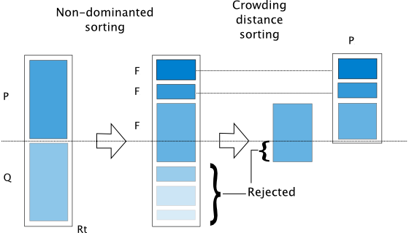
NSGA-II Optimization Model
Forward Model Summary
Inverse Model Summary
Optimization algorithm calculates the number of units for wind turbines, photovoltaic panels, CSP systems, and batteries for each month
NSGA-II Non-dominated Sorting Genetic Algorithm
Suitable for multi-objective optimization.
Similar to a typical genetic algorithm, with a modified mating and survival selection
n_{wt}
n_{pv}
n_{csp}
n_{b}
Optimize for Cost
Optimize for CO₂ Emissions

Slide 30
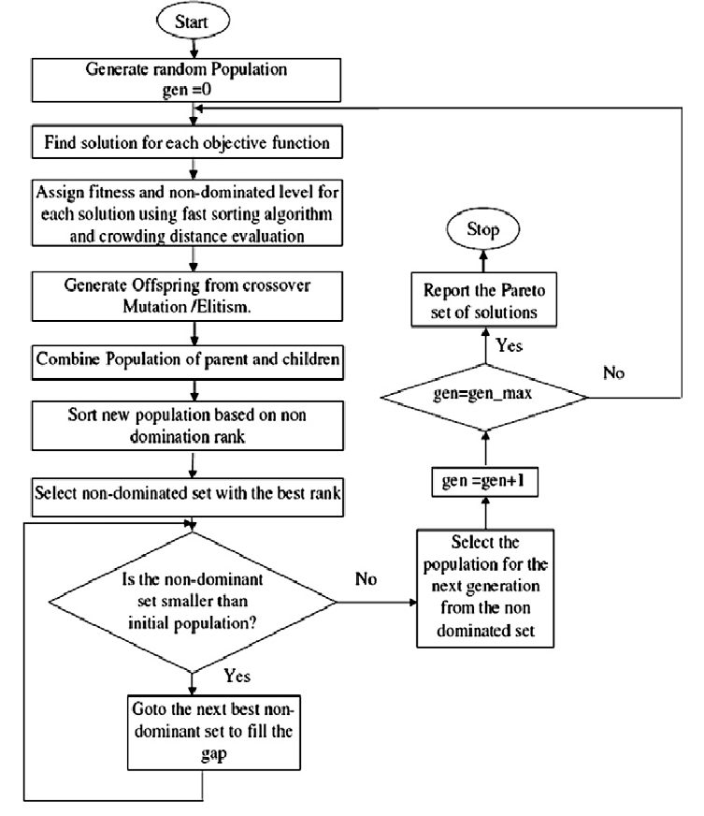
NSGA-II Optimization Model
Main Loop on Month and Year
Optimum n_{wt}, n_{pv}, n_{csp}, and n_{b} for each month
Optimum n_{wt}, n_{pv}, n_{csp}, and n_{b} for each year (2023-2027)
Optimum n_{wt}, n_{pv}, n_{csp}, and n_{b} for the entire 5-year duration (2023-2027)

Slide 31
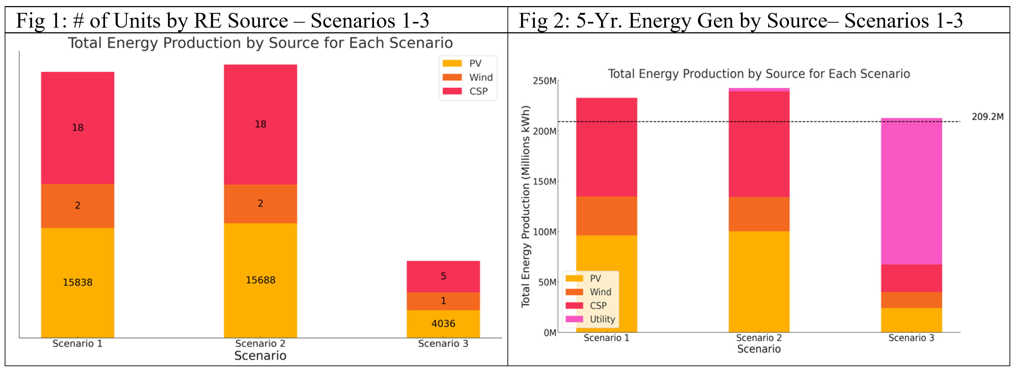
PSO Model - Optimization Results (Tampa Bay)
Optimization of Scenarios 1, 2 and 3 result in: 100%, 99%, and 30% RE mix, respectively, and produce excess energy of 11%, 15%, and 0%, respectively (as there is no net metering)

Slide 32
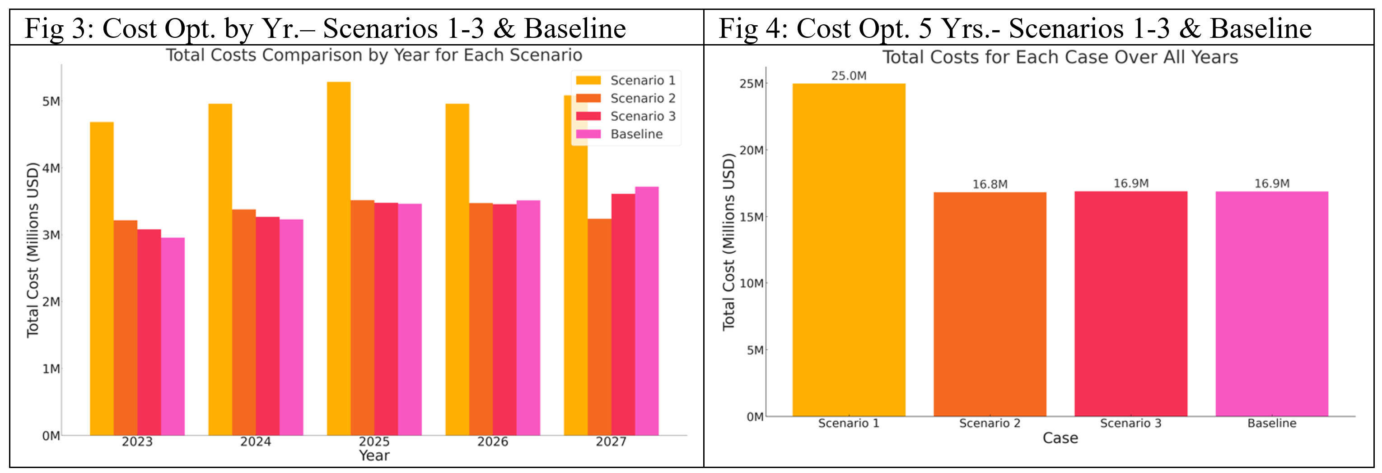
PSO Model - Optimization Results (Tampa Bay)
5-year Total Cost of Scenario 2, 3, Baseline (100% Utility) is ~$16.9 million, whereas Scenario 1 is ~$25 million due to use of 12 batteries to create 100% energy independence.
CO2 Emissions (grams/kWh) of Scenario 1, 2, 3, Baseline = 5M, 1.4B, 62.5B, 90B, resp.

Slide 33
Potential Limitations
There is uncertainty in forecasted water/energy/weather data
We did not account for plant downtime in model training for energy consumption and water flows
This study takes into account PV, Wind, CSP, and Battery Storage.
Future Studies can include Geothermal Energy and Hydrogen Storage

Slide 34
Conclusions
Key Achievements
Established a robust framework and formulas for optimizing RE integration in desalination
Water production, energy consumption, and weather forecasting using AI models to calculate RE generation
Multi-objective optimization algorithim for optimal mix of RE investments needed to supply a desalination plant for a given region.
Future Study
Perform sensitivity analysis for optimization mix of RE system and battery storage

Slide 35
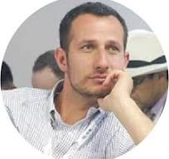
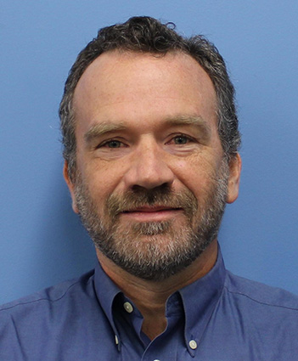

Acknowledgement
Dr. Joshua Sperling National Renewable Energy Laboratory Manager – New Concepts Incubator, Urban Futures and the Energy-X Nexus Colorado | David Greene National Renewable Energy Laboratory Water, Energy, Climate, and Sustainability Engineer and Program Manager Colorado | Ross Greer UC – San Diego PhD Candidate - Electrical & Computer Engineering California

