Slide 1

Data-Intensive Text Processing with MapReduce
Jimmy Lin The iSchool
University of Maryland
Chris Dyer*
Department of Linguistics
University of Maryland
*Presenting
Tuesday, June 1, 2010
This work is licensed under a Creative Commons Attribution-Noncommercial-Share Alike 3.0 United States See http://creativecommons.org/licenses/by-nc-sa/3.0/us/ for details

Slide 2
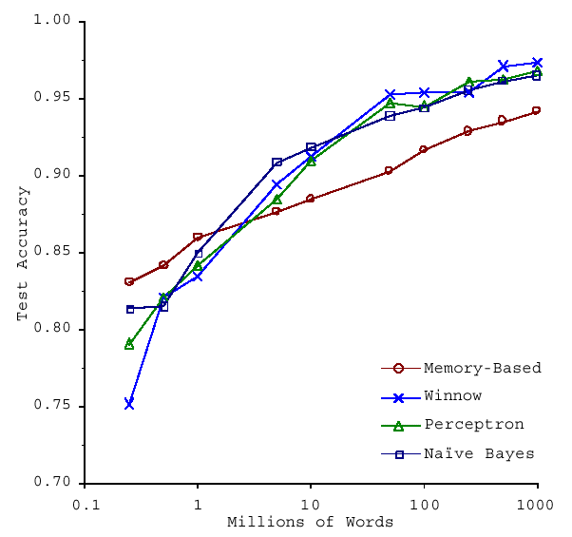
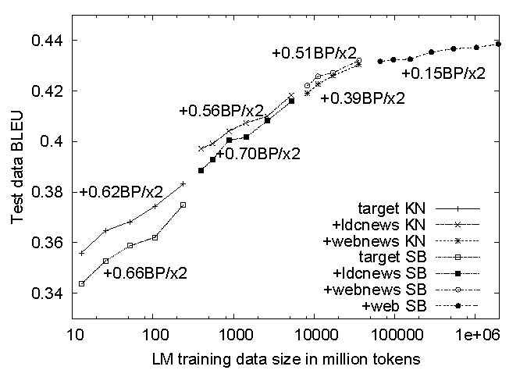
No data like more data!
(Banko and Brill, ACL 2001)
(Brants et al., EMNLP 2007)

Slide 3
cheap commodity clusters
+ simple, distributed programming models
= data-intensive computing for the masses!

Slide 4
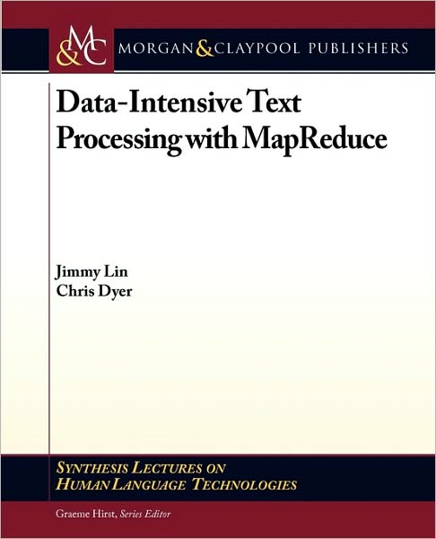
Outline of Part I
Why is this different?
Introduction to MapReduce (Chapters 2)
MapReduce “killer app” #1 (Chapter 4) Inverted indexing
MapReduce “killer app” #2: (Chapter 5) Graph algorithms and PageRank

Slide 5
Outline of Part II
MapReduce algorithm design
Managing dependencies
Computing term co-occurrence statistics
Case study: statistical machine translation
Iterative algorithms in MapReduce
Expectation maximization
Gradient descent methods
Alternatives to MapReduce
What’s next?

Slide 6
Why is this different?

Slide 7
Divide and Conquer
“Work”
Partition
w₁
w₂
w₃
“worker”
“worker”
“worker”
r₁
r₂
r₃
Combine
“Result”

Slide 8
It’s a bit more complex…
Fundamental issues
scheduling, data distribution, synchronization, inter-process communication, robustness, fault tolerance, …
Different programming models
Message Passing
Shared Memory
Memory
P₁
P₂
P₃
P₄
P₅
P₁
P₂
P₃
P₄
P₅
Architectural issues
Flynn’s taxonomy (SIMD, MIMD, etc.), network typology, bisection bandwidth UMA vs. NUMA, cache coherence
Different programming constructs
mutexes, conditional variables, barriers, …
masters/slaves, producers/consumers, work queues, …
Common problems
livelock, deadlock, data starvation, priority inversion…
dining philosophers, sleeping barbers, cigarette smokers, …
The reality: programmer shoulders the burden of managing concurrency…

Slide 9
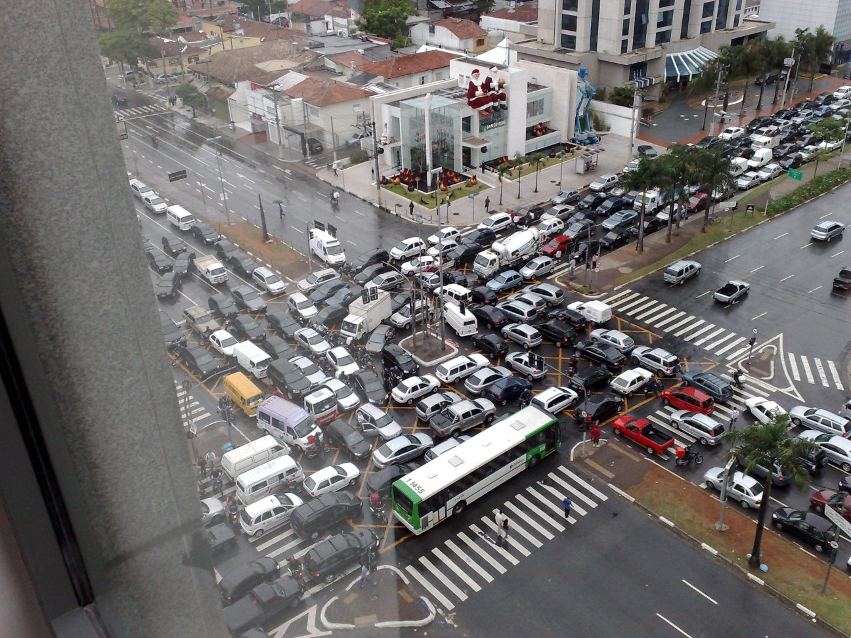
Source: Ricardo Guimarães Herrmann

Slide 10
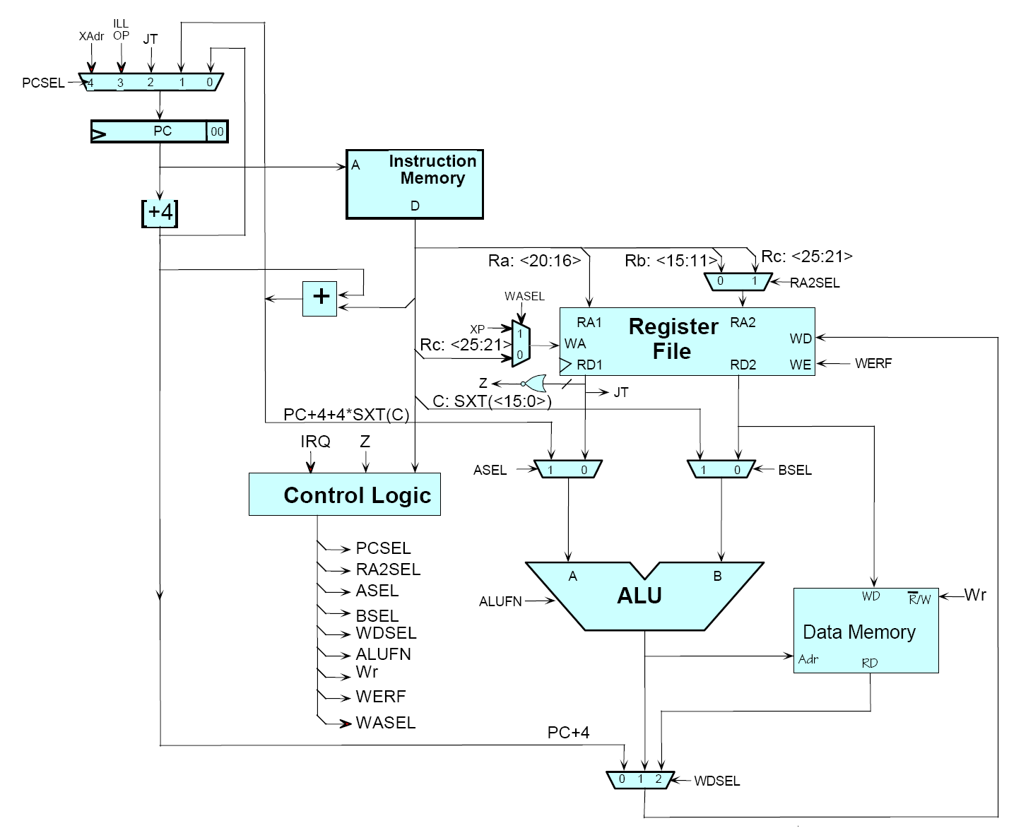
Source: MIT Open Courseware

Slide 11

Source: MIT Open Courseware

Slide 12
Typical Problem
Iterate over a large number of records
Extract something of interest from each
Shuffle and sort intermediate results
Aggregate intermediate results
Generate final output
Map
Reduce
Key idea: functional abstraction for these two operations

Slide 13
Map
f
f
f
f
f
Map
Fold
Reduce
g
g
g
g
g

Slide 14
MapReduce
Programmers specify two functions:
map (k, v) → <k’, v’>*
reduce (k’, v’) → <k’, v’>*
All values with the same key are reduced together
Usually, programmers also specify:
partition (k’, number of partitions ) → partition for k’
Often a simple hash of the key, e.g. hash(k’) mod n
Allows reduce operations for different keys in parallel
combine(k’,v’) → <k’,v’>
“Mini-reducers” that run in memory after the map phase
Optimizes to reduce network traffic & disk writes
Implementations:
Google has a proprietary implementation in C++
Hadoop is an open source implementation in Java

Slide 15
k₁
v₁
k₂
v₂
k₃
v₃
k₄
v₄
k₅
v₅
k₆
v₆
map
map
map
map
a
1
b
2
c
3
c
6
a
5
c
2
b
7
c
9
Shuffle and Sort: aggregate values by keys
a
1
5
b
2
7
c
2
3
6
9
reduce
reduce
reduce
r₁
s₁
r₂
s₂
r₃
s₃

Slide 16
MapReduce Runtime
Handles scheduling
Assigns workers to map and reduce tasks
Handles “data distribution”
Moves the process to the data
Handles synchronization
Gathers, sorts, and shuffles intermediate data
Handles faults
Detects worker failures and restarts
Everything happens on top of a distributed FS (later)

Slide 17
“Hello World”: Word Count
Map(String input_key, String input_value):
// input_key: document name
// input_value: document contents
for each word w in input_values:
EmitIntermediate(w, "1");
Reduce(String key, Iterator intermediate_values):
// key: a word, same for input and output
// intermediate_values: a list of counts
int result = 0;
for each v in intermediate_values:
result += ParseInt(v);
Emit(AsString(result));

Slide 18
User Program
(1) fork
(1) fork
(1) fork
Master
(2) assign map
(2) assign reduce
worker
split 0
(6) write
output
file 0
split 1
(3) read
(5) remote read
worker
split 2
(4) local write
split 3
worker
split 4
worker
output
file 1
worker
Input
files
Map
phase
Intermediate files
(on local disk)
Reduce
phase
Output
files
Redrawn from Dean and Ghemawat (OSDI 2004)

Slide 19

How do we get data to the workers?
NAS
SAN
Compute Nodes
What’s the problem here?

Slide 20
Distributed File System
Don’t move data to workers… Move workers to the data!
Store data on the local disks for nodes in the cluster
Start up the workers on the node that has the data local
Why?
Not enough RAM to hold all the data in memory
Disk access is slow, disk throughput is good
A distributed file system is the answer
GFS (Google File System)
HDFS for Hadoop (= GFS clone)

Slide 21
GFS: Assumptions
Commodity hardware over “exotic” hardware
High component failure rates
Inexpensive commodity components fail all the time
“Modest” number of HUGE files
Files are write-once, mostly appended to
Perhaps concurrently
Large streaming reads over random access
High sustained throughput over low latency
GFS slides adapted from material by Dean et al.

Slide 22
GFS: Design Decisions
Files stored as chunks
Fixed size (64MB)
Reliability through replication
Each chunk replicated across 3+ chunkservers
Single master to coordinate access, keep metadata
Simple centralized management
No data caching
Little benefit due to large data sets, streaming reads
Simplify the API
Push some of the issues onto the client

Slide 23
Application
GFS master
/foo/bar
(file name, chunk index)
GSF Client
File namespace
chunk 2ef0
(chunk handle, chunk location)
Instructions to chunkserver
(chunk handle, byte range)
Chunkserver state
GFS chunkserver
GFS chunkserver
chunk data
Linux file system
Linux file system
…
…
Redrawn from Ghemawat et al. (SOSP 2003)

Slide 24
Master’s Responsibilities
Metadata storage
Namespace management/locking
Periodic communication with chunkservers
Chunk creation, replication, rebalancing
Garbage collection

Slide 25
Questions?

Slide 26
MapReduce “killer app” #1:
Inverted Indexing
(Chapter 4)

Slide 27
Text Retrieval: Topics
Introduction to information retrieval (IR)
Boolean retrieval
Ranked retrieval
Inverted indexing with MapReduce

Slide 28
Architecture of IR Systems
Documents
Query
online
offline
Representation
Function
Representation
Function
Query Representation
Document Representation
Index
Comparison
Function
Hits

Slide 29
How do we represent text?
“Bag of words”
Treat all the words in a document as index terms for that document
Assign a weight to each term based on “importance”
Disregard order, structure, meaning, etc. of the words
Simple, yet effective!
Assumptions
Term occurrence is independent
Document relevance is independent
“Words” are well-defined

Slide 30
What’s a word?
天主教教宗若望保祿二世因感冒再度住進醫院。這是他今年第二度因同樣的病因住院。
وقال مارك ريجيف - الناطق باسم
الخارجية الإسرائيلية - إن شارون قبل
الدعوة وسيقوم للمرة الأولى بزيارة
تونس، التي كانت لفترة طويلة المقر
الرسمي لمنظمة التحرير الفلسطينية بعد خروجها من لبنان عام 1982.
Выступая в Мещанском суде Москвы экс-глава ЮКОСа заявил не совершал ничего противозаконного, в чем обвиняет его генпрокуратура России.
भारत सरकार ने आर्थिक सर्वेक्षण में वित्तीय वर्ष 2005-06 में सात फ़ीसदी विकास दर हासिल करने का आकलन किया है और कर सुधार पर ज़ोर दिया है
日米連合で台頭中国に対処…アーミテージ前副長官提言
조재영 기자= 서울시는 25일 이명박 시장이 `행정중심복합도시'' 건설안에 대해 `군대라도 동원해 막고싶은 심정''이라고 말했다는 일부 언론의 보도를 부인했다.

Slide 31
Sample Document
McDonald's slims down spuds
Fast-food chain to reduce certain types of fat in its french fries with new cooking oil.
NEW YORK (CNN/Money) - McDonald's Corp. is cutting the amount of "bad" fat in its french fries nearly in half, the fast-food chain said Tuesday as it moves to make all its fried menu items healthier.
But does that mean the popular shoestring fries won't taste the same? The company says no. "It's a win-win for our customers because they are getting the same great french-fry taste along with an even healthier nutrition profile," said Mike Roberts, president of McDonald's USA.
But others are not so sure. McDonald's will not specifically discuss the kind of oil it plans to use, but at least one nutrition expert says playing with the formula could mean a different taste.
Shares of Oak Brook, Ill.-based McDonald's (MCD: down $0.54 to $23.22, Research, Estimates) were lower Tuesday afternoon. It was unclear Tuesday whether competitors Burger King and Wendy's International (WEN: down $0.80 to $34.91, Research, Estimates) would follow suit. Neither company could immediately be reached for comment.
…
“Bag of Words”
16 × said
14 × McDonalds
12 × fat
11 × fries
8 × new
6 × company, french, nutrition
5 × food, oil, percent, reduce, taste, Tuesday
…

Slide 32
Boolean Retrieval
Users express queries as a Boolean expression
AND, OR, NOT
Can be arbitrarily nested
Retrieval is based on the notion of sets
Any given query divides the collection into two sets: retrieved, not-retrieved
Pure Boolean systems do not define an ordering of the results

Slide 33
Representing Documents
Document 1
Term
Document 1
Document 2
The quick brown
fox jumped over
the lazy dog’s
back.
aid
0
1
all
0
1
Stopword
List
back
1
0
brown
1
0
come
0
1
for
dog
1
0
is
fox
1
0
of
Document 2
good
0
1
the
jump
1
0
to
lazy
1
0
Now is the time
for all good men
to come to the
aid of their party.
men
0
1
now
0
1
over
1
0
party
0
1
quick
1
0
their
0
1
time
0
1
Notes:
9

Slide 34
Inverted Index
Term
Doc 2
Term
Postings
Doc 3
Doc 1
Doc 4
Doc 5
Doc 6
Doc 7
Doc 8
aid
0
0
0
1
0
0
0
1
aid
4
8
all
0
1
0
1
0
1
0
0
all
2
4
6
back
1
0
1
0
0
0
1
0
back
1
3
7
brown
1
0
1
0
1
0
1
0
brown
1
3
5
7
come
0
1
0
1
0
1
0
1
come
2
4
6
8
dog
0
0
1
0
1
0
0
0
dog
3
5
fox
0
0
1
0
1
0
1
0
fox
3
5
7
good
0
1
0
1
0
1
0
1
good
2
4
6
8
jump
0
0
1
0
0
0
0
0
jump
3
lazy
1
0
1
0
1
0
1
0
lazy
1
3
5
7
men
0
1
0
1
0
0
0
1
men
2
4
8
now
0
1
0
0
0
1
0
1
now
2
6
8
over
1
0
1
0
1
0
1
1
over
1
3
5
7
8
party
0
0
0
0
0
1
0
1
party
6
8
quick
1
0
1
0
0
0
0
0
quick
1
3
their
1
0
0
0
1
0
1
0
their
1
5
7
time
0
1
0
1
0
1
0
0
time
2
4
6
Notes:
12

Slide 35
Boolean Retrieval
To execute a Boolean query:
Build query syntax tree
For each clause, look up postings
Traverse postings and apply Boolean operator
Efficiency analysis
Postings traversal is linear (assuming sorted postings)
Start with shortest posting first
AND
( fox or dog ) and quick
quick
OR
fox
dog
dog
3
5
fox
3
5
7
dog
3
5
OR = union
fox
3
5
7
3
5
7

Slide 36
Extensions
Implementing proximity operators
Store word offset in postings
Handling term variations
Stem words: love, loving, loves … → lov

Slide 37
Strengths and Weaknesses
Strengths
Precise, if you know the right strategies
Precise, if you have an idea of what you’re looking for
Implementations are fast and efficient
Weaknesses
Users must learn Boolean logic
Boolean logic insufficient to capture the richness of language
No control over size of result set: either too many hits or none
When do you stop reading? All documents in the result set are considered “equally good”
What about partial matches? Documents that “don’t quite match” the query may be useful also

Slide 38
Ranked Retrieval
Order documents by how likely they are to be relevant to the information need
Estimate relevance(q, d_{i})
Sort documents by relevance
Display sorted results

Slide 39
Ranked Retrieval
Order documents by how likely they are to be relevant to the information need
Estimate relevance(q, d_{i})
Sort documents by relevance
Display sorted results
Vector space model (leave aside LM’s for now)
Document →weighted feature vector
Query→weighted eature vector

Slide 40
Vector Space Model
t₃
d₂
d₃
d₁
θ
φ
t₁
d₅
t₂
d₄
Assumption: Documents that are “close together” in vector space “talk about” the same things
Therefore, retrieve documents based on how close the document is to the query (i.e., similarity ~ “closeness”)

Slide 41
Similarity Metric
How about |d₁ – d₂|?
Instead of Euclidean distance, use “angle” between the vectors
It all boils down to the inner product (dot product) of vectors
d_{i} • q
cos(θ) = ----------
|d_{i}| |q|

Slide 42
Term Weighting
Term weights consist of two components
Local: how important is the term in this document?
Global: how important is the term in the collection?
Here’s the intuition:
Terms that appear often in a document should get high weights
Terms that appear in many documents should get low weights
How do we capture this mathematically?
Term frequency (local)
Inverse document frequency (global)

Slide 43
TF.IDF Term Weighting
weight assigned to term i in document j
number of occurrence of term i in document j
number of documents in entire collection
number of documents with term i

Slide 44
TF.IDF Example
tf
1
2
3
4
idf
complicated
5
2
0.301
complicated
0.301
3,5
4,2
contaminated
4
1
3
0.125
contaminated
0.125
1,4
2,1
3,3
fallout
5
4
3
0.125
fallout
0.125
1,5
3,4
4,3
information
6
3
3
2
0.000
information
0.000
1,6
2,3
3,3
4,2
interesting
1
0.602
interesting
0.602
2,1
nuclear
3
7
0.301
nuclear
0.301
1,3
3,7
retrieval
6
1
4
0.125
retrieval
0.125
2,6
3,1
4,4
siberia
2
0.602
siberia
0.602
1,2

Slide 45
Sketch: Scoring Algorithm
Initialize accumulators to hold document scores
For each query term t in the user’s query
Fetch t’s postings
For each document, score_{doc} += w_{t,d} × w_{t,q}
Apply length normalization to the scores at end
Return top N documents

Slide 46
MapReduce it?
The indexing problem
Must be relatively fast, but need not be real time
For Web, incremental updates are important
Crawling is a challenge itself!
The retrieval problem
Must have sub-second response
For Web, only need relatively few results

Slide 47
Indexing: Performance Analysis
Fundamentally, a large sorting problem
Terms usually fit in memory
Postings usually don’t
How is it done on a single machine?
How large is the inverted index?
Size of vocabulary
Size of postings

Slide 48
Vocabulary Size: Heaps’ Law
V is vocabulary size
n is corpus size (number of documents)
K and β are constants
Typically, K is between 10 and 100, β is between 0.4 and 0.6
When adding new documents, the system is likely to have seen most terms already… but the postings keep growing
Notes:
22

Slide 49
Postings Size: Zipf’s Law
George Kingsley Zipf (1902-1950) observed the following relation between frequency and rank
A few words occur frequently…most words occur infrequently
Zipfian distributions:
English words
Library book checkout patterns
Website popularity (almost anything on the Web)
f = frequency
r = rank
c = constant
or

Slide 50
MapReduce: Index Construction
Map over all documents
Emit term as key, (docid, tf) as value
Emit other information as necessary (e.g., term position)
Reduce
Trivial: each value represents a posting!
Might want to sort the postings (e.g., by docid or tf)
MapReduce does all the heavy lifting!

Slide 51
Query Execution
MapReduce is meant for large-data batch processing
Not suitable for lots of real time operations requiring low latency
The solution: “the secret sauce”
Most likely involves document partitioning
Lots of system engineering: e.g., caching, load balancing, etc.

Slide 52
Questions?

Slide 53
MapReduce “killer app” #2:
Graph Algorithms
(Chapter 5)

Slide 54
Graph Algorithms: Topics
Introduction to graph algorithms and graph representations
Single Source Shortest Path (SSSP) problem
Refresher: Dijkstra’s algorithm
Breadth-First Search with MapReduce
PageRank

Slide 55
What’s a graph?
G = (V,E), where
V represents the set of vertices (nodes)
E represents the set of edges (links)
Both vertices and edges may contain additional information
Different types of graphs:
Directed vs. undirected edges
Presence or absence of cycles
…

Slide 56
Some Graph Problems
Finding shortest paths
Routing Internet traffic and UPS trucks
Finding minimum spanning trees
Telco laying down fiber
Finding Max Flow
Airline scheduling
Identify “special” nodes and communities
Breaking up terrorist cells, spread of swine/avian/… flu
Bipartite matching
Monster.com, Match.com
And of course... PageRank

Slide 57
Representing Graphs
G = (V, E)
A poor representation for computational purposes
Two common representations
Adjacency matrix
Adjacency list

Slide 58
Adjacency Matrices
Represent a graph as an n x n square matrix M
n = |V|
M_{ij} = 1 means a link from node i to j
2
 | 1 | 2 | 3 | 4
1 | 0 | 1 | 0 | 1
2 | 1 | 0 | 1 | 1
3 | 1 | 0 | 0 | 0
4 | 1 | 0 | 1 | 0
1
3
4

Slide 59
Adjacency Lists
Take adjacency matrices… and throw away all the zeros
 | 1 | 2 | 3 | 4
1 | 0 | 1 | 0 | 1
2 | 1 | 0 | 1 | 1
3 | 1 | 0 | 0 | 0
4 | 1 | 0 | 1 | 0
1: 2, 4
2: 1, 3, 4
3: 1
4: 1, 3

Slide 60
Adjacency Lists: Critique
Advantages:
Much more compact representation
Easy to compute over outlinks
Graph structure can be broken up and distributed
Disadvantages:
Much more difficult to compute over inlinks

Slide 61
Single Source Shortest Path
Problem: find shortest path from a source node to one or more target nodes
First, a refresher: Dijkstra’s Algorithm

Slide 62
Dijkstra’s Algorithm Example
∞
∞
1
10
0
2
3
9
4
6
5
7
∞
∞
2
Example from CLR

Slide 63
Dijkstra’s Algorithm Example
10
∞
1
10
0
2
3
9
4
6
5
7
5
∞
2
Example from CLR

Slide 64
Dijkstra’s Algorithm Example
8
14
1
10
0
2
3
9
4
6
5
7
5
7
2
Example from CLR

Slide 65
Dijkstra’s Algorithm Example
8
13
1
10
0
2
3
9
4
6
5
7
5
7
2
Example from CLR

Slide 66
Dijkstra’s Algorithm Example
8
9
1
10
0
2
3
9
4
6
5
7
5
7
2
Example from CLR

Slide 67
Dijkstra’s Algorithm Example
8
9
1
10
0
2
3
9
4
6
5
7
5
7
2
Example from CLR

Slide 68
Single Source Shortest Path
Problem: find shortest path from a source node to one or more target nodes
Single processor machine: Dijkstra’s Algorithm
MapReduce: parallel Breadth-First Search (BFS)

Slide 69
Finding the Shortest Path
First, consider equal edge weights
Solution to the problem can be defined inductively
Here’s the intuition:
DistanceTo(startNode) = 0
For all nodes n directly reachable from startNode, DistanceTo(n) = 1
For all nodes n reachable from some other set of nodes S, DistanceTo(n) = 1 + min(DistanceTo(m), m ∈ S)

Slide 70
From Intuition to Algorithm
A map task receives
Key: node n
Value: D (distance from start), points-to (list of nodes reachable from n)
∀p ∈ points-to: emit (p, D+1)
The reduce task gathers possible distances to a given p and selects the minimum one

Slide 71
Multiple Iterations Needed
This MapReduce task advances the “known frontier” by one hop
Subsequent iterations include more reachable nodes as frontier advances
Multiple iterations are needed to explore entire graph
Feed output back into the same MapReduce task
Preserving graph structure:
Problem: Where did the points-to list go?
Solution: Mapper emits (n, points-to) as well

Slide 72
Visualizing Parallel BFS
3
1
2
2
2
3
3
3
4
4

Slide 73
Termination
Does the algorithm ever terminate?
Eventually, all nodes will be discovered, all edges will be considered (in a connected graph)
When do we stop?

Slide 74
Weighted Edges
Now add positive weights to the edges
Simple change: points-to list in map task includes a weight w for each pointed-to node
emit (p, D+w_{p}) instead of (p, D+1) for each node p
Does this ever terminate?
Yes! Eventually, no better distances will be found. When distance is the same, we stop
Mapper should emit (n, D) to ensure that “current distance” is carried into the reducer

Slide 75
Comparison to Dijkstra
Dijkstra’s algorithm is more efficient
At any step it only pursues edges from the minimum-cost path inside the frontier
MapReduce explores all paths in parallel
Divide and conquer
Throw more hardware at the problem

Slide 76
General Approach
MapReduce is adept at manipulating graphs
Store graphs as adjacency lists
Graph algorithms with for MapReduce:
Each map task receives a node and its outlinks
Map task compute some function of the link structure, emits value with target as the key
Reduce task collects keys (target nodes) and aggregates
Iterate multiple MapReduce cycles until some termination condition
Remember to “pass” graph structure from one iteration to next

Slide 77
Random Walks Over the Web
Model:
User starts at a random Web page
User randomly clicks on links, surfing from page to page
PageRank = the amount of time that will be spent on any given page

Slide 78
PageRank: Defined
Given page x with in-bound links t₁…t_{n}, where
C(t) is the out-degree of t
α is probability of random jump
N is the total number of nodes in the graph
t₁
X
t₂
…
t_{n}

Slide 79
Computing PageRank
Properties of PageRank
Can be computed iteratively
Effects at each iteration is local
Sketch of algorithm:
Start with seed PR_{i} values
Each page distributes PR_{i} “credit” to all pages it links to
Each target page adds up “credit” from multiple in-bound links to compute PR_{i+1}
Iterate until values converge

Slide 80
PageRank in MapReduce
Map: distribute PageRank “credit” to link targets
Reduce: gather up PageRank “credit” from multiple sources to compute new PageRank value
Iterate until
convergence
...

Slide 81
PageRank: Issues
Is PageRank guaranteed to converge? How quickly?
What is the “correct” value of α, and how sensitive is the algorithm to it?
What about dangling links?
How do you know when to stop?

Slide 82
Graph algorithms in MapReduce
General approach
Store graphs as adjacency lists (node, points-to, points-to …)
Mappers receive (node, points-to*) tuples
Map task computes some function of the link structure
Output key is usually the target node in the adjacency list representation
Mapper typically outputs the graph structure as well
Iterate multiple MapReduce cycles until some convergence criterion is met

Slide 83
Questions?

Slide 84
Outline of Part II
MapReduce algorithm design (Chapter 3)
Managing dependencies
Computing term co-occurrence statistics
Case study: statistical machine translation
EM algorithms in MapReduce (Chapter 6)
Expectation maximization
Gradient-based optimization
Alternatives to MapReduce
What’s next?

Slide 85
MapReduce Algorithm Design
(Chapter 3)

Slide 86
Managing Dependencies
Remember: Mappers run in isolation
You have no idea in what order the mappers run
You have no idea on what node the mappers run
You have no idea when each mapper finishes
Tools for synchronization:
Ability to hold state in reducer across multiple key-value pairs
Sorting function for keys
Partitioner
Cleverly-constructed data structures

Slide 87
Motivating Example
Term co-occurrence matrix for a text collection
M = N x N matrix (N = vocabulary size)
M_{ij}: number of times i and j co-occur in some context (for concreteness, let’s say context = sentence)
Why?
Distributional profiles as a way of measuring semantic distance
Semantic distance useful for many language processing tasks
“You shall know a word by the company it keeps” (Firth, 1957)
e.g., Mohammad and Hirst (EMNLP, 2006)

Slide 88
MapReduce: Large Counting Problems
Term co-occurrence matrix for a text collection = specific instance of a large counting problem
A large event space (number of terms)
A large number of events (the collection itself)
Goal: keep track of interesting statistics about the events
Basic approach
Mappers generate partial counts
Reducers aggregate partial counts
How do we aggregate partial counts efficiently?

Slide 89
First Try: “Pairs”
Each mapper takes a sentence:
Generate all co-occurring term pairs
For all pairs, emit (a, b) → count
Reducers sums up counts associated with these pairs
Use combiners!
Note: in these slides, we donate a key-value pair as k → v

Slide 90
“Pairs” Analysis
Advantages
Easy to implement, easy to understand
Disadvantages
Lots of pairs to sort and shuffle around (upper bound?)

Slide 91
Another Try: “Stripes”
Idea: group together pairs into an associative array
Each mapper takes a sentence:
Generate all co-occurring term pairs
For each term, emit a → { b: count_{b}, c: count_{c}, d: count_{d} … }
Reducers perform element-wise sum of associative arrays
(a, b) → 1
(a, c) → 2
(a, d) → 5
(a, e) → 3
(a, f) → 2
a → { b: 1, c: 2, d: 5, e: 3, f: 2 }
a → { b: 1, d: 5, e: 3 }
a → { b: 1, c: 2, d: 2, f: 2 }
a → { b: 2, c: 2, d: 7, e: 3, f: 2 }
+

Slide 92
“Stripes” Analysis
Advantages
Far less sorting and shuffling of key-value pairs
Can make better use of combiners
Disadvantages
More difficult to implement
Underlying object is more heavyweight
Fundamental limitation in terms of size of event space

Slide 93
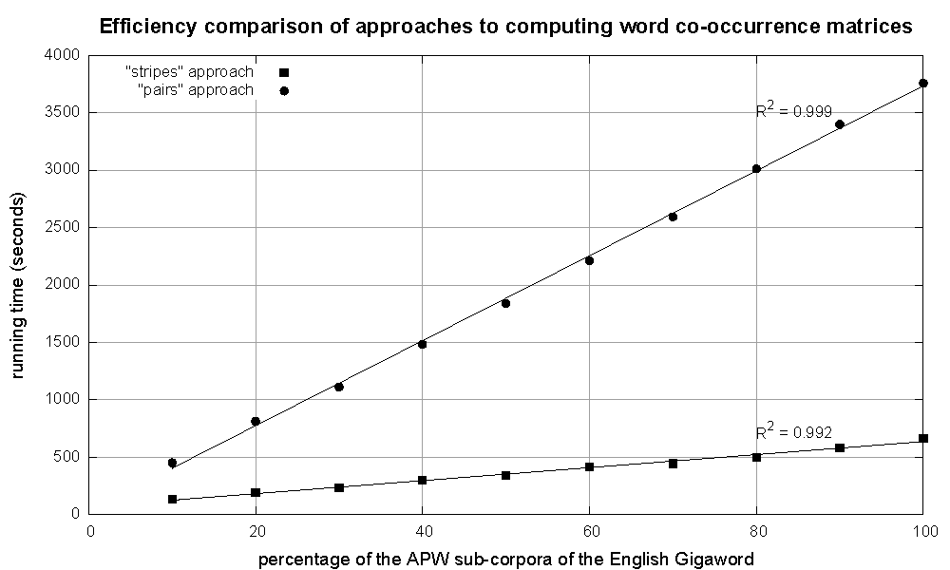
Cluster size: 38 cores
Data Source: Associated Press Worldstream (APW) of the English Gigaword Corpus (v3), which contains 2.27 million documents (1.8 GB compressed, 5.7 GB uncompressed)

Slide 94
Relative frequency estimates
How do we compute relative frequencies from counts?
Why do we want to do this?
How do we do this with MapReduce?

Slide 95
P(B|A): “Pairs”
For this to work:
Must emit extra (a, *) for every b_{n} in mapper
Must make sure all a’s get sent to same reducer (use partitioner)
Must make sure (a, *) comes first (define sort order)
Must hold state in reducer across different key-value pairs
(a, *) → 32
Reducer holds this value in memory
(a, b₁) → 3
(a, b₂) → 12
(a, b₃) → 7
(a, b₄) → 1
…
(a, b₁) → 3 / 32
(a, b₂) → 12 / 32
(a, b₃) → 7 / 32
(a, b₄) → 1 / 32
…

Slide 96
P(B|A): “Stripes”
Easy!
One pass to compute (a, *)
Another pass to directly compute f(B|A)
a → {b₁:3, b₂ :12, b₃ :7, b₄ :1, … }

Slide 97
Synchronization in Hadoop
Approach 1: turn synchronization into an ordering problem
Sort keys into correct order of computation
Partition key space so that each reducer gets the appropriate set of partial results
Hold state in reducer across multiple key-value pairs to perform computation
Illustrated by the “pairs” approach
Approach 2: construct data structures that “bring the pieces together”
Each reducer receives all the data it needs to complete the computation
Illustrated by the “stripes” approach

Slide 98
Issues and Tradeoffs
Number of key-value pairs
Object creation overhead
Time for sorting and shuffling pairs across the network
In Hadoop, every object emitted from a mapper is written to disk
Size of each key-value pair
De/serialization overhead
Combiners make a big difference!
RAM vs. disk and network
Arrange data to maximize opportunities to aggregate partial results

Slide 99
Questions?

Slide 100
Case study:
statistical machine translation

Slide 101
Statistical Machine Translation
Conceptually simple: (translation from foreign f into English e)
Difficult in practice!
Phrase-Based Machine Translation (PBMT) :
Break up source sentence into little pieces (phrases)
Translate each phrase individually
Dyer et al. (Third ACL Workshop on MT, 2008)

Slide 102
Maria
no
dio
una
bofetada
a
la
bruja
verde
Mary
not
give
a
slap
to
the
witch
green
did not
a slap
by
green witch
no
slap
to the
did not give
to
the
slap
the witch
Example from Koehn (2006)

Slide 103
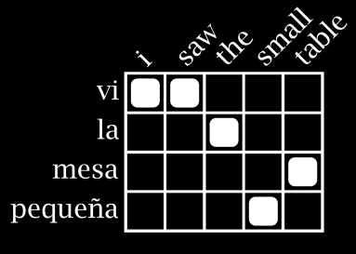
MT Architecture
Training Data
Word Alignment
Phrase Extraction
i saw the small table
(vi, i saw)
(la mesa pequeña, the small table)
…
vi la mesa pequeña
Parallel Sentences
he sat at the table
the service was good
Language Model
Translation Model
Target-Language Text
Decoder
maria no daba una bofetada a la bruja verde
mary did not slap the green witch
Foreign Input Sentence
English Output Sentence

Slide 104
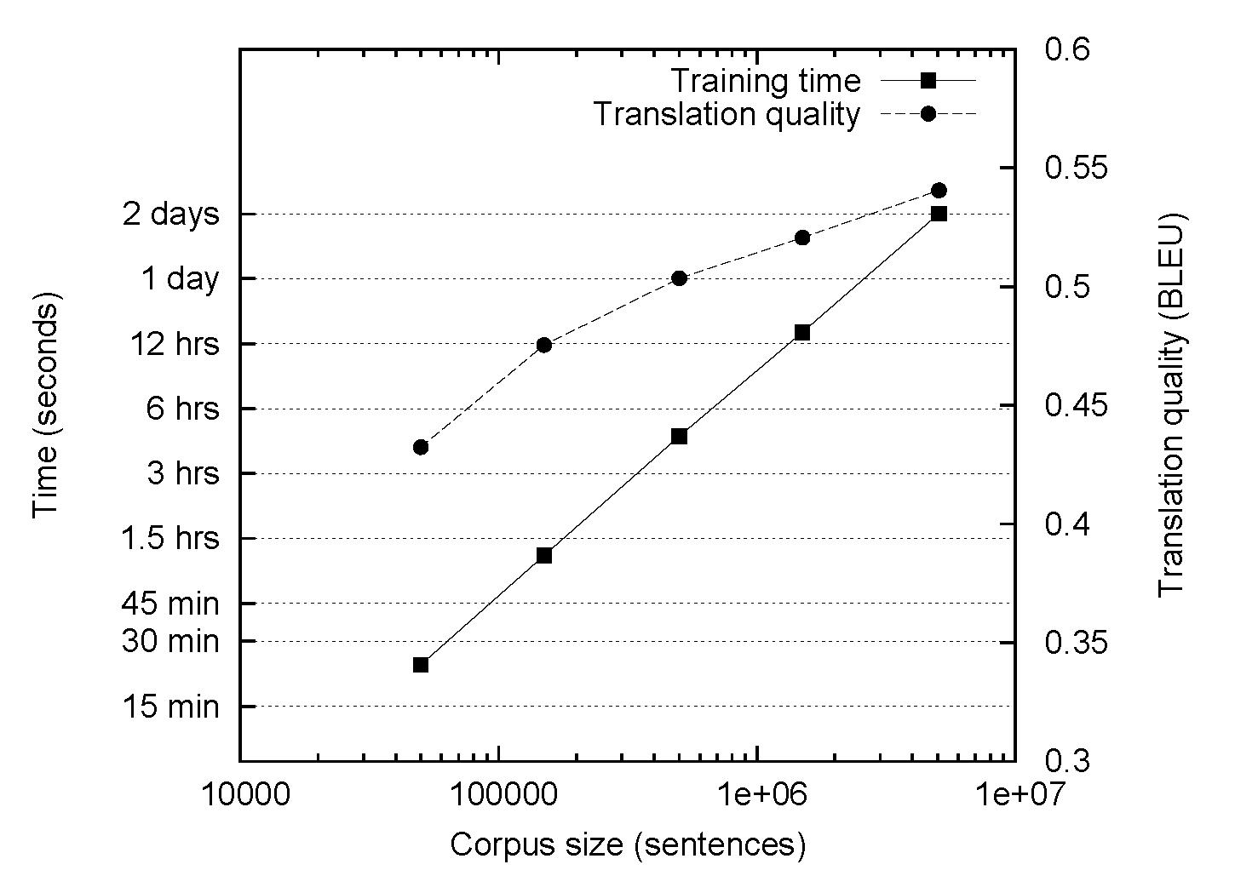
The Data Bottleneck

Slide 105
MT Architecture
There are MapReduce Implementations of these two components!
Training Data
Word Alignment
Phrase Extraction
i saw the small table
(vi, i saw)
(la mesa pequeña, the small table)
…
vi la mesa pequeña
Parallel Sentences
he sat at the table
the service was good
Language Model
Translation Model
Target-Language Text
Decoder
maria no daba una bofetada a la bruja verde
mary did not slap the green witch
Foreign Input Sentence
English Output Sentence

Slide 106
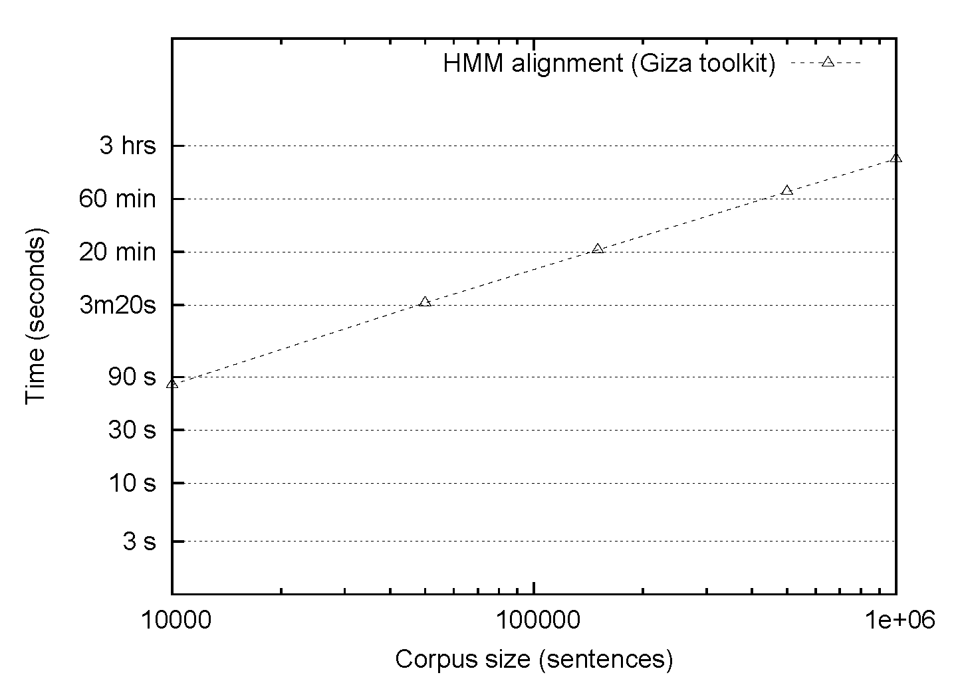
HMM Alignment: Giza
Single-core commodity server

Slide 107
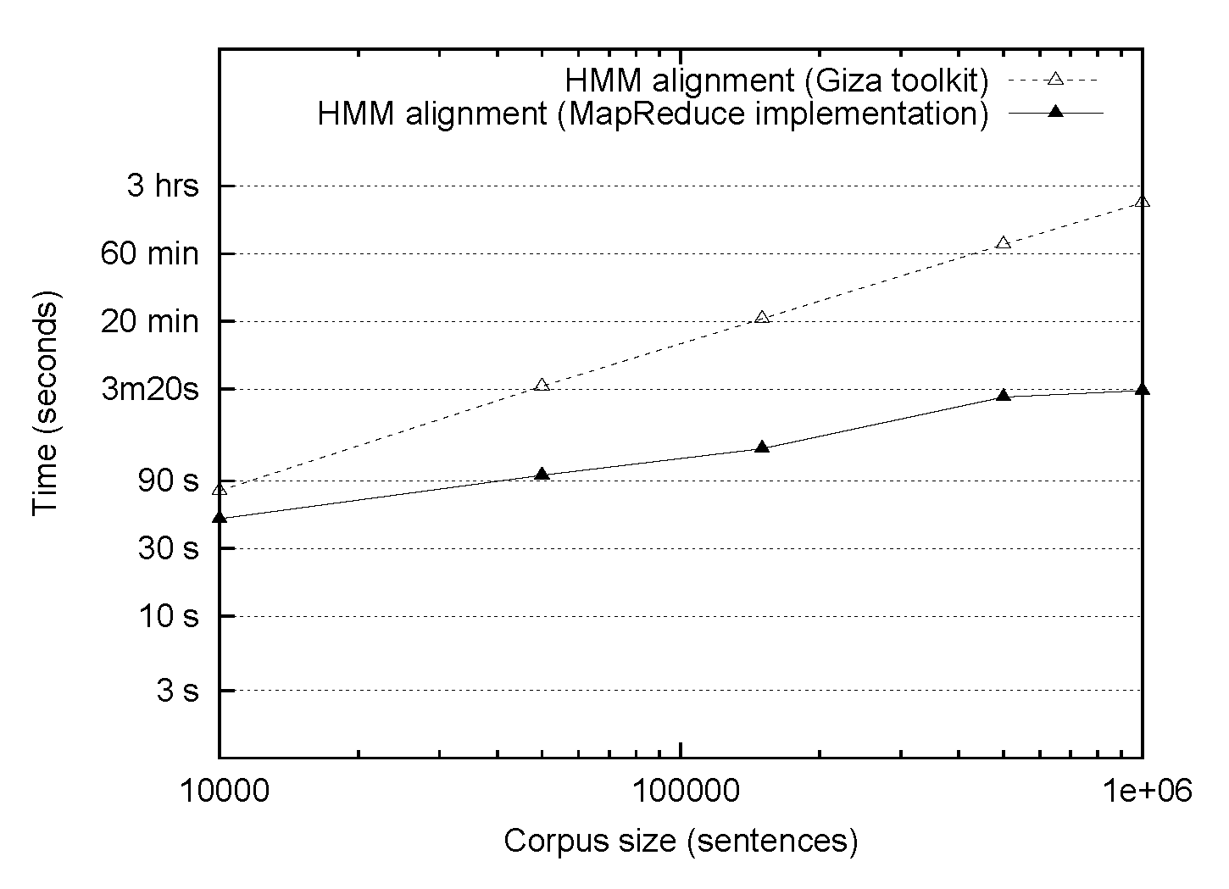
HMM Alignment: MapReduce
Single-core commodity server
38 processor cluster

Slide 108
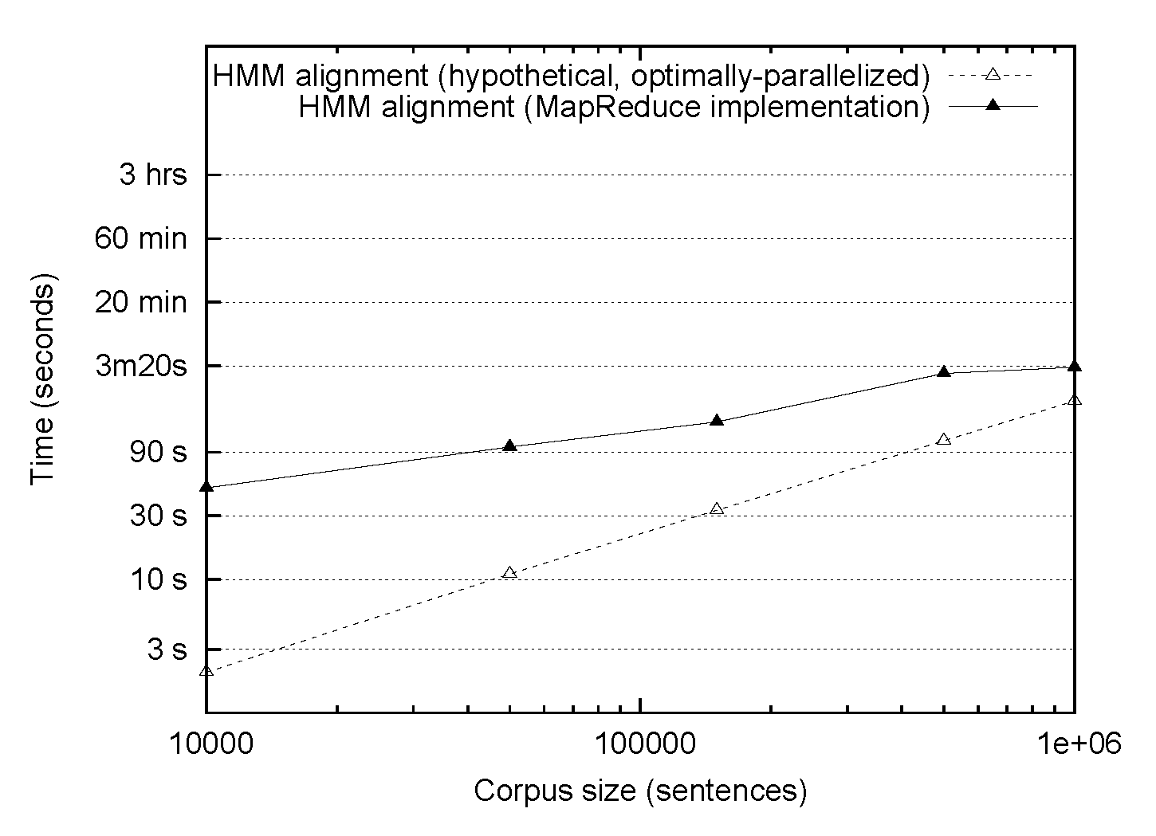
HMM Alignment: MapReduce
38 processor cluster
1/38 Single-core commodity server

Slide 109
What’s the point?
The optimally-parallelized version doesn’t exist!
It’s all about the right level of abstraction

Slide 110
Questions?

Slide 111
EM Algorithm in MapReduce
(Chapter 6)

Slide 112
Iterative Algorithms in MapReduce
Expectation maximization
Discriminative training of log linear models
Computing gradient, objective using MapReduce
Optimization questions

Slide 113


EM Algorithms in MapReduce
E step
Compute the expected log likelihood with respect to the conditional distribution of the latent variables with respect to the observed data.
M step
Chu et al. (NIPS 2006) “Map-Reduce for Machine Learning on Multicore“

Slide 114
EM Algorithms in MapReduce
E step
Compute the expected log likelihood with respect to the conditional distribution of the latent variables with respect to the observed data.
Expectations are just sums of function evaluation over an event times that event’s probability: perfect for MapReduce!
Mappers compute model likelihood given small pieces of the training data (scale EM to large data sets!)

Slide 115
EM Algorithms in MapReduce
M step
Many models used in NLP (HMMs, PCFGs, IBM translation models) are parameterized in terms of conditional probability distributions which can be maximized independently… Perfect for MR.

Slide 116
Challenges
Each iteration of EM is one MapReduce job
Mappers require the current model parameters
Certain models may be very large
Optimization: any particular piece of the training data probably depends on only a small subset of these parameters
Reducers may aggregate data from many mappers
Optimization: Make smart use of combiners!

Slide 117

Log-linear Models
NLP’s favorite discriminative model:
Applied successfully to classificiation, POS tagging, parsing, MT, word segmentation, named entity recognition, LM…
Make use of millions of features (h_{i}’s)
Features may overlap
Global optimum easily reachable, assuming no latent variables

Slide 118
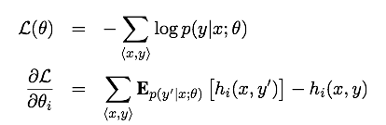
Exponential Models in MapReduce
Training is usually done to maximize likelihood (minimize negative llh), using first-order methods
Need an objective and gradient with respect to the parameterizes that we want to optimize

Slide 119
Exponential Models in MapReduce
How do we compute these in MapReduce?
As seen with EM: expectations map nicely onto the MR paradigm.
Each mapper computes two quantities: the LLH of a training instance <x,y> under the current model and the contribution to the gradient.

Slide 120
Exponential Models in MapReduce
What about reducers?
The objective is a single value – make sure to use a combiner!
The gradient is as large as the feature space – but may be quite sparse. Make use of sparse vector representations!

Slide 121
Exponential Models in MapReduce
After one MR pair, we have an objective and gradient
Run some optimization algorithm
LBFGS, gradient descent, etc…
Check for convergence
If not, re-run MR to compute a new objective and gradient

Slide 122
Challenges
Each iteration of training is one MapReduce job
Mappers require the current model parameters
Reducers may aggregate data from many mappers
Optimization algorithm (LBFGS for example) may require the full gradient
This is okay for millions of features
What about billions?
…or trillions?

Slide 123
Questions?

Slide 124
Alternatives to MapReduce
(Chapter 7)

Slide 125
When is MapReduce appropriate?
MapReduce is a great solution when there is a lot of data:
Input (e.g., compute statistics over large amounts of text) – take advantage of HDFS, data locality
Intermediate files (e.g., phrase tables) – take advantage of distributed storage, fault tolerance
Output (e.g., webcrawls) – avoids contention for shared resources
Little synchronization is necessary

Slide 126
When is MapReduce less appropriate?
MapReduce can be problematic when
“Online” processes are necessary, e.g. decisions must be made conditioned on the full state of the system
Perceptron-style algorithms
Monte Carlo simulations of certain models (e.g., Dirichlet processes, Hierarchical Dirichlet processes) may have global dependencies
Individual map or reduce operations are extremely expensive computationally
Large amounts of shared data are necessary

Slide 127
Alternatives to Hadoop: Parallelization of computation
 | libpthread | MPI | Hadoop
Job scheduling | none | with PBS | minimal (at pres.)
Synchronization | fine only | any | coarse only
Distributed FS | no | no | yes
Fault tolerance | no | no | via idempotency
Shared memory | yes | for messages | no
Scale | <16 | <100 | >10000
MapReduce | no | limited reducers | yes

Slide 128
Alternatives to Hadoop: Data storage and access
 | RDBMS | Hadoop/HDFS
Transactions | row/table | none
Write operations | Create, update, delete | Create, append*
Shared disk | some | Yes
Fault tolerance | yes | yes
Query language | SQL | Pig
Responsiveness | online | offline
Data consistency | enforced | no guarantee

Slide 129
Questions?

Slide 130
What’s next?
Thinking at “Web Scale” has required a new programming paradigm to scale up old algorithms
What about new algorithms?
Better approximations for “online” algorithms
Much of what we do is probabilistic
We can model failure modes probabilistically and incorporate them during inference
Sampling approaches might be a good starting point
Randomized algorithms to better represent summary statistics over large amounts of data

Slide 131

Thank you!

